Slide 1
COSE331 Computer Graphics 2023 Spring Syllabus

Slide 2
Who is Who
Lecturer
한정현
jhan@korea.ac.kr
정보관 311
Email me or come to my office any time you want.
TA
하정호, 이희성
2023.cg.ta@gmail.com
정보관 301A
Email them (and make an appointment if you want to visit their office).

Slide 3
Prerequisites
Prerequisites
Data Structure
Good programming skill in C++
Helpful course
Linear Algebra

Slide 4
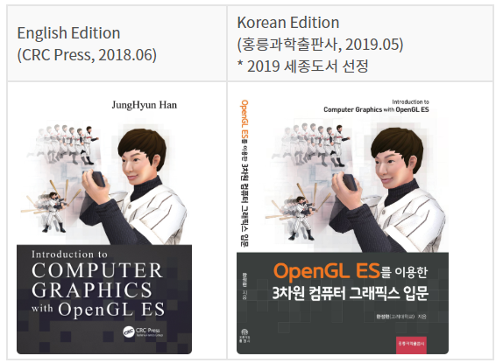
Textbook
Introduction to Computer Graphics with OpenGL ES, J. Han, CRC Press, 2018

Slide 5
Schedule and Tests
The textbook is composed of 18 chapters.
Tentative schedule
April 24th (Mon) – Midterm test for chapters 1 to 10
May 8th and 10th – Zoom classes
May 29th and 31st – Probably Zoom classes
June 14th (Wed) – Final test for chapters 11 to 17
Tests
The ranges of the midterm and final tests are restricted to what are taught in the classes.
The problems should be answered in your native languages.
Notes:
2021년 첫 날 강의소개만 하고, 휴일 없는 첫 8주의 마지막 시간에 중간고사 봤음 (범위는 10장까지)

Slide 6
Rules of the Game
Class materials
When we start a new chapter, its PDF file will be posted in the Blackboard and also emailed to you around midnight of the day before the class date.
After a chapter is done, its “updated” PPT file may be posted at media.korea.ac.kr or https://github.com/medialab-ku/openGLESbook.
2019 lecture videos are available at YouTube: [video]. This term’s content, which is not covered in the 2019 videos, may be added to YouTube.
Grading Policy (tentative)
Written homework – 5 to 10%
Three individual programming assignments – 30 to 40%
Midterm test – 25 to 30%
Final test – 25 to 30%
“Integrity is something you owe to yourself and to the academic community. It is more important to be honest than to get an A+ or even a Ph.D.” – A. Requicha

