Slide 1
Intelligent Malicious Content Checker (I-MCC)
Mediana - A0231458E
Meng Chenxi - A0231546J
Sarah Elita Shi Yuan Wong - A0231507N
Zhou Xinyi - A0231538H

Slide 2
0
OBJECTIVES & SYSTEM OVERVIEW

Slide 3
Objectives
Building an application that allows users to quickly and efficiently check the safety and legitimacy of data packages, URL links and images.
Our application returns a summary of the findings obtained through various automated checking processes

Slide 4
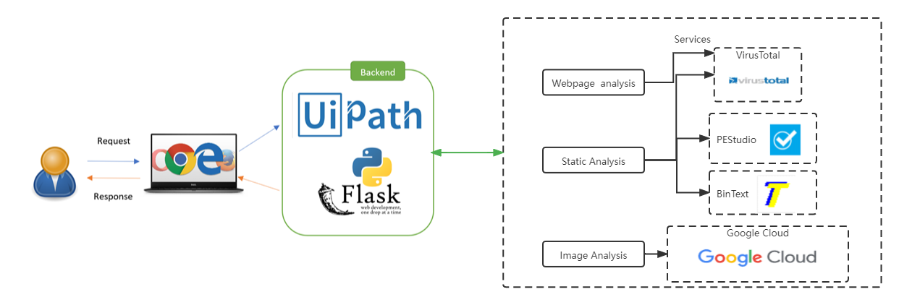
System Overview

Slide 5
Three Modules in I-MCC
01
02
03
Files Checker (Static Malware Analysis)
URL Checker
Images Content Checker

Slide 6
01
URL Checker Module

Slide 7
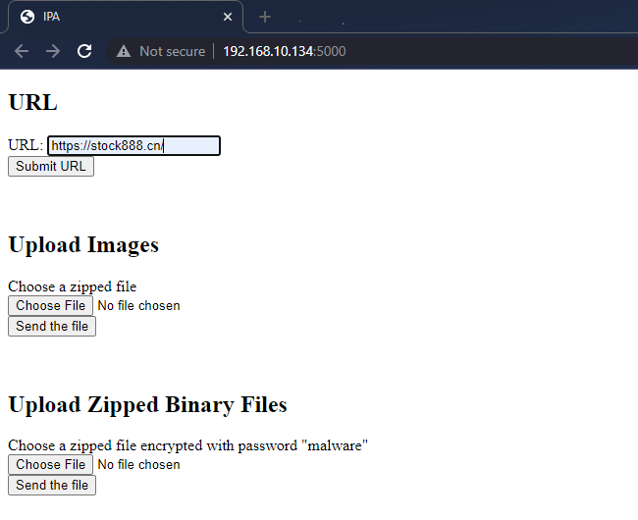
URL Checker

Slide 8
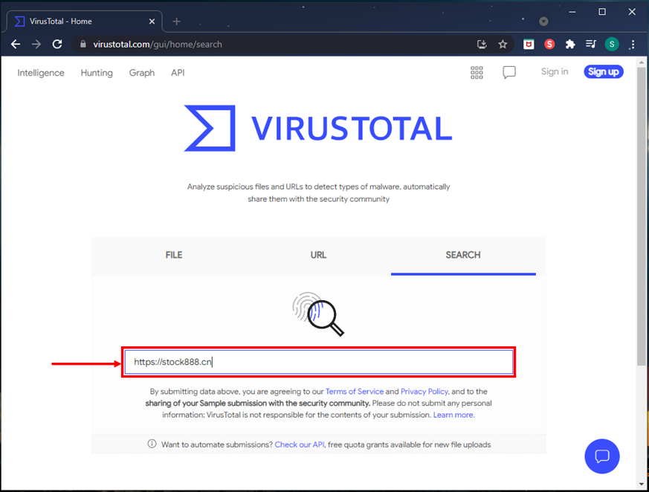
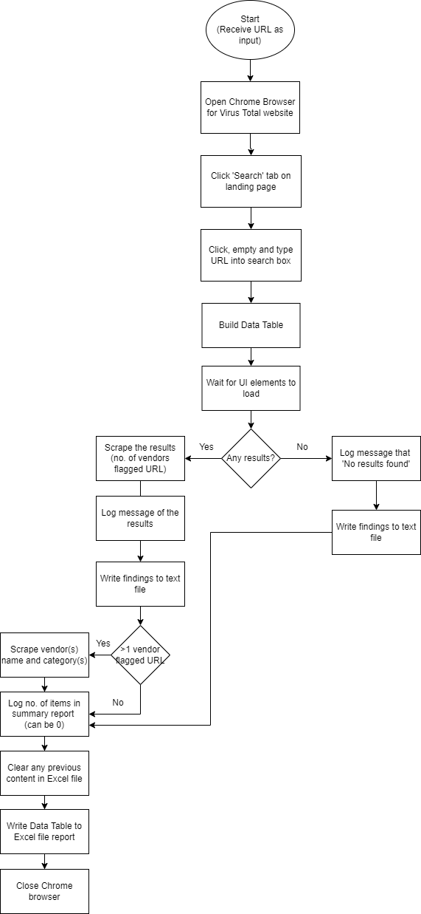
URL Checker - UiPath
Continued in next slide...

Slide 9
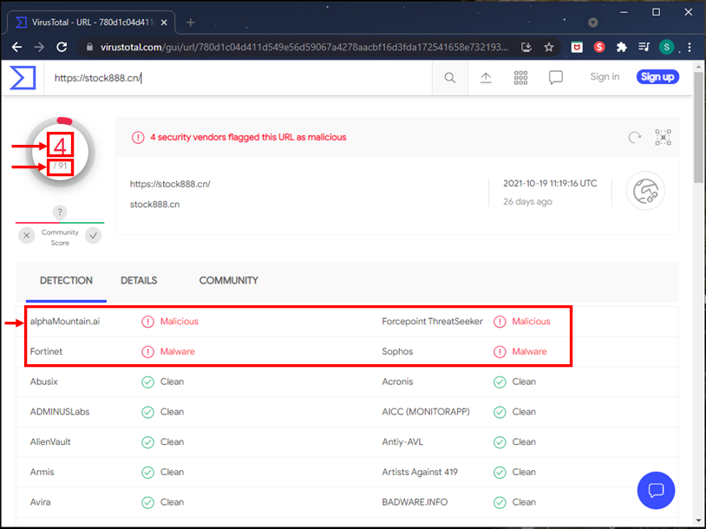
URL Checker - UiPath
Continuing from previous slide...

Slide 10
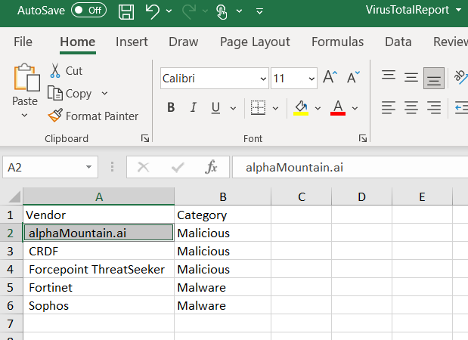
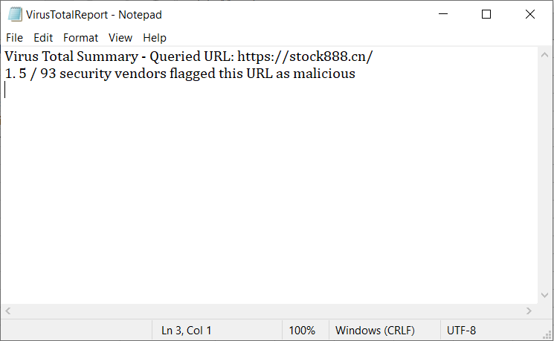
URL Checker - Report

Slide 11
02
Images Content Checker Module

Slide 12
Images Content

Slide 13

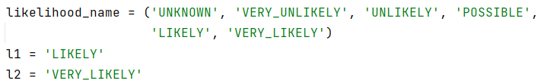
Images Content

Slide 14
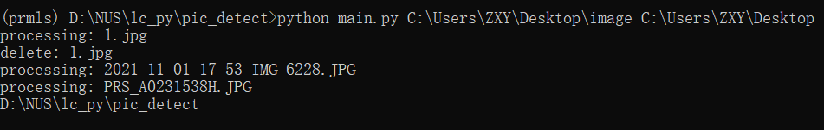

Images Content
Delete the explicit content image
Input file path
Input fil
Output file path

Slide 15
03
Files Checker (Static Malware Analysis) Module

Slide 16
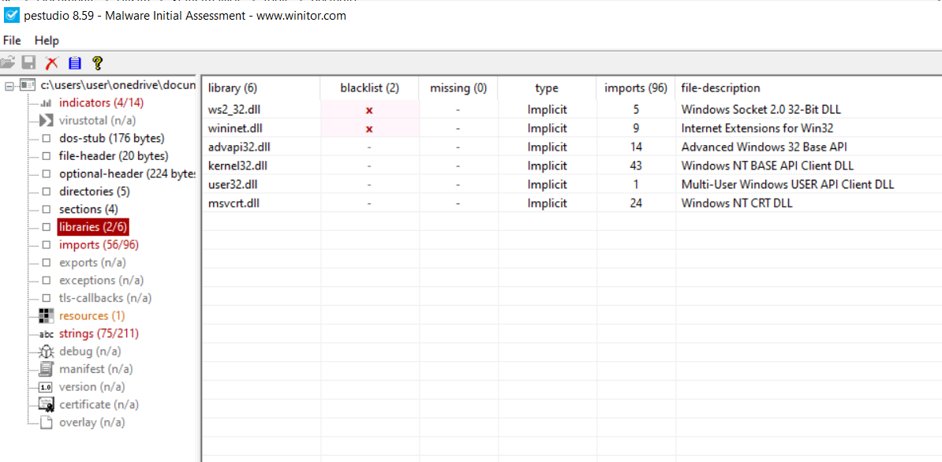
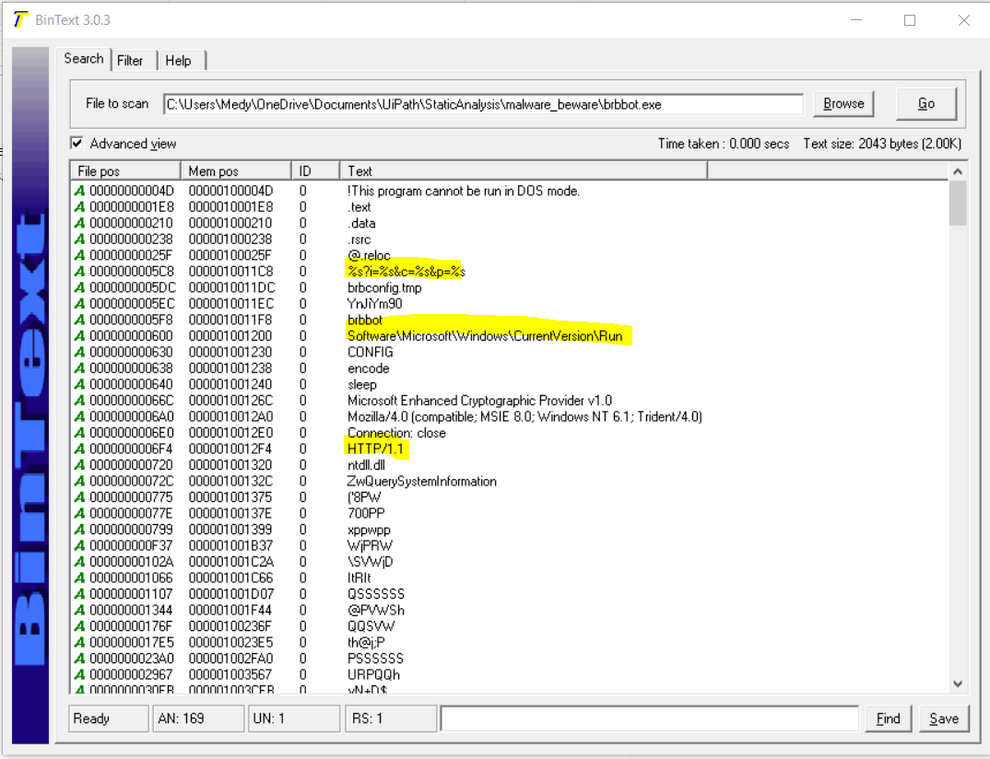
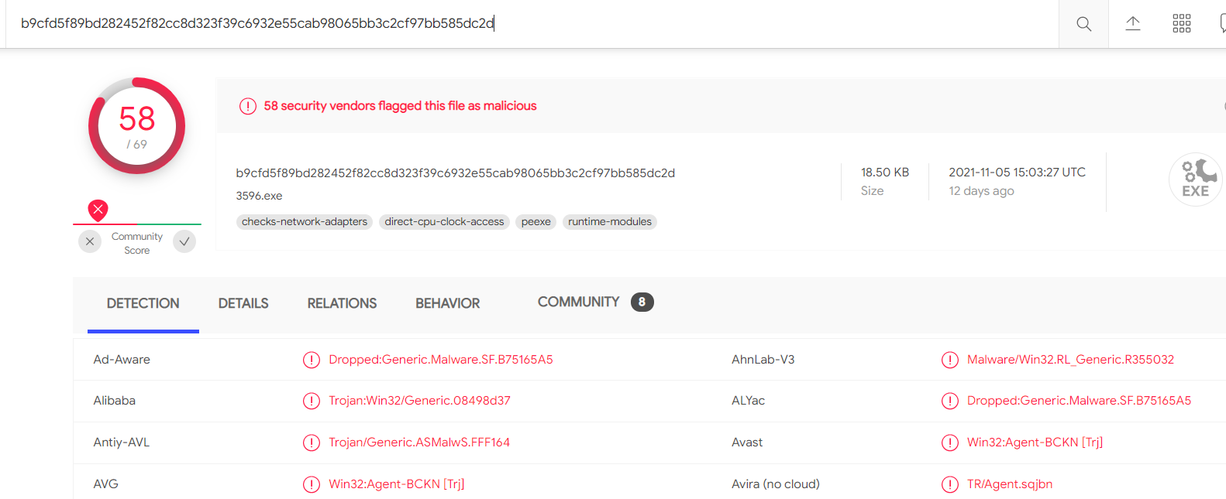
Files Checker (Static Malware Analysis)
PEStudio
BinText
VirusTotal (Hash Check)
03
01
02

Slide 17
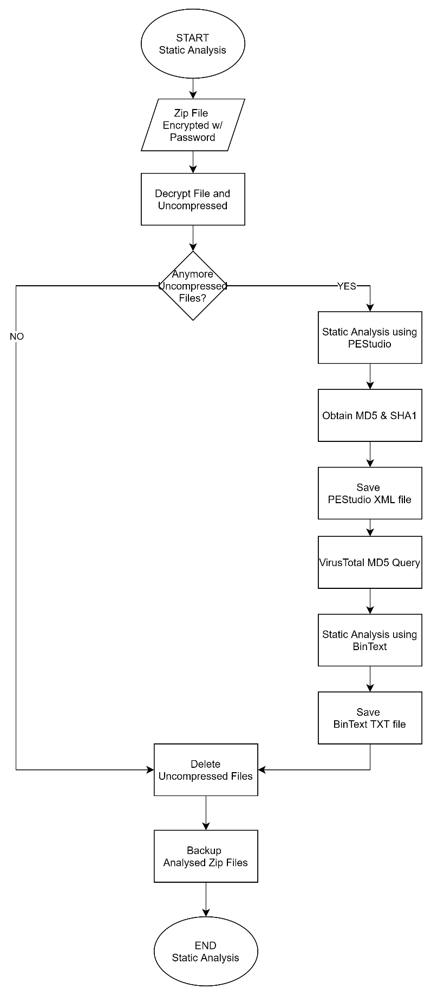
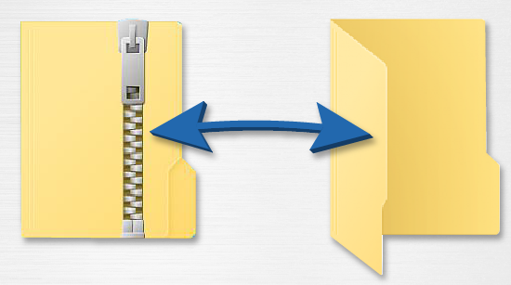
1
File Checker
Static Malware Analysis Flow Chart
2
3

Slide 18
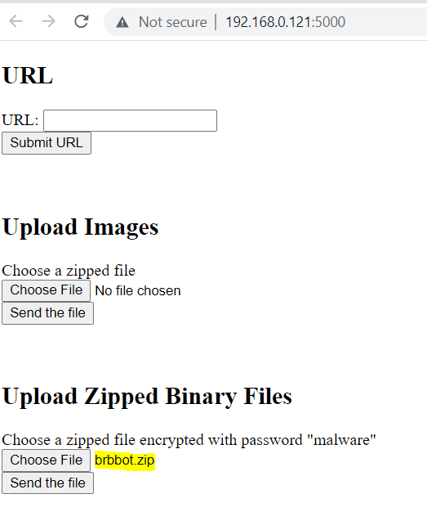

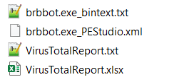
Static Malware Analysis
(Upload and Download)
1
Download Page
2
Analysis Report
Upload Page

Slide 19
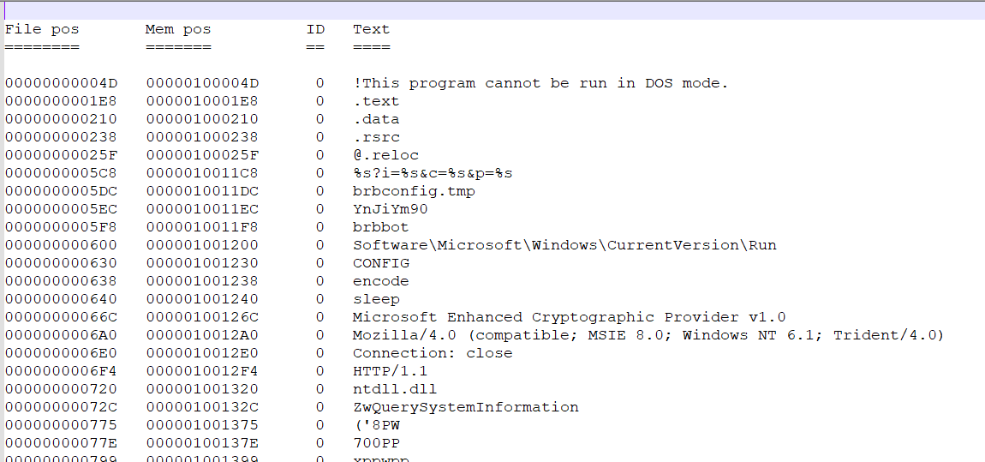
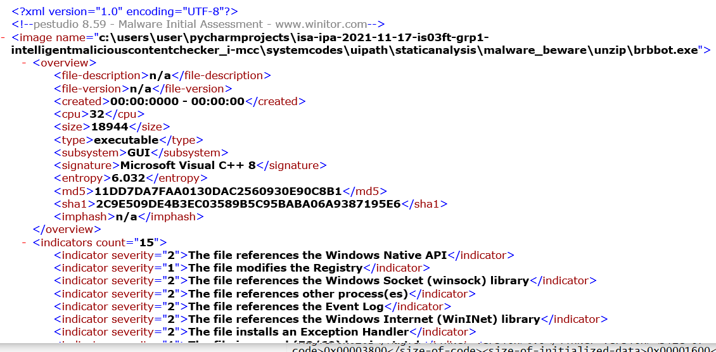
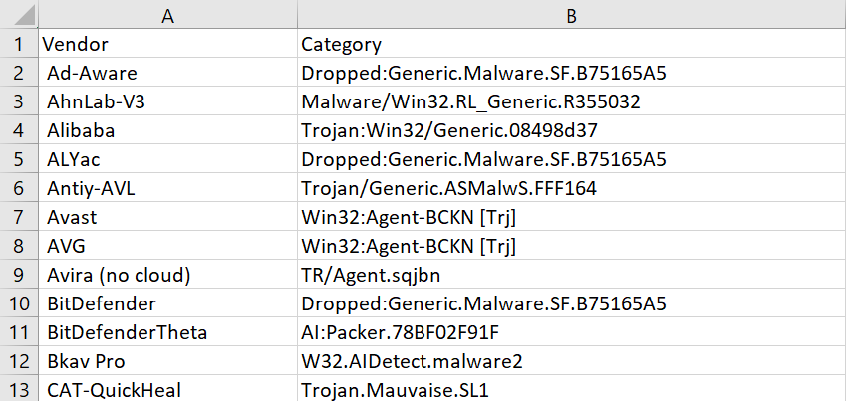
Static Malware Analysis
Report
Brbbot.exe_bintext.txt
Brbbot.exe_PEStudio.xml
VirusTotalReport.txt and VirusTotalReport.xlsx

Slide 20
04
Demo

Slide 21
05
SUMMARY

Slide 22
Conclusion and Future Improvement
We have proposed and successfully implemented a web-application that allow users to check the characteristics of URLs, Images and Files whether it is safe, appropriate and benign.
This Minimum Viable Product (MVP) obtain inputs (URL, Images and Files) from users and return the result of analysis to users in the form of report.
Three (3) activities are identified and automated using our system:
01
02
03
URL Checker
Images Content Checker
Files Checker
(Static Malware Analysis)
Future Improvements:
Incorporate more tools and websites that allows users to select based on their preferences and to provide more comprehensive results
New Selection* for Dynamic Malware Analysis
Extension of Images Content Checker to Video Content Checker, Music Content Checker and Articles Content Checker

Slide 23

Thank you
Prepared By:
Mediana - A0231458E
Meng Chenxi - A0231546J
Sarah Elita Shi Yuan Wong - A0231507N
Zhou Xinyi - A0231538H

