Slide 1


Web Changes Part II

Slide 2
REVIEW CONTENT : PRODUCT AREA
PRODUCT
DEMAND SIDE PLATFORM
ADSERVER
FOOTFALL MEASUREMENT
mediasmart DSP
mediasmart is a demand side platform designed for mobile that tracks post-click events both in the web and the in-app environment and that programmatically buys media in real time.
Adserver for Media Efficiency:
Measure how effective each of your digital advertising channels is, so that you can focus only on those who bring incremental results. Stop paying for installs you would get anyway!
Footfall Measurement
Measure footfall or the amount of visits to a store that can be attributed – or directly linked to the impact of - a Drive to Store campaign.

Slide 3
THE MEDIASMART DIFFERENCE
product
DATA MANAGEMENT & INTEGRATIONS
Creating and managing 1st party data. Enabling Integration with your DMP and/or 3rd party customer segmentation and audiences with ease. Full support for GDPR compliancy
01
06
MOBILE FIRST, PROPRIETARY
Purpose-built technology, UI, algorithms and customer success team
INCREMENTAL METRICS
Granular reporting on Incremental metrics (up to 5 tracked events configurable per campaign) so that you can focus your advertising budgets on what is effective at generating real value
PROVEN TECHNOLOGY
First to market, proven technology, loyal customer base, thousands of campaigns run
02
05
SELF SERVICE, FULL API & WHITELABEL
The cleanest and most user friendly UI in the business - intuitive and powerful. With full API that enables advertisers to build and support an in-house trading desks
03
04
FLEXIBILITY AND TRANSPARENCY
Agile and flexible technology team, can move fast and adapt to customer requirements. Full support and training services by account management team
Notes:
Review to ensure we mention everything that is in One Pager “One Mediasmart”

Slide 4
REVIEW CONTENT : PRODUCT AREA
PRODUCT
DEMAND SIDE PLATFORM
SMART CAMPAIGN CONTROL
ADVANCED TARGETING OPTIONS
AUDIENCE MANAGEMENT
WIDE RANGE OF FORMATS
GRANULAR REPORTING

Slide 5
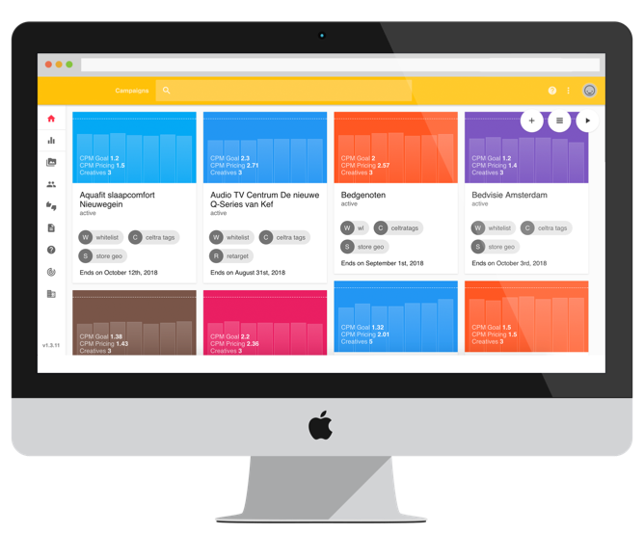
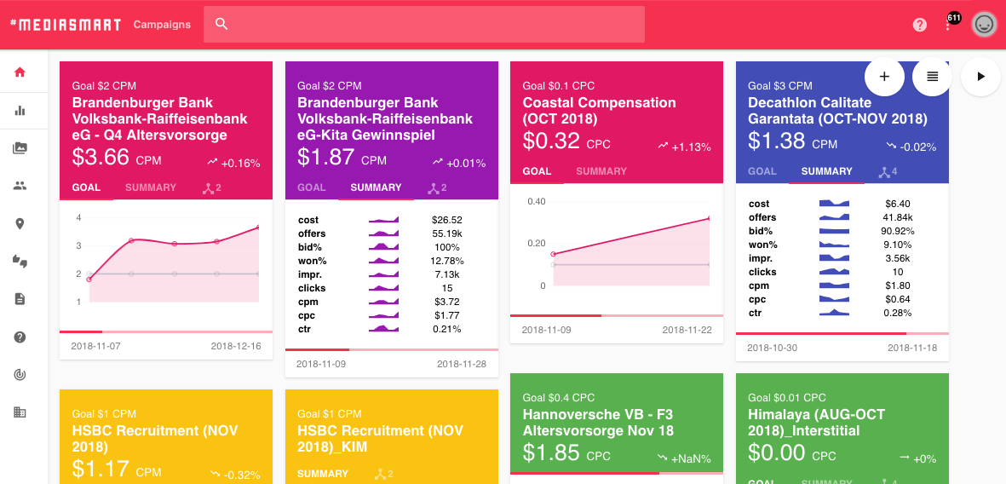
Smart Campaign management- Subsection
We bring together the most intuitive user experience and the most powerful platform so that you can easily keep all your campaigns under control and maximize results with little effort.
Algorithms that automatically manage campaign performance for you and notifications that alert you when something should call your attention. Set your pricing goals for engagement and let our predictive targeting algorithm do the rest.

Slide 6
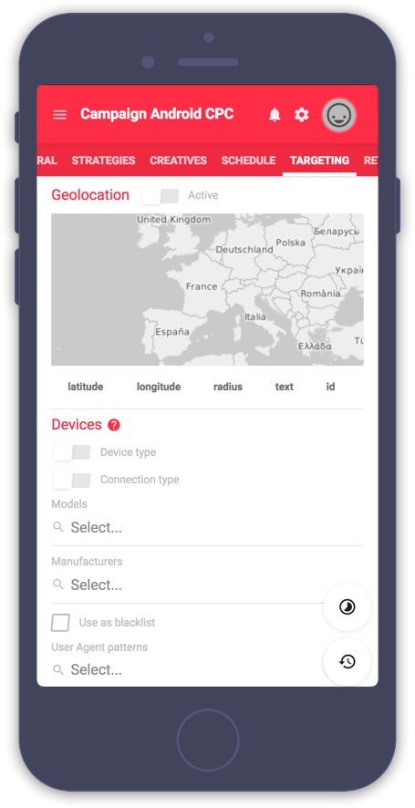
Advanced Targeting options - Subsection
Advanced Targeting Options
When it comes to segmentation and targeting, the mobile nature of mediasmart makes the difference. You can segment your campaigns using a lot of mobile specific variables without having to sacrifice reach. These are some examples of possible segmentation variables:
Mobile operator
Device type
Device make and model
Language
Connection type: Wifi vs Cellular
Operating system and version
App vs Mobile Web
Publisher by name, site ID or app ID/bundle ID
User Interests based on prior behaviour from more than 300 million users
Demographic information: Age and Gender
Geolocation: country, region, city and zipcode
Geofencing with multiple levels of precision
IP address
User ID: IDFA or GAID
Type of user ID: cookie, IDFA, GAID
Domain & Page URL
Target inventory compatible with Ads.txt
You can also run retargeting campaigns or target dynamic audiences. Create your own audiences and enrich them with every new campaign you run, either using mediasmart only or easily integrating with your very own DMP.

Slide 7
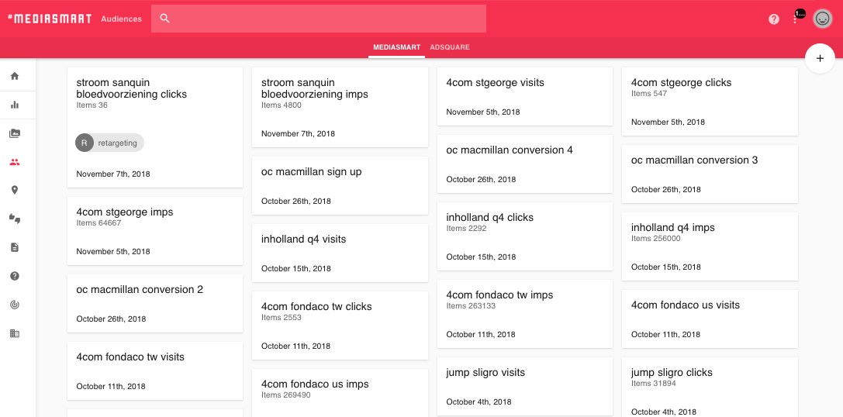
Audience Management - Subsection
Managing audiences is one of programmatic buying main advantages. You can benefit from it by buying at a user-level (taking full control with personalized messages, retargeting, blacklisting); creating your own audiences to make media buying much more efficient and optimizing thanks to Big data and self-learning algorithms.
The options:
Integrate your own DMP:
Sync to target your audiences and enrich your data with campaign information from mediasmart
Third party Data
Target User Segments from Data Providers
Mediasmart Audiences
Create and manage your own audiences based on campaign data and triggers
Working with audiences in mediasmart:
Upload lists through the API/Console and configure audiences to be dynamically update based on Campaign information and engagement triggers.
Target audience segments or lookalikes using complex business rules
Download and update audience files at any time
Target audiences being 100% sure to be GDPR compliant
Notes:
This should be moved to the Proximity Campaigns Solution

Slide 8
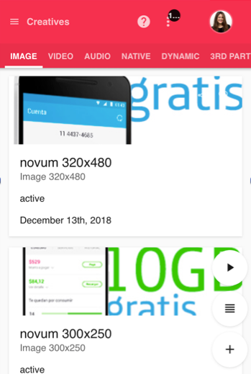
Wide Range of Formats - Subsection
Wide Range of Advertising Formats:
Mediasmart supports all industry ad formats to make sure you always have many options to communicate your message.
Display
Mediasmart can host your static banners and interstitials or deliver your own ad serving tags. The platform is certified with all rich media ad servers most used in mobile, and it also supports the creation of dynamic ads, which content varies with user location, right within the console.
Video
We can host your video files or point to external video URLs. Videos can be served in interstitials within applications, instream or inline, and in many cases can include companion banners.
Native
Upload text together with images or videos and a call to action, and they will be served in a format that seamlessly integrates with the app or website that displays the ads.
Audio
Upload an audio file, and as optional, you can add End-cards. Audio ads are composed by an audio spot, cover art, and clickable campaign name.

Slide 9
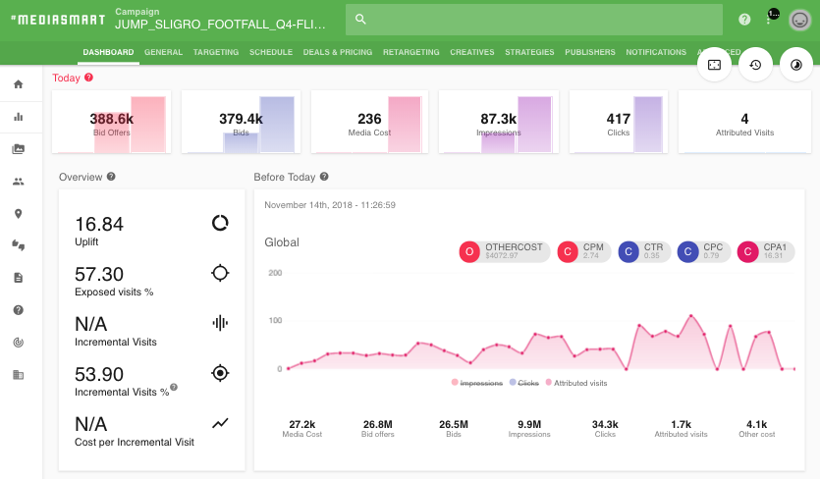
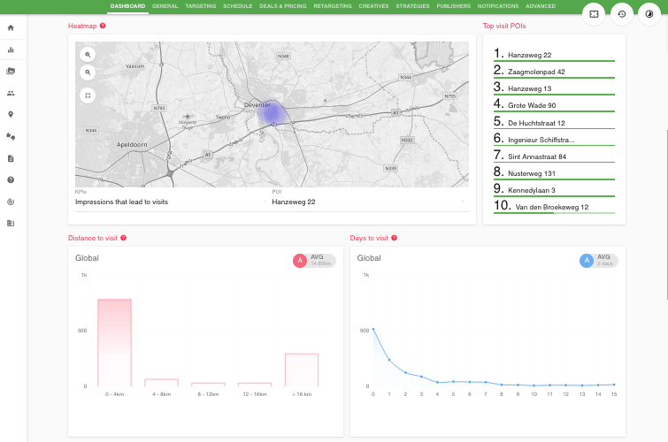
Granular reporting- Subsection
You will receive notifications with any detected issues, warnings and opportunities for improvement, which you can configure to get via the web interface and via email.
In depth analysis through fully transparent and granular reporting tools. Wizard, in depth contextual documentation and online customer support to ensure a seamless and intuitive experience, as well as fast resolution of any potential issues.

Slide 10
REVIEW CONTENT : PRODUCT AREA
PRODUCT
ADSERVER
Adserver for Media Efficiency:
Measure how effective each of your digital advertising channels is, so that you can focus only on those who bring incremental results. Stop paying for installs you would get anyway!

Slide 11
3. AdServer for Efficiency
If you have an app driven business and actively promote your app through managed advertising channels, chances are that you have been subject to attribution fraud (more than 50% paid installs, as per multiple industry reports). And if you are aware of this problem, you are likely to struggle with how to differentiate advertising channels that bring incremental value to your business from those that generate good “results” based on attribution fraud or non ethical practices.
At mediasmart, we believe the ultimate way to identify advertising channels that may be generating good results purely by playing your attribution system, is to actually measure the results they provide when your ads are served, versus when they are not.
With mediasmart Ad Server for Efficiency you will not only be able to quickly identify fraudulent advertising channels, but in general, you’ll be able to identify the incremental value that each of your digital advertising channels brings to your campaigns, allowing you to focus on what works for your business overall.
Download our whitepaper on EFFECTIVE APP PROMOTION
GET CONTROL! CONTACT US FOR A TRIAL.

Slide 12
REVIEW CONTENT : PRODUCT AREA
PRODUCT
FOOTFALL MEASUREMENT
Footfall Measurement
Measure footfall or the amount of visits to a store that can be attributed – or directly linked to the impact of - a Drive to Store campaign.

Slide 13
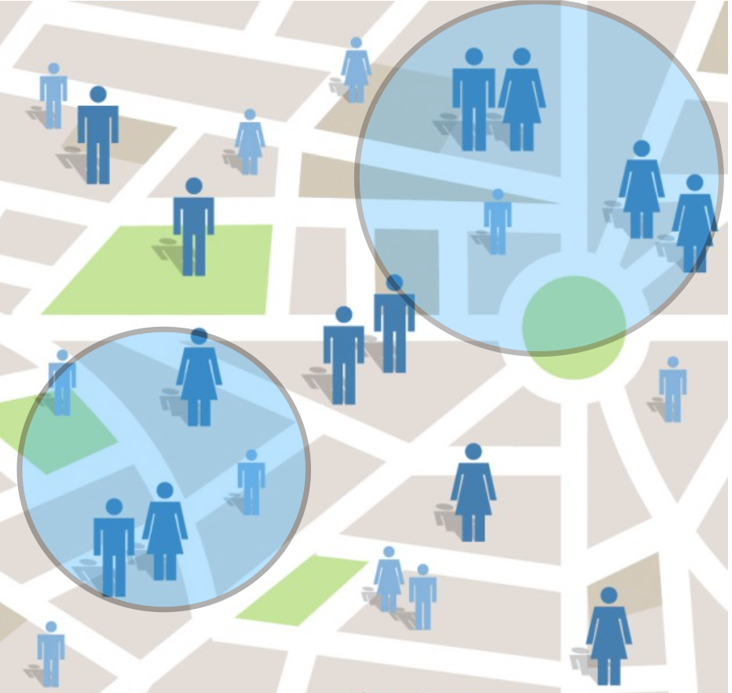
2. Footfall measurement Solution:
Footfall - or visits to a store - measures the number of people entering a shop.
1
2
Target areas to serve your ad or areas to drive users to
Choose Different tools for footfall measurement.
3
4
measure the actual campaign impact with additional kpis
Get advanced reports and insights
dDownload our One pager AND our guide on Footfall
CONTACT US FOR more information

Slide 14

NEW AREA: SOLUTIONS
Solutions
Branding
Proximity Campaigns
App Marketing
SWITCH TO MOBILE; WHERE USERS SPEND MOST OF THEIR TIME, IN A BRAND SAFE WAY
USE USER’S LOCATION TO PERSONALIZE YOUR ADVERTISING EFFORTS AND MEASURE THE IMPACT OF YOUR CAMPAIGNS IN DRIVING FOOTFALL
MEASURE UPLIFT IN YOUR CAMPAIGNS AND LET INCREMENTAL METRICS DRIVE YOUR INVESTMENTS FOR MAXIMUM EFFICIENCY

Slide 15
BRANDING
SWITCH TO MOBILE; WHERE USERS SPEND MOST OF THEIR TIME, IN A BRAND SAFE WAY
Access and manage deals (audience packages, PMP, etc…)
Integrate your First Party data and dynamically generate new audiences
Access third party data
Target inventory compatible with Ads.txt
Engaging formats including native video, audio and rich media
Target inventory with high viewability
Full publisher transparency and easy management of publisher lists
Automatically optimize to your KPIs
Monitor campaigns with easy to use dashboards and granular reports
Download use case

Slide 16
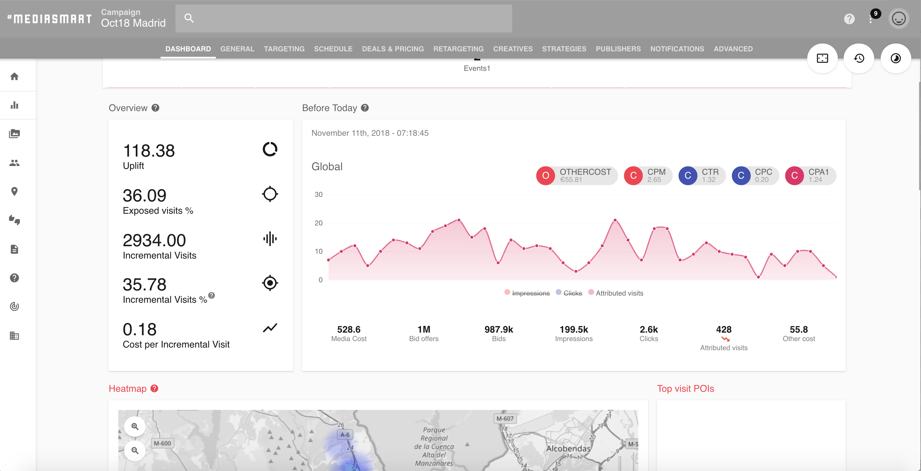
PROXIMITY CAMPAIGNS
USE USER’S LOCATION TO PERSONALIZE YOUR ADVERTISING EFFORTS AND MEASURE THE IMPACT OF YOUR CAMPAIGNS IN DRIVING FOOTFALL
Easily discover POIs (based on OpenStreetMaps)
Upload, download and modify lists of areas (geolists). Control their precision.
Measure footfall in real time (“attributed visits”) with multiple solutions
Follow Uplift and Incremental visits on a daily basis
Understand the statistical relevance of data gathered
Access daily insights about your proximity campaigns, including daily updated heatmaps
Create audiences based on user’s locations, and target them in campaigns
tO GET MORE INFO Download use case

Slide 17
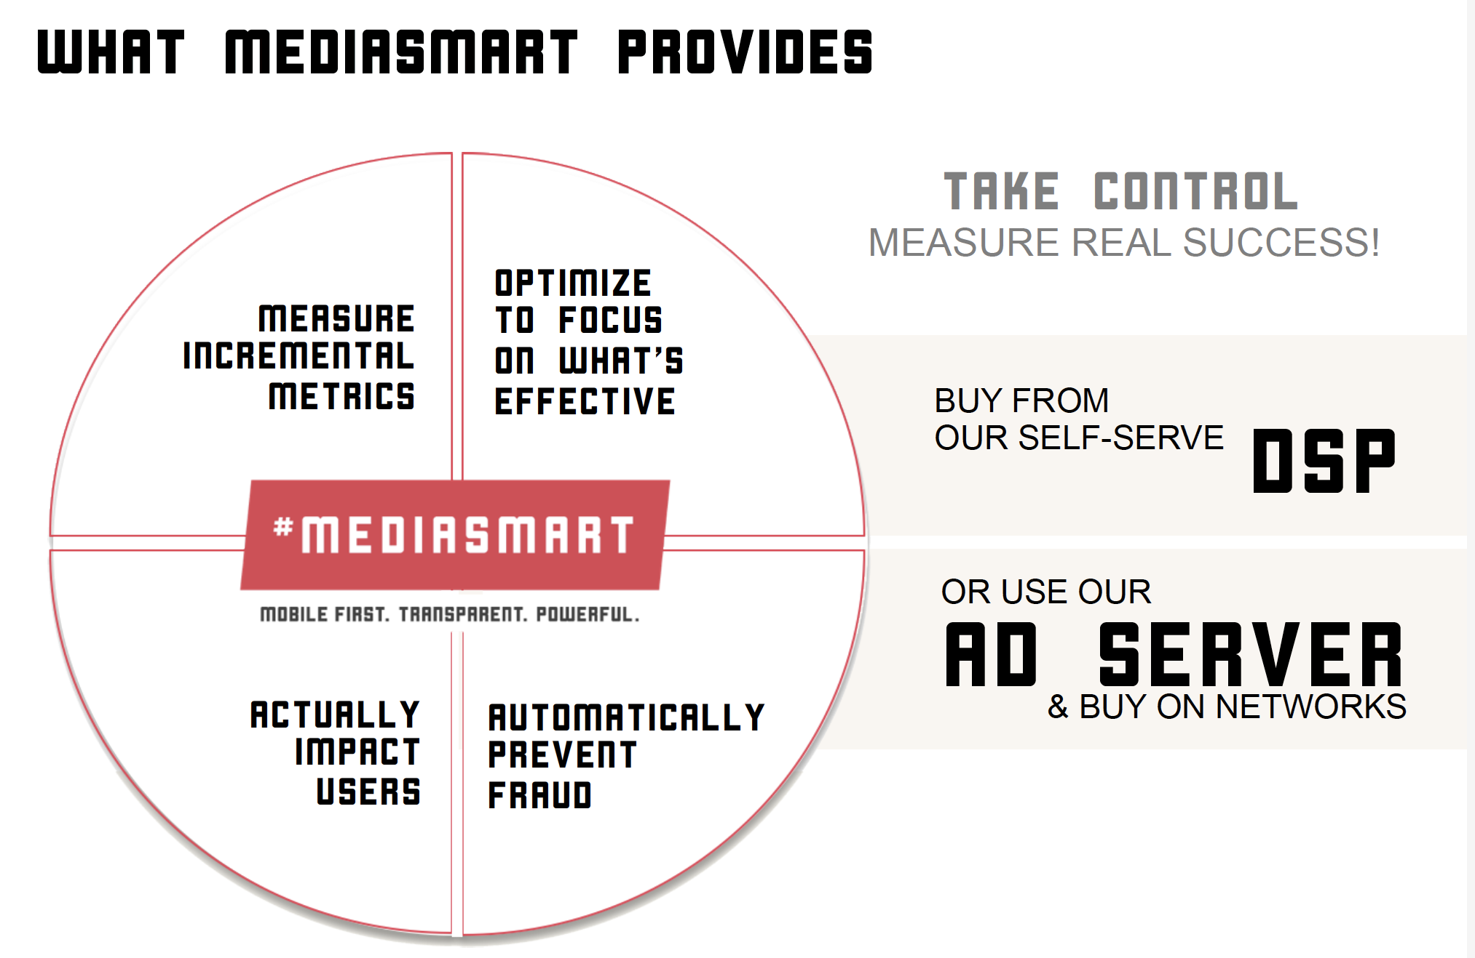
INCREMENTAL METRICS
MEASURE UPLIFT IN YOUR CAMPAIGNS AND LET INCREMENTAL METRICS DRIVE YOUR INVESTMENTS FOR MAXIMUM EFFICIENCY
Ad Server that can be used when running campaigns in any network/demand platform that supports third party ad tags
Automatic measurement of incremental metrics by running placebo campaigns
Fully granular and transparent reports, including session level data
Dashboard with daily Insights for immediate optimization
Certified with the main tracking players in the market: Tune, Appsflyer, Adjust and Kochava.
Download use case

Slide 18
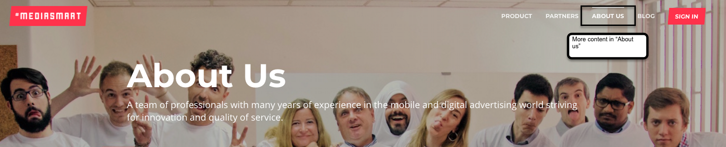
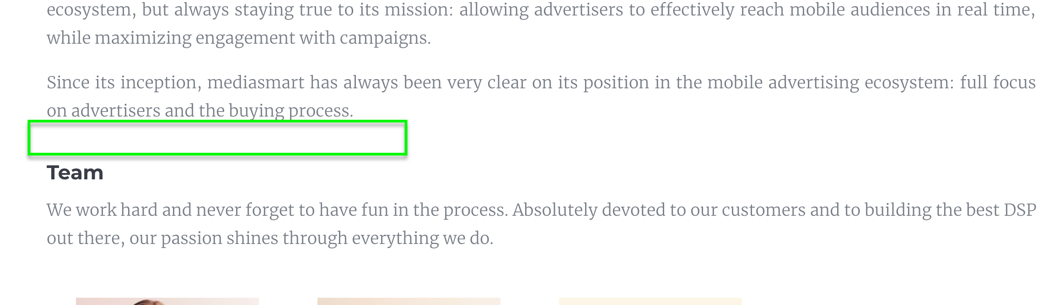
NEW AREA: MORE CONTENT IN ABOUT US
Adding a small gallery of slides about culture & values

Slide 19
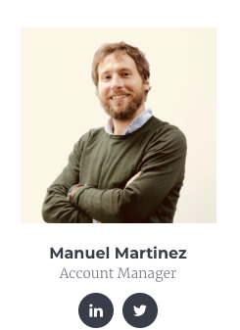

Change Team photos
Delete
Modify
Julio’s job Title: Commercial Director ES & LATAM
Mo’s job Title: Commercial Director UK
Add new one: Emilio
Title?

Slide 20
MORE CONTENT IN ABOUT US - from “culture & values”
Be a generous leader.
One that helps others succeed and celebrate their success.
A generous leader leads with example, is kind, compassionate, patient and empowers others, both colleagues and customers. And at mediasmart, we make it our goal is to do as much as we can to help both our teammates and our clients succeed.
Expand
---------------------------------
As generous leaders we care. We look for solutions rather than focusing on the problems, always keeping a positive mindset - even in the face of adversity - and trying to understand both sides in each conflict. We are the first ones to volunteer when we can help, and always encourage our team members, never put them down. We exercise patience and compassion, striving to understand the other’s perspective, whether they are our colleagues or our customers.
And last, but not least, we recognize the efforts or our team members and not only celebrate team successes, but also appreciate the learnings in case of failures. Everybody makes mistakes, and that is totally fine at mediasmart, because you often learn even more from mistakes than from successes.

Slide 21
MORE CONTENT IN ABOUT US - from “culture & values”
Love curiosity. Keep learning and stay relevant.
We believe that a curious attitude is the source of new ideas, possibilities and whole new worlds that will contribute to our company success. At mediasmart we encourage everyone to test “crazy ideas” and, because we know how difficult it is not to get bogged down by the never-ending wheel of the day to day, we have made the time to “explore” official in our calendars.
Expand
---------------------------------
Each team has its habits. For example, in the development team everyone can dedicate one day every two weeks to a project of his/her choosing that is outside of the daily priorities. Some projects may lead to something great, some others may not, but the value is in the trying.
Learning something new everyday keeps us going, and there is so much to learn in such a fast moving environment! We have an internal knowledge base and shared documentation that everybody contributes to as per our motto “if your explanation was useful to somebody, share it”, and this is great help for us to learn from each other. But we also organize frequent in-person sessions at our office with experts (mostly colleagues, but also external parties) on different subjects, both around our product features and industry trends.
But we could not stay relevant if we did not cherish the relationship with our customers and encouraged their feedback. Our customers are the ones who drive what we do, and we remember everyday that it is thanks to them that our company can thrive.

Slide 22
MORE CONTENT IN ABOUT US - from “culture & values”
It’s a team effort. Collaborate and cooperate to build a smart company.
We can only work as a team when we are all working toward the same goal, and that is something that is very present in mediasmart every day. The mission and strategy of the company, as well as our quantitative goals and progress towards them are very transparently shared across the organization in regular all-hands meetings.
Expand
---------------------------------
As in every organization, there are inevitably teams within the big team, but at mediasmart we do not like silos. That’s why we continuously make efforts to ensure that each team understands the “others”. There is full transparency and frequent proactive communication around how each team works, their internal processes and their priorities, as well as their challenges. By understanding each other and respecting each other processes, collaboration and effective cooperation tend to come naturally. On a day to day basis, trying to understand other team's needs first, helps us not only with communication, but determines the way we work and solve issues.
At mediasmart there is no room for personal agendas or egos. We all contribute selflessly, and try and help each other, both within our team, across teams and when working with clients or partners, as much as possible. The same spirit extends even to our competitors, who often become our allies to try and solve industry challenges.

Slide 23
MORE CONTENT IN ABOUT US - from “culture & values”
Go farther. Be an example for others. Set the bar.
Our ambition is to do our job as best as we can every single day. Mistakes can be made, expected results may not come on time, but it is all good if know we gave it our best. And giving it our best means to go out of our way to solve a customer problem or to squeeze the best performance out of a campaign, it means saving a customer or a colleague time when they ask you a question by providing more details even if it takes you more time to provide the answer, it means evaluating new ways of saving the company cost even when you have not been specifically asked for it… In summary, not only being professional, but strive for excellence.
Expand
---------------------------------
At mediasmart we are accountable for our mistakes, and do not try and hide them. Offering such a transparent and granular platform in the advertising world is the best proof of that. The customers we love will value and appreciate the transparency, just like we do. In the end, we want to be the reference for our customers and the industry in general, not only because we provide a powerful and user friendly mobile marketing platform, but also because they trust our team and share our values.

Slide 24
MORE CONTENT IN ABOUT US - from “culture & values”
Love what we do. Love our work with passion and respect.
Work should be fun. Our work should make us proud and happy.
We all at mediasmart try to smile and be positive, because good vibes are infections, just like yawning. And we believe that loving what you do comes naturally when you feel comfortable at work. With knowledge, confidence in what you do a then knowledge that the whole team is backing you up, you are comfortable and ready for anything. Then, happiness comes right up.
Expand
---------------------------------
But it is impossible to be happy at work if you are not happy in life. At mediasmart we do not have strict schedules and work remotely a lot (in our headquarters you will not find us at the office on Fridays or in August), and this gives us flexibility to accommodate work, around our other priorities in life. We are also aware that this “working from anywhere” style comes with the risk of not disconnecting from work enough, so we encourage detachment breaks, not only from work, but also from technology in general.
When working with both colleagues and clients we try to exercise empathy and we are always respectful. Not only in the way we speak to each other (no room for bad manners at mediasmart!) but also in the way we respect each others time and working habits. We also like private and public displays of thankfulness when someone helps us.

Slide 25
MORE CONTENT IN ABOUT US - from “culture & values”
Do good and do well. Our work matters.
We do well when we grow our revenue and margin year over year, and doing well is important for each of us. But we also want to do good, and for us that means knowing that we have a purpose, being honest and, when in doubt, always let ethics win over results.
Expand
---------------------------------
We want to contribute to enabling a world in which advertisers and publishers get connected in the most effective way. A world where sustainable business can be build around services that are provided to users for free. And a world where advertisers can reach audiences with the trust that their money is well invested, and where users can trust that advertisers are not going to invade their privacy.
Educating our customers, providing them with full transparency on campaign performance, fighting fraud, fighting for ad quality and giving users choice are some of the things that help us do good today, even if we may do well (or better) not doing some of them. We believe doing good and doing well go together in the long run. And we want to be here for the long run.

