Slide 1
Upload API Step and Parameter with their response

Slide 2
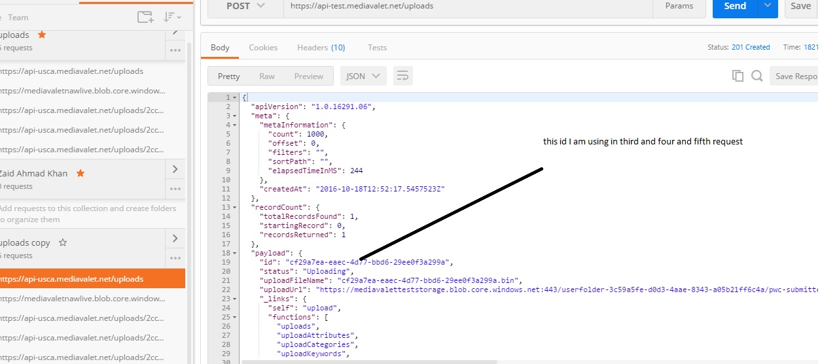

Slide 3
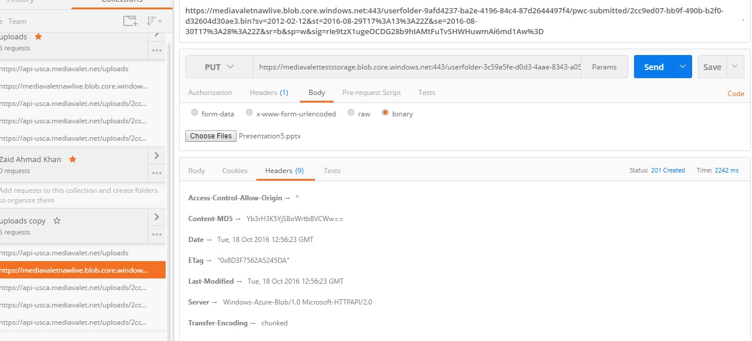

Slide 4
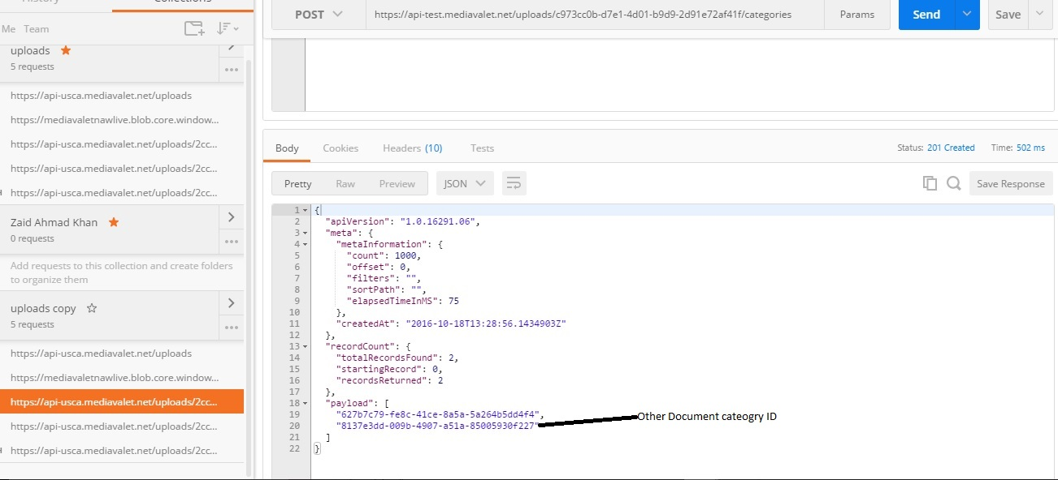

Slide 5
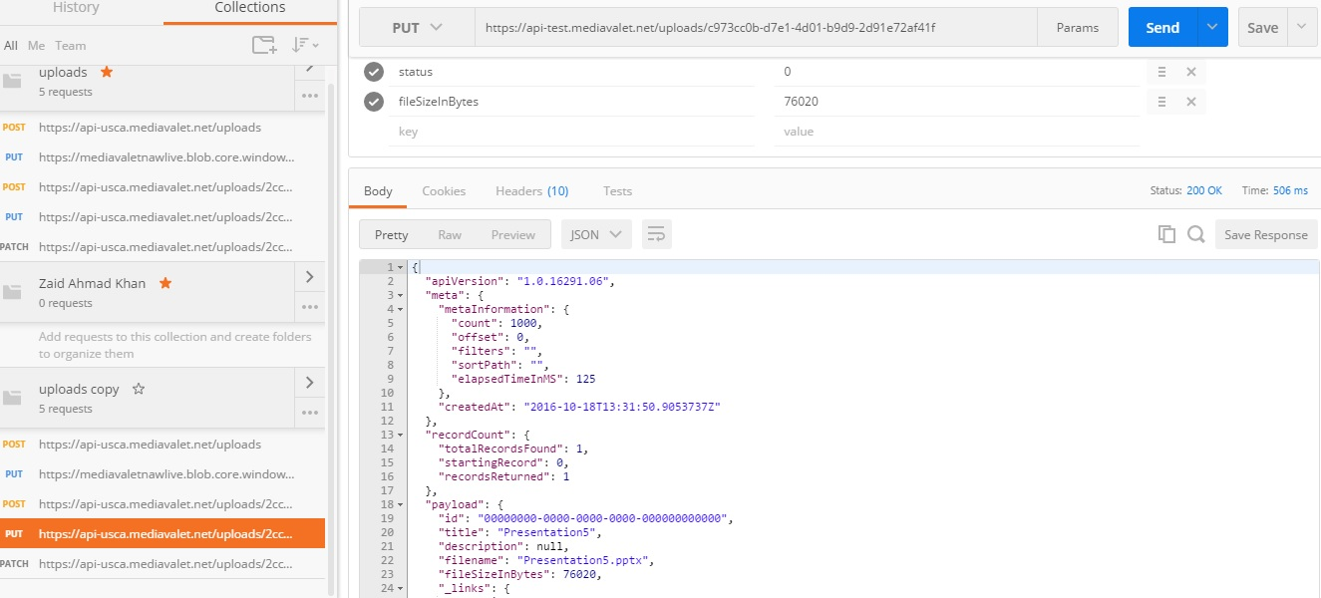
Response Status 200 and Payload id =0000000000000000 is it ok

Slide 6
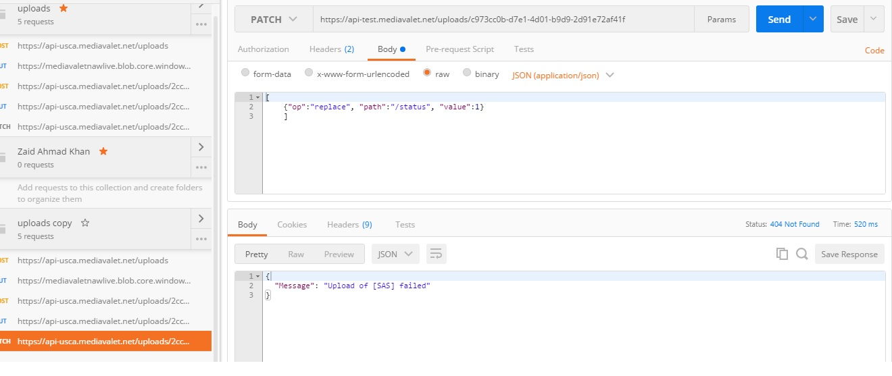
Final Api response is failed

