Slide 1
ML Models for Matching Clinical Trials
November 4, 2018
Mohammad

Slide 2
Diabetes

Slide 3
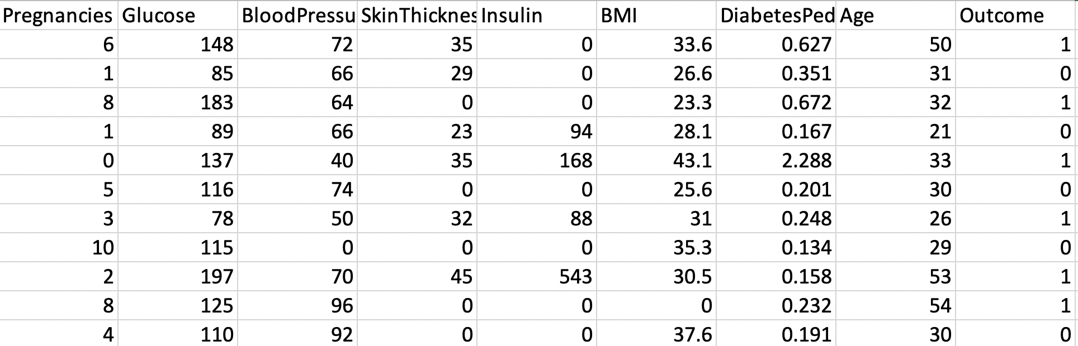
Training Data Set
Number of Patients = 768
Number of available features = 8
DataSet = https://github.com/susanli2016/Machine-Learning-with-Python/blob/master/diabetes.csv
Features
Target Variable

Slide 4
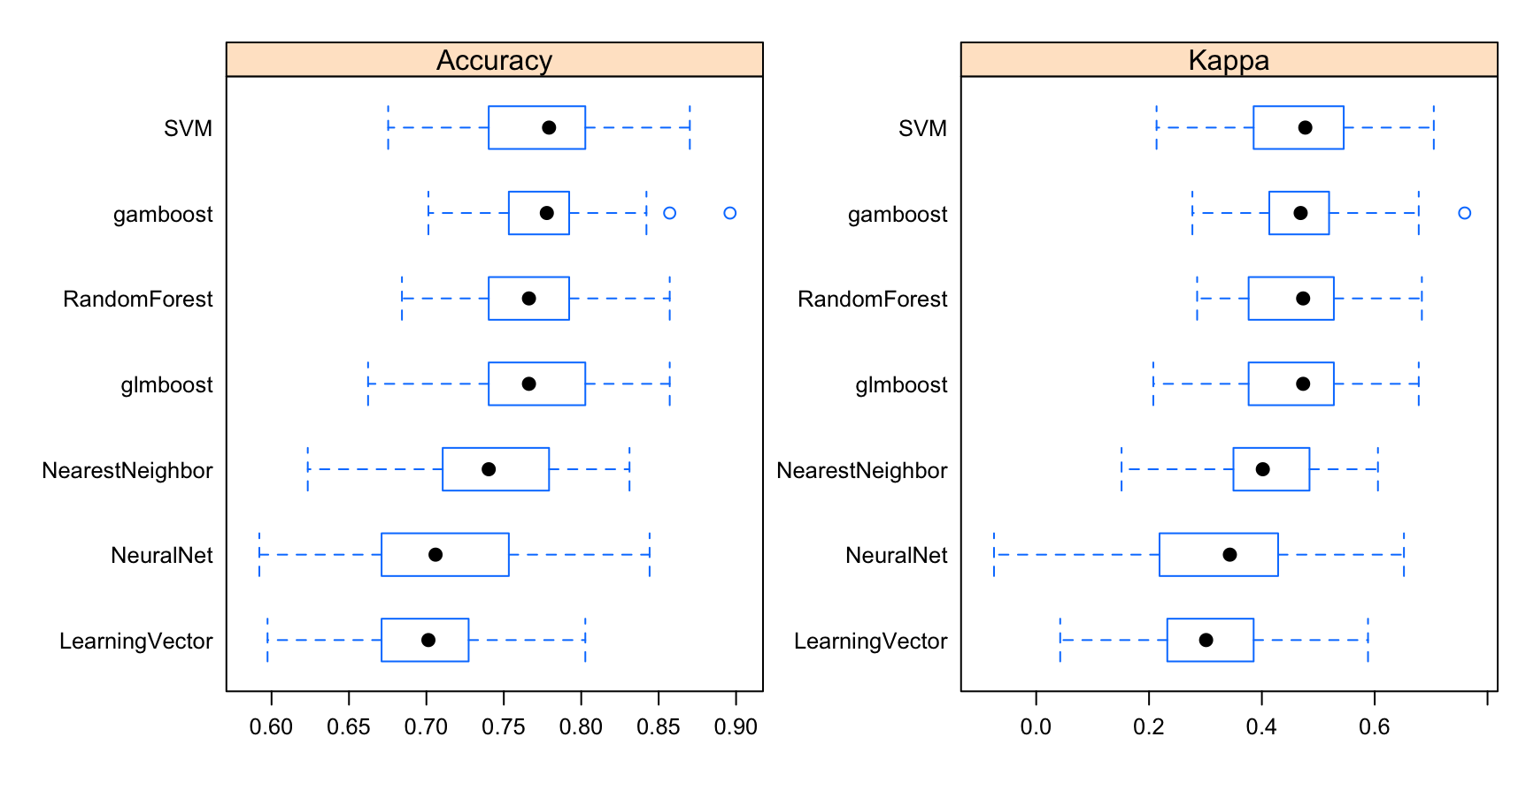
Comparing Models
Best Model = SVM
Accuracy ~ 80%

Slide 5
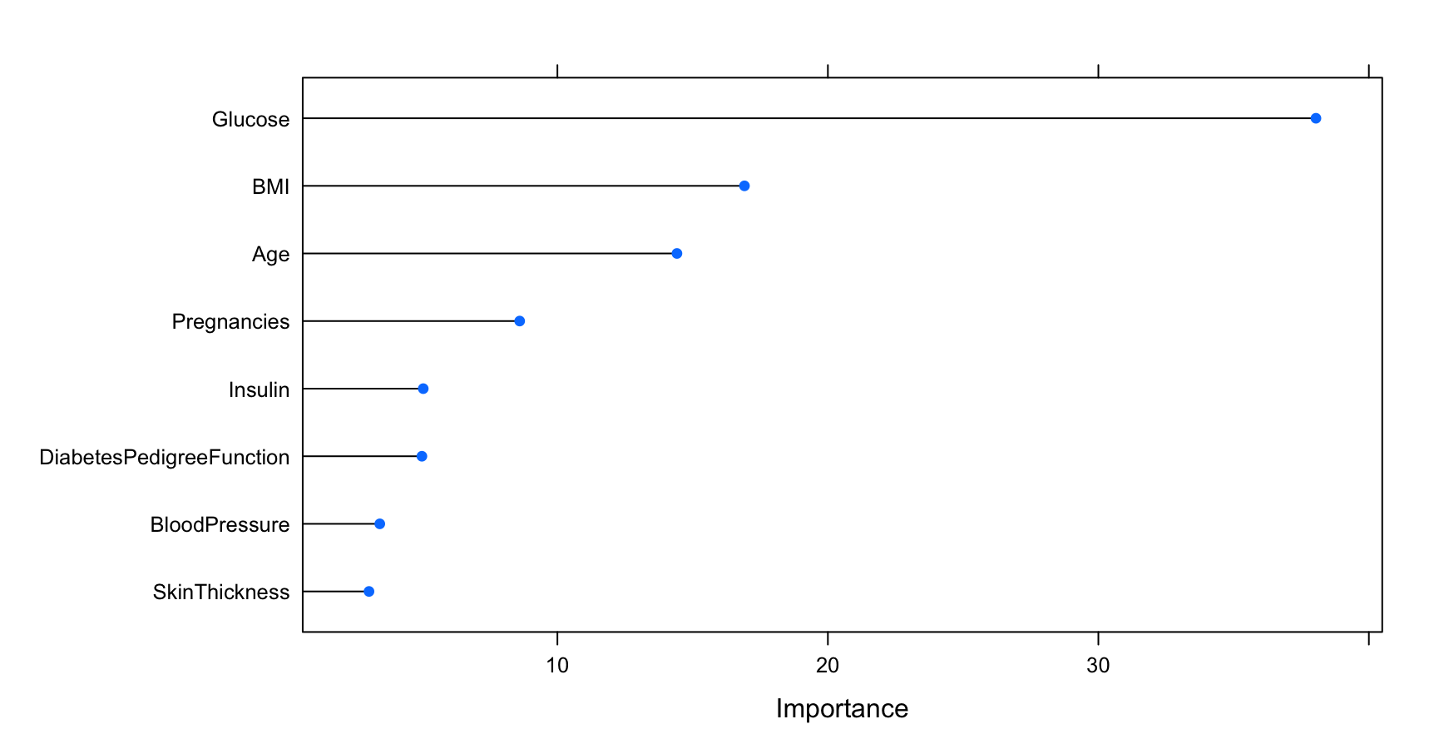
Feature Selection

Slide 6
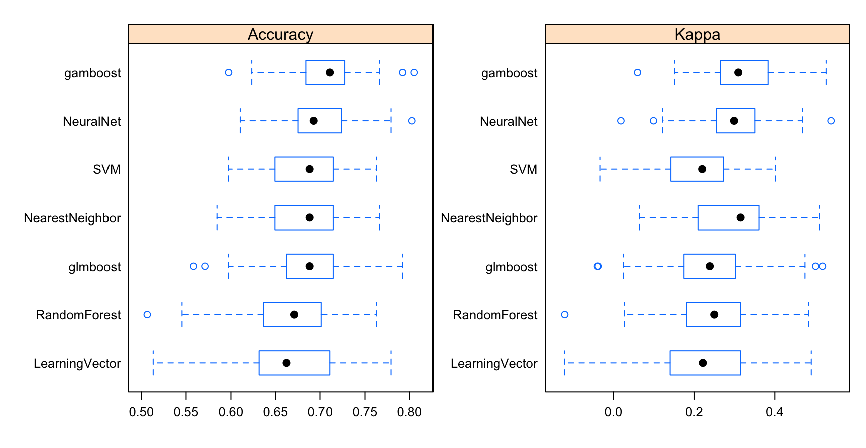
Training by Using Only BMI, Age and Pregnancies
Best Model = Boosted Generalized Additive Model
Accuracy ~ 72%

