Slide 1

Part 4

Slide 2
主要内容
文档与消息的差异
什么是CDA
CDA RMIM
CDA的内容
CDA的交换
CDA的验证

Slide 3
文档与 消息的差异
文档
持续
人对人
作者是医生并且被医生经常使用
有法律地位
一般是范例来决定
应用到整个世界
消息
临时的
系统对系统
医生一般不接触消息
一般无签名
没有法律地位
使用用例来设计
被每个应用所重建
生存时间
通讯
与医护人员
的关系
法律角度
来源
语境

Slide 4
什么是CDA
CDA 是CLINICAL DOCUMENT ARCHITECTURE的缩写. CDA指定XML的文档标准并且标准化了文档语义和文档结构。它基于HL7 V3的RIM模型， HL7 V3 方法学, 以及受控或本地的术语表 (SNOMED, LOINC等.)
CDA能以简单或复杂的方式应用，从带有最小的文档信息到完全编码文档
当变成CDA时编码的水平是关键因素：当我们在投入到包含在数据中的信息编码工作越多的时候，数据的重用性越好。

Slide 5
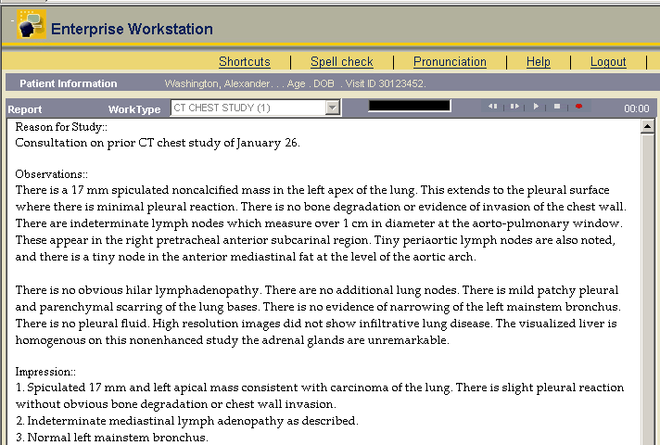
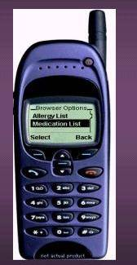
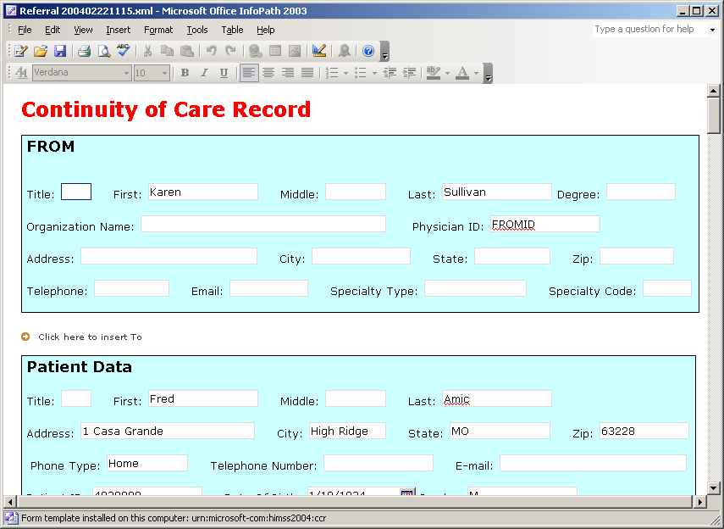
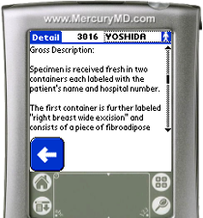
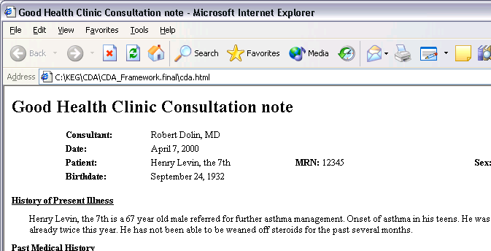
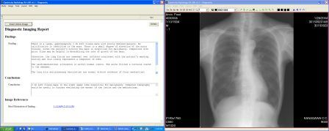
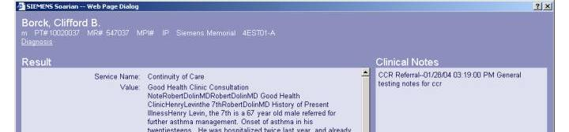
这些都是CDA
这是CDA
这也是
这也是
这也是
这也是
这也是
这也是

Slide 6

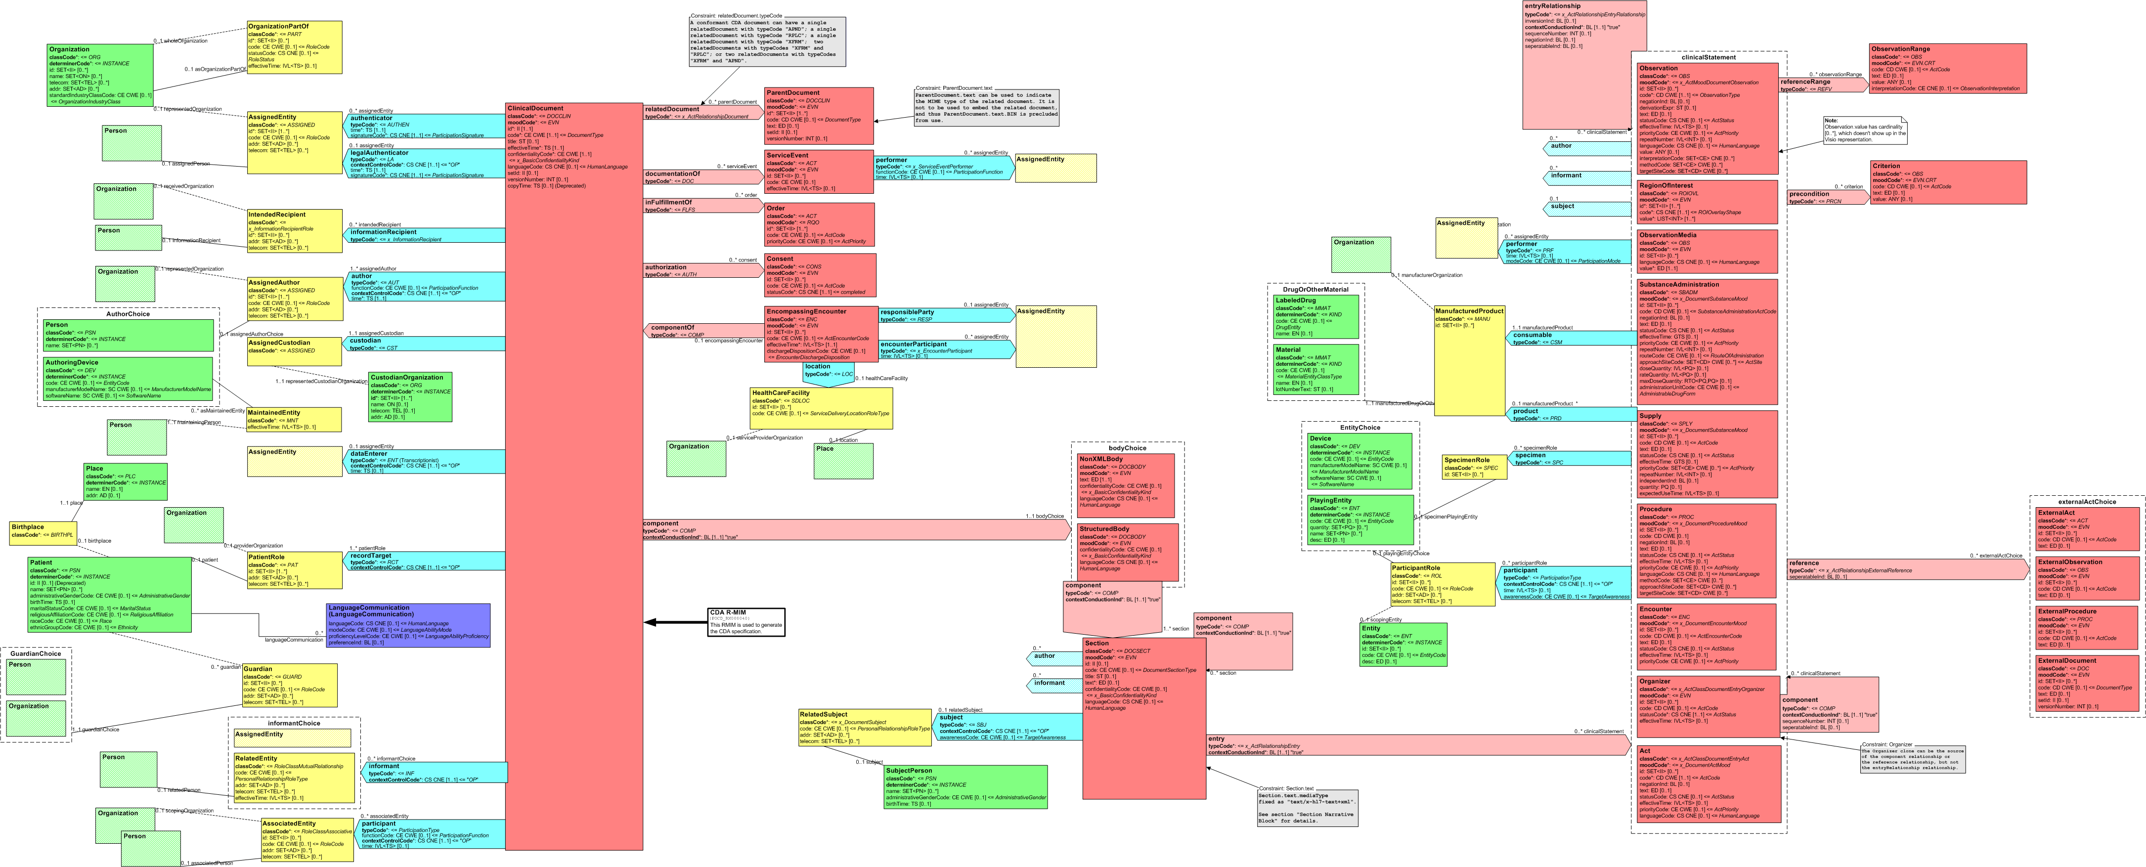
CDA Header
CDA Body,
Section, and
Narrative Block
CDA Entries
Ext'l
Refs

Slide 7
CDA = header + body
CDA Header
  用于文档查找、管理和恢复等的元数据
CDA Body
  临床报告
    出院小结
    医疗记录摘要
    病历
    转诊单
    检查检验报告
    公共卫生报告
  … 以及带有一个签名的任何内容

Slide 8
CDA Header
文档头描述了:
  文档本身(unique ID, document type classification, version)
  参与者(providers, authors, patients…)
  文档关系(to orders, other documents…)
足够用于文档管理的元数据

Slide 9
XML Body: 两种类型的标记
Human-readable(人可读的) “narrative block (叙述段)”, 所有这些需要复制法律的临床内容
可选的 machine-readable(机器可读的)CDA 实体, 用于自动化处理。

Slide 10
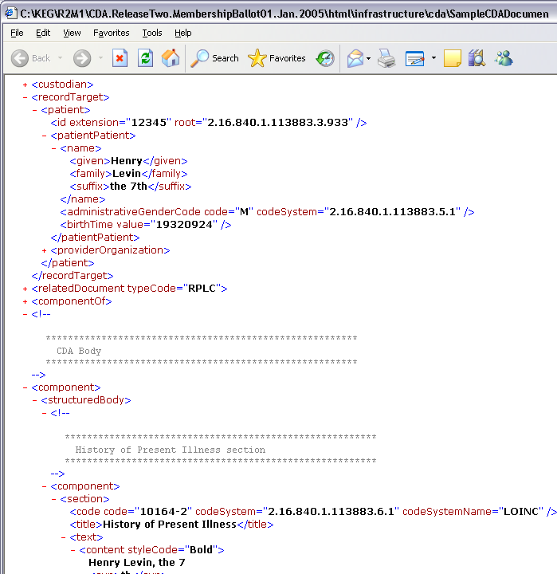
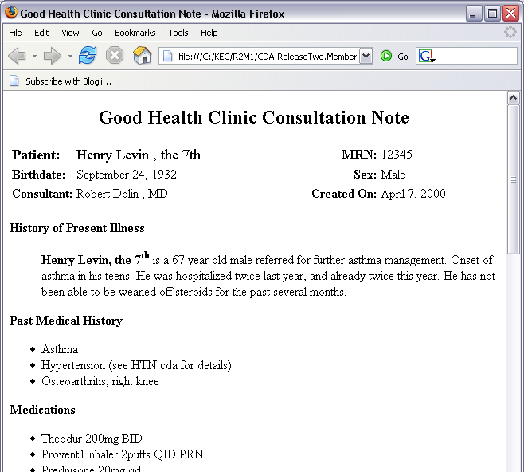
Sample CDA
Header
Body
  Readable: required
  Computable: optional
Notes:
Animation
The CDA XML and how it is rendered.
Maybe launch the actual CDA sample in a browser (with/without stylesheets).
Open one in FireFox and one in IE.

Slide 11
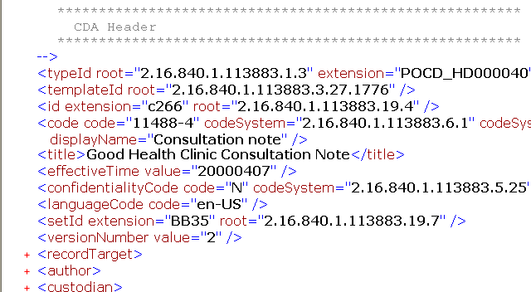
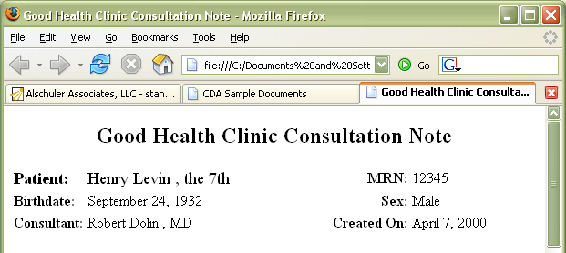
CDA Header: Metadata元数据
Identify
  Patient
  Provider
  Document type...
Sufficient for
  Medical records management
  Document management
  Registry/repositoryg
  Record locator service
  Store, query, retrieve
required
Notes:
Animation
Note that human readable text is required.

Slide 12
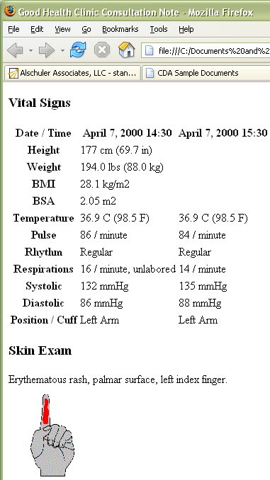
CDA Body: Human-readable report人可读报告
任何类型的临床文档
  病历
  转诊单
  手术通知
  出院小结...
格式: tif, PDF, HTML, XML:
  Paragraph
  List
  Table
  Caption
  Link
  Content
  Presentation
required
Notes:
Animation
Note that human readable text is required.

Slide 13
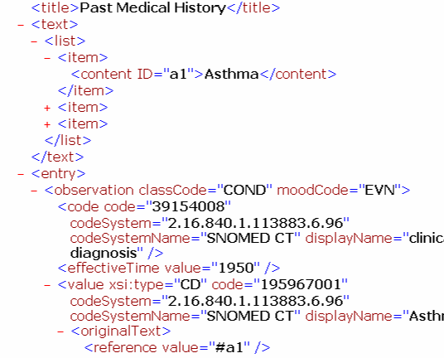
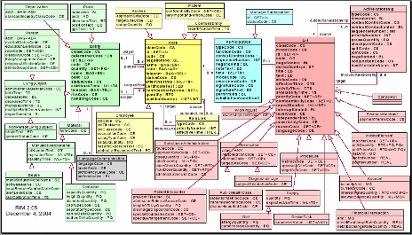
CDA Body: Machine Processible机器处理
  基于模型的可计算语义学
    观察
    操作
    组织者
    支持者
    就诊
    本体管理
    观察音频
    活动
Optional
Notes:
Animation
Machine processible data is optional.

Slide 14
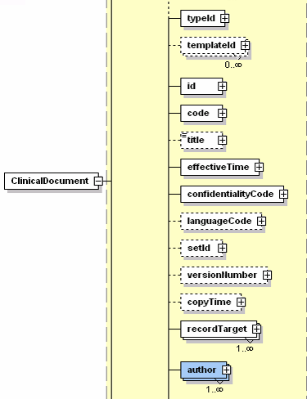
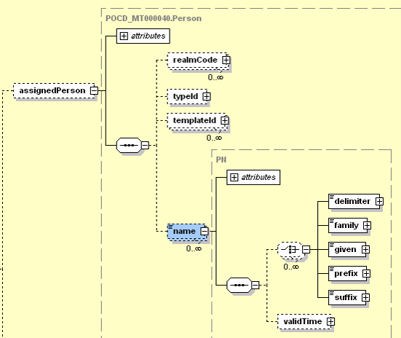
CDA & V3 Data Types
Data type
CDA

Slide 15
CDA Header
Good Health Clinic Consultation note
Consultant: Robert Dolin, MD
Date: April 7, 2000
Patient: Henry Levin, the 7th MRN: 12345 Sex: Male
Birthdate: September 24, 1932
<?xml version="1.0"?>
<ClinicalDocument xmlns="urn:hl7-org:v3" xmlns:voc="urn:hl7-org:v3/voc" xmlns:xsi="http://www.w3.org/2001/XMLSchema-instance" xsi:schemaLocation="urn:hl7-org:v3 CDA.ReleaseTwo.CommitteeBallot01.July.2003.xsd">
<!--
********************************************************
CDA Header
********************************************************
-->

Slide 16
Header Elements
Good Health Clinic Consultation note
Consultant: Robert Dolin, MD
Date: April 7, 2000
Patient: Henry Levin, the 7th MRN: 12345 Sex: Male
Birthdate: September 24, 1932
<id extension="c266" root="2.16.840.1.113883.3.933"/>
<code code="11488-4“
codeSystem="2.16.840.1.113883.6.1“ displayName="Consultation note"/>
<title>Good Health Clinic Consultation Note</title>
<effectiveTime value="20000407"/>
<setId extension="BB35" root="2.16.840.1.113883.3.933"/>
<versionNumber value="2"/>
<relatedDocument typeCode="RPLC">
<parentDocument>
<id extension="a123" root="2.16.840.1.113883.3.933"/>
<setId extension="BB35"root="2.16.840.1.113883.3.933"/>
<versionNumber value="1"/> </parentDocument> </relatedDocument>
<documnetationOf>
<inFulfillmentOf>
<authorization>
<componentOf>

Slide 17
Header Elements
Good Health Clinic Consultation note
Consultant: Robert Dolin, MD
Date: April 7, 2000
Patient: Henry Levin, the 7th MRN: 12345 Sex: Male
Birthdate: September 24, 1932
<recordTarget>
<patientRole>
<id extension="12345" root="2.16.840.1.113883.3.933"/>
<patientPatient><name>
<given>Henry</given>
<family>Levin</family>
<suffix>the 7th</suffix></name>
<administrativeGenderCode code="M"
codeSystem="2.16.840.1.113883.5.1"/>
<birthTime value="19320924"/>
</patientPatient></patientRole>
</recordTarget>

Slide 18
CDA Body
History of Present Illness
Henry Levin, the 7th is a 67 year old male referred for further asthma management. Onset of asthma in his twenties teens. He was hospitalized twice last year, and already twice this year. He has not been able to be weaned off steroids for the past several months.
Past Medical History
Asthma
Hypertension (see HTN.cda for details)
Osteoarthritis, right knee
Medications
Theodur 200mg BID
Albuterol inhaler 2puffs QID PRN
Prednisone 20mg qd
HCTZ 25mg qd
<!--
********************************************************
CDA Body
********************************************************
-->
<component>
<StructuredBody>
<!--

Slide 19
CDA Section Narrative Block
History of Present Illness
Henry Levin, the 7th is a 67 year old male referred for further asthma management. Onset of asthma in his twenties teens. He was hospitalized twice last year, and already twice this year. He has not been able to be weaned off steroids for the past several months.
Past Medical History
Asthma
Hypertension (see HTN.cda for details)
Osteoarthritis, right knee
Medications
Theodur 200mg BID
Albuterol inhaler 2puffs QID PRN
Prednisone 20mg qd
HCTZ 25mg qd
<content>
<link>
<renderMultiMedia>
<paragraph>
<list> <item>
<table> <tr> <th> <td>
<caption>
<!--
********************************************************
History of Present Illness section
********************************************************
-->
<component>
<section>
<code code="10164-2" codeSystem="2.16.840.1.113883.6.1" codeSystemName="LOINC"/>
<text>Henry Levin, the 7th is a 67 year old male referred for further asthma management. Onset of asthma in his <delete>twenties</delete><insert>teens</insert>. He was hospitalized twice last year, and already twice this year. He has not been able to be weaned off steroids for the past several months. </text>
<title>History of Present Illness</title>
</section>
</component>

Slide 20
CDA Section Narrative Block
Past Medical History
Asthma
Hypertension (see HTN.cda for details)
Osteoarthritis, right knee
Medications
Theodur 200mg BID
Albuterol inhaler 2puffs QID PRN
Prednisone 20mg qd
HCTZ 25mg qd
Allergies & Adverse Reactions
Penicillin - Hives
Aspirin - Wheezing
Codeine – Itching and nausea
<component>
<section>
<code code="10153-2" codeSystem="2.16.840.1.113883.6.1“ codeSystemName="LOINC"/>
<text>
<list>
<item><content ID="a1">Asthma</content></item>
<item><content ID="a2">Hypertension (see HTN.cda for details)</content></item>
<item><content ID="a3">Osteoarthritis, <content ID="a4">right knee</content></content></item>
</list>
</text>
<title>Past Medical History</title>
<component1>
<Observation classCode="COND">
<code code="G-1001" codeSystem="2.16.840.1.113883.6.5" codeSystemName="SNOMED" displayName="Prior dx"/> <effectiveTime value="1950"/> <value xsi:type="CD" code="D2-00036"
CDA Entries

Slide 21
CDA文档的交换
通过HL7 V2消息
发送这个文档附在HL7 V2消息中ED数据类型的字段，如第9章中的MDM^T02，CDA文档(基于64位编码)能被包含在V2 OBX段。
通过HL7 V3消息
RCMR消息域(如. Original Document Notification;RCMR_IN000003UV01). CDA文档(基于64位编码)能被包含消息的ClinicalDocument.text属性中。
事实上，CDA文档没有指定的交换方式，它能以任何传输文件的形式交换，如FTP、RPC、Web services等

Slide 22
CDA文档的验证
XML Schemas
CDA R2 包含了四个共同定义了CDA文档结构的XML Schemas， 他们是:
CDA Release Two: cda.xsd: 包含的header和body的定义, 和实体(直接来自R-MIM)
叙述段 narrativeblock.xsd: narrative block的标记 (section.text), XHTML的子集.
HL7 数据类型schema datatypes.xsd, datatypes-base.xsd: V3数据类型的 XML ITS
HL7 术语表 schema voc.xsd 用于 HL7 V3的术语表。

Slide 23
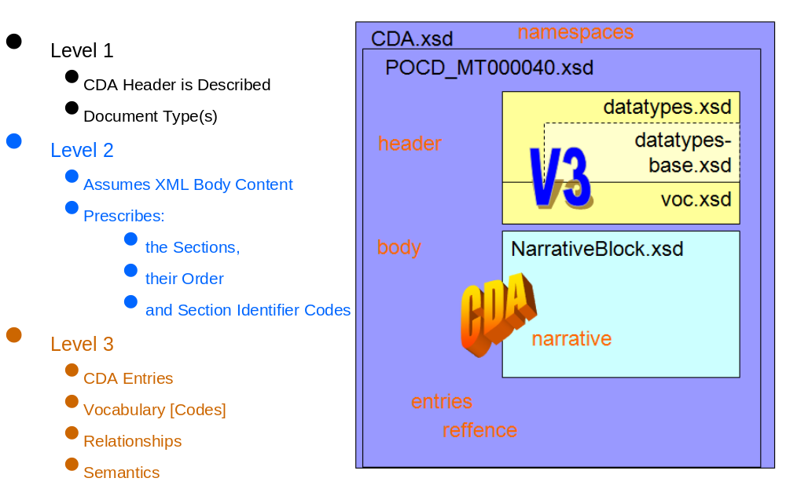
XSDs如何组成一个整体
Notes:
Level 1：仅验证CDA要求的那些字段。不要求任何实体或节点代码的使用
Level 2：验证强制性的节点的标题或节点的代码
Level 3：验证实体(活动编码或术语集)

