Slide 1
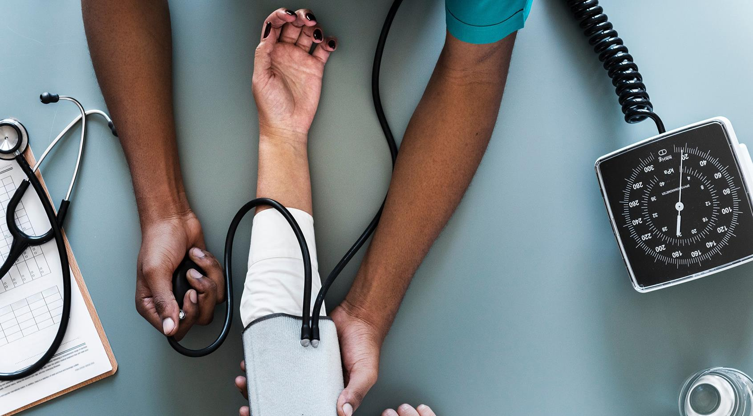

PHARMA
ESKİŞEHİR TECHNICAL UNIVERSITY
BİM444 SENIOR PROJECT

Slide 2
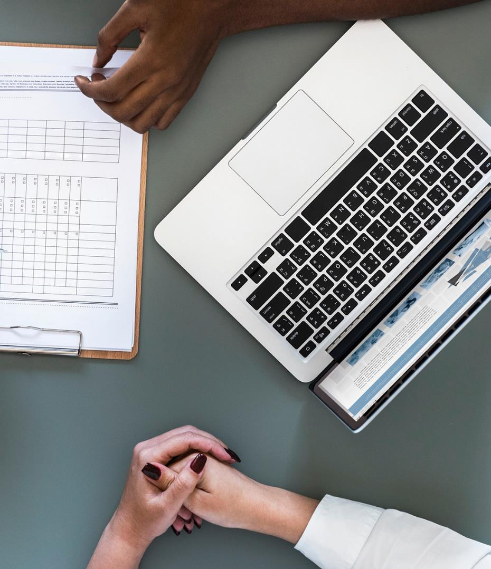
REVIEW OF PHARMA
The patients will be able to access to usage information of medicines.
Range
Usage Way
Dose
Max Usage Period
Our main aim is to inform the patients about the medicines they will use.

Slide 3
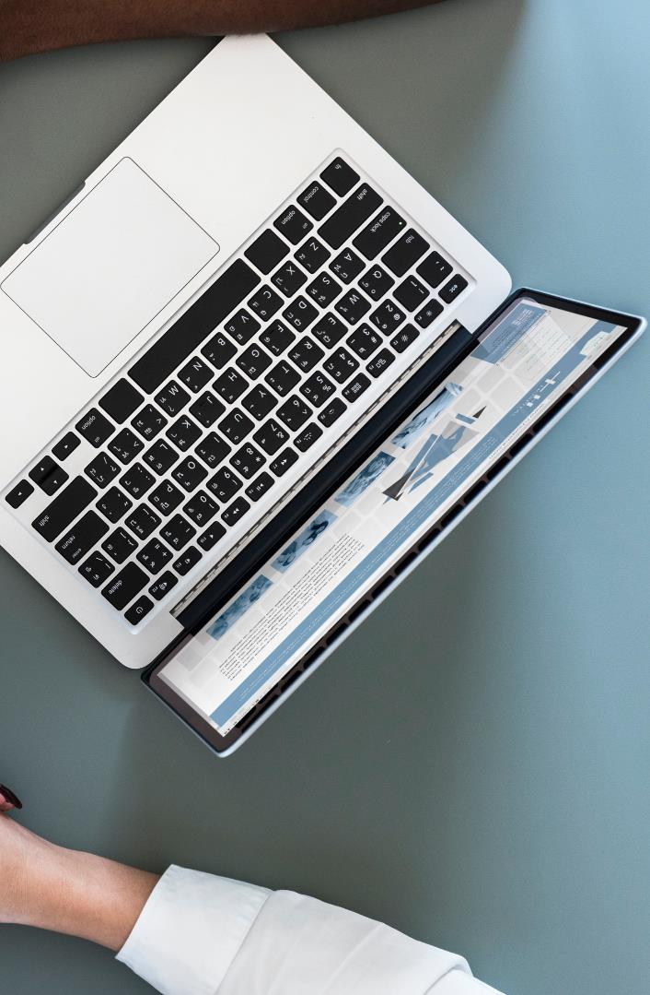
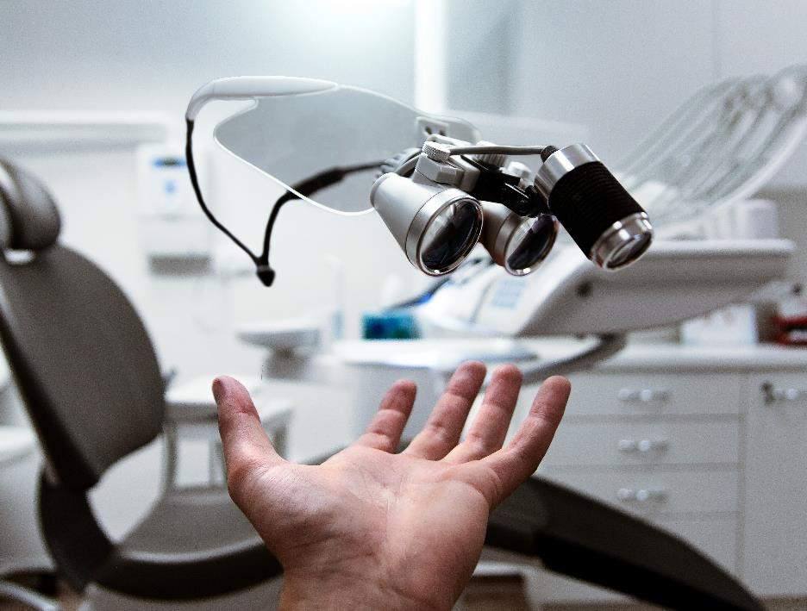
After doctors login, patients will scan own card then doctors will be able to see patients informations
And doctors will be able to prescribe to patients

Slide 4
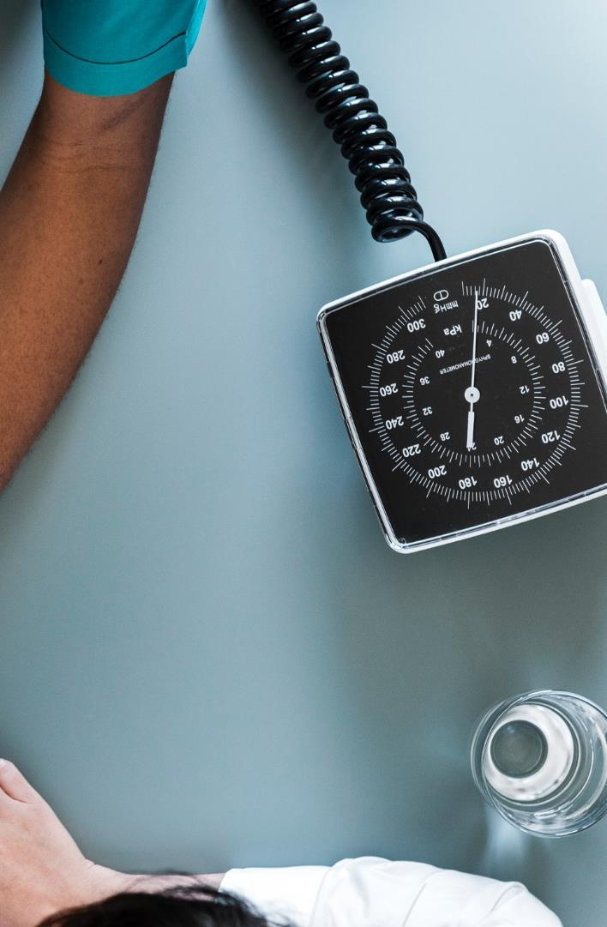



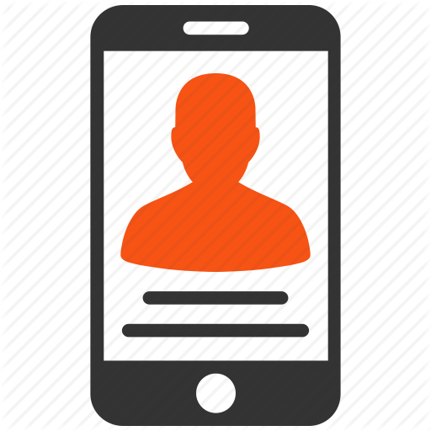
USERS
Admin Page
Doctor Page
Pharmacy Page
Patients Mobile App

Slide 5
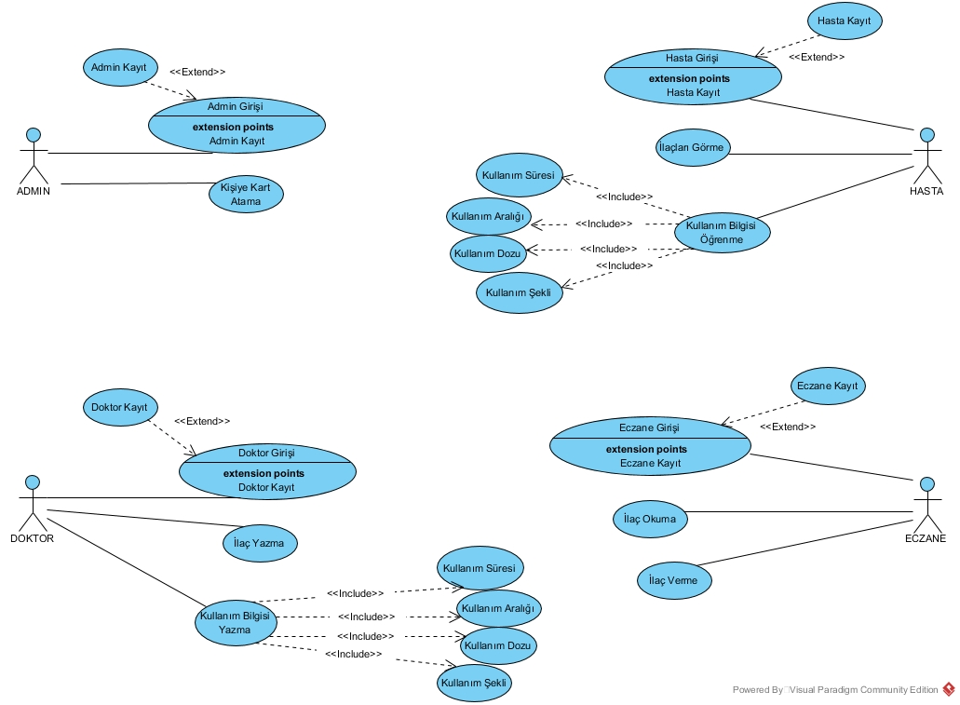
USE CASE DIAGRAM

Slide 6
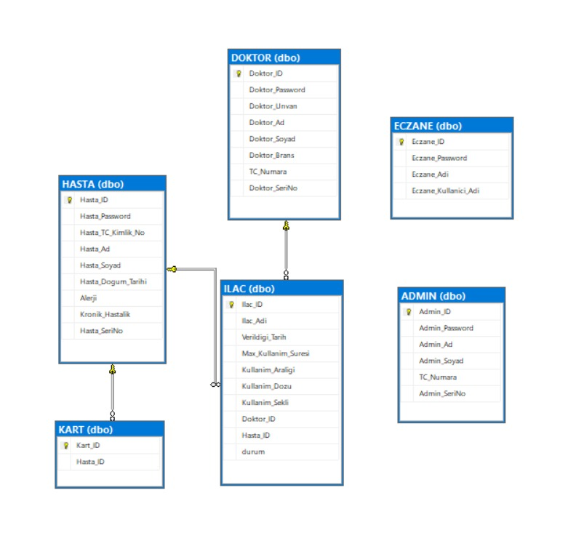
DATABASE DIAGRAM
Admin Page
Doctor Page
Pharmacy Page
Patients Mobile App

Slide 7
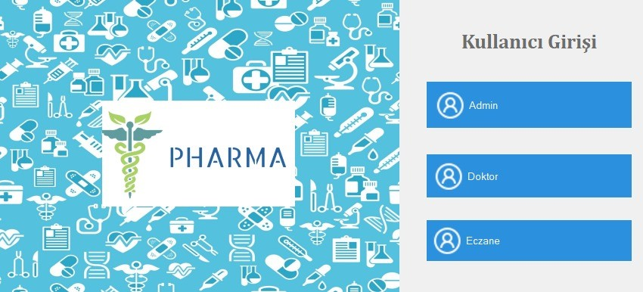
DESKTOP APPLICATION DESIGN

Slide 8
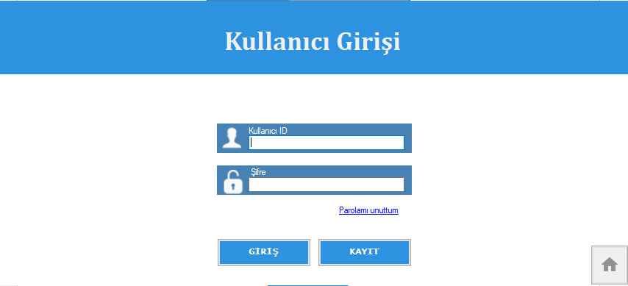
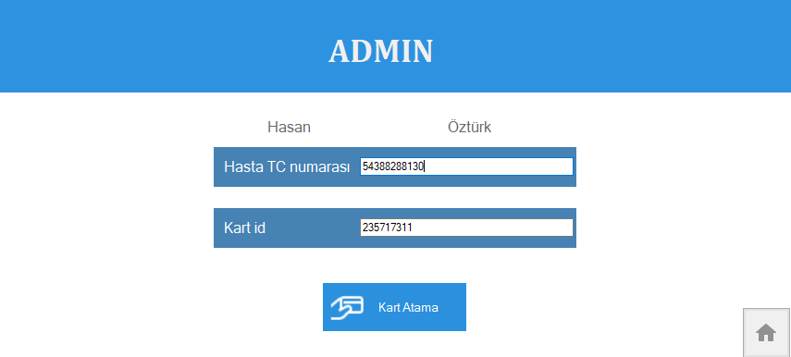
LOGIN AND ADMIN FORM

Slide 9
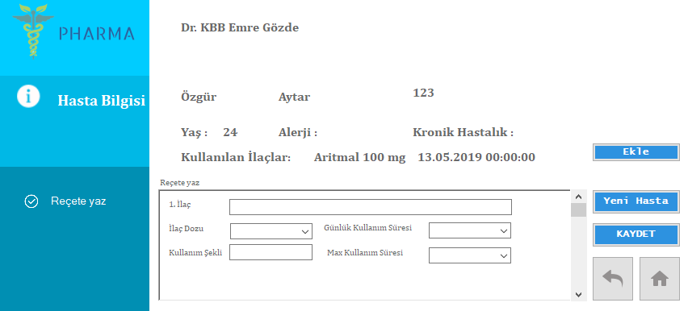
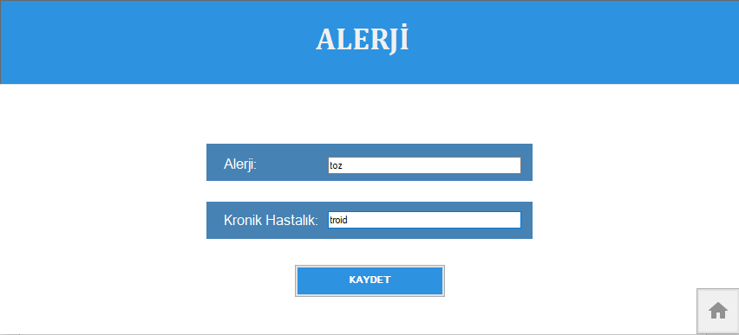
DOCTOR FORM

Slide 10
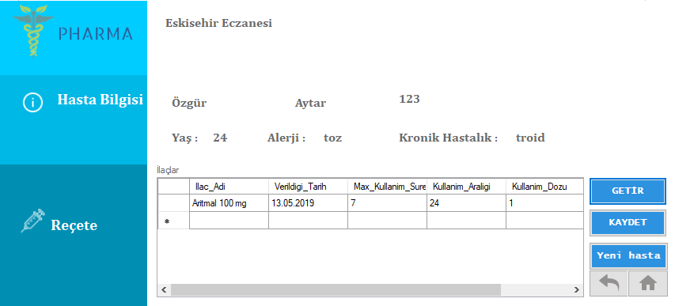
PHARMACY FORM

Slide 11
MOBILE APPLICATION DEMO

Slide 12
TECHNOLOGIES
Arduino Uno
RC522
Microsoft Visual Studio
Microsoft SQL Server
Microsoft Azure
Android Studio

Slide 13
Project Schedule
Our one semester plan
Research
Test - Deploy
Feb, 2019
May, 2019
JAN
FEB
MAR
APR
MAY
2019
Design
Programming
Feb, 2019
Mar,Apr, 2019

Slide 14

GOAL OF PROJECT
How to use the medicine of patients
When to use it
How often to use it with mobile application.

Slide 15
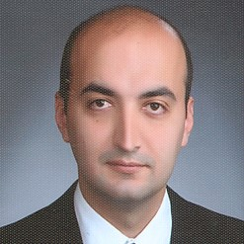
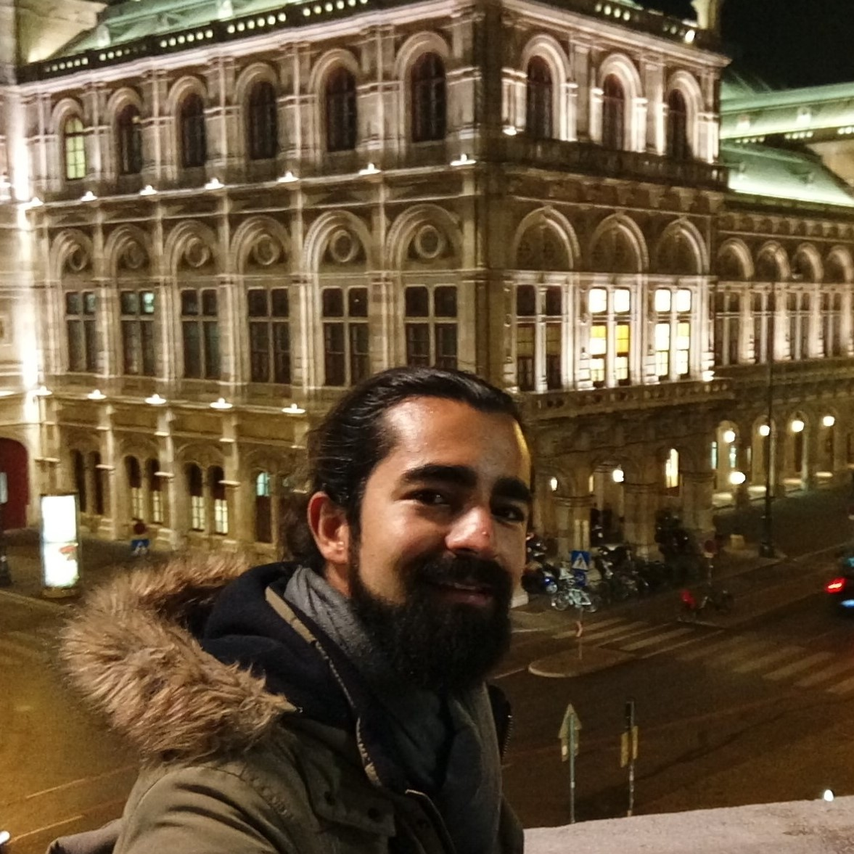
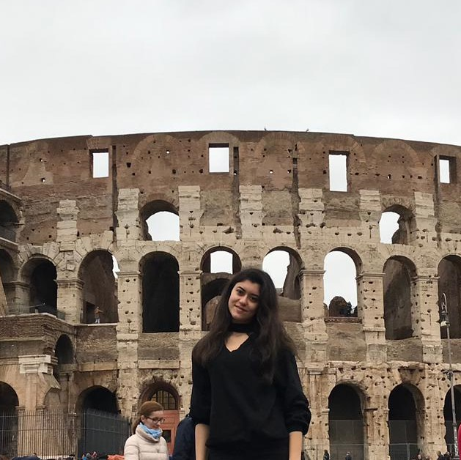
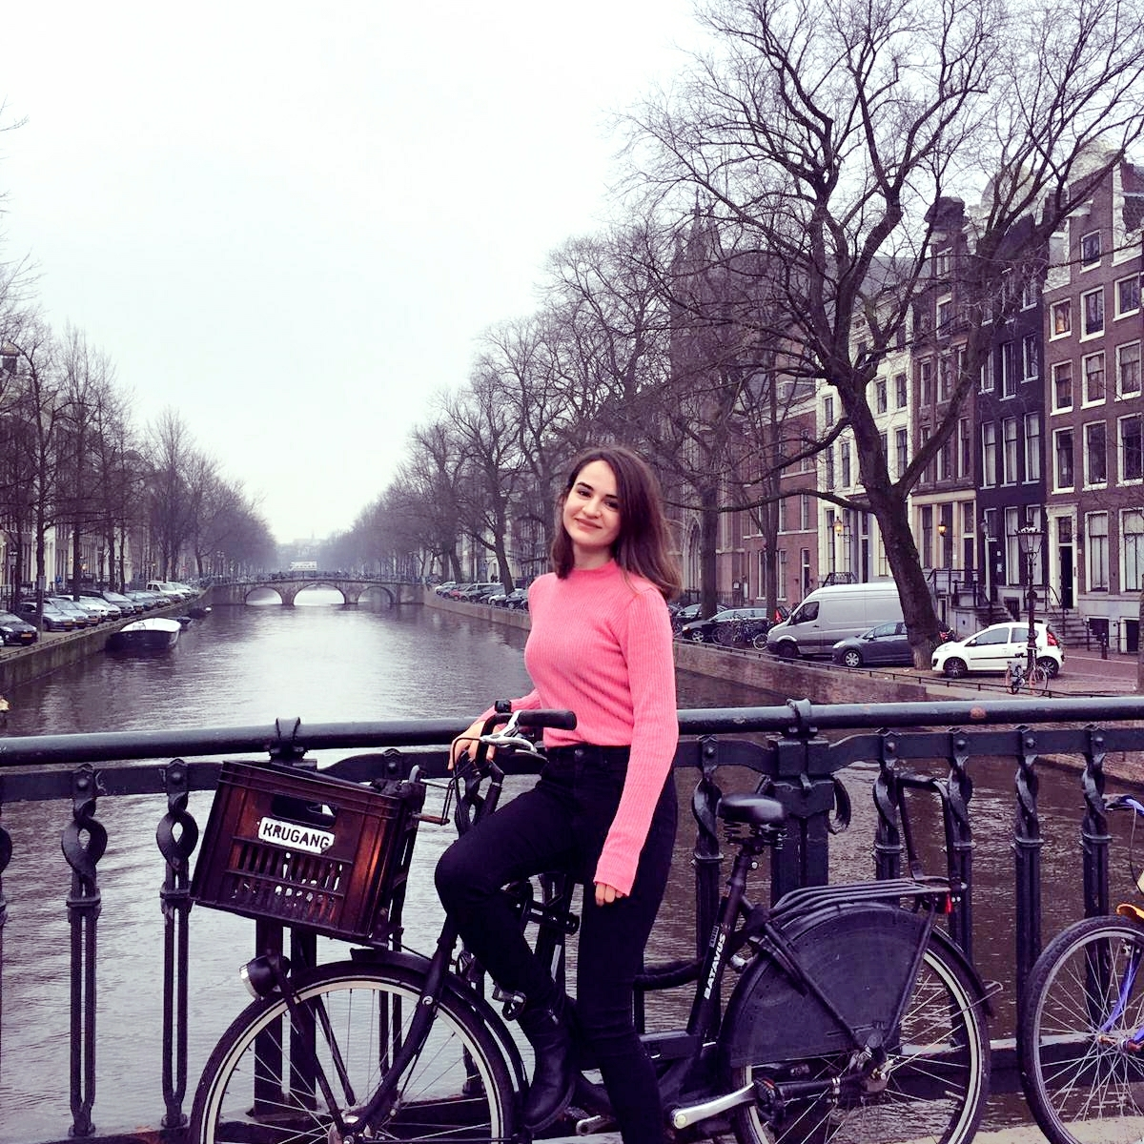
Team
Alper Kürşat Uysal
Özgür Hasan Aytar
Tuğba Öztürk
Gülşah Şahin

Slide 16
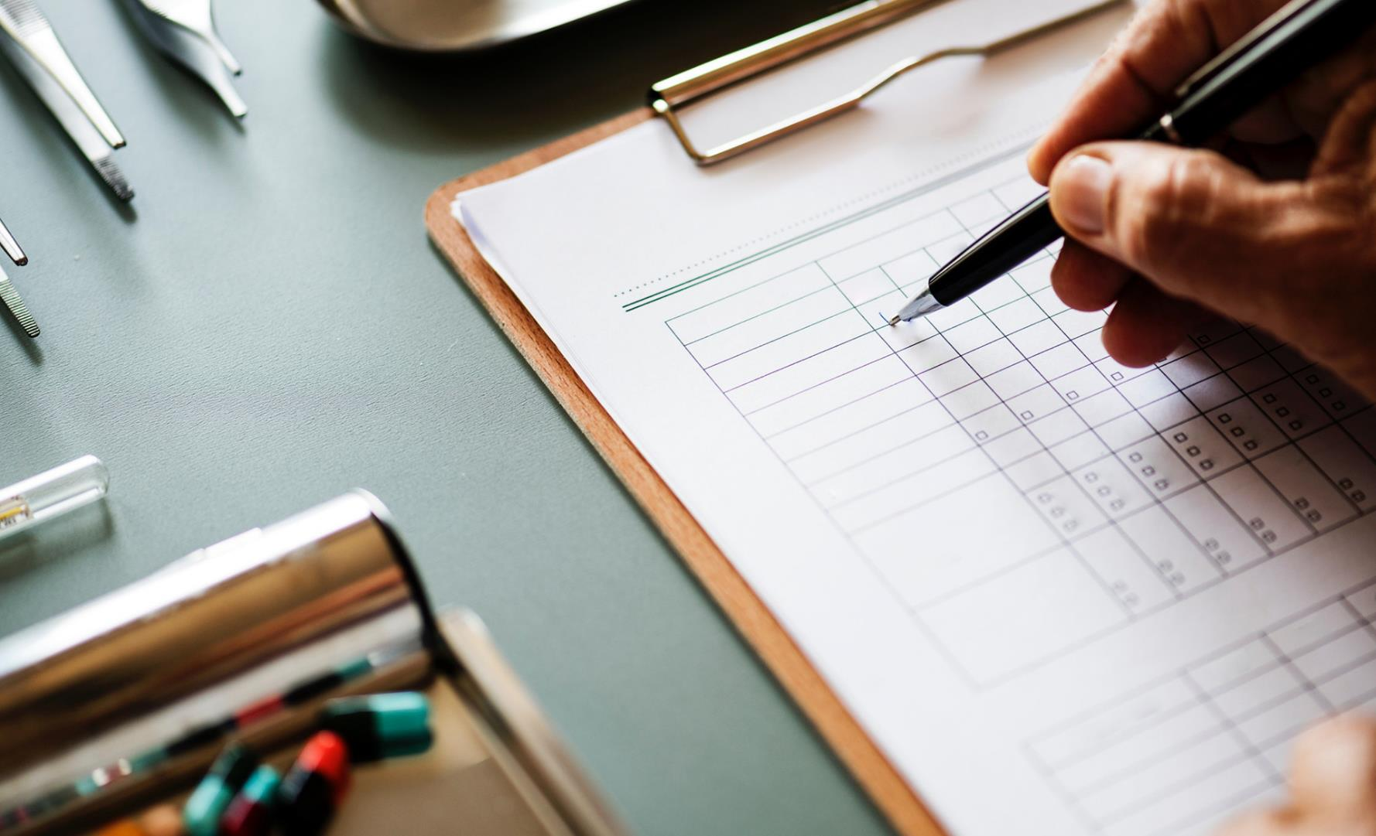

Thank You
Özgür Hasan Aytar
Gülşah Şahin
Tuğba Öztürk

