Slide 1
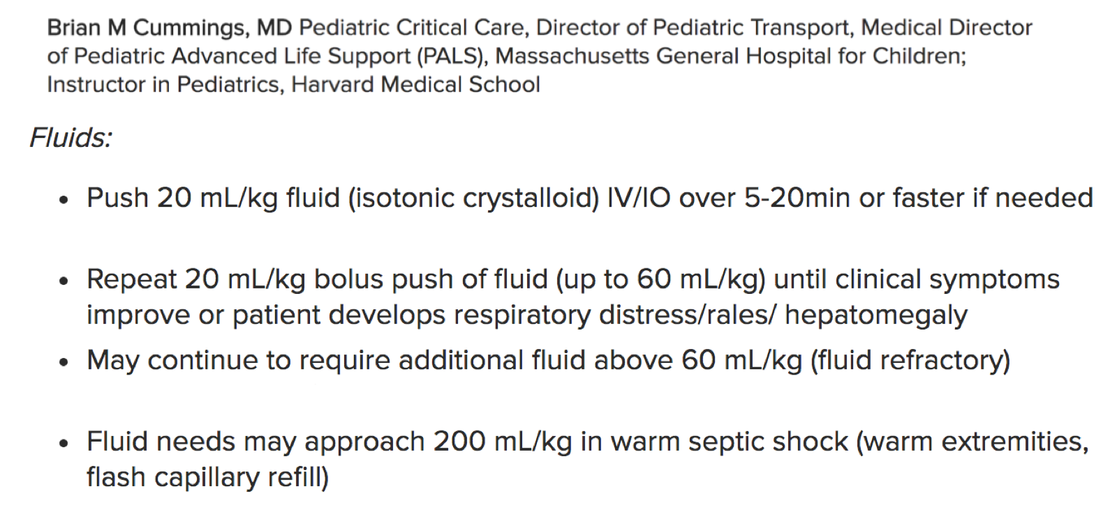
Fluid Therapy in Pediatric Sepsis and Septic Shock
OSF Modified Fluid Therapy:
Rapid Fluid Administration: When there is clinical concern for sepsis, IV fluid boluses should be given as rapidly as possible - 20 mL/kg completed within 20 minutes is ideal (and even faster - 5 minutes - in septic shock). The best method to accomplish this is to hand-push fluid using syringes (rather than hanging to gravity or running over an IV pump)
Risk of Fluid Overload: The best strategy for fluid resuscitation in a patient, in which we are worried about causing fluid overload is to treat them with small aliquots of fluid (5-10 mL/kg at a time) with continual reassessment. If hemodynamics are improving as fluids are being given, ongoing fluid resuscitation is indicated. If there is no improvement or the patient is worsening as fluids are administered, inotropes should be considered early in place of additional fluid resuscitation.

