Slide 1
Contact Manager
By Group 12

Slide 2
Product
It is a personal contact manager.
A new user is able to register an account.
The user can create, delete, and search for contacts.

Slide 3
Members
Steven Chen – UI, API, and database.
Christopher Donoso - acquired and set up server and domain.
Jose Medina – UI and API.
Huey Padua - created ER diagram.
Isaias Perez - created Use Case diagram.
Akane Sato - performed test cases.
Richard Tsai - performed test cases.

Slide 4
Functionality Testing
Entering incomplete info.
If anything is undefined it throws error.
Entering incorrect info.
Ensuring it is in the correct format.
Helps to prevent SQL Injections.
Does what it’s supposed to do.
Unique contacts for each individual.

Slide 5
Usability Testing
Ease of learning.
Navigation.
Appearance.
Components ensure the page is neat and organized.

Slide 6
Development Process
Used MEAN stack.
Quite the learning curve.
Originally hosted on DigitalOcean.
Ubuntu 16.04.
Switched to Heroku.
Acquired the domain name from GoDaddy.
contactmanager.xyz.
Setup still in process.

Slide 7
What is MEAN?
MongoDB – leading NoSQL database
Express - minimal and flexible node.js web application framework
AngularJS – extends HTML vocabulary for application
Node.js - platform built on JavaScript for easily building fast, scalable network applications

Slide 8
Development Issues
Documentation for setting up DigitalOcean was difficult to find and most were outdated.
DigitalOcean’s official documentation only supports Ubuntu 14.04 and it was created in 2014.
Environment set up was difficult due to dependencies.
No prior experience with MEAN.

Slide 9
Issues to Resolve
A search function needs to be implemented.
Contacts are shared when they should not be.
Make the UI cleaner.
Provide more artwork.

Slide 10
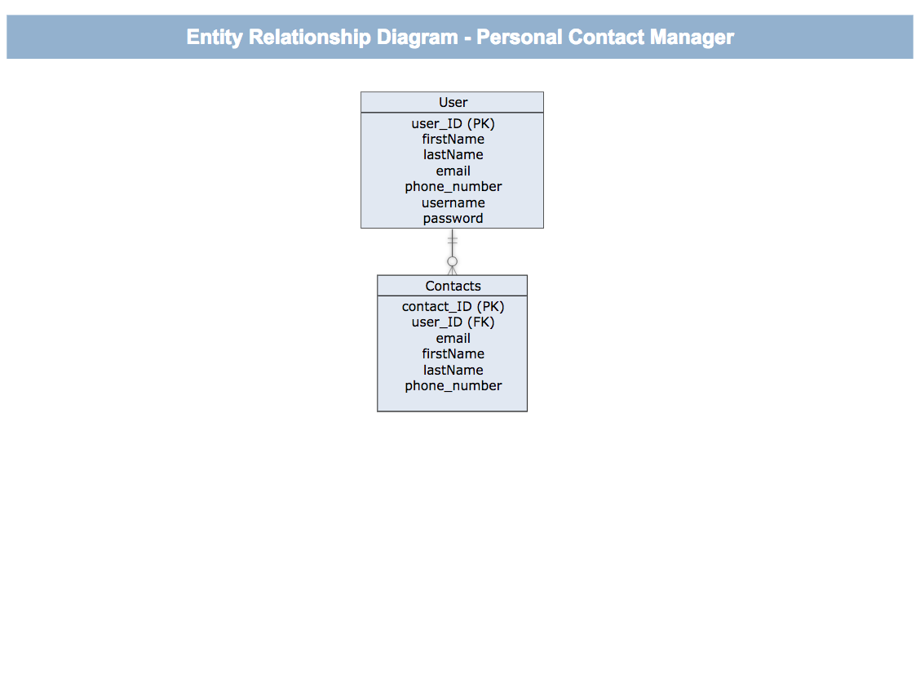
ER Diagram

Slide 11
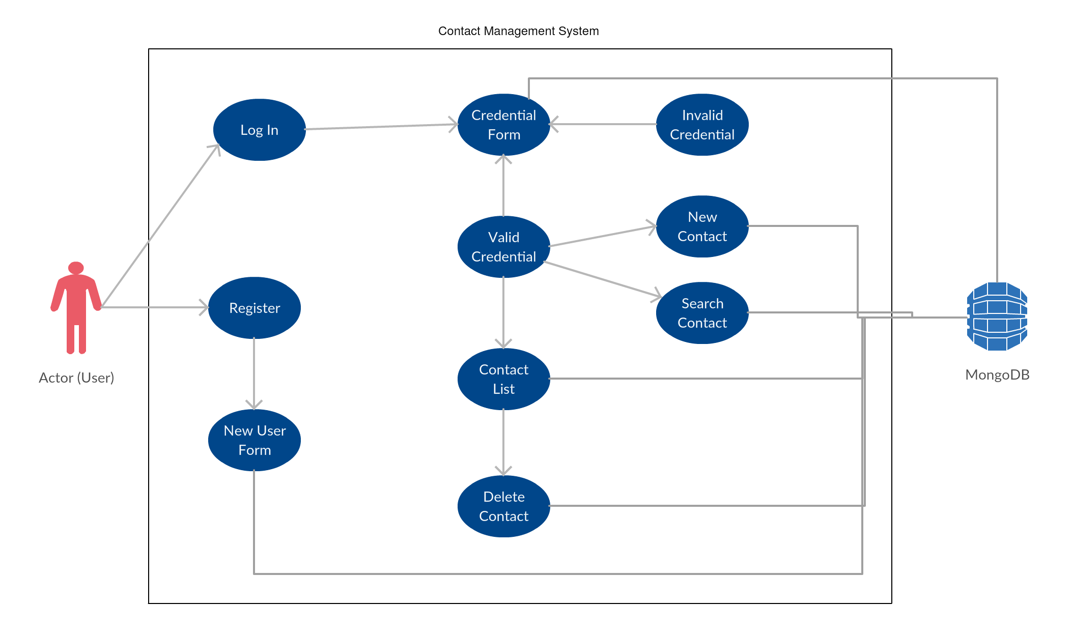
Use Case Diagram

Slide 12
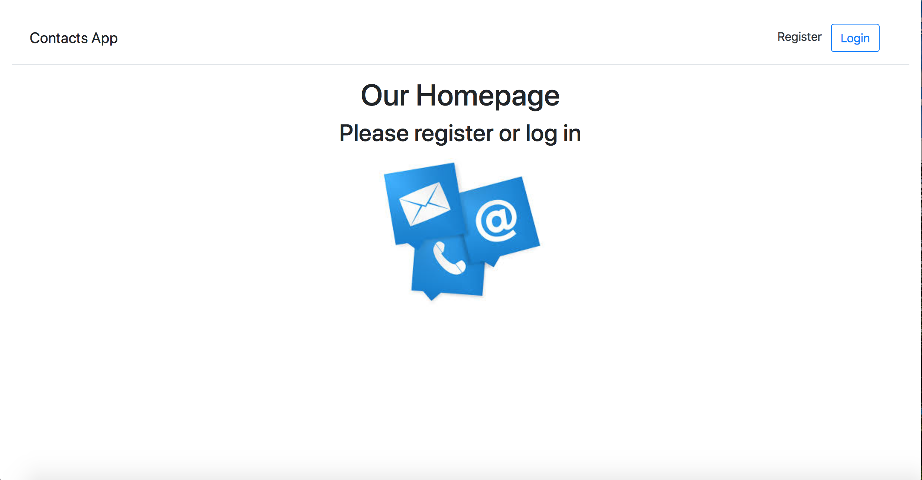
Demo

Slide 13

Questions?

