Slide 1
Project in ML and Electronics
Predicting the amount of LPG Gas

Slide 2
Predicting the amount of LPG Gas
THEME:
Suppose there is a Gas cylinder with an initial weight of 30 kg. During the usage of Gas, there is a decrease in the weight of the Gas cylinder continuously. We want to measure the amount of use of LPG gas after every 10 seconds.

Slide 3
Projective Objective
Project Challenge: Reading streaming data from Computer USB port and make excel sheet of reading and apply ML algorithms for prediction.
Hardware Used : 1. Load cell (for measuring weight) 2. Arduino 3. Amplifier ( Analog to Digital Converter)
Software Used : Arduino Programming, Python Programming, Serial Library

Slide 4
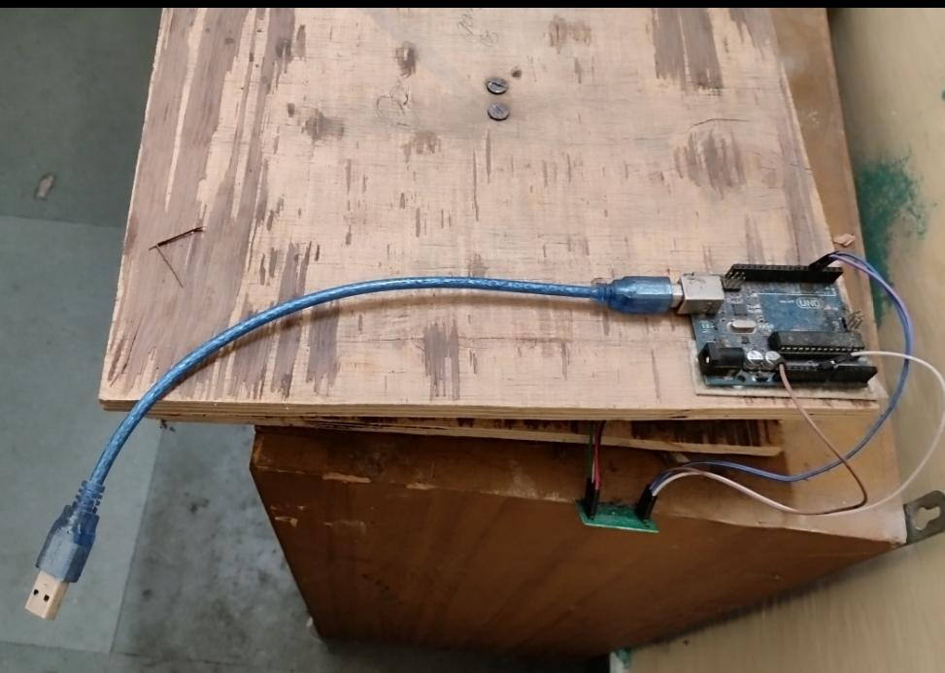
Top View
Plywood
Arduino
Amplifier

Slide 5
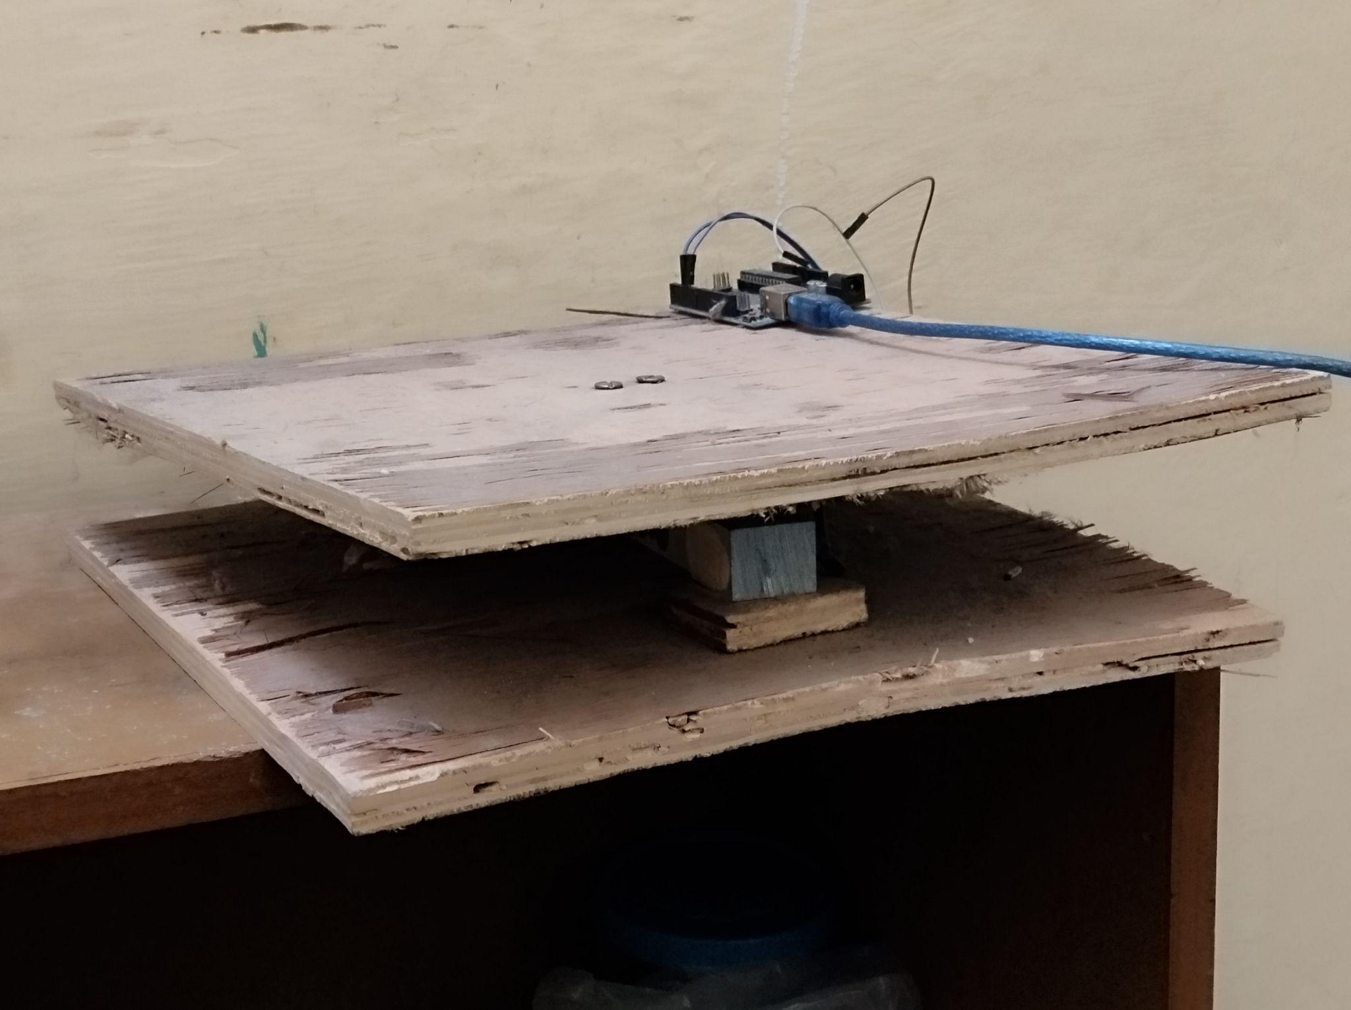
Side View
Load Cell

Slide 6
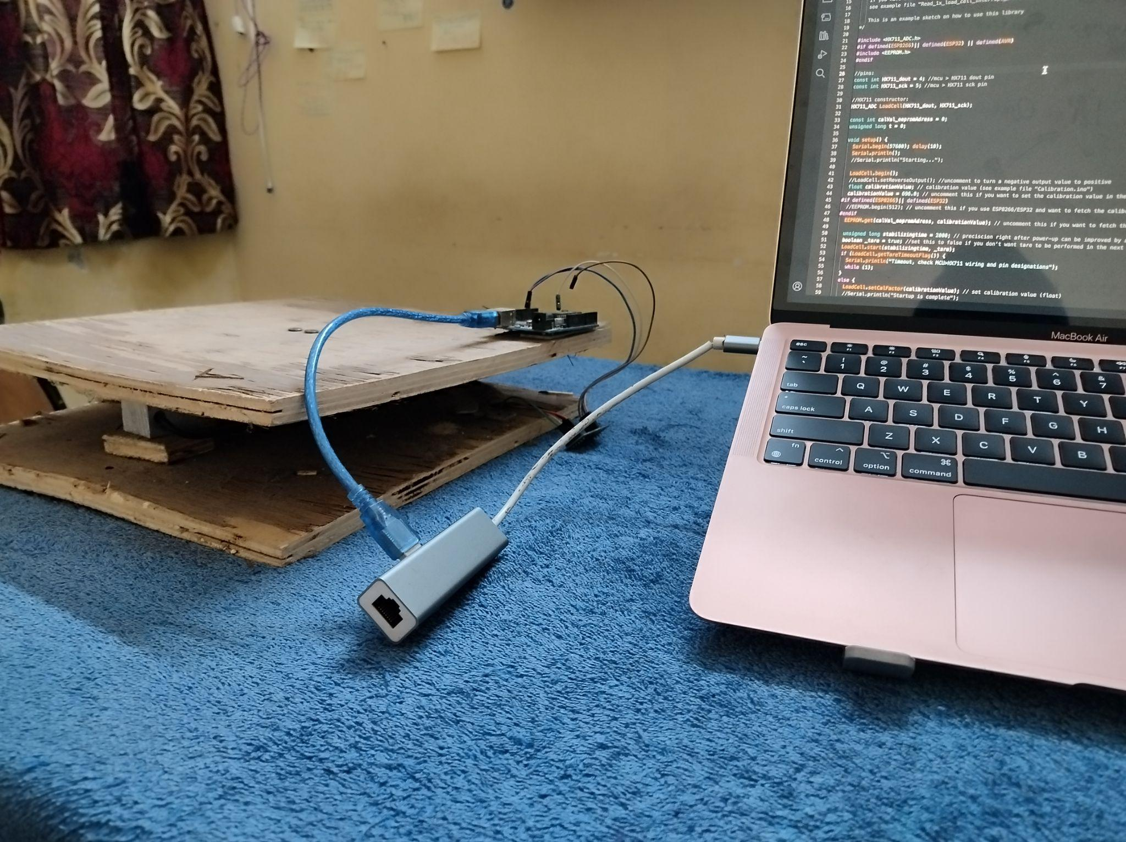
Transfer Arduino Data to USB Port
Connector

Slide 7
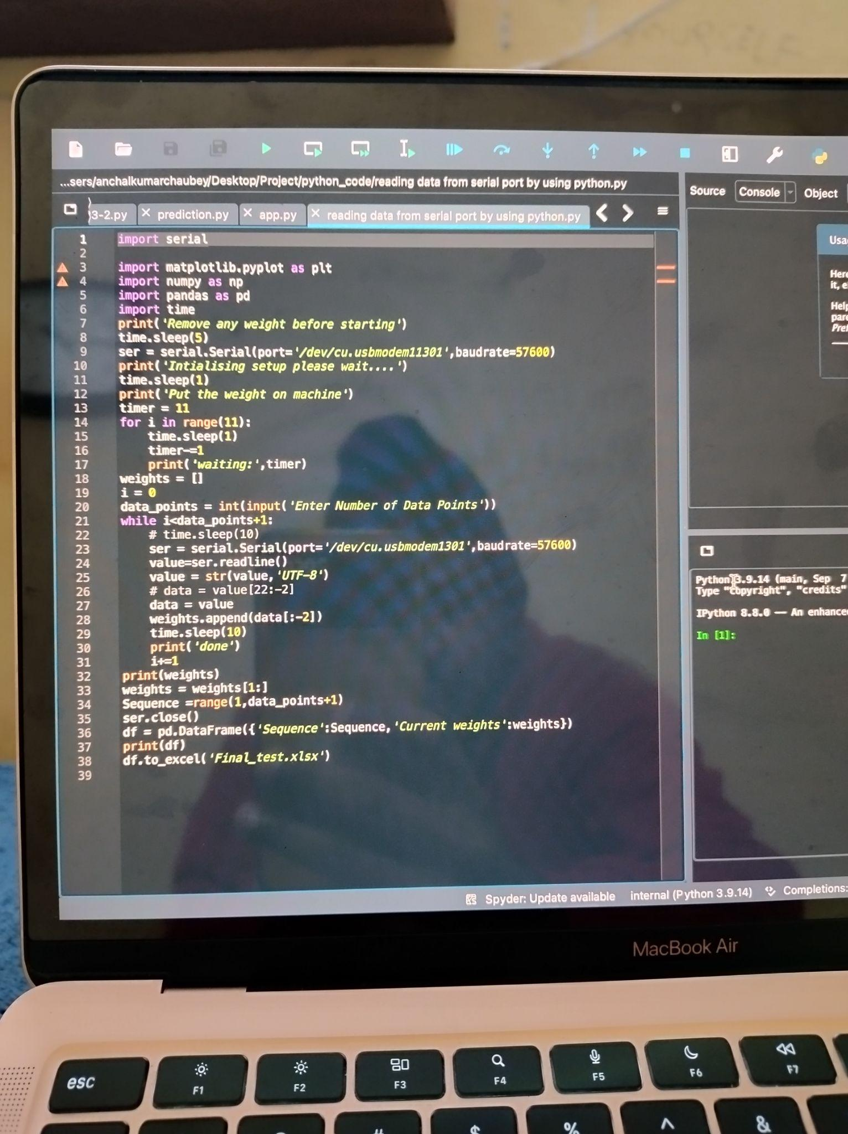
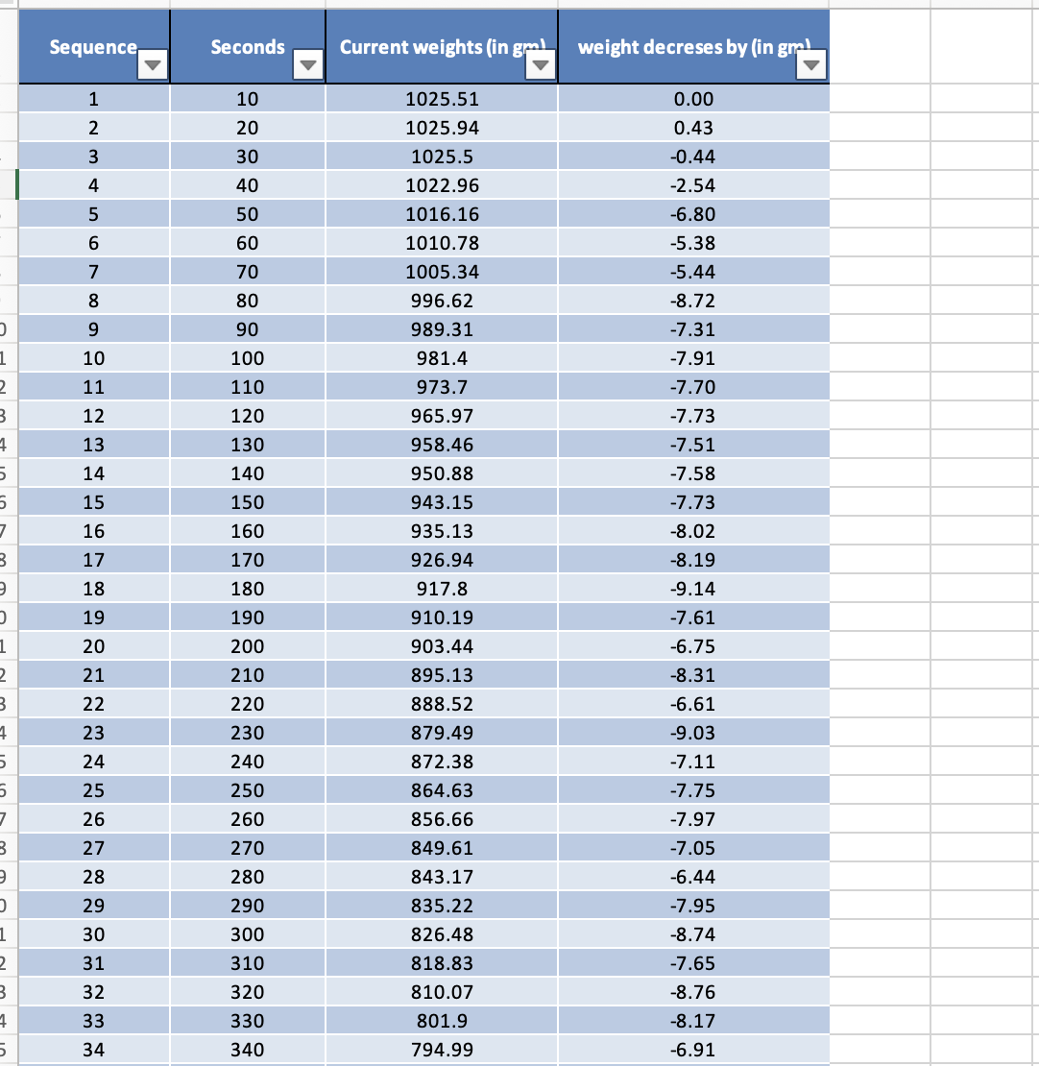
Read Data From USB Port by PYTHON SERIAL LIBRARY

Slide 8
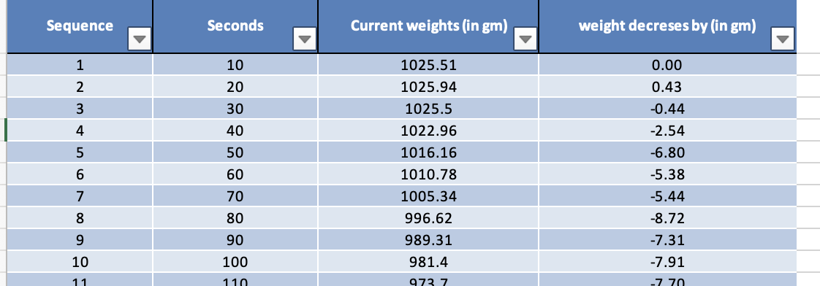
Real time data in excel

Slide 9
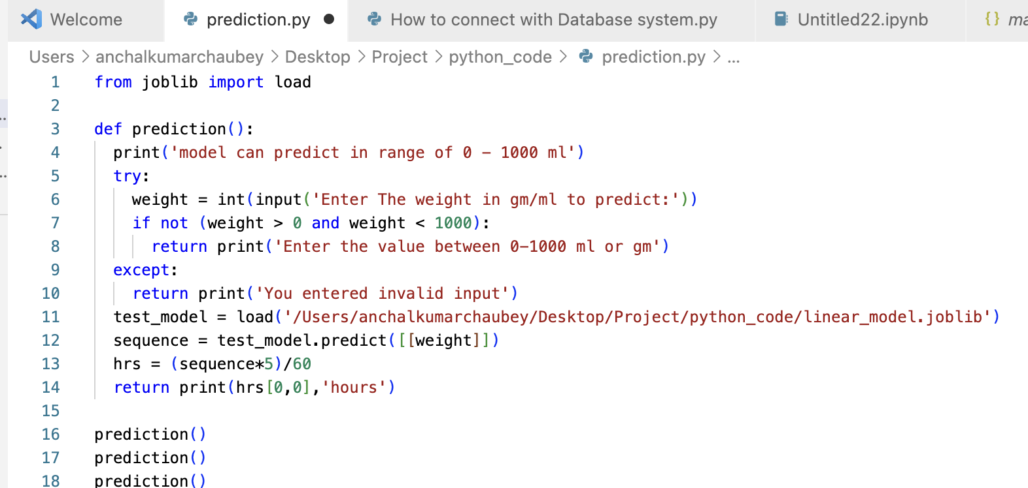
Use Data For Predictions by Regression

Slide 10
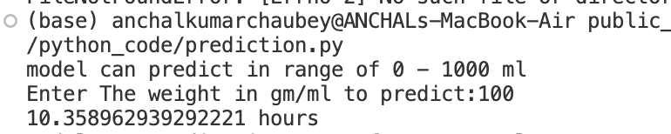
Prediction in hours
Predictions

