Slide 1
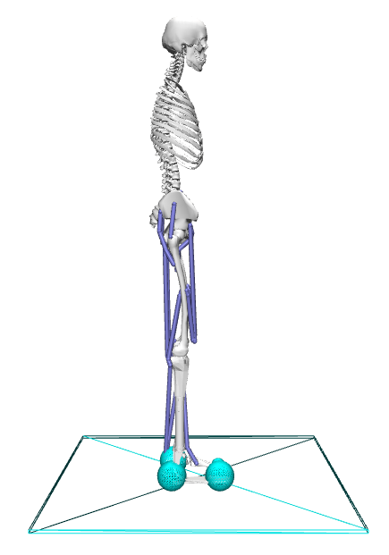
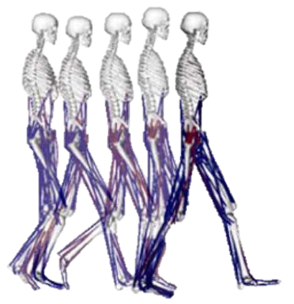

Standing motion
Gait cycle motion
from experimental data
Add hand-crafted motion
Add hand-crafted motion

