Slide 1
Edge-triggered, Fog-localized, Cloud-adapted
leak detection for water networks
Equipe-XX - M2 I2A - Embedded Systems & IoT (UMBB, 2026-2027)
Hanoi benchmark - simulation only

Slide 2
Problem & objectives
Water networks lose 20-40% of treated water to leaks
Detect AND localize leaks with cheap sensors + AI
Embedded constraints: energy, memory (520 KB RAM), latency, cost
Core question: WHERE should inference run? Edge / Fog / Cloud
Deliverable: quantified comparison + placement recommendation

Slide 3
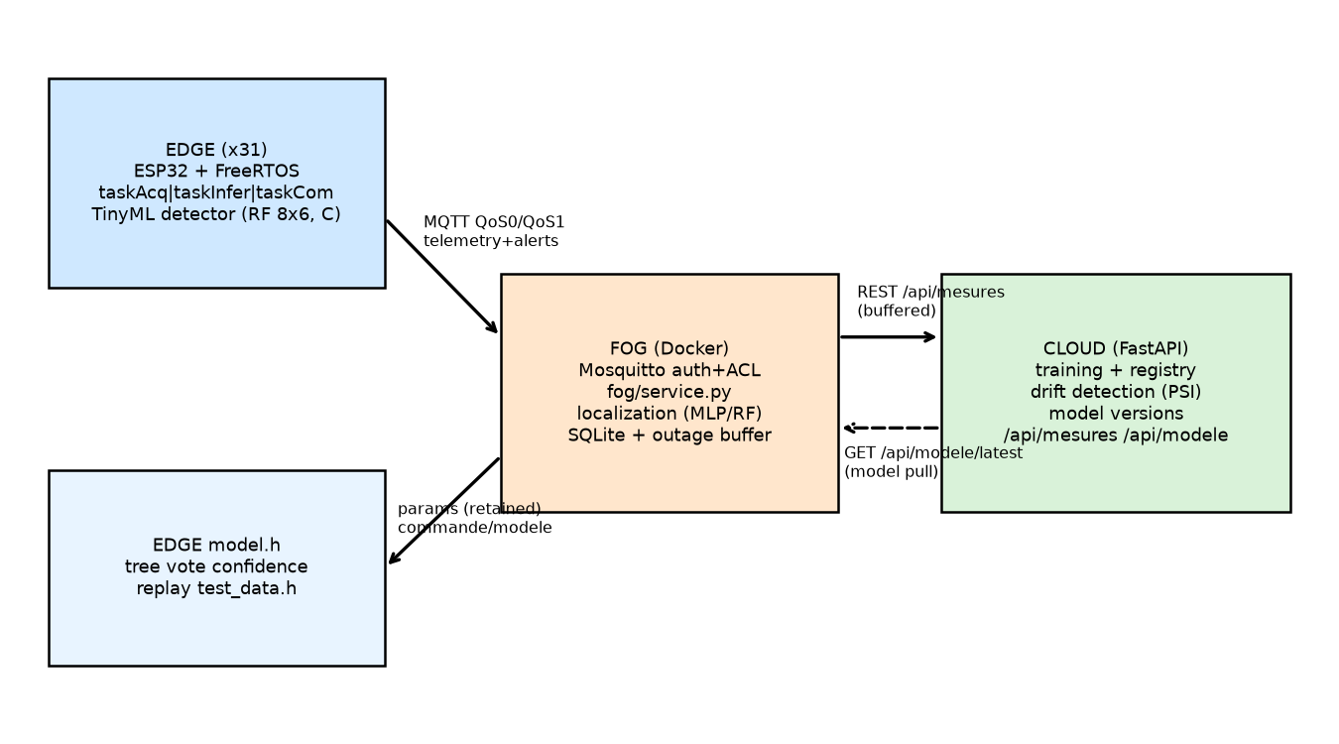
Architecture

Slide 4
Edge node (ESP32 / FreeRTOS)
3 tasks: taskAcq (prio 3), taskInfer (prio 2), taskCom (prio 1)
Hardware-timer ISR -> binary semaphore -> queue
Sensors: pressure, flow, vibration (virtual, replayed)
Preprocessing: moving average + baseline normalization (dp)
TinyML: RandomForest 8x6 exported to C (micromlgen), ~112 KB
MQTT QoS0 telemetry / QoS1 alerts (emulated nodes), LWT

Slide 5
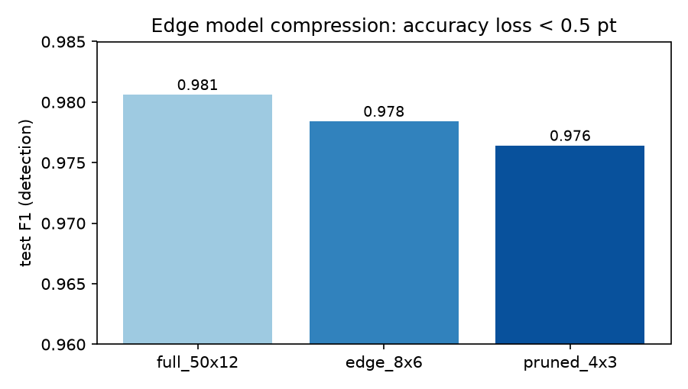
AI: Edge detector
Baseline dp-threshold: F1=0.9733
RF 8x6 (edge): F1=0.9784, acc=0.9774
Compression: full RF -> 8x6 -> 4x3: < 0.5 pt F1 loss
PC vs C consistency: 0 mismatches on 500 replay vectors [M]
Inference: ~30 us estimate on ESP32 [E], micros() in Wokwi [I]

Slide 6
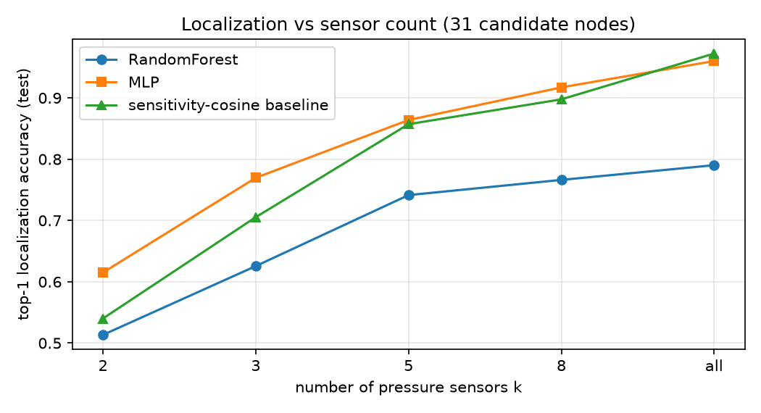
AI: Fog localization (31 nodes)

Slide 7
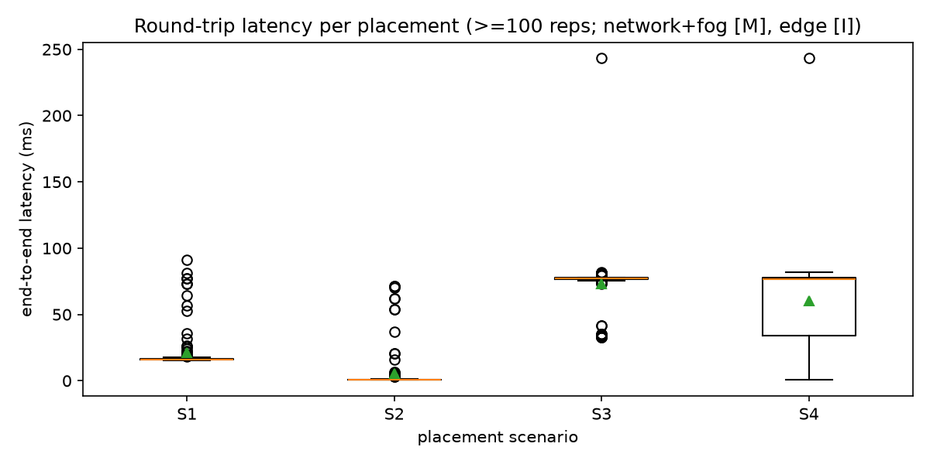
Placement comparison (S1-S4)
S1 all-Cloud latency: 21.09 ms
S2 Fog: 5.43 ms
S3 Edge-triggered-Fog: 72.86 ms
Network: S1/S2 stream raw (bytes/min), S3 alerts only (~xN less)
Energy [E]: S3 cuts radio time -> lower mAh/day
Cost [E]: S3 = 31 ESP32 + RPi3 + small VM

Slide 8
Robustness
Broker stop: node buffers locally (ring), reconnects, flushes
Cloud outage: Fog buffers in SQLite, flush on recovery
Node drop: LWT/keepalive offline status
Measured timeline in results/robustness_timeline.csv [M]

Slide 9
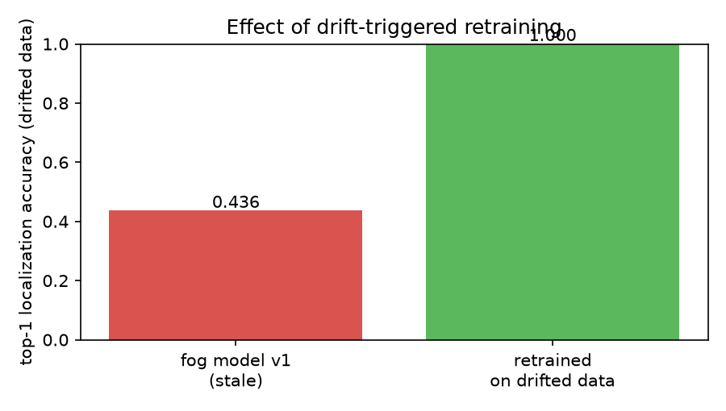
Drift & retraining
Drift detected (PSI): 2.1086 > 0.2
Fog top-1 before retrain: 0.4361
After retrain: 1.0
Loop: drift flag -> POST /api/retrain -> new version -> Fog pulls -> Edge params pushed (retained MQTT)

Slide 10
Innovation
1. Cost-aware dynamic offloading (Edge/Fog/Cloud per window)
policy: confidence gate + RTT gate + battery gate
2. Drift-triggered retraining with model + parameter push
Compared to fixed S1-S3 on accuracy / latency / bytes / energy

Slide 11
Limits of the simulation
Synthetic data (WNTR), emulated nodes, synthetic vibration channel
Wokwi timing is indicative [I]; energy/cost estimated [E]
Leak = pressure-dependent orifice (WNTR), areas calibrated 1-10%
Public broker shared; no TLS on the demo path (own Mosquitto for E5)
Port path to real ESP32 documented in the report

Slide 12
Conclusion & recommendation
Detection AT THE EDGE (fast, private, outage-tolerant)
Localization AT THE FOG (multi-sensor view, low latency)
Training / drift / versions AT THE CLOUD (compute, not urgent)
Justified by measured latency, bytes, energy + robustness results
Future: real sensors, BattLeDIM stress test, GNN localizer

Slide 13
Live demo script
1. Nominal run: nodes streaming -> dashboard live view
2. Inject leak: Edge alerts -> Fog localizes top-3 -> dashboard
3. Inject failure: stop broker -> buffer -> recovery flush
4. Placement comparison page (S1-S4 with [M]/[I]/[E] labels)
5. Drift + retrain: model version change visible end-to-end

