Slide 1
Kafka

Slide 2
feature
Read and write streams of data like a messaging system.
Write scalable stream processing applications react to events in real-time
Store streams of data safely in a distributed, replicated, fault-tolerant cluster

Slide 3
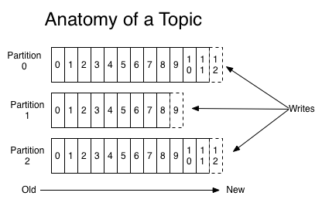
Topic
A topic is a category or feed name to which records are published.

Slide 4
Partition
Each partition is an ordered, immutable sequence of records that is continually appended to—a structured commit log

Slide 5
Offset
The records in the partitions are each assigned a sequential id number called the offset that uniquely identifies each record within the partition

Slide 6
Producer
Producers publish data to the topics of their choice
a round-robin fashion simply to balance load or it can be done according to some semantic partition function

Slide 7
Consumers
Consumers label themselves with a consumer group name
Each record published to a topic is delivered to one consumer instance within each subscribing consumer group
Consumer instances can be in separate processes or on separate machines

Slide 8
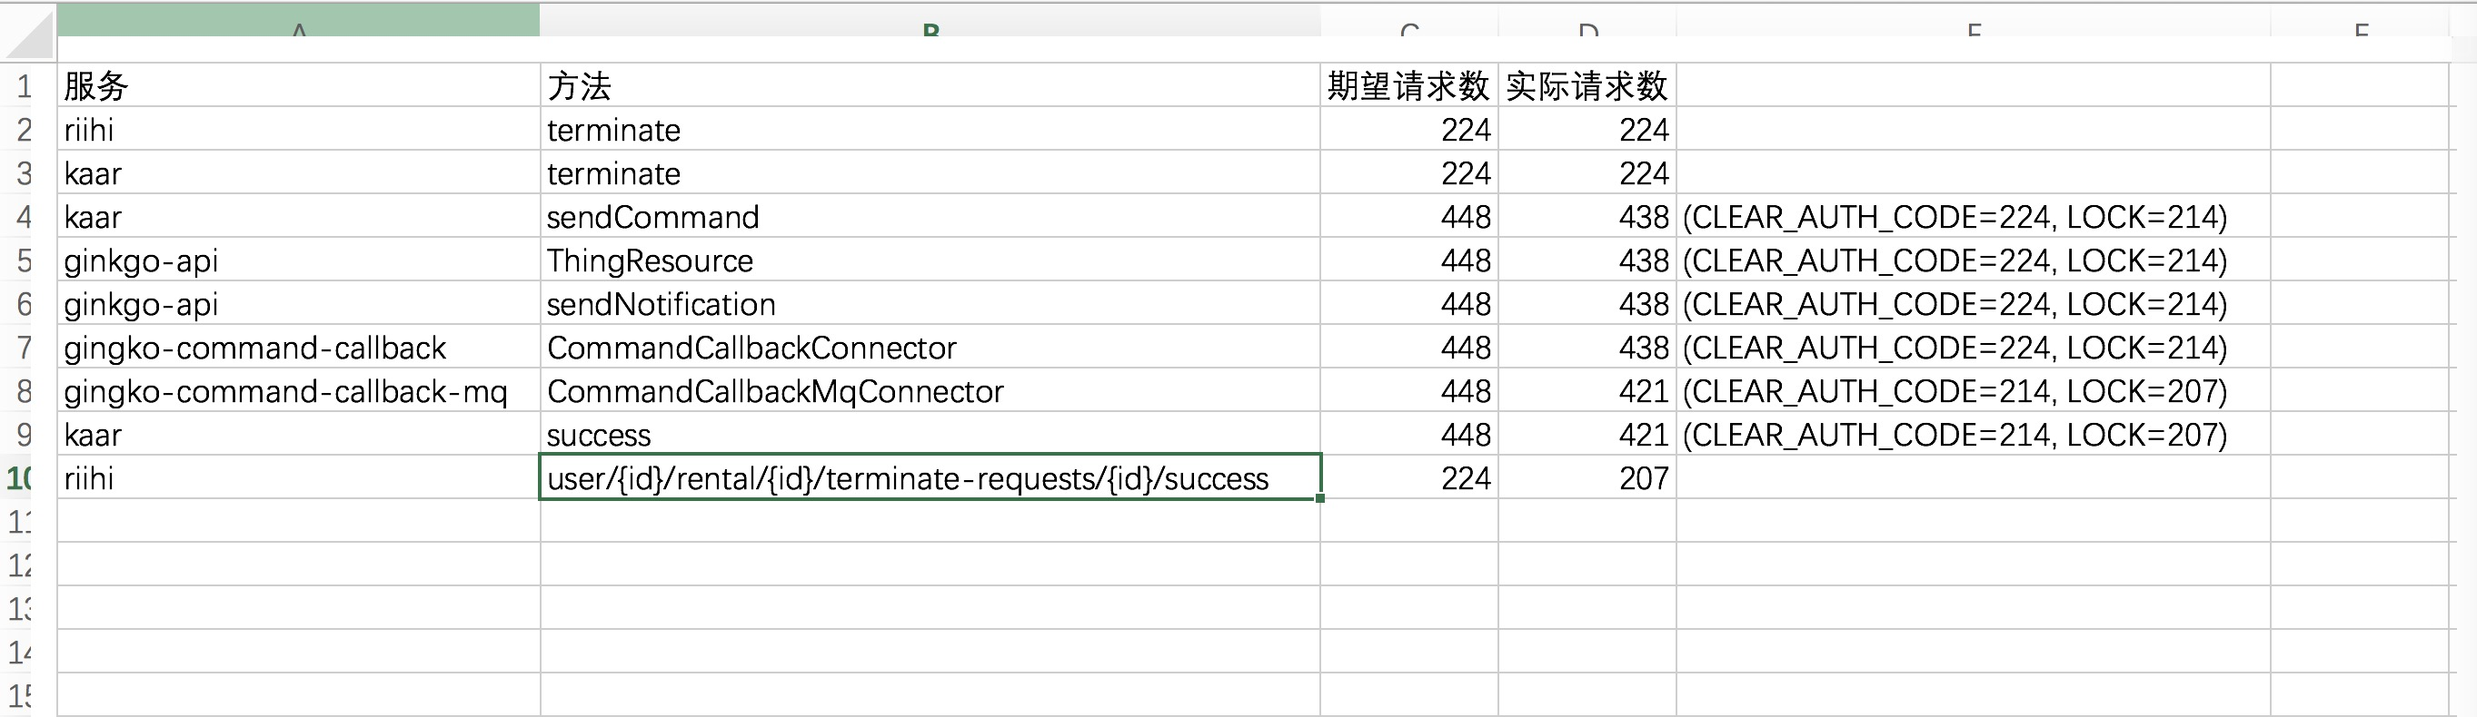
碰到的问题
Consumer数据没有被消费

Slide 9
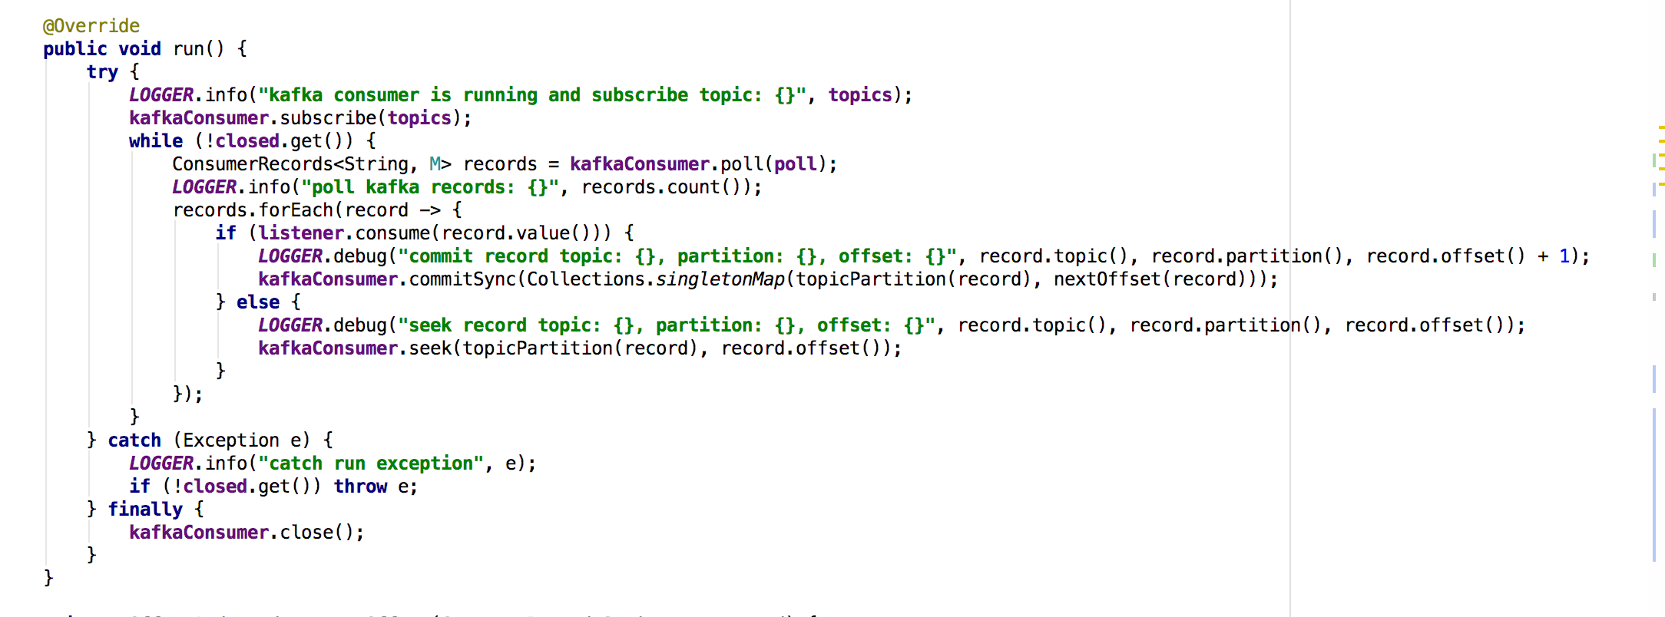
以前consumer的处理方法

Slide 10
以前的consumer配置
enable.auto.commit=true auto.commit.interval.ms=1000

Slide 11
以前consumer存在的问题
如果消息没有准备好被消费，但是offset在下一次消息被消费后会被提交
enable.auto.commit=true会自动提交offset，并且会在消息被处理前就会被提交

Slide 12
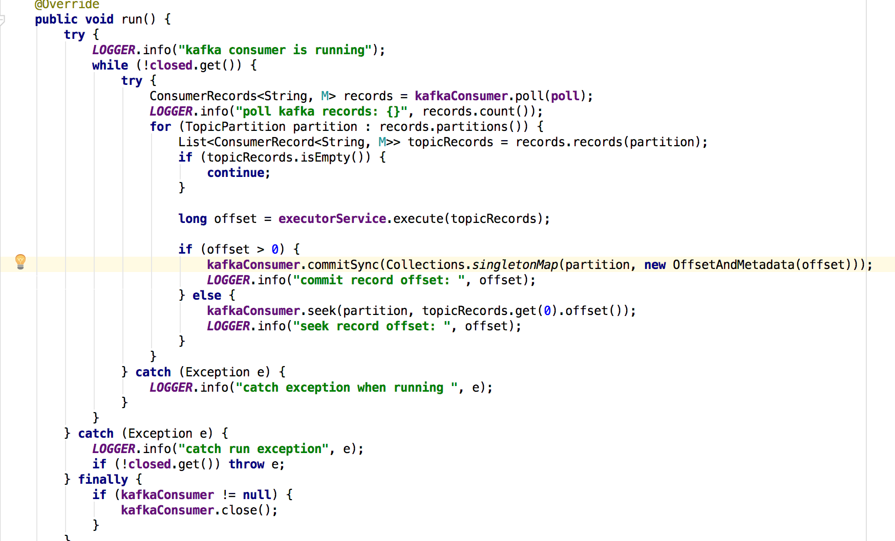
修改consumer，问题依然存在

Slide 13
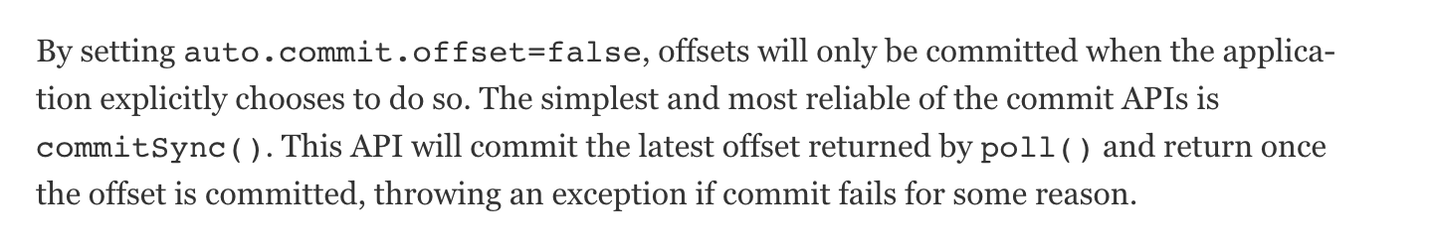
commitSync方法

Slide 14
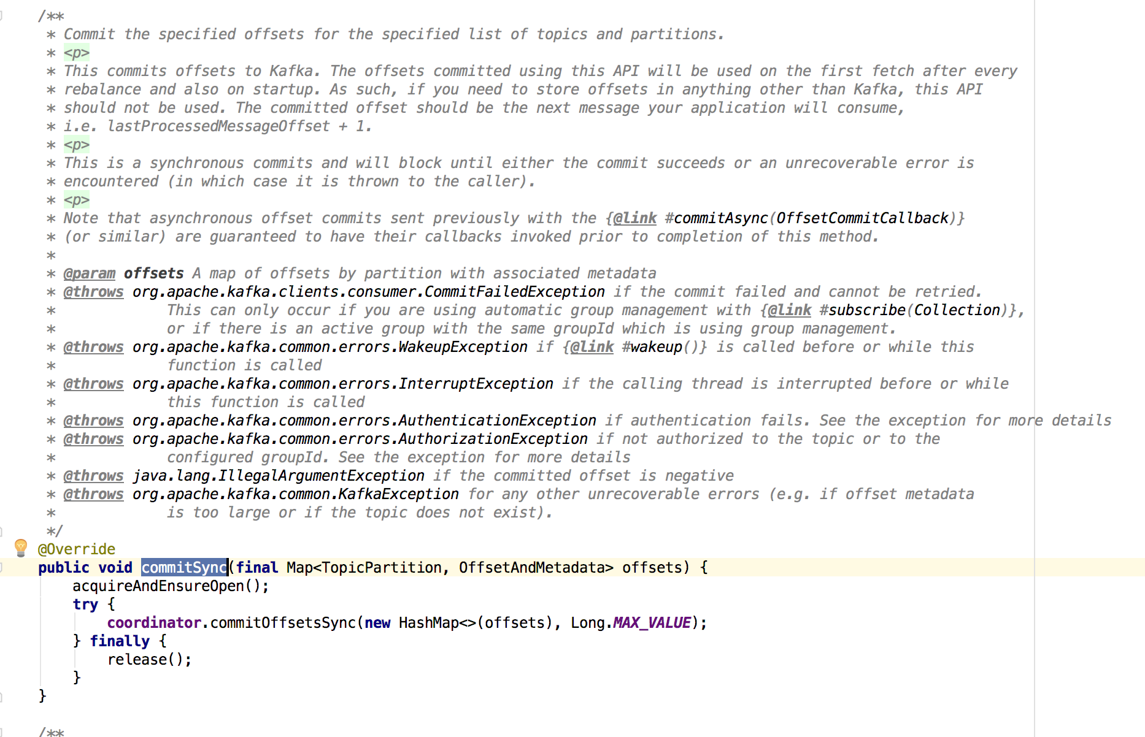
commitSync方法

Slide 15
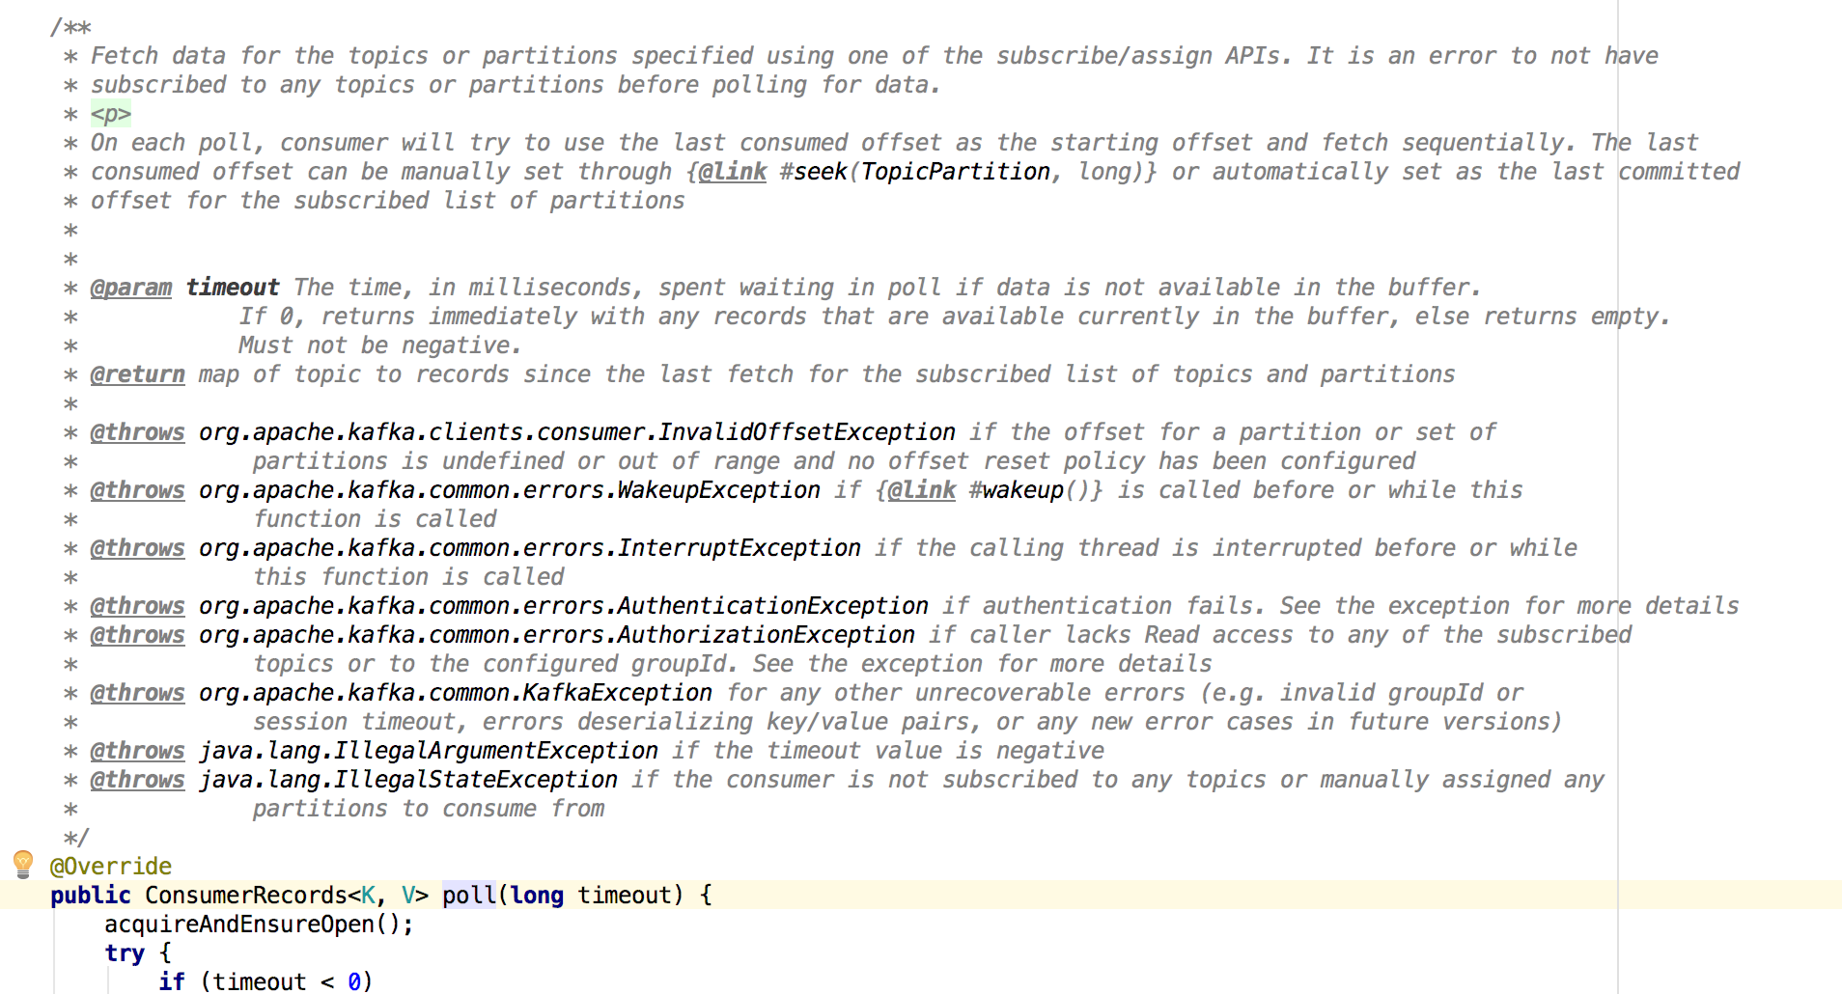
poll方法

Slide 16
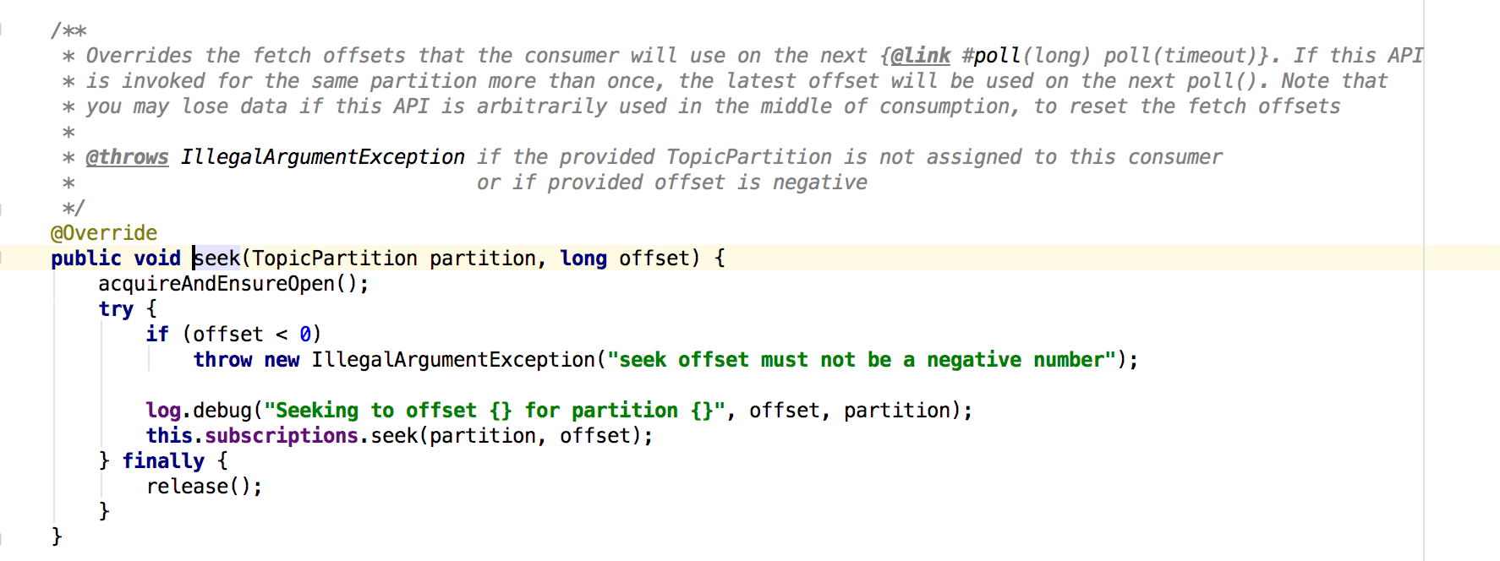
seek方法

Slide 17
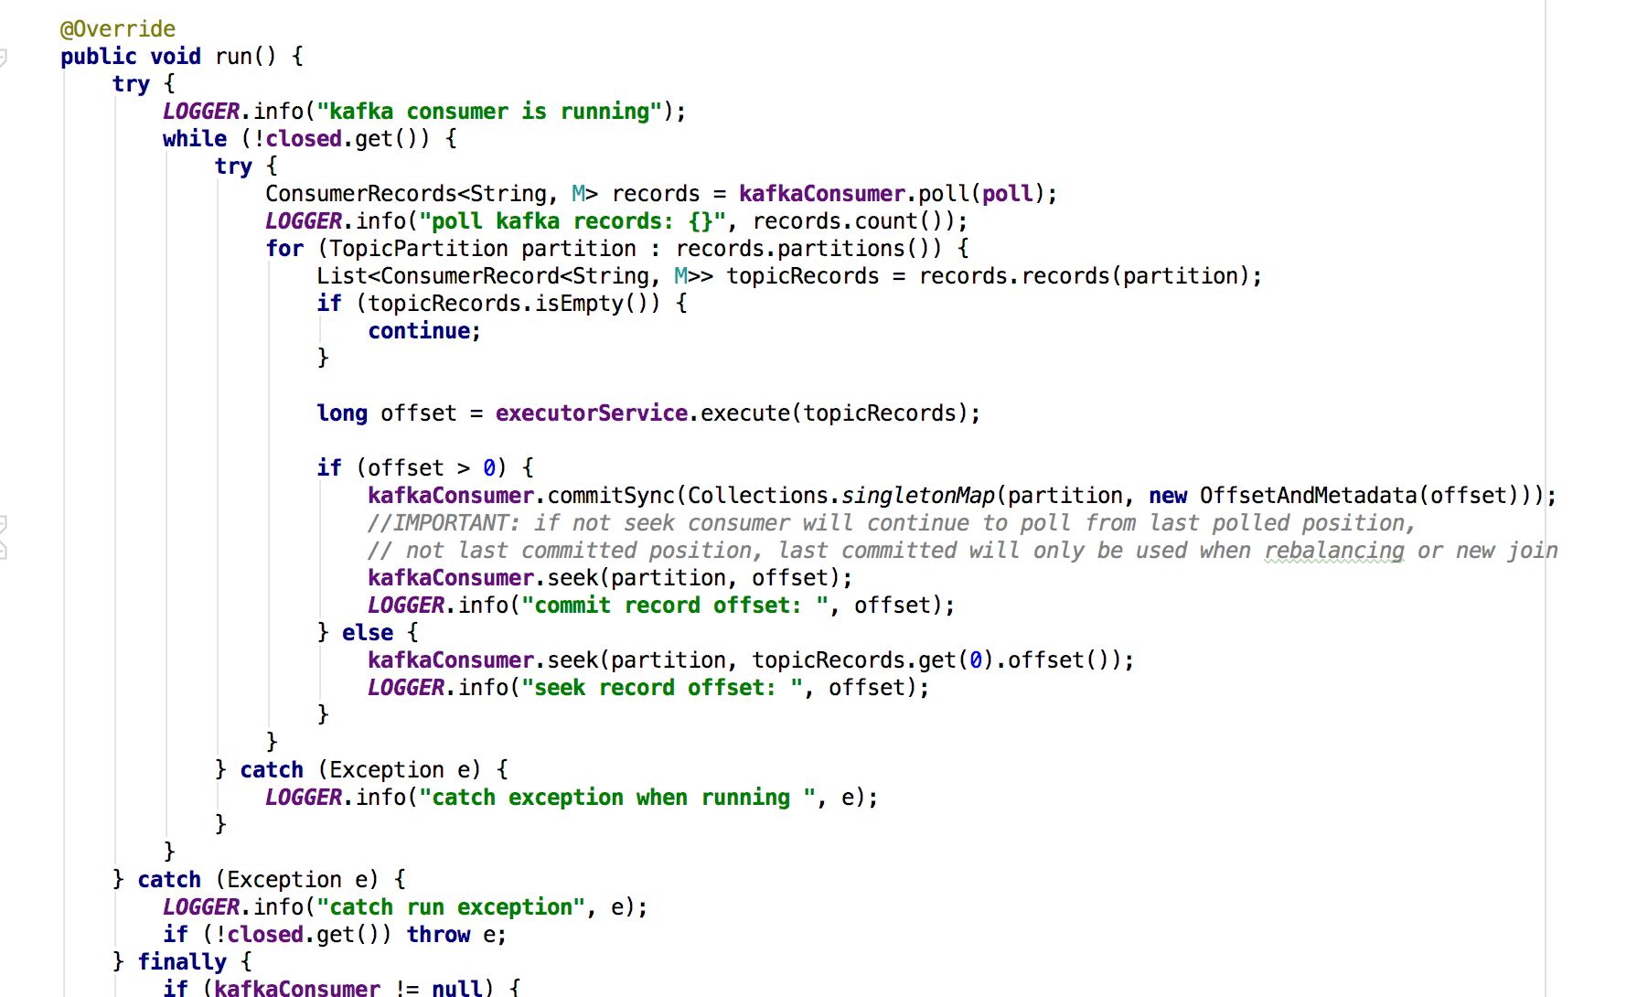
最后consumer的处理方法

Slide 18
参考文章
https://www.safaribooksonline.com/library/view/kafka-the-definitive/9781491936153/ch04.html

