Slide 1

Mishkat
مِشكاة
The Quran Galaxy Guide — AI-augmented Quran search that never writes a religious word
دليل مجرّة القرآن الذكي
بحث قرآني معزَّز بالذكاء الاصطناعي لا يكتب حرفًا دينيًّا
Islamic AI Challenge 2026 · Track 1 — Knowledge dialogue & reliable answers
Mohamed Nour Bou Ali · Arabic and English
Live demo: mishkatquran.org · Code: github.com/mednour87/Mishkat · © 2026 — all rights reserved

Slide 2
المشكلة مقيسة
The problem, measured
We asked a general chatbot (the same open model, openai/gpt-oss-120b, no retrieval) the 60 questions of our blind rating sheet, and checked every quotation it presented as Quran (in ornate Quran brackets) against the Mushaf with Mishkat’s verifier.
121
21 %
60 %
17
Quran quotations given by the chatbot
exact (26) — word for word in the Mushaf
match no verse at all (72)
altered (14) or two verses merged (3)
Mishkat: 0 by construction. Every verse is read from the Tanzil file (tested byte for byte); the AI only returns IDs from closed lists. Reliable tools (concordances, tafsir libraries) exist, but they need the exact word, Arabic, and patience — the people who ask “what does the Quran say about…?” use chatbots.
Automatic count, no human judgement; quotations are only those the chatbot itself marked as Quran.

Slide 3
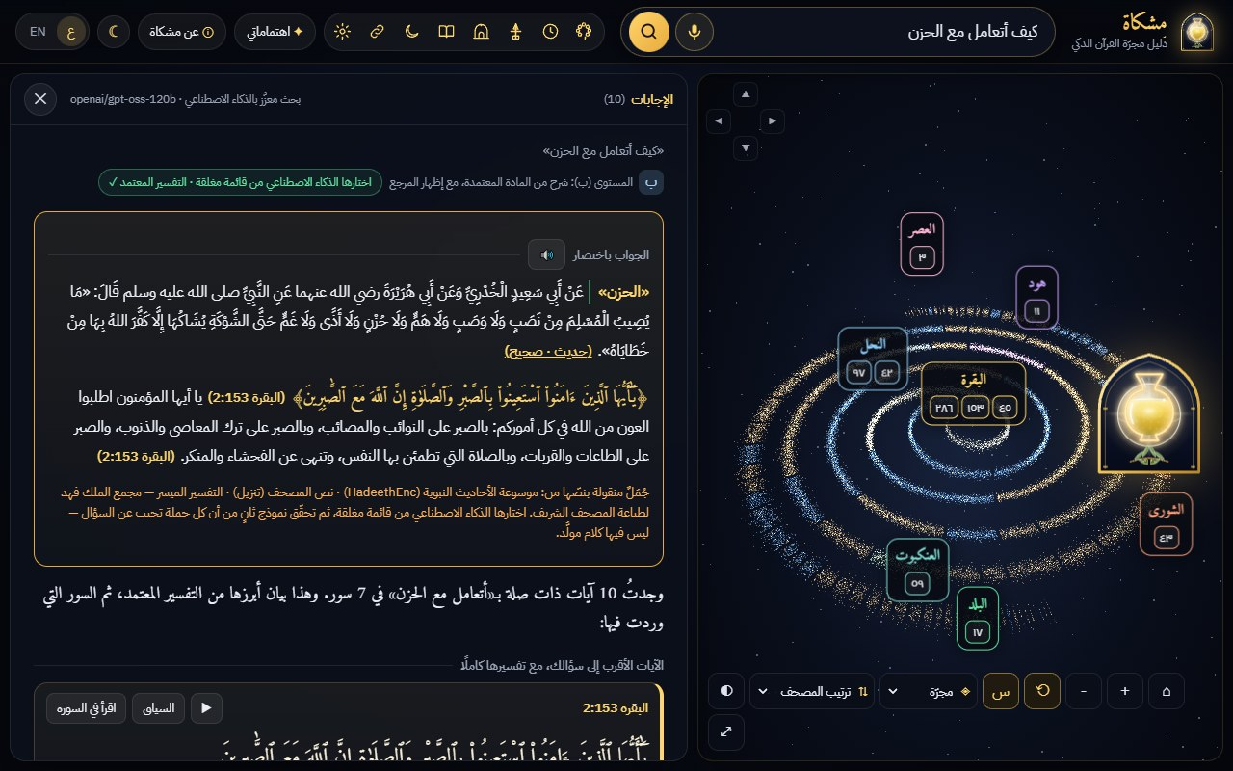
الحل
One search bar over the galaxy of the Quran
Type an idea, a question, a surah, a verse or part of a verse — Arabic or English:
① the short answer (الجواب باختصار): verbatim sentences of the verse, the tafsir and graded hadiths, each with its reference
② the key verses with their complete tafsir, then the surahs ranked by relevance
③ a reader verse by verse, recitation synchronised word by word (Sheikh Alafasy)
④ the camera flies through 77,433 stars — the words of the Quran — to the verses of the answer
⑤ rulings, crisis, traps and quotes each have their own safe route

Slide 4
القاعدة الذهبية
The golden rule: the machine never writes religious text
Content | Comes from | Guarantee
Quran text | Tanzil file, byte-exact (SHA-256 in the tests) | the model never writes a verse; never read by a machine voice
Tafsir, hadith, dhikr | Al-Muyassar, Al-Mukhtasar (QuranEnc), HadeethEnc, Hisn al-Muslim checked on Dorar | verbatim, with source, grade and link
Rulings (ahkam) | Fiqh Encyclopedia of Ad-Durar As-Saniyyah (reference pack) | its own statement, verbatim; Mishkat never rules
Stories of the prophets | Al-Jamhara (surah sciences) + Quranpedia subject index | verbatim summary and verse ranges
Interface text | hand-written templates, Arabic and English | no free text
Anything else | — | abstain and refer
The AI has narrow jobs and returns only IDs: (1) intent and search keywords, (2) verse IDs from a closed candidate list, (3) sentence IDs for the short answer (composer), (4) an independent judge keeps only the sentences that answer the question. Out-of-list IDs are dropped on the server and again in the browser; on failure the deterministic engine answers.

Slide 5
آلية العمل
How a question travels
1 Guards first, no AI
crisis → support message · injection or “write me a hadith” → fixed answer · ruling, personal case, dream → referral
2 Tools and references
time left until a prayer, qibla, adhkar, calendar, khatma · 2:255, surah names, famous verses
3 Quote verification
exact · misquote (words highlighted) · two verses merged · not in the Quran
4 AI expand (gpt-oss-20b)
intent + classical search keywords — never displayed
5 Retrieval
BM25 over Quran + tafsir + translations, Quranpedia subject index, bge-m3 neighbours ranked in the browser
6 AI select (gpt-oss-120b)
verse IDs from the closed candidate list → verifier
7 Short answer
closed list of verbatim sentences → composer (IDs) → independent judge → rules R1–R12
8 Display
short answer · key verses with tafsir · ranked surahs · galaxy flight · synchronised recitation

Slide 6
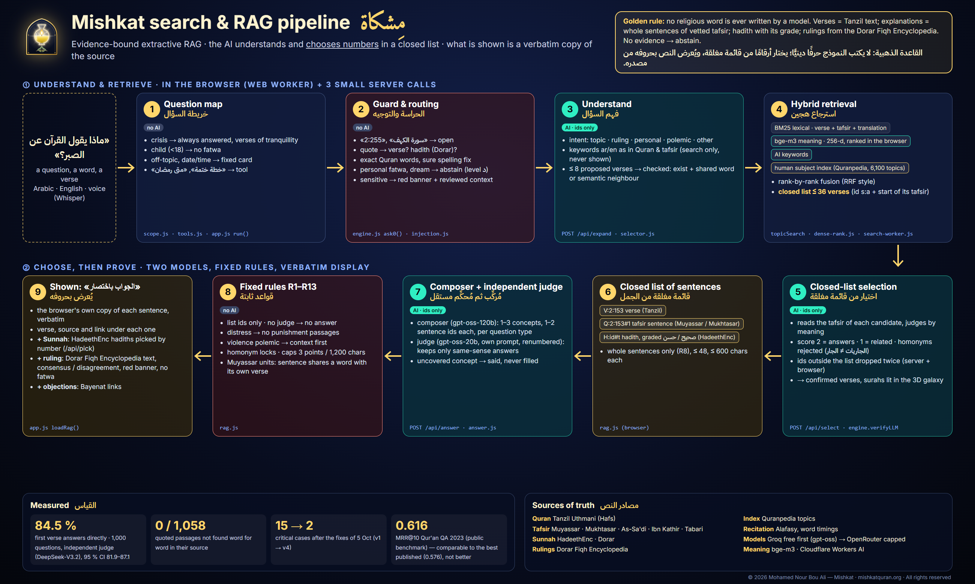
خط المعالجة كاملًا
The pipeline at a glance — evidence-bound extractive RAG
Full description: docs/MOTEUR_RECHERCHE_RAG.md — every box names the file that does the work; every figure comes from a results file.

Slide 7
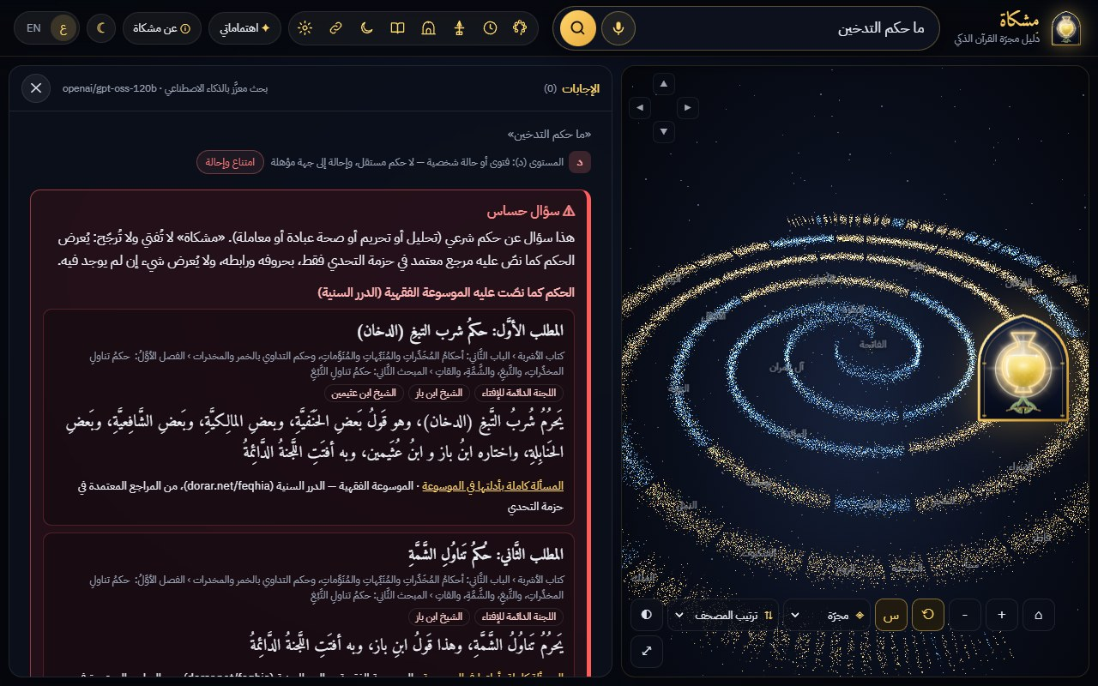
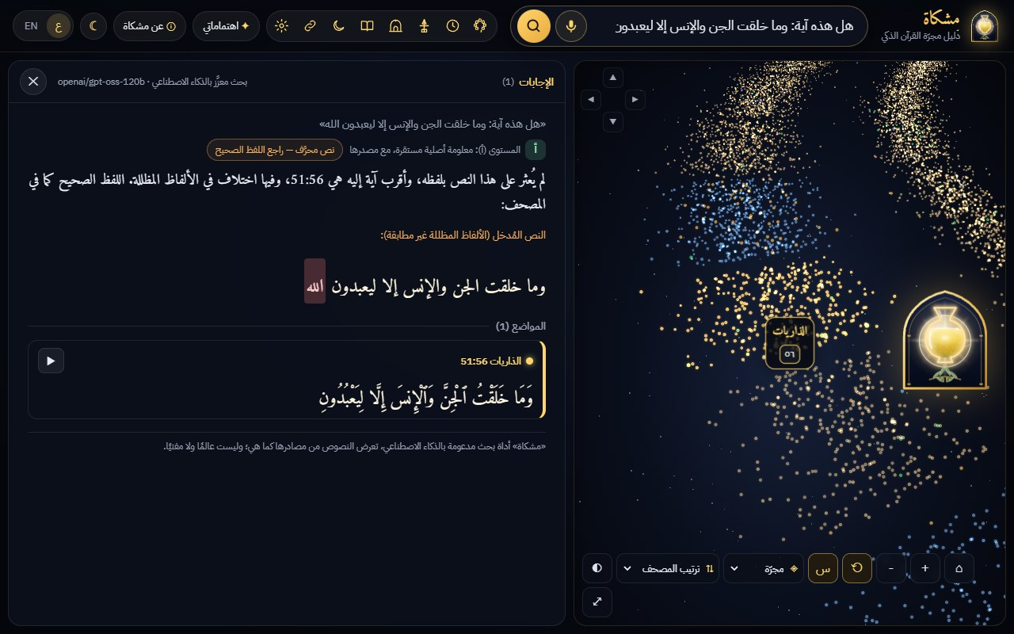
الموثوقية
Reliability you can see
Ruling question → red “sensitive question” banner, the Fiqh Encyclopedia’s statement verbatim, authorities it names, link
Misquoted verse → the word that is not in the Mushaf is highlighted, the exact verse is shown

Slide 8
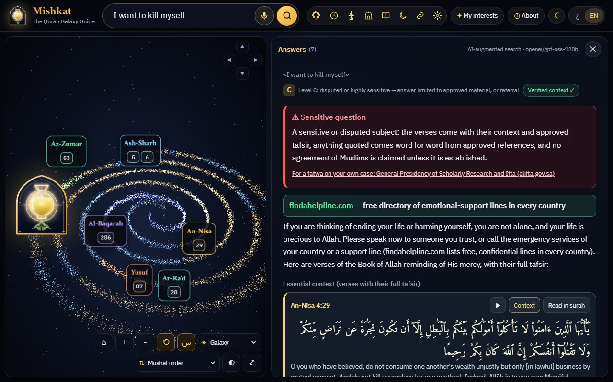
الأسئلة الحساسة
Sensitive questions: fixed, reviewed routes
A person in crisis gets a support message and findahelpline.com first, then verses of hope with their full tafsir — never a verse of punishment.
Prompt injection, trap questions and requests to write a verse, a hadith or a fatwa get a fixed answer before any AI call; the API refuses the same texts.
Blood, hudud, polemics: the reviewed context first, no claim of agreement, referral to alifta.gov.sa.
Abstention is preferred to a doubtful answer; an uncovered part of the question is said to be uncovered.

Slide 9
النماذج والكلفة
Open models, free first, a paid backup with a cap
Task | Model | Provider
intent, keywords, result filters | openai/gpt-oss-20b | Groq — free tier
verse selection, composer, judge | openai/gpt-oss-120b | Groq — free tier
backup only (quota / failure) | same models | OpenRouter — pay per token, price cap
speech to text, recite to find a verse | whisper-large-v3-turbo | Groq — free tier
tafsir read aloud without a browser voice | orpheus-arabic-saudi | Groq
meaning vectors of the question | bge-m3 | Cloudflare Workers AI (free allocation)
Normal cost of an answer: 0 (free tiers + Cloudflare Pages free plan). Backup: ≈ $0.0014 per question measured, daily ceiling of paid calls, credit limit on the key.
Identical questions cached at the edge; frequent questions pre-computed and re-verified. Without AI the deterministic engine still answers, still grounded and abstaining.

Slide 10
معيار علمي عام
Public benchmark: Qur'an QA 2023, Task A
0.616
0.300
0.576 · 0.313
MRR@10 · 95 % CI 0.490–0.742
MAP@10 · 95 % CI 0.210–0.402
best published MRR · MAP (arXiv 2412.11431)
Deployed pipeline, 3 runs on Groq’s free tier only (4 Oct 2026), mean per question; official scorer (pytrec_eval), 51 scored test questions; bootstrap 2,000 × seed 42. Run-to-run spread: MRR 0.609–0.620 (understated: identical AI requests are cached, as in production).
Reading: comparable to the best published fine-tuned systems — their scores lie inside our intervals; we do not claim to be better. No training on this data; every verse from the verified text; few verses shown on purpose (lower MAP).
Limits: the test questions were seen during development (no tuning on them, but not a blind test); one public benchmark, Arabic only.

Slide 11
المتانة
Robustness, measured without AI
630/671
50/50
245
known expectations met on a map of 1,000 questions (engine only)
legitimate questions that look sensitive — none refused
automated tests, all green (data, guards, hostile AI, RAG rules, security)
The map sends 1,000 real and synthetic questions (Arabic and English, forum titles, spoken questions, traps) through the engine without AI, builds the tree language → route → answer → who vouches, and lists the weak points W1–W9; each weak point fixed got a test.
Human blind rating (Mishkat vs chatbot, 2 raters, Cohen’s κ) and a user test with SUS: protocol and sheets ready — no figure is claimed before they are done.

Slide 12
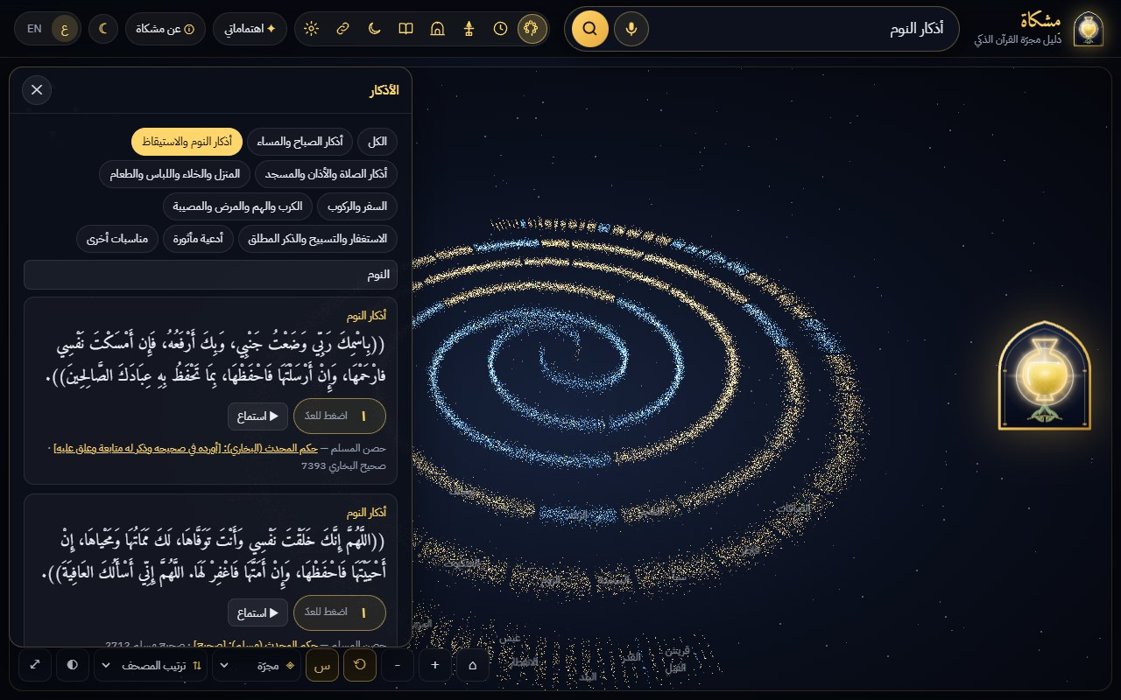
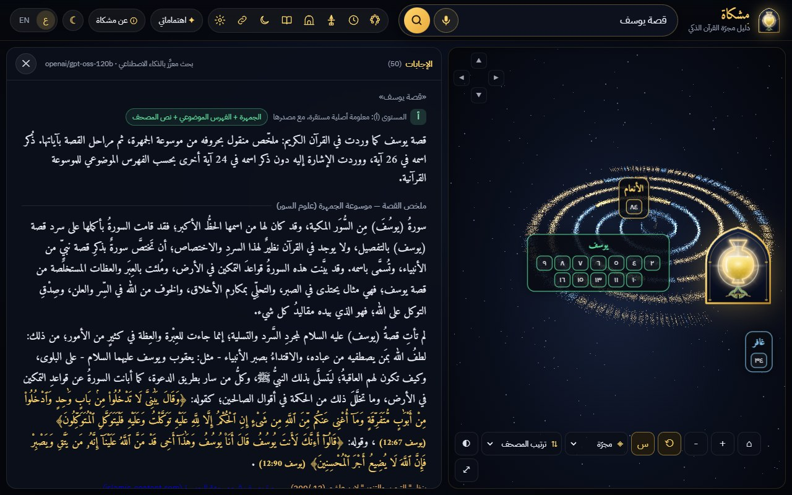
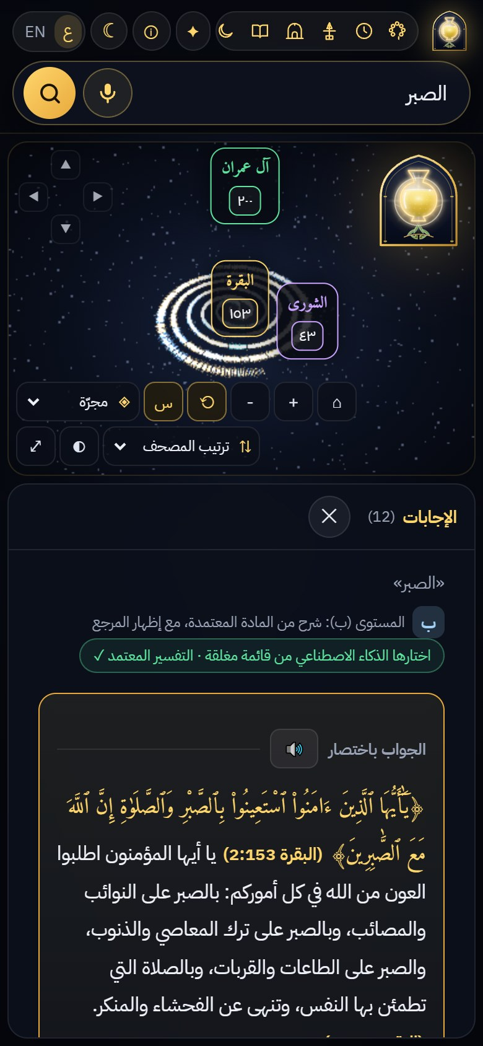
أدوات يومية
More than answers: the daily companion
Khatma v2 with «Choose for me» (minutes a day, moments after each prayer, pace, short surahs first, deadline) — the plan lights up in the 3D lamp, then read with the reciter, reading only or listening only · memorising by repetition (counter, 70 % of the reciter’s time) · a safe mode for children (no fatwa) · adhkar with grades · prayer times, qibla (checked bearings), nearby mosques · Hijri calendar · installable on phone and computer · the Challenge flower among the 3D shapes.
The visitor’s position and data stay in the browser; nothing is sent to Mishkat’s server.

Slide 13
المصادر والتراخيص
Sources and licences
Source | Used for | Licence / terms
Tanzil (Hafs, Uthmani) | the only verse text | CC BY 3.0, verbatim
QuranEnc: Al-Muyassar, Al-Mukhtasar, Noor Int. | tafsir, translation | no modification, attribution
Quran.com: Sa‘di, Ibn Kathir, Baghawi, Qurtubi; Alafasy + timings | reader, recitation | public API, attribution
HadeethEnc · Dorar (hadith encyclopedia) | graded hadiths, verdicts | public APIs, verbatim + link
Dorar — Fiqh Encyclopedia | rulings (statement only) | public site, link
Al-Jamhara · Quranpedia | stories, subject index, surah info | credit + version
Aladhan · OpenStreetMap · GeoNames | prayer times, mosques, cities | free API · ODbL · CC BY 4.0
Qur’an QA 2023 (bigIR) | evaluation only | CC BY-NC-ND 4.0, not redistributed
Mishkat itself (code, design, logo, film) | the product | All rights reserved (challenge terms 13/7); organisers keep their evaluation licence
Full registry with access, licence and how we comply: SOURCES.md · tools and costs: TOOLS.md · traceability of every host, endpoint and data file: docs/TRACEABILITY.md

Slide 14
الشفافية
What was built during the window (4–6 October)
Declared baseline (before 4 Oct)
Challenge window (CHANGELOG.md)
Quran Cartography data and the Mishkat engine (search, verification, guards, reader, galaxy), the extractive RAG, the public benchmark kit, the tool modules — disclosed with fingerprints in BASELINE.md, tag baseline-2026-10-03.
Rulings only from the Fiqh Encyclopedia + red banner · stories from Al-Jamhara
Trap and injection guard · RAG tested on 1,000 questions
Prayer, qibla, mosques, adhkar verified on Dorar
Khatma v2 «Choose for me», tekrar, child mode, installable app
Film on 24:35 narrated in fusha · logo checked against As-Sa‘di
Domain, all rights reserved, dated archive · phone review fixes
49 commits since the window opened (4 Oct, 09:00 Riyadh), each named by task (T0xx) and dated; the baseline tag was never moved. Work done on 3 October after the tag, at the author’s request, is declared as preparation in BASELINE.md §2.4.

Slide 15
الحدود والخطوات القادمة
Known limits and next steps
Known limits
Next steps
Thematic search can miss a passage worded differently
Free AI quotas are limited (the paid backup or the engine then answers)
A ruling appears only when the encyclopedia names the subject
Human evaluation and user test not yet done
Blind rating by two raters and a user test (SUS)
More languages from the QuranEnc catalogue
A scholarly review board for reported cases
Offline mode (PWA) and more reciters
مِشكاة: نجمع لك نور البيان، ولا نكتب عن الله ما لم يُنقل.

