Slide 1



STUDENT PERFORMANCE RISK CLASSIFICATION & SENTIMENT ANALYSIS
By Mohammed Osman

Slide 2
INTRODUCTION
Importance of identifying at-risk students for early intervention
Combining quantitative academic data with qualitative text feedback
Goal: Predict risk levels and analyze student sentiments

Slide 3
PROBLEM STATEMENT
Traditional academic risk detection relies mainly on grades and attendance
Textual feedback holds rich but underutilized information
Challenge: integrate structured and unstructured data for better risk classification

Slide 4
DATASET OVERVIEW
Source: UCI Machine Learning Repository + supplementary Excel student feedback
Sample size: 649 students
Features: demographics, grades (G1, G2, G3), lifestyle behaviors, textual feedback
Clean dataset with no missing values

Slide 5
DATA CLEANING & FEATURE ENGINEERING
Cleaned text (lowercase, punctuation & digits removed)
Categorical data encoding (Label Encoder & One-Hot)
Created new features:
Attendance Ratio
Average Grade
Care Indicator (family support & health)
Alcohol Addiction flag
Target variable: fail_risk (High, Medium, Low)

Slide 6
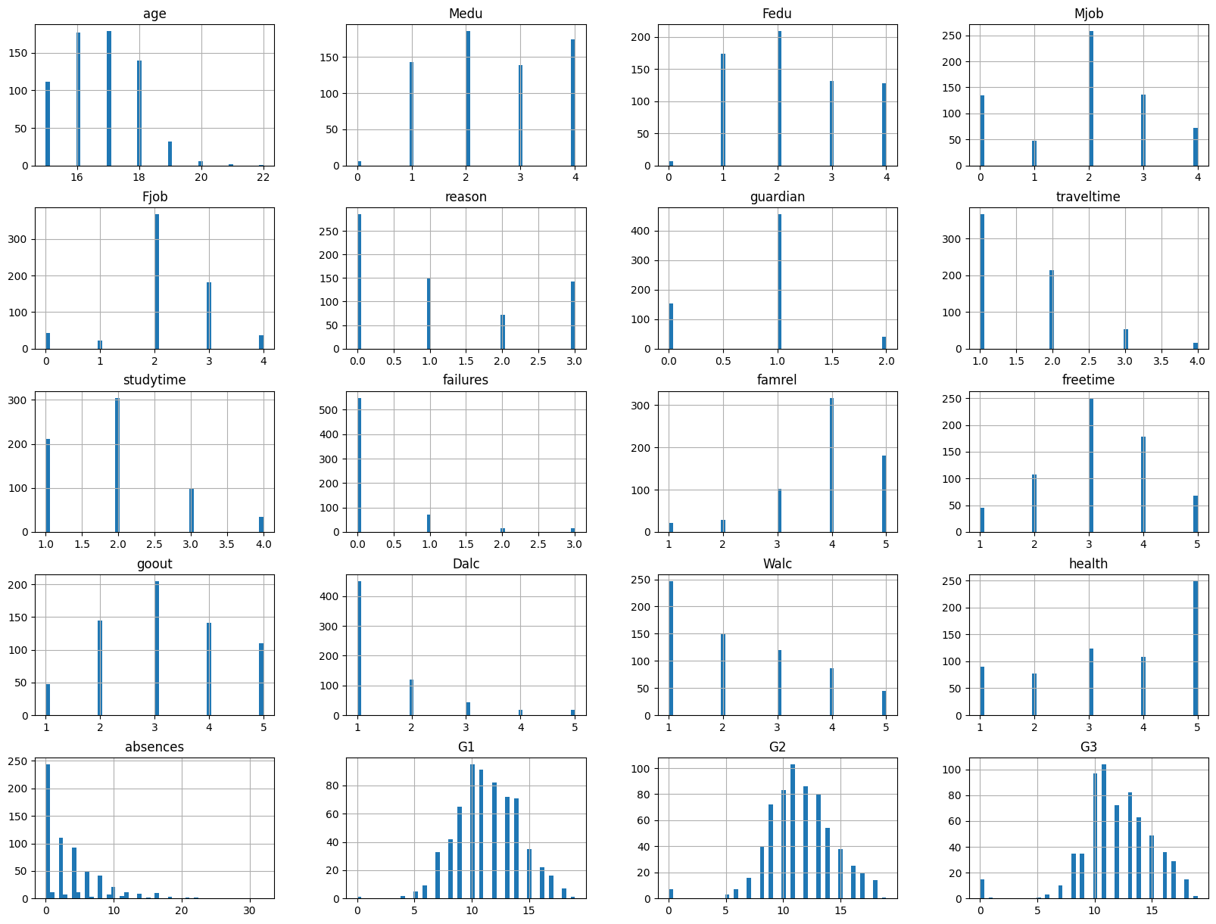
Data
Distribution

Slide 7
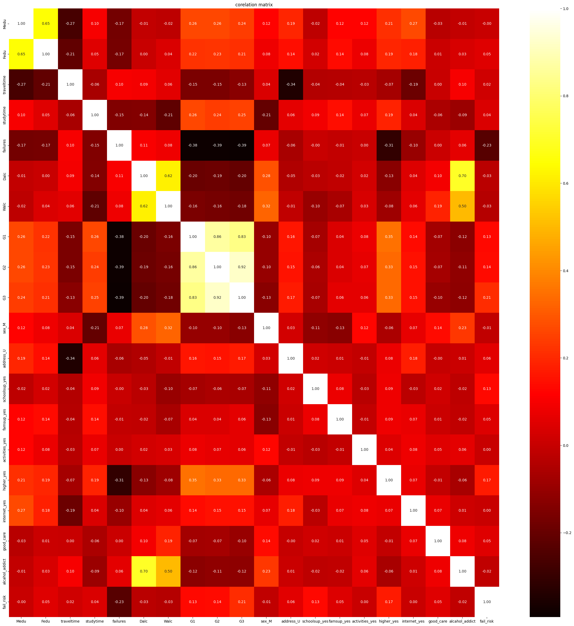

Slide 8

MODELING APPROACH
Models trained: Logistic Regression, Decision Tree, Random Forest, SVM
Data split: 80% train, 20% test
Feature scaling with MinMaxScaler
Evaluation metrics: accuracy, precision, recall, F1-score, confusion matrix

Slide 9
MODEL EVALUATION RESULTS
Best performance with SVM and Random Forest models
Model | Accuracy | Precision | Recall | F1-score
Logistic Regression | 80% | 82% | 80% | 80%
Decision Tree | 68% | 72% | 68% | 68%
Random Forest | 83% | 85% | 83% | 83%
SVM | 85% | 86% | 85% | 85%

Slide 10

SENTIMENT ANALYSIS
Cleaned and tokenized student feedback texts
Used deep learning (Keras) with embedding + dense layers
Binary sentiment classification (positive/negative)
Achieved validation accuracy around 85-89%
Augments risk classification with emotional insights

Slide 11
DEPLOYMENT
Saved best model (SVM) with pickle
Developed Flask API for realtime predictions
API accepts JSON inputs, returns risk category JSON output
Enables easy integration with dashboards or school systems

Slide 12
ETHICAL CONSIDERATIONS
Ensured student data privacy and anonymity
Avoided bias and discrimination in model predictions
Transparency: model supports decision-making, does not replace human judgement
Informed consent from students for data usage
Emphasis on positive intervention, not punishment

Slide 13
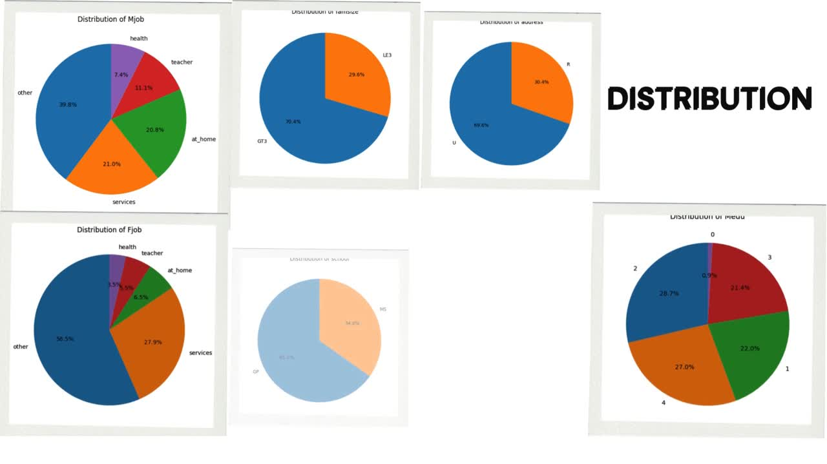

Slide 14
THANK YOU

