Slide 1

Detector Description: Basics
http://cern.ch/geant4
Notes:
Geant4: Detector description module

Slide 2
Detector Description: the Basics
PART II
Components of a detector geometry
and hierarchical relationship
Volumes & solids
Notes:
Geant4: Detector description module

Slide 3
Describe your detector
Derive your own concrete class from G4VUserDetectorConstruction abstract base class.
Implementing the method Construct():
  Modularize it according to each detector component or sub-detector:
    Construct all necessary materials
    Define shapes/solids required to describe the geometry
    Construct and place volumes of your detector geometry
    Define sensitive detectors and identify detector volumes which to associate them
    Associate magnetic field to detector regions
    Define visualization attributes for the detector elements
Detector Description: Basics - Geant4 Course
Notes:
Geant4: Detector description module
The main class defining the detector geometry is derived from G4VUserDetectorConstruction.
It is advised to modularize its design according to the geometry components (I.e. define a class for each geometry component), especially for complex geometry structures.
Definition of attributes, like sensitive detectors, local fields or visualization are optional.

Slide 4
Creating a Detector Volume
  Solid
  Logical-Volume
  Physical-Volume
Start with its Shape & Size
  Box 3x5x7 cm, sphere R=8m
Add properties:
  material, B/E field,
  make it sensitive
Place it in another volume
  in one place
  repeatedly using a function
Detector Description: Basics - Geant4 Course
Notes:
Geant4: Detector description module
So you can re-use
i) one solid for 10 or 100 or any number of logical volumes.
ii) one logical volume for 100 or 1000 physical volumes.
Solids are geometrical entities. They can also be used to describe sensitive volumes, ...

Slide 5
Detector geometry components
Three conceptual layers
  G4VSolid -- shape, size
  G4LogicalVolume -- daughter physical volumes,
  material, sensitivity, user limits, etc.
  G4VPhysicalVolume -- position, rotation
G4VSolid
G4LogicalVolume
G4VPhysicalVolume
G4Box
G4Material
G4VisAttributes
G4PVPlacement
G4Tubs
G4VSensitiveDetector
G4PVParameterised
Detector Description: Basics - Geant4 Course
Notes:
Geant4: Detector description module
Possible attributes associated to a G4LogicalVolume:
Magnetic field
Material
If sensitive, associated sensitive detector
Quality of geometry optimization (smartless)
Visualization attributes
User limits (maximum allowed step, track length, minimum kinetic energy, …)
…

Slide 6
Detector geometry components
Step 1
Create the geom. object : box
Basic strategy
  G4VSolid* pBoxSolid =
  new G4Box(“aBoxSolid”, 1.*m, 2.*m, 3.*m);
  G4LogicalVolume* pBoxLog =
  new G4LogicalVolume( pBoxSolid, pBoxMaterial,
  “aBoxLog”, 0, 0, 0);
  G4VPhysicalVolume* aBoxPhys =
  new G4PVPlacement( pRotation,
  G4ThreeVector(posX, posY, posZ),
  pBoxLog, “aBoxPhys”, pMotherLog,
  0, copyNo);
A unique physical volume which represents the experimental area must exist and fully contains all other components
  The world volume
Step 2
Assign properties
to object : material
Step 3
Place it in the coordinate system of mother volume
Detector Description: Basics - Geant4 Course

Slide 7
Describing a detector - II
Solids

Slide 8
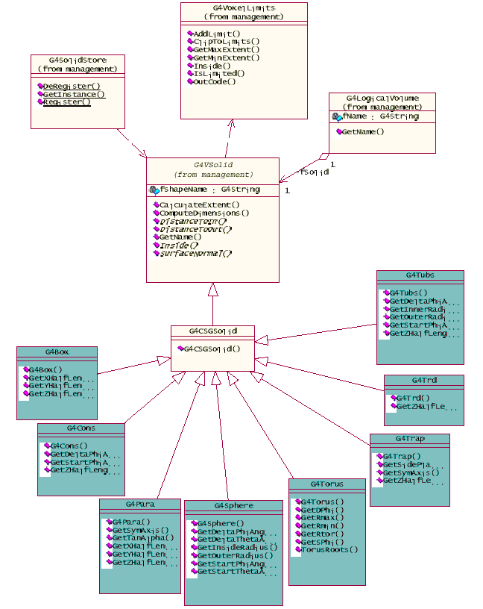
G4VSolid
Abstract class. All solids in Geant4 derive from it
  Defines but does not implement all functions required to:
    compute distances to/from the shape
    check whether a point is inside the shape
    compute the extent of the shape
    compute the surface normal to the shape at a given point
Once constructed, each solid is automatically registered in a specific solid store
Detector Description: Basics - Geant4 Course
Notes:
Geant4: Detector description module

Slide 9

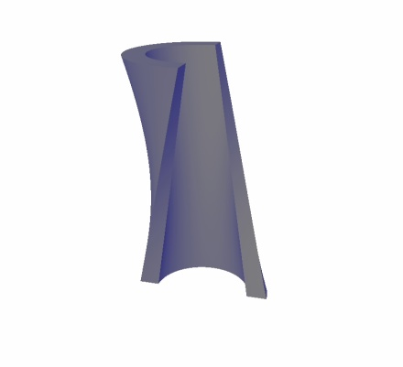
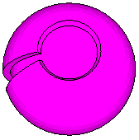
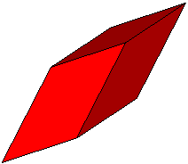
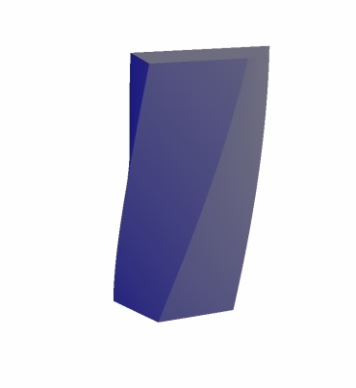
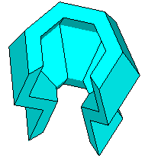
Solids
Solids defined in Geant4:
  CSG (Constructed Solid Geometry) solids
    G4Box, G4Tubs, G4Cons, G4Trd, …
    Analogous to simple GEANT3 CSG solids
  Specific solids (CSG like)
    G4Polycone, G4Polyhedra, G4Hype, …
    G4TwistedTubs, G4TwistedTrap, …
  BREP (Boundary REPresented) solids
    G4BREPSolidPolycone, G4BSplineSurface, …
    Any order surface
  Boolean solids
    G4UnionSolid, G4SubtractionSolid, …
Detector Description: Basics - Geant4 Course
Notes:
Geant4: Detector description module

Slide 10
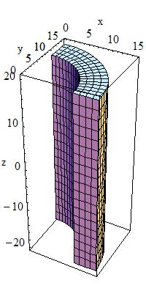
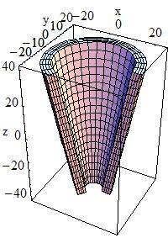
CSG: G4Tubs, G4Cons
G4Tubs(const G4String& pname, // name
G4double pRmin, // inner radius
G4double pRmax, // outer radius
G4double pDz, // Z half length
G4double pSphi, // starting Phi
G4double pDphi); // segment angle
G4Cons(const G4String& pname, // name
G4double pRmin1, // inner radius -pDz
G4double pRmax1, // outer radius -pDz
G4double pRmin2, // inner radius +pDz
G4double pRmax2, // outer radius +pDz
G4double pDz, // Z half length
G4double pSphi, // starting Phi
G4double pDphi); // segment angle
Detector Description: Basics - Geant4 Course
Notes:
Geant4: Detector description module

Slide 11
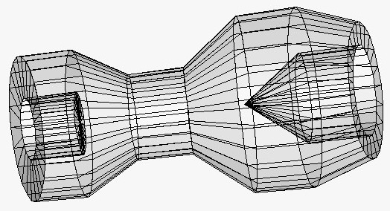
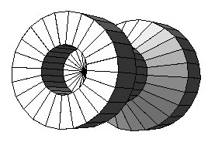
Specific CSG Solids: G4Polycone
G4Polycone(const G4String& pName,
G4double phiStart,
G4double phiTotal,
G4int numRZ,
const G4double r[],
const G4double z[]);
numRZ - numbers of corners in the r,z space
r, z - coordinates of corners
Also available additional constructor using planes
Detector Description: Basics - Geant4 Course
Notes:
Geant4: Detector description module
Constructor by planes:
G4Polycone( const G4String& pName,
G4double phiStart,
G4double phiTotal,
G4int numZPlanes,
const G4double zPlane[],
const G4double rInner[],
const G4double rOuter[])

Slide 12
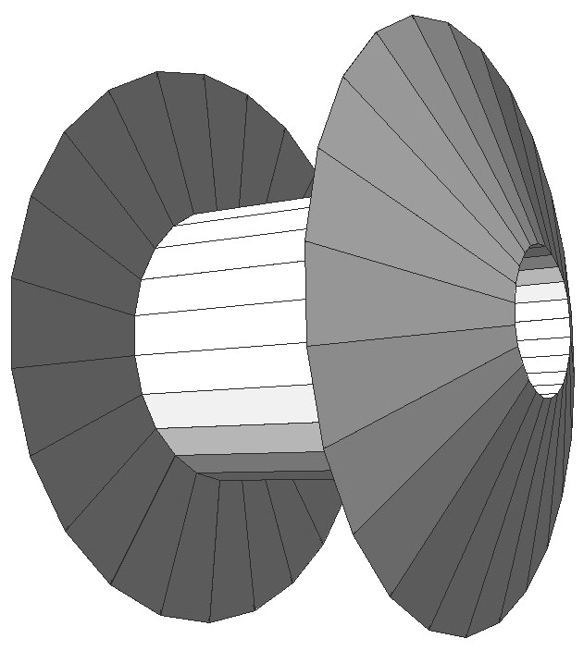
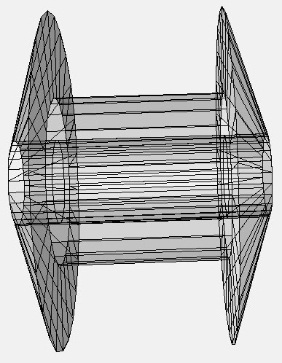
BREP Solids
BREP = Boundary REPresented Solid
Listing all its surfaces specifies a solid
  e.g. 6 squares for a cube
Surfaces can be
  planar, 2nd or higher order
    elementary BREPS
  Splines, B-Splines,
  NURBS (Non-Uniform B-Splines)
    advanced BREPS
Few elementary BREPS pre-defined
  box, cons, tubs, sphere, torus, polycone, polyhedra
Advanced BREPS built through CAD systems
Detector Description: Basics - Geant4 Course
Notes:
Geant4: Detector description module
In picture:
G4double zval[6] = { -4000*mm, -3500*mm, -3500*mm, -1500*mm, -1500*mm, -1000*mm };
G4double rmin[6] = { 500*mm, 500*mm, 500*mm, 500*mm, 500*mm, 500*mm };
G4double rmax[6] = { 500*mm, 2000*mm, 1000*mm, 1000*mm, 2000*mm, 500*mm };
G4BREPSolidPCone *Solid =
new G4BREPSolidPCone( "BREPSolidPCone", 0.0*rad, twopi*rad, 6, zval[0], zval, rmin, rmax );

Slide 13
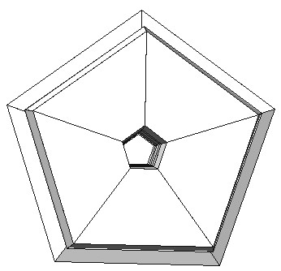
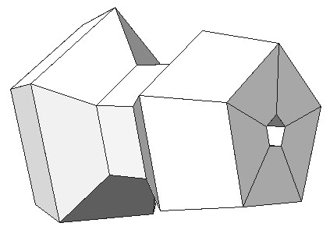
BREPS example:
G4BREPSolidPolyhedra
G4BREPSolidPolyhedra(const G4String& pName,
G4double phiStart,
G4double phiTotal,
G4int sides,
G4int nZplanes,
G4double zStart,
const G4double zval[],
const G4double rmin[],
const G4double rmax[]);
sides - numbers of sides of each polygon in the x-y plane
nZplanes - numbers of planes perpendicular to the z axis
zval[] - z coordinates of each plane
rmin[], rmax[] - Radii of inner and outer polygon at each plane
Detector Description: Basics - Geant4 Course
Notes:
Geant4: Detector description module
In picture:
#define VECSIZE 6
G4int sides = 5;
G4double rmin[VECSIZE] = { 100*mm, 100*mm, 100*mm, 100*mm, 100*mm, 100*mm };
G4double rmax[VECSIZE] = { 700*mm, 800*mm, 400*mm, 400*mm, 600*mm, 500*mm };
G4double zval[VECSIZE] = { 3500*mm, 3800*mm, 4000*mm, 4300*mm, 4500*mm, 5000*mm };
G4BREPSolidPolyhedra *sphedra =
new G4BREPSolidPolyhedra( "sphedra", pi/2*rad, 2*pi*rad, sides, VECSIZE, zval[0], zval, rmin, rmax);
G4LogicalVolume *lvphedra =
new G4LogicalVolume( sphedra, Al, "lvphedra" );
G4PVPlacement *pvphedra =
new G4PVPlacement( 0, G4ThreeVector(), "pvphedra1", lvphedra, worldPhysic, false, 0 );

Slide 14
Boolean Solids
G4UnionSolid
G4SubtractionSolid
G4IntersectionSolid
Solids can be combined using boolean operations:
  G4UnionSolid, G4SubtractionSolid, G4IntersectionSolid
  Requires: 2 solids, 1 boolean operation, and an (optional) transformation for the 2nd solid
    2nd solid is positioned relative to the coordinate system of the 1st solid
    Component solids must not be disjoint and must well intersect
G4Box box(“Box", 20, 30, 40);
G4Tubs cylinder(“Cylinder”, 0, 50, 50, 0, 2*M_PI); // r: 0 -> 50
// z: -50 -> 50
// phi: 0 -> 2 pi
G4UnionSolid union("Box+Cylinder", &box, &cylinder);
G4IntersectionSolid intersect("Box Intersect Cylinder", &box, &cylinder);
G4SubtractionSolid subtract("Box-Cylinder", &box, &cylinder);
Solids can be either CSG or other Boolean solids
Note: tracking cost for the navigation in a complex Boolean solid is proportional to the number of constituent solids
Detector Description: Basics - Geant4 Course
Notes:
Geant4: Detector description module
Passive transformation: a rotation matrix/translation is provided to transform the coordinate system of the 1st solid to the coordinate system of the 2nd solid. The final transformation in this case is NOT copied, therefore, once defined and used it must not be modified.
Active transformation: a transformation (G4Transform3D) is first created to move the 2nd solid to the correct position. The transformation in this case is stored (copied) in the final boolean solid.

Slide 15
Areas, volumes and masses
Surface area and geometrical volume of a generic solid or Boolean composition can be computed from the solid:
G4double GetSurfaceArea();
G4double GetCubicVolume();
Overall mass of a geometry setup (sub-detector) can be computed from the logical volume:
G4double GetMass(G4Bool forced=false,
G4Material* parameterisedMaterial=0);
Detector Description: Basics - Geant4 Course
Notes:
Geant4: Detector description module
10/21/08
Geant4: Detector description module
10/21/08
Geant4: Detector description module
10/21/08
GetSurfaceArea():
Returns an estimation of the solid surface area in internal units.
Should be overloaded by the concrete solid implementation to perform exact computation of the area quantity and eventually “cache” the computed value, such that it is NOT recomputed each time the method is called.
GetCubicVolume():
Returns an estimation of the solid volume in internal units.
Should be overloaded by the concrete solid implementation to perform exact computation of the volume quantity and eventually “cache” the computed value, such that it is NOT recomputed each time the method is called.
GetMass:
Returns the mass of the logical-volume tree computed from the estimated geometrical volume of each solid and material associated to the logical volume and its daughters.
The computation may require a considerable amount of time, depending from the complexity of the geometry tree.
The returned value is cached and can be used for successive calls (default), unless re-computation is forced by providing 'true' for the ‘forced’ argument in input. Computation should be forced if the geometry setup has changed after the previous call.
An optional argument to specify a parameterised material is provided.

Slide 16
Describing a detector - III
Logical and Physical Volumes

Slide 17
G4LogicalVolume
G4LogicalVolume(G4VSolid* pSolid, G4Material* pMaterial,
const G4String& name, G4FieldManager* pFieldMgr=0,
G4VSensitiveDetector* pSDetector=0,
G4UserLimits* pULimits=0,
G4bool optimise=true);
  Contains all information of volume except position:
    Shape and dimension (G4VSolid)
    Material, sensitivity, visualization attributes
    Position of daughter volumes
    Magnetic field, User limits
    Shower parameterisation
  Physical volumes of same type can share a logical volume.
  The pointers to solid and material must be NOT null
  Once created it is automatically entered in the LV store
  It is not meant to act as a base class
Detector Description: Basics - Geant4 Course
Notes:
Geant4: Detector description module
It is possible to deactivate optimisation (voxelisation) of the geometry for a given logical volume.
Optimisation is built by default, if the flag “optimise” is set to false, the whole hierarchy of volumes identified by the logical volume will not be optimised. Note that optimisation is always applied for logical volumes whose physical volumes are parameterised volumes.

Slide 18
Geometrical hierarchy
Mother and daughter volumes
  A volume is placed in its mother volume
    Position and rotation of the daughter volume is described with respect to the local coordinate system of the mother volume
    The origin of the mother's local coordinate system is at the center of the mother volume
    Daughter volumes cannot protrude from the mother volume
    Daughter volumes cannot overlap
  One or more volumes can be placed in a mother volume
Detector Description: Basics - Geant4 Course
Notes:
Geant4: Detector description module
10/21/08
Geant4: Detector description module
10/21/08
Geant4: Detector description module
10/21/08

Slide 19
Geometrical hierarchy
Mother and daughter volumes (cont.)‏
  The logical volume of mother knows the daughter volumes it contains
    It is uniquely defined to be their mother volume
    If the logical volume of the mother is placed more than once, all daughters appear by definition in all these physical instances of the mother
World volume is the root volume of the hierarchy
  The world volume must be a unique physical volume which fully contains with some margin all other volumes
    The world defines the global coordinate system
    The origin of the global coordinate system is at the center of the world volume
    Should not share any surface with contained geometry
Detector Description: Basics - Geant4 Course
Notes:
Geant4: Detector description module
10/21/08
Geant4: Detector description module
10/21/08
Geant4: Detector description module
10/21/08

Slide 20
Geometrical hierarchy
One logical volume can be placed more than once. One or more volumes can be placed in a mother volume
Note that the mother-daughter relationship is an information of G4LogicalVolume
  If the mother volume is placed more than once, all daughters by definition appear in each placed physical volume
The world volume must be a unique physical volume which fully contains with some margin all the other volumes
  The world volume defines the global coordinate system. The origin of the global coordinate system is at the center of the world volume
  Position of a track is given with respect to the global coordinate system
Detector Description: Basics - Geant4 Course

Slide 21
Kinds of G4VPhysicalVolume
  G4PVPlacement 1 Placement = One Volume
    A volume instance positioned once in a mother volume
  G4PVParameterised 1 Parameterised = Many Volumes
    Parameterised by the copy number
      Shape, size, material, position and rotation can be parameterised, by implementing a concrete class of G4VPVParameterisation.
    Reduction of memory consumption
      Parameterisation can be used only for volumes that either a) have no further daughters or b) are identical in size & shape.
  G4PVReplica 1 Replica = Many Volumes
    Slicing a volume into smaller pieces (if it has a symmetry)
Detector Description: Basics - Geant4 Course

Slide 22
Physical Volumes
Placement: it is one positioned volume
Repeated: a volume placed many times
  can represent any number of volumes
  reduces use of memory.
  Replica
    simple repetition, similar to G3 divisions
  Parameterised
A mother volume can contain either
  many placement volumes OR
  one repeated volume
placement
repeated
Detector Description: Basics - Geant4 Course
Notes:
Geant4: Detector description module

Slide 23
G4PVPlacement
G4PVPlacement(G4RotationMatrix* pRot, // rotation of mother frame
const G4ThreeVector& tlate, // position in rotated frame
G4LogicalVolume* pCurrentLogical,
const G4String& pName,
G4LogicalVolume* pMotherLogical,
G4bool pMany, // not used. Set it to false…
G4int pCopyNo, // unique arbitrary index
G4bool pSurfChk=false); // optional overlap check
Single volume positioned relatively to the mother volume
  In a frame rotated and translated relative to the coordinate system of the mother volume
Three additional constructors:
  A simple variation: specifying the mother volume as a pointer to its physical volume instead of its logical volume.
  Using G4Transform3D to represent the direct rotation and translation of the solid instead of the frame (alternative constructor)
  The combination of the two variants above
Detector Description: Basics - Geant4 Course
Notes:
Geant4: Detector description module
Adopting the constructor using the pointer to the logical volume of the mother, is a very natural way of defining a physical volume, and is especially useful when creating sub-detectors: the mother volumes is not placed until a later stage of the assembly program.
The G4Transform3D argument should be constructed by:
i) First rotating it to align the solid to the system of reference of its mother volume, and
ii) Then placing the solid at the location Transform3D.getTranslation(), with respect to the origin of the system of coordinates of the mother volume.
This is useful for the people who prefer to think in terms of moving objects in a given reference frame.

Slide 24
G4PVPlacement
Rotation of mother frame …
G4PVPlacement(G4RotationMatrix* pRot, // rotation of mother frame
const G4ThreeVector& tlate, // position in mother frame
G4LogicalVolume* pCurrentLogical,
const G4String& pName,
G4LogicalVolume* pMotherLogical,
G4bool pMany, // not used. Set it to false…
G4int pCopyNo, // unique arbitrary index
G4bool pSurfChk=false ); // optional overlap check
Single volume positioned relatively to the mother volume
Mother volume
Mother volume
translation in mother frame
translation in mother frame
rotation
Notes:
The rotation matrix is OWNED by the user; NO copy is made of it;
Rotation matrix can be modified for dynamic rotations of the reference frame.

Slide 25
G4PVPlacement
Rotation in mother frame …
G4PVPlacement( G4Transform3D( G4RotationMatrix &pRot, // rotation of daughter frame
const G4ThreeVector &tlate), // position in mother frame
G4LogicalVolume *pDaughterLogical,
const G4String &pName,
G4LogicalVolume *pMotherLogical,
G4bool pMany, // not used, set it to false…
G4int pCopyNo, // unique arbitrary integer
G4bool pSurfChk=false ); // optional overlap check
Mother volume
rotation
translation in mother frame
Notes:
The G4Transform3D argument should be constructed by:
i) Rotating the object (solid) to align it to the system of
reference of its mother volume *pMother, and
ii) Placing it at the location Transform3D.getTranslation(),
with respect to the origin of the system of coordinates of the mother volume.
This is useful for the people who prefer to think in terms of moving objects in a given reference frame.

Slide 26
Exercise 1b
Placements

