Slide 1

Detector Description: Basics
http://cern.ch/geant4
Notes:
Geant4: Detector description module

Slide 2
Detector Description: the Basics
PART III
Parameterised Volumes and Replicas
Detector description persistency: GDML
Notes:
Geant4: Detector description module

Slide 3
Describing a detector - IV
Parameterised Volumes and Replicas

Slide 4
Parameterised Physical Volumes
User written functions define:
  the size of the solid (dimensions)
    Function ComputeDimensions(…)
  where it is positioned (transformation)
    Function ComputeTransformations(…)
Optional:
  the type of the solid
    Function ComputeSolid(…)
  the material
    Function ComputeMaterial(…)
Limitations:
  Applies to a limited set of solids
  Daughter volumes allowed only for special cases
Very powerful
  Consider parameterised volumes as “leaf” volumes
Detector Description: Basics - Geant4 Course
Notes:
Geant4: Detector description module
For parameterised volumes the mother volume must be always specified, therefore the world volume can never be a parameterised volume.
All methods in G4VPVParameterisation provides an argument (integer) for specifying the copy number of the parameterisation instance under consideration.
Only parameterised volumes in which all the solids have the same size, currently allows the addition of daughter volumes.

Slide 5
Uses of Parameterised Volumes
Complex detectors
  with large repetition of volumes
    regular or irregular
Medical applications
  the material in animal tissue is measured
    cubes with varying material
Detector Description: Basics - Geant4 Course
Notes:
Geant4: Detector description module

Slide 6
G4PVParameterised
G4PVParameterised(const G4String& pName,
G4LogicalVolume* pCurrentLogical,
G4LogicalVolume* pMotherLogical,
const EAxis pAxis,
const G4int nReplicas,
G4VPVParameterisation* pParam,
G4bool pSurfChk=false);
Replicates the volume nReplicas times using the parameterisation pParam, within the mother volume
The positioning of the replicas is dominant along the specified Cartesian axis
  If kUndefined is specified as axis, 3D voxelisation for optimisation of the geometry is adopted
Represents many touchable detector elements differing in their positioning and dimensions. Both are calculated by means of a G4VPVParameterisation object
Alternative constructor using pointer to physical volume for the mother
Detector Description: Basics - Geant4 Course
Notes:
Geant4: Detector description module

Slide 7
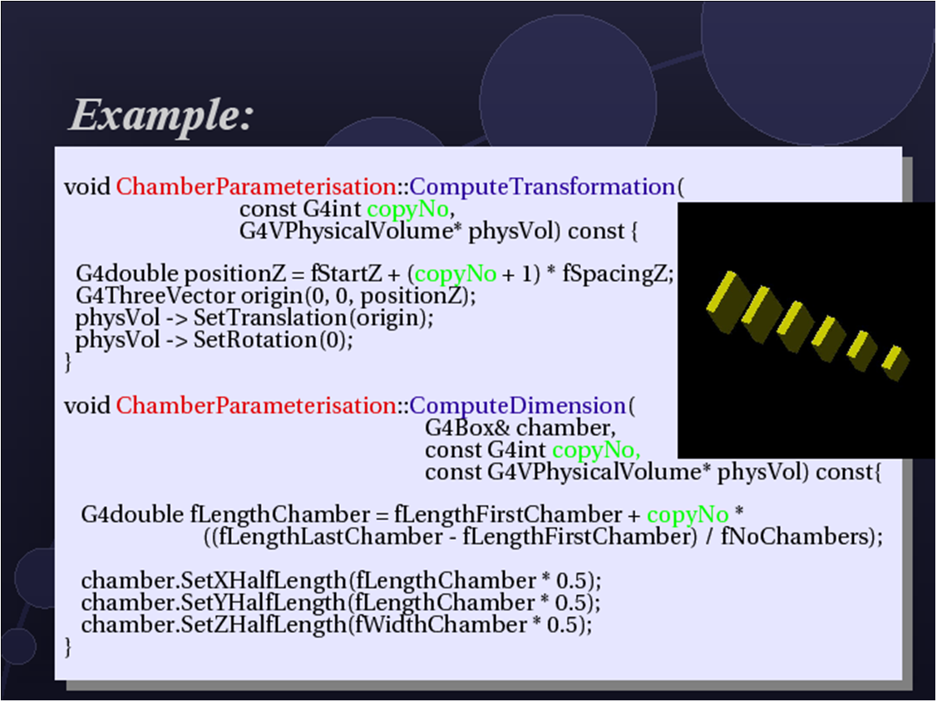
Parameterisation example - 1
  G4VSolid* solidChamber = new G4Box("chamber", 100*cm, 100*cm, 10*cm);
  G4LogicalVolume* logicChamber =
  new G4LogicalVolume(solidChamber, ChamberMater, "Chamber", 0, 0, 0);
  G4double firstPosition = -trackerSize + 0.5*ChamberWidth;
  G4double firstLength = fTrackerLength/10;
  G4double lastLength = fTrackerLength;
  G4VPVParameterisation* chamberParam =
  new ChamberParameterisation( NbOfChambers, firstPosition,
  ChamberSpacing, ChamberWidth,
  firstLength, lastLength);
  G4VPhysicalVolume* physChamber =
  new G4PVParameterised( "Chamber", logicChamber, logicTracker,
  kZAxis, NbOfChambers, chamberParam);
Use kUndefined for activating 3D voxelisation for optimisation
Detector Description: Basics - Geant4 Course
Notes:
Geant4: Detector description module
Example of parameterisation along the Z axis (kZAxis)
NbOfChambers - Number of chambers
firstPosition - Z of center of first chamber
ChamberSpacing - Z spacing of centers
ChamberWidth - Width of chamber
firstLength - initial length
lastLength - final length

Slide 8
Parameterisation example - 2
  class ChamberParameterisation : public G4VPVParameterisation
  {
  public:
  ChamberParameterisation( G4int NoChambers, G4double startZ,
  G4double spacing, G4double widthChamber,
  G4double lenInitial, G4double lenFinal );
  ~ChamberParameterisation();
  void ComputeTransformation (const G4int copyNo,
  G4VPhysicalVolume* physVol) const;
  void ComputeDimensions (G4Box& trackerLayer, const G4int copyNo,
  const G4VPhysicalVolume* physVol) const;
  }
Detector Description: Basics - Geant4 Course
Notes:
Geant4: Detector description module
Example of parameterisation along the Z axis (kZAxis)

Slide 9
Parameterisation example - 3
  void ChamberParameterisation::ComputeTransformation
  (const G4int copyNo, G4VPhysicalVolume* physVol) const
  {
  G4double Zposition= fStartZ + (copyNo+1) * fSpacing;
  G4ThreeVector origin(0, 0, Zposition);
  physVol->SetTranslation(origin);
  physVol->SetRotation(0);
  }
  void ChamberParameterisation::ComputeDimensions
  (G4Box& trackerChamber, const G4int copyNo,
  const G4VPhysicalVolume* physVol) const
  {
  G4double halfLength= fHalfLengthFirst + copyNo * fHalfLengthIncr;
  trackerChamber.SetXHalfLength(halfLength);
  trackerChamber.SetYHalfLength(halfLength);
  trackerChamber.SetZHalfLength(fHalfWidth);
  }
Detector Description: Basics - Geant4 Course
Notes:
Geant4: Detector description module
Example of parameterisation along the Z axis (kZAxis)

Slide 10
Replicated Physical Volumes
The mother volume is sliced into replicas, all of the same size and dimensions.
Represents many touchable detector elements differing only in their positioning.
Replication may occur along:
  Cartesian axes (X, Y, Z) – slices are considered perpendicular to the axis of replication
    Coordinate system at the center of each replica
  Radial axis (Rho) – cons/tubs sections centered on the origin and un-rotated
    Coordinate system same as the mother
  Phi axis (Phi) – phi sections or wedges, of cons/tubs form
    Coordinate system rotated such as that the X axis bisects the angle made by each wedge
repeated
Detector Description: Basics - Geant4 Course
Notes:
Geant4: Detector description module
The elements positions are calculated by means of a simple linear formula, and the elements completely fill the containing mother volume.
If a G4PVReplica is positioned inside a given mother, it must be the only daughter volume for that mother.
During tracking, translation and rotation of each replica object are computed according to the current active replication.

Slide 11
G4PVReplica
a daughter logical volume to be replicated
G4PVReplica(const G4String& pName,
G4LogicalVolume* pCurrentLogical,
G4LogicalVolume* pMotherLogical,
const EAxis pAxis,
const G4int nReplicas,
const G4double width,
const G4double offset=0);
Alternative constructor:
  Using pointer to physical volume for the mother
An offset can be associated
  Only to a mother offset along the axis of replication
Features and restrictions:
  Replicas can be placed inside other replicas
  Normal placement volumes can be placed inside replicas, assuming no intersection or overlaps with the mother volume or with other replicas
  No volume can be placed inside a radial replication
  Parameterised volumes cannot be placed inside a replica
mother volume
Detector Description: Basics - Geant4 Course
Notes:
Geant4: Detector description module
The width of the replica refers to its extent along the axis of replication.

Slide 12
Replica – axis, width, offset
Cartesian axes - kXaxis, kYaxis, kZaxis
  offset shall not be used
  Center of n-th daughter is given as
    -width*(nReplicas-1)*0.5+n*width
Radial axis - kRaxis
  Center of n-th daughter is given as
    width*(n+0.5)+offset
Phi axis - kPhi
  Center of n-th daughter is given as
    width*(n+0.5)+offset
width
width
offset
width
offset
Detector Description: Basics - Geant4 Course

Slide 13
Replication example
G4double tube_dPhi = 2.* M_PI * rad;
G4VSolid* tube =
new G4Tubs("tube",20*cm,50*cm,30*cm,0.,tube_dPhi);
G4LogicalVolume * tube_log =
new G4LogicalVolume(tube, Air, "tubeL", 0, 0, 0);
G4VPhysicalVolume* tube_phys =
new G4PVPlacement(0,G4ThreeVector(-200.*cm,0.,0.),
"tubeP", tube_log, world_phys, false, 0);
G4double divided_tube_dPhi = tube_dPhi/6.;
G4VSolid* div_tube =
new G4Tubs("div_tube", 20*cm, 50*cm, 30*cm,
-divided_tube_dPhi/2., divided_tube_dPhi);
G4LogicalVolume* div_tube_log =
new G4LogicalVolume(div_tube,Pb,"div_tubeL",0,0,0);
G4VPhysicalVolume* div_tube_phys =
new G4PVReplica("div_tube_phys", div_tube_log,
tube_log, kPhi, 6, divided_tube_dPhi);
Detector Description: Basics - Geant4 Course
Notes:
Example of replication in Phi

Slide 14
Divided Physical Volumes
Implemented as “special” kind of parameterised volumes
  Applies to CSG-like solids only (box, tubs, cons, para, trd, polycone, polyhedra)
  Divides a volume in identical copies along one of its axis (copies are not strictly identical)
    e.g. - a tube divided along its radial axis
    Offsets can be specified
The possible axes of division vary according to the supported solid type
Represents many touchable detector elements differing only in their positioning
G4PVDivision is the class defining the division
  The parameterisation is calculated automatically using the values provided in input
Detector Description: Basics - Geant4 Course
Notes:
Geant4: Detector description module

Slide 15
Divided Volumes - 2
G4PVDivision is a special kind of parameterised volume
  The parameterisation is automatically generated according to the parameters given in G4PVDivision.
Divided volumes are similar to replicas but …
  Allowing for gaps in between mother and daughter volumes
    Planning to allow also gaps between daughters and gaps on side walls
Shape of all daughter volumes must be same shape as the mother volume
  Solid (to be assigned to the daughter logical volume) must be the same type, but different object.
Replication must be aligned along one axis
If no gaps in the geometry, G4PVReplica is recommended
  For identical geometry, navigation in pure replicas is faster
mother volume
Detector Description: Basics - Geant4 Course

Slide 16
Divided Volumes - 3
G4PVDivision(const G4String& pName,
G4LogicalVolume* pDaughterLogical,
G4LogicalVolume* pMotherLogical,
const EAxis pAxis,
const G4int nDivisions, // number of division is given
const G4double offset);
The size (width) of the daughter volume is calculated as
  ( (size of mother) - offset ) / nDivisions
nDivisions
offset
Detector Description: Basics - Geant4 Course

Slide 17
Divided Volumes - 4
G4PVDivision(const G4String& pName,
G4LogicalVolume* pDaughterLogical,
G4LogicalVolume* pMotherLogical,
const EAxis pAxis,
const G4double width, // width of daughter volume is given
const G4double offset);
The number of daughter volumes is calculated as
  int( ( (size of mother) - offset ) / width )
As many daughters as width and offset allow
width
offset
Detector Description: Basics - Geant4 Course

Slide 18
Divided Volumes - 5
G4PVDivision(const G4String& pName,
G4LogicalVolume* pDaughterLogical,
G4LogicalVolume* pMotherLogical,
const EAxis pAxis,
const G4int nDivisions, // both number of divisions
const G4double width, // and width are given
const G4double offset);
nDivisions daughters of width thickness
nDivisions
width
offset
Detector Description: Basics - Geant4 Course

Slide 19
Divided Volumes - 6
Divisions are allowed for the following shapes / axes:
  G4Box : kXAxis, kYAxis, kZAxis
  G4Tubs : kRho, kPhi, kZAxis
  G4Cons : kRho, kPhi, kZAxis
  G4Trd : kXAxis, kYAxis, kZAxis
  G4Para : kXAxis, kYAxis, kZAxis
  G4Polycone : kRho, kPhi, kZAxis
  G4Polyhedra : kRho, kPhi, kZAxis
    kPhi - the number of divisions has to be the same as solid sides, (i.e. numSides), the width will not be taken into account
In the case of division along kRho of G4Cons, G4Polycone, G4Polyhedra, if width is provided, it is taken as the width at the -Z radius; the width at other radii will be scaled to this one
Detector Description: Basics - Geant4 Course

Slide 20
GDML
Importing and exporting detector descriptions

Slide 21
GDML components
user application (1)
GDML (Geometry Description Markup Language) is defined through XML Schema (XSD)
  XSD = XML based alternative to Document Type Definition (DTD)
  defines document structure and the list of legal elements
  XSD are in XML -> they are extensible
GDML can be written by hand or generated automatically in Geant4
  'GDML writer' allows exporting a GDML file
GDML needs a “reader”, integrated in Geant4
  'GDML reader' imports and creates 'in-memory' the representation of the geometry description
Geant4
GDML writer
GDML
Schema
GDML file
GDML reader
user application (2)
Detector Description: Advanced Features - Geant4 Course

Slide 22
GDML – Geant4 binding
XML schema available from http://cern.ch/gdml
  Also available within Geant4 distribution
    See in geant4/source/persistency/gdml/schema/
  Latest schema release GDML_3_0_0 (as from 9.2 release)
Requires XercesC++ XML parser
  Available from: http://xerces.apache.org/xerces-c
  Tested with versions 2.8.0 and 3.0.1
Optional package to be linked against during build
  G4LIB_BUILD_GDML and XERCESCROOT variables
  Examples available: geant4/examples/extended/persistency/gdml
Detector Description: Advanced Features - Geant4 Course

Slide 23
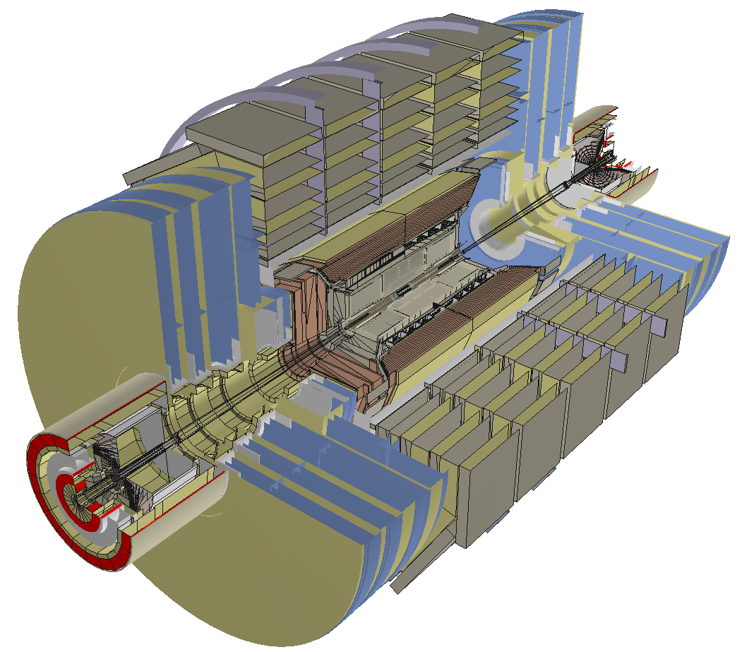
CMS detector through GDML
~19000 physical volumes
Geant4 CMS geometry imported in Root through GDML
Detector Description: Advanced Features - Geant4 Course

Slide 24
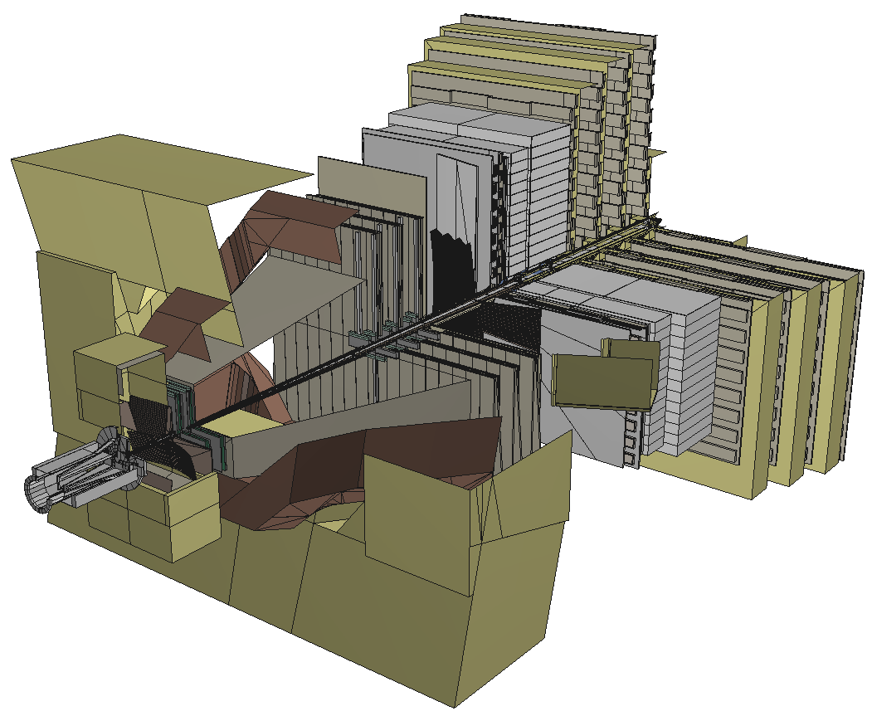
LHCb detector through GDML
~5000 physical volumes
Geant4 LHCb geometry imported in Root through GDML
Detector Description: Advanced Features - Geant4 Course

Slide 25
Using GDML in Geant4
to write:
#include "G4GDMLParser.hh"
G4GDMLParser parser;
parser.Write(“g4test.gdml”, pWorld, true, “path_to_schema/gdml.xsd”);
to read:
parser.Read( “g4test.gdml”, true );
pWorld = GDMLProcessor::GetInstance()->GetWorldVolume();
instantiate GDML parser
Concatenate or not pointers to entity names
pass the 'top' volume to the writer
Activate or de-activativate schema validation
get pointer to 'top' world volume
Detector Description: Advanced Features - Geant4 Course

Slide 26
Using GDML in Geant4 - 2
Any geometry tree can be dumped to file
  … just provide its physical volume pointer (pVol):
  parser.Write(“g4test.gdml”, pVol);
A geometry setup can be split in modules
  … starting from a geometry tree specified by a physical volume:
  parser.AddModule(pVol);
  … indicating the depth from which starting to modularize:
  parser.AddModule(depth);
Provides facility for importing CAD geometries generated through STEP-Tools
Allows for easy extensions of the GDML schema and treatment of auxiliary information associated to volumes
Full coverage of materials, solids, volumes and simple language constructs (variables, loops, etc…)
Detector Description: Advanced Features - Geant4 Course

Slide 27
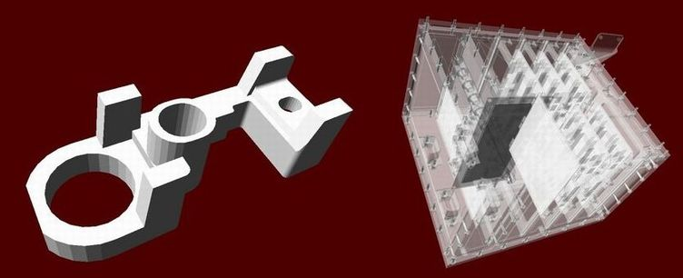
Importing CAD geometries with GDML
CAD geometries generated through STEP-Tools (stFile.geom, stFile.tree files) can be imported through the GDML reader:
  parser.ParseST(“stFile”, WorldMaterial, GeomMaterial);
  Example provided in examples/extended/persistency/gdml/G02
Tools like FastRad allow for importing CAD STEP files and directly convert to GDML
Detector Description: Advanced Features - Geant4 Course

Slide 28
GDML processing performance
GDML reader/writer tested on
  complete LHCb and CMS geometries
  parts of ATLAS geometry
    full ATLAS geometry includes custom solids
for LHCb geometry (~5000 logical volumes)
  writing out ~10 seconds (on P4 2.4GHz)
  reading in ~ 5 seconds
  file size ~2.7 Mb (~40k lines)
for CMS geometry (~19000 logical volumes)
  writing out ~30 seconds
  reading in ~15 seconds
  file size ~7.9 Mb (~120k lines)
Detector Description: Advanced Features - Geant4 Course

Slide 29
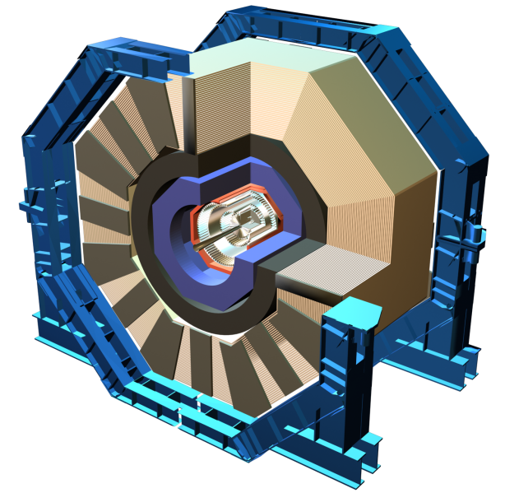
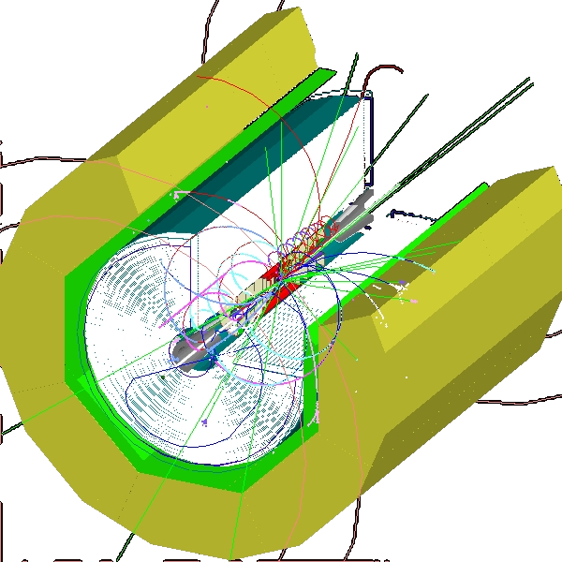
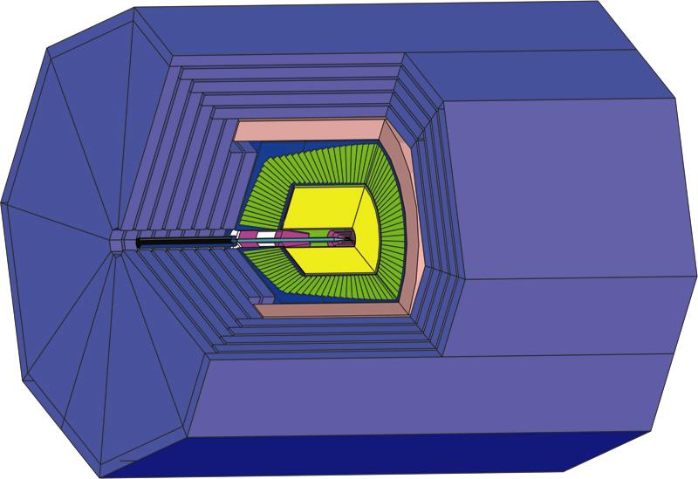
GDML as primary geometry source
Linear Collider
  Linear Collider Detector Description (LCDD) extends GDML with Geant4-specific information (sensitive detectors, physics cuts, etc)
  GDML/LCDD is generic and flexible
    several different full detector design concepts, including SiD, GLD, and LDC, where simulated using the same application
SiD
LDC
GLD
Detector Description: Advanced Features - Geant4 Course

Slide 30
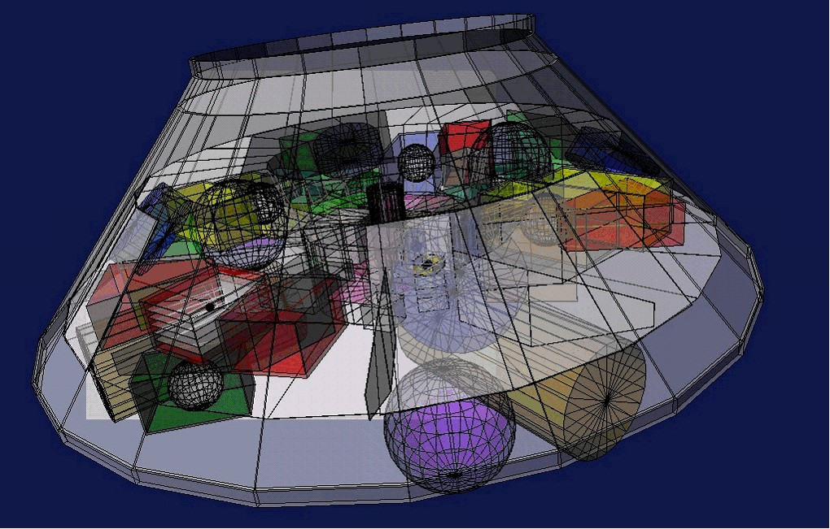
GDML as primary geometry source - 2
Space Research @ ESA
  Geant4 geometry models
    component degradation studies (JWST, ConeXpress,...)
    GRAS (Geant4 Radiation Analysis for Space)
  enables flexible geometry configuration and changes
  main candidate for CAD to Geant4 exchange format
ConeXpress
Detector Description: Advanced Features - Geant4 Course

Slide 31
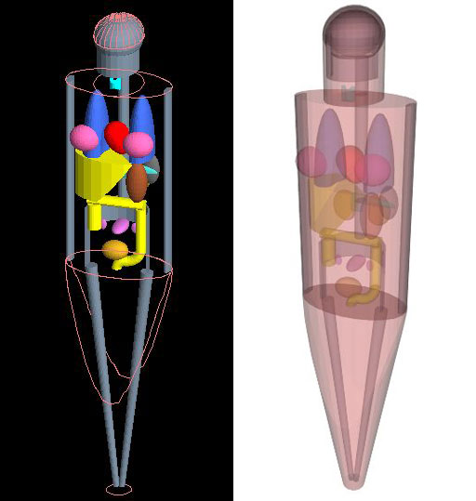
GDML as primary geometry source - 3
Anthropomorphic Phantom
  Modeling of the human body and anatomy for radioprotection studies
  no hard-coded geometry, flexible configuration
Detector Description: Advanced Features - Geant4 Course

Slide 32
Exercise 1c
GDML

