Slide 1

Detector Description: Basics
http://cern.ch/geant4
Notes:
Geant4: Detector description module

Slide 2
Detector Description: tools
PART IV
How to identify a volume in the hierarchy
Optimisation techniques
Debugging tools
Notes:
Geant4: Detector description module

Slide 3
Identifying a volume
Touchables

Slide 4
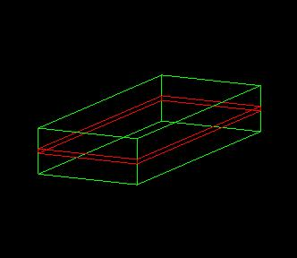
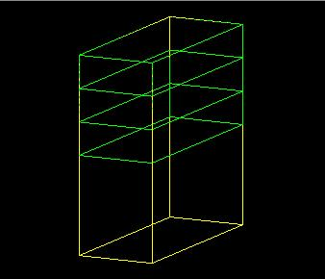
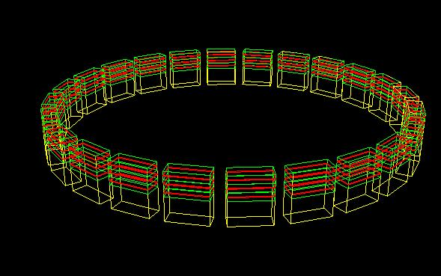
How to identify a volume in a unique way?
Suppose a geometry is made of sensitive layers C which are placed in a volume B
Volume B is a daughter volume of a divided volume A
B
C
B
A
Volume A has 24 positions in the world
While in the 'logical' geometry tree volume C is represented by just one physical volume, in the real world there are many C 'volumes'
How can we then identify these volumes C ?
Detector Description: Basics - Geant4 Course
Notes:
Geant4: Detector description module
10/21/08
Geant4: Detector description module
10/21/08
Geant4: Detector description module
10/21/08
Geant4: Detector description module
A physical volume can represent many actual volumes in a detector, due to:
replica, parameterisation
repetition of mother logical volume in different places in the hierarchy
To identify a volume uniquely, we must ‘anchor’ it to create a touchable.
A touchable may have information on all levels of the hierarchy, from the world volume to the current physical volume.

Slide 5
Basics of Touchables
B.1
A touchable for a volume serves the purpose of providing a unique identification for a detector element
It is a geometrical entity (volume or solid) which has a unique placement in a detector description
  It can be uniquely identified by providing the copy numbers for all daughters in the geometry hierarchy
  In our case these are
    CopyNo of C in B: 1
    CopyNo of B in A: 1,2,3
    CopyNo of A in the world: 1, .., 24
  Example of touchable identification:
    A.3/B.2/C.1
B.2
B.3
C.1
A.1
A.2
A.3
...
A.4
Detector Description: Basics - Geant4 Course
Notes:
Geant4: Detector description module
10/21/08
Geant4: Detector description module
10/21/08
Geant4: Detector description module
10/21/08
Geant4: Detector description module

Slide 6
Copy numbers
Suppose a calorimeter is made of 4x5 cells
  and is implemented by two levels of replica
In reality, there is only one physical volume object for each level. Its position is parameterized by its copy number
How to get the copy number of each level, when a step belongs to two cells ?
CopyNo = 0
0
1
2
3
4
CopyNo = 1
0
1
2
3
4
CopyNo = 2
0
1
2
3
4
CopyNo = 3
0
1
2
3
4
  Remember: geometrical information in G4Track is identical to "PostStepPoint". You cannot get the correct copy number for "PreStepPoint" if you directly access to the physical volume
Use touchable to get the proper copy number, transformation matrix,…
Detector Description: Basics - Geant4 Course

Slide 7
What a touchable provides ?
G4VTouchable - a base class for all touchable implementations – defines the following 'requests' (methods) which all touchable have to respond, where depth means always the number of levels up in the tree to be considered:
  depth = 0 : the bottom level (volume C in B)‏
  depth = 1 : the level of its mother volume (volume B in A)‏
  depth = 2 : the grandmother volume (volume A in world)‏
GetCopyNumber(G4int depth =0)
  returns the copy number of the given level
GetTranslation(G4int depth = 0); GetRotation(G4int depth=0)‏
  return the components of the volume's transformation
GetSolid(G4int depth =0)‏
  returns the solid
GetVolume(G4int depth =0)‏
  returns the physical volume
Detector Description: Basics - Geant4 Course
Notes:
Geant4: Detector description module
10/21/08
Geant4: Detector description module
10/21/08
Geant4: Detector description module
10/21/08
Geant4: Detector description module
MoveUpHistory(num) moves the current pointer of the touchable to point “num” levels up in the history tree.
Therefore, num=1 means moving to point to the mother of the current volume.
The state of the touchable is changed by calling this method.

Slide 8
Benefits of Touchables in track
Full geometrical information available
  to processes, to sensitive detectors, to hits
All the geometrical information of the particular step should be taken from “PreStepPoint”
  Available in G4TouchableHistory object
    Copy-number, transformations
  Accessible via Handles (or smart-pointers) to touchables
  Note: the geometrical information associated with G4Track is basically the same as “PostStepPoint”
A1
A2
Detector Description: Basics - Geant4 Course
Notes:
Geant4: Detector description module
10/21/08
Geant4: Detector description module
10/21/08
Geant4: Detector description module
10/21/08
Geant4: Detector description module

Slide 9
Touchable & Steps
G4Step has two G4StepPoint objects as its starting and ending points. All the geometrical information of the particular step should be got from “PreStepPoint”
  Geometrical information associated with G4Track is basically same as “PostStepPoint”
Each G4StepPoint object provides:
  position in world coordinate system
  global and local time
  Material
  Associated G4TouchableHistory
    Touchable to be used for geometrical information
    Copy-number, transformations
Handles (or smart-pointers) to touchables are intrinsically used. Touchables are reference counted
Detector Description: Basics - Geant4 Course
Notes:
Geant4: Detector description module
Since release 4.0 touchables are reference counted.
the lifetime of a single touchable object is assured for the whole lifetime of the application
memory management of the created touchables is performed in an automatic way

Slide 10
How to use Touchables …
G4TouchableHistory has information of the geometrical hierarchy at the point
  G4Step* aStep = ..;
  G4StepPoint* preStepPoint = aStep->GetPreStepPoint();
  G4TouchableHandle theTouchable =
  preStepPoint->GetTouchableHandle();
  G4int copyNo = theTouchable->GetReplicaNumber();
  G4int motherCopyNo = theTouchable->GetReplicaNumber(1);
  G4ThreeVector worldPos = preStepPoint->GetPosition();
  G4ThreeVector localPos = theTouchable->GetHistory()->
  GetTopTransform().TransformPoint(worldPos);
Detector Description: Basics - Geant4 Course
Notes:
Geant4: Detector description module
In the example code, it is shown how to use touchables for:
Retrieve the copy number of the current volume
Retrieve the copy number of the mother volume
Retrieve the absolute position in global world coordinates
Transform the position to local coordinates

Slide 11
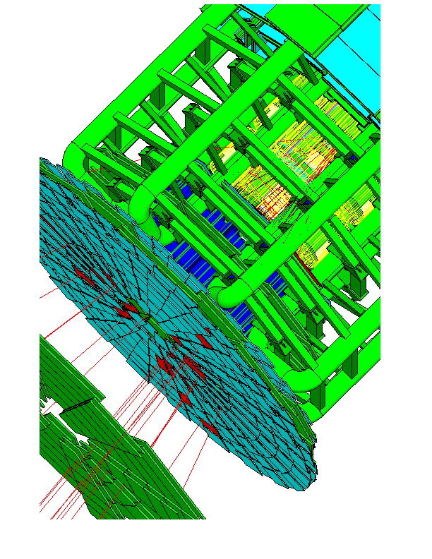
Optimisation Techniques
Smart voxels
Notes:
Geant4: Detector description module
10/21/08
Geant4: Detector description module
10/21/08
Geant4: Detector description module
10/21/08

Slide 12
Smart voxels
For each mother volume
  a one-dimensional virtual division is performed
    the virtual division is along a chosen axis
    the axis is chosen by using an heuristic
  Subdivisions (slices) containing same volumes are gathered into one
  Subdivisions containing many volumes are refined
    applying a virtual division again using a second Cartesian axis
    the third axis can be used for a further refinement, in case
Smart voxels are computed at initialisation time
  When the detector geometry is closed
  Do not require large memory or computing resources
  At tracking time, searching is done in a hierarchy of virtual divisions
Detector Description: Visualization, optimisation & debugging - Geant4 Course
Notes:
Geant4: Detector description module
Time needed to tune the detector description is much reduced

Slide 13
Detector description tuning
Some geometry topologies may require ‘special’ tuning for ideal and efficient optimisation
  for example: a dense nucleus of volumes included in very large mother volume
Granularity of voxelisation can be explicitly set
  Methods Set/GetSmartless() from G4LogicalVolume
Critical regions for optimisation can be detected
  Helper class G4SmartVoxelStat for monitoring time spent in detector geometry optimisation
    Automatically activated if /run/verbose greater than 1
Percent Memory Heads Nodes Pointers Total CPU Volume
------- ------ ----- ----- -------- --------- -----------
91.70 1k 1 50 50 0.00 Calorimeter
8.30 0k 1 3 4 0.00 Layer
Detector Description: Visualization, optimisation & debugging - Geant4 Course
Notes:
Geant4: Detector description module

Slide 14
Visualising voxel structure
The computed voxel structure can be visualized with the final detector geometry
  Helper class G4DrawVoxels
  Visualize voxels given a logical volume
    G4DrawVoxels::DrawVoxels(const G4LogicalVolume*)
  Allows setting of visualization attributes for voxels
    G4DrawVoxels::SetVoxelsVisAttributes(…)
  useful for debugging purposes
  Can also be done through a visualization command at run-time:
    /vis/scene/add/logicalVolume <logical-volume-name> [<depth>]
Detector Description: Visualization, optimisation & debugging - Geant4 Course
Notes:
Geant4: Detector description module

Slide 15
Customising optimisation
Detector regions may be excluded from optimisation (ex. for debug purposes)
  Optional argument in constructor of G4LogicalVolume or through provided set methods
    SetOptimisation/IsToOptimise()
  Optimisation is turned on by default
Optimisation for parameterised volumes can be chosen
  Along one single Cartesian axis
    Specifying the axis in the constructor for G4PVParameterised
  Using 3D voxelisation along the 3 Cartesian axes
    Specifying in kUndefined in the constructor for G4PVParameterised
Detector Description: Visualization, optimisation & debugging - Geant4 Course
Notes:
Geant4: Detector description module

Slide 16
Debugging geometries
Debugging tools
Optional checks at Construction
DAVID
Run-time commands
OLAP
Notes:
Geant4: Detector description module
10/21/08
Geant4: Detector description module
10/21/08
Geant4: Detector description module
10/21/08

Slide 17
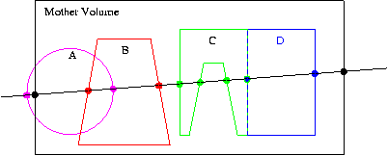
Debugging
geometries
protruding
overlapping
An overlapping volume is a contained volume which actually protrudes from its mother volume
  Volumes are also often positioned in a same volume with the intent of not provoking intersections between themselves. When volumes in a common mother actually intersect themselves are defined as overlapping
Geant4 does not allow for malformed geometries
The problem of detecting overlaps between volumes is bounded by the complexity of the solid models description
Utilities are provided for detecting wrong positioning
  Graphical tools
  Kernel run-time commands
Detector Description: Visualization, optimisation & debugging - Geant4 Course
Notes:
Geant4: Detector description module
10/21/08
Geant4: Detector description module
10/21/08
Geant4: Detector description module
10/21/08
Geant4: Detector description module

Slide 18
Debugging tools:
Overlapping check at Construction
Constructors of G4PVPlacement and G4PVParameterised have an optional argument pSurfChk:
  G4PVPlacement(G4RotationMatrix* pRot, …, G4bool pSurfChk=false);
If this flag is true, overlap check is done at construction
  A number of points (1000 by default) are randomly sampled on the surface of the volume being created
  Each of these points are examined
    if outside of the mother volume, or
    if inside of already existing other volumes in the same mother volume
  NOTE: this check may requires lots of CPU time
    Depending on the complexity of geometry
  Can also be forced on a specific physical volume though the method:
    G4bool CheckOverlaps(G4int points=1000, G4double tol=0, G4bool verbose=true);
Worth to try when first implementing a geometry of some complexity !
Detector Description: Visualization, optimisation & debugging - Geant4 Course
Notes:
Geant4: Detector description module
10/21/08

Slide 19
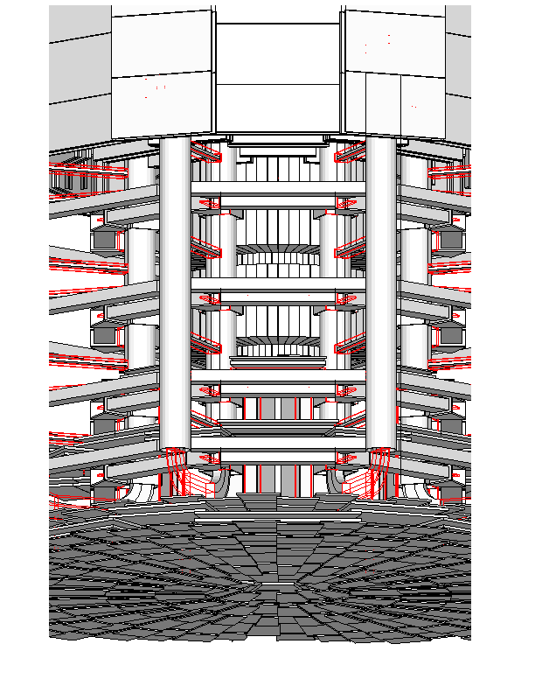
Debugging tools: DAVID
DAVID is a graphical debugging tool for detecting potential intersections of volumes
Accuracy of the graphical representation can be tuned to the exact geometrical description.
  physical-volume surfaces are automatically decomposed into 3D polygons
  intersections of the generated polygons are parsed.
  If a polygon intersects with another one, the physical volumes associated to these polygons are highlighted in color (red is the default).
DAVID can be downloaded from the Web as external tool for Geant4
  http://geant4.kek.jp/GEANT4/vis/DAWN/About_DAVID.html
Detector Description: Visualization, optimisation & debugging - Geant4 Course
Notes:
Geant4: Detector description module
10/21/08
Geant4: Detector description module
10/21/08
Geant4: Detector description module
10/21/08
Geant4: Detector description module

Slide 20
Debugging run-time commands
Built-in run-time commands to activate verification tests for the user geometry. Tests can be applied recursively to all depth levels (may require CPU time!): [recursion_flag]
geometry/test/run [recursion_flag] or
geometry/test/grid_test [recursion_flag]
to start verification of geometry for overlapping regions based on a standard grid setup
geometry/test/cylinder_test [recursion_flag]
shoots lines according to a cylindrical pattern
geometry/test/line_test [recursion_flag]
to shoot a line along a specified direction and position
geometry/test/position and geometry/test/direction
to specify position & direction for the line_test
Resolution/dimensions of grid/cylinders can be tuned
Detector Description: Visualization, optimisation & debugging - Geant4 Course
Notes:
Geant4: Detector description module
10/21/08
Geant4: Detector description module
10/21/08
Geant4: Detector description module
10/21/08
Geant4: Detector description module
To avoid spurious errors caused by round off, a tolerance of 0.1 micron is used by default.
The tolerance can be adjusted as needed by the application through the run-time command:
geometry/test/tolerance <new-value>

Slide 21
Debugging run-time commands - 2
Example layout:
GeomTest: no daughter volume extending outside mother detected.
GeomTest Error: Overlapping daughter volumes
The volumes Tracker[0] and Overlap[0],
both daughters of volume World[0],
appear to overlap at the following points in global coordinates: (list truncated)‏
length (cm) ----- start position (cm) ----- ----- end position (cm) -----
240 -240 -145.5 -145.5 0 -145.5 -145.5
Which in the mother coordinate system are:
length (cm) ----- start position (cm) ----- ----- end position (cm) -----
. . .
Which in the coordinate system of Tracker[0] are:
length (cm) ----- start position (cm) ----- ----- end position (cm) -----
. . .
Which in the coordinate system of Overlap[0] are:
length (cm) ----- start position (cm) ----- ----- end position (cm) -----
. . .
Detector Description: Visualization, optimisation & debugging - Geant4 Course
Notes:
Geant4: Detector description module
10/21/08
Geant4: Detector description module
10/21/08
Geant4: Detector description module
10/21/08
Geant4: Detector description module

Slide 22
Debugging tools: OLAP
Adopt tracking of neutral particles to verify boundary crossing in opposite directions
Stand-alone batch application
  Provided as extended example
  Can be combined with a graphical environment and GUI
    ex. Qt library
  Integrated in the CMS Iguana Framework
Detector Description: Visualization, optimisation & debugging - Geant4 Course
Notes:
Geant4: Detector description module
10/21/08
Geant4: Detector description module
10/21/08
Geant4: Detector description module
10/21/08
Geant4: Detector description module

Slide 23
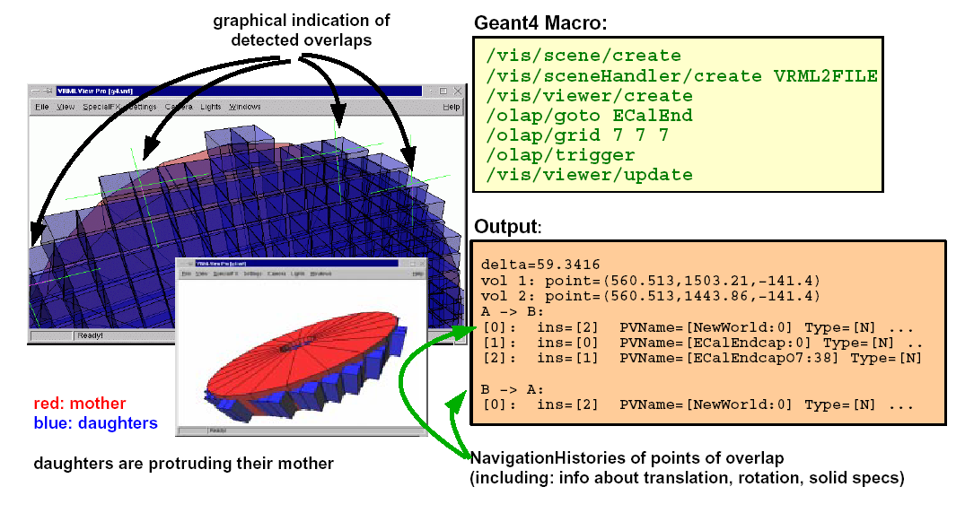
Debugging tools: OLAP
Detector Description: Visualization, optimisation & debugging - Geant4 Course
Notes:
Geant4: Detector description module
10/21/08
Geant4: Detector description module
10/21/08
Geant4: Detector description module
10/21/08
Geant4: Detector description module

