Slide 1

Detector Description: Advanced Features
http://cern.ch/geant4
Notes:
Geant4: Detector description module

Slide 2
Detector Description
Advanced features
PART V
Grouping volumes
Reflections of volumes and hierarchies
Nested parameterisations
Navigation in regular structures
Detector regions
User defined solids
Notes:
Geant4: Detector description module

Slide 3
Grouping volumes
To represent a regular pattern of positioned volumes, composing a more or less complex structure
  structures which are hard to describe with simple replicas or parameterised volumes
  structures which may consist of different shapes
Assembly volume
  acts as an envelope for its daughter volumes
  its role is over once its logical volume has been placed
  daughter physical volumes become independent copies in the final structure
Detector Description: Advanced Features - Geant4 Course
Notes:
Geant4: Detector description module

Slide 4
G4AssemblyVolume
G4AssemblyVolume( G4LogicalVolume* volume,
G4ThreeVector& translation,
G4RotationMatrix* rotation);
Helper class to combine logical volumes in arbitrary way
  Participating logical volumes are treated as triplets
    logical volume, translation, rotation
  Imprints of the assembly volume are made inside a mother logical volume through G4AssemblyVolume::MakeImprint(…)
  Each physical volume name is generated automatically
    Format: av_WWW_impr_XXX_YYY_ZZZ
      WWW – assembly volume instance number
      XXX – assembly volume imprint number
      YYY – name of the placed logical volume in the assembly
      ZZZ – index of the associated logical volume
  Generated physical volumes (and related transformations) are automatically managed (creation and destruction)
Detector Description: Advanced Features - Geant4 Course
Notes:
Geant4: Detector description module
Be careful in the usage of G4AssemblyVolume.
Unnecessary or incorrect use of it can lead to ‘proliferation’ of many volumes all placed in the same mother.
Generated volume names and count-base can also be defined by the user.

Slide 5
Assembly of volumes: example -1
// Define a plate
G4VSolid* PlateBox = new G4Box( "PlateBox", plateX/2., plateY/2., plateZ/2. );
G4LogicalVolume* plateLV = new G4LogicalVolume( PlateBox, Pb, "PlateLV", 0, 0, 0 );
// Define one layer as one assembly volume
G4AssemblyVolume* assemblyDetector = new G4AssemblyVolume();
// Rotation and translation of a plate inside the assembly
G4RotationMatrix Ra; G4ThreeVector Ta;
// Rotation of the assembly inside the world
G4RotationMatrix Rm;
// Fill the assembly by the plates
Ta.setX( caloX/4. ); Ta.setY( caloY/4. ); Ta.setZ( 0. );
assemblyDetector->AddPlacedVolume( plateLV, G4Transform3D(Ra,Ta) );
Ta.setX( -1*caloX/4. ); Ta.setY( caloY/4. ); Ta.setZ( 0. );
assemblyDetector->AddPlacedVolume( plateLV, G4Transform3D(Ra,Ta) );
Ta.setX( -1*caloX/4. ); Ta.setY( -1*caloY/4. ); Ta.setZ( 0. );
assemblyDetector->AddPlacedVolume( plateLV, G4Transform3D(Ra,Ta) );
Ta.setX( caloX/4. ); Ta.setY( -1*caloY/4. ); Ta.setZ( 0. );
assemblyDetector->AddPlacedVolume( plateLV, G4Transform3D(Ra,Ta) );
// Now instantiate the layers
for( unsigned int i = 0; i < layers; i++ ) {
// Translation of the assembly inside the world
G4ThreeVector Tm( 0,0,i*(caloZ + caloCaloOffset) - firstCaloPos );
assemblyDetector->MakeImprint( worldLV, G4Transform3D(Rm,Tm) );
}
Detector Description: Advanced Features - Geant4 Course
Notes:
Geant4: Detector description module

Slide 6
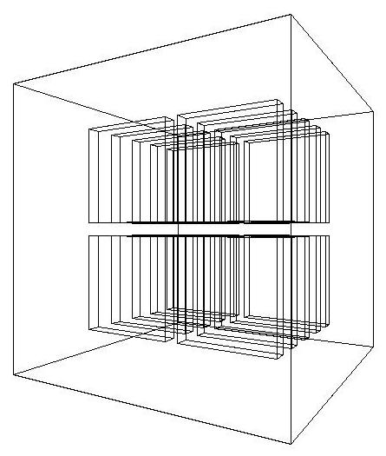
Assembly of volumes: example -2
Detector Description: Advanced Features - Geant4 Course
Notes:
Geant4: Detector description module

Slide 7
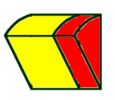
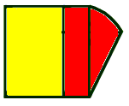
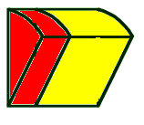
Reflecting volumes
Let's take an example of a pair of mirror symmetric volumes
Such geometry cannot be made by parallel transformation
or 180 degree rotation
G4ReflectedSolid
  utility class representing a solid shifted from its original reference frame to a new symmetric one
  the reflection (G4Reflect[X/Y/Z]3D) is applied as a decomposition into rotation and translation
G4ReflectionFactory
  Singleton object using G4ReflectedSolid for generating placements of reflected volumes
  Provides tools to detect/return a reflected volume
Reflections can be applied to CSG and specific solids
Detector Description: Advanced Features - Geant4 Course

Slide 8
Reflecting hierarchies of volumes - 1
G4ReflectionFactory::Place(…)‏
  Used for normal placements:
    Performs the transformation decomposition
    Generates a new reflected solid and logical volume
      Retrieves it from a map if the reflected object is already created
    Transforms any daughter and places them in the given mother
    Returns a pair of physical volumes, the second being a placement in the reflected mother
G4PhysicalVolumesPair
Place(const G4Transform3D& transform3D, // the transformation
const G4String& name, // the actual name
G4LogicalVolume* LV, // the logical volume
G4LogicalVolume* motherLV, // the mother volume
G4bool noBool, // currently unused
G4int copyNo) // optional copy number
Detector Description: Advanced Features - Geant4 Course
Notes:
Geant4: Detector description module
10/21/08
Geant4: Detector description module
10/21/08
Geant4: Detector description module
10/21/08
Geant4: Detector description module

Slide 9
Reflecting hierarchies of volumes - 2
G4ReflectionFactory::Replicate(…)‏
  Creates replicas in the given mother volume
  Returns a pair of physical volumes, the second being a replica in the reflected mother
G4PhysicalVolumesPair
Replicate(const G4String& name, // the actual name
G4LogicalVolume* LV, // the logical volume
G4LogicalVolume* motherLV, // the mother volume
Eaxis axis // axis of replication
G4int replicaNo // number of replicas
G4int width, // width of single replica
G4int offset=0) // optional mother offset
Detector Description: Advanced Features - Geant4 Course
Notes:
Geant4: Detector description module
10/21/08
Geant4: Detector description module
10/21/08
Geant4: Detector description module
10/21/08
Geant4: Detector description module

Slide 10
Advanced Parameterisations
Nested parameterisations

Slide 11
3D Parameterised Volumes
Typical use-case: geometry with three-dimensional repetition of same shape and size of volumes without gap between them
  Materials of such volumes are changing according to position
    E.g. voxels made by CT Scan data (DICOM)
Solution: instead of direct 3D parameterised volume…
  Use replicas for 1st and 2nd axes sequentially, and then use one-dimensional parameterisation along the 3rd axis !
Less memory for geometry optimisation and faster navigation for many voxels

Slide 12
G4VNestedParameterisation
2
0
Given that the geometry is defined as two sequential replicas and then one-dimensional parameterisation…
  Material of a voxel must be parameterised not only by the copy number of the voxel, but also by the copy numbers of its ancestors
  Material is indexed by three indices
1
2
0
1
2
3
1
0
G4VNestedParameterisation is a special parameterisation class derived from G4VPVParameterisation base class.
  ComputeMaterial() method of G4VNestedParameterisation has a touchable object of the parent physical volume, in addition to the copy number of the voxel.
    Index of first axis = theTouchable->GetCopyNumber(1);
    Index of second axis = theTouchable->GetCopyNumber(0);
    Index of third axis = copy number
Detector Description: Advanced Features - Geant4 Course

Slide 13
Using Nested Parameterisations
G4VNestedParameterisation is a specialised kind of the generic G4VPVParameterization abstract class.
  It can be used as argument to G4PVParameterised for defining a parameterised volume
Nested parameterisation of “placement” type for volumes is not supported
  All levels used as indices for the materials must be of kind repeated volume (either parameterised or replica)
    There cannot be a level of “placement” volumes in between
Detector Description: Advanced Features - Geant4 Course

Slide 14
Using Nested Parameterisations - 2
G4VNestedParameterisation class has three pure virtual methods which must be implemented
  in addition to the ComputeTransformation() method, which is mandatory for all sub-classes of G4VPVParameterization
virtual G4Material* ComputeMaterial(G4VPhysicalVolume *currentVol,
const G4int repNo, const G4VTouchable *pTouchable=0)=0;
  Returns a material pointer w.r.t. copy numbers of itself and ancestors
  Typically, returns a default material if the parent touchable pointer is zero
virtual G4int GetNumberOfMaterials() const=0;
  Returns the total number of materials which may appear as the return value for the ComputeMaterial() method.
virtual G4Material* GetMaterial(G4int idx) const=0;
  Returns idx-_{th} material.
  idx is not a copy number. idx = [0, nMaterial-1]
Detector Description: Advanced Features - Geant4 Course

Slide 15
Regular Structures
Specialised navigation

Slide 16
Regular Patterned geometries
Typical use-case: DICOM phantoms for medical physics studies
  Regular pattern of volumes
    In particular: three-dimensional grids of boxes
    Up to hundreds millions voxels parameterised by material
    Challenge for CPU time in initialisation and consumed memory
  Geometry optimisation for tracking redundant (regular structure)
    Could avoid to build optimisation tree (smart-voxels)
      Big gain in CPU at initialisation and consumed memory
    Could consider specialised algorithm for determining neighboring voxels in the structure to interserct at tracking time
    Could optionally further reduce number of voxels in the structure by collapsing neighboring voxels with same material
Solution: G4RegularNavigation
Detector Description: Advanced Features - Geant4 Course

Slide 17
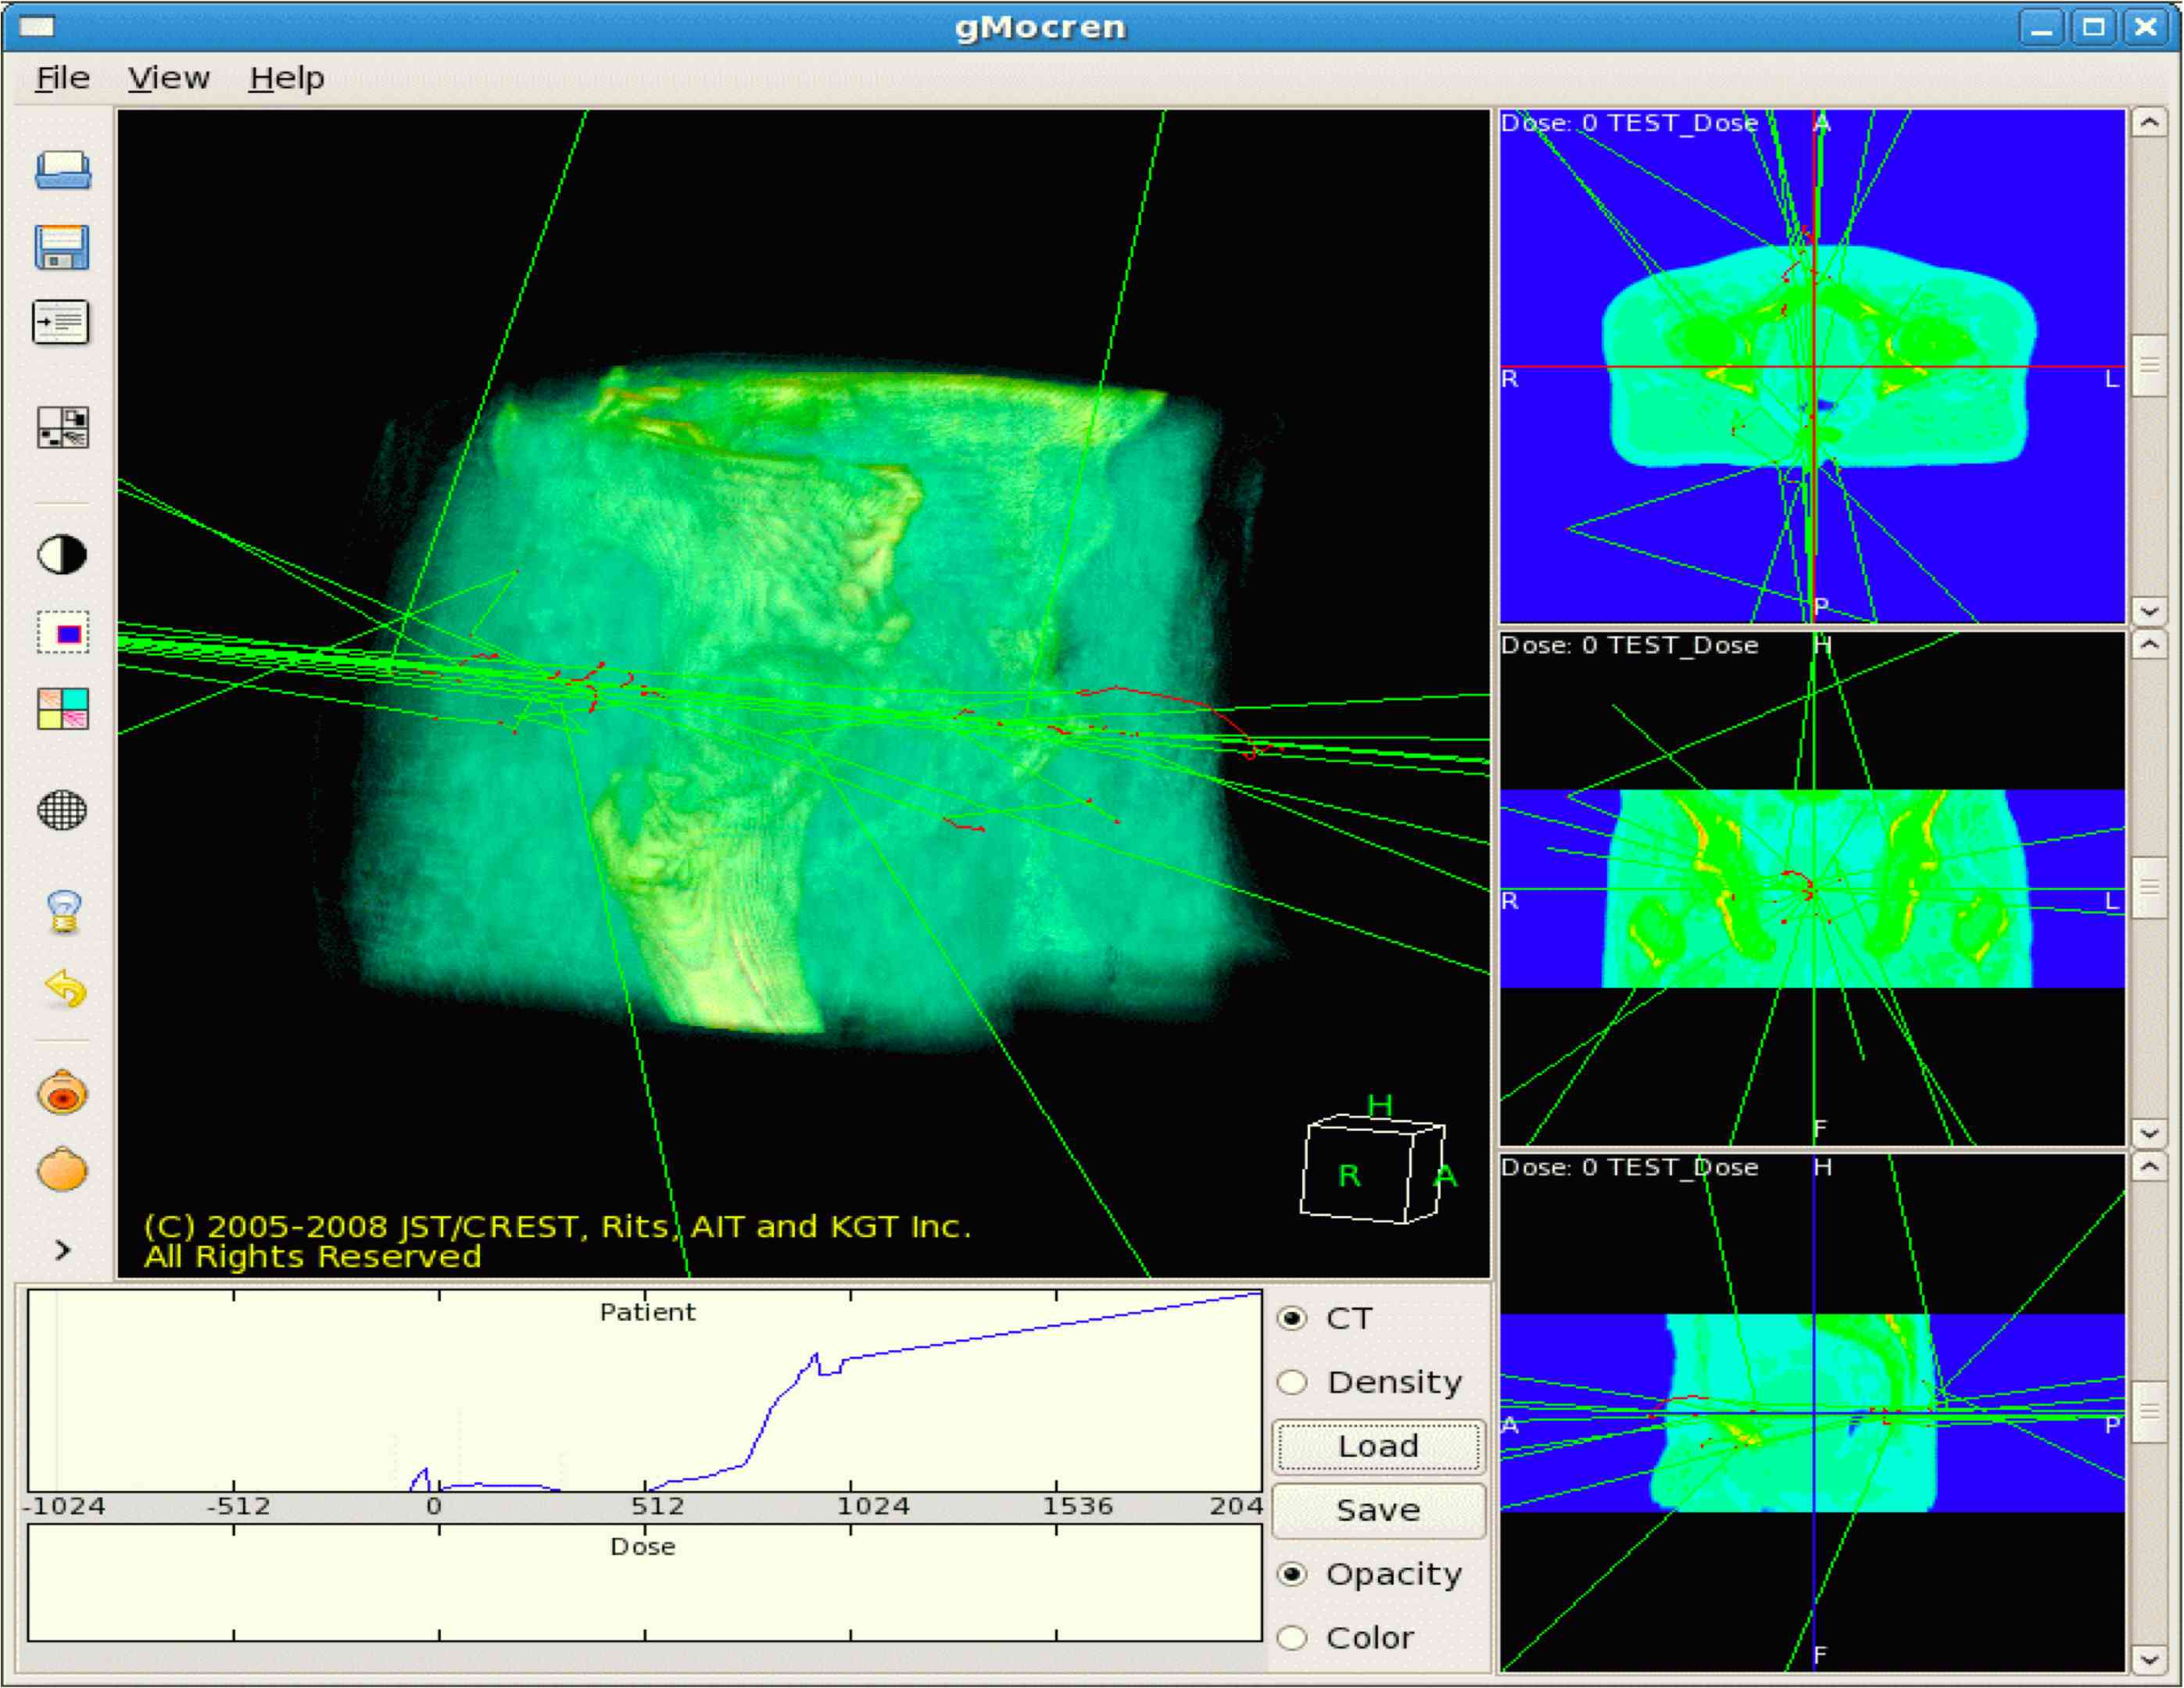
G4RegularNavigation
Algorithm automatically activated for geometries defined as regular structures
  Requires the specification of a special kind of parameterisation, through G4PhantomParameterisation
  Location of a point inside a voxel can be done in a fast way, transforming the position to the coordinate system of the container volume and doing a simple calculation
  Optimisation can be optionally provided by skipping the frontiers of two voxels with same material assigned, so that bigger steps can be done
    SetSkipEqualMaterials(bool);
    From G4PhantomParameterisation
    To avoid when the number of materials is very big or when the physical step is small compared to the voxel dimensions
Tracks on regular structure visualized with gMocren
Detector Description: Advanced Features - Geant4 Course

Slide 18
Defining a regular geometry…
Need to first create an object of type G4PhantomParameterisation (with voxels and materials), param, where to …
  define the voxel dimensions in the parameterisation
    param->SetVoxelDimensions( halfX, halfY, halfZ );
  specify the number of voxels in the three dimensions
    param->SetNoVoxel( nVoxelX, nVoxelY, nVoxelZ );
  define the list of materials to associate to voxels according to indeces
    param->SetMaterialIndices( mateIDs );
A “container” volume (box) for the voxel structure has to be defined
  The voxel structure must completely fill the container box
  Its physical volume be assigned to the phantom parameterisation, assuring that voxels are completely filling the structure
    param->BuildContainerSolid( cont_phys );
    param->CheckVoxelsFillContainer( x, y, z );
  Assign the parameterisation as a normal parameterised volume (e.g. patient_phys) and set it as a regular structure
    patient_phys->SetRegularStructureId( 1 );
Detector Description: Advanced Features - Geant4 Course

Slide 19
Regions
Cuts by Region
Concept of Region
Example
Notes:
Geant4: Detector description module
10/21/08
Geant4: Detector description module
10/21/08
Geant4: Detector description module
10/21/08

Slide 20
Cuts by Region
Geant4 used to have a unique production threshold (‘cut’) expressed in length (i.e. minimum range of secondary)‏
  For all volumes, but possibly different for each particle (e+,e-,gamma)‏
Appropriate length scales can vary greatly between different areas of a large detector
  E.g. a vertex detector (5 μm) and a muon detector (2.5 cm)‏
  Having a unique (low) cut can create a performance penalty
Geant4 allows for several cuts
  Globally or per particle
  Enabling the tuning of production thresholds at the level of a sub-detector, i.e. region
  Cuts are applied only for gamma, electron and positron and only for processes which have infrared divergence
Detector Description: Advanced Features - Geant4 Course
Notes:
Geant4: Detector description module
10/21/08
Geant4: Detector description module
10/21/08
Geant4: Detector description module
10/21/08

Slide 21
Detector Region
Concept of region:
  Set of geometry volumes, typically of a sub-system
    barrel + end-caps of the calorimeter;
    “Deep” areas of support structures can be a region.
  Or any group of volumes
A set of cuts in range is associated to a region
  a different range cut for each particle among gamma, e-, e+ is allowed in a region
Default
Region
Region B
Region
B
Region
B
Region A
C
C
Region B
Detector Description: Advanced Features - Geant4 Course
Notes:
Geant4: Detector description module
10/21/08
Geant4: Detector description module
10/21/08
Geant4: Detector description module
10/21/08
Some Details:
A region
- Has one or several ‘root’ volumes
The world is in a predefined ‘default region’

Slide 22
Region and cut
World Volume - Default Region
Each region has its unique set of cuts
World volume is recognized as the default region. The default cuts defined in Physics list are used for it.
  User is not allowed to define a region to the world volume or a cut to the default region
A logical volume becomes a root logical volume once it is assigned to a region.
  All daughter volumes belonging to the root logical volume share the same region (and cut), unless a daughter volume itself becomes to another root
Important restriction :
  No logical volume can be shared by more than one regions, regardless of root volume or not
Root logical - Region A
Root logical - Region B
Detector Description: Advanced Features - Geant4 Course

Slide 23
Setting up regions: example
// Create a region
G4Region* emCalorimeter = new G4Region(“EM-Calorimeter”);
// Attach a logical volume to the region
emCalorimeter->AddRootLogicalVolume(emCalorimeterLV);
[…]
// Retrieve the region by its name
G4Region* region
= G4RegionStore::GetInstance()->GetRegion(“EM-Calorimeter”);
// Create production cuts
cuts = new G4ProductionCuts;
cuts->SetProductionCut(0.01*mm, G4ProductionCuts::GetIndex(“gamma”));
cuts->SetProductionCut(0.1*mm, G4ProductionCuts::GetIndex(“e-”));
cuts->SetProductionCut(0.1*mm, G4ProductionCuts::GetIndex(“e+”));
// Attach cuts to the region
region->SetProductionCuts(cuts);
Detector Description: Advanced Features - Geant4 Course
Notes:
Geant4: Detector description module
10/21/08
Geant4: Detector description module
10/21/08
Geant4: Detector description module
10/21/08
Example of replication in Phi

Slide 24
Geometry customisation
User defined solids
Notes:
Geant4: Detector description module
10/21/08
Geant4: Detector description module
10/21/08
Geant4: Detector description module
10/21/08

Slide 25
User defined solids
All solids should derive from G4VSolid and implement its abstract interface
  will guarantee the solid is treated as any other solid predefined in the kernel
Basic functionalities required for a solid
  Compute distances to/from the shape
  Detect if a point is inside the shape
  Compute the surface normal to the shape at a given point
  Compute the extent of the shape
  Provide few visualization/graphics utilities
Detector Description: Advanced Features - Geant4 Course
Notes:
Geant4: Detector description module

Slide 26
What a solid should reply to…- 1
EInside Inside(const G4ThreeVector& p) const;
Should return, considering a predefined tolerance:
  kOutside - if the point at offset p is outside the shapes boundaries
  kSurface - if the point is close less than Tolerance/2 from the surface
  kInside - if the point is inside the shape boundaries
G4ThreeVector SurfaceNormal(const G4ThreeVector& p) const;
Should return the outwards pointing unit normal of the shape for the surface closest to the point at offset p.
G4double DistanceToIn(const G4ThreeVector& p,
const G4ThreeVector& v) const;
Should return the distance along the normalized vector v to the shape from the point at offset p. If there is no intersection, returns kInfinity. The first intersection resulting from ‘leaving' a surface/volume is discarded. Hence, it is tolerant of points on the surface of the shape
Detector Description: Advanced Features - Geant4 Course
Notes:
Geant4: Detector description module

Slide 27
What a solid should reply to…- 2
G4double DistanceToIn(const G4ThreeVector& p) const;
Calculates the distance to the nearest surface of a shape from an outside point p. The distance can be an underestimate
G4double DistanceToOut(const G4ThreeVector& p,
const G4ThreeVector& v,
const G4bool calcNorm=false,
G4bool* validNorm=0,
G4ThreeVector* n=0) const;
Returns the distance along the normalised vector v to the shape, from a point at an offset p inside or on the surface of the shape. Intersections with surfaces, when the point is less than Tolerance/2 from a surface must be ignored. If calcNorm is true, then it must also set validNorm to either:
  True - if the solid lies entirely behind or on the exiting surface. Then it must set n to the outwards normal vector (the Magnitude of the vector is not defined)
  False - if the solid does not lie entirely behind or on the exiting surface
G4double DistanceToOut(const G4ThreeVector& p) const;
Calculates the distance to the nearest surface of a shape from an inside point p. The distance can be an underestimate
Detector Description: Advanced Features - Geant4 Course
Notes:
Geant4: Detector description module

Slide 28
Solid: more functions…
G4bool CalculateExtent(const EAxis pAxis,
const G4VoxelLimits& pVoxelLimit,
const G4AffineTransform& pTransform,
G4double& pMin, G4double& pMax) const;
Calculates the minimum and maximum extent of the solid, when under the specified transform, and within the specified limits. If the solid is not intersected by the region, return false, else return true
Member functions for the purpose of visualization:
void DescribeYourselfTo (G4VGraphicsScene& scene) const;
“double dispatch” function which identifies the solid to the graphics scene
G4VisExtent GetExtent () const;
Provides extent (bounding box) as possible hint to the graphics view
Detector Description: Advanced Features - Geant4 Course
Notes:
Geant4: Detector description module

Slide 29
Computation of area and geometrical volume
Any solid must provide the ability to compute its own surface area and geometrical volume:
G4double GetSurfaceArea();
G4double GetCubicVolume();
Must return an estimation of the solid area and volume in internal units
Overloaded by the concrete solid implementation to perform exact computation of the quantity
  Should eventually “cache” the computed value, such that it is NOT recomputed each time the method is called
Detector Description: Advanced Features - Geant4 Course
Notes:
Geant4: Detector description module

Slide 30
Documentation & Support …
User’s Guide for Application Developers …
Hypernews User’s Forum …
Problem reports …
Contacts …
Notes:
Geant4: Detector description module
10/21/08
Geant4: Detector description module
10/21/08
Geant4: Detector description module
10/21/08

