Slide 1
Input/Output

Slide 2

ROOT Trees and TFile
Input/Output

Slide 3
Why Trees ?
Trees have been designed to support very large collections of objects. The overhead in memory is in general less than 4 bytes per entry.
Trees allow direct and random access to any entry (sequential access is the best)
Trees have branches and leaves. One can read a subset of all branches.
High level functions like TTree::Draw loop on all entries with selection expressions.
Trees can be browsed via TBrowser
Trees can be analyzed via TTreeViewer

Slide 4
Memory <--> Tree Each Node is a branch in the Tree
Memory
0
T.GetEntry(6)
1
2
3
4
5
6
7
8
9
10
11
12
13
14
15
16
17
T.Fill()
18
T
tr

Slide 5
ROOT I/O -- Split/Cluster Tree version
Tree entries
Streamer
Branches
Tree in memory
File

Slide 6
Writing/Reading a Tree
class Event : public Something {
Header fHeader;
std::list<Vertex*> fVertices;
std::vector<Track> fTracks;
TOF fTOF;
Calor *fCalor;
}
Event.h
Write.C
Read.C
main() {
Event *event = 0;
TFile f(“demo.root”,”recreate”);
int split = 99; //maximum split
TTree *T = new TTree(“T”,”demo Tree”);
T->Branch(“event”,&event,split);
for (int ev=0;ev<1000;ev++) {
event = new Event(…);
T->Fill();
delete event;
}
t->AutoSave();
}
main() {
Event *event = 0;
TFile f(“demo.root”);
TTree *T = (TTree*)f.Get”T”);
T->SetBranchAddress(“event”,&event);
Long64_t N = T->GetEntries();
for (Long64_t ev=0;ev<N;ev++) {
T->GetEntry(ev);
// do something with event
}
}

Slide 7
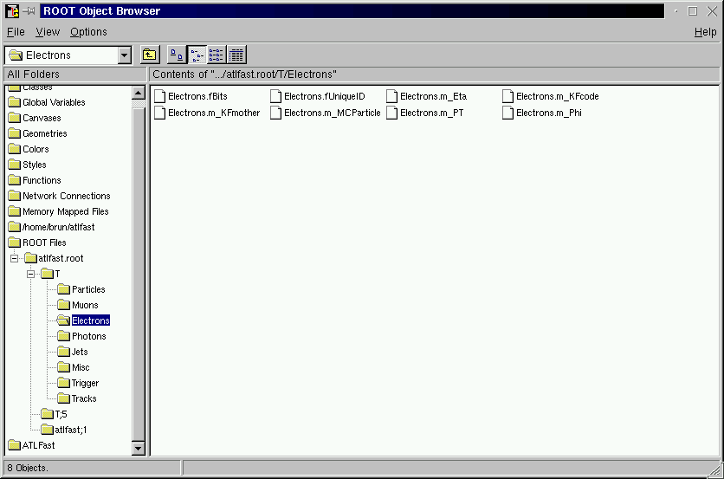



Browsing a TTree with TBrowser
8 leaves of branch
Electrons
A double-click
to histogram
the leaf
8 Branches of T

Slide 8
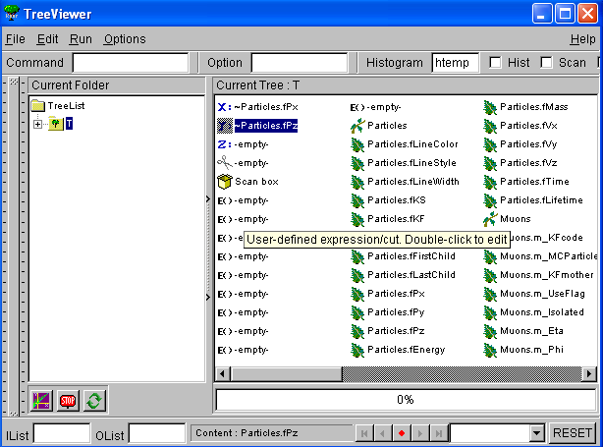
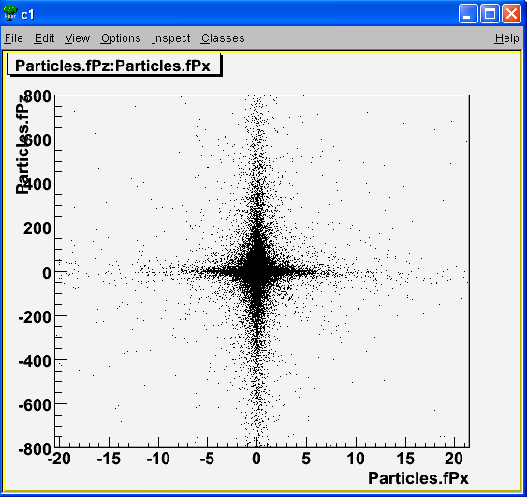
The TTreeViewer

Slide 9
TTree Selection Syntax
Prints the first 8 variables of the tree.
Prints all the variables of the tree.
Specific variables of the tree can be explicit selected by list them in column separated list:
Prints the values of var1, var2 and var3.
A selection can be applied in the second argument:
Prints the values of var1, var2 and var3 for the entries where var1 is exactly 0.
MyTree->Scan();
MyTree->Scan("*");
MyTree->Scan("var1:var2:var3");
MyTree->Scan("var1:var2:var3", "var1==0");

Slide 10
Chains of Trees
A TChain is a collection of Trees.
Same semantics for TChains and TTrees
root > .x h1chain.C
root > chain.Process(“h1analysis.C”)
{
//creates a TChain to be used by the h1analysis.C class
//the symbol H1 must point to a directory where the H1 data sets
//have been installed
TChain chain("h42");
chain.Add("$H1/dstarmb.root");
chain.Add("$H1/dstarp1a.root");
chain.Add("$H1/dstarp1b.root");
chain.Add("$H1/dstarp2.root");
}

Slide 11
Tree Friends
Entry # 8
0
1
2
3
4
0
5
1
6
0
2
7
1
3
8
2
4
9
3
5
10
4
5
6
11
6
7
12
7
8
13
8
9
9
10
14
10
11
15
11
12
16
12
13
17
13
14
14
18
15
15
16
16
17
17
18
18
Public
read
Public
read
User
Write

