Slide 1
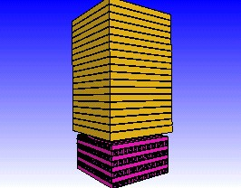
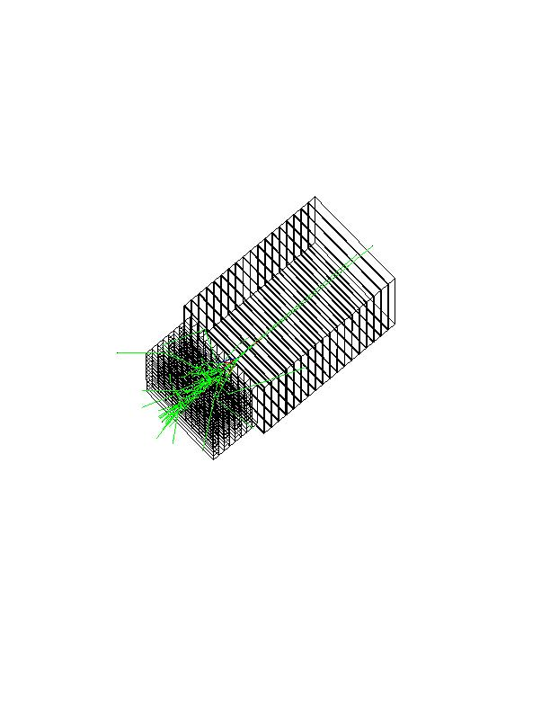
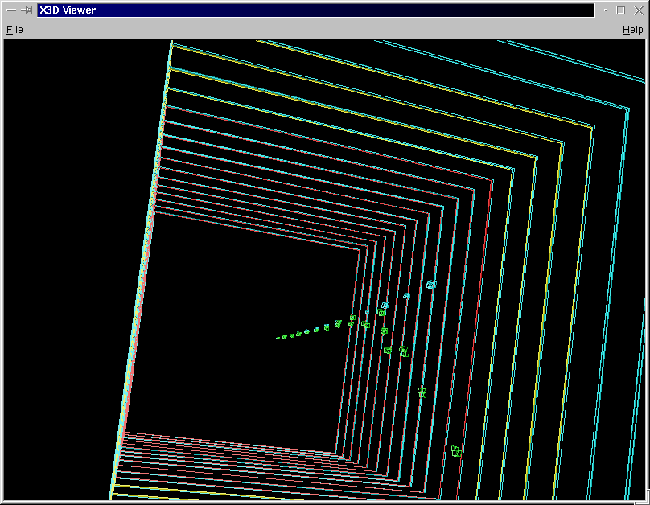
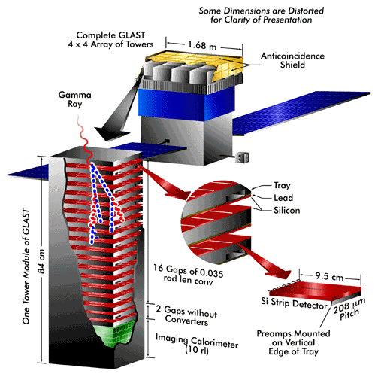

http://cern.ch/geant4/ http://www.ge.infn.it/geant4/
through an application example

Slide 2
Outline
This basic introduction is not meant to replace Geant4 Application Developer Guide!
Geant4 user initialisation and action classes
How to describe the experimental set-up
  Basics of materials, geometry, hits&digits
How to generate primary events
  Basics of primary generators
How to define the physics to be activated
  Basic concepts of how Geant4 kernel works
  Particles and their physics interactions
  Physics processes, their management and how tracking deals with them
  Cuts
How to control and monitor the execution
  Basics of user interface, visualisation
How to analyse the result of the simulation
  Andreas Pfeiffer’s talk

Slide 3
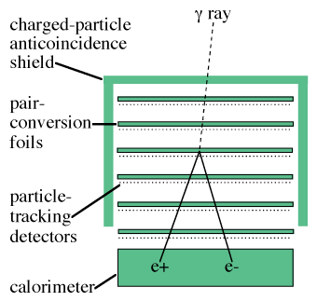
The experimental set-up of our exercise
A simple configuration, consisting of
  a tracking detector
  an electromagnetic calorimeter
  a system of anti-coincidences
What happens in our detectors
incident particles interact in the experimental set-up
secondary particles may be generated and interact too
detectors and their read-out electronics record the effects produced by primary and secondary particles

Slide 4


What shall we do now?
Sit in front of a PC and start writing code…
Wonder what we want to do…
Ask our boss what he wants us to do…
Chat with collaborators in the experiment…
Ask and think and plan and analyse and design and develop and test and get feedback and ask and think and plan and analyse and design and develop and test and get feedback and ask and think and…
Software process

Slide 5


Software Process
SEI’s definition:
A set of activities, methods, practices and transformations that people use to develop and maintain software and associated products
Three key components:
the people involved
the organization of the development process
the technology used
Reference for guidance and assessment
Capability Maturity Model (CMM)
SPICE/ISO 15504
Various software process models
USDP / RUP
OPEN
OOSP
XP, Agile etc.
waterfall
USDP

Slide 6
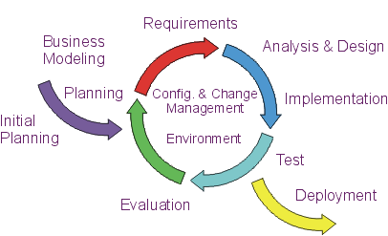
The software life-cycle
A software process
provides guidance to a team’s activities
specifies which work products should be produced and when
offers criteria for monitoring and measuring the project’s products and activities
Advantages of
iterative and incremental
development
Complexity is never overwhelming
  only tackle small bits at a time
Early feedback from using the software
  provides input to the analysis of subsequent iterations
Developers’ skills can grow with the project
  don’t need to apply latest techniques/technology at the start
Requirements can be modified
  each iteration is a mini-project (analysis, design…)

Slide 7
The inception phase
Formulating the scope of the project
  capturing the context and the most important requirements and constraints
Planning
  project plan, risk management, staffing etc.
Synthesizing a candidate architecture
  to demonstrate feasibility through some kind of proof of concept
Preparing the environment for the project
Capture User Requirements
Select a simulation framework
Identify a candidate architecture

Slide 8
Capture User Requirements
Define the scope of the software system to be built (“what it should do”)

Slide 9
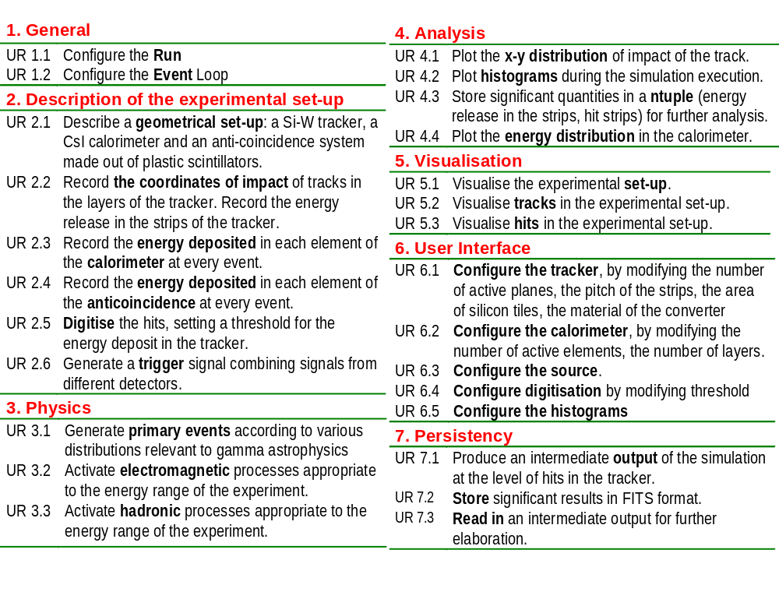
User Requirements

Slide 10
Select a simulation framework

Slide 11
The zoo
DPM
EA-MC
FLUKA
GEM
HERMES
LAHET
MCBEND MCU
MF3D
NMTC
MONK MORSE
RTS&T-2000 SCALE
TRAX
VMC++
EGS4, EGS5, EGSnrc
Geant3, Geant4
MARS
MCNP, MCNPX, A3MCNP, MCNP-DSP, MCNP4B
MVP, MVP-BURN
Penelope
Peregrine
Tripoli-3, Tripoli-3 A, Tripoli-4
...and I probably forgot some more
Many codes not publicly distributed
A lot of business around MC
Monte Carlo codes presented at the MC200 Conference, Lisbon, October 2000

Slide 12
Identify a candidate architecture

Slide 13
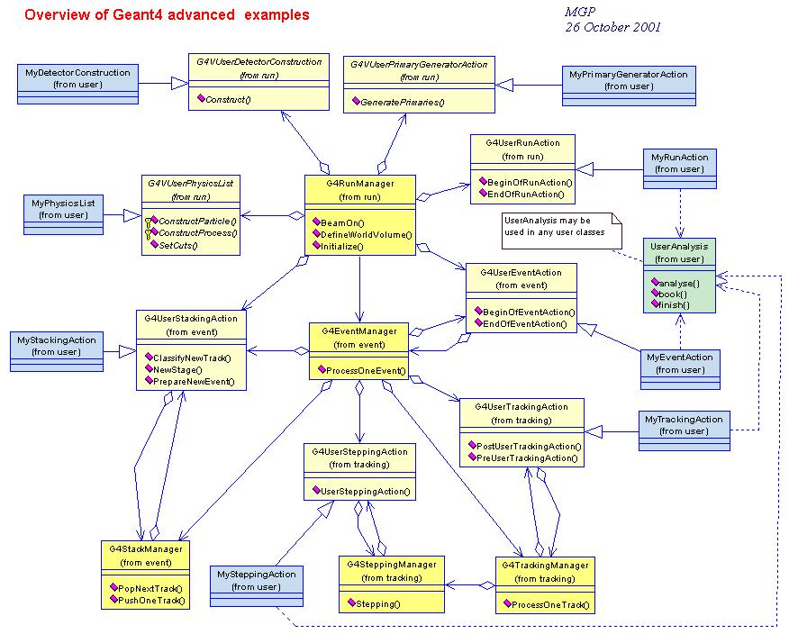

Slide 14
The elaboration
Refining the vision
  a solid understanding of the most critical use cases
Defining, validating and refining the architecture
Iteration plans for the construction phase
Putting in place the development environment
Architecture (based on the Geant4 framework)
Use case realizations
Priorities of requirements: plan iterations

Slide 15
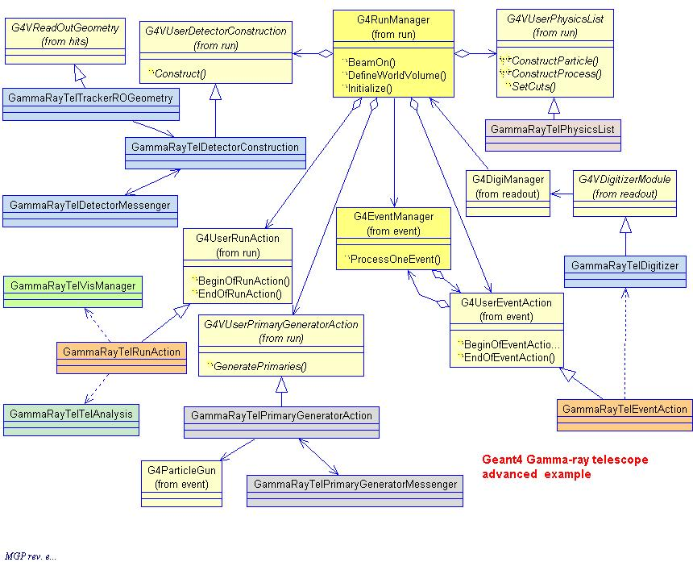
Physics
Detector description
Management
Detector response
Visualisation
Primary event generation
Analysis
Architecture

Slide 16
The main program
Geant4 does not provide the main()
In his/her main(), the user must
  construct G4RunManager (or his/her own derived class)
  notify the mandatory user classes to G4RunManager
    G4VUserDetectorConstruction
    G4VUserPhysicsList
    G4VUserPrimaryGeneratorAction
The user can define
  VisManager, (G)UI session, optional user action classes, one’s own persistency manager, an AnalysisManager…
in his/her main()

Slide 17
User classes
Initialisation classes
Invoked at initialization
G4VUserDetectorConstruction
G4VUserPhysicsList
Action classes
Invoked during the execution loop
G4VUserPrimaryGeneratorAction
G4UserRunAction
G4UserEventAction
G4UserStackingAction
G4UserTrackingAction
G4UserSteppingAction
G4VUserDetectorConstruction
describe the experimental set-up
G4VUserPhysicsList
select the physics you want to activate
G4VUserPrimaryGeneratorAction
generate primary events
Mandatory classes:

Slide 18
Describe the experimental set-up
Derive your own concrete class from the G4VUserDetectorConstruction abstract base class
Implement the Construct() method
(modularise it according to each detector component or sub-detector)
  construct all necessary materials
  define shapes/solids required to describe the geometry
  construct and place volumes of your detector geometry
  define sensitive detectors and identify detector volumes to associate them to
  associate magnetic/electric field to detector regions
  define visualisation attributes for the detector elements

Slide 19
Select physics processes
Geant4 does not have any default particles or processes
  even for particle transportation, one has to define it explicitly
Derive your own concrete class from the G4VUserPhysicsList abstract base class
  define all necessary particles
  define all necessary processes and assign them to proper particles
  define production thresholds (in terms of range)
Read the Physics Reference Manual first!
The Advanced Examples offer a guidance for various typical experimental domains

Slide 20
Generate primary events
Derive your concrete class from the G4VUserPrimaryGeneratorAction abstract base class
Pass a G4Event object to one or more primary generator concrete class objects, which generate primary vertices and primary particles
The user can implement or interface his/her own generator
  specific to a physics domain or to an experiment

Slide 21
Optional user action classes
G4UserRunAction
BeginOfRunAction(const G4Run*)
  example: book histograms
EndOfRunAction(const G4Run*)
  example: store histograms
G4UserEventAction
BeginOfEventAction(const G4Event*)
  example: event selection
EndOfEventAction(const G4Event*)
  example: analyse the event
G4UserTrackingAction
PreUserTrackingAction(const G4Track*)
  example: decide whether a trajectory should be stored or not
PostUserTrackingAction(const G4Track*)
G4UserSteppingAction
UserSteppingAction(const G4Step*)
  example: kill, suspend, postpone the track
G4UserStackingAction
PrepareNewEvent()
  reset priority control
ClassifyNewTrack(const G4Track*)
  Invoked every time a new track is pushed
  Classify a new track (priority control)
  Urgent, Waiting, PostponeToNextEvent, Kill
NewStage()
  invoked when the Urgent stack becomes empty
  change the classification criteria
  event filtering (event abortion)

Slide 22
Select (G)UI and visualisation
In your main(), taking into account your computer environment, construct a G4UIsession concrete class provided by Geant4 and invoke its sessionStart() method
Geant4 provides:
  G4UIterminal
  csh or tcsh like character terminal
  G4GAG
  tcl/tk or Java PVM based GUI
  G4Wo
  Opacs
  G4UIBatch
  batch job with macro file
  etc…
Derive your own concrete class from G4VVisManager, according to your computer environment
Geant4 provides interfaces to various graphics drivers:
  DAWN
  Fukui renderer
  WIRED
  RayTracer
  ray tracing by Geant4 tracking
  OPACS
  OpenGL
  OpenInventor
  VRML

Slide 23
GammaRayTel main
// Construct the default run manager
G4RunManager* runManager = new G4RunManager;
// Set mandatory user initialization classes
GammaRayTelDetectorConstruction* detector = new GammaRayTelDetectorConstruction;
runManager->SetUserInitialization(detector);
runManager->SetUserInitialization(new GammaRayTelPhysicsList);
// Set mandatory user action classes
runManager->SetUserAction(new GammaRayTelPrimaryGeneratorAction);
// Set optional user action classes
GammaRayTelEventAction* eventAction = new GammaRayTelEventAction();
runManager->SetUserAction(eventAction);
GammaRayTelRunAction* runAction = new GammaRayTelRunAction();
runManager->SetUserAction(runAction);

Slide 24
GammaRayTel main (continued)
// Creation of the analysis manager
GammaRayTelAnalysis* analysis = GammaRayTelAnalysis::getInstance();
// Initialization of the User Interface Session
G4UIsession* session = new G4UIterminal();
// Visualisation manager
G4VisManager* visManager = new GammaRayTelVisManager;
visManager->Initialize();
// Initialize G4 kernel
runManager->Initialize();

Slide 25
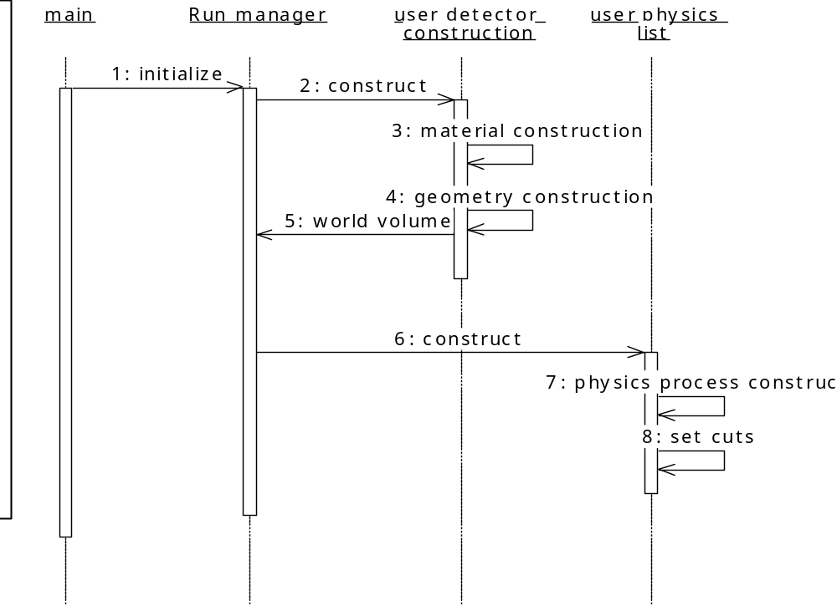
Initialisation
Describe a geometrical set-up: a Si-W tracker, a CsI calorimeter and an anti-coincidence system made out of plastic scintillators.
Activate electromagnetic/hadronic processes appropriate to the energy range of the experiment

Slide 26
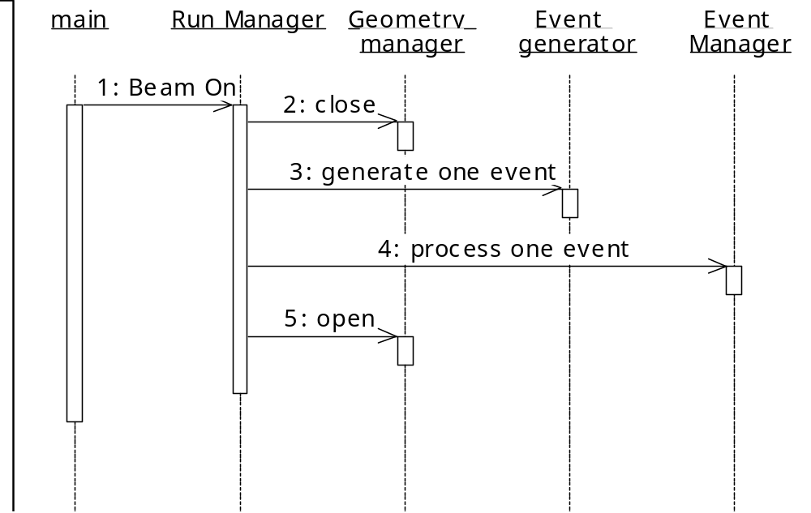
Beam On
Generate primary events according to various distributions relevant to gamma astrophysics

Slide 27
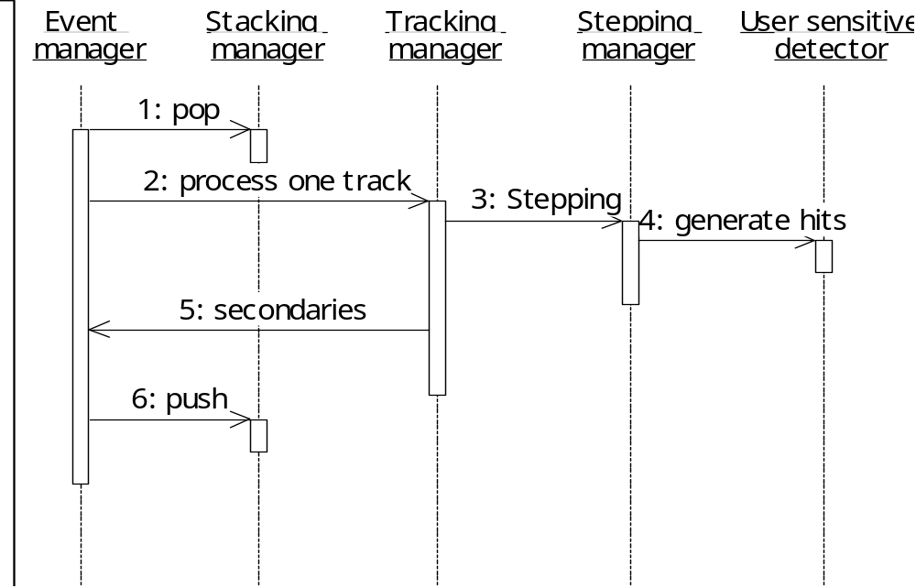
Event processing
Record the coordinates of impact of tracks in the tracker layers
Record the energy deposited in each element of the calorimeter at every event

Slide 28
The construction
Completing the
  analysis
  design
  development
  testing
of all required functionality

Slide 29
Detailing the design

Slide 30
Describe the experimental set-up

Slide 31
Definition of materials in GammaRayTel
// define elements
G4double a = 1.01*g/mole;
G4Element* H = new G4Element(name="Hydrogen", symbol="H", z= 1., a);
a = 12.01*g/mole;
G4Element* C = new G4Element(name="Carbon", symbol="C", z= 6., a);
// define simple materials
G4double density = 1.032*g/cm3;
G4Material* scintillator = new G4Material(name="Scintillator", density, nComponents=2);
scintillator->AddElement(C, nAtoms=9);
scintillator->AddElement(H, nAtoms=10);

Slide 32
Define detector geometry
Three conceptual layers
  G4VSolid -- shape, size
  G4LogicalVolume -- daughter physical volumes, material, sensitivity, user limits, etc.
  G4VPhysicalVolume -- position, rotation
A unique physical volume (the world volume), which represents the experimental area, must exist and fully contain all other components
G4VSolid
G4LogicalVolume
G4VPhysicalVolume
G4Box
G4Material
G4VisAttributes
G4PVPlacement
G4Tubs
G4VSensitiveDetector
G4PVParameterised
Notes:
Possible attributes associated to a G4LogicalVolume:
Magnetic field
Material
If sensitive, associated sensitive detector
Quality of geometry optimization (smartless)
Visualization attributes
User limits (maximum allowed step, track length, minimum kinetic energy, …)
…

Slide 33
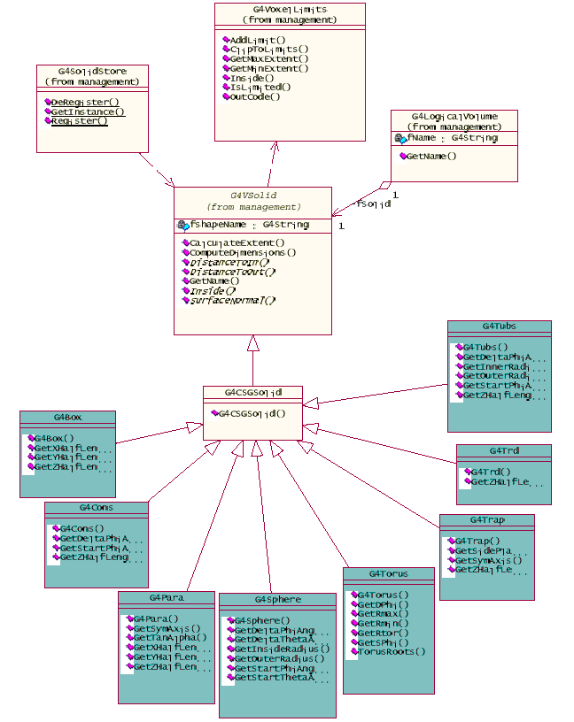
G4VSolid
Abstract class: all solids in Geant4 derive from it
Defines, but does not implement, all functions required to:
  compute distances to/from the shape
  check whether a point is inside the shape
  compute the extent of the shape
  compute the surface normal to the shape at a given point

Slide 34

Solids
Solids defined in Geant4:
CSG (Constructed Solid Geometry) solids
  G4Box, G4Tubs, G4Cons, G4Trd, …
Specific solids (CSG like)
  G4Polycone, G4Polyhedra, G4Hype, …
BREP (Boundary REPresented) solids
  G4BREPSolidPolycone, G4BSplineSurface, …
  Any order surface
Boolean solids
  G4UnionSolid, G4SubtractionSolid, …

Slide 35
G4LogicalVolume
G4LogicalVolume(G4VSolid* solid, G4Material* material,
const G4String& name,
G4FieldManager* fieldManager=0,
G4VSensitiveDetector* senditiveDetector=0,
G4UserLimits* userLimits=0);
Contains all information of volume except position:
  Shape and dimension (G4VSolid)
  Material, sensitivity, visualization attributes
  Position of daughter volumes
  Magnetic field, User limits
  Shower parameterization
Physical volumes of same type can share a logical volume

Slide 36

Physical Volumes
Placement: it is one positioned volume
Repeated: a volume placed many times
  can represent any number of volumes
  reduces use of memory
  Replica: simple repetition, similar to G3 divisions
  Parameterised
A mother volume can contain either
  many placement volumes OR
  one repeated volume
placement
repeated

Slide 37
G4VPhysicalVolume
G4PVPlacement 1 Placement = One Volume
  A volume instance positioned once in a mother volume
G4PVParameterized 1 Parameterized = Many Volumes
  Parameterized by the copy number
    Shape, size, material, position and rotation can be parameterized, by implementing a concrete class of G4PVParameterisation
  Reduction of memory consumption
G4PVReplica 1 Replica = Many Volumes
  Slicing a volume into smaller pieces (if it has a symmetry)

Slide 38


Grouping volumes
To represent a regular pattern of positioned volumes, composing a more or less complex structure
  structures which are hard to describe with simple replicas or parameterised volumes
  structures which may consist of different shapes
Assembly volume
  acts as an envelope for its daughter volumes
  its role is over, once its logical volume has been placed
  daughter physical volumes become independent copies in the final structure

Slide 39
DetectorConstruction
// Calorimeter Structure (caloLayerX + caloLayerY)
// Solid
solidCaloLayerX = new G4Box(“caloLayerX", caloSizeXY/2, caloSizeXY/2, caloBarThickness/2);
// Logical volume
logicCaloLayerX = new G4LogicalVolume(solidCaloLayerX, caloMaterial, “caloLayerX");
// Physical volume
for (G4int i = 0; i < numberOfCaloLayers; i++)
{
physicalCaloLayerY = new G4PVPlacement(…);
physicalCaloLayerX = new G4PVPlacement(…);
…
}

Slide 40
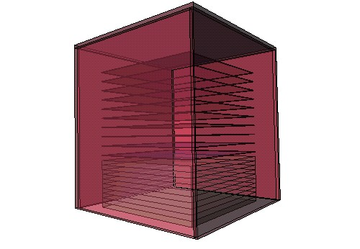
Visualisation of Detector
Each logical volume can have a G4VisAttributes object associated
  Visibility, visibility of daughter volumes
  Color, line style, line width
  Force flag to wire-frame or solid-style mode

Slide 41
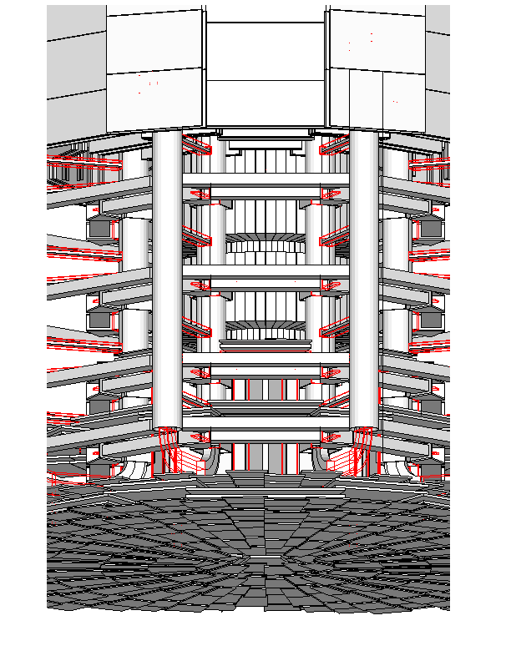
Debugging tools: DAVID
DAVID is a graphical debugging tool for detecting potential intersections of volumes
Accuracy of the graphical representation can be tuned to the exact geometrical description
  physical-volume surfaces are automatically decomposed into 3D polygons
  intersections of the generated polygons are parsed
  if a polygon intersects with another one, the physical volumes associated to these polygons are highlighted in colour (red is the default)
DAVID can be downloaded from the web as an external tool for Geant4

Slide 42
Detector response
Record the coordinates of impact of tracks in the layers of the tracker.
Record the energy deposited in each element of the calorimeter at every event.
The user must provide his/her own implementation of the detector response
Concepts:
  Sensitive Detector
  Readout Geometry
  Hits
  Digits

Slide 43
Detector sensitivity
A logical volume becomes sensitive if it has a pointer to a concrete class derived from G4VSensitiveDetector
A sensitive detector
  either constructs one or more hit objects
  or accumulates values to existing hits
using information given in a G4Step object

Slide 44
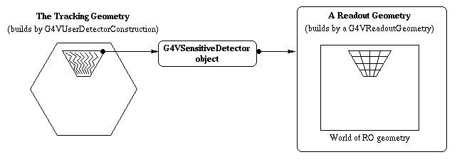
Read-out Geometry
Readout geometry is a virtual and artificial geometry
  it is associated to a sensitive detector
  can be defined in parallel to the real detector geometry
  helps optimising the performance

Slide 45
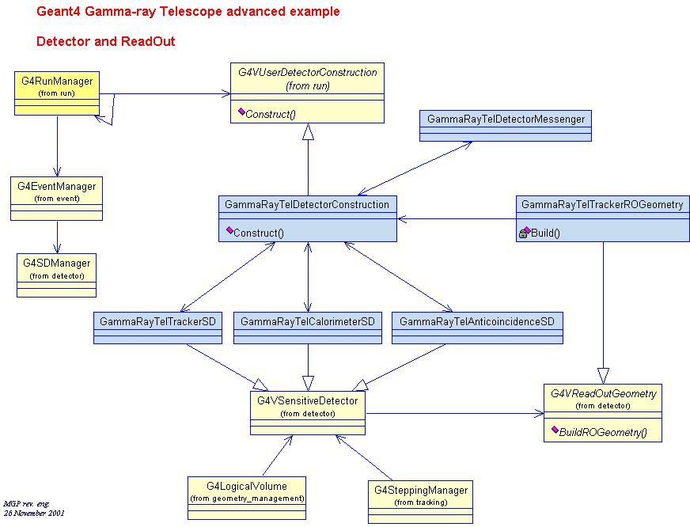

Slide 46
GammaRayTel Sensitive Detector and Readout Geometry
// Sensitive Detector Manager
G4SDManager* sensitiveDetectorManager = G4SDManager::GetSDMpointer();
// Sensitive Detectors - Tracker
trackerSD = new GammaRayTelTrackerSD("TrackerSD");
sensitiveDetectorManager->AddNewDetector( trackerSD );
// Readout geometry
G4String roGeometryName = "TrackerROGeom";
G4VReadOutGeometry* trackerRO =
new GammaRayTelTrackerROGeometry(roGeometryName);
trackerRO->BuildROGeometry();
trackerSD->SetROgeometry(trackerRO);
logicTKRActiveTileX->SetSensitiveDetector(trackerSD); // ActiveTileX
... // ActiveTileY etc.

Slide 47
Hit
Hit is a user-defined class derived from G4VHit
You can store various types information by implementing your own concrete Hit class, such as:
  position and time of the step
  momentum and energy of the track
  energy deposition of the step
  geometrical information
  etc.
Hit objects of a concrete hit class must be stored in a dedicated collection, which is instantiated from G4THitsCollection template class
The collection is associated to a G4Event object via G4HCofThisEvent
Hit collections are accessible
  through G4Event at the end of event
  through G4SDManager during processing an event

Slide 48
Digitisation
A Digi represents a detector output
  e.g. ADC/TDC count, trigger signal
A Digi is created with one or more hits and/or other digits
The digitise() method of each G4VDigitizerModule must be explicitly invoked by the user’s code
  e.g. in the UserEventAction

Slide 49
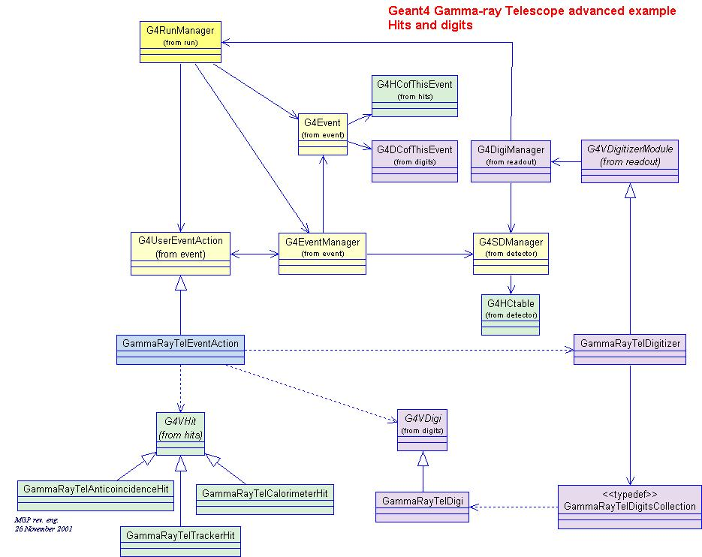
Hits and Digis

Slide 50
Hits in our example
Each tracker hit contains the following information:
ID of the event (this is important for multiple events run)
Energy deposition of the particle in the strip
Number of the strip
Number of the plane
Type of the plane
Position of the hit (x,y,z) in the reference frame of the payload

Slide 51
public:
GammaRayTelTrackerHit();
~GammaRayTelTrackerHit();
GammaRayTelTrackerHit(const GammaRayTelTrackerHit&);
const GammaRayTelTrackerHit& operator=(const GammaRayTelTrackerHit&);
int operator==(const GammaRayTelTrackerHit&) const;
inline void* operator new(size_t);
inline void operator delete(void*);
void Draw();
void Print();
inline void AddSil(G4double eDeposit) {eDepositSilicon += dE;};
inline void SetNStrip(G4int i) {nStrip = i;};
inline void SetNSilPlane(G4int i) {nSiliconPlane = i;};
inline void SetPlaneType(G4int i) {isXPlane = i;};
inline void SetPos(G4ThreeVector xyz) { position = xyz; }
inline G4double GetEdepSil() { return eDepositSilicon; };
inline G4int GetNStrip() { return nStrip; };
inline G4int GetNSilPlane() { return nSilPlane; };
inline G4int GetPlaneType() { return isXPlane;};
inline G4ThreeVector GetPos() { return position; };
GammaRayTelTrackerHit

Slide 52
Digits in our example
A digi is generated when the hit energy deposit is greater than a threshold
The Tracker digits contain:
  ID of the event (this is important for multiple events run)
  Number of the strip
  Number of the plane
  Type of the plane (1=X 0=Y)
A concrete class GammaRayTelDigitizer, inheriting from G4VDigitizerModule, implements the digitize() method
  The digitize() method of each G4VDigitizerModule must be explicitly invoked by the user code (e.g. at EventAction)

Slide 53
GammaRayTelDigi
public:
GammaRayTelDigi();
~GammaRayTelDigi();
GammaRayTelDigi(const GammaRayTelDigi&);
const GammaRayTelDigi& operator=(const GammaRayTelDigi&);
int operator==(const GammaRayTelDigi&) const;
inline void* operator new(size_t);
inline void operator delete(void*);
void Draw();
void Print();
inline void SetPlaneNumber(G4int planeN) {planeNumber = planeN;};
inline void SetPlaneType(G4int planeT) {planeType = planeT;};
inline void SetStripNumber(G4int stripN) {stripNumber = stripN;};
inline G4int GetPlaneNumber() {return planeNumber;};
inline G4int GetPlaneType() {return planeType;};
inline G4int GetStripNumber() {return stripNumber;};

Slide 54
GammaRayTelDigitizer
class GammaRayTelDigitizer : public G4VDigitizerModule
{
public:
GammaRayTelDigitizer(G4String name);
~GammaRayTelDigitizer();
void Digitize();
void SetThreshold(G4double value) { energyThreshold = value;}
private:
GammaRayTelDigitsCollection* digitsCollection;
G4double energyThreshold;
GammaRayTelDigitizerMessenger* digiMessenger;
};

Slide 55
Generate primary events

Slide 56
Generating primary particles
Generate primary events according to various distributions relevant to γ astrophysics
Interface to Event Generators
  Primary vertices and particles to be stored in G4Event before processing the event
Various utilities provided within the Geant4 Toolkit
  ParticleGun
    beam of selectable particle type, energy etc.
  G4HEPEvtInterface
    Suitable to /HEPEVT/ common block, which many of (FORTRAN) HEP physics generators are compliant to
    ASCII file input
  GeneralParticleSource
    provides sophisticated facilities to model a particle source
    used to model space radiation environments, sources of radioactivity in underground experiments etc.
You can write your own, inheriting from G4VUserPrimaryGeneratorAction

Slide 57
Primary generator in our example
GammaRayTelParticleGenerationAction and its Messenger are responsible for the generation of primary particles and the related configuration through the UI
Define the incident flux of particles:
  from a specific direction
  or from an isotropic background
Choose also between two spectral options:
  monochromatic
  or with a power-law dependence
The particle generator parameters are accessible through the UI
  /gun/ tree

Slide 58
GammaRayTelPrimaryGeneratorAction
void GammaRayTelPrimaryGeneratorAction::GeneratePrimaries(G4Event* anEvent)
{
// This function is called at the beginning of event
G4double z0 = 0.5*(GammaRayTelDetector->GetWorldSizeZ());
G4double x0 = 0.*cm;
G4double y0 = 0.*cm;
G4ThreeVector vertex0 = G4ThreeVector(x0,y0,z0);
G4ThreeVector dir0 = G4ThreeVector(0.,0.,-1.);
particleGun->SetParticlePosition(vertex0);
particleGun->SetParticleMomentumDirection(dir0);
G4double pEnergy = G4UniformRand() * 10. * GeV;
particleGun->SetParticleEnergy(pEnergy);
particleGun->GeneratePrimaryVertex(anEvent);
}

Slide 59
Activate physics processes

Slide 60
Physics processes in Geant4
Present the concepts needed to understand how to build a PhysicsList
i.e. to set-up the physics to be activated in a simulation application
A PhysicsList is the class where the user defines
  which particles, processes and production thresholds
are to be used in his/her application
This is a mandatory and critical user’s task
We will go through several aspects regarding the kernel of Geant4

Slide 61
Outline (it is quite complex…)
G4ParticleDefinition
G4DynamicParticle
G4Track
What is tracked
The process interface
The production cuts
Building the PhysicsLists
User-defined limits
G4VProcess
How processes are used in tracking
Why production cuts are needed
The cuts scheme in Geant4
G4VUserPhysicsList
Concrete physics lists
G4UserLimit
G4UserSpecialCuts process

Slide 62
G4ParticleDefinition
intrisic particle properties: mass, width, spin, lifetime…
sensitivity to physics
G4ParticleDefinition
This is realized by a G4ProcessManager attached to the G4ParticleDefinition
G4ProcessManager manages the list of processes the user wants the particle to be sensitive to
G4ParticleDefinition does not know by itself its sensitivity to physics
G4ProcessManager
Process_1
Process_2
G4ParticleDefinition
Process_3
G4ParticleWithCuts
G4VIon
G4VLepton
G4VBoson
G4VShortLivedParticles
G4Electron
G4VMeson
G4VBaryon
G4Alpha
G4Geantino
G4PionPlus
G4Proton
G4ParticleDefinition is the base class for defining concrete particles

Slide 63
More about particle design
G4DynamicParticle
Describes the purely dynamic part (i.e. no position, nor geometrical information…) of the particle state:
  momentum, energy, polarization
Holds a G4ParticleDefinition pointer
Retains eventual pre-assigned decay information
  decay products
  lifetime
G4Track
Defines the class of objects propagated by Geant4 tracking
Represents a snapshot of the particle state
Aggregates:
  a G4ParticleDefinition
  a G4DynamicParticle
  geometrical information:
    position, current volume …
  track ID, parent ID;
  process which created this G4Track
  weight, used for event biaising

Slide 64
Summary view
G4Track
Propagated by tracking
Snapshot of the particle state
G4DynamicParticle
Momentum, pre-assigned decay…
The particle type:
  G4Electron,
  G4PionPlus…
G4ParticleDefinition
G4ProcessManager
Holds the physics sensitivity
Process_1
The physics processes
Process_2
Process_3
The classes involved in building the PhysicsList are:
  the G4ParticleDefinition concrete classes
  the G4ProcessManager
  the processes

Slide 65
G4VProcess
Abstract class defining the common interface of all processes in Geant4
AlongStep
Define three kinds of actions:
AtRest actions: decay, annihilation …
AlongStep actions: continuous interactions occuring along the path, like ionisation
PostStep actions: point-like interactions, like decay in flight, hard radiation…
A process can implement any combination of the three AtRest, AlongStep and PostStep actions: eg: decay = AtRest + PostStep
Each action defines two methods:
  GetPhysicalInteractionLength()
  used to limit the step size
    either because the process triggers an interaction or a decay
    or in other cases, like fraction of energy loss, geometry boundary, user’s limit…
  DoIt()
    implements the actual action to be applied to the track
    implements the related production of secondaries
PostStep

Slide 66
Processes, ProcessManager and Stepping
G4ProcessManager retains three vectors of actions:
  one for the AtRest methods of the particle
  one for the AlongStep ones
  one for the PostStep actions
  these are the vectors which the user sets up in the PhysicsList and which are used by the tracking
The stepping treats processes generically
  it does not know which process it is handling
The stepping lets the processes
  cooperate for AlongStep actions
  compete for PostStep and AtRest actions
Processes emit also signals to require particular treatment:
  notForced: normal case
  forced: PostStepDoIt action applied anyway;
  conditionallyForced: PostStepDoIt applied if AlongStep has limited the step

Slide 67
Invocation sequence of processes: particle in flight
At the beginning of the step, determine the step length
  consider all processes attached to the current G4Track
  define the step length as the smallest of the lengths among
    all AlongStepGetPhysicalInteractionLenght()
    all PostStepGetPhysicalInteractionLength()
Apply all AlongStepDoIt() actions at once
  changes computed from particle state at the beginning of the step
  accumulated in G4Step
  then applied to G4Track, by G4Step
Apply PostStepDoIt() action(s) sequentially, as long as the particle is alive
  apply PostStepDoIt() of the process which proposed the smallest step length
  apply forced and conditionnally forced actions

Slide 68
Invocation sequence of processes: particle at rest
If the particle is at rest, is stable and cannot annihilate, it is killed by the tracking
  more properly said: if a particle at rest has no AtRest actions defined, it is killed
Otherwise determine the lifetime
  Take the smallest time among all AtRestGetPhysicalInteractionLenght()
  Called physical interaction length, but it returns a time
Apply the AtRestDoIt() action of the process which returned the smallest time

Slide 69
Processes ordering
Ordering of following processes is critical:
  assuming n processes, the ordering of the AlongGetPhysicalInteractionLength of the last processes should be:
    [n-2] …
    [n-1] multiple scattering
    [n] transportation
Why ?
  Processes return a true path length
  The multiple scattering virtually folds up this true path length into a shorter geometrical path length
  Based on this new length, the transportation can geometrically limit the step
Other processes ordering usually do not matter
×

Slide 70
Cuts in Geant4
In Geant4 there are no tracking cuts
  particles are tracked down to a zero range/kinetic energy
Only production cuts exist
  i.e. cuts allowing a particle to be born or not
Why are production cuts needed ?
Some electromagnetic processes involve infrared divergences
  this leads to an infinity [huge number] of smaller and smaller energy photons/electrons (such as in Bremsstrahlung, δ-ray production)
  production cuts limit this production to particles above the threshold
  the remaining, divergent part is treated as a continuous effect (i.e. AlongStep action)

Slide 71
Range vs. energy production cuts
The production of a secondary particle is relevant if it can generate visible effects in the detector
  otherwise “local energy deposit”
A range cut allows to easily define such visibility
  “I want to produce particles able to travel at least 1 mm”
  criterion which can be applied uniformly across the detector
The same energy cut leads to very different ranges
  for the same particle type, depending on the material
  for the same material, depending on particle type
The user specifies a unique range cut in the PhysicsList
  this range cut is converted into energy cuts
  each particle (G4ParticleWithCut) converts the range cut into an energy cut, for each material
  processes then compute the cross-sections based on the energy cut

Slide 72
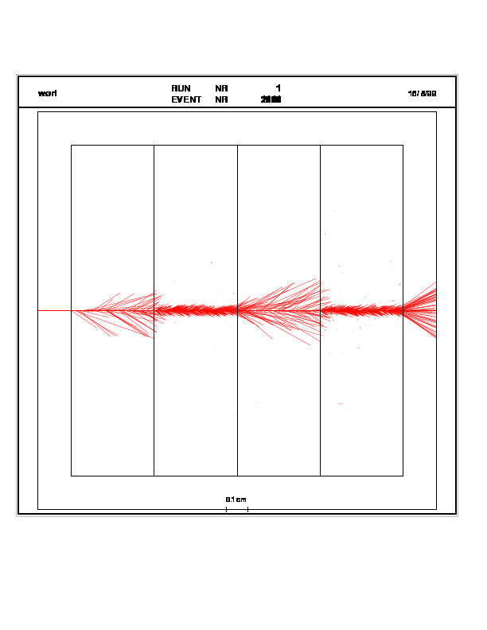
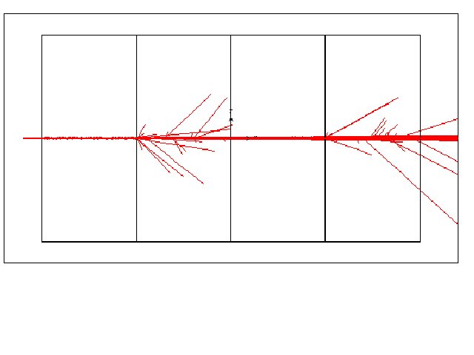
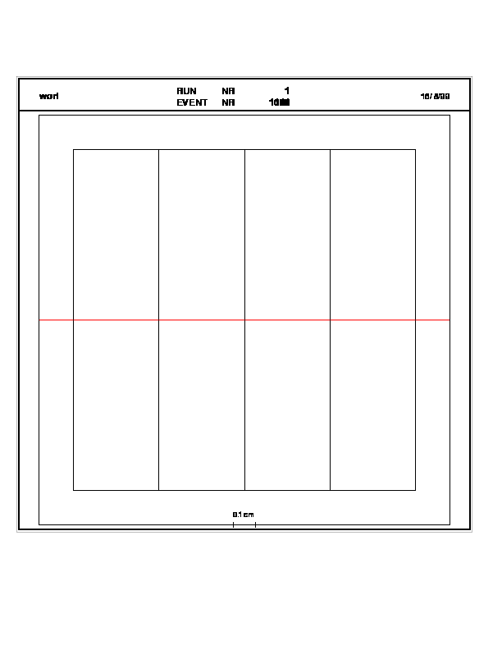
Effect of production thresholds
In Geant3
DCUTE = 455 keV
500 MeV incident proton
one must set the cut for delta-rays (DCUTE) either to the Liquid Argon value, thus producing many small unnecessary δ-rays in Pb,
Liquid
Ar
Pb
Liquid
Ar
Pb
Threshold in range: 1.5 mm
or to the Pb value, thus killing the δ-rays production everywhere
455 keV electron energy in liquid Ar
2 MeV electron energy in Pb
DCUTE = 2 MeV

Slide 73
Violations of the production threshold
In some cases particles are produced even if they are below the production threshold
This is intended to let the processes do the best they can
It happens typically for
  decays
  positron production:
    in order to simulate the resulting photons from the annihilation
  hadronic processes:
    since no infrared divergences affect the cross-sections
Note these are not “hard-coded” exceptions, but a sophisticated, generic mechanism of the tracking

Slide 74
G4VUserPhysicsList
It is one of the mandatory user classes (abstract class)
Pure virtual methods
  ConstructParticles()
  ConstructProcesses()
  SetCuts()
to be implemented by the user in his/her concrete derived class

Slide 75
ConstructParticles()
To get particle G4xxx, you should invoke the static method xxxDefinition() in your ConstructParticles() method:
  for example, to have electrons, positrons and photons:
    void MyPhysicsList::ConstructParticles()
    {
      G4Electron::ElectronDefinition();
      G4Positron::PositronDefinition();
      G4Gamma::GammaDefinition();
    }
Alternatively, some helper classes are provided:
  G4BosonConstructor, G4LeptonConstructor
  G4MesonConstructor, G4BaryonConstructor
  G4IonConstructor, G4ShortlivedConstructor
  G4BaryonConstructor baryonConstructor;
  baryonConstructor.ConstructParticle();

Slide 76
ConstructProcesses()
G4ProcessManager
  attaches processes to particles
  sets their ordering
Several ways to add a process
  AddProcess
  AddRestProcess, AddDiscreteProcess, AddContinuousProcess
And to order AtRest/AlongStep/PostStep actions of processes
  SetProcessOrdering
  SetProcessOrderingToFirst, SetProcessOrderingToLast
  (This is the ordering for the DoIt() methods,
  the GetPhysicalInteractionLength() ones have the reverse order)
Various examples available

Slide 77
SetCuts()
This pure virtual method is used to define the range cut
Recommended way of setting cuts: same cut for all particles
  it is possible to set particle dependent cuts, but it requires some care
The G4VUserPhysicsList base class has a protected member
    protected:
    G4double defaultCutValue;
  (which is set to 1.0*mm in the constructor)
You may change this value in your implementation of SetCuts()
    void MyPhysicsList::SetCuts()
    {
    defaultCutValue = 1.0*mm;
    SetCutsWithDefault();
    }

Slide 78
G4UserLimit
This class allows the user to define the following limits in a given G4LogicalVolume:
  Maximum step size
  Maximum track length
  Maximum track time
  Minimum kinetic energy
  Minimum range
The user can inherit from G4UserLimit, or can instantiate the default implementation
The object has then to be set to the G4LogicalVolume

Slide 79
Summary
The PhysicsList exposes, deliberately, the user to the choice of physics (particles + processes) relevant to his/her application
This is a critical task, but guided by the framework
Examples can be used as starting point

Slide 80
GammaRayTelPhysicsList
…
if (particleName == "gamma") {
// gamma
pManager->AddDiscreteProcess(new G4PhotoElectricEffect());
pManager->AddDiscreteProcess(new G4ComptonScattering());
pManager->AddDiscreteProcess(new G4GammaConversion());
} else if (particleName == "e-") {
// electron
pManager->AddProcess(new G4MultipleScattering(), -1, 1,1);
pManager->AddProcess(new G4eIonisation(), -1, 2,2);
pManager->AddProcess(new G4eBremsstrahlung(), -1,-1,3);
} else if (particleName == "e+") {
// positron
pManager->AddProcess(new G4MultipleScattering(), -1, 1,1);
pManager->AddProcess(new G4eIonisation(), -1, 2,2);
pManager->AddProcess(new G4eBremsstrahlung(), -1,-1,3);
pManager->AddProcess(new G4eplusAnnihilation(), 0,-1,4);
…
SetCutValue(cutForGamma, "gamma");
SetCutValue(cutForElectron, "e-");
SetCutValue(cutForElectron, "e+");
select physics processes to be activated for each particle type:
Geant4 Standard Electromagnetic package is adequate for this experiment
set production thresholds

Slide 81
Now we can run our simulation, track particles, produce showers and record the effects in the detectors…
…but our job is not limited to simulation only

Slide 82
Control, monitor and analyse the simulation

Slide 83
Detailing the design

Slide 84
User Interface in Geant4
Configure the tracker, by modifying the number of active planes, the pitch of the strips, the area of silicon tiles, the material of the converter
Configure the calorimeter, by modifying the number of active elements, the number of layers
Configure the source
Configure digitisation by modifying the threshold
Configure the histograms
Two phases of user user actions
  setup of simulation
  control of event generation and processing
Geant4 provides interfaces for various (G)UI:
  G4UIterminal: C-shell like character terminal
  G4UItcsh: tcsh-like character terminal with command completion, history, etc
  G4UIGAG: Java based GUI
  G4UIOPACS: OPACS-based GUI, command completion, etc
  G4UIBatch: Batch job with macro file
  G4UIXm: Motif-based GUI, command completion, etc
Users can select and plug in (G)UI by setting environmental variables
    setenv G4UI_USE_TERMINAL 1
    setenv G4UI_USE_GAG 1
    setenv G4UI_USE_XM 1
  Note that Geant4 library should be installed setting the corresponding environmental variable G4VIS_BUILD_GUINAME_SESSION to “1” beforehand

Slide 85
Geant4 UI command
A command consists of
  command directory
  command
  parameter(s)
Geant4 UI command can be issued by
  (G)UI interactive command submission
  macro file
  hard-coded implementation
G4UImanager* UI = G4UImanager::GetUIpointer();
UI->ApplyCommand("/run/verbose 1");
To get a list of available commands, including your custom ones:
  /control/manual [directory] (plain text format to standard output)
  /control/createHTML [directory] (HTML file)
List of built-in commands also in the Application Developers User's Guide

Slide 86
UI command and messenger
(G)UI
messenger
2. apply
1. register
4. invoke
UImanager
3. do it
Target class
command
parameter

Slide 87
Messenger class
To define user commands, one implements a concrete messenger class
Constructor
  Instantiate command objects, set guidance, parameter information, etc., and register commands to UImanager
Destructor
  Delete commands (automatically unregistered)
SetNewValue method
  Convert parameter string to values
  Invoke appropriate method of target class object
GetCurrentValue method
  Get current values from target class
  Convert to string

Slide 88
A GammaRayTel user command
GammaRayTelDetectorMessenger::GammaRayTelDetectorMessenger (GammaRayTelDetectorConstruction* gammaRayTelDetector) :GammaRayTelDetector(gammaRayTelDetector)
{
gammaRayTeldetDir = new G4UIdirectory("/payload/");
gammaRayTeldetDir->SetGuidance("GammaRayTel payload control.");
// converter material command
converterMaterialCommand = new G4UIcmdWithAString("/payload/setConvMat",this);
converterMaterialCommand->SetGuidance("Select Material of the Converter.");
converterMaterialCommand->SetParameterName("choice",false);
converterMaterialCommand->AvailableForStates(Idle);
}
void GammaRayTelDetectorMessenger::SetNewValue(G4UIcommand* command,G4String newValue)
{
if (command == converterMaterialCommand) GammaRayTelDetector->SetConverterMaterial(newValue);
}

Slide 89
Macro
A macro is an ASCII file containing UI commands
All commands must be given with their full-path directories
/control/verbose 2
/control/saveHistory
/run/verbose 2
/gun/particle gamma
/gun/energy 1 GeV
/gun/vertexRadius 25. cm
/gun/sourceType 2
# you can modify the geometry of the telescope via a messenger
/payload/setNbOfTKRLayers 10
/payload/update
# run 10 events
/run/beamOn 10
A macro can be executed by
  /control/execute
  /control/loop
  /control/foreach

Slide 90
Visualisation in Geant4
Visualise the experimental set-up
Visualise tracks in the experimental set-up
Visualise hits
Control of several kinds of visualisation
  detector geometry
  particle trajectories
  hits in the detectors
Using abstract G4VisManager class
  takes 3-D data from geometry/track/hits
  passes on to abstract visualization driver
  G4VGraphicsSystem (initialization)
  G4VSceneHandler (processing 3-D data for visualisation)
  G4VViewer (rendering the processed 3-D data)

Slide 91
Visualisable Objects
You can visualise simulation data such as:
  detector components
  a hierarchical structure of physical volumes
  a piece of physical volume, logical volume, and solid
  particle trajectories and tracking steps
  hits of particles in detector components
You can also visualise other user defined objects such as:
  a polyline, that is, a set of successive line segments (e.g. coordinate axes)
  a marker which marks an arbitrary 3D position (e.g. eye guides)
  texts (i.e. character strings for description, comments, or titles)
Visualisation is performed either with commands or by writing C++ source codes of user-action classes
  various pre-defined commands available (see User Documentation)

Slide 92
Available Graphics Software
By default, Geant4 provides visualisation drivers, i.e. interfaces, for
  DAWN : Technical high-quality PostScript output
  OPACS: Interactivity, unified GUI
  OpenGL: Quick and flexible visualisation
  OpenInventor: Interactivity, virtual reality, etc.
  RayTracer : Photo-realistic rendering
  VRML: Interactivity, 3D graphics on Web

Slide 93
How to use visualisation drivers
Users can select/use visualisation driver(s) by setting environmental variables before compilation:
  setenv G4VIS_USE_DRIVERNAME 1
Example (DAWNFILE, OpenGLXlib, and VRMLFILE drivers):
  setenv G4VIS_USE_DAWNFILE 1
  setenv G4VIS_USE_OPENGLX 1
  setenv G4VIS_USE_VRMLFILE 1
Note that Geant4 libraries should be installed with setting the corresponding environmental variables G4VIS_BUILD_DRIVERNAME_DRIVER to “1” beforehand
  setenv G4VIS_BUILD_DAWNFILE_DRIVER 1

Slide 94
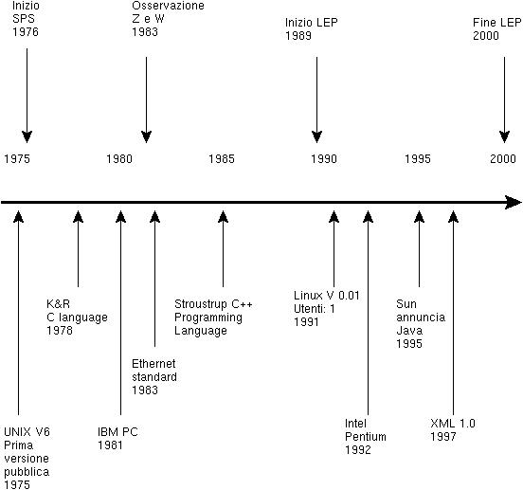


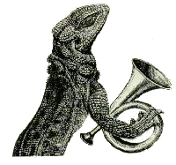

The analysis framework
Plot the x-y distribution of impact of the track
Plot the energy distribution in the calorimeter.
Store significant quantities in a ntuple (energy release in the strips, hit strips) for further analysis
Plot histograms during the simulation execution.
PI (LCG Physicist’s Interfaces)
JAS
OpenScientist
Lizard

Slide 95
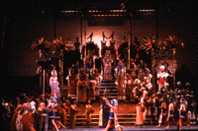
AIDA
Abstract Interfaces for Data Analysis (in HEP)
“The goals of the AIDA project are to define abstract interfaces for common physics analysis tools, such as histograms. The adoption of these interfaces should make it easier for developers and users to select to use different tools without having to learn new interfaces or change their code. In addition it should be possible to exchange data (objects) between AIDA compliant applications.” (http://aida.freehep.org)
Unify/standardize “look and feel” for various tools
  there is no longer “only one tool”
Provide flexibility to interchange implementations of these interfaces
  can use specific features of specific tools w/o change!
Allows and try to re-use existing packages
  even across “language boundaries”
    e.g., C++ analysis using Java Histograms
Minimize coupling between components

Slide 96

Abstract Interfaces
Only pure virtual methods, inheritance only from other Abstract Interfaces
Components use other components only through their Abstract Interfaces
Defines a kind of a “protocol” for a component
Maximize flexibility and re-use of packages
Allow each component to develop independently
De-couple the implementation of a component from its use

Slide 97
Use of Components with Abstract Interfaces
User Code uses only Interface classes
  IHistogram1D* hist = histoFactory-> create1D(‘track quality’, 100, 0., 10.)
Actual implementations are
selected at run-time
  loading of shared libraries
No change at all to user
code but keep freedom
to choose implementation
  flexible
  customizable
User Code
Histo-IF
Fitter-IF
Histo-
Impl. 1
Fitter-
Impl. X
Histo-
Impl. 2
Fitter-
Impl. Y

Slide 98
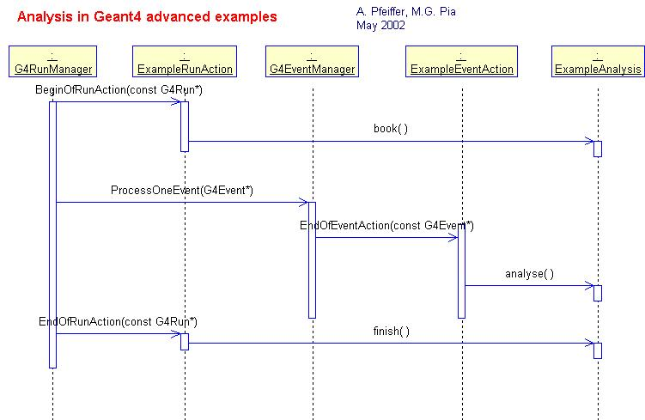
Analysis dynamic flow

Slide 99
Are we done?
Not yet…
Did we satisfy all the original requests?
Which element of the design does a requirement correspond to?
Which requirement does a design element correspond to?
Same for the implementation…
Did we test that each requirement has been correctly satisfied?
Did we provide documentation for usage?
Where are we now in the process of producing our software product?

Slide 100
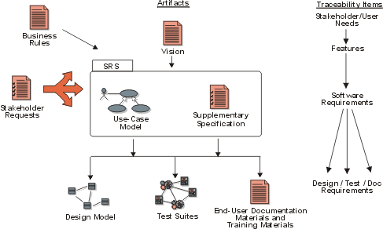
Traceability
Traceability is the ability to trace a project element to other related project elements
From RUP

Slide 101
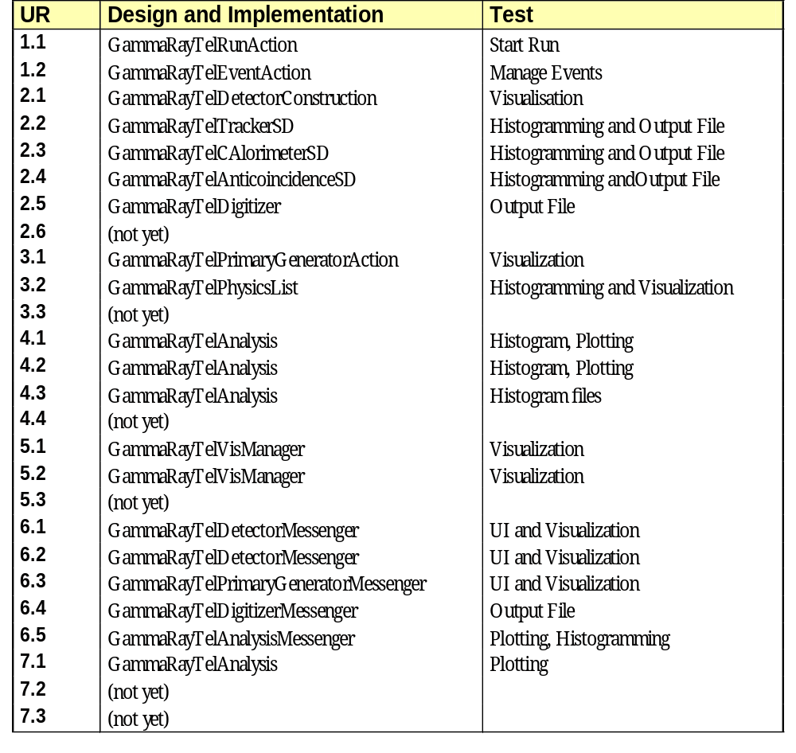
A simple traceability through
User Requirements, Design, Implementation,
Test
Iterative and incremental process
Every release cycle increments the functionality, until all requirements are satisfied

Slide 102
The transition phase
In most cases our software is used in the wider context of an experiment
  documentation
  training collaborators to use our software
  feedback from users
  maintenance
…start an evolutionary cycle for a new version of our software

Slide 103
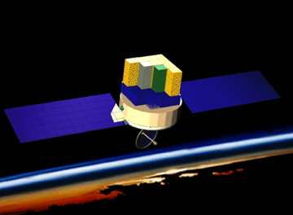
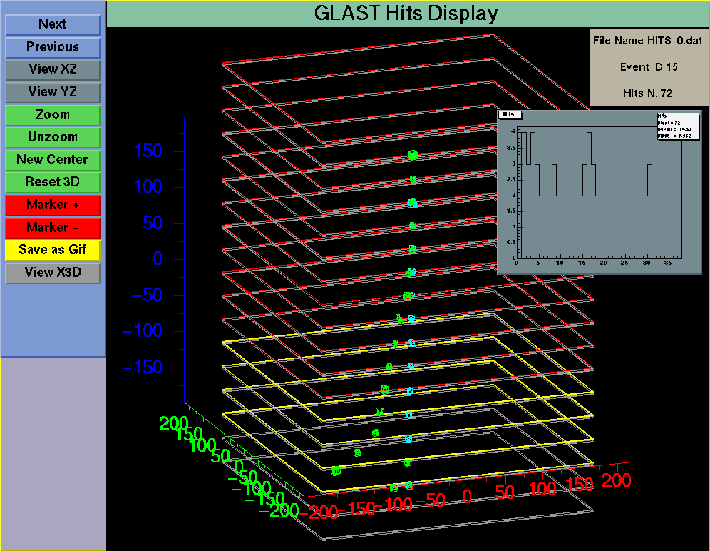
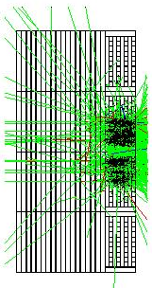
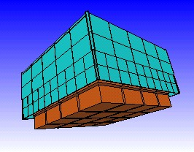
GLAST γ−ray telescope
Credit: Hytec
GLAST
Courtesy of F. Longo and R. Giannitrapani, GLAST

Slide 104
Geant4 GammaRayTelescope advanced example
Developed by
Riccardo Giannitrapani, Francesco Longo, Giovanni Santin
INFN Trieste - Udine
Design and documentation in
http://www.ge.infn.it/geant4/examples/gammaray_telescope/index.html
Source code in
geant4/examples/advanced/gammaray_telescope/

Slide 105

After this school
Any volunteers for an “Alghero advanced example” to be released in Geant4?
Contact me: pia@ge.infn.it

Slide 106


Next Geant4 Training course
IEEE NSS/MIC Short Course on Geant4
  great success in 2003 (46 students)
  repeated in 2004
1 full day
Lectures by Geant4 developers
Guided tour of a simple application
CD with Geant4 installation, examples, documentation, lectures
Conference Sponsors:
The registration fees goes entirely to IEEE, Geant4 lecturers get no money at all!

Slide 107
Documentation
http://cern.ch/geant4/
Introduction to Geant4
Installation Guide
User Guide - For Application Developers
  for those wishing to use Geant4
User Guide - For Toolkit Developers
  for those wishing to extend Geant4 functionality
Software Reference Manual
  documentation of the public interface of all Geant4 classes
Physics Reference Manual
  extended documentation on Geant4 physics
Examples
Novice examples
Extended examples
Advanced examples
illustrating the main functionality of Geant4 in realistic set-ups
Contact persons: TSB members
(listed on the web site)

