Slide 1

MedNudge
Members:
Name: Aastha Goel 01925602714
Megha Goel 03525602714
Parisha Santoshi 02025602714
Mentor’s Name: Mrs. Deepika Garg
MedNudge: A medicine reminder android application

Slide 2
Introduction
People are prone to diseases of different types and it is our duty to make ourselves stay fit and healthy.
In our developing and technology dependent life we totally rely on gadgets especially smart phones.
Most out-patient medication errors were made when patients bought prescribed medicines from different drug stores and use them at home without guidance.
Our application will work as a reminder for those people who miss out medicine due to their busy schedule.

Slide 3

Objectives of our Project
Issue medicine in-take reminders
Provide medicine identification and in-take directions
Maintain medicine in-take records
Remind the patient them about medicine in-take time if they forget to take their medicines
Give care every individual who live away from family because of work

Slide 4
Why we stand out?
We agree that there are various similar applications that exist. But we stand out because:
We have better UI than existing applications which makes it easier to use.
No previous application uses server, that provides them with their information on other devices also.
No other application connects them with their doctor.
We intent to update with voice to text conversion facility.

Slide 5
Working of the project
Launching the Application
This simply includes the process where the user opens the application and is welcomed by the splash screen. This splash screen appears for 4 secs only and is then directly directed to the login page after the end of 4s.
Login Screen
This screen will provide the user with the option of login in the application. Also new users will see the option of signup. There will be separate login for doctor and patient. The credentials will be matched with separate database created.
Signup Screen
This page is only for first time users. First time users can create their username and password with the help of this page. This page will ask for additional details like name, age, sex, contact number etc. Separate Signup pages are designed for patient and doctor.

Slide 6
A patient logins
Whenever a patient logins, he/she will be redirected to the page where they can see its profile. They can edit their profile. Also this will provided the 3 important options of View prescription, Add medication, and History. These have the most significant role in the application.
View Prescription
This will show details of all the added medicines. User can also upload the image of the written prescription. User can edit this at any instance.
Add Medicine/Set Alarm
Here the patient will be allowed to add new medicines in the prescription. Wherein he/she will be asked to input the name, prescribed by, dosage unit, and other specification. They can set their alarm at this page.

Slide 7
History
This page will show the intake history of the medicines. This will help users to keep track of the medicine take.
A doctor logins
Whenever a patient logins, he/she will be redirected to the page where they can see its profile. They can edit their profile. Doctor can perform all similar functionality other than setting the alarm.

Slide 8
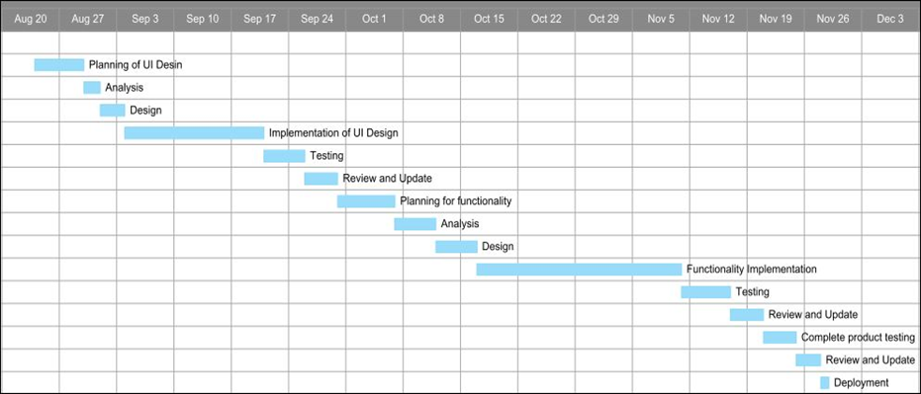
Time plan as per synopsis proposal

Slide 9
Work Completed till now
Requirement Analysis
Planning of UI design
Analysis of design
Implementation of UI design
Testing of Design
Planning of functionality
Analysis of functionality

Slide 10
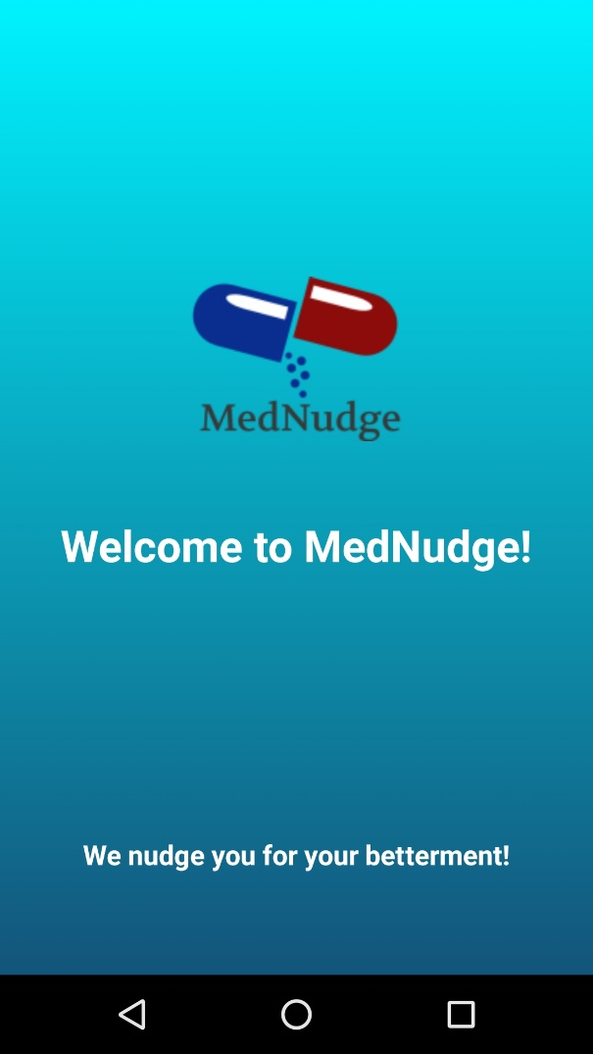
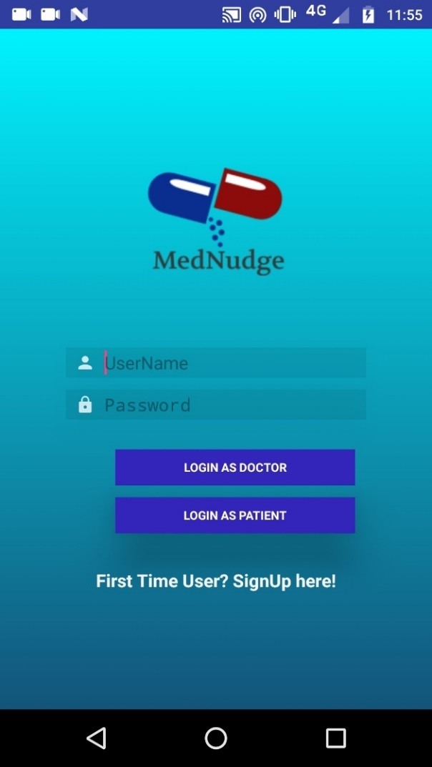
Where have we reached so far

Slide 11
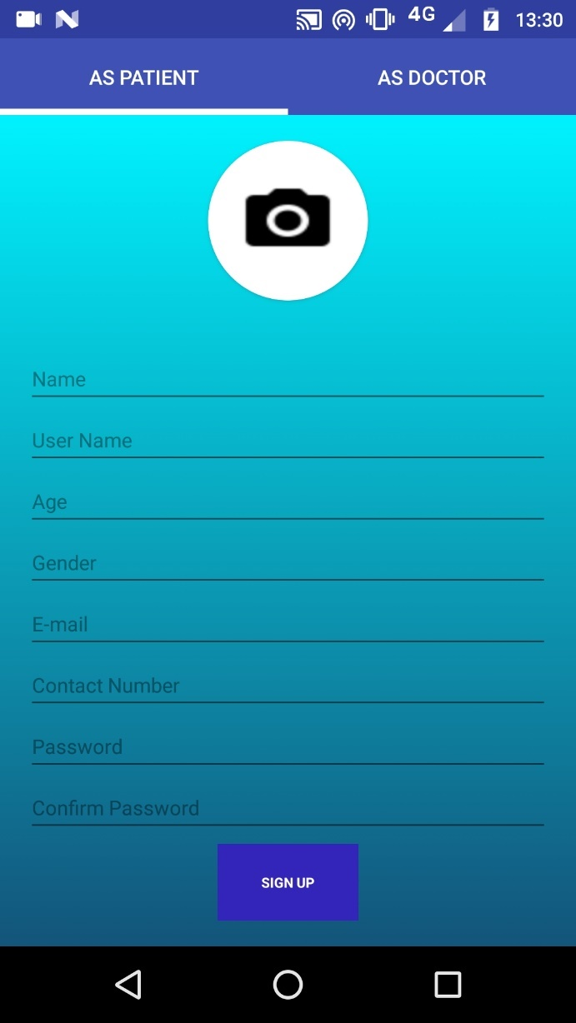
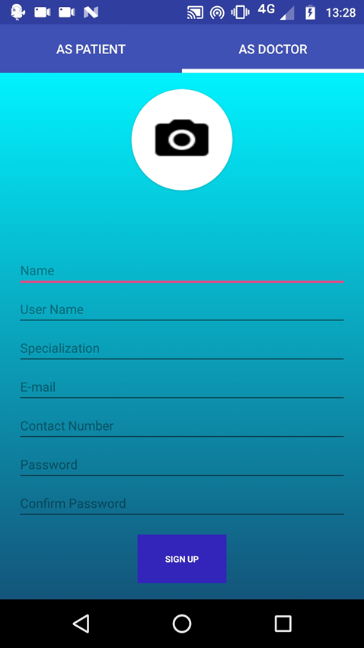

Slide 12
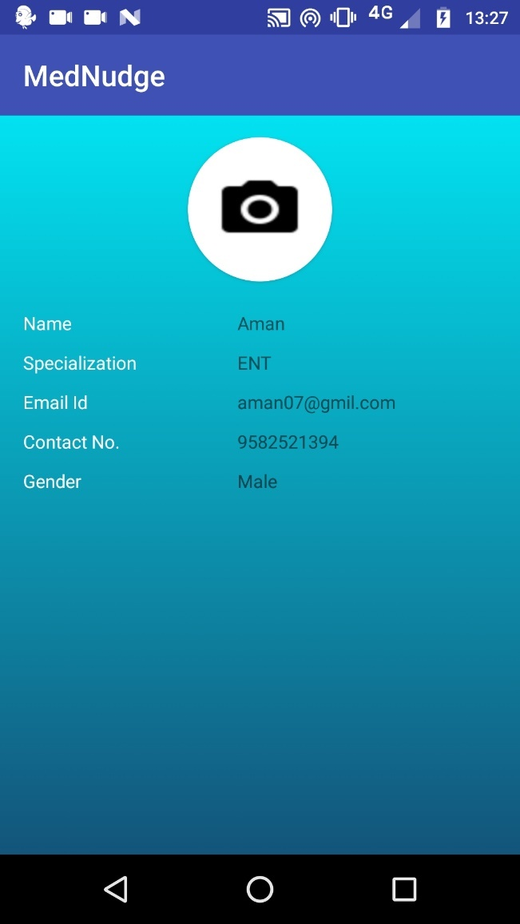
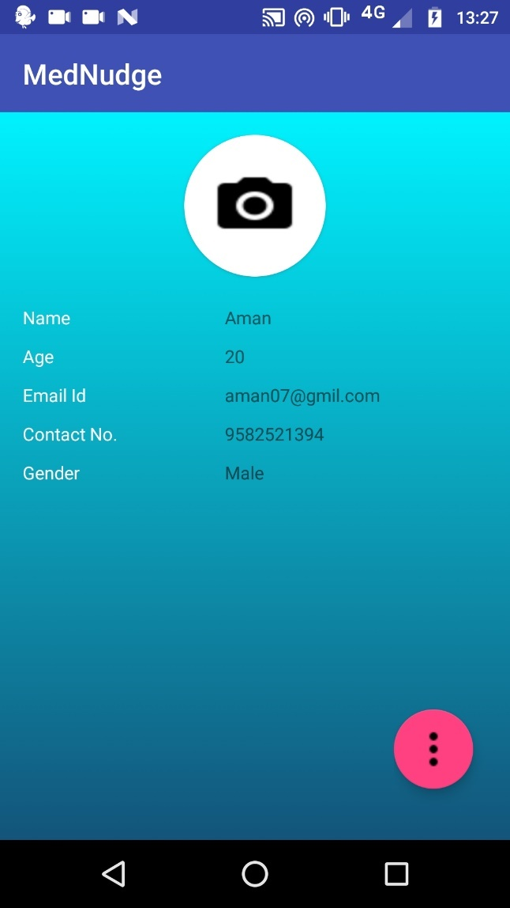
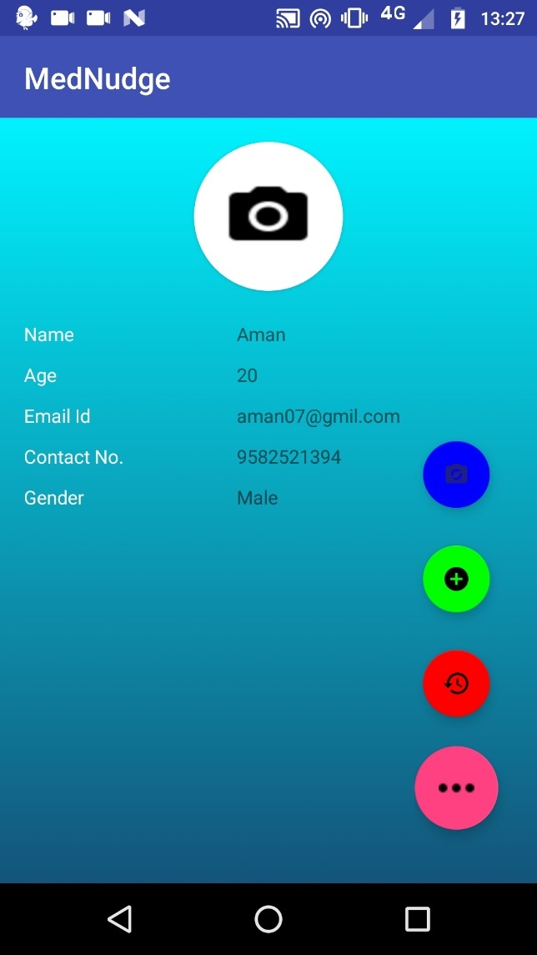


Slide 13
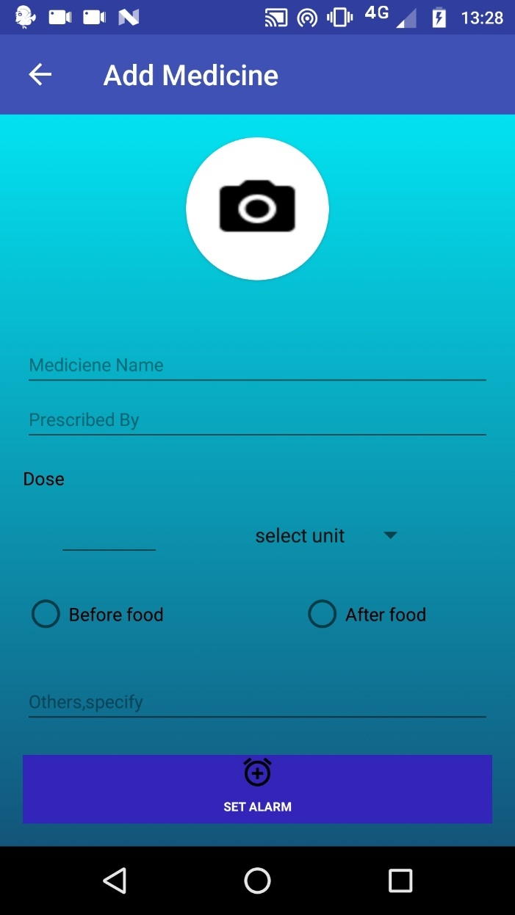
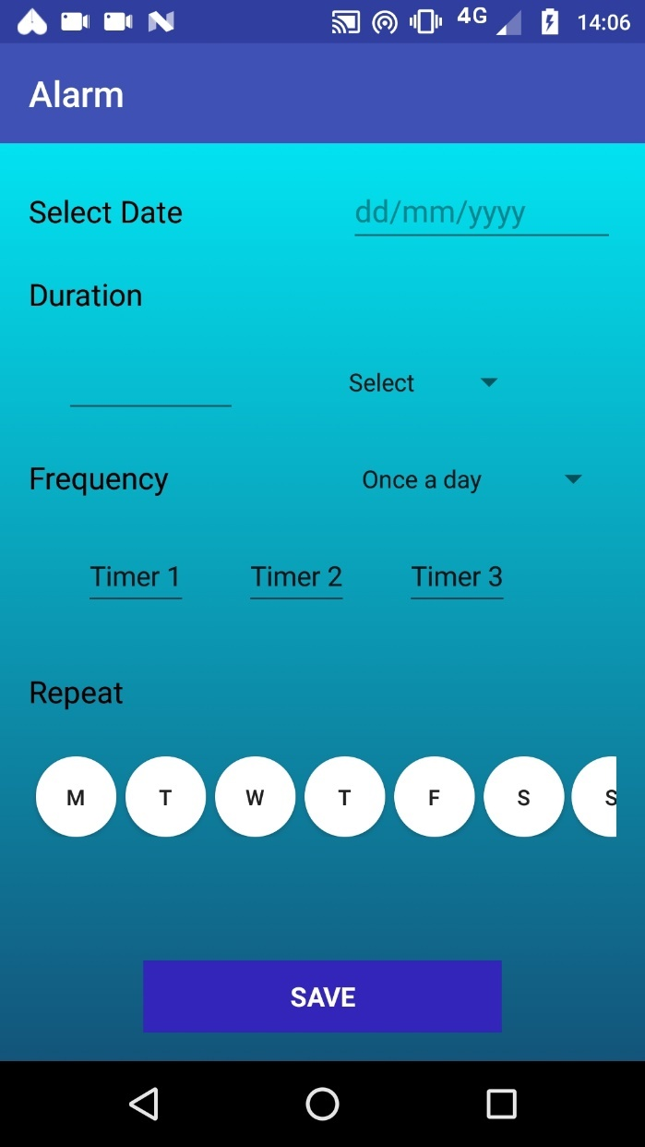
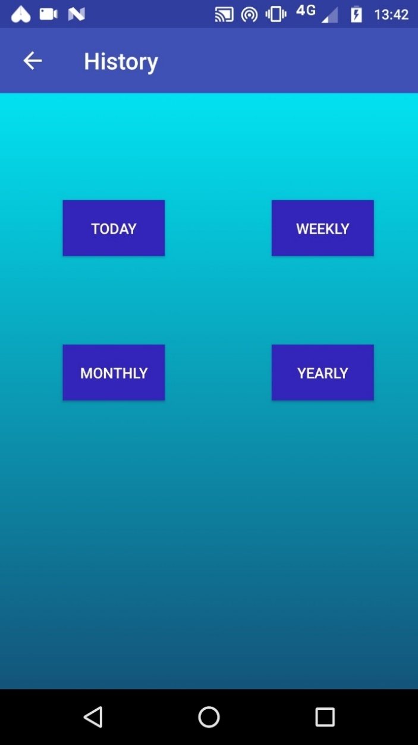

Slide 14
Thankyou!

