Slide 1
Introduction to Reproduction
Date: 18-06-2025
Dr. Yerra Vishnu Akhil Raj Kumar
Senior Resident, AIIMS Bibinagar
MBBS- AIIMS Patna
Bio-Design Fellow- IIT Hyderabad
MD Physiology- AIIMS Raipur

Slide 2
Contents
Case Scenarios
Male and Female Reproduction systems
Techniques
Recent Advances

Slide 3
Case Scenarios

Slide 4
Case 1

Slide 5
A 17-year-old girl, Priya from Bhopal, visits the gynecology OPD with her mother due to absent menstruation.
History reveals
Well-developed breasts (Tanner Stage V)
Sparse/absent pubic and axillary hair
No history of menarche
Height is taller than peers
External genitalia appear female
Ultrasound shows absence of uterus and ovaries
Karyotyping: 46, XY

Slide 6
What is the likely diagnosis?
What is the physiological cause behind this presentation?
Why are breasts present but no menstruation?

Slide 7
Case 2

Slide 8
A 16-year-old schoolgirl, Meenakshi from Chennai, presents with no onset of periods and short stature.
History:
Height: 138 cm
Webbed neck and broad chest
No breast development
External genitalia: normal female
No significant pubertal growth spurt
USG: Streak ovaries and hypoplastic uterus
Karyotyping: 45, X0

Slide 9
What is the likely chromosomal abnormality?
Why has puberty not progressed in this girl?
What hormones would be altered?

Slide 10
Case 3

Slide 11
An IT professional couple from Hyderabad, married for 4 years, unable to conceive.
History of wife (28 yrs):
Irregular periods since adolescence
Weight gain and facial hair
BMI: 30
Acne, hirsutism
Ultrasound: Bilaterally enlarged ovaries with peripheral cysts
Hormones: ↑LH:FSH ratio, ↑androgens, normal prolactin

Slide 12
What hormonal imbalance leads to infertility in this case?
What lifestyle modifications or treatments can help?

Slide 13
Case 4

Slide 14
Rani, 25-year-old mother from rural UP, delivered her second child 6 weeks ago, now visiting for family planning advice.
History:
Wants to space next pregnancy for at least 3 years
Breastfeeding regularly
Husband prefers reversible method
Limited access to healthcare
Wants something long-term and hassle-free

Slide 15
What contraceptive options are ideal for her?
Why is lactational amenorrhea not a long-term solution?
How does each method (CuT, POPs, DMPA) work physiologically?

Slide 16
Case 5

Slide 17
Mr. Rakesh, a 32-year-old software engineer from Pune, presents to the fertility clinic with his wife after 2 years of unprotected intercourse with no conception.
History:
Normal libido and sexual function
No significant past medical or surgical history
No history of mumps or trauma
No exposure to chemotherapy or radiation
Married for 3 years
No prior pregnancies in wife or himself

Slide 18
Clinical Findings:
Secondary sexual characteristics normal
Testicular volume: Normal
Vas deferens palpable bilaterally
Semen analysis:
  Volume: 2.5 ml
  Sperm count: 0 / high power field (confirmed on two samples)
  Fructose test: Positive
Hormonal profile:
  FSH & LH: Normal
  Testosterone: Normal

Slide 19
What are the possible causes of azoospermia?
How do you differentiate between obstructive and non-obstructive azoospermia?
What is the significance of fructose positivity in semen?
How is spermatogenesis regulated hormonally?
What next investigations are needed (e.g., testicular biopsy, scrotal ultrasound)?

Slide 20
Male and Female Reproductive Systems

Slide 21
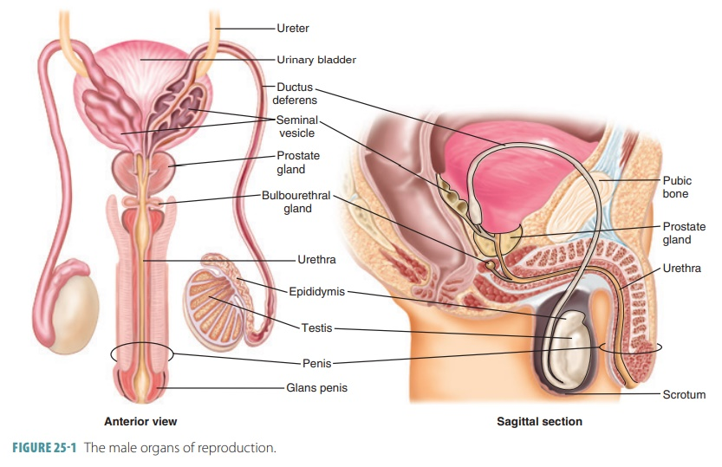

Slide 22
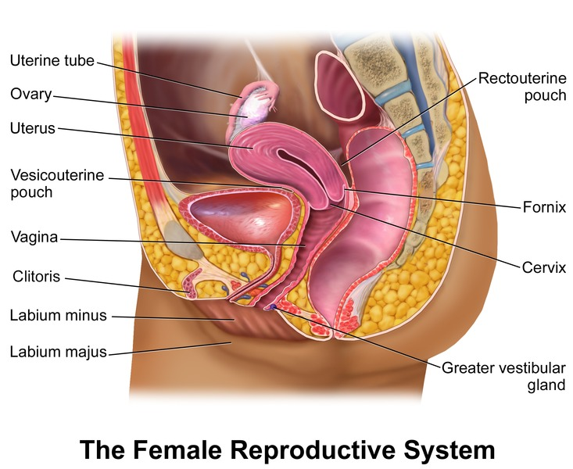

Slide 23
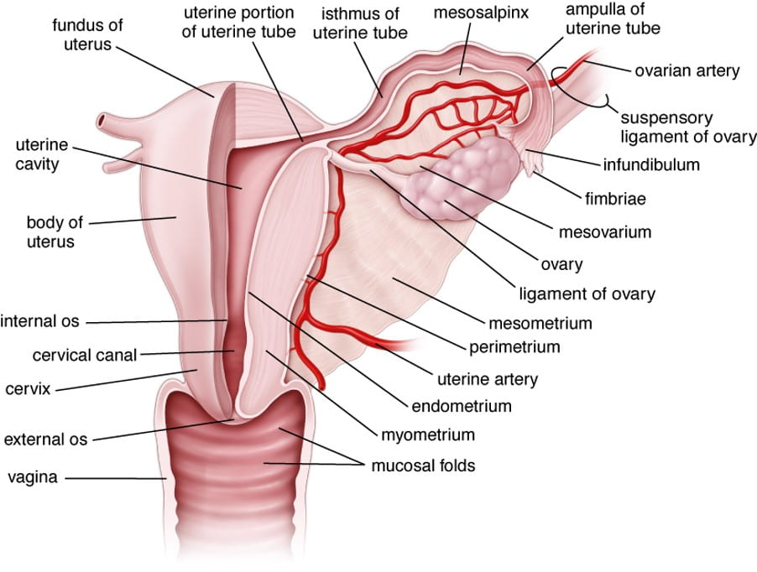

Slide 24
Techniques

Slide 25
Diagnostic & Imaging Techniques
1. Ultrasound (USG)
Transabdominal Sonography (TAS)
Transvaginal Sonography (TVS)
Obstetric USG – Biometry, fetal well-being, anomaly scan
Doppler Studies – Uterine, umbilical, and fetal vessels
2. Hysterosalpingography (HSG)
Radiographic imaging of uterus and fallopian tubes using contrast
Used in infertility evaluation (tubal patency)
3. Saline Infusion Sonohysterography (SIS/Saline Hysterosonography)
Ultrasound with saline injected into uterine cavity to visualize polyps, fibroids, septa
4. Magnetic Resonance Imaging (MRI)
For pelvic mass characterization, deep infiltrating endometriosis
5. CT Scan (limited use)
Usually for malignancy staging when MRI not available

Slide 26
Endoscopic Techniques
1. Hysteroscopy
Direct visualization of uterine cavity using a hysteroscope
Diagnostic and operative (polyp removal, septum resection)
2. Laparoscopy
Minimally invasive inspection of pelvic cavity
Diagnostic (infertility, endometriosis) or operative (ectopic pregnancy, ovarian cysts, sterilization)
3. Colposcopy
Magnified inspection of cervix after applying acetic acid/Lugol’s iodine
For evaluation of abnormal Pap smear
4. Culdoscopy (less commonly used now)
Endoscopic exam of pelvic organs via posterior vaginal fornix

Slide 27
Interventional & Therapeutic Techniques
1. Dilation and Curettage (D&C)
Used in abnormal uterine bleeding, incomplete abortion, diagnostic curettage
2. Dilation and Evacuation (D&E)
For second-trimester abortion or retained products
3. Endometrial Biopsy
For evaluating abnormal uterine bleeding and infertility
4. Amniocentesis
Sampling amniotic fluid for genetic diagnosis, fetal lung maturity
5. Chorionic Villus Sampling (CVS)
First-trimester test for fetal karyotyping/genetic disorder
6. Non-Stress Test (NST)
Fetal monitoring in antenatal care to assess heart rate variability
7. Cardiotocography (CTG)
Fetal heart rate and uterine contraction tracing

Slide 28
Assisted Reproduction Techniques (ART)
1. Intrauterine Insemination (IUI)
Processed sperm introduced into uterine cavity around ovulation
2. In Vitro Fertilization (IVF)
Oocyte retrieval, fertilization in lab, embryo transfer
3. Intracytoplasmic Sperm Injection (ICSI)
Single sperm injected into oocyte, used in severe male factor infertility
4. Embryo Cryopreservation & Transfer
Embryos stored for later use, common in IVF cycles

Slide 29
Genetic & Hormonal Tests
1. Karyotyping
Chromosomal analysis for infertility, recurrent pregnancy loss
2. Hormonal Assays
FSH, LH, AMH, Prolactin, TSH, Estradiol, Testosterone
3. Pap Smear
Cervical cancer screening
4. HPV DNA Testing
For high-risk HPV strains (cervical cancer risk assessment)

Slide 30
Recent Advances

Slide 31
Advances In Diagnostic Technologies
1. Microfluidic Sperm Sorting
Replaces centrifugation-based methods in IUI/IVF labs
Enhances selection of motile, morphologically normal sperm
Less DNA fragmentation → higher success in ART
2. Endometrial Receptivity Analysis (ERA Test)
Genetic test that determines optimal window of implantation
Tailors embryo transfer timing in IVF → personalized embryo transfer (pET)

Slide 32
3. Non-Invasive Prenatal Testing (NIPT) with AI Algorithms
Uses cell-free fetal DNA from maternal blood
Detects trisomies and microdeletions as early as 9–10 weeks
Now enhanced with machine learning for risk stratification
4. Artificial Intelligence in Ultrasound Interpretation
AI-powered transvaginal scans to detect PCOS, adenomyosis, ovarian reserve
Pattern recognition for anomaly scans and tumor classification
5. Digital Colposcopy + AI (Cervical Cancer Screening)
Smartphone-based high-res colposcopy + automated VIA/VILI interpretation
Increases cervical cancer detection in low-resource settings (like rural India)

Slide 33
Therapeutic and Interventional Advances
1. Uterine Transplantation (Live Donor)
Now considered for women with Müllerian agenesis / Asherman’s syndrome
Trials in India and abroad for ethical feasibility and outcomes
First successful Indian baby born post-uterine transplant: Pune, 2017, followed by newer refinements
2. CRISPR/Cas9 for Infertility Research
Gene-editing tools applied in germline mutation correction
Focus on genes causing azoospermia, ovarian insufficiency
Still experimental, but breakthroughs in mice and cell lines

Slide 34
3. Platelet-Rich Plasma (PRP) for Ovarian Rejuvenation
PRP injected into ovaries in women with premature ovarian failure (POI)
Reported cases of resumed menstruation and egg retrieval in some women
4. Robotic-Assisted Laparoscopic Surgery
Used for deep endometriosis, fibroid removal, myomectomy
Increased precision with minimal invasiveness and better fertility outcomes
5. Organoid Models of Uterus, Ovary, and Testis
Lab-grown miniature organs mimicking real tissue
For drug testing, reproductive cancer research, and stem cell therapy development

Slide 35
Artificial Reproductive Technology (ART) Innovations
1. Time-Lapse Embryo Imaging (EmbryoScope™)
Monitors embryo development in real-time
Uses AI to predict embryo viability and improves IVF success rate
2. 3D Printed Ovaries (Bioengineered Scaffolds)
Animal studies show potential of 3D-printed scaffolds seeded with follicles
Could help preserve fertility in cancer survivors

Slide 36
3. In Vitro Gametogenesis (IVG)
Deriving sperm and eggs from iPSCs (induced pluripotent stem cells)
Future hope for infertile and same-sex couples, still in experimental stages
4. Wearable Fertility Trackers
Devices measuring temperature, heart rate variability, LH
Uses AI to predict ovulation and menstrual phase with higher accuracy

Slide 37
Preventive & Genomic Tools
1. Preimplantation Genetic Testing (PGT-A / PGT-M / PGT-SR)
Detects aneuploidy, monogenic disorders, and structural rearrangements
Increasing IVF success by ensuring healthy embryo transfer
2. Fertility Preservation in Transgender Individuals
Oocyte, sperm, and testicular/ovarian tissue cryopreservation before hormone therapy
Now more streamlined and ethically supported across clinics in India

Slide 38
Other trends
Menstrual blood stem cell (MenSC) research – for endometrial regeneration
Nano-formulations for hormone delivery (e.g., estrogen/progesterone nanoparticles)
Virtual reality and gamification in antenatal counseling and reproductive education

Slide 39
Thank You

