Slide 1
Ovulation and Oogenesis
Date: 26-06-2025
Dr. Yerra Vishnu Akhil Raj Kumar
Senior Resident, AIIMS Bibinagar
MBBS- AIIMS Patna
Bio-Design Fellow- IIT Hyderabad
MD Physiology- AIIMS Raipur

Slide 2
Primordial germ cells
Migrate into ovary from the yolk sac of the embryo
Oogonia
Primordial germ cells undergo multiple times mitosis to form oogonia (Primordial ova)
Primordial Follicle
Oogonia surrounded by a single layer of cells of ovarian stroma
The primary oocyte arrest in Prophase-1 of meiosis 1 till puberty

Slide 3
7th month of gestation
7 million germ cells
At birth
2 million germ cells
At Puberty
Only 3,00,000 germ cells

Slide 4
At Puberty
First meiotic division completes- Forms one secondary oocyte and first polar body
Female reproductive monthly cycles (both ovarian and endometrial) starts

Slide 5
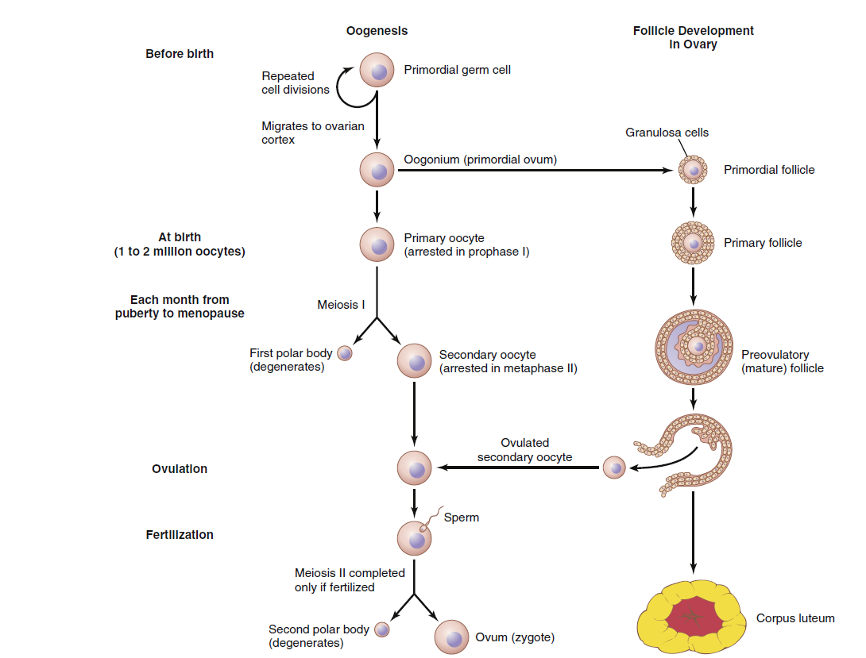

Slide 6
Female reproductive monthly cycle= Menstrual Cycle
Ovarian Cycle
Uterine Cycle
Formation of ovum from primordial follicles.
Secretion of female sex hormones. (Estrogen and Progesterone)
Action of estrogen and progesterone released act on uterine endometrium
If pregnancy, the endometrial layer is shed

Slide 7
Ovarian cycle

Slide 8
Phases of ovarian cycle
Follicular Phase
Ovulation
Luteal Phase

Slide 9
Follicular Phase
Oocyte differentiates into mature egg and this process is called Oogenesis.

Slide 10
Primordial Follicle
Present since 4-5 month post-conception
Contains oocyte with single layer of granulosa cells
Primary Follicle
Ovum diameter doubled
Proliferation of granulosa cells (due to action of FSH)
Secondary Follicle
Appearance of theca cells in discrete layers (Interna and Externa)
Fully Mature Antral Follicle
Quiescent or Least Biological Activity
Zona pellucida develops
Contains enzymes to help sperm penetration
Formation of antral cavity
Also known as Graafian follicle
Different cells respond to FSH and LH
Ready for ovulation

Slide 11
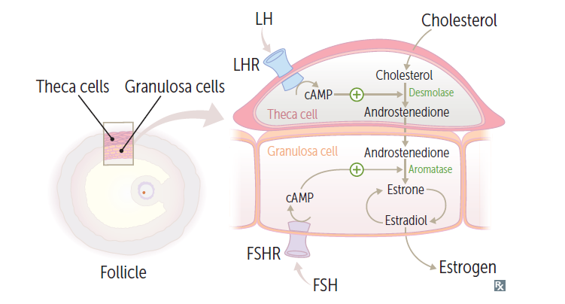
Granulosa cells convert androgen and progesterone synthetized by theca cells to oestrogen by enzyme aromatase

Slide 12
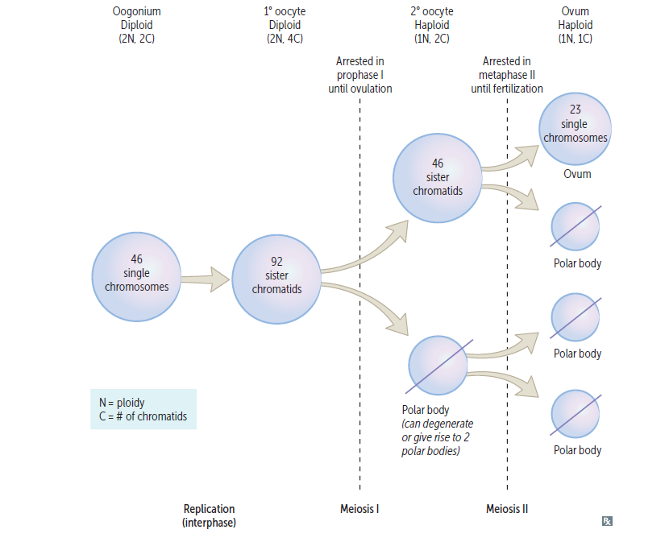

Slide 13
Ovulation

Slide 14
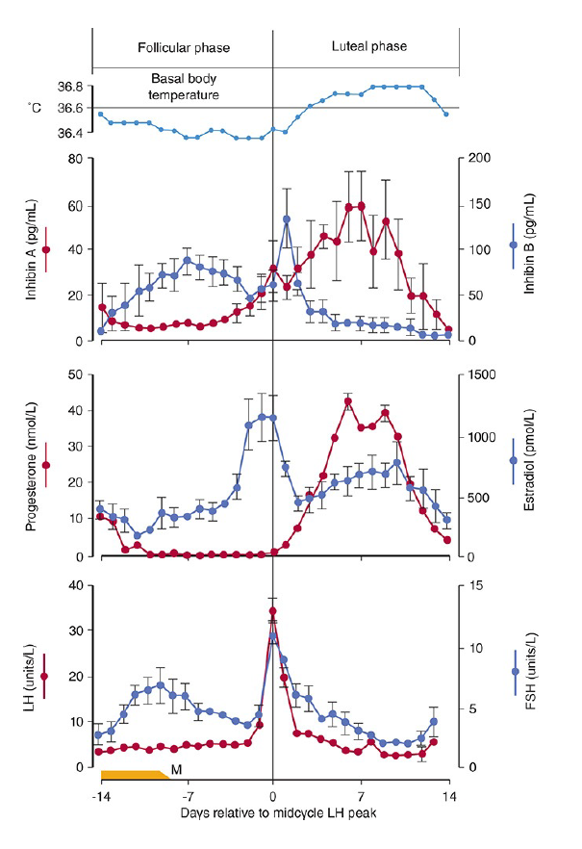

Slide 15
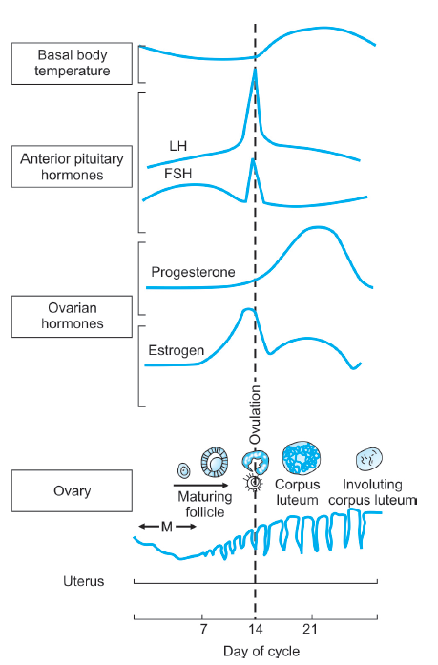

Slide 16
LH Surge
Oestrogen secreted at 200pg/ml or greater for more than 48 hours causes LH surge.

Slide 17
Ovulation
Luteinizing hormone surge
(Peaks 16 hours before ovulation)
Progesterone
Proteolytic enzymes
(collagenase)
Follicular hyperemia and prostaglandin secretion
Weakening of follicular wall
Plasma transduction into follicle
Disintegration at stigma
Follicular swelling
Follicular rupture and release of OVUM

Slide 18
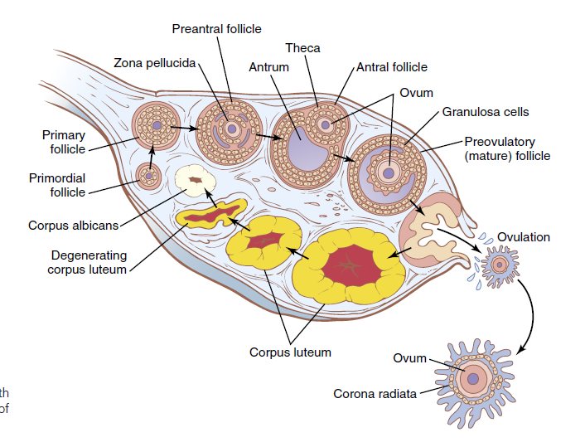

Slide 19
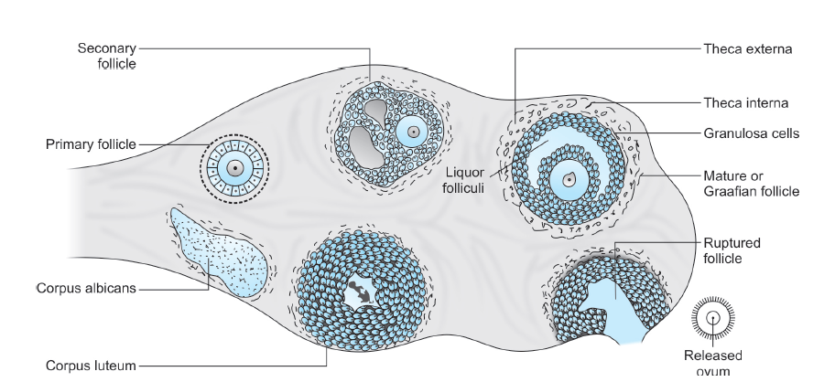

Slide 20
Indicators of Ovulation
Increase in body temperature
(0.5 degree Celsius)
1 to 2 days after ovulation
Lower abdominal pain
(Mittelschmerz)
Due to leakage of blood in abdominal cavity during ovulation
LH surge
Immunological test
Progesterone acts on hypothalamus increasing the set point
Cervical mucus test
(Decrease in viscosity of mucus)
Estrogen makes cervical mucus elastic. In luteal phase it becomes cellular and thick by progesterone
Spinnbarkeit Phenomenon

Slide 21
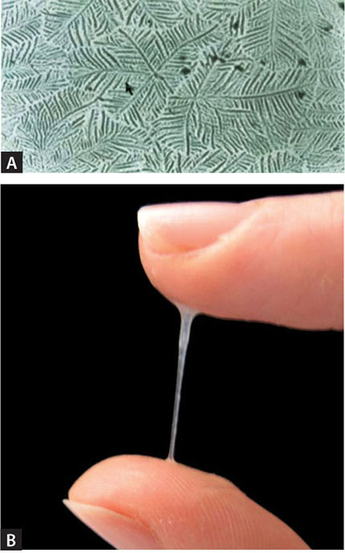

Slide 22
Indicators of Ovulation
Fern test
When cervical mucus is smeared on a slide, it dries like a fern pattern
Endometrial
biopsy
Secretive/ Proliferative changes
Ultrasound
Monitoring growth of Follicle
Laparoscopy
Demonstration of ovum in abdominal cavity
After ovulation, progesterone is high and fern pattern does not form
Vaginal cytology
Proliferative phase- Oestrogen high- Keratinization more
Secrertory phase- progesterone high- wet, less keratinization

Slide 23
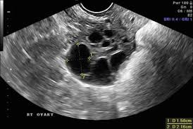

Slide 24
Thank You

