Slide 1
Visual and Auditory pathways
Dr. Yerra Vishnu Akhil Raj Kumar
Senior Resident, Dept. of Physiology, AIIMS Bibinagar
MBBS- AIIMS Patna
MD Physiology- AIIMS Raipur

Slide 2
Contents
Visual Pathway
Auditory Pathway

Slide 3
Visual Pathway

Slide 4
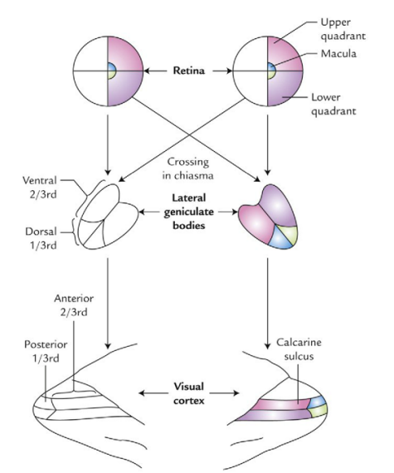

Slide 5
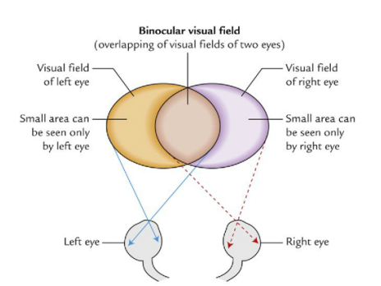

Slide 6
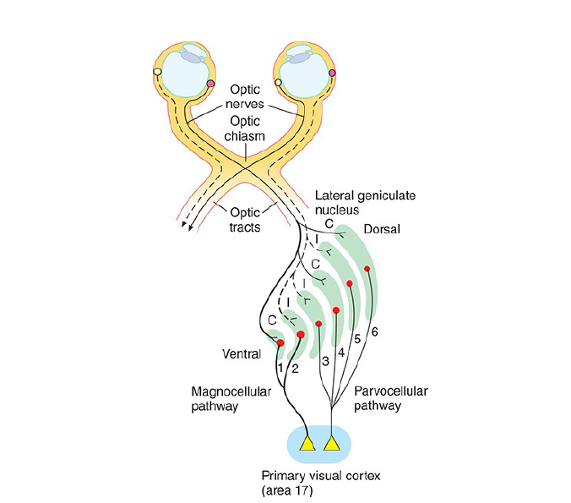

Slide 7
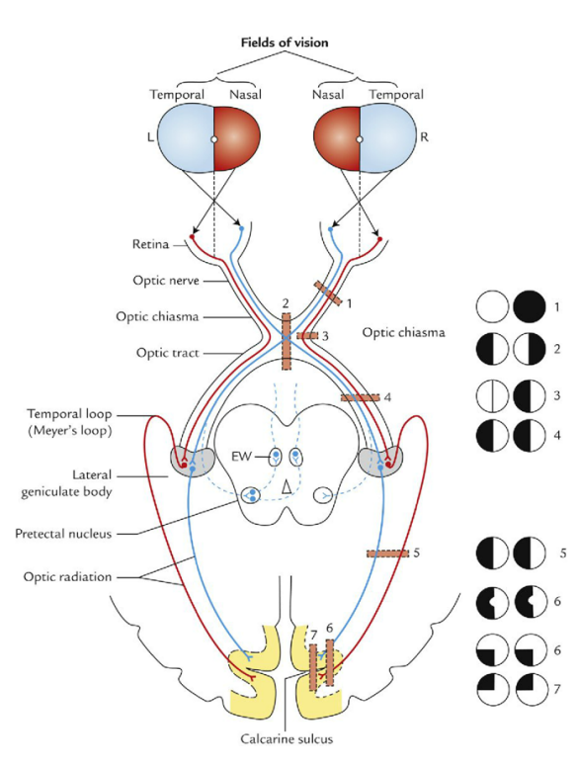

Slide 8
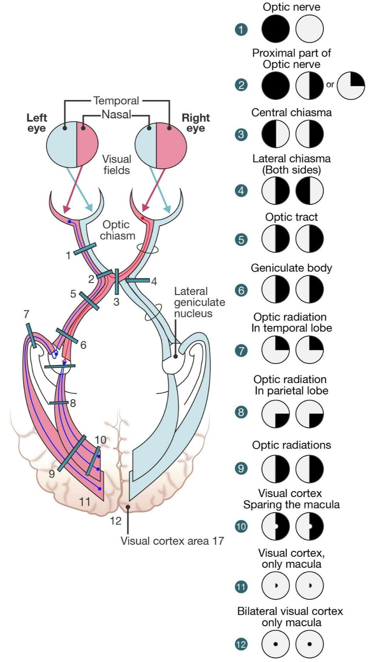

Slide 9
Auditory Pathway

Slide 10
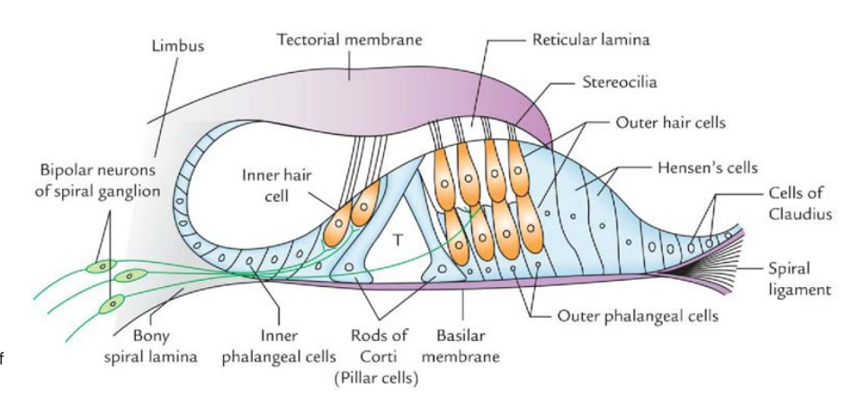

Slide 11
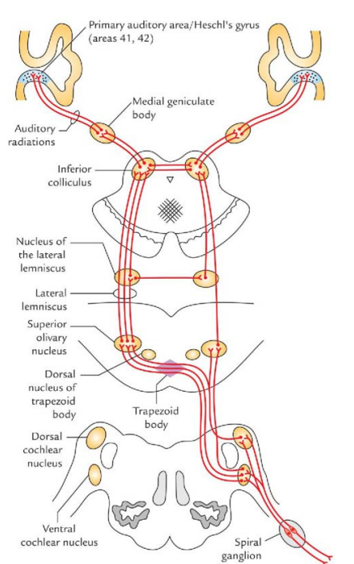
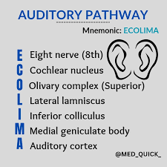

Slide 12
Thank You

