Slide 1
Cardiac cycle
Date: 29-10-2025
Dr. Yerra Vishnu Akhil Raj Kumar
Senior Resident, AIIMS Bibinagar
MBBS- AIIMS Patna
Bio-Design Fellow- IIT Hyderabad
MD Physiology- AIIMS Raipur

Slide 2
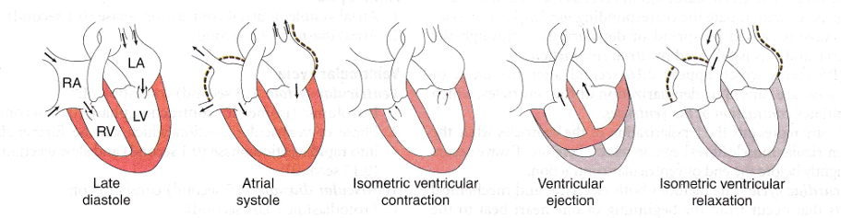

Slide 3
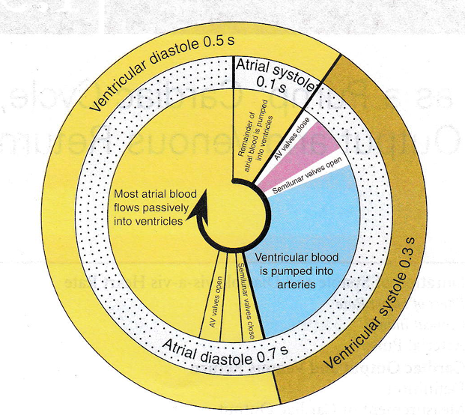

Slide 4
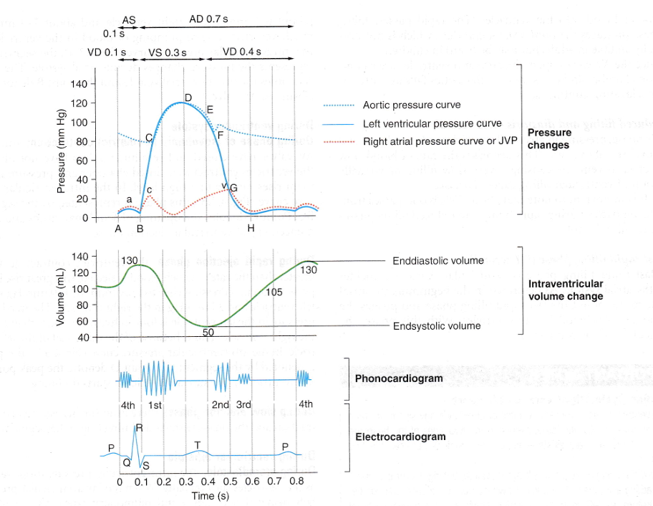

Slide 5
