Slide 1
Apoptosis
Date: 01-10-2025
Dr. Yerra Vishnu Akhil Raj Kumar
Senior Resident, AIIMS Bibinagar
MBBS- AIIMS Patna
Bio-Design Fellow- IIT Hyderabad
MD Physiology- AIIMS Raipur

Slide 2
Contents
Case Scenario
History
Apoptosis and Necrosis
Extrinsic and Intrinsic pathways
Recent Advances

Slide 3
Case Scenarios

Slide 4
A 52-year-old man presented with complaints of progressive fatigue, weight loss, and abdominal fullness. On examination, he was found to have splenomegaly, and a bone marrow biopsy confirmed chronic myeloid leukemia. He was started on standard chemotherapy. The effectiveness of many anticancer drugs depends on their ability to trigger apoptosis in malignant cells. Chemotherapeutic agents and radiation therapy induce DNA damage, and cells with intact apoptotic machinery undergo programmed cell death once the damage is irreparable. However, in cancer, mutations in tumor suppressor genes such as p53 or overexpression of anti-apoptotic proteins like Bcl-2 allow malignant cells to evade apoptosis, leading to drug resistance and disease persistence.

Slide 5
A 70-year-old woman presented with progressive memory loss, disorientation, and difficulty performing daily activities. Neuroimaging revealed cortical atrophy, and cerebrospinal fluid analysis showed reduced β-amyloid clearance. In Alzheimer’s disease, abnormal accumulation of β-amyloid plaques and tau protein tangles leads to oxidative stress, mitochondrial dysfunction, and activation of pro-apoptotic pathways in neurons. This results in gradual neuronal apoptosis, particularly in the hippocampus and cortex, causing progressive cognitive decline. Unlike necrosis, which is inflammatory and abrupt, the slow, regulated nature of apoptosis explains the insidious onset and chronic progression of symptoms. Therapies targeting amyloid or modulating apoptosis-related proteins (such as caspase inhibitors or mitochondrial stabilizers) are being explored to delay neuronal loss.

Slide 6
History

Slide 7
Carl Vogt (1842) – First described programmed cell death in tadpole tail resorption.
Walther Flemming (1885) – Observed “chromatin condensation and nuclear fragmentation” during normal tissue turnover; early light-microscopic description.
Glücksmann (1951) – Proposed cell death as a normal part of embryogenesis and tissue remodeling.
Kerr, Wyllie & Currie (1972) – Coined the term “apoptosis” (from Greek, “falling off,” like leaves from a tree) in their landmark paper; distinguished it from necrosis.
John Kerr (1970s–80s) – Detailed morphological features of apoptosis.
Andrew Wyllie – Described the biochemical hallmarks (DNA fragmentation into nucleosome ladders).
Stanley Korsmeyer (1980s–1990s) – Identified Bcl-2 family genes regulating apoptosis (anti-apoptotic vs pro-apoptotic).
Yoshinori Ohsumi (1990s) – Studied autophagy but helped separate autophagic cell death from apoptosis.
Sydney Brenner, John Sulston, H. Robert Horvitz (2002 Nobel Prize) – Discovered genetic control of apoptosis in C. elegans, including ced-3, ced-4, ced-9.

Slide 8


Slide 9
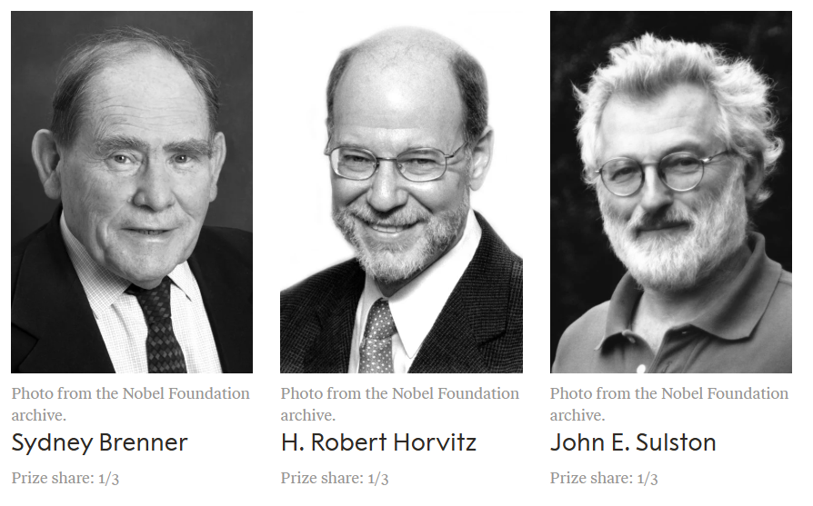

Slide 10
Apoptosis and Necrosis

Slide 11
Feature | Necrosis | Apoptosis
Cause | Always pathological (ischemia, toxins, infections, trauma) | Physiological (embryogenesis, hormone withdrawal, immune regulation) or pathological (DNA damage, misfolded proteins, viral infection)
Cell size | Enlarged (cell swelling) | Reduced (cell shrinkage)
Plasma membrane | Disrupted, contents leak out | Intact but altered → blebbing, formation of apoptotic bodies
Nucleus | Pyknosis → Karyorrhexis → Karyolysis (random breakdown) | Fragmentation into nucleosome-sized pieces (ordered)
Cytoplasm | Increased eosinophilia, amorphous debris | Cytoplasm intact, packed into apoptotic bodies
Inflammation | Frequent (due to leakage of contents) | Absent (cell fragments phagocytosed without leakage)
Pathological/Physiological role | Pathological cell death in response to irreversible injury | Physiological cell removal, also some pathological settings
Energy requirement | Passive (no ATP required) | Active (ATP-dependent)
Outcome | Tissue injury with inflammatory response | Silent cell removal, no inflammation

Slide 12
Intrinsic and Extrinsic Pathways

Slide 13




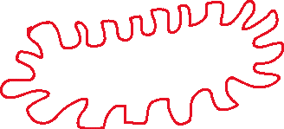













Slide 14















Slide 15






Slide 16
Recent Advances

Slide 17
Cancer Treatment
  Scientists have made medicines that can “switch on” apoptosis in cancer cells.
  Example: Bcl-2 inhibitors like Venetoclax are now used in some leukemias. These drugs block the proteins that normally prevent cancer cells from dying.
Neurodegenerative Diseases
  In diseases like Alzheimer’s and Parkinson’s, too much apoptosis causes loss of brain cells.
  Researchers are testing drugs that protect neurons by slowing down apoptosis, so memory and movement problems may progress more slowly.
Autoimmune Diseases
  In conditions like systemic lupus erythematosus (SLE), faulty clearance of apoptotic cells triggers the immune system to attack the body.
  New treatments aim to improve clearance of dying cells and reduce autoimmunity.

Slide 18
Infections and Immunology
  Some viruses (like HIV, hepatitis) try to block apoptosis to survive inside cells.
  Research is focused on drugs that can force infected cells to undergo apoptosis, limiting viral spread.
Targeted Therapies
  Instead of killing all cells (like traditional chemotherapy), newer drugs act like “precision switches” that only push diseased cells into apoptosis.
  This reduces side effects and makes treatments safer.

Slide 19
1. Electroporation
What it is: Application of short, high-voltage electrical pulses to cells.
What it does: Creates temporary pores (“holes”) in the cell membrane.
Effect on Cancer Cells:
  If low intensity → used to deliver chemotherapy drugs or DNA/RNA directly into tumor cells (“electrochemotherapy”).
  If high intensity and repeated → causes loss of membrane integrity, ion imbalance, mitochondrial damage → apoptosis (programmed cell death).
Example: Electrochemotherapy with bleomycin or cisplatin is now used in skin tumors, head and neck cancers, and soft tissue sarcomas in Europe.

Slide 20
2. Electrical Stimulation (Direct Current / Pulsed Fields)
What it is: Passing controlled electrical currents through tumors.
Effect:
  Alters cell membrane potential, leading to calcium influx and mitochondrial stress.
  Activates caspase cascade → apoptosis.
Clinical Angle: Known as Tumor Treating Fields (TTFs) in glioblastoma. Low-intensity alternating electric fields disrupt mitosis and trigger apoptosis selectively in tumor cells, sparing most normal tissue.

Slide 21
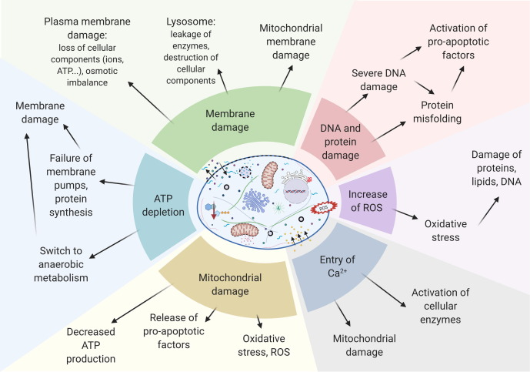

Slide 22
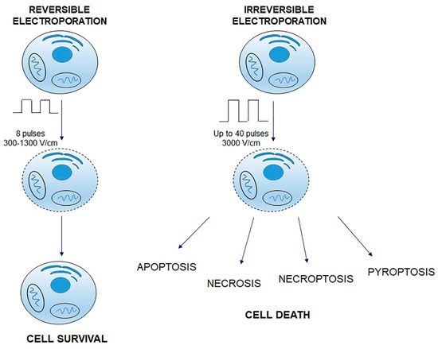
Ref: https://doi.org/10.3390/cancers14174341

Slide 23
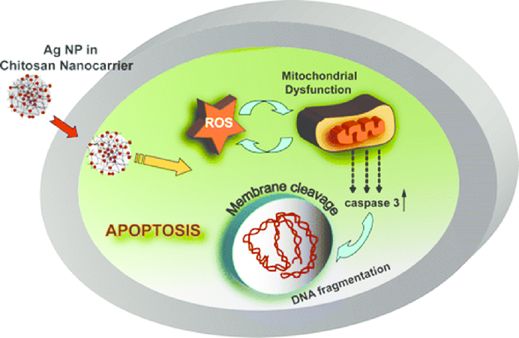
Functional Chitosan Nanoparticles in Cancer Treatment - Scientific Figure on ResearchGate. Available from: https://www.researchgate.net/figure/Schematic-illustration-of-induced-apoptosis-in-HT-29-cells-by-chitosan-nanocarriers_fig7_305739578 [accessed 1 Oct 2025]

Slide 24
Take Home message
Apoptosis is not just a textbook concept — it is at the heart of modern medicine. Whether in cancer, brain diseases, immunity, or infections, scientists are learning to control apoptosis to either save cells or make harmful cells die at the right time.

Slide 25
Thank You

