Slide 1



Web application for managing restaurants or coffees and mobile application for discovery service
MINISTRY OF HIGHER EDUCATION AND SCIENTIFIC RESEARCH
Realized by: Ahmed CHEBIL
Ibtissem CHALBI
Directed by: Zied ELLEUCH
2017/2018
Notes:
Good morning today we are here to present to our final year project by the name … realized by me Ibtissem Chalbi and my colleague ahmed Chebil with the guidnesse of mrs Zied Elleuch

Slide 2

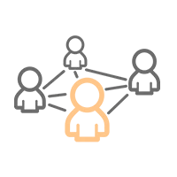

Planning
Introduction
Problematic
Requirements
Conception
Summary
Perspectives
Analysis of the existing
Solution
Use case
Realization
Notes:
we ll begin by mentioning the plan we used to make this project , first of all we ll start by a general introduction, followed by the analysis of the existing next we ll give a glimpse of our Problematic and our solution
Than we will move on to the requirements and the use case, after that there is the conception and the realization of our application , finally we ll conclude this presentation by a summary and we ll give some perspectives.
We ll start by the introduction

Slide 3

Introduction
Restaurants and coffee-shops
Food consumption away from home
|1
Notes:
nowadays people intend to go out and eat outside wether in a restaurant or a coffee shop Which they are both outnumbered .
That leads to a huge development in the food consumption away from home,But it’s not easy to find the right place for the right occupation or weather or even taste
so we made a list of the available methods that helps us reach our goal,
we will demonstrate that in the analysis of the existing’s part

Slide 4
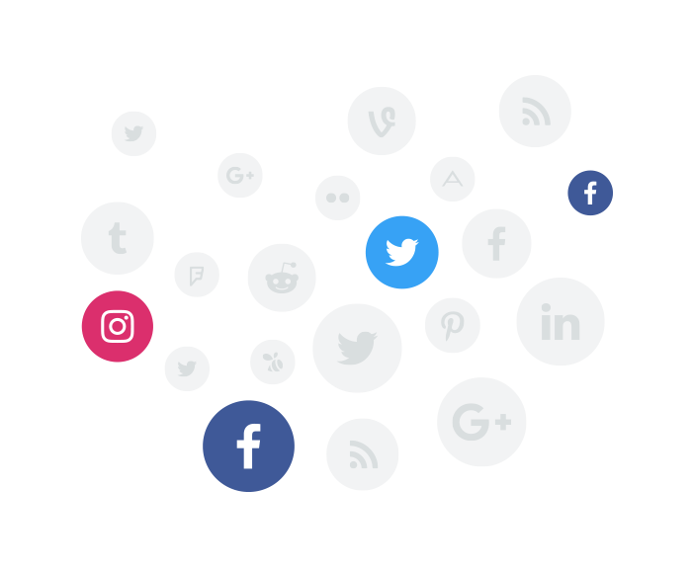


Analysis of the existing
Existing applications
Social media
Get opinions
Find places
The application inform the users about menus and Happy-Hours in the shops.
find organized events in shops and book directly
Get opinions
Find places
Communicate with the place manager
Get opinions
Find places
Add and manage shops
|2
Notes:
We selected multiple examples, the most common one is the social media where you can find a verity of choices and number of opinions that can guide the user to select the right place. Vynd is an android application that helps you find the perfect place recording to your plans. And we also picked a popular web application which is Yelp it is knowen for its tremendous power in the restaurant industry.

Slide 5
Analysis of the existing
Criticism
Time consuming
Places are added by the users not the owner
Not available in Tunisia
No information about whether the place is crowded or closed.
The suggestion are only based on the location of the user.
|3
Notes:
with all the services provides by those and other apps, there comes some disadvantages , thy can be time consuming like the social media , or not available in Tunisia such as Yelp, and even if they are available thy can only be used in the capital like Vynd, for yelp it’s only used for reviews

Slide 6

Problematic
Choosing a place to dine or to get coffee
Getting more information regarding the place
Promoting a place
|4
Notes:
That leads us to the problematic,
It’s not easy to choose a place to eat or drink ,
The place owners can promote their places using Advertisement but that will cost a lot of money

Slide 7



Solution
Mobile
Web
|5
Notes:
As a solution for the previous problematic , we chose to create a mobile application designed for the foodies everywhere in Sousse and a web application that is dedicated to the shop owners and managers

Slide 8

Requirements
Functional
Place owner
Foodie
Place Manager
Inscription & Authentication
Manage places
View ratings/reviews
View statistics
Manage account
Receive notifications
Inscription & Authentication
View the list of places provided by the app
Make reservation
Gets suggestions
Review a place or a dish
View a specific place with all its details
Make a filtered research
Manage account
Add place to favorite or black list
Receive notifications
Authentication
Mange reservations
Manage the place’s menu
View reviews regarding their place
Manage their schedule
Manage comments
|6
Notes:
Passing on to the requirments needed for the realization of this app, we have three main users , the place owner …

Slide 9
Requirements
Non functional
Portability
Performance
Maintainability
Reliability
Security
|7
Notes:
For the non functional requirements
Portable: works on any operating system Performance: quick response
Reliable: fault tolerance
Maintainable: easy to fix and evolve

Slide 10
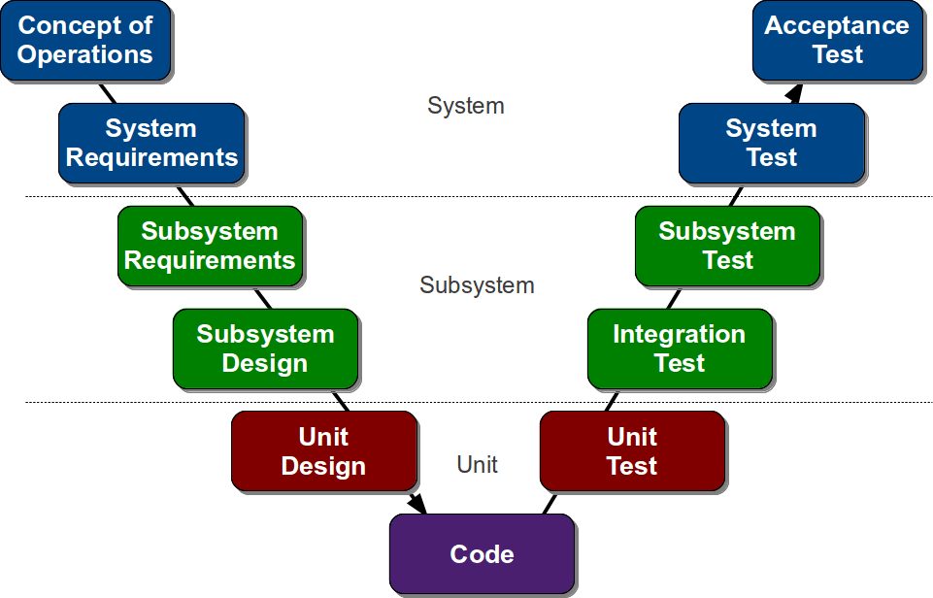
Requirements
Methodology
|8
Notes:
As a methodology we decided to use one the waterfall models which is the V-model. The V-Model is a unique, linear development methodology used during a Software Development Life Cycle, the V-Shaped life cycle is a sequential path of execution of processes. Each phase must be completed before the next phase begins. Testing activities like planning, test designing happens well before coding
So far we talked about the existing and the problematic, we also presented our solution followed by the functional and non functional requirement, finishing by the methology used.
Here now is my teammate Ahmed CHBILE to talk about the use case, the conception and also the realization of this project. Ahmed

Slide 11

Use case diagram
Actors
Place owner
Web
Place manager
Administrator
Mobile
Foodie
|9
Notes:
We will start by presenting the actors for this application to facilitate the understanding of the use case diagram ,
Our app have two types of actors , the web version will be used by the Place owner, He is the owner of the business he is responsible for the managing of his own places. the Place manager The manage is on charge of managing one place with limited access and the Admin or Administrator This is a secondary actor, he has access to all the data of both web and mobile applications.
For the mobile version we have one actor which is the Foodie He has only access to the mobile application.

Slide 12
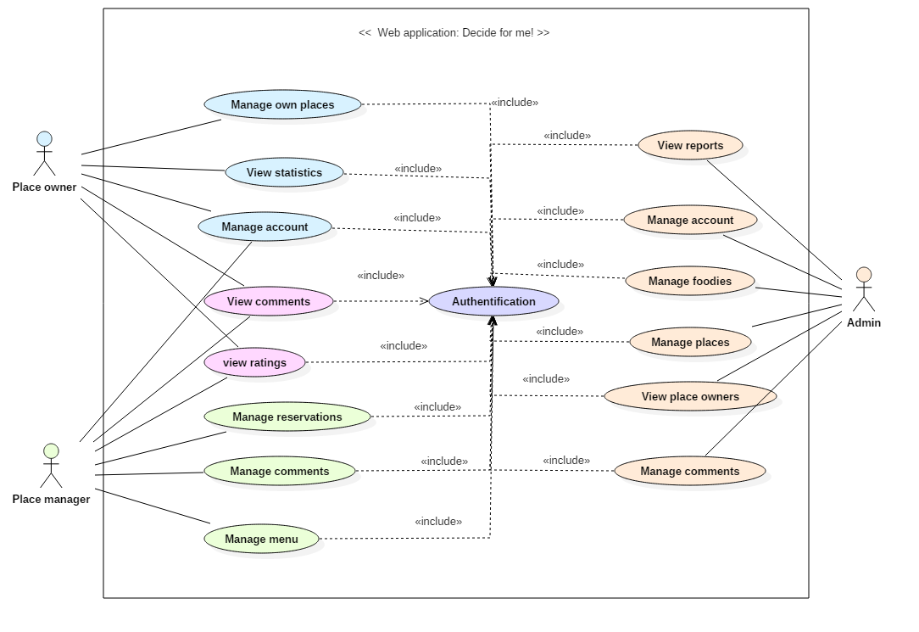
Use case diagram
Web
|10
Notes:
Passing on to the web use case diagram, we can see that the three actors have multiple cases, for the place owner he can manage his own places, he can also view the statistics made regarding his shops, as for the place manager he can mange the reservation, the comments and also the menu of the place, they both can mange their account and have access to view the reviews.
For the secondary actor which is the admin he has acces to manage all the actors , all the comments and the places

Slide 13
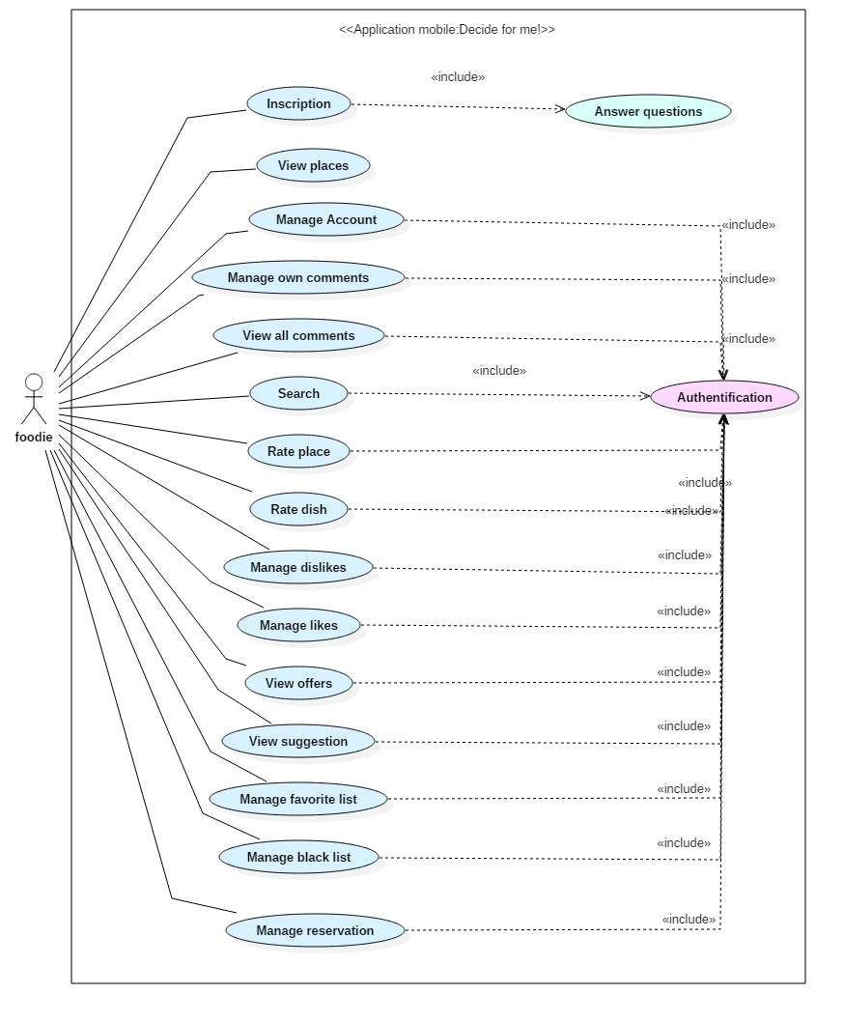
Use case diagram
Mobile
|11
Notes:
Concernning the mobile use case we only have one actor, the foodie , he has the bility to …

Slide 14
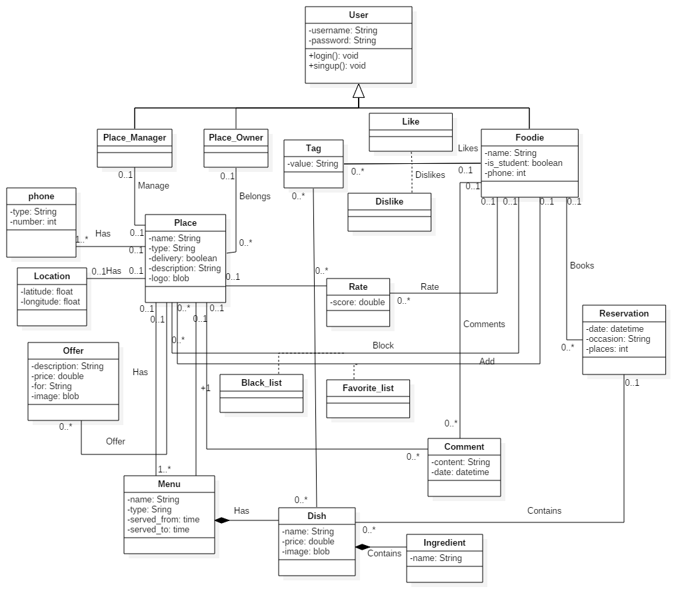
Conception
Class diagram
|12
Notes:
For the conception, we ll be seeing the classe and the sequence diagram
Starting by the calsse diagram

Slide 15
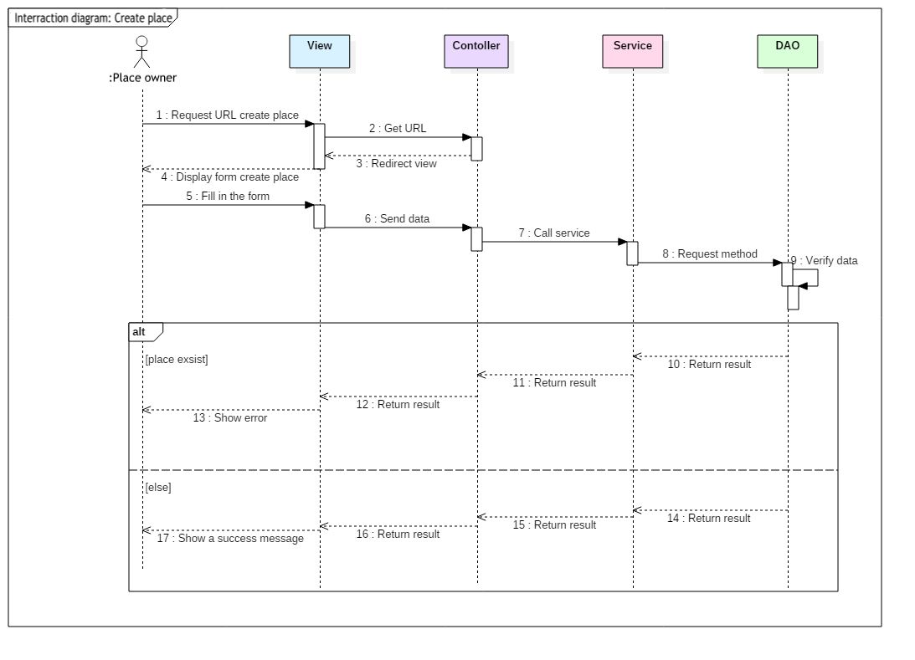
Conception
sequence diagram (Add place)
|13
Notes:
Passing on to the sequence diagram, we selected two diagram one for adding a place in the web application and another for making reservation in the mobile version,
For the scenario of adding a place …

Slide 16
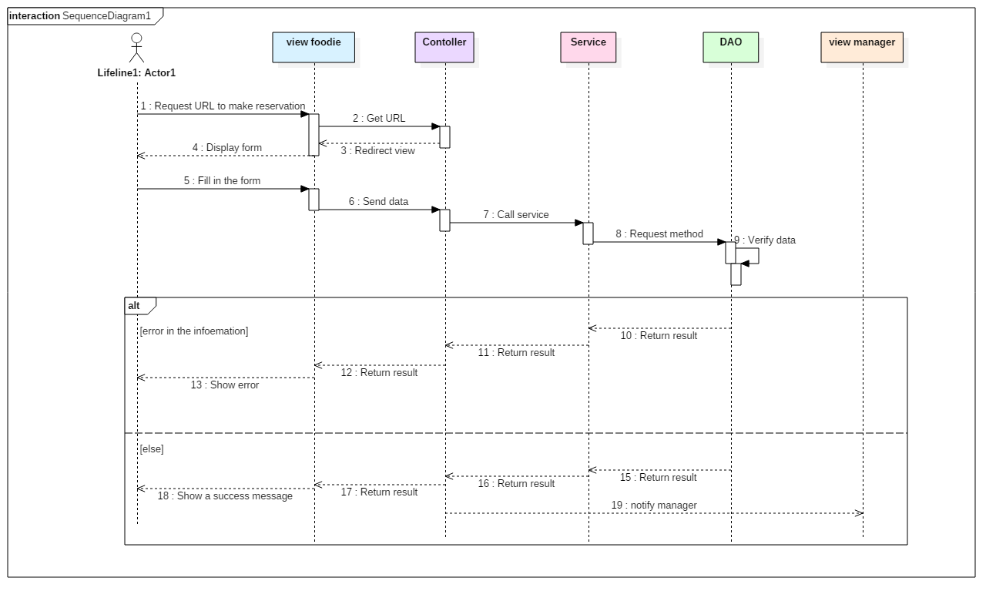
Conception
sequence diagram (make reservation)
|14
Notes:
As for the scenario for making a reservation …

Slide 17




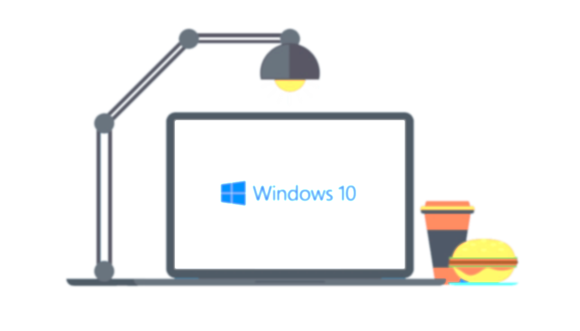
Realization
Used technologies (Web)
Spring MVC
Spring security
Hibernate
Bootstrap
|15
Notes:
For the realization part we will give a breve description of the used technologies flowed by the architecture of our application and a demonstration of both applications.
We used the Spring Web MVC framework that provides Model-View-Controller architecture and ready components that can be used to develop flexible and loosely coupled web applications.
Since we are using spring We chose Spring Security framework to secure our application because it is a powerful and highly customizable authentication and access-control framework.
Hibernate is an Object/Relational Mapping (ORM) framework in the Java world. It allows developers to map the object structures of normal Java classes to the relational structure of a database.
We decided to choose the open source Twitter framework called Bootstrap due to its responsiveness, adaptability to screens and its ease to use

Slide 18

Realization
Used technologies (Mobile)
Android
|16
Notes:
For the mobile version we decided on Android it is a mobile Operating System (OS) developed by GOOGLE, Written primarily in Java and based on the Linux operating system.
We decided to use a native mobile application for the mare reason which is , Native apps can provide optimized performance and take advantage of the latest technology, such as a GPS.

Slide 19
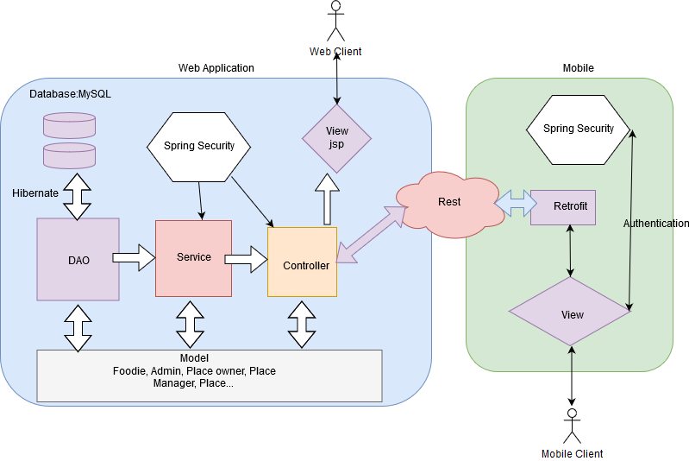
Realization
Architecture
|17
Notes:
Since we created two different apps with two different approach we had to create our own architecture,
For the web version the user can interact with the system via the view, the view will then call the controller which will get the result requested from the service and the service itself will call the function from the DAO, the interaction with the database will be through hibernate, the model presents the entities used. For the mobile part , the user will call an url which will lead him to the views, and this is where the Retrofit role start, the Retrofit will consume the RESTful web services. Both applications are connected by Restful web services and they both use spring security to secure their data

Slide 20
Realization
Demonstration
|18
Notes:
Now we will pause this presentation for a demonstration of our work with detailed description of how the two apps work

Slide 21

Summary & perspective
Web application
Mobile application
Add artificial intelligence
Make a mobile application for other platform like iOS windows phone
|19
Notes:
Now we conclude this presentation by a summary and a perspective.
Up until now we got to design and develop a web application using the spring mvc framework that helps the place owners and managers to easly promote their shop without any cost, we also created a mobile application that gives the user a clear guide to his favorite places in the area.
As perspective we thought about adding artificial intelligence to the application so it can learn from its user or we can also make the mobile version available for the IOS and window phone users

Slide 22

THANK YOU
FOR YOUR
ATTENTION
Notes:
Thank you for your attention and we ll be honored to answer any questions

