Slide 1
MEE427 Microcontroller Overview
29/02/2024

Slide 2
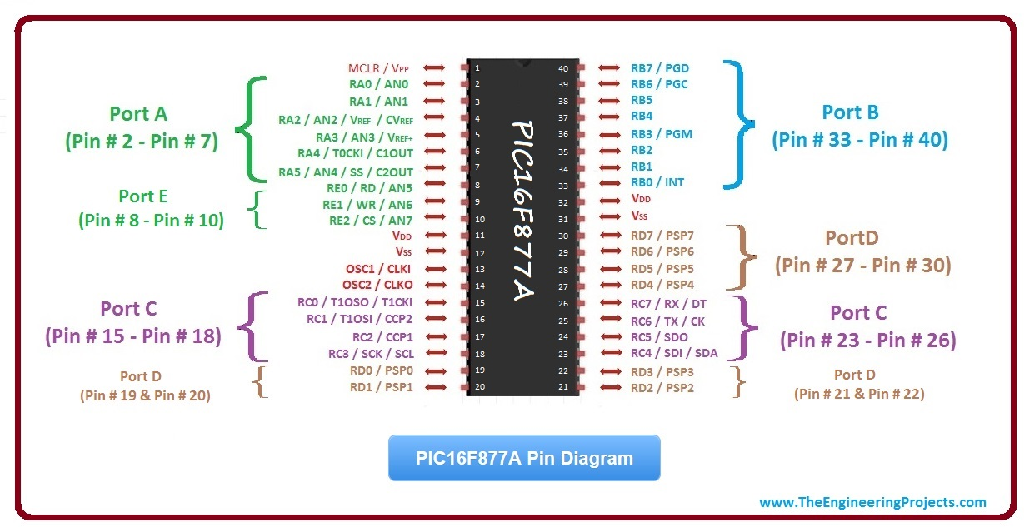
PIC 16F877A

Slide 3
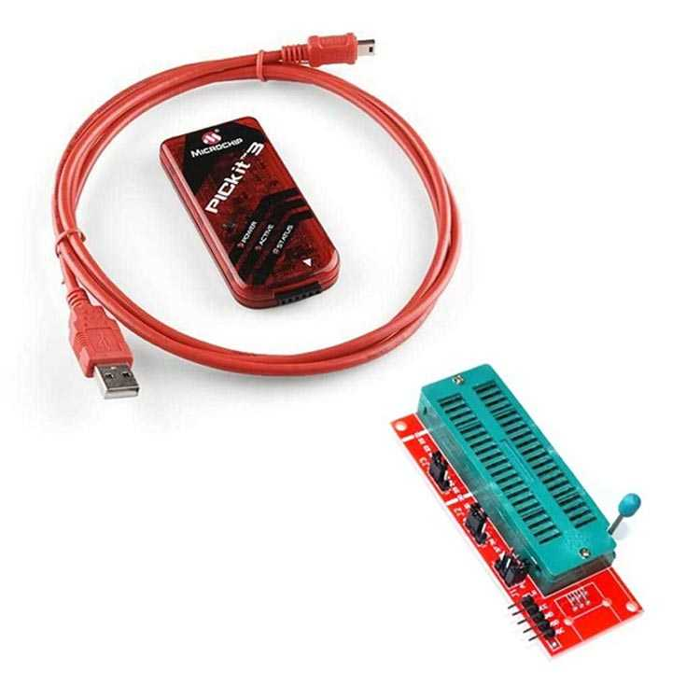
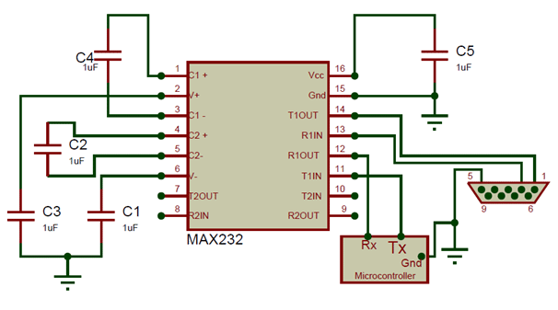
Components and Software
Needed Hardware;
PIC 16F877A
PIC Programmer (available)
Crystal and capacitors
Max232 and rs232 to usb converter or FTDI Cable or Arduino Uno without chip (needed for debugging)

Slide 4
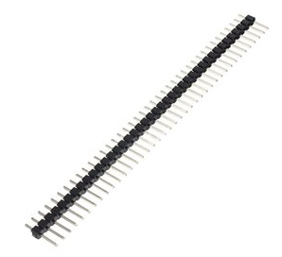
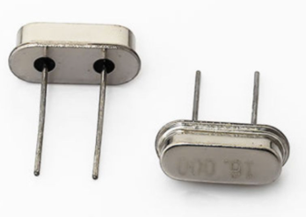
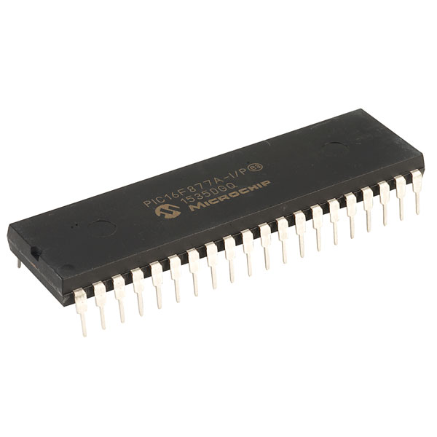
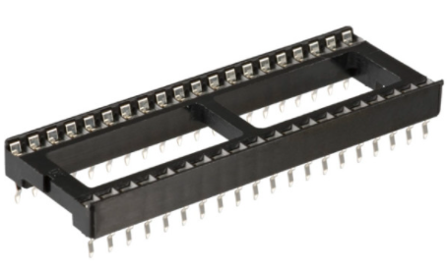
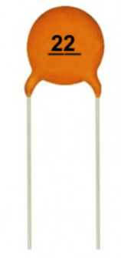
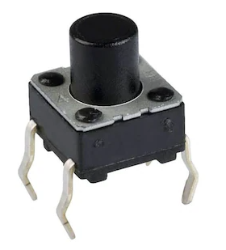
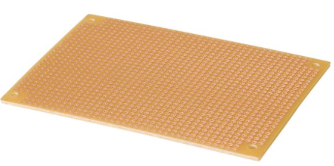
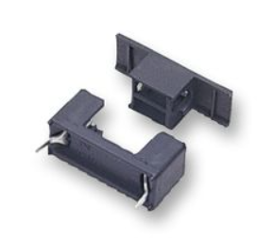
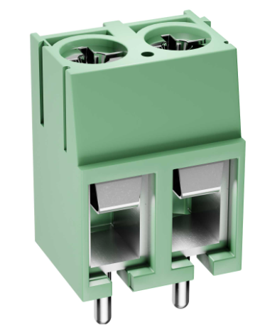
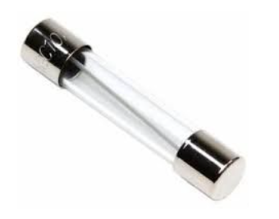
What needed as Hardware
PIC16F877A
40 Pin Socket
Crystal 20MHz
22 pF Capacitor (x2)
100 μF Capacitor (x2)
Perforated Board
40 pin male header
10kΩ Potentiometer
1 Tach Button
10k Resistor
Fuse (2A) and Fuse Socket
7805 5V Regulator
Terminal Blocks (x8)
PIC Programmer (Available)

Slide 5
Connections
Reset pin should be powered
OSC1 & OSC2 should be connected to crystal and 22pF capacitors
Programmer is connected to Reset, PGD & PGC pins.

Slide 6
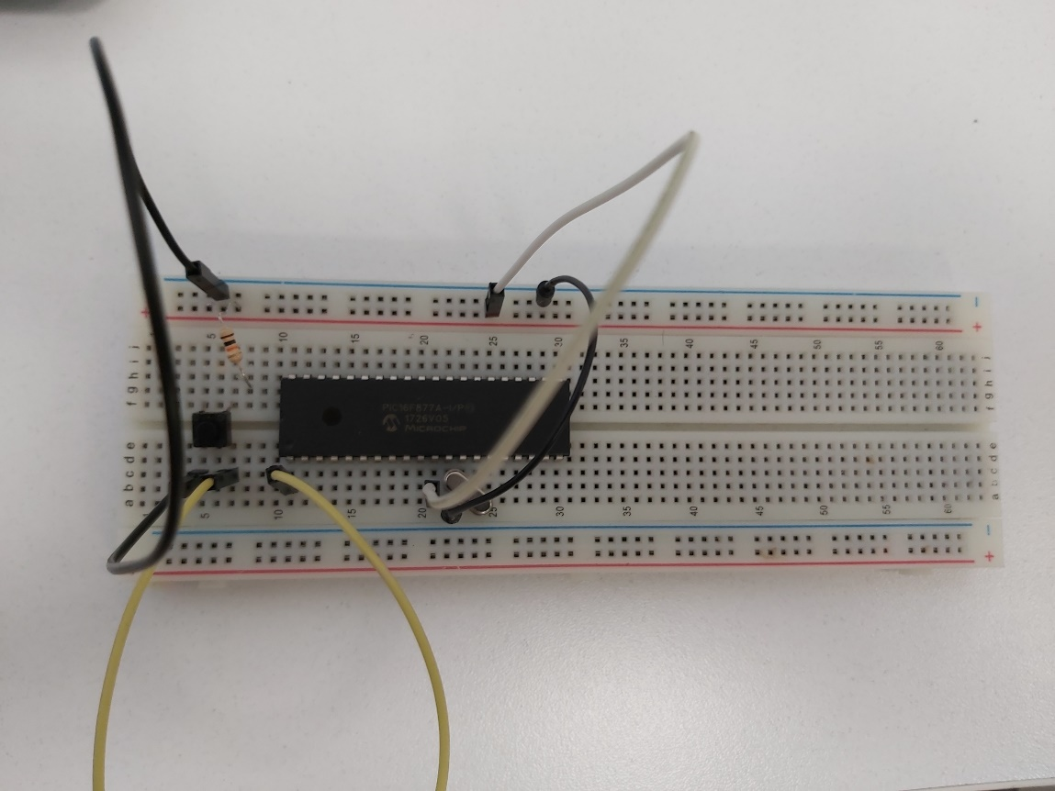
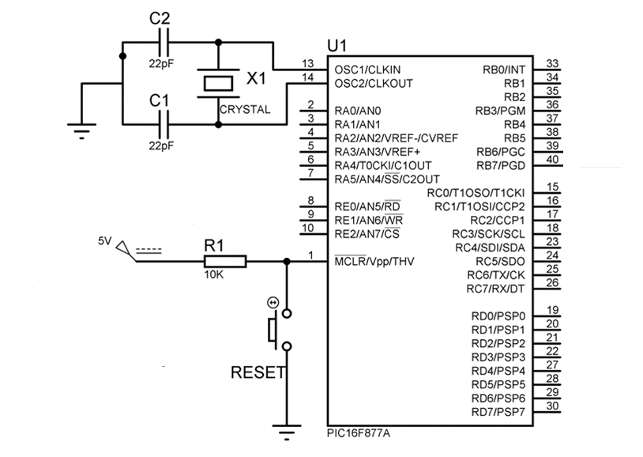
Hardware
Minimum connection for PIC16F877A

Slide 7
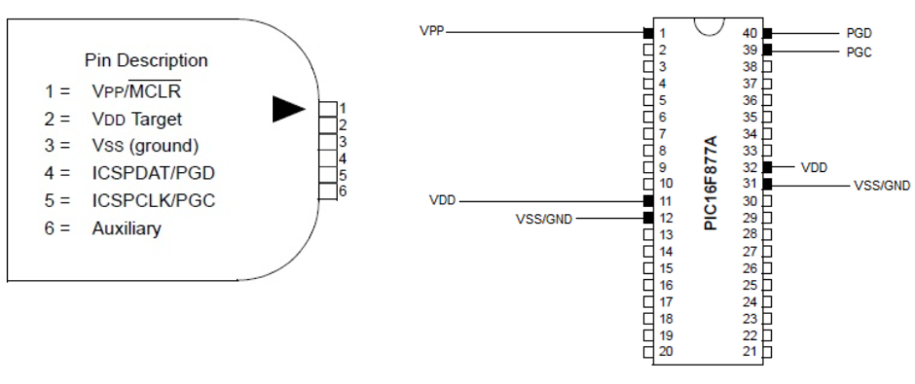
Proper PIC16F877A Custom Board
Advantages;
Strong connections
Proper code uploading opportunity (less damage)
Customization possibility

Slide 8
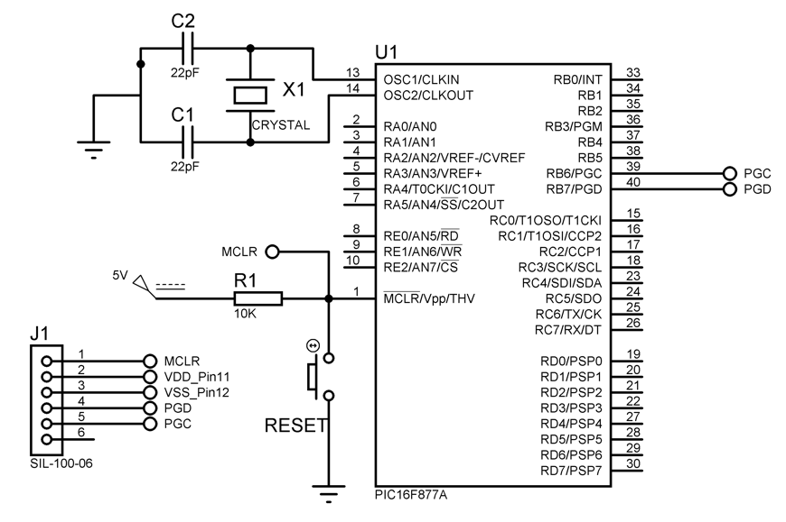
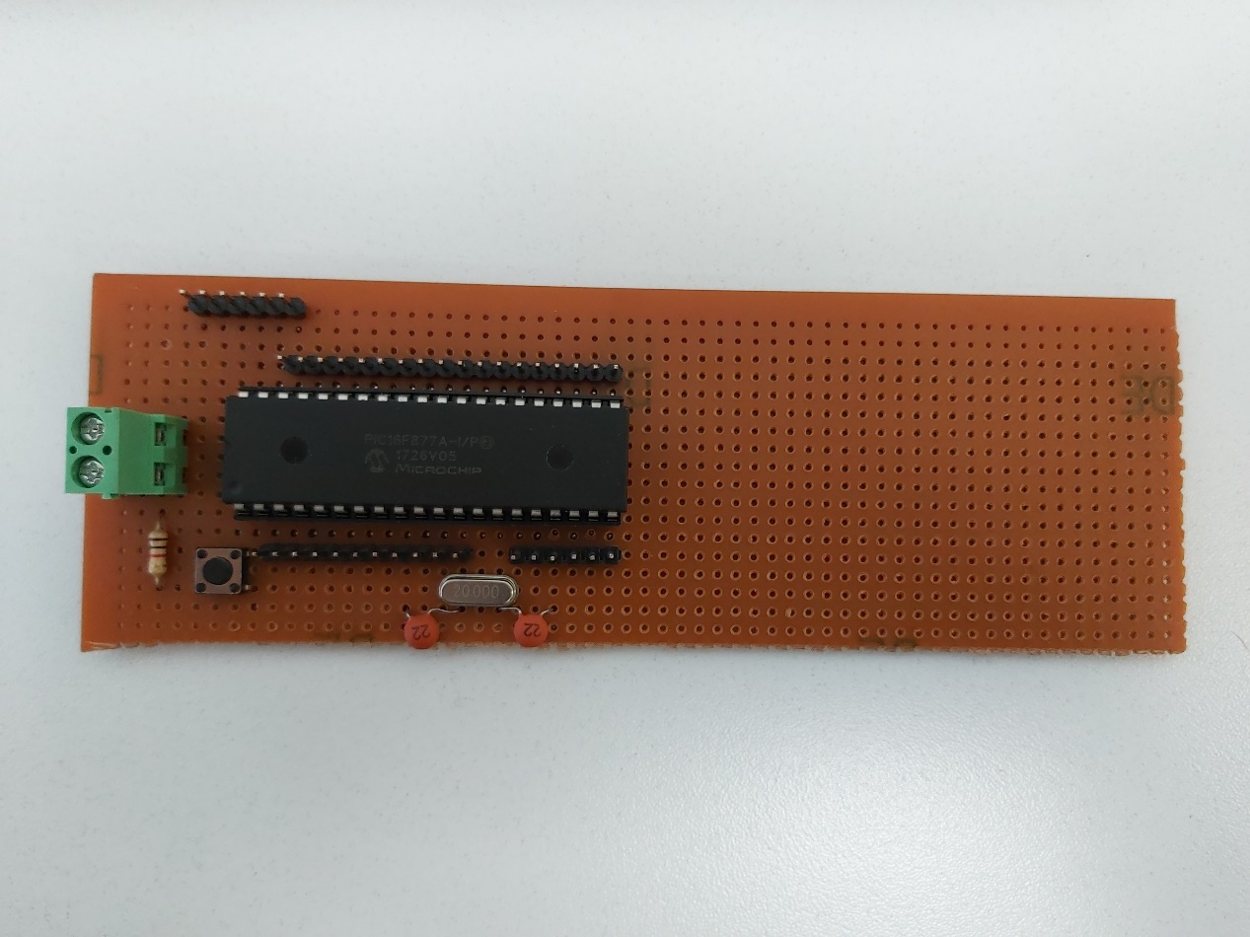

Slide 9
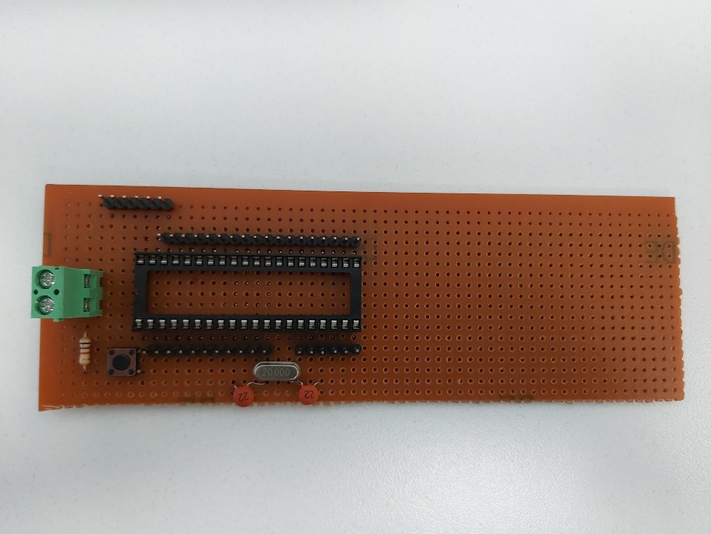
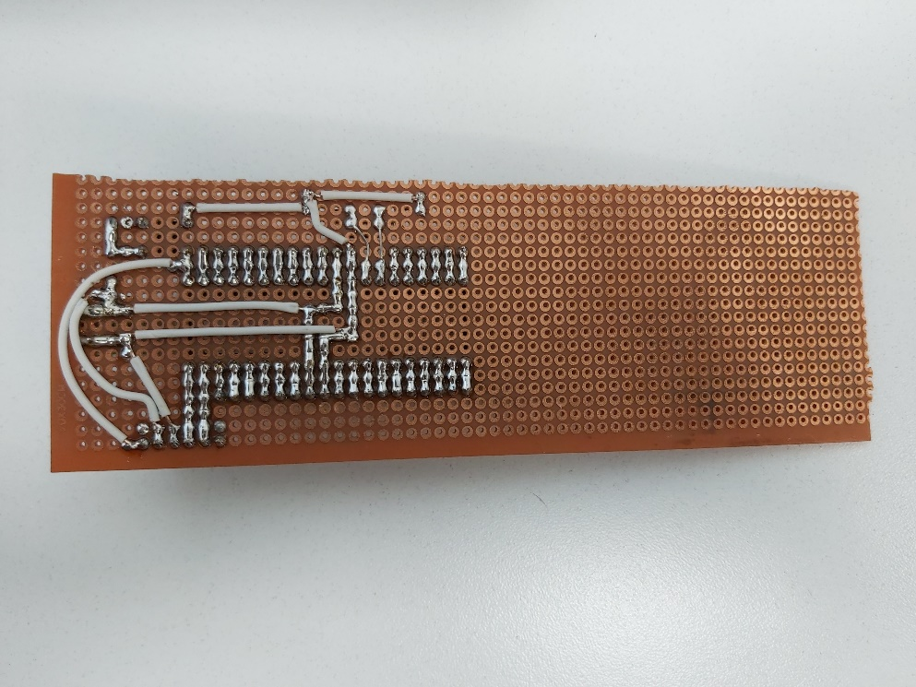
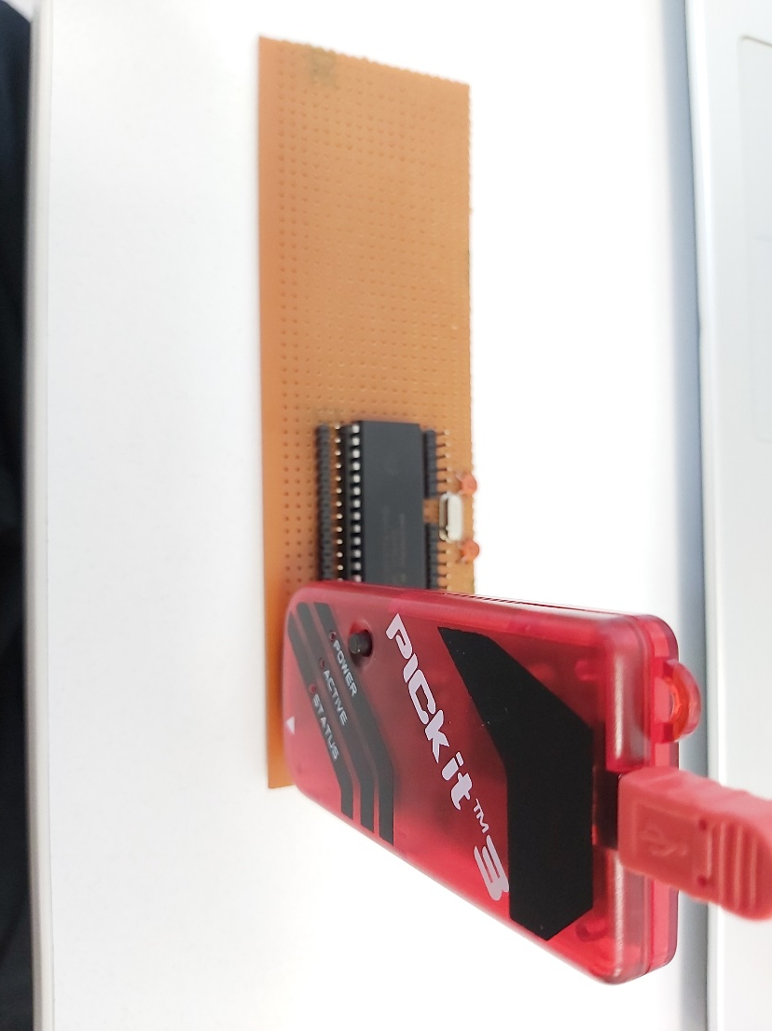
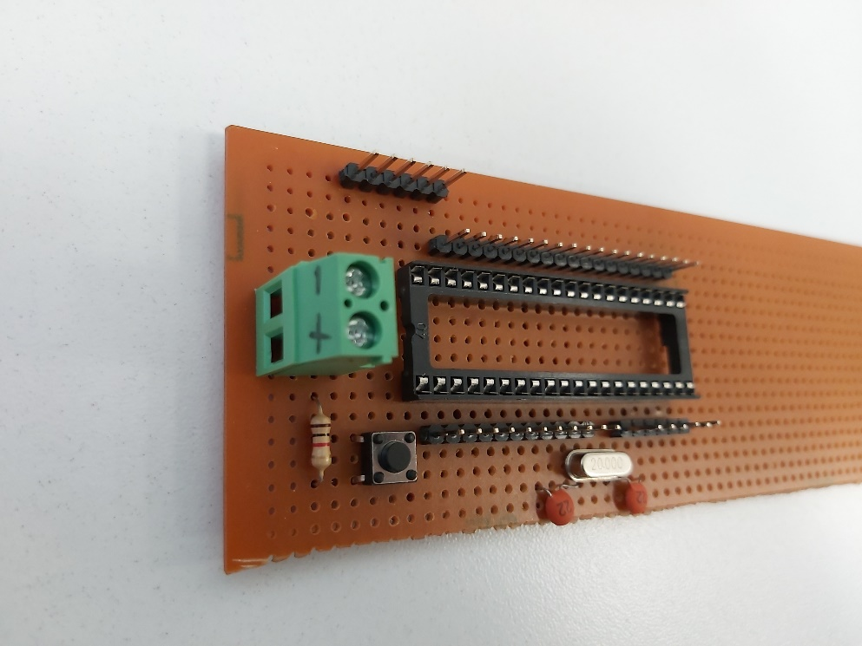
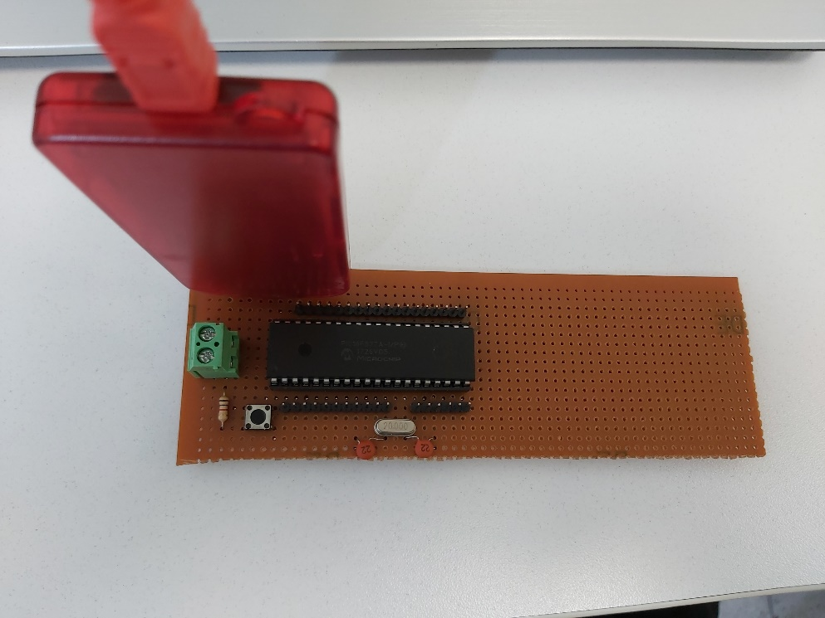

Slide 10
Components and Software
Needed Software
CCS C Compiler (Coding Environment and Converter to .hex)
Proteus (Simulation Environment)
PIC Programmer Software
MPLAB X IPE
PICkit™ 3 Programming App and Scripting Tool

Slide 11
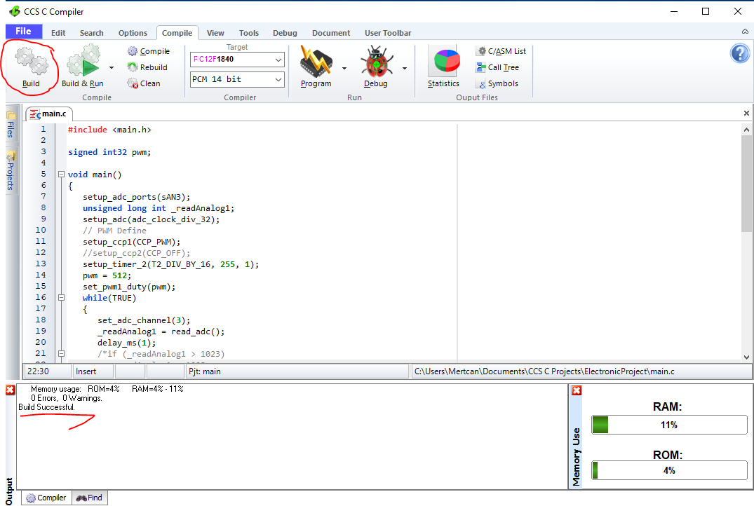

Slide 12
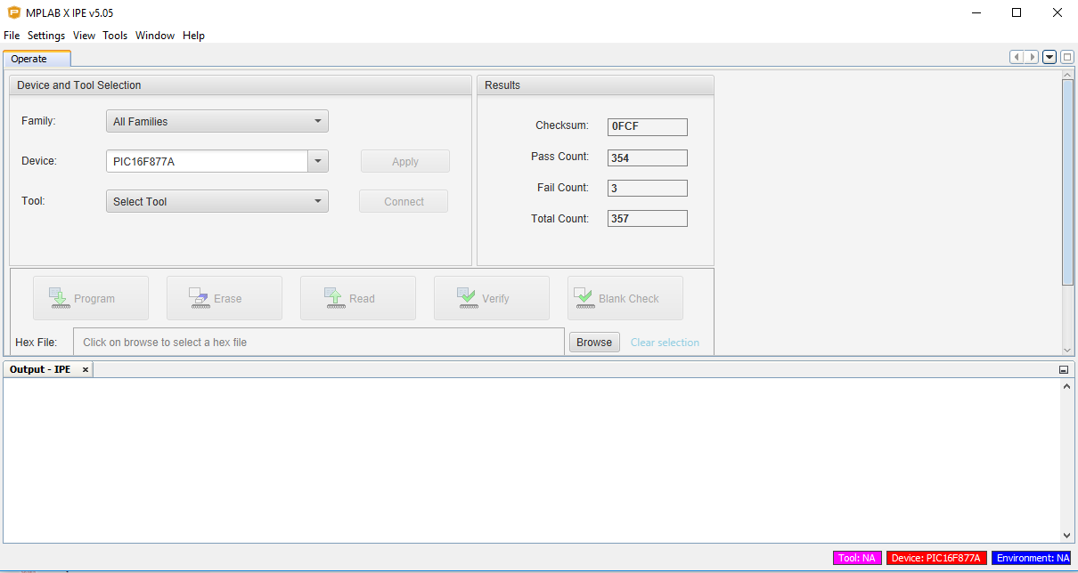

Slide 13
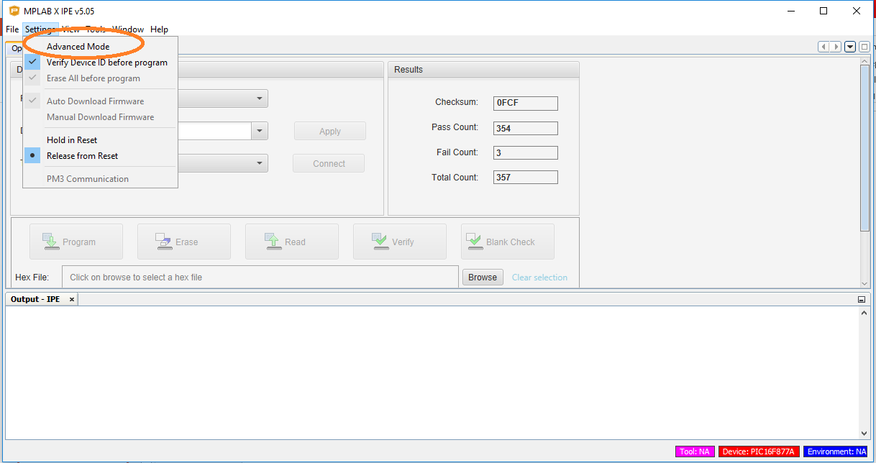

Slide 14
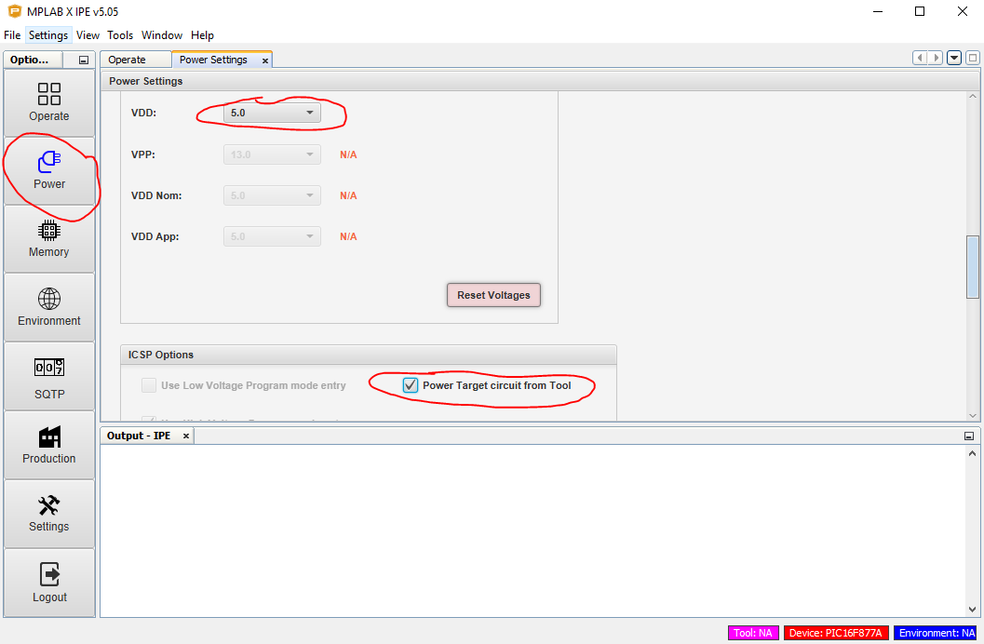

Slide 15
