Slide 1
MEE306 – Microcontrollers

Slide 2
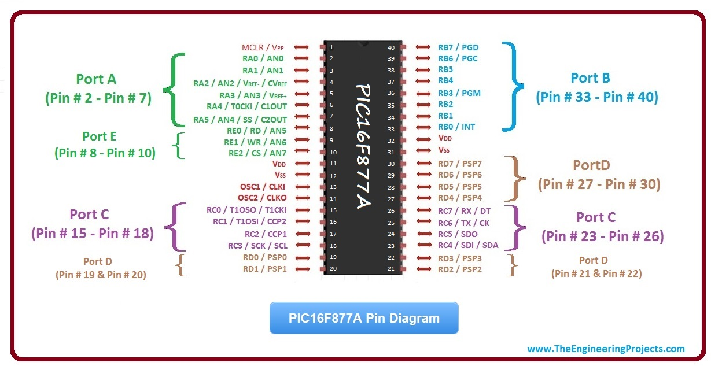
PIC 16F877a

Slide 3
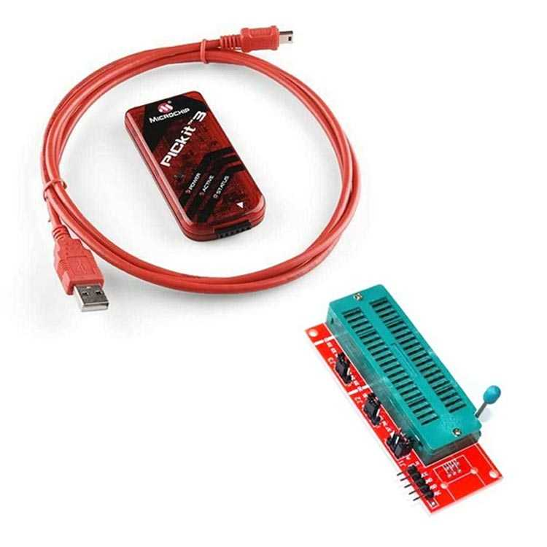
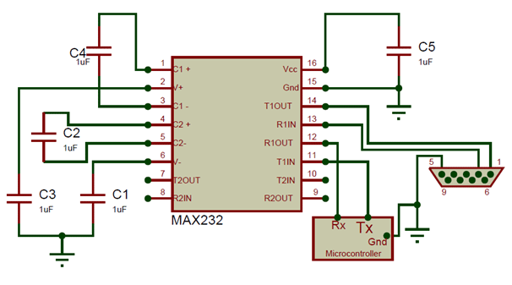
Components and Softwares
Needed Hardware;
PIC 16F877a (or similar)
PIC Programmer (available)
Crystal and capacitors
Max232 and rs232 to usb converter or FTDI Cable or Arduino Uno without chip (needed for debugging)
Needed Software;
Proteus for simulation
CCS C Compiler (recommended)
MPLAB X IPE (recommended)

Slide 4
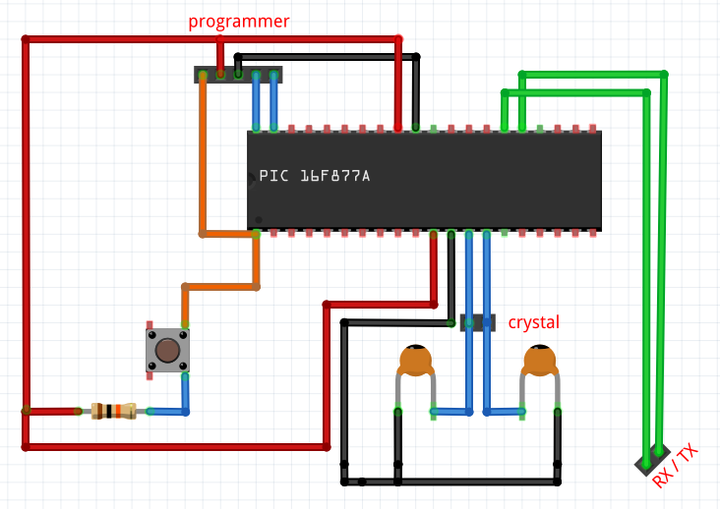
Connections
Reset pin should be powered
OSC1 & OSC2 should be connected to crystal and 22pF capacitors
Programmer is connected to Reset, PGD & PGC pins.

Slide 5
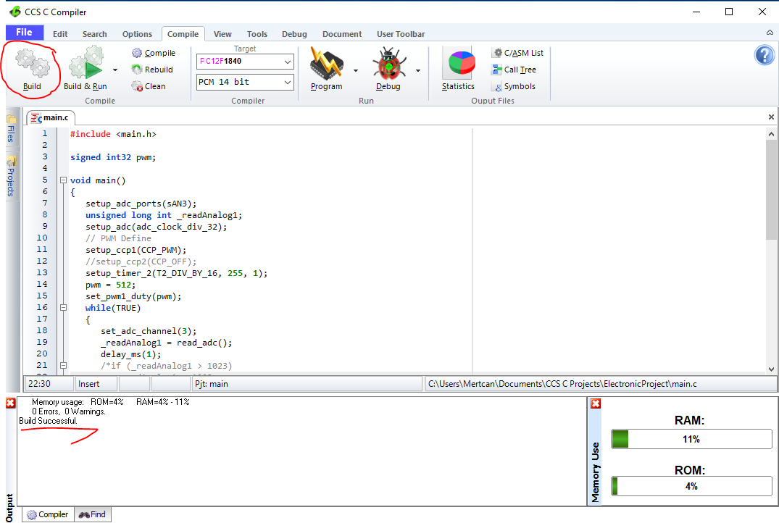

Slide 6
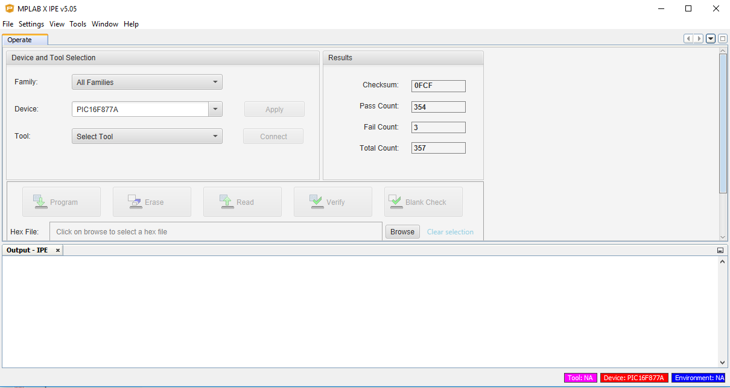

Slide 7
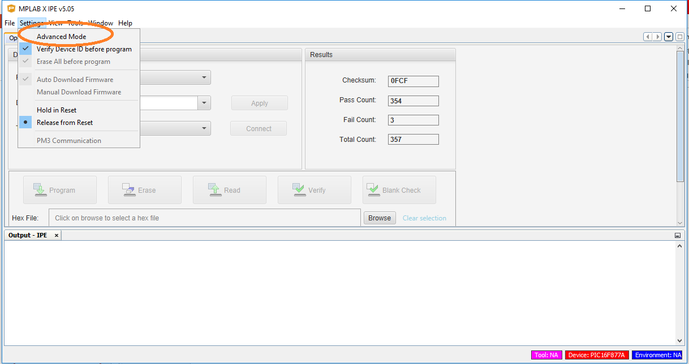

Slide 8
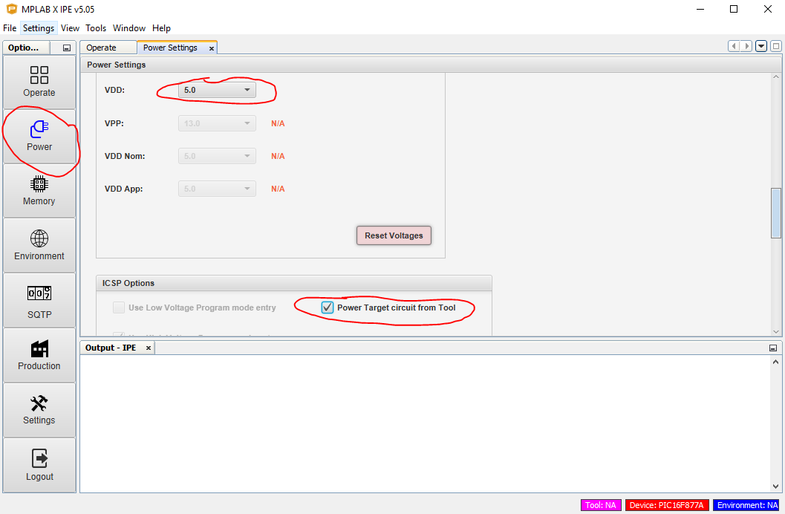

Slide 9
