Slide 3

Balanced Staff Routing for Maintenance
Optimization Mini-Project | Course: IT3052E | Class: 167686 | Group: 5
Group Members:
• Bui Dang Quang
• Dinh Phuong Mai
• Do Anh Minh
• Ngo Nam Nhat Minh

Slide 4
Table of Contents
1. Introduction
2. Problem Overview (Objective · Inputs · Outputs · Constraints)
3. Branch & Bound Algorithm
3.1 State Representation 3.2 Base/Recursive Steps 3.3 Pseudocode
4. Constraint Programming (CP-SAT)
4.1 Background 4.2 Process 4.3 Modelling (Variables + Constraints) 4.4 Results & Scalability
5. Greedy Algorithm — Sorted Cheapest Insertion
5.1 Background 5.2 Logic (3 Phases) 5.3 Pseudocode 5.4 Complexity
6. Hill Climbing Heuristic
6.1 Logic 6.2 Six Sub-Algorithms (pseudocode)
7. Comparative Analysis & Conclusion

Slide 5
1. Introduction
The Vehicle Routing Problem (VRP)
Originally formulated by Dantzig & Ramser (1959). A classic challenge in combinatorial optimization.
Traditional VRP: minimize cumulative distance or total travel time of all vehicles.
Balanced Staff Routing for Maintenance (BSRM)
The focus shifts to minimizing the MAKESPAN — the workload of the most heavily loaded technician.
Ensures equitable distribution of labor and prevents individual technician fatigue.
Why is this hard?
Inherits NP-hard complexity from TSP and multi-depot vehicle routing.
Exact methods (CP, ILP) cannot scale beyond small instances.
This report presents a tailored deterministic construction heuristic solving large test cases (N=1000) within milliseconds.

Slide 6
2. Problem Overview
Objective
Inputs
Outputs
Constraints
Workload Formula

Slide 7
2.1 Objective & Inputs
Objective
Minimize the maximum workload (makespan) of any technician such that:
• All customers i ∈ {1,…,N} are serviced exactly once
• All technicians start and finish their routes at the central depot (node 0)
Inputs
N Number of customers to be serviced (1 ≤ N ≤ 1000)
K Number of available technicians (1 ≤ K ≤ 100)
d(i) Maintenance service duration for customer i (1 ≤ i ≤ N), d(0) = 0 for depot
t(i,j) Travel time matrix of size (N+1) × (N+1)
Represents travel cost between any two locations i, j ∈ {0, 1, …, N}

Slide 8
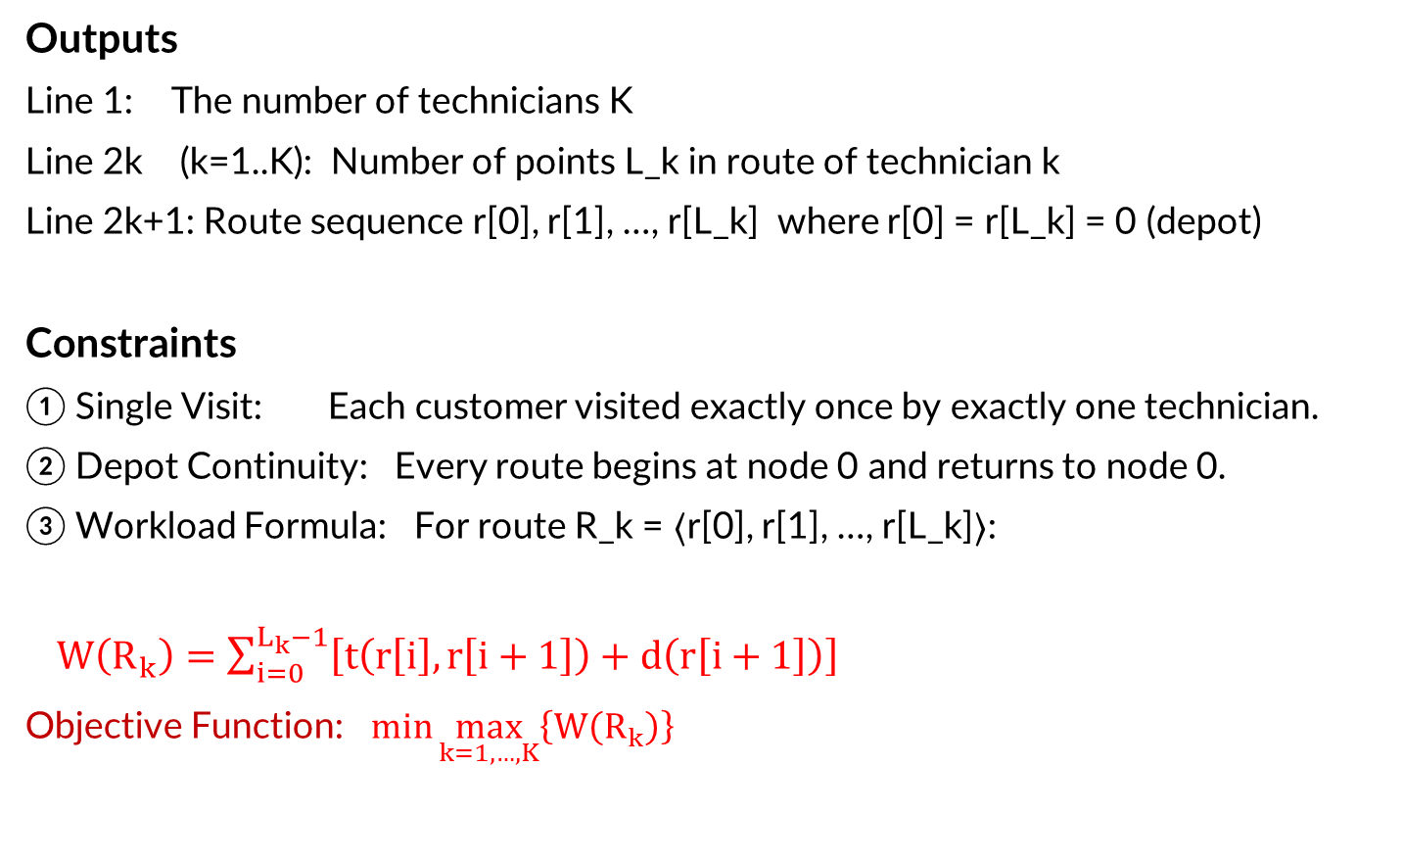
2.2 Outputs, Constraints & Workload Formula
Outputs
Line 1: The number of technicians K
Line 2k (k=1..K): Number of points L_k in route of technician k
Line 2k+1: Route sequence r[0], r[1], …, r[L_k] where r[0] = r[L_k] = 0 (depot)
Constraints
① Single Visit: Each customer visited exactly once by exactly one technician.
② Depot Continuity: Every route begins at node 0 and returns to node 0.
③ Workload Formula: For route R_k = ⟨r[0], r[1], …, r[L_k]⟩:
$W\left(R_{k}\right)=\sum_{i=0}^{L_{k}−1}{\left[t\left(r\left[i\right],r\left[i+1\right]\right)+d\left(r\left[i+1\right]\right)\right]}$
Objective Function: $\min{\max_{k=1,…,K}\left\{W\left(R_{k}\right)\right\}}$

Slide 9
3. Branch & Bound Algorithm
State Representation
Base Case
Recursive Step
Pseudocode

Slide 10
3.1 Background & State Representation
Background
One of the earliest exact approaches for VRP. Guarantees optimal solutions.
Complexity grows EXPONENTIALLY — impractical for large-scale instances.
Used early in VRP research; now complemented by metaheuristics and MIP/CP systems.
Still used as benchmark for evaluating heuristics on small instances.
State Representation
At any point in recursion, the algorithm tracks:
• Set of customers NOT yet visited
• List of routes (one per technician)
• Total accumulated time cost by each technician
• Current position of each technician
Memory Key (Memoization)
key = ( frozenset(unvisited), tuple(cur_positions) )
If memo[key] ≤ max(worker_times) → skip this subtree (already found a better solution).

Slide 11
3.2 Base Case & Recursive Step
Base Case: All customers assigned
1. Compute: total_times[k] = worker_times[k] + dist[cur_positions[k]][0]
for all k where worker_routes[k] ≠ ∅
2. max_time = max(total_times)
3. If max_time < best_time: update best_time and best_routes
Recursive Step: For each unvisited customer
for each customer ∈ unvisited:
for k = 0 to K−1:
total = worker_times[k] + dist[last_pos][customer] + d[customer]
PRUNING: if total ≥ best_time → continue (skip)
Assign customer to k → recurse → UNDO assignment
Search Space: O(K^N)
N=80, K=10: ≈ 10^80 possible assignments (> atoms in observable universe)
Practical limit: N ≤ 10 only.

Slide 12
3.3 Pseudocode — DFS Function
function DFS(unvisited, worker_routes, worker_times, cur_positions)
key ← (frozenset(unvisited), tuple(cur_positions))
if key ∈ memo AND memo[key] ≤ max(worker_times): return
memo[key] ← max(worker_times)
if unvisited is empty:
total_times ← [worker_times[k] + dist[cur_positions[k]][0]
for all k where worker_routes[k] ≠ ∅]
if max(total_times) < best_time:
best_time ← max(total_times)
best_routes ← worker_routes (with 0 appended to each route)
return
for each customer ∈ unvisited:
for k ← 0 to K−1:
total ← worker_times[k] + dist[cur_positions[k]][customer] + d[customer]
if total ≥ best_time: continue { PRUNING }
worker_routes[k].append(customer)
worker_times[k] ← total ; cur_positions[k] ← customer
DFS(unvisited \ {customer}, worker_routes, worker_times, cur_positions)
worker_routes[k].pop() { UNDO }
worker_times[k] ← worker_times[k] − (move_cost + service_cost)
cur_positions[k] ← last_pos
end function

Slide 13
4. Constraint Programming (CP-SAT)
Background
Process
Modelling
Constraints
Results & Scalability

Slide 14
4.1 Background
CP with AddCircuit — Mathematically Guaranteed Solutions
Provides provably correct solutions for small instances of the BSRM problem.
Fundamental Limitation
O(K × N²) variable count means CP CANNOT scale to large inputs.
This is not an implementation failure — it is a theoretical boundary.
VRP is NP-Hard: any exact formulation requires variables growing quadratically with N.
CP is most valuable as a benchmark producing provably correct solutions for small cases.

Slide 15
4.2 Process of Constraint Programming
Step 1: Model the Problem
Define decision variables, their domains, and all constraints.
Step 2: Propagate Constraints
Reduce variable domains by eliminating impossible values.
Techniques: domain consistency, bound consistency.
Step 3: Search Systematically
Assign values to variables (branching).
Backtrack when constraints are violated.
Use heuristics to guide variable/value selection.
Step 4: Optimize
Tighten bounds iteratively to find the best solution within the time limit.
Solver configuration used:
solver.parameters.max_time_in_seconds = 100.0

Slide 16
4.3 Modelling — Decision Variables & Objective
Decision Variables
x[i][j][k] (BoolVar)
= 1 if technician k travels from node i to node j (i ≠ j)
One variable per ordered pair (i,j) per technician k
self_loop[i][k] (BoolVar)
= 1 if technician k does NOT visit customer i
Required by AddCircuit to allow circuits to skip certain nodes
y[k] (IntVar)
Total workload of technician k. Domain: [0, UB]
UB = N × max(t) + Σd (tight upper bound computed from input)
z (IntVar) — THE OBJECTIVE
Maximum workload across all technicians. This is the value being MINIMIZED.
Objective Function:
minimize z

Slide 17
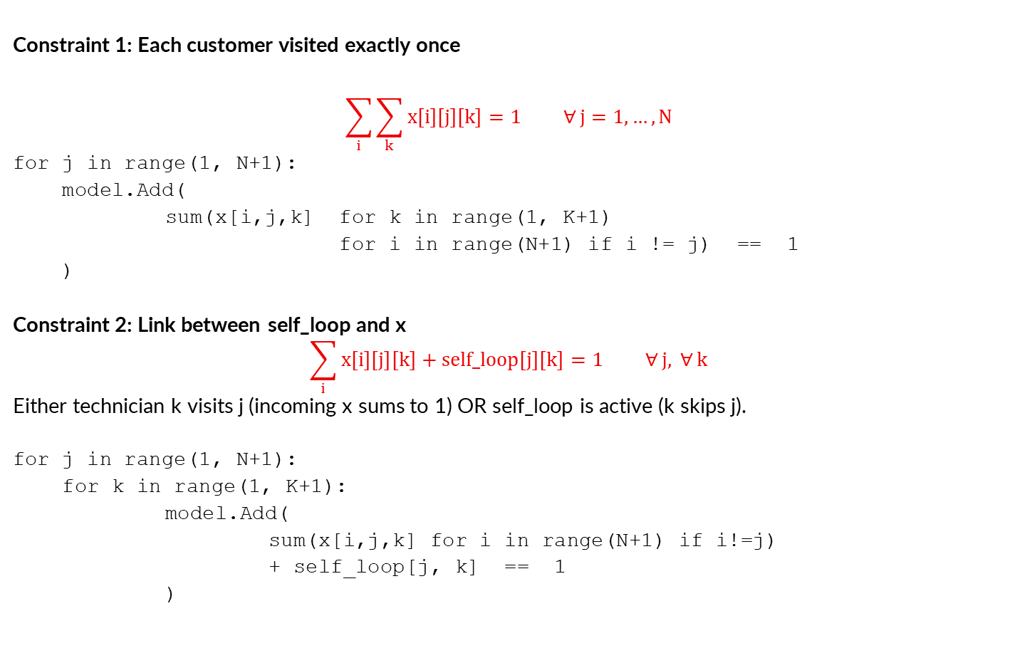
4.4 Constraints (1) & (2)
Constraint 1: Each customer visited exactly once
$$\sum_{i}{\sum_{k}{x\left[i\right]\left[j\right]\left[k\right]}}=1 ∀ j=1,…,N$$
for j in range(1, N+1):
model.Add(
sum(x[i,j,k] for k in range(1, K+1)
for i in range(N+1) if i != j) == 1
)
Constraint 2: Link between self_loop and x
$$\sum_{i}{x\left[i\right]\left[j\right]\left[k\right]}+\text{self}\text{_}\text{loop}\left[j\right]\left[k\right]=1 ∀ j, ∀ k$$
Either technician k visits j (incoming x sums to 1) OR self_loop is active (k skips j).
for j in range(1, N+1):
for k in range(1, K+1):
model.Add(
sum(x[i,j,k] for i in range(N+1) if i!=j)
+ self_loop[j, k] == 1
)

Slide 18
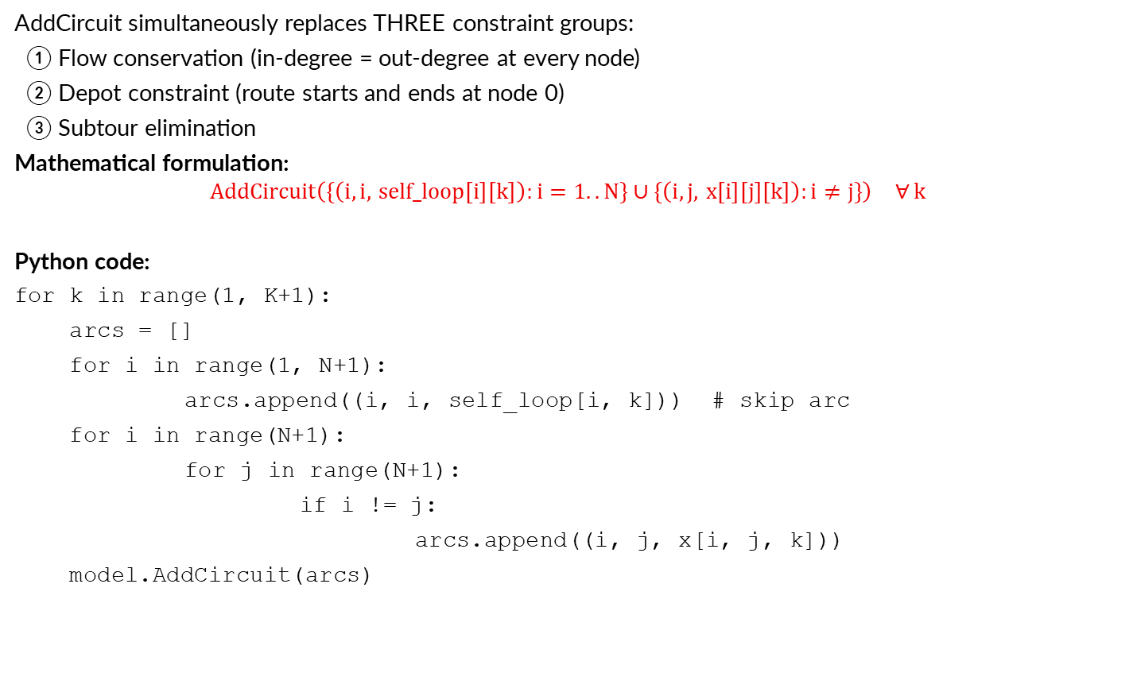
4.4 Constraint (3): AddCircuit — Valid Route Structure
AddCircuit simultaneously replaces THREE constraint groups:
① Flow conservation (in-degree = out-degree at every node)
② Depot constraint (route starts and ends at node 0)
③ Subtour elimination
Mathematical formulation:
$$\text{AddCircuit}​\left(\{\left(i,i, \text{self}\text{_}\text{loop}\left[i\right]\left[k\right]\right):i=1..N\}∪\{\left(i,j, x\left[i\right]\left[j\right]\left[k\right]\right):i≠j\}\right) ∀ k$$
Python code:
for k in range(1, K+1):
arcs = []
for i in range(1, N+1):
arcs.append((i, i, self_loop[i, k])) # skip arc
for i in range(N+1):
for j in range(N+1):
if i != j:
arcs.append((i, j, x[i, j, k]))
model.AddCircuit(arcs)

Slide 19

4.4 Constraints (4) & (5): Workload & Objective
Constraint 4: Workload Calculation
$$y\left[k\right]=\sum_{i}{\sum_{j≠0}{x\left[i\right]\left[j\right]\left[k\right]}}⋅\left(t_{i,j}+d_{j}\right)+\sum_{i≠0}{x\left[i\right]\left[0\right]\left[k\right]}⋅t_{i,0} ∀k$$
for k in range(1, K+1):
total = []
for i in range(N+1):
for j in range(N+1):
if i != j:
cost = matrix[i][j]
service = d[j] if j != 0 else 0
total.append(x[i,j,k] * (cost + service))
model.Add(y[k] == sum(total))
Constraint 5: z is the Maximum Workload
z ≥ y[k] ∀ k = 1, …, K
for k in range(1, K+1):
model.Add(z >= y[k])
model.Minimize(z)

Slide 20
4.5 CP Results — Online Judge Test Execution
Test Results Submitted to Online Judge
N K Message Runtime (ms) Memory (MB)
Tests 3 and 7 PASSED (small inputs, fit within 1024 MB limit).
All 8 failing tests hit Memory Limit Exceeded before any search began.
Memory consumed entirely during MODEL CONSTRUCTION — not during search.
Why the hard 1,024 MB ceiling?
At N=1000, K=100: ~100 million BoolVars required.
Each BoolVar carries internal memory overhead beyond a single bit.
Failing tests show EXACTLY 1,024 MB used — the hard ceiling is hit during model build.
5 | 2 | Perfect, jury solution is 370, participant solution is 360 | 2,538 | 49,633
10 | 2 | Perfect, jury solution is 560, participant solution is 540 | 12,811 | 90,867

Slide 21
4.6 Why CP Cannot Scale — Variable Count Analysis
Variable Count: O(K × N²)
x[i][j][k] BoolVars: one per ordered pair (i,j) per technician k → K × N(N+1) vars
self_loop[i][k] BoolVars: N × K additional vars
Variable Count Scaling Table
N | K | x[i][j][k] vars | self_loop vars | Total
────────────────────────────────────────────────────────────────────────────
5 | 2 | 60 | 10 | ≥ 73
10 | 2 | 220 | 20 | ≥ 243
20 | 3 | 1,260 | 60 | ≥ 1,324
100 | 10 | 100,100 | 1,000 | ≥ 102,011
400 | 40 | 6,400,160 | 16,000 | ≥ 6,432,041
1,000 | 100 | 100,100,000 | 100,000 | ≥ 100,200,101
────────────────────────────────────────────────────────────────────────────
VRP is NP-Hard
Even unlimited memory would not help — the search space grows exponentially.
K=10, N=80: search space ≈ 10^80 (> atoms in observable universe).

Slide 22
5. Greedy Algorithm
Sorted Cheapest Insertion
Background
Logic (3 Phases)
Pseudocode
Complexity Analysis

Slide 23
5.1 Background
Classic Greedy Heuristics — Limitation
Nearest Neighbor constructs routes sequentially or greedily appends nodes to the end of a route.
Problem: remaining nodes at end are often far apart → subsequent routes absorb massive travel times → extreme workload imbalance.
Sorted Cheapest Insertion — Two Core Modifications
① Furthest-First Sort
Prioritizes customers far from depot (the starting point) or with long maintenance times by routing "difficult" nodes FIRST, reserves flexible nearby nodes for later.
② Global Cheapest Insertion
Instead of appending to the end, evaluates inserting the target customer at ANY feasible position within ANY route.
Naturally balances workloads — inserting into a shorter route is computationally favored.

Slide 24
5.2 Logic — Phase 1: Initialization & Phase 2: Sorting
Phase 1: Initialization
Initialize K empty technician routes starting and ending at the depot:
R_k = ⟨0, 0⟩ with initial workload = 0 for all k ∈ {1, …, K}
Phase 2: Priority Sorting
Compute priority metric P(u) for each customer u (the distance):
P(u) = t(0, u) + d(u)
(where t(0, u) = travel time from depot, d(u) = service duration)
Sort the customer set in descending order of P(u).
Rationale:
Commit Early to Hard Decisions: Routing the most distant or time-consuming customers first takes advantage of maximum routing flexibility when routes are empty.
Mitigate the "Isolated Node" Bottleneck: Traditional greedy approaches leave distant nodes for last, forcing highly inefficient, long-distance trips at the end. This sorting scheme avoids that bottleneck.

Slide 25
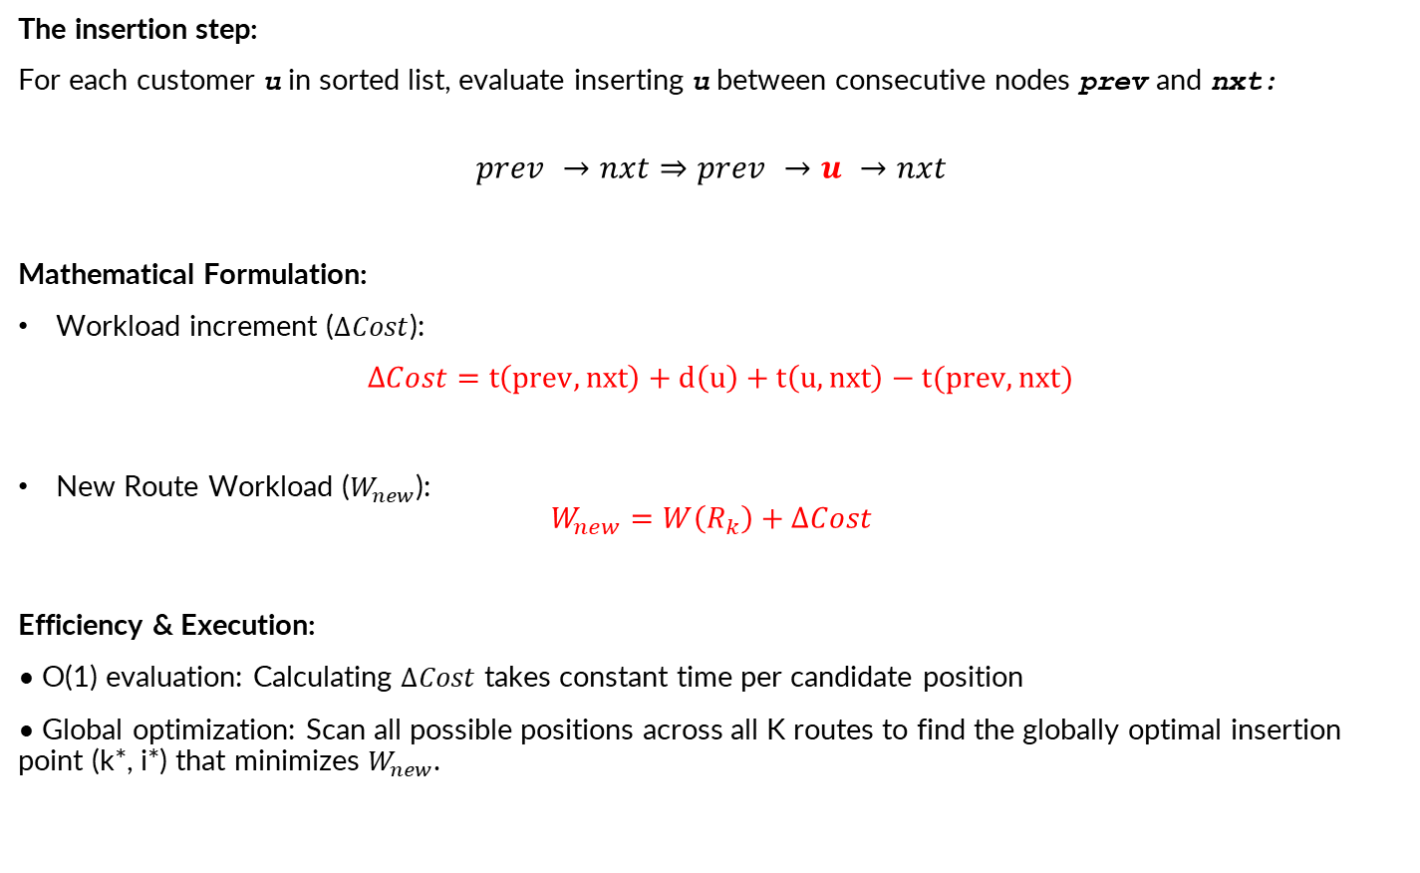
5.3 Logic — Phase 3: Sorted Cheapest Insertion
The insertion step:
For each customer u in sorted list, evaluate inserting u between consecutive nodes prev and nxt:
$$prev →nxt⇒prev →u →nxt$$
Mathematical Formulation:
Workload increment ($∆Cost$):
$∆Cost=t\left(prev, nxt\right)+d\left(u\right)+t\left(u, nxt\right)−t(prev, nxt)$
New Route Workload ($W_{new}$):
$$W_{new}=W\left(R_{k}\right)+∆Cost$$
Efficiency & Execution:
• O(1) evaluation: Calculating $∆Cost$ takes constant time per candidate position
• Global optimization: Scan all possible positions across all K routes to find the globally optimal insertion point (k*, i*) that minimizes $W_{new}$.

Slide 26
5.4 Pseudocode — SolveSRM (Part 1 of 2)
procedure SOLVESRM(N, K, d, t)
routes[1..K] ← array of ⟨0, 0⟩
workloads[1..K] ← 0
customers ← [1, 2, …, N]
Sort customers ↓ by ( t(0,u) + d(u) )
for each u in customers do
best_k ← −1 ; best_pos ← −1 ; min_new_wl ← ∞
for k = 1 to K do
R ← routes[k]
for i = 1 to len(R)−1 do
prev ← R[i−1] ; nxt ← R[i]
Δ ← −t(prev,nxt) + t(prev,u) + d(u) + t(u,nxt)
new_wl ← workloads[k] + Δ
if new_wl < min_new_wl then
min_new_wl ← new_wl ; best_k ← k ; best_pos ← i
end if
end for
end for
Insert u into routes[best_k] at index best_pos
workloads[best_k] ← min_new_wl
end for
return routes
end procedure

Slide 27
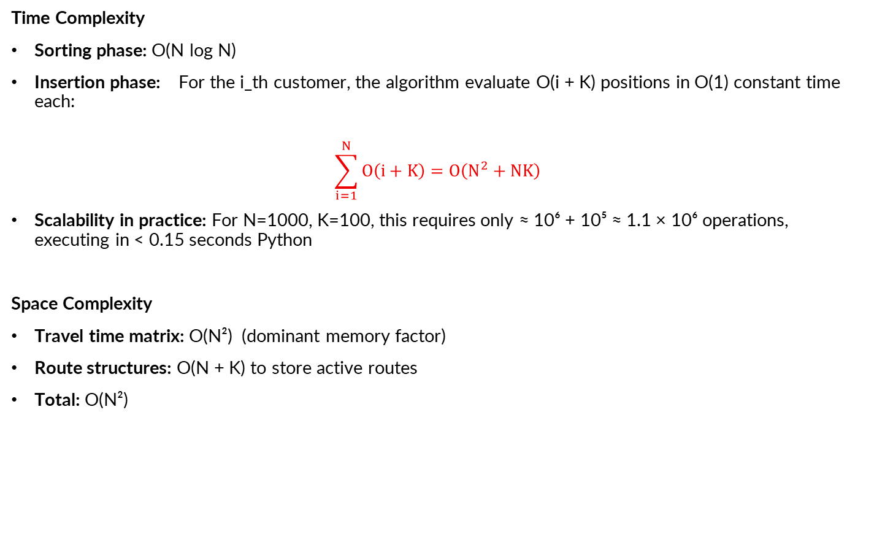
5.5 Complexity & Performance Analysis
Time Complexity
Sorting phase: O(N log N)
Insertion phase: For the i_th customer, the algorithm evaluate O(i + K) positions in O(1) constant time each:
$$\sum_{i=1}^{N}{O\left(i+K\right)}=O\left(N^{2}+NK\right)$$
Scalability in practice: For N=1000, K=100, this requires only ≈ 10⁶ + 10⁵ ≈ 1.1 × 10⁶ operations, executing in < 0.15 seconds Python
Space Complexity
Travel time matrix: O(N²) (dominant memory factor)
Route structures: O(N + K) to store active routes
Total: O(N²)

Slide 28
6. Hill Climbing Heuristic
Background
Logic
6 Sub-Algorithms with Pseudocode

Slide 29
6.1 Background & Logic
Background
Hill climbing is a mathematical optimization and heuristic search technique.
Belongs to the family of LOCAL SEARCH methods.
Continually moves in the direction of decreasing cost to find the best possible solution.
Search Logic
① Initialize: Generate initial candidate solution using greedy algorithm.
② Compute: Use compute_max_time() to measure total makespan of current state.
③ Check Neighbors: Make minor tweaks to create nearby alternative solutions:
• Swap: Choose 2 routes randomly; swap 1 customer between them.
• Multiple Swap: Choose 2 routes randomly; swap multiple customers between them.
• Move: Choose 1 customer from a route; move it to another route.
④ If a neighboring state has a BETTER (lower) makespan → step into it.
⑤ Stop when no surrounding neighbor offers an improvement (local minimum).

Slide 30
6.2 Algorithm 1: Compute Max Time & Algorithm 2: Swap
Algorithm 1: compute_max_time(routes)
function compute_max_time(routes):
Initialize max_time = 0, time = 0
for each route do
time = 0
for i = 0 to (length of route − 1) do
time += travel_time(route[i], route[i+1])
if route[i+1] != depot: time += service_time(route[i+1])
max_time = max(max_time, time)
return max_time
end function
Algorithm 2: try_neighbor_swap(routes, best_cost)
function try_neighbor_swap(routes, best_cost):
Randomly select two routes r1, r2 with |r1| >= 2 and |r2| >= 2
Randomly select nodes i in r1 \ {0}, j in r2 \ {0}
Swap nodes i and j between routes
if modified solution is improved (lower cost):
return modified cost
If not: UNDO the swap
return best_cost
end function

Slide 31
6.2 Algorithm 3: Multiple Swap & Algorithm 4: Move
Algorithm 3: try_neighbor_swap_multiples(routes, best_cost, num_nodes)
function try_neighbor_swap_multiples(routes, best_cost, num_nodes):
Randomly select two routes r1, r2 with |r1| >= 2 and |r2| >= 2
Randomly select starting nodes i in r1 \ {0}, j in r2 \ {0}
for i = 0 to (num_nodes − 1) do
Swap consecutive nodes i and j between routes
if modified solution is improved:
return modified cost
If not: UNDO the multi-swap
return best_cost
end function
Algorithm 4: try_neighbor_move(routes, best_cost)
function try_neighbor_move(routes, best_cost):
Randomly select two routes r1, r2 with |r1| >= 2 and |r2| >= 2
Randomly select node i in r1 \ {0}, j in r2 \ {0}
MOVE the customer from node i into route r2 at position j
if modified solution is improved:
return modified cost
If not: UNDO the move
return best_cost
end function

Slide 32
6.2 Algorithm 5: Greedy Initialization (Part 1)
function greedy():
// Initialize K technicians
technicians = array of K elements, each with:
route = [0] and work = 0
visited = array of size (N+1) filled with FALSE
visited[0] = TRUE
customers = list [1..N]
SHUFFLE customers randomly
for N iterations do:
best_cost = INFINITY ; best_tech = −1 ; best_cust = −1
for each cust in customers do:
if visited[cust]: continue
for k = 0 to K−1 do:
last_node = last node in technicians[k].route
cost = technicians[k].work + matrix[last_node][cust] + d[cust]
if cost < best_cost:
best_cost = cost ; best_tech = k ; best_cust = cust

Slide 33
6.2 Algorithm 5 (Part 2) & Algorithm 6: Hill Climbing Loop
// Assign best customer to selected technician
technicians[best_tech].route.append(best_cust)
technicians[best_tech].work += matrix[prev_node][best_cust] + d[best_cust]
visited[best_cust] = TRUE
// Return all technicians to depot
for each tech: tech.route.append(0)
return list of routes from all technicians
end function
Algorithm 6: hill_climbing(routes, max_iter=20000)
function hill_climbing(routes, max_iter=20000):
best_cost = compute_max_time(routes)
for iteration = 1 to max_iter do:
old_cost = best_cost
best_cost = try_neighbor_swap(routes, best_cost)
if best_cost < old_cost: continue { restart search }
best_cost = try_neighbor_swap_multiple(routes, best_cost)
if best_cost < old_cost: continue { restart search }
best_cost = try_neighbor_move(routes, best_cost)
return routes
end function

Slide 34
7. Comparative Analysis & Conclusion

Slide 35
7.1 Benchmark Results — Full Comparison Table
N K | CP Makespan CP Time | B&B Makespan B&B Time | Greedy Makespan Time | HC Makespan Time
─────────────────────────────────────────────────────────────────────────────────────────────────────────────
5 2 | 1,800 571 | 1,800 44 | 1,800 29 | 1,800 235
10 2 | 2,560 589 | 2,560 581 | 2,740 25 | 2,730 243
100 10 | N/A N/A | N/A N/A | 2,370 27 | 2,440 709
200 10 | N/A N/A | N/A N/A | 3,120 32 | 3,790 1,119
200 20 | N/A N/A | N/A N/A | 2,220 31 | 2,180 1,179
400 40 | N/A N/A | N/A N/A | 2,050 61 | 2,300 2,586
500 50 | N/A N/A | N/A N/A | 2,020 85 | 2,290 3,438
700 70 | N/A N/A | N/A N/A | 1,990 140 | 2,090 5,733
900 90 | N/A N/A | N/A N/A | 2,050 244 | 2,110 9,575
1000 100 | N/A N/A | N/A N/A | 2,020 325 | 2,160 12,118
─────────────────────────────────────────────────────────────────────────────────────────────────────────────
Time unit: milliseconds (ms). N/A = exceeded memory or time limit (15s).

Slide 36
7.3 Conclusion
Common Conclusion
Both exact methods are strictly limited to tiny instances (N ≤ 10).
They are most useful as correctness benchmarks for evaluating heuristic outputs.\
Summary
Greedy: deterministic, O(N²+NK), sub-second. Best for production use.
Hill Climbing: stochastic, competitive on medium N, too slow for N > 500.
Recommendation
The DETERMINISTIC Sorted Cheapest Insertion algorithm provides:
• High-quality balanced routes in milliseconds
• Near-optimal results at maximum scale (N=1000, makespan=2,020 in 325ms)
• Fully deterministic — no stochastic variance between runs
• Highly suitable for LARGE-SCALE real-world maintenance dispatching operations

Slide 37
THANK YOU !

