Slide 1


11-FA25-SP26-F-WEB: Voiland Food Pantry – Sprint 1
Jodie Butterworth, Kaitlyn Cornish, Matthew Hill, Alex Langland
October 5, 2025

Slide 2
Introduction
Project and Team
Web application for Voiland Food Pantry and volunteers
Members and roles
Sprint 1 Objectives
Gather requirements from clients
Documentation creation
Identify and learn full-stack development frameworks
Working alongside a team for the database
Notes:
1 – 1.5 min. Presenter: Team leader or designated spokesperson (Matthew)

Slide 3
Sprint Objectives
Client Requirement Collection
User Stories, Use Cases, UML diagrams
Install and Evaluate Existing Systems
Identify Necessary Full-Stack Framework and Begin Learning
Development of Identified Features
Notes:
1 – 1.5 min. Presenter: Team leader

Slide 4
Requirements Gathering Process
Client Meetings Recap and Meeting of Minutes
Methods for Gathering Project Requirements
Key Requirements Identified
Notes:
1.5 – 2 min. Presenter: Member responsible for client communication (Matthew)

Slide 5
Documentation of User Stories, Use Cases, and UML Diagrams
User Stories
Use Case Diagrams
UML Diagrams
Notes:
3 – 4 min. Presenter: Member responsible for documentation (Jodie? – Completed the UML and Use Case diagrams – or a volunteer)

Slide 6
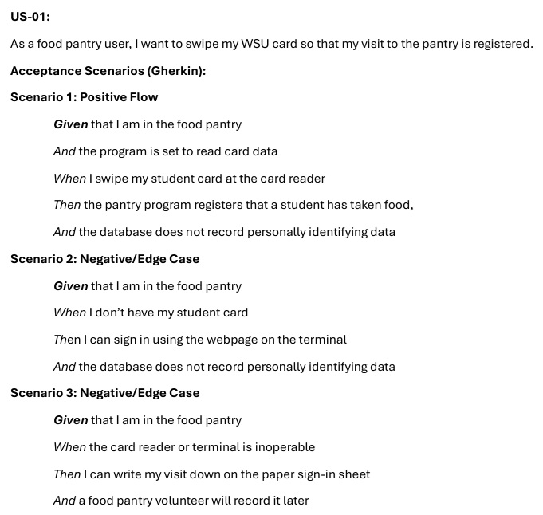
User Stories
Notes:
User Stories – 1 minute: Walk through a few user stories based on client requirements

Slide 7
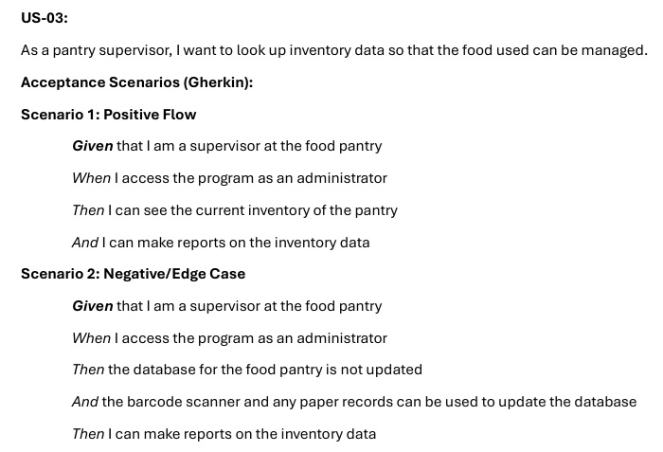
User Stories
Notes:
User Stories – 1 minute: Walk through a few user stories based on client requirements

Slide 8
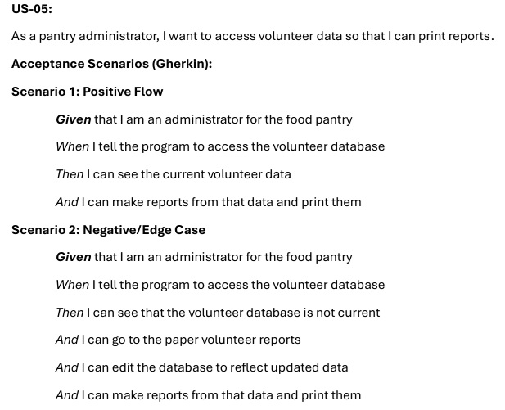
User Stories
Notes:
User Stories – 1 minute: Walk through a few user stories based on client requirements

Slide 9
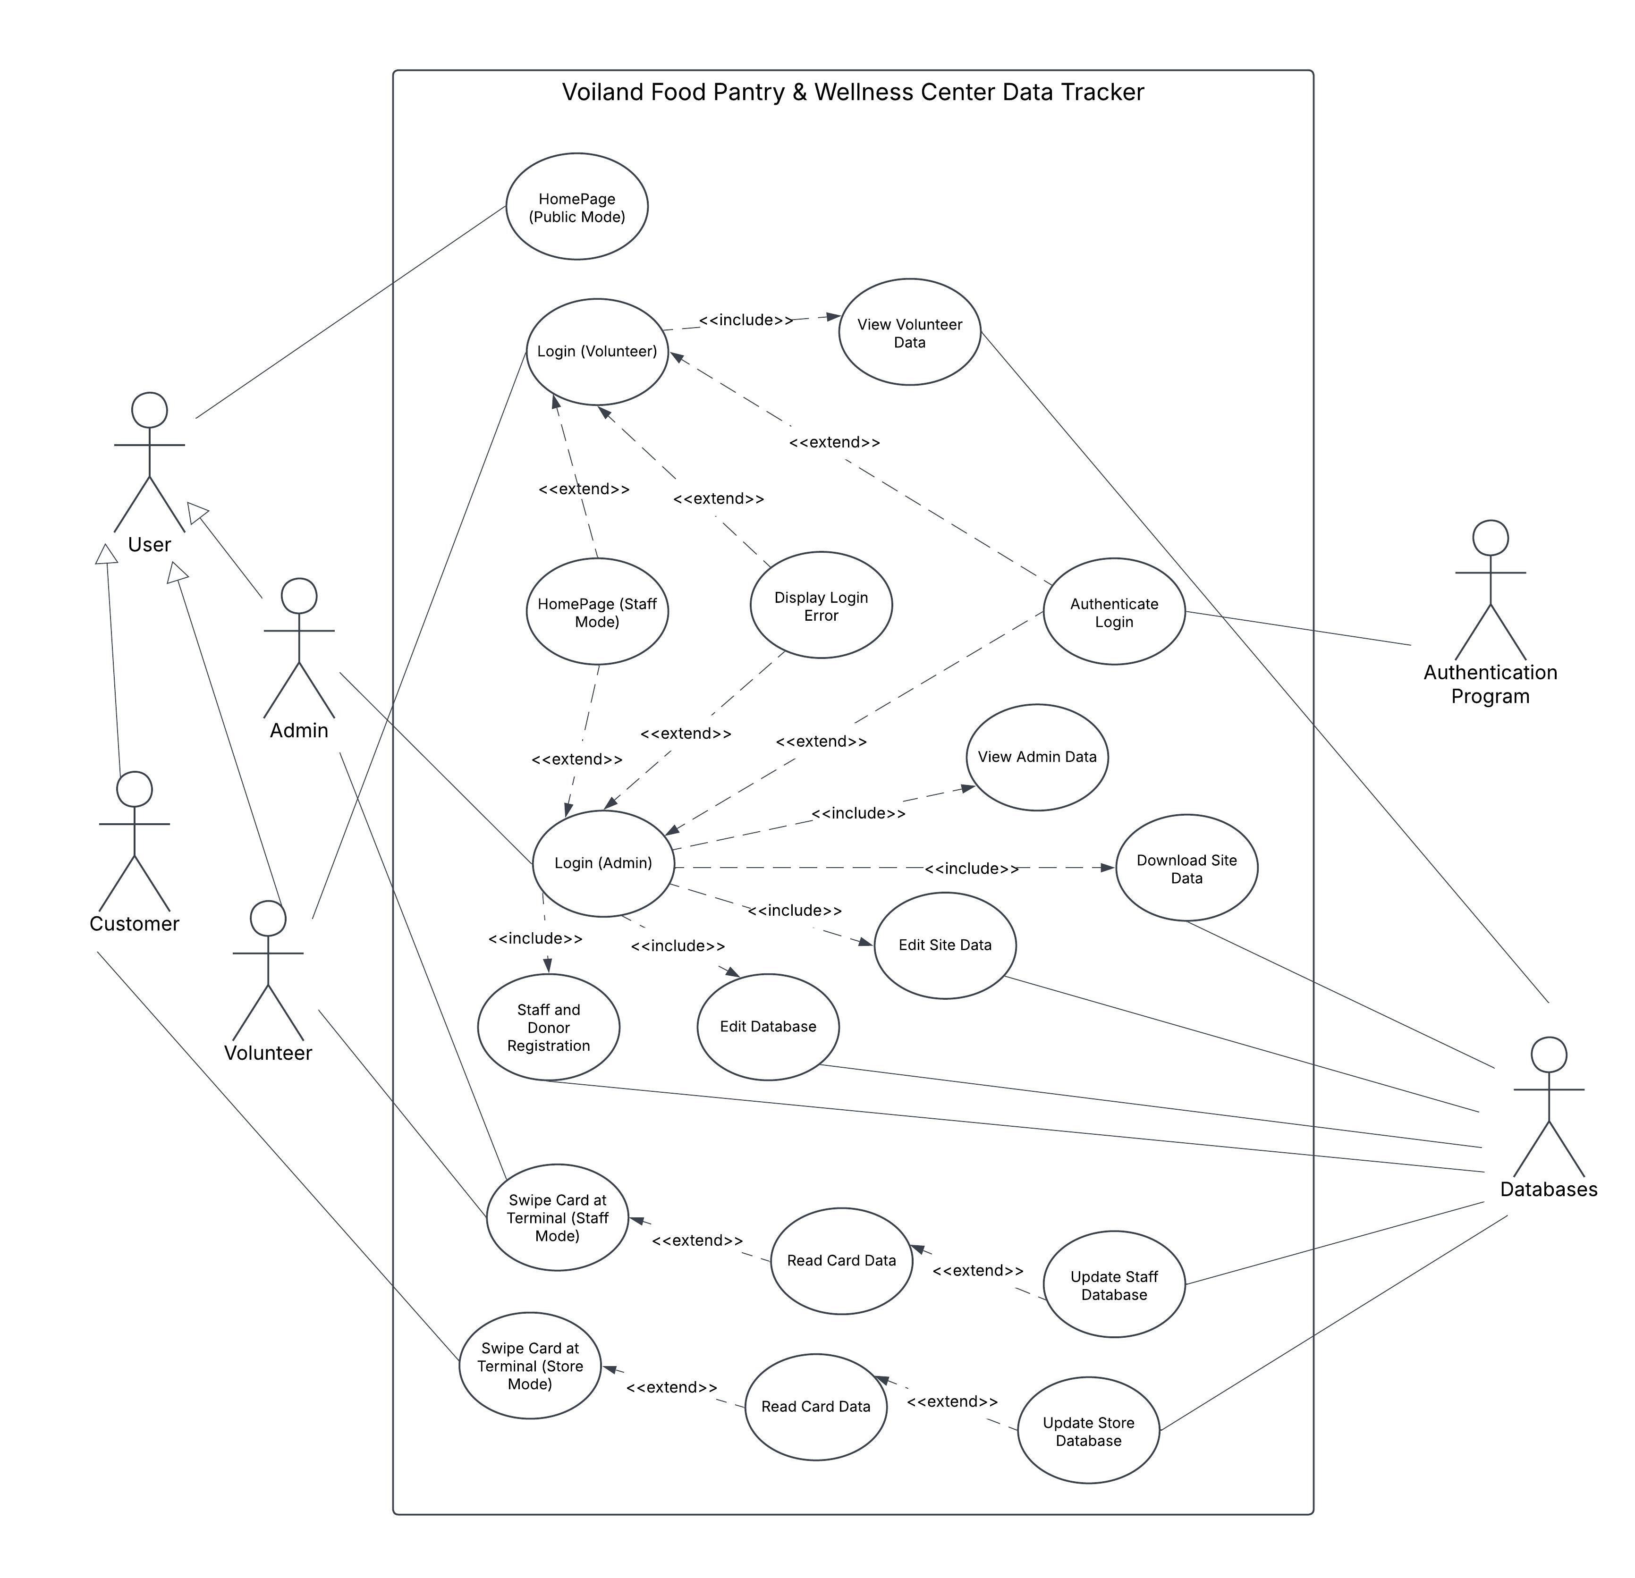
Use Case Diagram
Notes:
Use Case Diagrams – 1 – 1.5 minutes: Present key Use Case diagrams, explain user interactions they represent

Slide 10
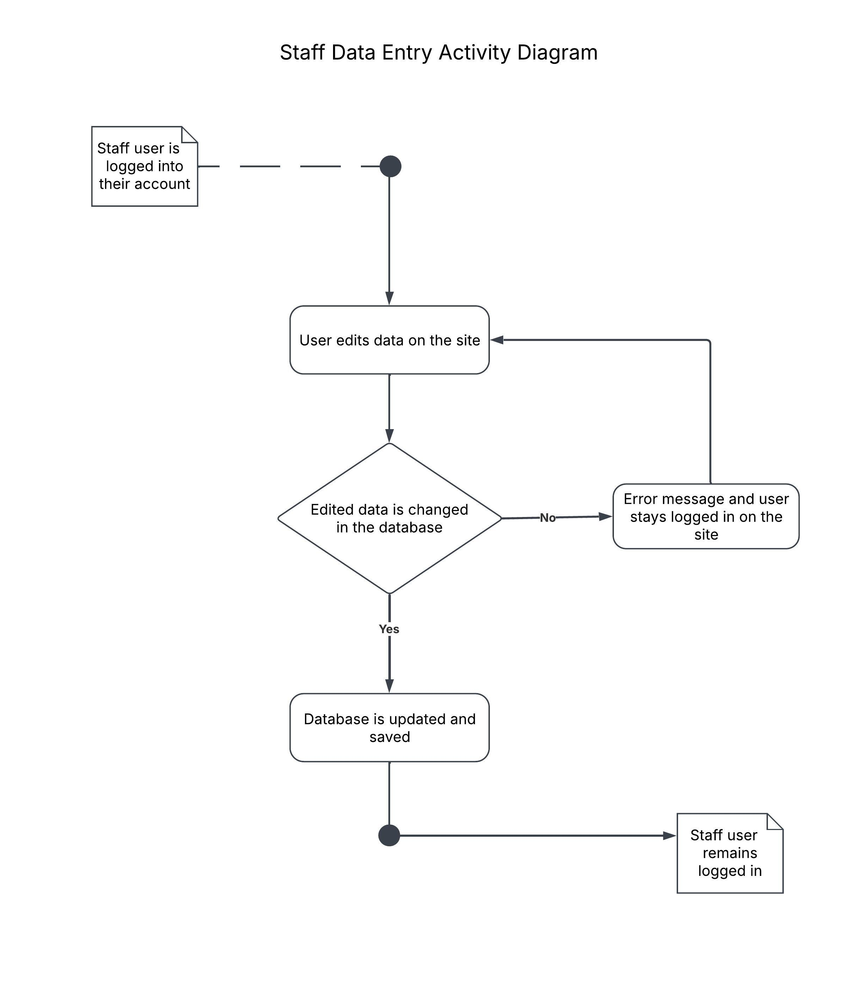
UML Diagrams
Notes:
UML Diagrams – 1 – 1.5 minutes: Show class and activity diagrams, explain how they relate to the system’s structure

Slide 11
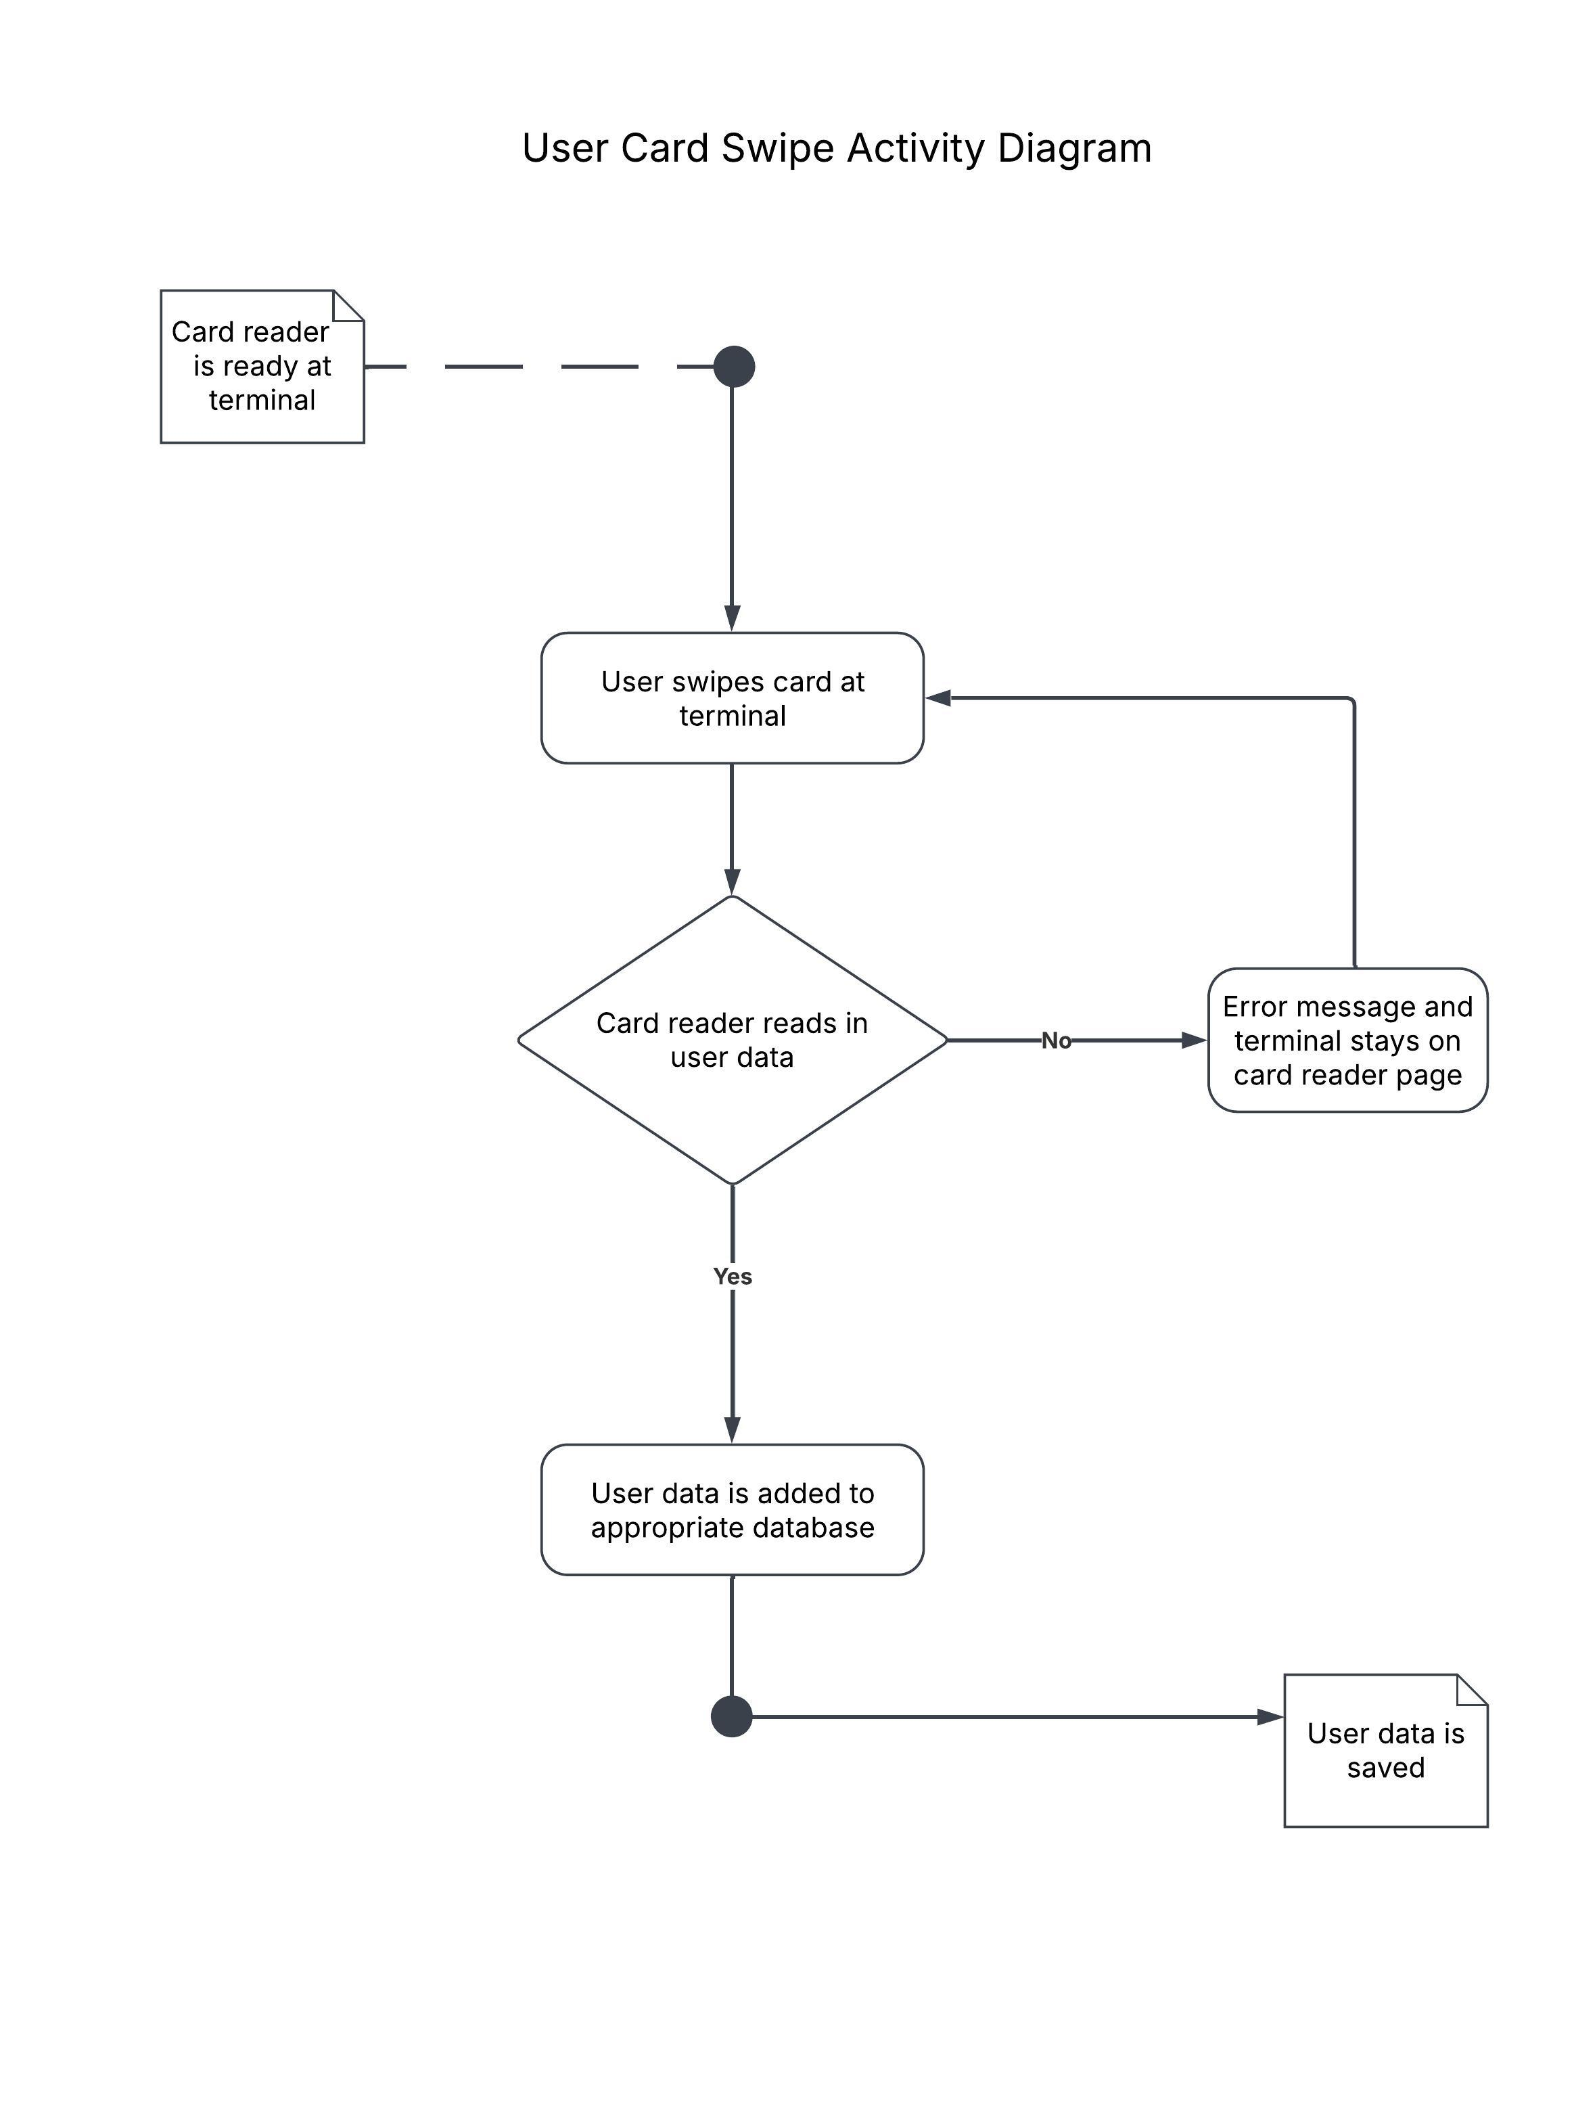
UML Diagrams
Notes:
UML Diagrams – 1 – 1.5 minutes: Show class and activity diagrams, explain how they relate to the system’s structure

Slide 12
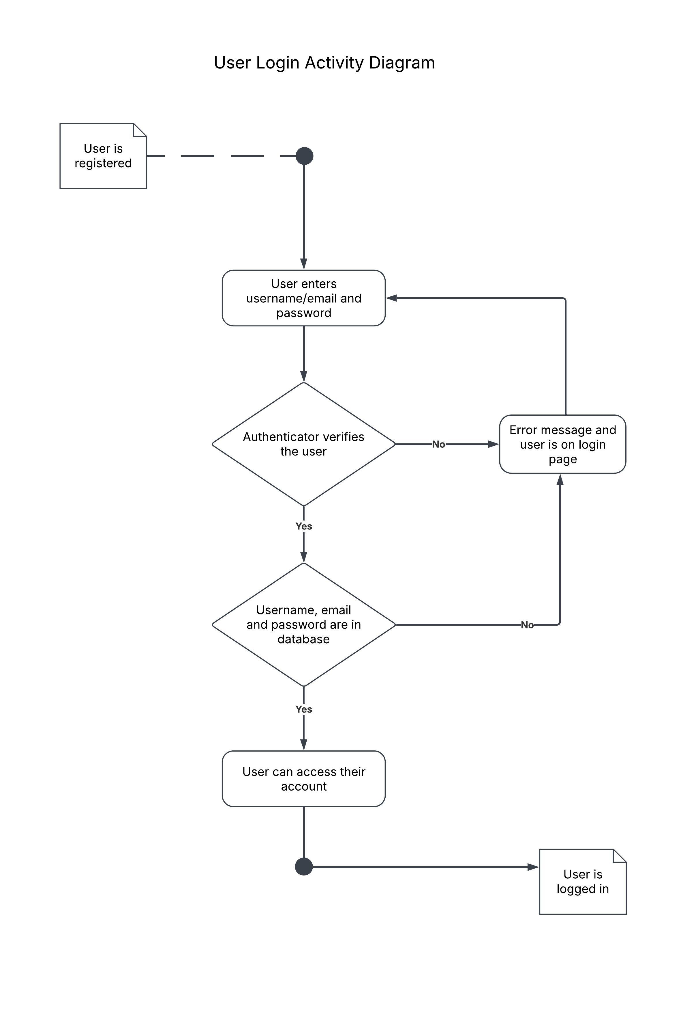
UML Diagrams
Notes:
UML Diagrams – 1 – 1.5 minutes: Show class and activity diagrams, explain how they relate to the system’s structure

Slide 13
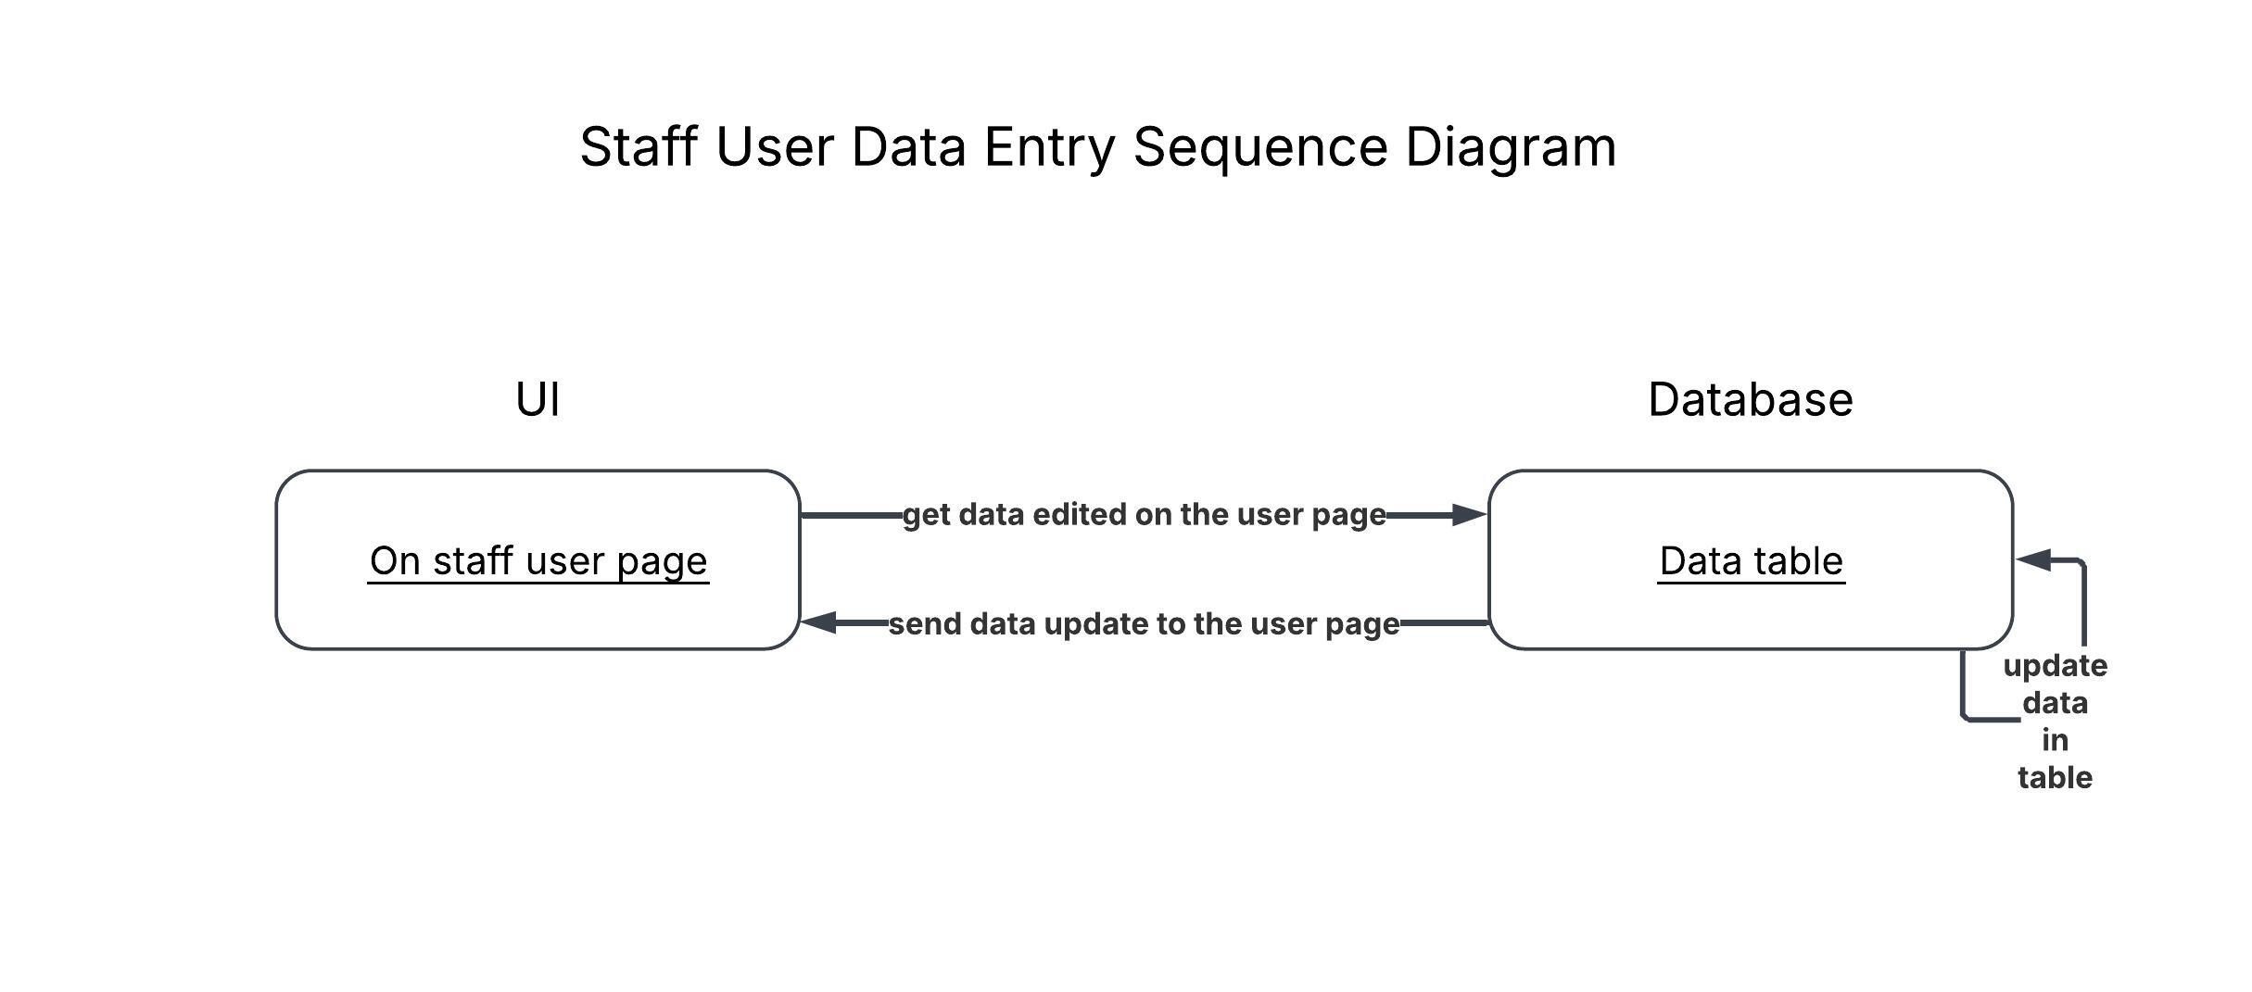
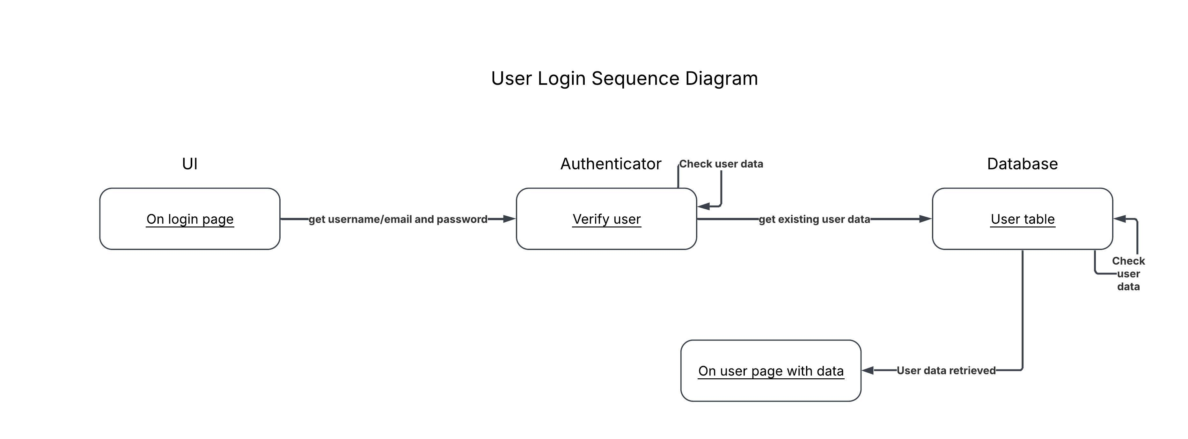
UML Diagrams
Notes:
UML Diagrams – 1 – 1.5 minutes: Show class and activity diagrams, explain how they relate to the system’s structure

Slide 14
Installation and Evaluation of Existing Solution
Tasks Currently Handled Physically
Clientele must sign in using a sheet of paper
Time-Consuming and Inefficient
Volunteers manually collect customer information
Volunteers also manually log volunteer hours
Seek to Collect Information More Easily
Ensure clientele are willing to use the application over the paper
Want to maintain a sense of trust
Notes:
1.5 – 2 min. Presenter: Member responsible for system evaluation (Volunteer?)

Slide 15
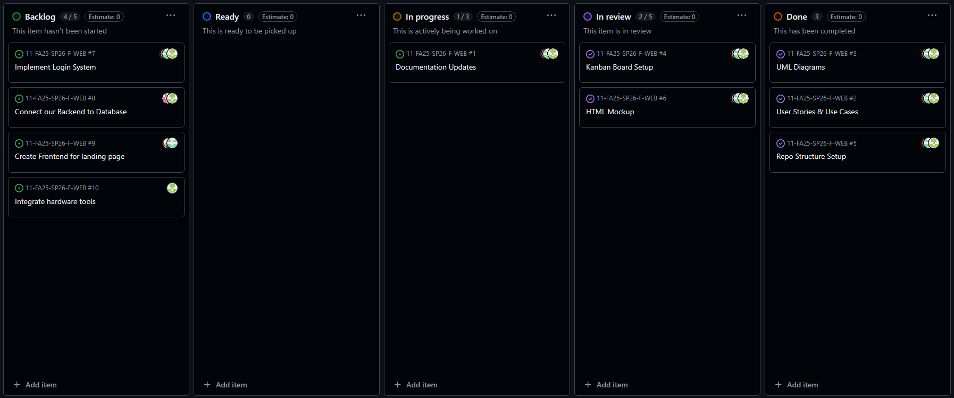
Kanban Overview and Team Contributions
Notes:
3 – 4 min. Presenter: Team leader Display the Kanban board, showing the tasks completed during Sprint 1.
Each team member briefly explains their contributions, highlighting task completion and progress.

Slide 16

Feature Demonstration
Notes:
3 – 5 min. Present features in action – probably just by one presenter
Present each completed feature in action
Explain functionality, user stories, and how acceptance criteria were met
If any feature was not completed, briefly discuss reasons

Slide 17
Skills Identification and Learning Process
Jodie Butterworth: Front-End
Skill Set Identified
Learning Resource
What I Learned
Kaitlyn Cornish: Back-End
Skill Set Identified
Learning Resource
What I Learned
Matthew Hill: Front-End
Skill Set Identified
Learning Resource
What I Learned
Alex Langland: Back-End
Skill Set Identified
Learning Resource
What I Learned
Notes:
3 – 4 min. Each team member presents their role and learning experience related to the project
Mention database team belongs to a different course

Slide 18
Sprint Achievements and Challenges
Achievements of Sprint 1
Requirements gathered
Documentation created
System evaluated
Skills learned
Challenges Faced
Scheduling conflicts
Unforeseen switch from WordPress
Notes:
1 – 1.5 min. Presenter: Team leader

Slide 19
Responsible Use of AI
Disclosure
Application and Improvements
Limitations and Checks
Accountability
Notes:
1.5 – 2 min. Presenter: Any member (rotating each Sprint – who’s first?) Disclosure: State whether GenAI tools were used during the sprint Application and Improvements: Explain how AI tools were applied (e.g., drafting documentation, suggesting code, brainstorming design ideas). Share specific improvements AI helped achieve (time saved, clarity, efficiency)
Limitations and Checks: Mention any limitations or errors noticed in AI output. Describe how the team verified and refined AI-assisted content.
Accountability: Reiterate final decisions and deliverables are the team’s responsibility.

Slide 20
Next Steps and Sprint Retrospective
Next Steps for Sprint 2
Begin front-end and back-end development based on selected frameworks
Retrospective
What went well
Areas to improve for the next Sprint
Notes:
1.5 – 2 min. Presenter: Team leader Next Steps: Start coding the front-end and back-end based on the selected frameworks. Retrospective: What went well and areas to improve for the next sprint

Slide 21
Conclusion
Thank you!
Notes:
0.5 – 1 min. Presenter: Team leader Mention excitement for the upcoming development in Sprint 2.

