Slide 1


11-FA25-SP26-F-WEB:
Voiland Food Pantry – Sprint 2
Jodie Butterworth, Kaitlyn Cornish, Matthew Hill, Alex Langland
November 12, 2025

Slide 2
Introduction
Project Introduction
Voiland Food Pantry management system
Web application for food pantry clientele and volunteers
Sign-in, inventory management, volunteer hours tracking
Team Roles
Jodie Butterworth – Front-end developer
Matthew Hill – Front-end developer, team lead
Kaitlyn Cornish – Back-end developer
Alex Langland – Back-end developer
Cristobal Escobar and Alan Sun – Database team
Sprint 2 Goals
Begin development for inventory management, as per client’s request
Create Minimum Viable Product (MVP) for client feedback
Refine project functionalities and UI to fit expectations
Notes:
1.5 – 2 minutes

Slide 3
Sprint Objectives
Defined Objectives
Inventory management and barcode scanner functionality
Testing with locally-hosted website mockup
Receive client feedback
Key Goals and Rationale
Barcode scanning and inventory database and UI up and running
Full stack mock-up in Java that can be integrated with WordPress or HTML UI
Connection to Overall Vision
Setting up the program to be useable on terminal or web-based hosting
Getting the barcode scanner working and connected to the database
Providing UI interface for testing and interaction
Notes:
1.5 – 2 minutes

Slide 4
Feature Implementation
Feature Overview
Inventory management database
Barcode scanner integration
Customer login with returning credential recognition
Before and After Scenarios
Inventory: Initially, no implementation – added ability to track stock, ounces of food, specific items
Barcode scanner: Initially, no implementation – added ability to read food barcodes and output UPC
Customer login: Initially, paper sign-in – added recognition for user’s standing and major
Features Demo
Demo follows
Testing and Validation
Inventory: Testing with barcode scanner by adding, subtracting, searching, and testing edge cases (subtract stock of 0, etc.)
Barcode scanner: Cross-reference with UPC database to ensure item matches
Customer login: Recall previous logins, log in again to ensure recognition functions accordingly
Notes:
4 minutes

Slide 5
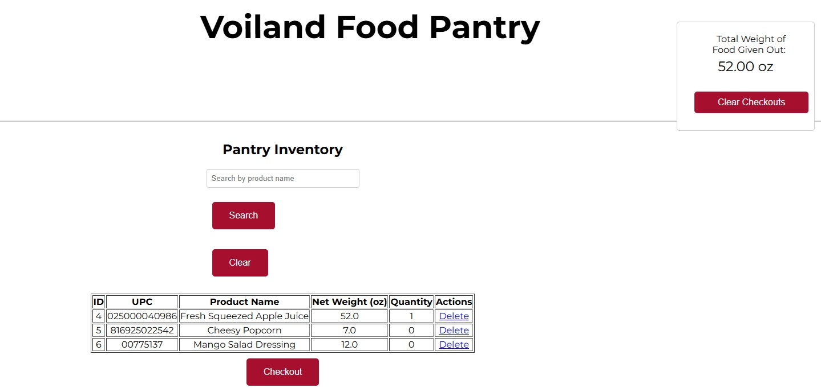
Prototype & Client Feedback
Prototype Overview
  New Barcode Scan and Inventory UI
Notes:
1.5 – 2 minutes

Slide 6
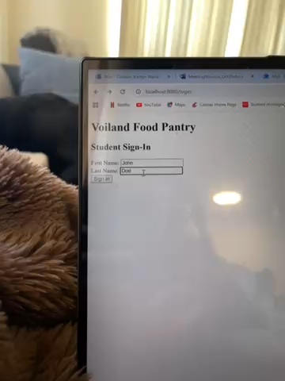
Prototype & Client Feedback
Prototype Overview
  New Login UI and functionality
Notes:
1.5 – 2 minutes

Slide 7



Prototype & Client Feedback
Client Feedback Adjustments
  Clients requested that the UI have a functioning database for the demo model
  Clients requested that the scanners for cards and barcodes work
  Clients requested that inventory reports be made and automatically emailed at the end of the month
Notes:
1.5 – 2 minutes

Slide 8
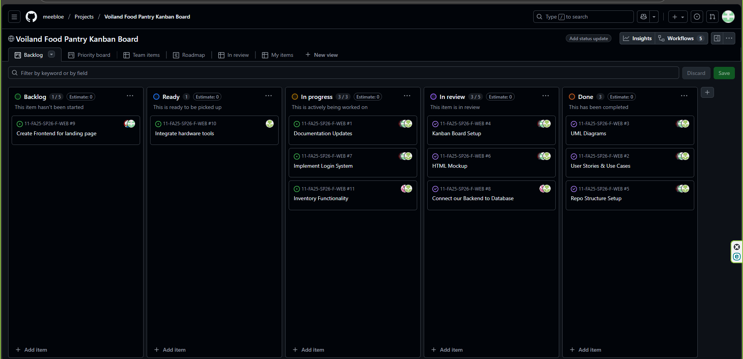
Kanban Overview & Team Contributions
Kanban Board:
Individual Contributions
Jodie Butterworth: Front-End Pages, Documentation
Kaitlyn Cornish: Java Full-Stack, Login Page Functionality
Mathew Hill: Project Management, Documentation
Alex Langland: Scanner Hardware Integration, Inventory Management Implementation
Notes:
1 – 1.5 minutes

Slide 9
Website Development
Static Functionality
Decided to use WordPress again after events of Sprint 1
Currently using locally hosted HTML website for testing feature implementation
Adjusted UI to include requested features (login, inventory, scan, etc.)
User Navigation and Responsiveness
Application only meant for functionality as a website for terminal provided by client
As showcased in demo, current responsiveness meets expectations
Navigation is typical and matches UI
Alignment with Client Requirements
Requested work on inventory and barcode scanner first – website functions reflect this
Clients wanted ounces of food checked out
Keep items in database, even after stock reaches 0
Notes:
3 minutes

Slide 10
Documentation of System Components
System Architecture
Clients requested use of WordPress – currently, still working with contacts on that front
Major components include login, inventory, and volunteer tracking
Components directly tied to each other for thorough function of entire system
Database Design
Shown in following slide
User Interface Design
Current UI structure, shown in features demo, is temporary for sake of feature testing
Following client feedback, inventory system improved by variable quantity input for efficiency
New fields and trackers added in consideration of client requirements
Testing Plan
Edge cases covered during development of inventory features
Testing undergone using barcode scanner to verify both hardware and software
Real-world testing by showing clients and discussing changes needed if using the application themselves
Notes:
3 minutes

Slide 11
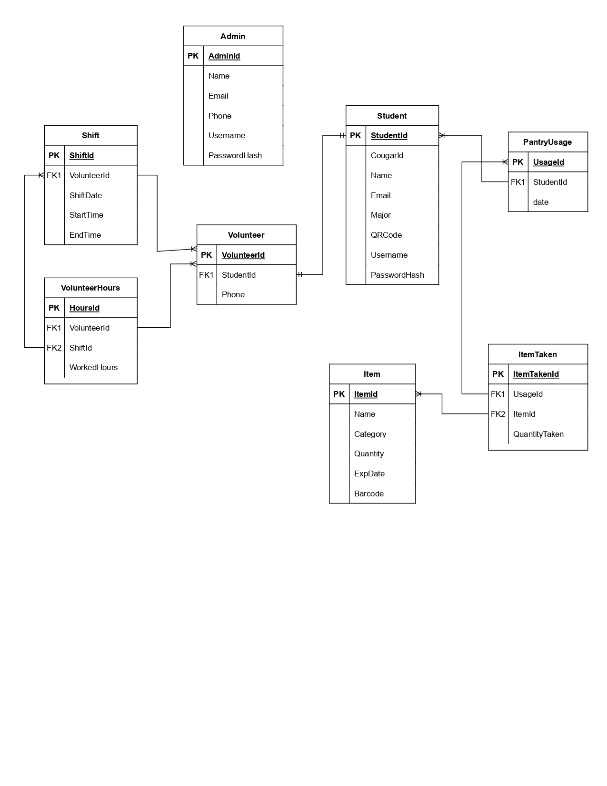
Documentation of System Components
Database Design
  Database design is handled by the database team separate from our course
  Relational schema using MySQL
  Emphasizes scalability for increasing inventory, clientele, and volunteers
  Referential integrity for consistent table relationships
  Flask testing front-end to provide testing and verification before delivery
Entity-Relationship (ER) Diagram
Notes:
3 minutes

Slide 12
Sprint Achievements & Challenges
Achievements
Began testing functionalities requested by clients to receive feedback
Approved and experimented with hardware to understand scanner integration
Established a set timeline for the project
Challenges and Solutions
Lack of proper communication within development team
However, treated with diligence by entire team for future sprints
Progress from Sprint 1
Reestablished using WordPress for application
Began development of prototype to explore and test requirements
Received feedback from clients to find areas of improvement for prototype
Notes:
1.5 – 2 minutes

Slide 13
Next Steps & Sprint Retrospective
Upcoming Tasks
Create dev version to host locally on provided computer
General UI improvements for already implemented features
Monthly email reports, sign-in system updates, volunteer hour tracking
Sprint Retrospective
Clients were impressed with prototype functionality
Features were prioritized, but needs UI cleaning up
Inadequate communication made for avoidable issues
This will be a team focus for upcoming sprints
Client Feedback Consideration
End of semester deadline for dev application established by clients
Editing features based on feedback on Sprint 2’s prototype
Notes:
1 – 1.5 minutes

Slide 14
Summary
Testing progress from both development team and database team
Ensured heavy client involvement for feedback and improvements
Planning for a dev version of application for clients to interact with and use to request a budget for food pantry
Notes:
1 minute

Slide 15

Thank You!

