Slide 1


11-FA25-SP26-F-WEB:
Voiland Food Pantry – Final Presentation
Jodie Butterworth, Kaitlyn Cornish, Matthew Hill, Alex Langland
December 3, 2025
Notes:
30 seconds

Slide 2
Project Overview
Objective
Create a web application with hardware integration for the Voiland Food Pantry
Magstripe reader and barcode scanner
Streamline food pantry operations
Sign-in system, food inventory management, volunteer tracking
Problem Statement
Improve pantry’s sign-in system efficiency
Establish an organized method of food inventory management
Provide support for pantry volunteers
Scope
Target audience is pantry clientele and staff, which includes volunteers
Create an intuitive system to handle facility tasks during hours of operation
Technologies Used
Hardware: Magstripe reader and barcode scanner
Front-end: WordPress for final product, Thymeleaf for local prototype of HTML pages
Back-end: Spring Boot and MySQL as the relational database
Notes:
1 minute

Slide 3
Functional and Non-Functional Requirements
Overall Requirements
Functional: User registration and login, inventory management, and volunteer hour tracking
Related hardware integration and report generation for these requirements
Non-functional: Security, performance, uptime, accuracy, usability, learnability
Ensures streamlined performance for food pantry tasks
Implemented Requirements
Inventory management
User registration and login
Barcode scanner integration
Notes:
1 minute

Slide 4
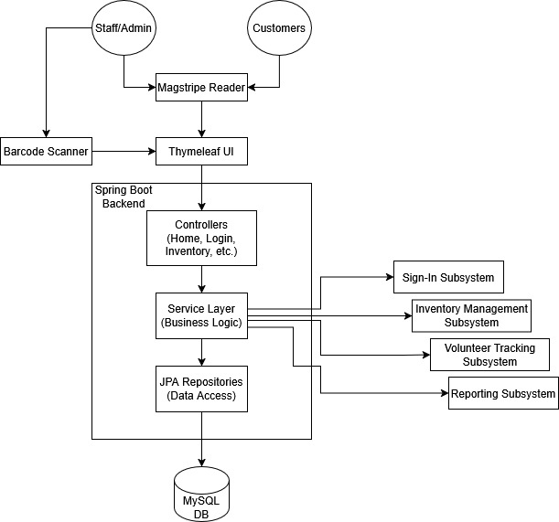
Overall Architecture of the System
Figure 1: System Architecture Diagram
Notes:
1 minute

Slide 5
Sprint 3 Achievements
Major Accomplishments
Continued implementation of sign-in features
User roles now have separate login pages
Built upon and improved previous work in this area
Such as customer user recognition
Connection to Overall Vision
The sign-in system is a major requirement
Which is also tied to other system components, such as inventory data and volunteer tracking
Creates basis for magstripe reader integration
This feature will be next in line for implementation
Sprint Retrospective
Application is now closer to how the final product should operate
Faced challenges regarding scheduling and communication
However, solved internally via group discussions
Notes:
5 minutes

Slide 6
System Demonstration
Feature Overview
Demonstration
User Interaction
Notes:
4 minutes

Slide 7
Testing
Testing Methodologies
Manual testing performed at three levels: unit testing, integration testing, then system testing
Narrows down the area where an error may occur for easier debugging
Methodology ensures that all components behave as expected in executing typical workflows
Test Results
No significant outcomes observed at the moment
Testing has gone smoothly on all three levels
Challenges
No major challenges thus far
However, prepared for potential obstacles as more major features are implemented
Notes:
1 minute

Slide 8
Responsible Use of AI
Areas of Application
Basis of UI for testing prototype was generated using ChatGPT
Brainstorming for technical phrasing and formatting in documentation using ChatGPT
PowerPoint Designer AI to assist in organized, engaging presentation layout
Improvements
Improved clarity and reduce repetition in documentation
Allowed to focus on presentation content rather than struggling with layout, saving time
Also saved time for prototype creation so testing and feature implementation were prioritized
Limitations and Refinement
AI occasionally misunderstood portions of the project
However, this was indicative that these areas needed to be further refined
Notes:
1 minute

Slide 9
Plan and Deliverables for Next Semester
Planned Functional Requirements
Continue sign-in system implementation, including magstripe reader integration
Improve inventory management by storing both stock-in and stock-out
Begin implementation of volunteer hour tracking
Begin implementation of report generation
Planned Non-Functional Requirements
Maintain current performance, accuracy, and security
Begin UI design and learnability to adhere to accessibility standards and intuitiveness
Timeline
Complete magstripe reader integration, stock-out storage, and UI improvements
Volunteer hour tracking and improvements in other features according to client feedback
Report generation, final touches, and verification with clients
Final Deliverables
Completed application with requirements met satisfactorily
Application will be set up on pantry’s terminal for operation
Thorough documentation for any future work that may be needed

Slide 10

Thank You!
Notes:
30 seconds -- Progress Made, Lessons Learned, Overall Achievements

