Slide 1
CIS350: Data Structures and Algorithm Analysis
Dr. Jinhua Guo
Office: 211CIS
jinhua@umich.edu

Slide 2
Topics
Data structures
Abstract data types (ADTs), vector, list, deque, stack, queue, graph, digraph, table, map, priority queue, sets, trees. etc.
Algorithms
Algorithm design, complexity analysis, and correctness proof
Generic programming
Generic programming permits component re-use and leads to more maintainable code. This course teaches coding for re-use of both data structures and algorithms.

Slide 3
Goals of This Class
Learning efficient data structure & algorithms
Design & write large programs
Choice of data structure
  Never should be chosen since EASY
  Should be fast, little space, modifiable, Scalable.

Slide 4
Selection Problem
Find the k^{th}-largest number from a group of N numbers
  How would you solve this?
Algorithm 1:
  Sort the N numbers by some simple algorithm such as bubblesort and Pick the k^{th} one
  Easy to implement, but
    Sorting requires many comparisons
    Much work comparing elements that have no chance of being in position k

Slide 5
Another strategy
Algorithm 2: (Better)
  Sort first K elements in the array.
  Insert elements (K+1) to N, discarding the smallest element each time.
  Then pick the k^{th} element
N = 10,000,000 and K = 5,000,000 ?
A simulation show that each algorithm requires several days of computer processing to terminate.
A better algorithm can solve this in a second!

Slide 6
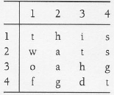
Word Puzzle
Find all words, given a 2-D array and a word-list.
Algorithm 1:
  For each word in the word list,
    compare each combination of letters in the puzzle
Algorithm 2:
  For each combination of letters
    Check if the word is in the word-list
What if the word-list is the entire dictionary?

Slide 7
Recursion
Recursive function
  Function that is defined in terms of itself
  E.g. f(0)=0 and f(x) = 2*f(x-1)+ x²
  Implementation in C or C++
    int f( int x )
    {
    if( x == 0)
    return 0;
    else
    return 2 * f( x - 1) + x * x;
    }
⬅Base Case
⬅Recursive Call

Slide 8
Recursion Examples
Evaluating f(x) = 2*f(x-1) + x*x
  f(4) = 2*f(3) + 4*4
    f(3) = 2*f(2) + 3*3
      f(2) = 2*f(1) + 2*2
        f(1) = 2*f(0) + 1*1
        f(0) = 0
        f(1) = 2*0 + 1*1 = 1
      f(2) = 2*1 + 2*2 = 6
    f(3) = 2*6 + 3*3 = 21
  f(4) = 2*21 + 4*4 = 58

Slide 9
Ensuring recursive programs terminate
What happens if you make the call f(-1) in the implementation in slide 7?
Another non-terminating recursive function
int bad(int n)
{
if(n == 0)
return 0;
else
return bad(n/3 + 1) + n - 1;
}
What happens on
call to bad(1)?
And bad(2)?
And bad(3)?

Slide 10
Ensuring recursive programs terminate (contd.)
Two rules for writing correct recursive programs
  Define a base case
    This is what terminates recursion
  Making progress:
    At each step make progress towards the base case
More rules for writing clean recursive programs
  Design Rule
    Assume that all recursive calls work.
  Compound Interest Rule:
    Never duplicate work by making same recursive call twice!
      E.g f(i) = f(i-1) + f(i-2). Why??

Slide 11
C++ Basics Review
Notes:
Introduction
Welcome to COP 4530, Data Structures, Algorithms, and Generic Programming. I hope very much, and sincerely believe, that this course will change you in ways that are deeply satisfying. So far, you have acquired proficiency in programming. This course will start the process of your transformation from a programmer to a computer scientist. One of the important tasks of a computer scientist is to make efficient use of computational resources. This course will teach you about different ways of organizing the data to facilitate such efficient use, and will also discuss efficient techniques to perform some fundamental operations in computer science. A subsequent course on Algorithms, COP 4531, will teach you to use the techniques discussed in this course to solve commonly encountered computer science problems efficiently. Both these courses will also teach you to analyze the efficiency, and prove the correctness, of your program in a mathematically rigorous manner. Material you learn in these two courses is critical to your becoming a good software developer later.

Slide 12
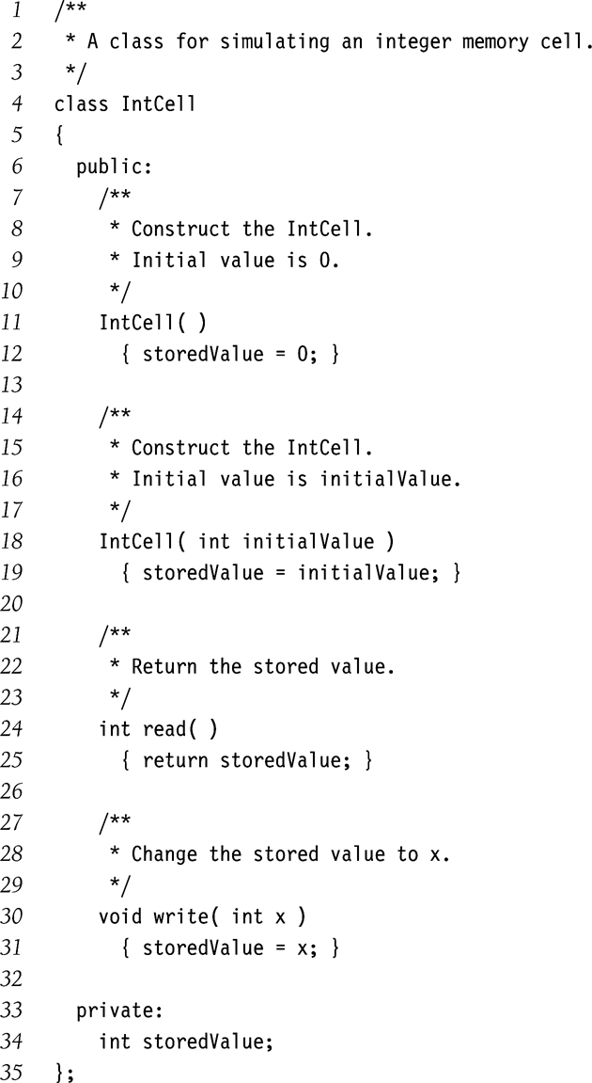
Classes
Defines the organization of a data user-defined type.
Members can be
  Data
  Functions/Methods
Information Hiding Labels
  public
  private
  protected
Constructors
  We have two in this example

Slide 13
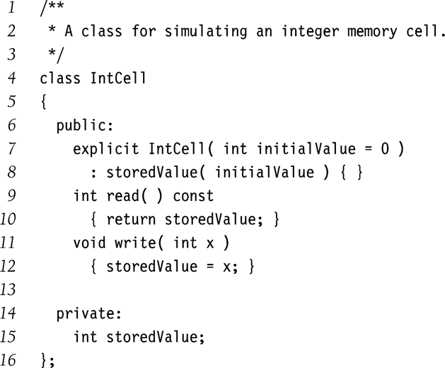
Additional Syntax and Accessors
Initializer list
  Init data members directly in the constructor
Explicit constructor
  Avoids automatic type conversion (and resulting bugs)
Constant member functions
  Examines, but does not change the object state
  Also called ‘accessor’
  Non-const functions are called ‘mutators’

Slide 14
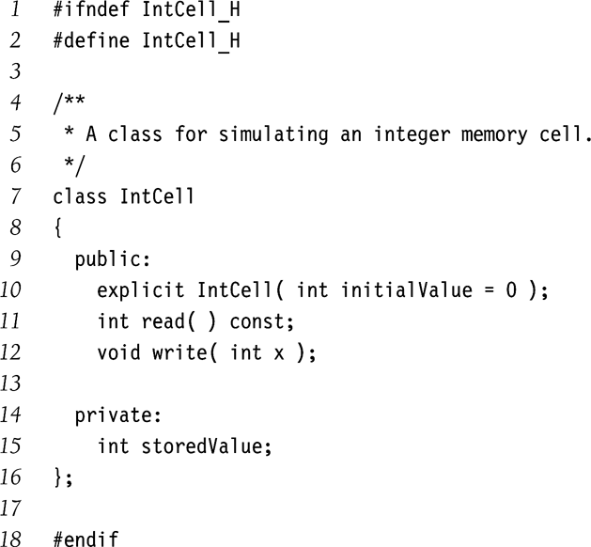
Interface Vs. Implementation
Interface
Interface typically defined in .h files
  #include in .c file
Preprocessor commands
  Guards against multiple inclusion of .h files

Slide 15
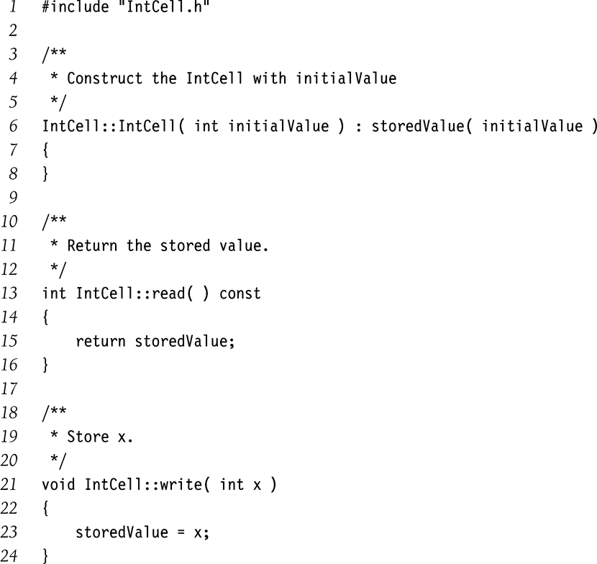
Interface Vs. Implementation (contd.)
Scoping operator
  To identify the class corresponding to each function
Remember
  Function signatures must match in both interface and implementation
  Default parameters are specified only in the interface
Implementation

Slide 16
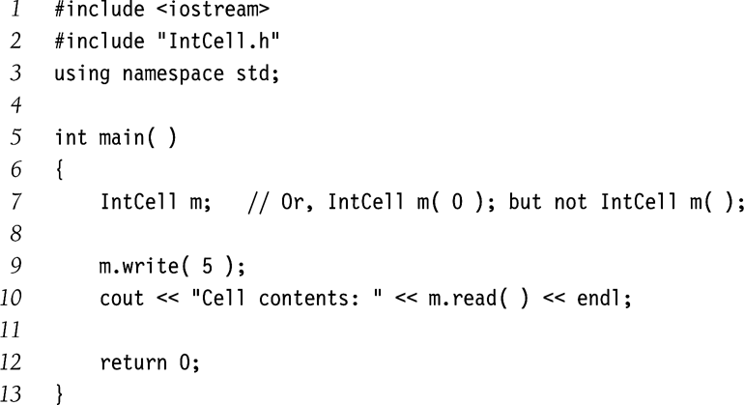
main() function
Objects are declared just like primitive data types.
Legal Declarations
  Intcell obj1; // zero parameter constructor
  Intcell obj2(12); // one parameter constructor
Illegal declarations
  Intcell obj3 = 37; // explicit constructor used
  Intcell obj4(); // function declaration
main() function

Slide 17
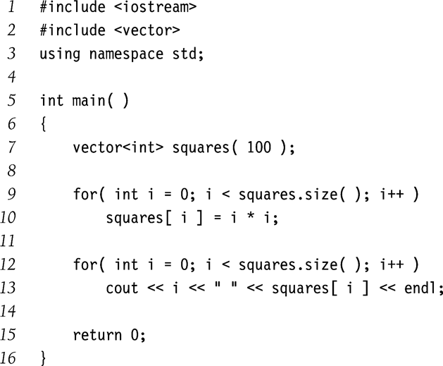
Vectors
Replaces built-in C++ arrays
  Built-in arrays do not act as proper C++ objects
Standard vector class
  Gives a size() function
  Can be assigned using =
Similarly C++ also provides standard string class.

Slide 18
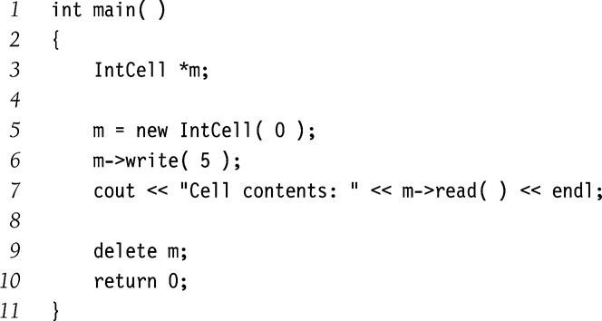
Pointers
Pointer variable
  Stores the address of another object in memory.
Declaration
  * before the variable name indicates a pointer declaration
  Pointers are uninitialized at declaration time.
  Reading uninitialized pointer values results in bugs.
Dynamic object creation
  Using the new keyword

Slide 19
Pointers (contd)
Garbage collection
  Objects allocated using new must be explicitly deleted.
  Else your program will have memory leaks
  There’s no automatic GC in C++.
Accessing members of an object
  Use the -> operator
Address-of operator
  &obj gives the address where obj is stored.
Memory leaks=
errors and grade
penalties in your
programming
assignment
(we will check
for those)

Slide 20
Parameter Passing
double avg( const vector<int> & arr, int n, bool & errorFlag);
Call by value
  Copies the value of parameter being passed.
  Called function can modify the parameter, but cannot alter the original variable.
  What happens if the parameter is an object?
Call by reference
  Used when the function needs to change the value of original argument
Call by constant reference
  Typically used when
    parameter is a large object
    Should not be changed by the function
    Using call-by-value would result in large copying overhead.

Slide 21
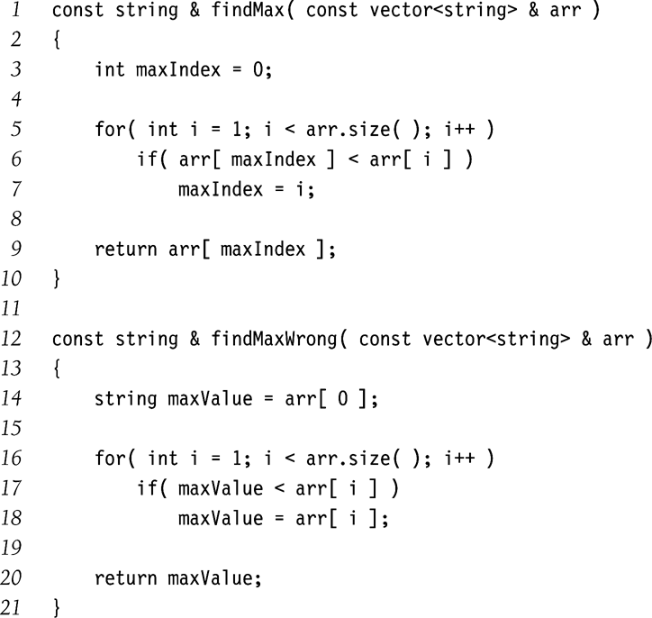
Return Passing
Return by value
  Makes a copy of the variable returned
Return by reference
  Return the address of the variable returned
Return by constant reference
  Return the address of the variable returned
  Return value cannot be modified by caller.
Last two techniques
  Lifetime of returned value should extend beyond the function called
Correct
Incorrect
Why??

Slide 22
Reference Variables
Synonyms of objects they reference
  Reference are not pointers
Can be used for
  Parameter passing
  Local variables
Avoid the cost of copying
Thus
  string x = findMax(a);
  Is better written as
  const string &x = findMax(a);
Also used for renaming an object with complex expression
  list<T> &whichList = theLists[ hash(x, theLists.size()) ];

Slide 23
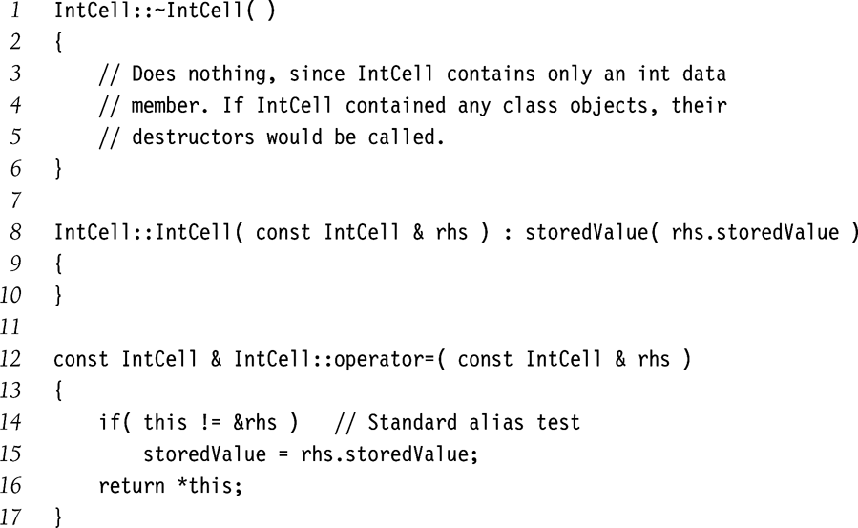
Destructor
Called whenever
  Object goes out of scope
  delete called
Frees up resource allocated for the object

Slide 24
Copy constructor
Initializes a new object to another of its own type
Invoked during
  Declaration
    IntCell B = C;
    Intcell B (C);
  Call by value
  Return by value
But not in
  B = C; (assignment operator)

Slide 25
operator=
Copy assignment operator
Called when both LHS and RHS objects have been created

Slide 26
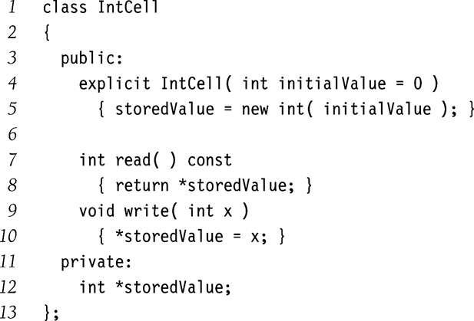
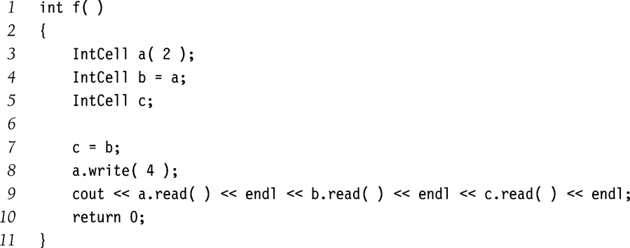
Problem with defaults
Usually don’t work when data member is a pointer type.
What is the output of f() in the adjacent example?
In this example, default operator= and copy constructor copy the pointer instead of the value

Slide 27
C++ Templates
Notes:
Introduction
Welcome to COP 4530, Data Structures, Algorithms, and Generic Programming. I hope very much, and sincerely believe, that this course will change you in ways that are deeply satisfying. So far, you have acquired proficiency in programming. This course will start the process of your transformation from a programmer to a computer scientist. One of the important tasks of a computer scientist is to make efficient use of computational resources. This course will teach you about different ways of organizing the data to facilitate such efficient use, and will also discuss efficient techniques to perform some fundamental operations in computer science. A subsequent course on Algorithms, COP 4531, will teach you to use the techniques discussed in this course to solve commonly encountered computer science problems efficiently. Both these courses will also teach you to analyze the efficiency, and prove the correctness, of your program in a mathematically rigorous manner. Material you learn in these two courses is critical to your becoming a good software developer later.

Slide 28
Templates
Type-independent patterns that can work with multiple data types.
Function Templates
  These define logic behind the algorithms that work for multiple data types.
Class Templates
  These define generic class patterns into which specific data types can be plugged in to produce new classes.

Slide 29
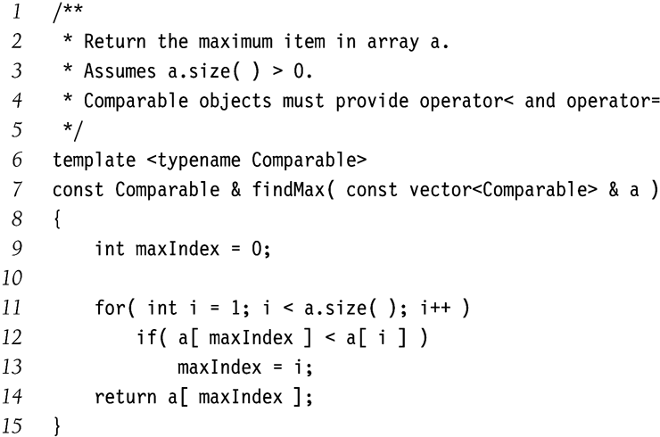
Function Templates example
Generic function to find a maximum value in a given vector
If argument is a vector<int> type, then compiler generates a corresponding function which Comparable is replaced by vector<int> type.
Similarly for vector<double>, vector<string> etc.
Assumption in this example:
  Operator< is defined in the Comparable.
Hence assumptions made by the template must be clearly stated.

Slide 30
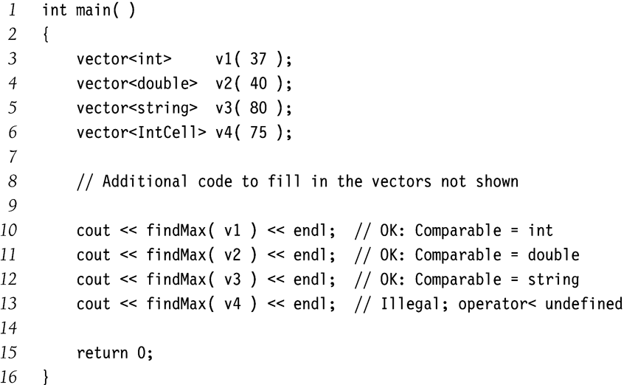
Function Templates Usage
Each call to findMax(Comparable a) on a different data type forces the compiler to generate a different function using the template.
Compiler will complain about findMax(v4) because IntCell class does not define operator<

Slide 31
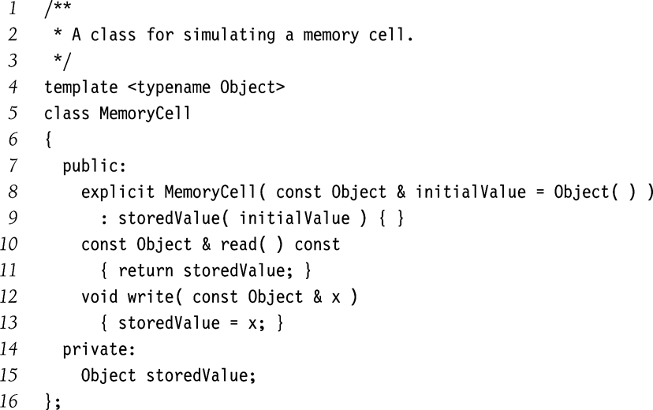
Class Template Example
MemoryCell template can be used for any type Object.
Assumptions
  Object has a zero parameter constructor
  Object has a copy constructor
  Copy-assignment operator
Convention
  Class templates declaration and implementation usually combined in a single file.
  It is not easy to separate them in independent files due to complex C++ syntax.
  This is different from the convention of separating class interface and implementation in different files.

Slide 32
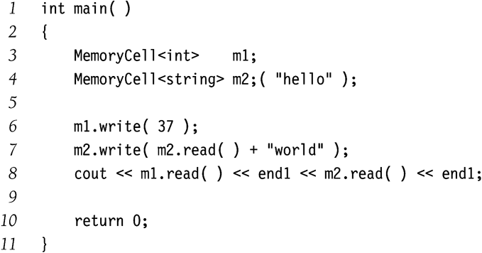
Class Template Usage Example
MemoryCell can be used to store both primitive and class types.
Remember
  MemoryCell is not a class.
  It’s a class template.
  MemoryCell<int>, MemoryCell<string> are classes.

Slide 33
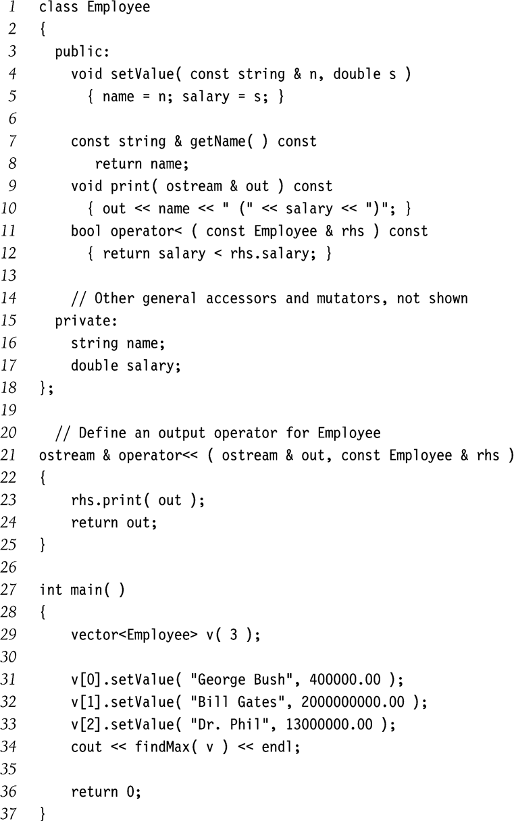
Another example
Operator Overloading
  Defines the meaning of operator< for Employee class.
Output operator<<
  Define a public member function
  print(ostream &out)
  Define a global nonclass function operator<< that calls print(…)

Slide 34
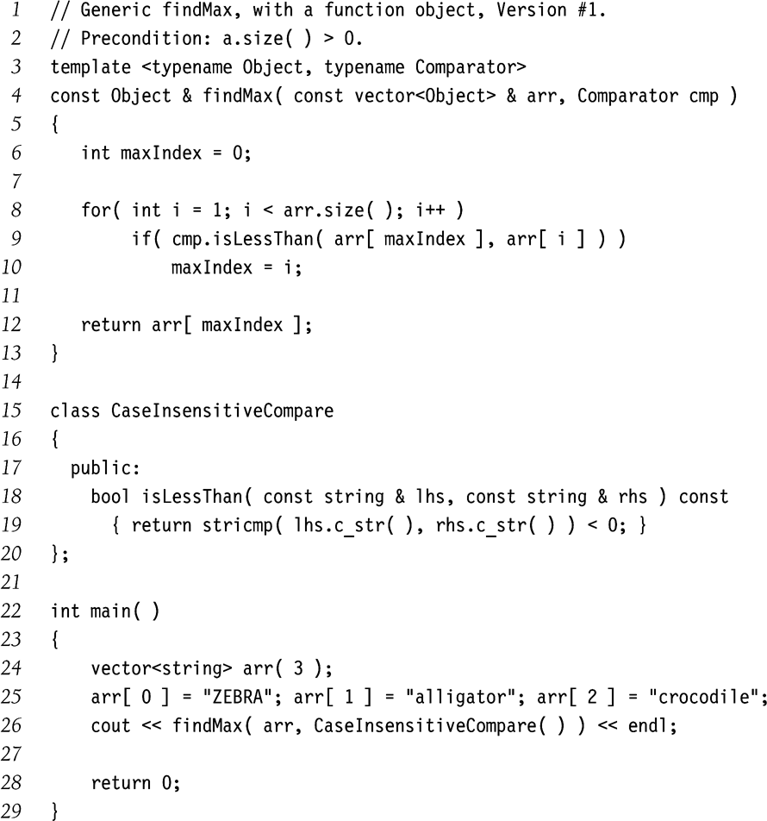
Function Objects
Objects whose primary purpose is to define a function
Here findMax() accepts a Comparator parameter as a function object.
  Comparator assumed to define the isLessThan(Comparator) function.
There is a more formal way to define function objects in C++ (next slide).

Slide 35
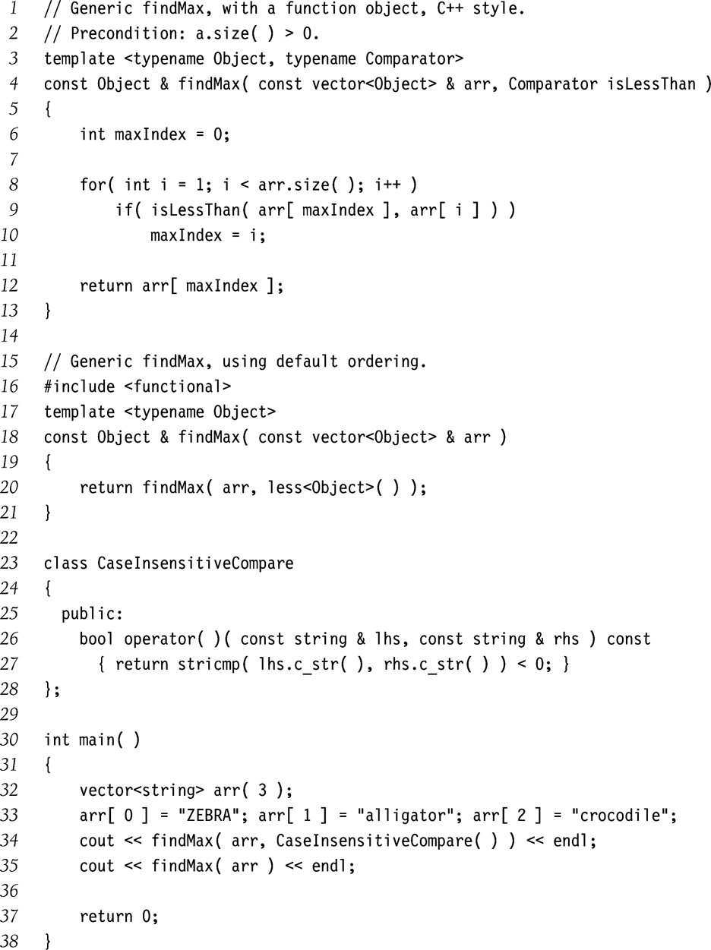
Function objects in C++ style
Define operator() for CaseInsensitiveCompare class.
Case-sensitive comparison can also be performed using STL function object less<Object>(...)

Slide 36
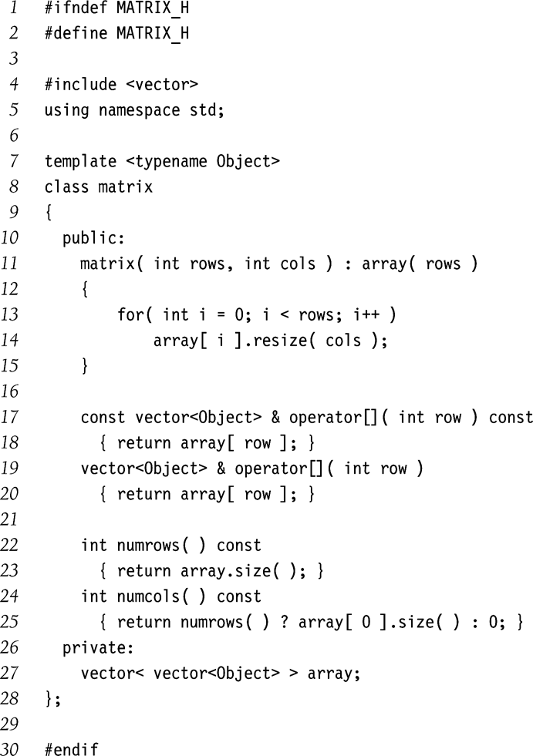
Matrices
C++ library does not provide a matrix class
Constructor
  Creates rows number of zero-sized vectors
  Resizes each vector to col elements
Two types of [] operators
  One for LHS that returns by reference
  Another for RHS that returns by constant reference
  So we have two very identical functions
    What makes their signatures different?

