Slide 1
Priority Queues

Slide 2
Priority Queues
Priority queues
Support the operations
Insert,
deleteMax(deleteMin)
Using an array implementation
Max will be at the root (index 1)
Children will be less than their parent
i has children 2i and 2i+1
i has parent i/2

Slide 3
Priority Queues
A priority queue is a collection of 0 or more elements with each element having a priority or a value.
Example Jobs to be submitted to a cpu
2 types min or max (which one needs attention 1st)
AbstractDataType
{
instances finite collection of elements, each has a priority
operations
Create(): create an empty priority queue
Size (): return the number of elements in the queue
Max(): return the element with max priority
Insert(x): insert x into the queue
DeleteMax(x) delete the element with the max priority
}

Slide 4
Implementation Linear List
Simpliest method is to use an unordered list
Create(): Θ(1)
Size (): Θ(n)
Max(): Θ(n)
Insert(x): Θ(1)
DeleteMax(x) Θ(n)
Or use an ordered list with max element 1st
Create(): Θ(1)
Size (): Θ(n)
Max(): Θ(1)
Insert(x): Θ(n)
DeleteMax(x) Θ(1)

Slide 5
Heaps

Slide 6
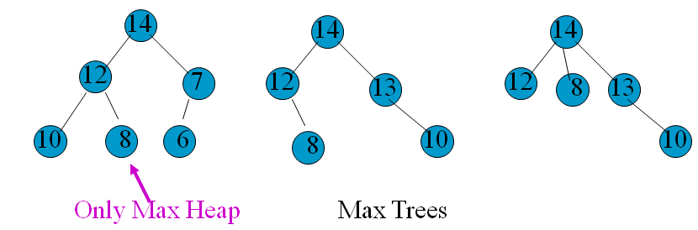
Implementation Heap
Defintion A max tree (min tree) is a tree in which the value in each node is greater (less) than or equal to those in its children (if any)
Definition A max heap(min heap) is a max (min) tree in that is also a complete binary tree. (filled from left to right then down)

Slide 7
More on Heaps
As a consequence of the complete binary tree structure of a heap
Can be efficiently represented by an array
The height is lg(n+1) so if can insert and delete in O(height) then all operations will be O(lg(n))
Compare with the other implementation where the worst operation takes O(n) to accomplish.

Slide 8
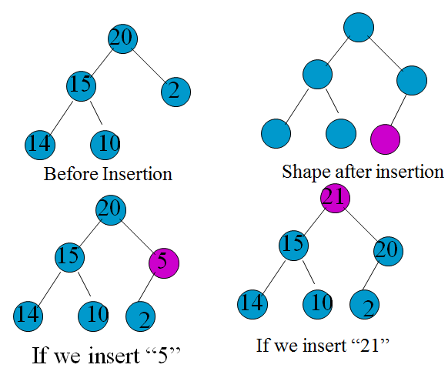
Insertion into a Heap
To insert into a heap we must
Keep the tree complete
Must keep the “heap” property
Method: walk
up from the insertion point to find where the insertion place is moving down elements like in insertion sort. Θ(lg(n))

Slide 9
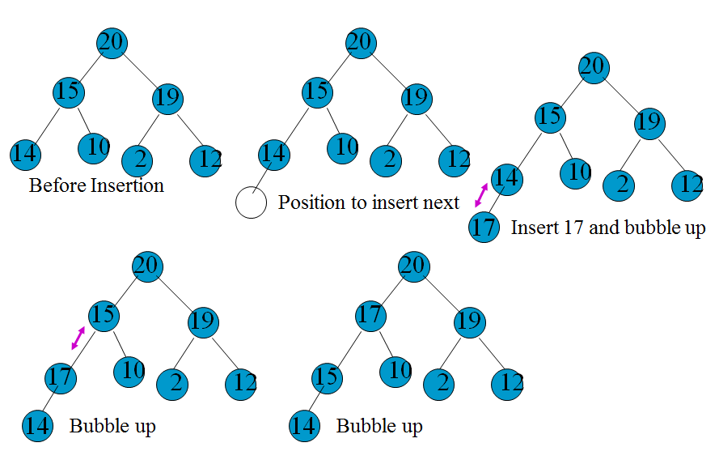
Another Insert into Heap Example
Note this insertion requires pointers from the children to their parent. With arrays no problem. With pointers another 2 bytes for the pointer.

Slide 10
Delete from a Max Heap
The max is always at the top so it is easy to find but again we need to maintain the complete binary tree and heap properties
Our method is copy the last element that was entered into the heap onto the root. Then delete the last element. This keeps the complete binary tree property. Now adjust elements in the tree so that the heap property is maintained.
The promotion of the max child continues until the heap property is restored. At most to the height of the tree O(lg(n))

Slide 11
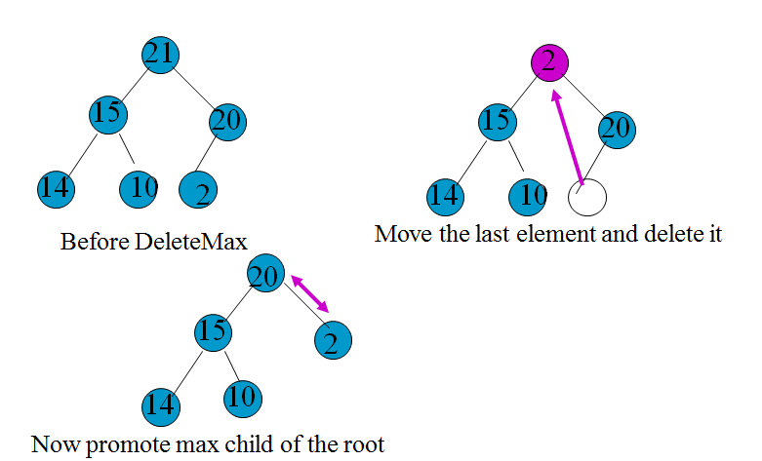
Delete from a Max Heap

Slide 12
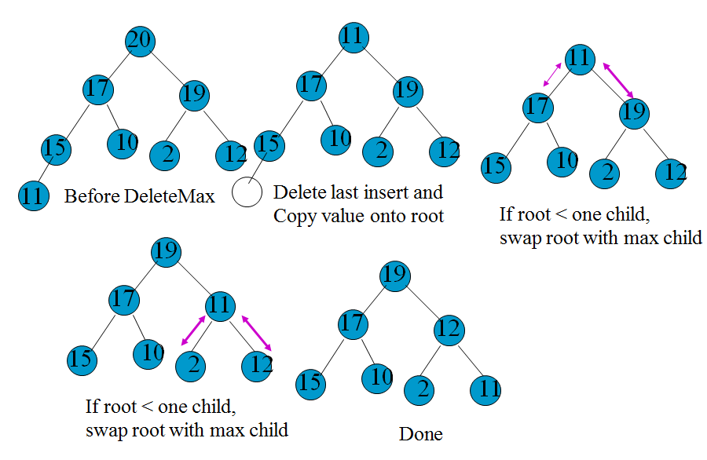
Another DeleteMax Example
Again this takes the height of the tree time
or O(lg(n))

Slide 13
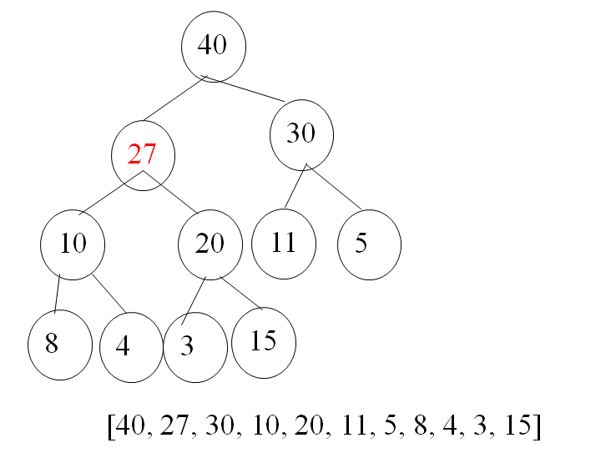
Example
Show the result of adding 27 to the following max priority queue.
[40 20 30 10 15 11 5 8 4 3 ]
[40 20 30 10 15 11 5 8 4 3 ]
[40 20 30 10 15 11 5 8 4 3 27 ]
[40 20 30 10 27 11 5 8 4 3 15 ]
[40 27 30 10 20 11 5 8 4 3 15 ]

Slide 14
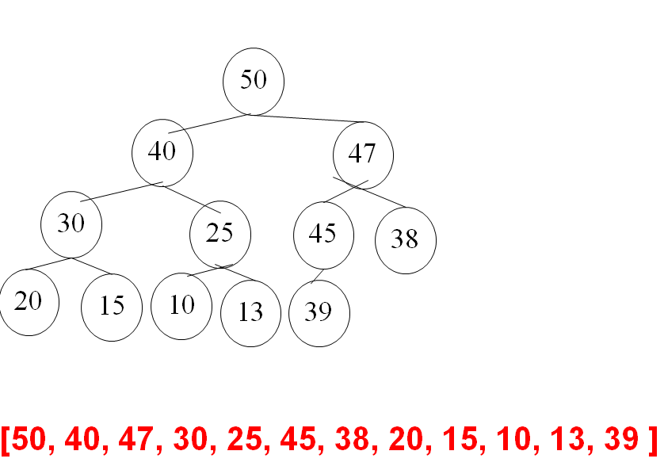
Add of 47 [50 40 45 30 25 39 38 20 15 10 13]
[50 40 45 30 25 39 38 20 15 10 13]
[50 40 45 30 25 39 38 20 15 10 13 47]
[50 40 45 30 25 47 38 20 15 10 13 39]
[50 40 47 30 25 45 38 20 15 10 13 39]

Slide 15
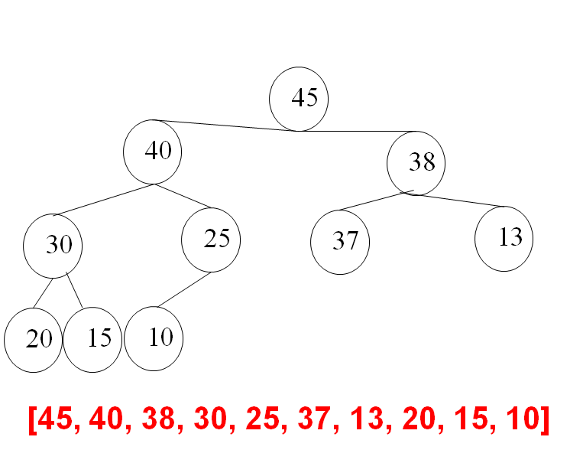
DeleteMax of [50 40 45 30 25 37 38 20 15 10 13]
[50 40 45 30 25 37 38 20 15 10 13]
[ 40 45 30 25 37 38 20 15 10 13]
[13 40 45 30 25 37 38 20 15 10]
[45 40 13 30 25 37 38 20 15 10]
[45 40 38 30 25 37 13 20 15 10]

Slide 16
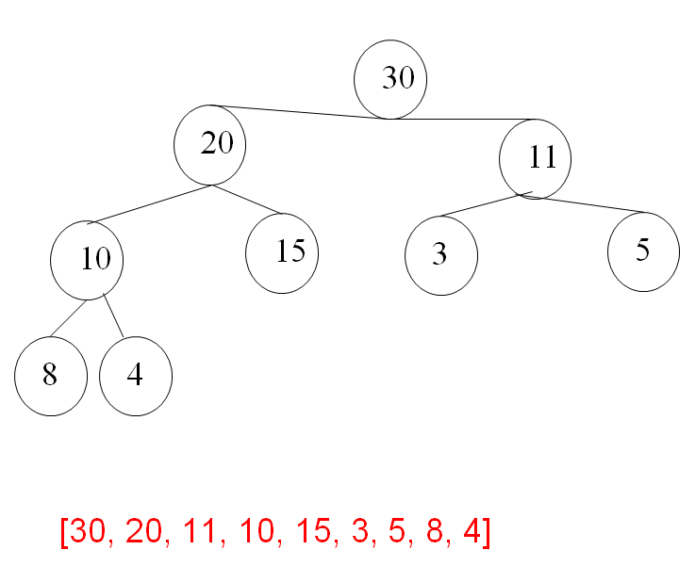
Delete Max of [40 20 30 10 15 11 5 8 4 3 ]
[40 20 30 10 15 11 5 8 4 3 ]
[ 20 30 10 15 11 5 8 4 3 ]
[ 3 20 30 10 15 11 5 8 4 ]
[ 30 20 3 10 15 11 5 8 4 ]
[ 30 20 11 10 15 3 5 8 4 ]

Slide 17
Max Heap Initialization
It is sometimes the case that you begin with lots of elements to put in the heap.
Ex Machine shop comprises m machines. Each job can be broken into tasks with a single machine working on 1 task at a time. Different machines perform different tasks. Once a machine starts a task it continues it finishes. The tasks are ordered. If a machine is busy the next task must wait.
Schedule the tasks for the greatest efficiency
It is intuitively evident that if all the machines are working all of the time, you can’t do better.
Find the machine with the earliest finish time and change the schedule to give it more work to do.
If we do this we might have to add another operation to our ADT of changing a priority. (if we change it down we just do a bubble down of the insert)

Slide 18
Max Heap Initialization
One way to initialize the heap with n elements is to perform n insertions. – O(nlg(n))
Below is an algorithm to do it in n time.
Put all the elements into position regardless of value O(n)
Now for start at the first position that has a child i = (n/2)
Make the subtree of i a heap, i– and repeat until i==1

Slide 19
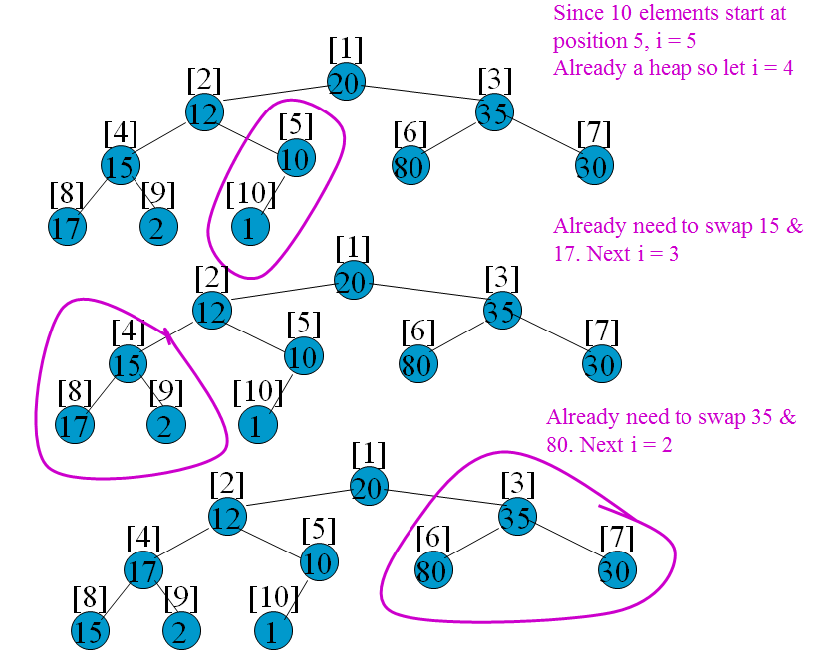
Initialization Example

Slide 20
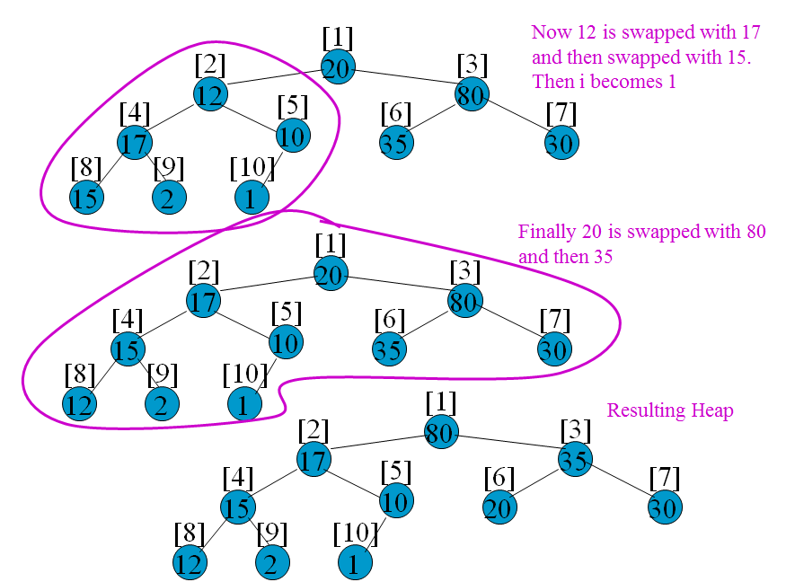
Initialization Example

Slide 21
Initialize Implementation
template<class T>
MaxHeap<T>& MaxHeap<T>::Init(T a[], int startSize , int arraySize)
{// Initalize the maxHeap to array a
delete [] heap;
heap = a;
size = startSize;
maxSize = arraySize;
for (int i = size/2; i>=1; i--)
{
T y = heap[i]; // root of subtree to heapify
int c = 2*i; // c is 1st child of i
while( c< size)
{
if (c < size && heap[c] < heap[c+1]) c++; // c is the larger child
if (y > =heap[c]) break;
{
heap[c/2] = heap[c]; // move child up
c*= 2; // move down a level
}
}
heap[c/2] = y;
}
}

Slide 22
Analysis of Initialize
In the worst case traverse all subtrees of height 1 or more.
If at node i, then we must do O(h_{i}) work, where h_{i} is the height of tree with the root i.
Further if are level j, there are at most 2^{j-1} nodes at level j. Now h_{j} = h – j + 1. Thus the time to initialize the max heap is (# of nodes at each level)*(height of subtree at each node)
O(Σ_{j=1}^{h-1}2^{j-1}(h-j+1)) //(let k = h-j+1)
=O(Σ_{k=2}^{h}k 2^{h-k}) // pull the 2^{h} out of the summation
= O(2^{h} Σ_{k=2}^{h} k/2^{k}) // recall the ½+2/4+3/8 + … = 2
= O(2^{h}) // recall h = log₂(n+1)
= O(n)

Slide 23
Heap Sort
One way to sort is to put all the elements into a heap (by Initialize O(n))
Then do DeleteMin (O(lg(n)) n times (but elements at the back.
Time for a heap sort is O(nlg(n))
The previous sort methods were O(n²)

Slide 24
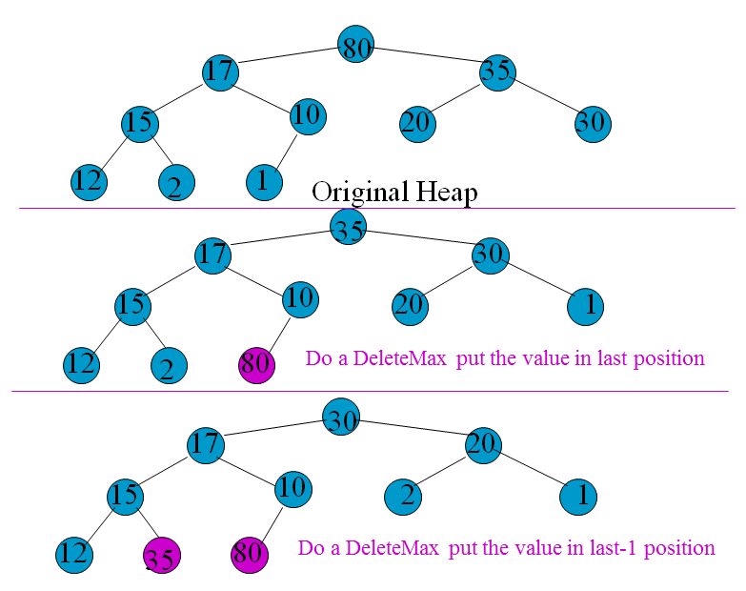
Heap Sort Example

Slide 25
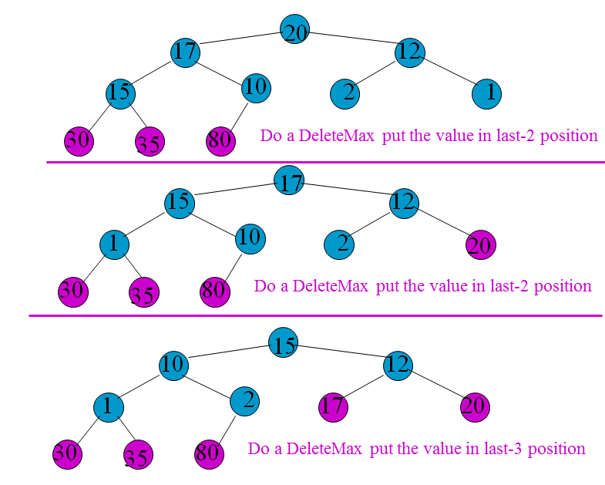
Heap Sort Example

Slide 26
HeapSort Discussion
Heapsort is actually used
Has optimal worst case performance (is outperformed by some other sorts in average case)
Heapsort is best when time to copy the data is significant. (does not require any extra space unlike other sorts)

Slide 27
Review of Heaps
The max(min) heap performs the following operations
Insert Θ(lg(n))
[ put in next array position and bubble up]
DeleteMax(Min) Θ(lg(n))
[copy the last element into root, then delete last element, and bubble down]
Initialize Θ(n)
Put all elements into the array (ignoring values)
Then for each subtree of height >0 bubble the root down
(starting at the bottom of the tree)
In this way the upper portions of the tree are almost heaps already

Slide 28
Machine Scheduling
Consider a machine shop with m identical machines. We have n jobs to process. The time required by job i is t_{i}.
A schedule is an assignment of jobs to time intervals on machines such that
No machine processes more than one job at a time
No job is process on more than one machine at a time
Each job i is assigned for a total of t_{i} units of processing.
The length of the schedule is the time for all jobs to complete.

Slide 29
Machine Scheduling
Consider a 3 machine schedule for 7 jobs with processing requirements (2, 14, 4, 16, 6, 5, 3). The machines are labeled M1, M2 and M3.
A possible schedule:
M1 only does job 4 for 16 time units
M2 does jobs 2 and 7 for 17 time units
M3 does jobs 5,6,3,1 for 17 time units
M1
4
M2
2
7
M3
5
6
3
1
6
11
15
17

Slide 30
Discussion of the Problem
No one has come up with a polynomial solution i.e. no solution is O(n^{k}m^{l}) for any k and l.
Must settle for an approximation algorithm (works in reasonable time and comes close to the optimal solution)
This solution uses longest processing time first (LPT)
Sort the jobs in terms of requirements assign the longest job to M1, 2nd longest to M2, etc. The first Machine schedule to finish gets the next job.

Slide 31
LPT Example
7 jobs are (2, 14, 4, 16, 6, 5, 3).
The machines are labeled M1, M2 and M3.
Sort the jobs (j-t_{j}) (4-16, 2-14, 5-6, 6-5, 3-4,7-3,1-2)
M1 gets job 4 expects to finish at 16
M2 gets job 2 expects to finish at 14
M3 gets job 5 expects to finish at 6
M3 gets job 6 next expects to finish at 11
M3 gets job 3 next expects to finish at 15
M2 gets job 7 next expects to finish at 17
M3 gets job 1 next expects to finish at 17

Slide 32
LPT Discussion
In practice LPT is very close to optimal
Can be constructed in O(nlg(n)) time
Sort using HeapSort O(nlg(n))
Then go through the jobs and assign them to the machines in a heap. For each job assign them reheapify by time expected to finish. n jobs each heapify takes lg(m) for a total of O(nlg(m))
Total is O(nlg(n)+nlg(m)) = O(nlg(n)) if n>m

