Slide 1
Depth-First Search Revisited
Recall Depth First Search
Starting at some vertex, process the current vertex and then recursively traverse the first vertices adjacent to it.(backtrack if necessary)
If this is done on a tree - O(|E|)
If this is done on a graph with cycles - need to avoid going in the cycle forever.

Slide 2
DFS Revisited
void Graph::dfs(Vertex v)
{
v.visited = true;
for each w adjacent to v
if (!w.visited)
dfs(w);
}
Each vertex initialize visited to false
As visit it change visited to true
Visit each vertex once, and possibly try every edge O(|E| + |V|)

Slide 3
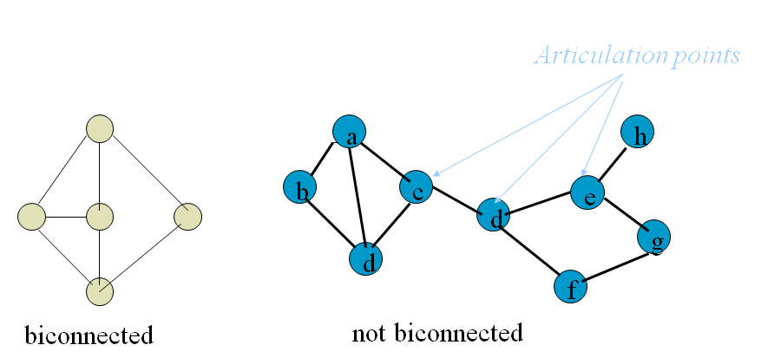
DFS Application - Biconnectivity
A connected undirected graph is biconnected if there are no vertices whose removal disconnects the rest of the graph.
A measure of robustness in a network

Slide 4
Biconnectivity Algorithm
Start at any vertex and perform a dfs and number the nodes in the order visited. (Num(v))
Then for each vertex compute (Low(v)) which is the lowest number vertex reachable from v by taking some of the tree edges and possibly one back (non-tree) edge (in that order).
The root is an articulation point iff it has more than 1 child
Any other point v is an articulation point iff it has some child w and Low(w) > Num(v)

