Slide 1
MaxFlow

Slide 2
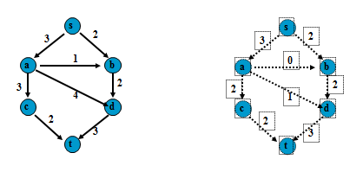
Network Flow Picture
No edge carries more than its capacity

Slide 3
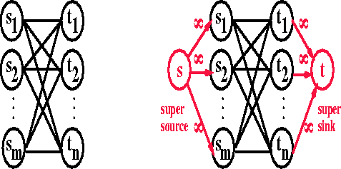
The Problem Specifics/Variation
At any vertex (that is not the source nor the sink) the amount leaving must equal the amount entering.
The amount used on an edge must be less than or equal to the capacity of that edge.
Note if we can solve the above can solve the problem of multiple sources and sinks (see picture below)

Slide 4
An Algorithm
Basically find any flow then successively attempt to increase it. Look for paths from s to t that can accept more flow (augmenting path) and increase flow along this path.
Keep 2 graphs, one which records the flow so far, the other (called the residual graph) which holds the unused capacity. If can ever find a flow in the residual graph (call it the augmenting path) then add it to the current flow to get more output. When can’t do that - done.
Ford-Fulkerson-Method(G, s, t)
flow f = 0
while an augmenting path p exists
augment flow f along p
return f

Slide 5
An Algorithm
In order to make this algorithm work, need to allow the algorithm to change its mind.
To do this, for every edge (v,w) with flow f_{v,w} in the flow graph add an edge in the residual graph (w,v) of capacity f_{v,w}.
In effect, allowing the algorithm to change its mind.

Slide 6
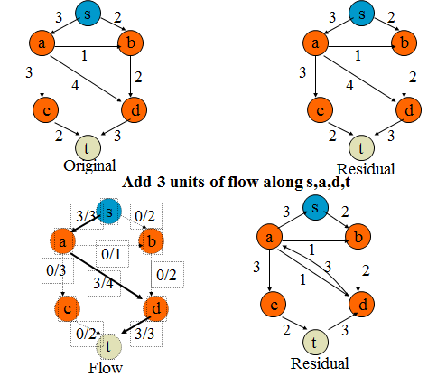
An Example

Slide 7
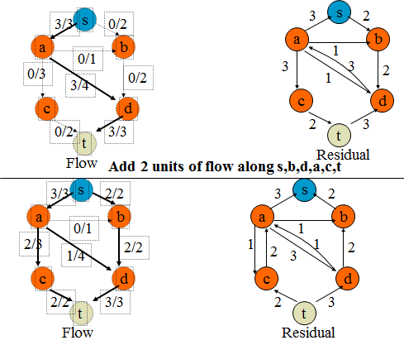
Example continued
“give back” 2 on flow from a-d, redirect to a-c

Slide 8
Analysis
It can be shown can be shown that the algorithm
Works even with graphs that contain cycles
If the capacities are all integers we could augment the path by 1 (but this is very inefficient some times) O(f*|E|) if the total flow f is Large)
One method to get around this problem is to always choose the augmenting path that allows the largest increase in the flow. Finding such a path is similar to solving a weighted shortest-path problem and a single line modification to Dijkstra’s algorithm will do the trick.
If cap_{max} is the maximum edge capacity, then one can show that O(|E|log cap_{max}) augmentations will suffice to find the max flow.
In this case since O(|E|log|V|) time is used for each calculation of an augmenting path, a total bound of O(|E|²log|V|) is obtained

Slide 9
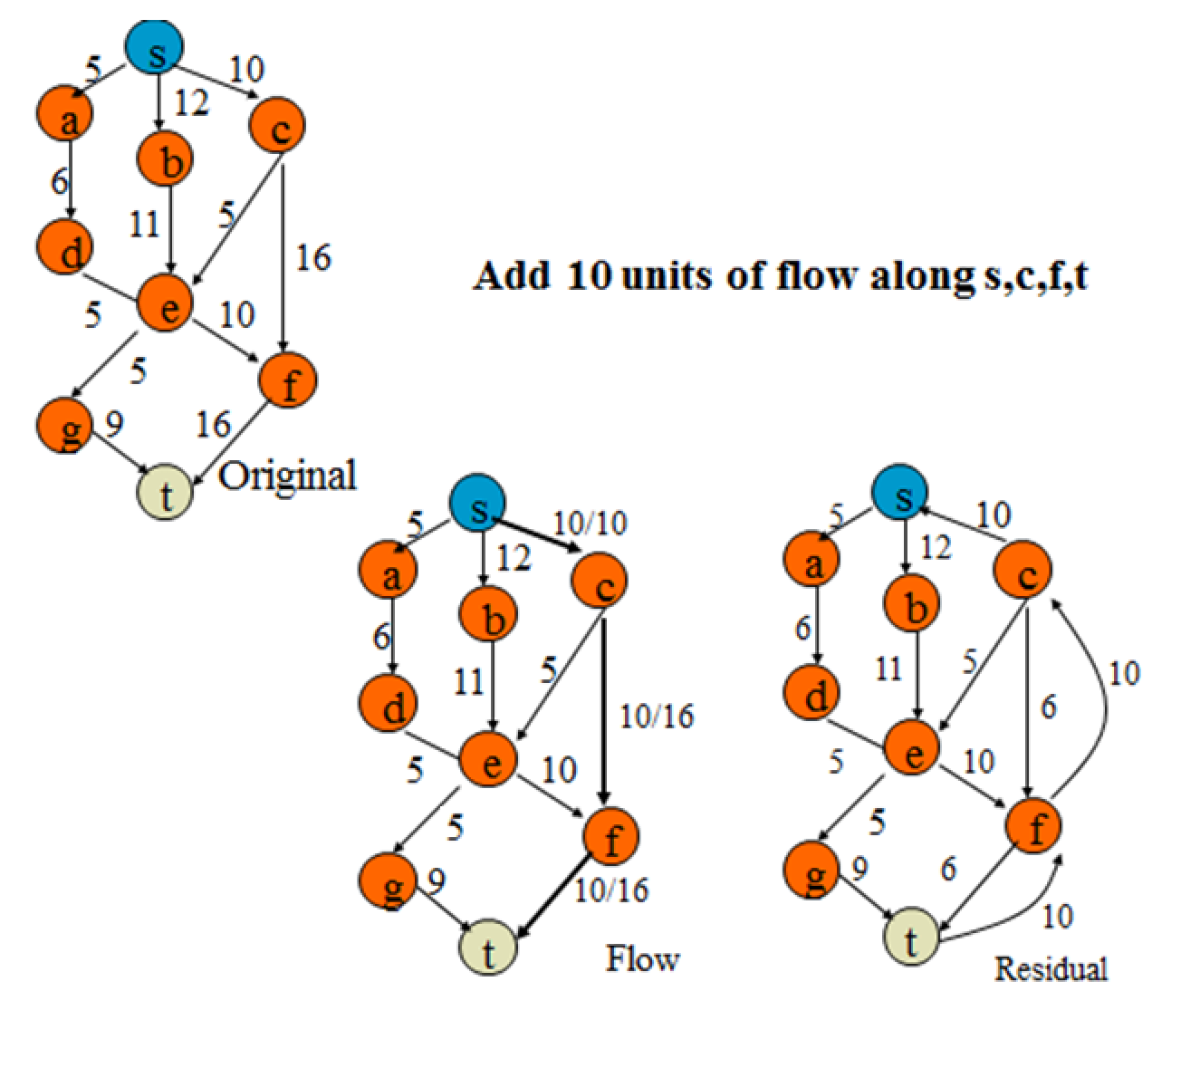
Another Example

Slide 10
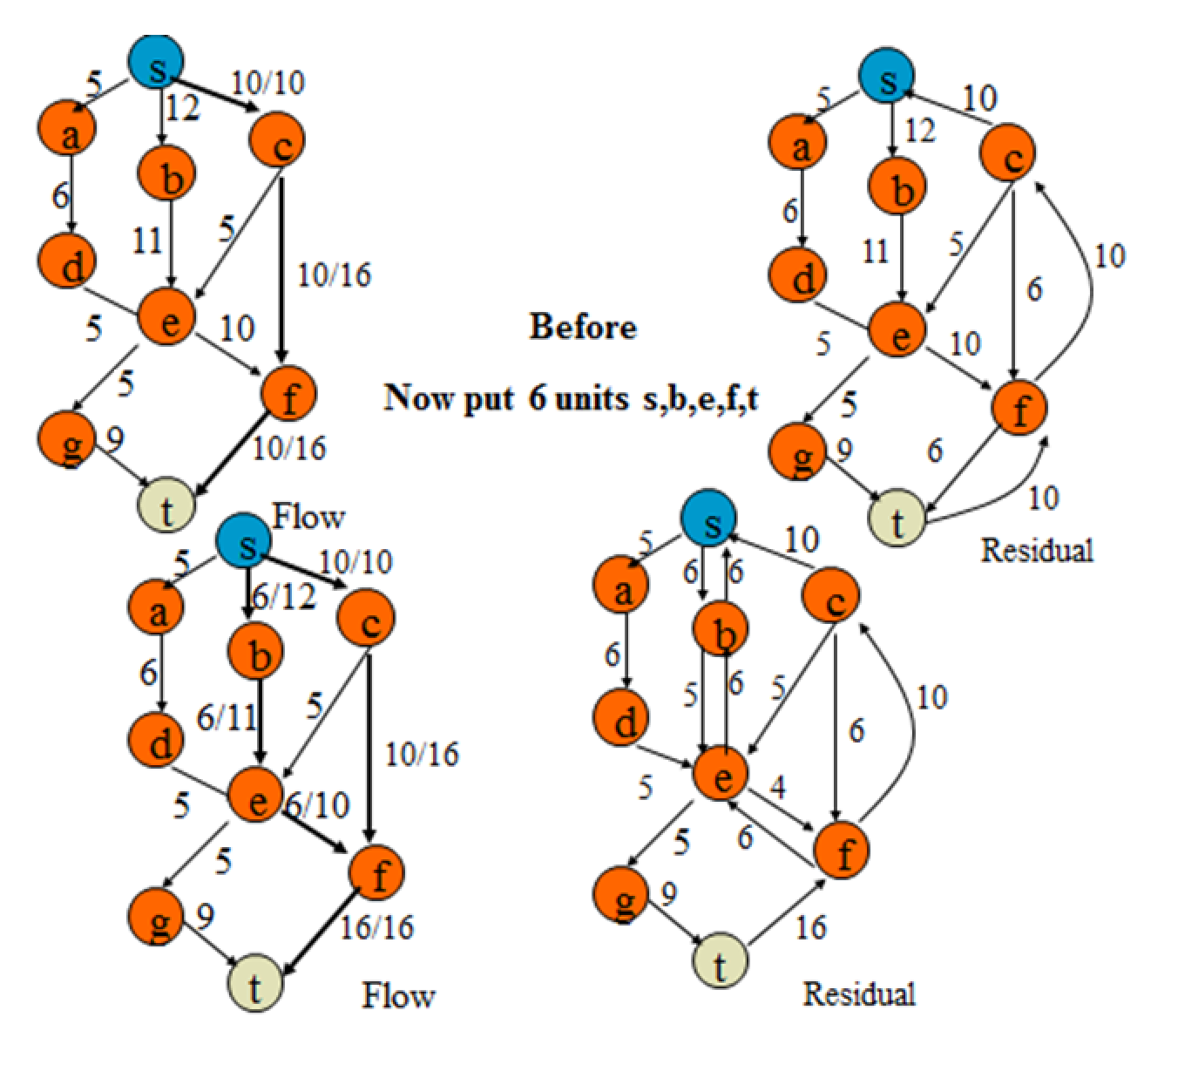
Another Example

Slide 11
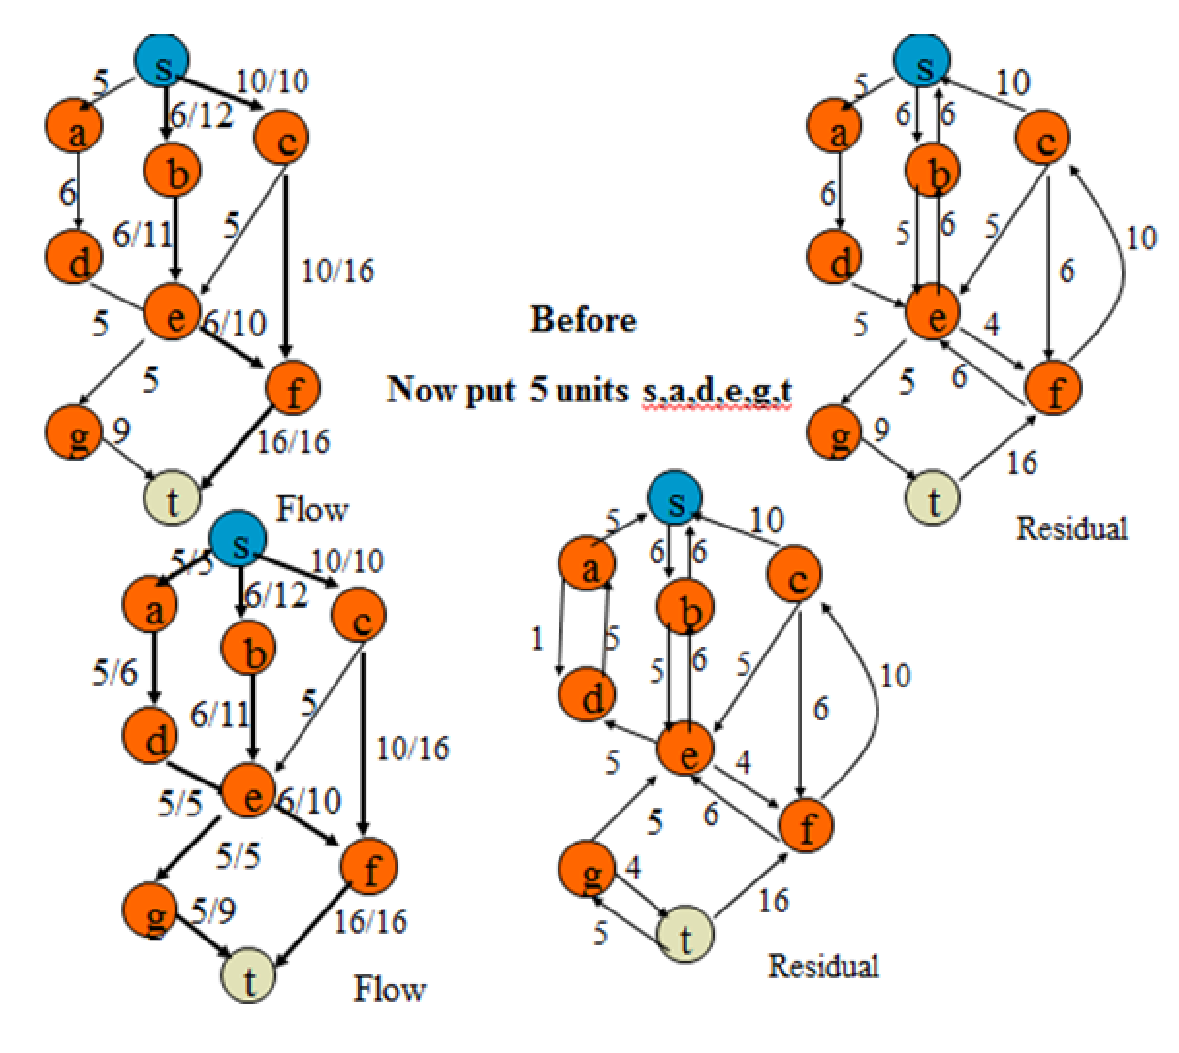
Another Example
There are no residual paths from s to t. So the optimal is flow is 21

Slide 12
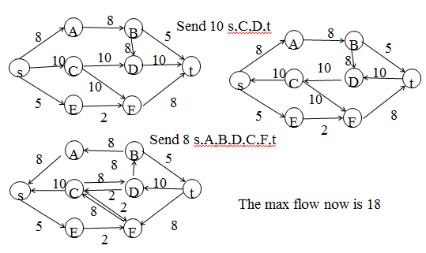
Another Example
Show the residual graphs after sending the 2 greatest flows in order. List each flow along with the number of units sent. If the algorithm terminated here, what is the maximum flow?
“give back” 8 on flow from C-D, redirect to C-F

Slide 13
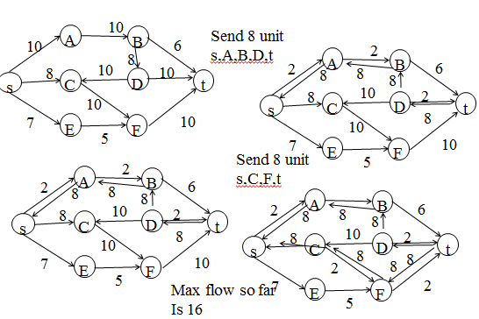
Another Example
Show the residual graphs after sending 8 units each on the 2 greatest flows in order. List each flow along with the number of units sent. If the algorithm terminated here, what is the maximum flow?

