Slide 1
Sets

Slide 2
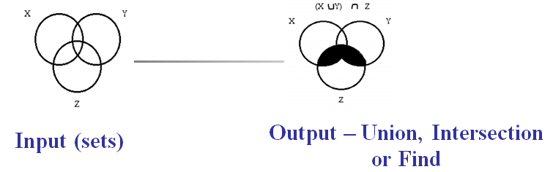
Sets, Union/Find
Input Description: A universe of objects U = { u₁,...,u_{n}} , and a collection of subsets S₁,...,S_{m}, S_{i} a subset U .
Problem: Represent each subset so as to efficiently
(1) test whether u_{i} in S_{j},
(2) find the union or intersection of S_{i} and S_{j},
(3) insert or delete members of S_{i}.

Slide 3
Disjoint Sets
Suppose we have n items (student records, bank account records, whatever) each with unique keys from 1..n.
We want to keep the items in a collection of sets (disjoint sets) such that an item must occur in exactly one of those sets.
For example, we want to partition a set of students into "students with GPA >= 2.0" and "students with GPA < 2.0." Or we might want the collection to have many sets, e.g. different income levels of people. The point is, the sets are mutually exclusive and include all the items.

Slide 4
Disjoint Sets
In disjoint sets, each set is identified by a representative that is some member of the set.
For convenience, we can choose this element to be the one with the smallest key, but we need to be able to choose some representative.
It will soon become convenient to think of the representative as the parent of the other items in the set, like in a tree.

Slide 5
Disjoint Sets Operations
In many situations in computer science, problems involving disjoint sets naturally arise such that the sets grow dynamically (i.e., during the course of an algorithm, sets change by merging) and two important operations are:
Find (x) - determine which set an item with key x is in, i.e., return the key of the representative of the set x is in. Using this operation, one can tell whether two elements are in the same set: you just do a Find on both of them and compare the return values. If they are the same, then the two items are in the same set.
Union (x, y) - unite the sets containing x and y. (Note: union is a C keyword; don't write a function called union in your C or C++ program!)

Slide 6
Disjoint Sets Example Usage
Here is an example of an algorithm that uses these operation. It computes the connected components of an undirected graph G=(V,E). Recall that the connected components of a graph are the subgraphs that are all mutually connected:
Connected-Components (G)
for each vertex v in V do
// each vertex is initially in its own component make v a singleton set with a unique key from 1..|V|
end for
for each edge (u, v) in E do
// if u and v are connected by an edge, then
// everything in u's component is connected
// to everything in v's component, so Union the sets
if Find (u) != Find (v) then Union (u, v)
end for

Slide 7
Disjoint Sets Example Usage
Now, if we want to find out whether two vertices are in the same connected component, we just call Find on both vertices and see if the result is the same. If so, then they are connected.

Slide 8
Disjoint Sets Implementation
There is an easy algorithm that implements the disjoint set operations. The idea is that we have an array p[1..n] with an element for each item that is in some set. If the item is a representative (parent) of some set, then the value of this element its own index, otherwise the value is the index of another item in the array, giving rise to a linked list eventually ending in the parent item.

Slide 9
Disjoint Sets Implementation
For example, suppose we have the following disjoint sets (indicated by their unique 1..n keys):
{ 6 14 1 } { 2 3 13 } { 5 12 7 8 10 }
{ 9 11 4 15 }
Then we might have the following lists giving the set relationships:
1 <-- 14 <-- 6
2 <-- 3 <-- 13
5 <-- 12 <-- 7 <-- 8 <-- 10
9 <-- 11 <-- 4 <-- 15
To find the representative of an element, we just traverse the list until we reach the parent (which points to itself).

Slide 10
Disjoint Sets Implementation
Of course, nothing (except for ASCII graphics) prevents us from having tree-like structures with this representation, where more than one item points to the same parent item
1 2
/ \ / \
14 6 13 3
5
\ 9
12 / | \
/ | \ / | \
10 8 7 4 11 15
An array representing this forest would look like this:
i 1 2 3 4 5 6 7 8 9 10 11 12 13 14 15
p[i]-1-1 2 9 -1 1 12 12 -1 12 9 5 2 1 9

Slide 11
Find Compression
Any solution that satisfies the constraints is called a feasible solution.
One obvious improvement would be to have all set members point directly to their representatives, instead of to arbitrary other members of the set. One way to do this is called path compression: each time we do a Find on a set element, we make its parent the representative element. We "compress" the path from leaf to root; after a Find, instead of many levels between a leaf and the root, there is just one.

Slide 12
Find Compression
And, every item along the path from leaf to root is also directly connected to the root:
Find (x)
if p[x] > 0 then
p[x] = Find (p[x])
end if
return p[x]
The next time a Find is done on any element along this path, the parent will be returned in O(1) time. This yields very good performance in practice, since any long chain will likely be broken quickly

Slide 13
Improving Unions
Each time we do a Union, we push some tree down a level.
Then the next find done on a member of this subtree will take a little longer than it would have before the Union (although the path is compressed during the Find, the damage is already done with the time spent doing the Find).
We can minimize the impact of this situation using a heuristic called union by rank.
We keep track of how many elements are in a subtree, and make the smaller subtree the child of the larger subtree.
This ensures that most of the items in the new tree are unaffected by the Union in terms of how long it takes to find the representative.
With each item x we associate a count count[x] that contains the number of items in the tree rooted at x. When the sets first start out as singletons, they each have a count of one.

Slide 14
Improving Union Code
Union (x, y)
a = Find (x)
b = Find (y)
if count[a] > count[b] // a has more kids;
// make b its child
p[b] = a // and update the count
// of a to include b's kids
count[a] += count[b]
else // or vice-versa
p[a] = b
count[b] += count[a]
endif

Slide 15
Algorithm 1 Union/Find
Let's see algorithms to implement this linked-list Union/Find. We'll assume that p[1..n] is initialized to p[i] = i so each item is in its own singleton set and is its own set's representative.
// return the key of the representative of this set
Find (x)
if p[x] != x then
return Find (p[x])
end if
return x
// join two sets containing items x and y together
Union (x, y)
a = Find (x) // a is x's representative
b = Find (y) // b is y's representative
p[a] = b // now b is a's parent, and Find (x)
// would return b

Slide 16
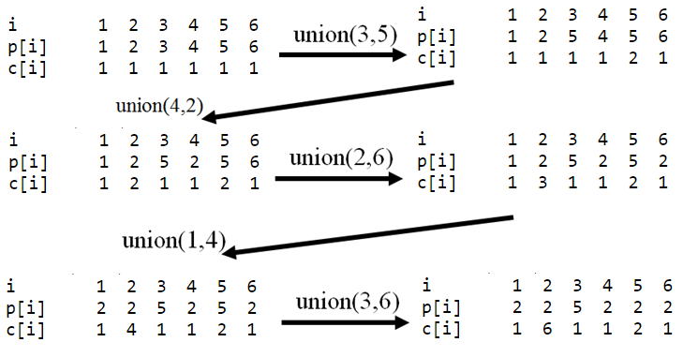
Example Unions
Here is an example of doing some Union operations on sets with indices 1..6 (c[i] is count[i]):

Slide 17
Analysis Union/Find
A Union or Find operation takes O(lg* n) time amortized over all the operations (i.e., one particular instance may take longer, but overall, each one averages out to O(lg* n). This lg* is the iterated logarithm function; it's the number of times you can take the log base 2 of a number. This is a very slowly growing number; lg* 10²⁰ is about 4. You will probably never need to do Union/Find on sets with that many elements; indeed, there aren't even that many bytes in all the computers in the world. So for all practical purposes, Union/Find can be considered to run in constant time.

Slide 18
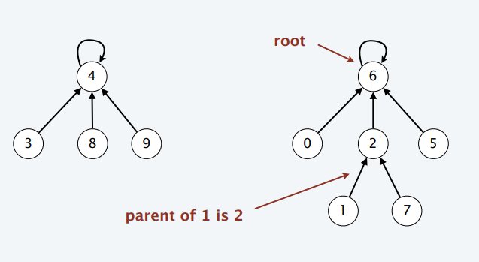
Disjoint-Sets Data Structure
Representation. Represent each set as a tree of elements. ・
Each element has a parent pointer in the tree.
The root serves as the canonical element.
FIND(x). Find the root of the tree containing x.
UNION(x, y). Make the root of one tree point to root of other tree.

Slide 19
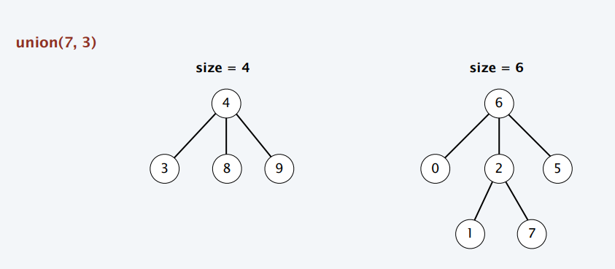
Union-by-Size
Maintain a subtree count for each node, initially 1. Link root of smaller tree to root of larger tree (breaking ties arbitrarily).

Slide 20
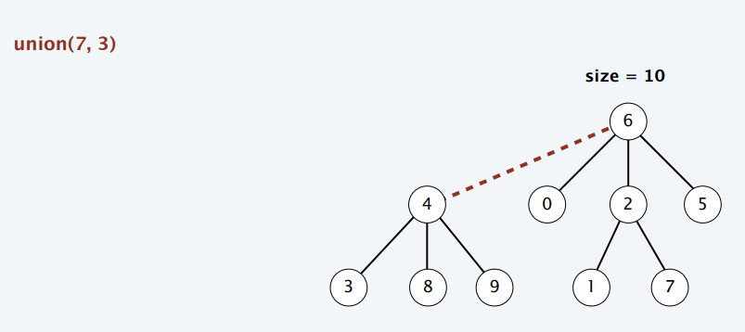
Union-by-Size
Maintain a subtree count for each node, initially 1. Link root of smaller tree to root of larger tree (breaking ties arbitrarily).

Slide 21
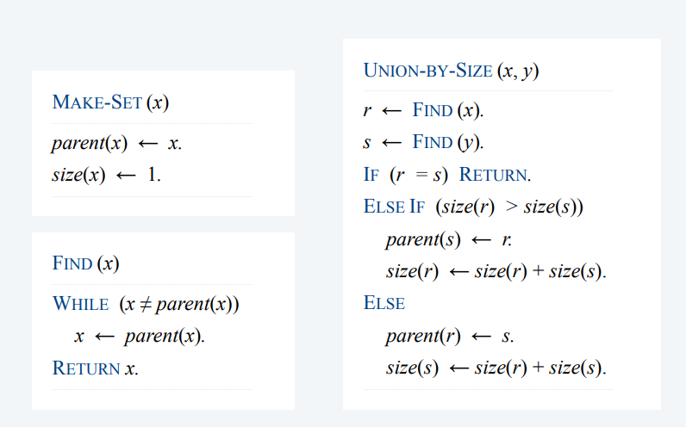
Union-by-Size

Slide 22
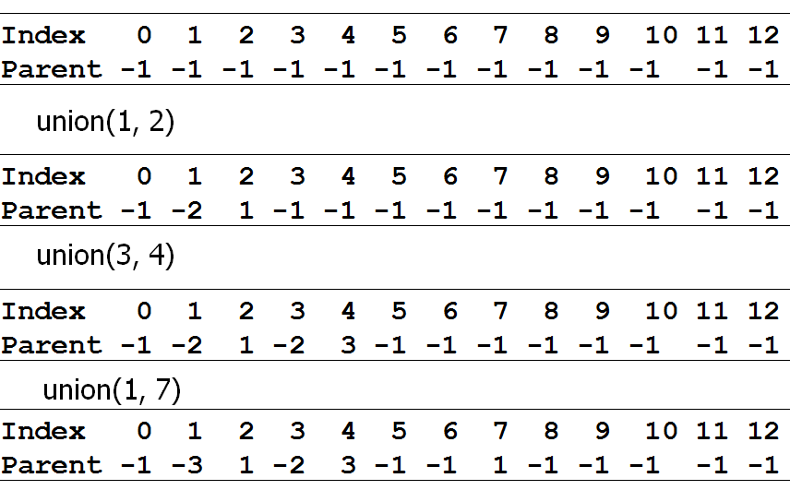
Another Example: Union-by-Size
Consider the following sequence of union commands on the set of elements {0, ... , 12}:, union (1,2), union(3, 4), union(1, 7) Show the result when the unions are performed using union-by-size

Slide 23
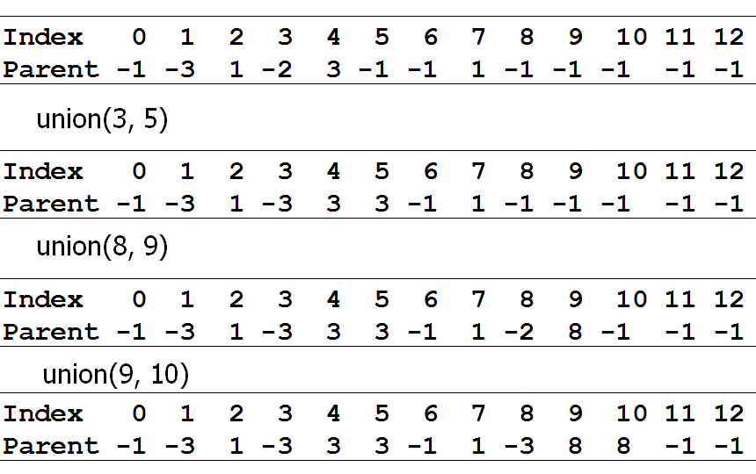
Another Example: Union-by-Size
Consider the following sequence of union commands on the set of elements {0, ... , 12}:, union (3,5), union(8, 9), union(9, 10) Show the result when the unions are performed using union-by-size

Slide 24
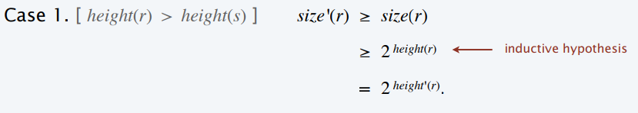
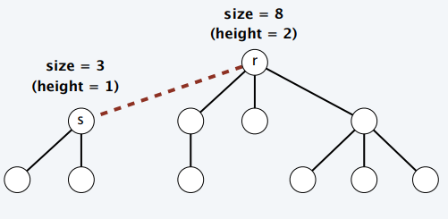
Union-by-Size Analysis
Property. Using union-by-size, for every root node r, size(r) ≥ 2 height(r) .
Proof. [ by induction on number of unions ]
Base case: singleton tree has size 1 and height 0.
Inductive hypothesis: assume true after first i unions.
Tree rooted at r changes only when a smaller tree rooted at s is unioned into r.

Slide 25
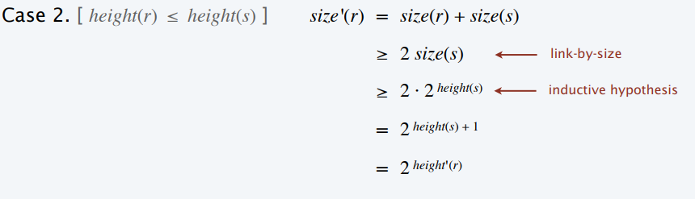
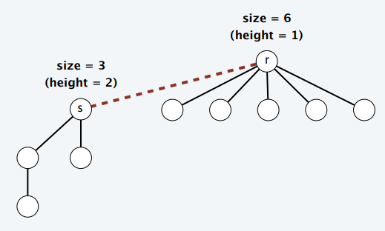
Union-by-Size Analysis
Property. Using union-by-size, for every root node r, size(r) ≥ 2 height(r) .
Proof. [ by induction on number of unions ]
Base case: singleton tree has size 1 and height 0.
Inductive hypothesis: assume true after first i unions.
Tree rooted at r changes only when a smaller tree rooted at s is unioned into r

Slide 26
Union-by-Size Analysis
Theorem. Using union-by-size, any UNION or FIND operations takes O(log n) time in the worst case, where n is the number of elements.
Proof.
The running time of each operation is bounded by the tree height.
By the previous property, the height is ≤ ⎣lg n⎦. where lg n = log₂ n

Slide 27
Equivalence Relations
A relation R is defined on a set S if for every pair of elements (a, b), a, b ∈ S, aRb (a ~ b) is either true or false.
An equivalence relation is a relation R that satisfies 3 properties:
Reflexive aRa, for all a∈S.
Symmetric aRb if and only if bRa.
Transitive aRb and bRc implies that aRc.
Example: network connectivity

Slide 28
Dynamic Equivalence Problem
The equivalence class of an element a ∈ S is the subset of S that contains all the elements related to a.
The equivalence classes form a partition of S (S_{i}∩S_{j} =∅); i.e., the sets are disjoint.
Find (X) returns the name of the set (equivalence class) containing a given element X.
Union (X, Y) returns the new root

Slide 29
Basic Data Structure
Use a tree to represent each set, and the root to name a set.
Find (X) returns the name of the set (equivalence class) containing a given element X.
Union (X, Y) returns the new root of the union of the 2 sets, with roots X and Y. The new root is X.

Slide 30
Basic Data Structure
Eight elements, initially in different sets
1
2
3
4
5
6
7
8
After Union (5,6)
1
2
3
4
5
7
8
6

Slide 31
Basic Data Structure
After Union (7,8)
1
2
3
4
5
7
6
8
After Union (5, 7)
1
2
3
4
5
6
7
8

Slide 32
Basic Data Structure
/* Disjoint set declaration */
typedef int DisjSet [NumSets + 1];
typedef int SetType;
typedef int ElementType;
void Initialize (DisjSet S);
void SetUnion (DisjSet S, SetType Root1, SetType Root2);
SetType Find( ElementType X, DisjSet S );

Slide 33
Basic Data Structure
/* Disjoint set initialization routine */
void Initialize (DisjSet S)
{
int i;
for (i = NumSets; i > 0; i--)
S [i] = 0;
}

Slide 34
Basic Data Structure
/* Union */
/* Assumes Root1 and Root2 are roots */
/* union is a C keyword, so this routine */
/* is named SetUnion */
void SetUnion (DisjSet S, SetType Root1, SetType Root2)
{
S [Root2] = Root1;
}

Slide 35
Basic Data Structure
/* Find algorithm */
SetType Find (ElementType X, DisjSet S)
{
if (S [X] <= 0)
return X;
else
return Find (S [X], S);
}

Slide 36
Smart Union Algorithms
The previous union algorithm arbitrarily makes the second tree a subtree of the first.
Heuristics to reduce the depth of the tree.
Union by size
making the smaller tree a subtree of the larger
depth of any node is never more than log N
find operation is O(log N)

Slide 37
Smart Union Algorithms
has to keep track of the size of each tree
for a non-root node, record the name of the parent node
for a root node, record the negative value of the size of the tree (number of nodes in the tree)

Slide 38
Smart Union Algorithms
Result of union by size after Union (4,5)
1
2
3
5
4
6
7
8
node 1 2 3 4 5 6 7 8
value -1 -1 -1 5 -5 5 5 7

Slide 39
Smart Union Algorithms
Result of an arbitrary union (4,5)
1
2
3
4
5
6
7
8

Slide 40
Smart Union Algorithms
Union by height
keep track of the height, and make the shallow tree a subtree of the deeper tree
the height of a tree increases only when 2 trees of the same height are joined
result of Union (4,5) is the same as that for union by size.

Slide 41
Smart Union Algorithms
to keep track of the depth of a tree
for a non-root node, record the name of the parent node
for a root node, record the negative value of the height of the tree
node 1 2 3 4 5 6 7 8
value 0 0 0 5 -2 5 5 7

Slide 42
Smart Union Algorithms
/* Union by height (rank) */
/* Assume Root1 and Root2 are roots */
/* union is a C keyword, so this routine */
/* is named SetUnion */
void SetUnion (DisjSet S, SetType Root1, SetType Root2)
{
if (S [Root2] < S [Root1]) /* Root2 is deeper */
S [Root1] = Root2; /* new root */

Slide 43
Smart Union Algorithms
else
{
if (S [Root1] == S [Root2]) /* Same height, */
S [Root1]--; /* so update */
S [Root2] = Root1;
}
}

Slide 44
Path Compression
Modify Find (X) such that every node on the path from X to the root has its parent changed to the root.
Effectively reduce the length of the path
Incompatible with union by height because it is difficult to determine the correct height of a tree (which has several branches).

Slide 45
Path Compression
Result of Find (7) for the disjoint set
1
2
3
4
5
7
6
8

Slide 46
Path Compression
/* Fig. 8.15 Find with path compression */
SetType Find (ElementType X, DisjSet S)
{
if (S [X] <= 0)
return X;
else
return S [X] = Find (S [X], S);
}

