Slide 1
Backtracking

Slide 2
Backtracking
Backtracking is closely related to the brute-force problem-solving method in which the solution space is scanned, but with the additional condition that only the possible candidate solutions are considered.
What is meant by possible solutions and how these are differentiated from the impossible ones are issues specific to the problem being solved.

Slide 3
Backtracking (animation)
dead end
?
dead end
dead end
?
start
?
?
dead end
dead end
?
success!

Slide 4
Backtracking
Is a systematic way to go through all the possible configurations of a space.
These may be all possible arrangements of objects
all possible ways of building a collection of them
enumerating all spanning trees of a graph
all paths between 2 vertices
all possible ways to partition the vertices into some classes
Must generate each configuration exactly once
We represent our configuration by a vector A = (a₁,a₂,…a_{n})
The search procedure works by growing solutions one element at a time. At each step we have constructed a partial solution with elements fixed for the first k elements of the vector, where k < n, From this we try to extend our solution by adding the next element from S_{k+1}.
However if S_{k+1} is empty we must backtrack.

Slide 5
Already Seen Backtracking
Depth-First Tree Search
Backtrack when necessary then move forward

Slide 6
Depth-First Search
Depth First Search
Starting at some vertex, we process the current vertex and then recursively traverse the first vertices adjacent to it.(backtrack if necessary)
If this is done on a tree O(|E|)
If this is done on a graph with cycles we need to avoid going in the cycle forever.

Slide 7
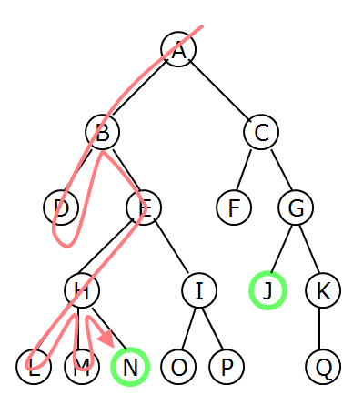
Depth-First Searching
A depth-first search (DFS) explores a path all the way to a leaf before backtracking and exploring another path
For example, after searching A, then B, then D, the search backtracks and tries another path from B
Node are explored in the order A B D E H L M N I O P C F G J K Q
N will be found before J

Slide 8
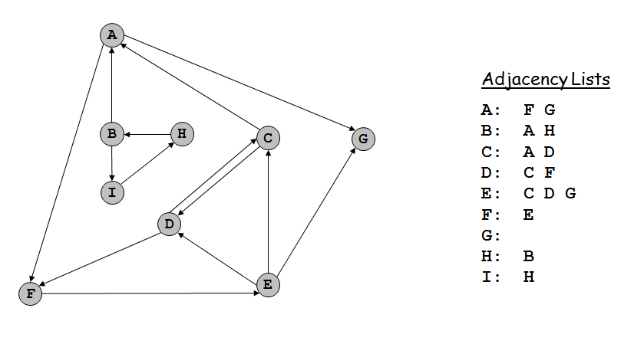
Directed Depth First Search

Slide 9
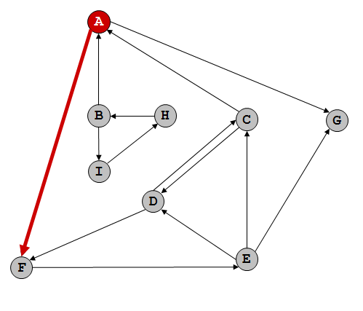
Directed Depth First Search
dfs(A) A-F A-G (use alphabet order for ties)
Function call stack: dfs(A)

Slide 10
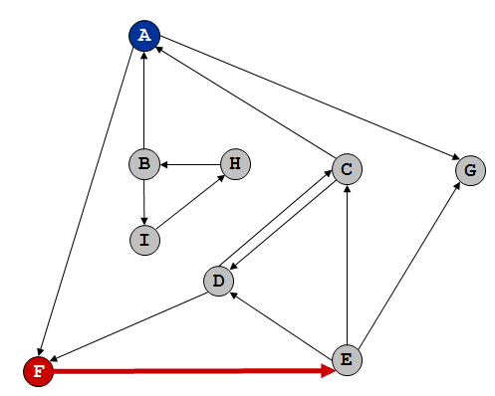
Directed Depth First Search
dfs(F) F-E
Function call stack: dfs(A) dfs(F)

Slide 11
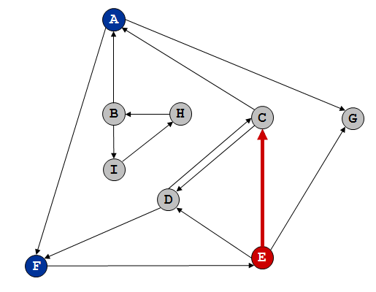
Directed Depth First Search
dfs(E) E-C E-D E-G – visit C
Function call stack: dfs(A) dfs(F) dfs(E)

Slide 12
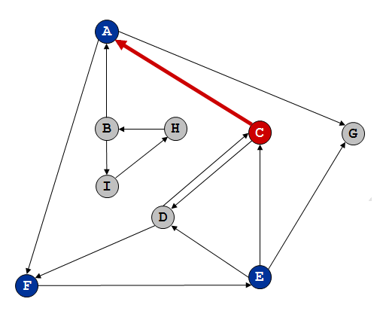
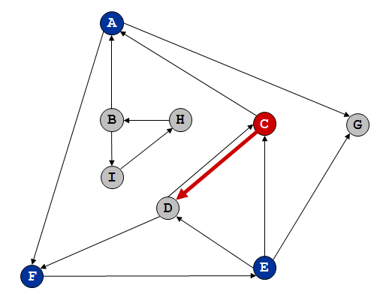
Directed Depth First Search
dfs(C) C-A C-D – A already visited
C-A C-D – visit D
Function call stack: dfs(A) dfs(F) dfs(E) dfs(C)

Slide 13
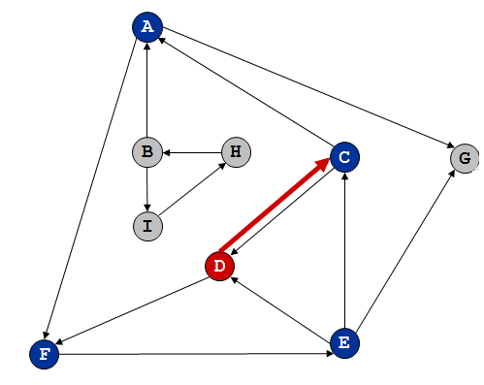
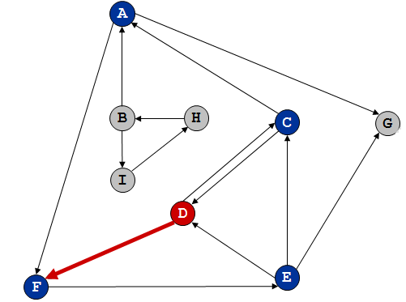
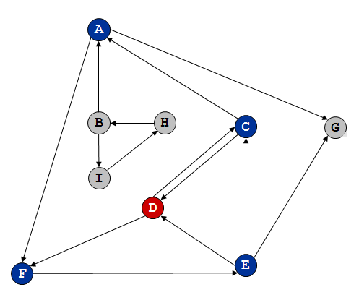
Directed Depth First Search
dfs(D) D-C D-F – C already visited
D-C D-F – F already visited
no more paths, backtrack to C
Function call stack: dfs(A) dfs(F) dfs(E) dfs(C) dfs(D)

Slide 14
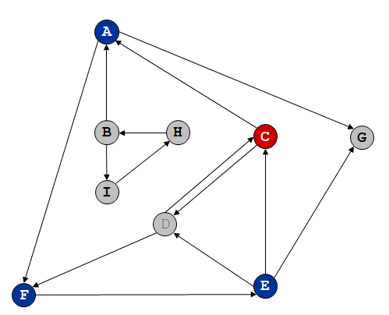
Directed Depth First Search
dfs(C) C-A C-D – A already visited previously
C-A C-D – D already visited
no more paths, backtrack to E and continue
Function call stack: dfs(A) dfs(F) dfs(E) dfs(C)

Slide 15
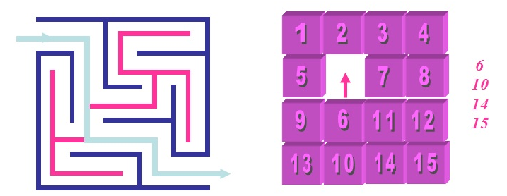
Backtracking Technique
Backtracking is used to solve problems in which a feasible solution is needed rather than an optimal one, such as the solution to a maze or an arrangement of squares in the 15-puzzle. Backtracking problems are typically a sequence of items (or objects) chosen from a set of alternatives that satisfy some criterion.

Slide 16
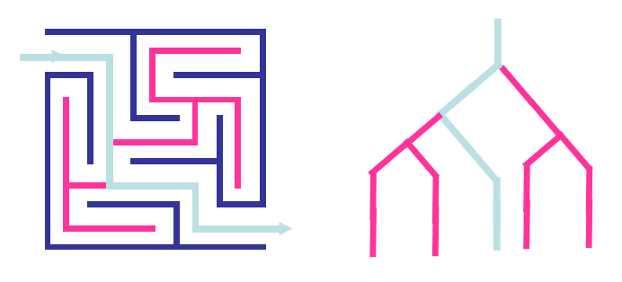
Backtracking Implementation
Backtracking is a modified depth-first search of the solution-space tree. In the case of the maze the start location is the root of a tree, that branches at each point in the maze where there is a choice of direction.

Slide 17
n Queens
Given: n-queens and an n x n chess board
Find: A way to place all n queens on the board such that no queens are attacking another queen.

Slide 18
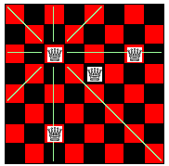
How Queens Work

Slide 19
Solution Ideas
First Solution Idea
Consider every placement of each queen 1 at a time.
How many placements are there?
n²!/(n²-n)!
Second Solution Idea
Don’t place 2 queens in the same row
Now how many placements are there? n^{n}

Slide 20
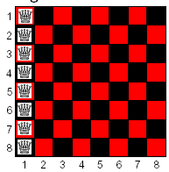
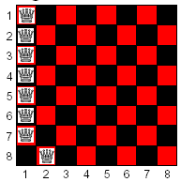
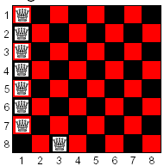
One Queen per Row

Slide 21
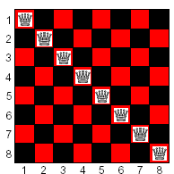
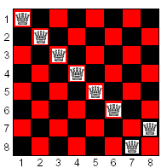
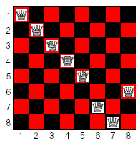
Third Solution Idea
Don’t place 2 queens in the same row or in the same column.
Generate all permutations of (1,2…8)
Now how many positions must be checked? n!

Slide 22
The Point
So far, only check a solution after placing all 8 queens.
A better idea is to check after each placement of a queen.
“Determine we are on a dead-end road without exploring the entire road”

Slide 23
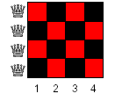
Four Queens Problem

Slide 24
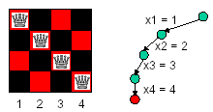
Four Queens Problem Tree
Each branch of the tree represents a decision to place a queen.
The leaf is not a solution!

Slide 25
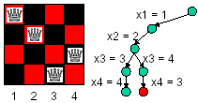
Four Queens Problem Tree
Is this leaf a solution?

Slide 26
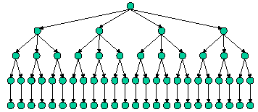
Four Queens Entire Tree
If we evaluate at the end this is our search tree

Slide 27
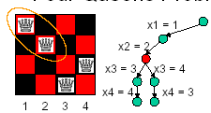
Four Queens Check As We Go
A better question is : “ Is any child of this every going to be a solution? “

Slide 28
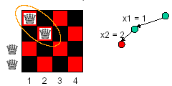
Four Queens Check As We Go
Since this does not work, we can eliminate all the children and move on

Slide 29
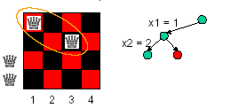
Four Queens Check As We Go
This may work

Slide 30
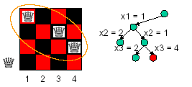
Four Queens Check As We Go
Now try both places for the 3rd Queen
Does not work

Slide 31
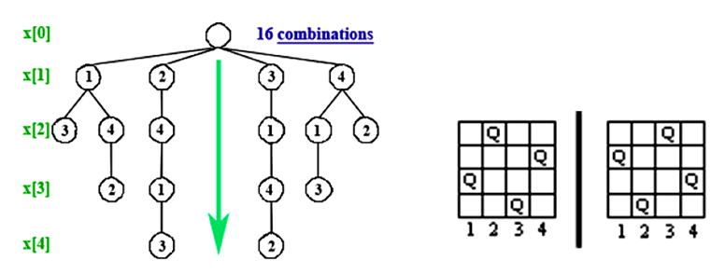
Another View

Slide 32
Pseudo Code for Backtracking
// It is always recursive.
Bool takeAStep(partial solution)
if (done)
return true;
else
{ for all possible extensions
{
try to extend the solution
if (! takeAstep (extended solution))
undo the extension
}
}
return false

Slide 33
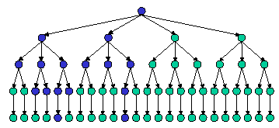
Four Queens Check Entire Tree
The blue indicates the only places we need to look

Slide 34
Efficiency of Backtracking
Algorithms depends on:
The time to generate the next x_{k}
The number of x_{k} satisfying the explicit constraints
The time to compute B_{k}
The number of x_{k} satisfying the B_{k}
A bounding function is considered good, if it substantially reduces the number of nodes that are generated.
But, bounding functions take more time to evaluate.

Slide 35
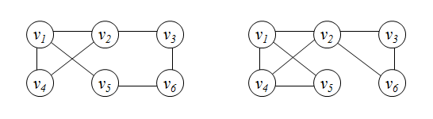
Hamiltonian Circuits Problem
A Hamiltonian circuit or tour of a graph is a path that starts at a given vertex, visits each vertex in the graph exactly once, and ends at the starting vertex. Some graphs do not contain Hamiltonian circuits.
A state space tree for this problem is as follows. Put the starting vertex at level 0 in the tree, call this the zero'th vertex on the path. At level 1, consider each vertex other than the starting vertex as the first vertex after the starting one. At level 2, consider each of these vertices as the second vertex, and so on. You may now backtrack in this state space tree.

Slide 36
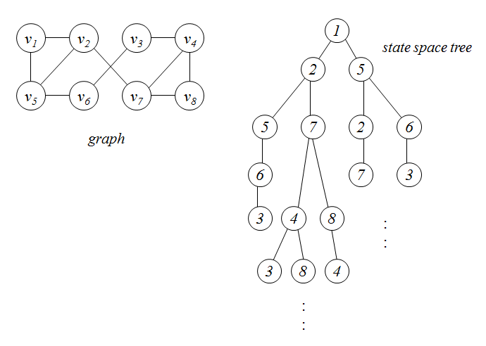
Sample Problem

Slide 37
Game Trees
The state-space tree showing all legal moves of both players starting from some valid game state is called the game tree. We can define a function that estimates the value of any game state relative to one of the players. For example, a large positive value can mean that this is a good move for Player 1, while a large negative value would represent a good move for Player 2. The computer plays the game by expanding the game tree to some arbitrary depth and then bringing back values to the current game state node.
Ply 0
current node
Ply 1
-3
+2
+1
+3
-1
-3
-2
+1

Slide 38
Mini-Max - a definition
A program starts with the current game state and generates all legal moves...all legal responses to these moves...and so on until a fixed depth is reached.
At each leaf node, an evaluation function is applied which assigns a numerical score to that board position. These scores are then ``backed up'' by a process called mini-maxing, which is simply the assumption that each side will choose the line of play most favorable to it at all times.
If positive scores favor Player 1, then Player 1 picks the move of maximum score and Player 2 picks the move of minimum score.

Slide 39
Minimax Game Tree
We will assume that a large positive value is good for the Player 1. To determine Player 1's next move, we will search the possible moves for both players assuming that each player will make the best possible move. Ply 1 is Player 2's move so we will want to return the minimum value from Ply 2 into each Ply 1 node.
Ply 0 is the Player 1's move so we choose the maximum of the Ply 1 values. So the best move for Player 1 results in at least a +1 return value...
MAX
+1
Ply 0
MIN
-3
+1
-3
-2
Ply 1
-3
+2
+1
+3
-1
-3
-2
+1

Slide 40
Alpha-Beta Pruning Rule
If A is an ancestor of X, where A is a max node and X is a min node, then whenever Beta(X) < Alpha(A), we know that if f(X) is good enough to be propagated all the way to B, then it will lose to one of A’s alternative moves.
So in either case, f(X) will have no influence in determining the next move, so we can stop evaluating its children.
Similarly, if Y is a max node and a descendant of B, then we can prune Y whenever Alpha(Y) > Beta(B).
≥-1
max
-1
≤-3
≤-4
min
max
-1
≥+2
-3
-4
-1
-2
-3
+2
-1
-3
-4
-3
+3
+4
-4
-5
+4
+5

