Slide 1
Sorting

Slide 2
Selection Sort
Scan original list to create new sorted list one element at a time
As “by hand”
34, 8, 64, 51, 32, 21
8
8, 21
…..
8, 21, 32, 34, 51, 64

Slide 3
Modified Selection Sort
Scan original list to create new sorted list one element at a time
Use only one list – swap elements
Scan repeats looking only at unsorted elements
34, 8, 64, 51, 32, 21
8, 34, 64, 51, 32, 21
8, 21, 64, 51, 32, 34
…..
8, 21, 32, 34, 51, 64

Slide 4
Bubble Sort
Bubble elements to top of the list by swapping elements
Elements can move different number of locations as each pass finds the next value to place in order
“Modified” version only looks at unsorted elements

Slide 5
Insertion Sort
Pretend to start with an empty list
As each element is accessed, place it in the correct position in the list by moving up and inserting in correct position
Original data 34, 8, 64, 51, 32, 21 (the 0 element is sorted)
After p =1 8, 34, 64, 51, 32, 21 (the 0-1 elements are sorted)
After p =2 8, 34, 64, 51, 32, 21 (the 0-2 elements are sorted)
After p =3 8, 34, 51, 64, 32, 21 (the 0-3 elements are sorted)
After p =4 8, 32, 34, 51, 64, 21 (the 0-4 elements are sorted)
After p =5 8, 21, 32, 34, 51, 64 (the 0-5 elements are sorted)

Slide 6
Insertion Sort Code
template <class Compare>
void insertSort(<Compare> & a)
{
int j;
for (int p =1; p<a.size();p++)
{
Compare temp = a[p];
for (j = p; j>0 && temp < a[j-1]; j--)
a[j] = a[j-1];
a[j] = temp;
}
}

Slide 7
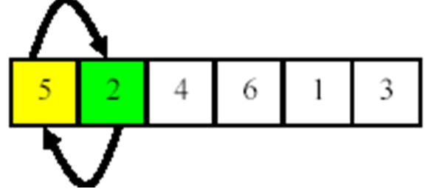
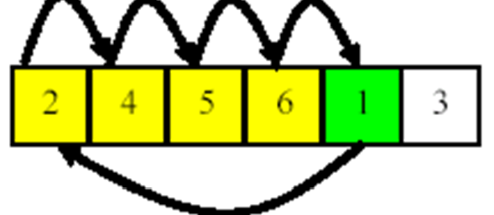
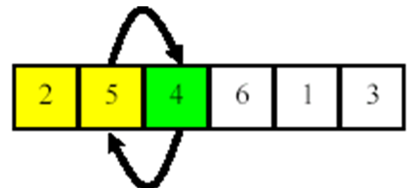
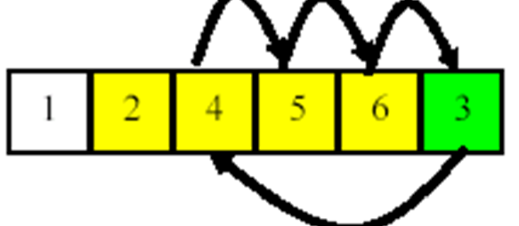
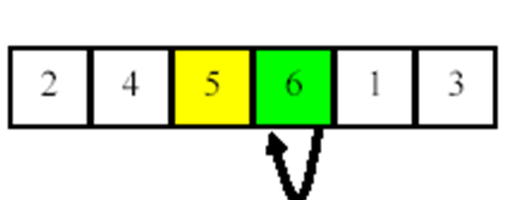
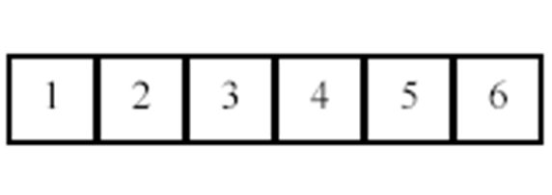
Insertion Sort
Example A= {5,2,4,6,1,3}

Slide 8
Insertion Sort Code Analysis
template <class Compare>
void insertSort(<Compare> & a)
{
int j;
for (int p =1; p<a.size();p++)
{
Compare tmp = a[p];
for (j = p; j>0 && temp < a[j-1]; j--)
a[j] = a[j-1];
a[j] = temp;
}
}
there are 2 nested for loops so the code runs in O(n²) worst case time
Note that if the input is almost sorted then it runs in O(n) time. This is a good sort when you add a little bit of new data and resort each time

Slide 9
A Lower Bound on Simple Sorting
In general it is hard to find a lower bound on anything. (how fast ANY algorithm can go)
In insertion sort only swap adjacent elements
When x > y and yet the index of x < index of y this is called an inversion.
In insertion sort example [34,8,64,51,32,21] there are 9 inversions – these are the moving of elements to find insertion point
{34,8}
{64,51}
{34,32}, {51,32}, {64,32}
{32,21}, {34,21}, {51,21}, {64,21}

Slide 10
Average Number of Inversions
If we know the number of inversions then we know a lower bound on the time needed to sort.
Consider any list of n elements
Let L be the list of sorted elements and L_{r} be the list of elements reverse sorted.
Any pair of elements (x,y) are either in L or L_{r}.
There are n(n-1)/2 such pairs.
Hence there are on average n(n-1)/4 inversions

Slide 11
Lower Bound with Adjacent Swaps
Any sorting algorithm that swaps adjacent elements works in O(n²) on average.

Slide 12
Shell Sort
“modified” insertion sort
Concept – for large data sets move values to the top of list faster
Break list into subsets with multiple increments
Start at 10% of list, then divide by 2 repeating until increment is 1
50,000 elements
Increment are: 5000 2500 1250 625 312 156 78 39 20 10 5 3 1
Increment 1 insertion sort on elements - each data move is 5000 elements
1 5001 10001 15001 20001 ….
2 5002 10002 15002 20002 ….
3 5003 10003 15003 20003 ….
….
5000 10000 15000 20000 ….
Increment 2 insertion sort on elements – each data move is 2500 elements
1 2501 5001 7501 10001 ….
2 2502 5002 7502 10002 ….
3 2503 5003 7502 10003 ….
….
2500 5000 7500 10000 ….
Final increment must be 1 (“regular” insertion sort) – adjacent moves

Slide 13
Divide-and-Conquer
Divide the problem into a number of sub-problems
Similar sub-problems of smaller size
Conquer the sub-problems
Solve the sub-problems recursively
Sub-problem size small enough ⇒ solve the problems in straightforward manner
Combine the solutions of the sub-problems
Obtain the solution for the original problem

Slide 14
Sorting
Insertion sort
Design approach:
Sorts in place:
Best case:
Worst case:
Bubble Sort
Design approach:
Sorts in place:
Running time:
incremental
Yes
Θ(n)
Θ(n²)
incremental
Yes
Θ(n²)

Slide 15
Sorting
Selection sort
Design approach:
Sorts in place:
Running time:
Merge Sort
Design approach:
Sorts in place:
Running time:
incremental
Yes
Θ(n²)
divide and conquer
No
Let’s see!!

Slide 16
Mergesort
Strategy: make partitioning as simple as possible and concentrate on merging the two sorted arrays.
Key process: Merge sorted halves of an array into one sorted array:
these halves have to be sorted first
which is done by merging the already sorted halves of these halves
process of dividing arrays into two halves stops when the array has fewer than two elements.

Slide 17
Mergesort - pseudocode...
mergesort(data, first, last)
if first < last
mid = (first + last)/2
mergesort(data,first,mid)
mergesort(data,mid+1,last)
merge(data,first,last)

Slide 18
... pseudocode
merge(array1, first,last)
mid = (first + last)/2;
i1 = 0;
i2 = first;
i3 = mid + 1;
while both left and right subarrays of array1 contain elements
if array1[i2] < array1[i3]
temp[i1++] = array1[i2++];
else temp[i1++] = array1[i3++];
load into temp the remaining of array1;
load to array1 the content of temp;

Slide 19
Mergesort Complexity...
Data moves:
Merge: array1 is always copied to temp and then temp is copied back to array1 => always 2(last-first+1) => 2n
Mergesort: use the recurrence relation:
M(1) = 0
M(n) = 2M(n/2) + 2n

Slide 20
Mergesort
Divide the n values to be sorted into two halves
Recursively sort each half using Mergesort
Base case n=1 ➔ no sorting required
Merge the two halves
O(n) operation

Slide 21
Merge Sort Approach
To sort an array A[p . . r]:
Divide
Divide the n-element sequence to be sorted into two subsequences of n/2 elements each
Conquer
Sort the subsequences recursively using merge sort
When the size of the sequences is 1 there is nothing more to do
Combine
Merge the two sorted subsequences

Slide 22
Merge Sort
p
q
r
1
2
3
4
5
6
7
8
MERGE-SORT(A, p, r)
if p < r Check for base case
then q ← ⎣(p + r)/2⎦ Divide
MERGE-SORT(A, p, q) Conquer
MERGE-SORT(A, q + 1, r) Conquer
MERGE(A, p, q, r) Combine
Initial call: MERGE-SORT(A, 1, n)
5
2
4
7
1
3
2
6

Slide 23
Example – n Power of 2
Divide
1
2
3
4
5
6
7
8
5
2
4
7
1
3
2
6
q = 4
1
2
3
4
5
6
7
8
5
2
4
7
1
3
2
6
1
2
3
4
5
6
7
8
5
2
4
7
1
3
2
6
1
2
3
4
5
6
7
8
5
2
4
7
1
3
2
6

Slide 24
Example – n Power of 2
Conquer
and
Merge
1
2
3
4
5
6
7
8
1
2
2
3
4
5
6
7
1
2
3
4
5
6
7
8
2
4
5
7
1
2
3
6
1
2
3
4
5
6
7
8
2
5
4
7
1
3
2
6
1
2
3
4
5
6
7
8
5
2
4
7
1
3
2
6

Slide 25
Example – n Not a Power of 2
1
2
3
4
5
6
7
8
9
10
11
Divide
4
7
2
6
1
4
7
3
5
2
6
q = 6
1
2
3
4
5
6
7
8
9
10
11
q = 3
4
7
2
6
1
4
7
3
5
2
6
q = 9
1
2
3
4
5
6
7
8
9
10
11
4
7
2
6
1
4
7
3
5
2
6
1
2
3
4
5
6
7
8
9
10
11
4
7
2
6
1
4
7
3
5
2
6
1
2
4
5
7
8
4
7
6
1
7
3

Slide 26
Example – n Not a Power of 2
Conquer
and
Merge
1
2
3
4
5
6
7
8
9
10
11
1
2
2
3
4
4
5
6
6
7
7
1
2
3
4
5
6
7
8
9
10
11
1
2
4
4
6
7
2
3
5
6
7
1
2
3
4
5
6
7
8
9
10
11
2
4
7
1
4
6
3
5
7
2
6
1
2
3
4
5
6
7
8
9
10
11
4
7
2
1
6
4
3
7
5
2
6
1
2
4
5
7
8
4
7
6
1
7
3

Slide 27
Merging
p
q
r
1
2
3
4
5
6
7
8
2
4
5
7
1
2
3
6
Input: Array A and indices p, q, r such that p ≤ q < r
Subarrays A[p . . q] and A[q + 1 . . r] are sorted
Output: One single sorted subarray A[p . . r]

Slide 28
Merging
p
q
r
Idea for merging:
Two piles of sorted cards
Choose the smaller of the two top cards
Remove it and place it in the output pile
Repeat the process until one pile is empty
Take the remaining input pile and place it face-down onto the output pile
1
2
3
4
5
6
7
8
2
4
5
7
1
2
3
6
A1← A[p, q]
A[p, r]
A2← A[q+1, r]

Slide 29
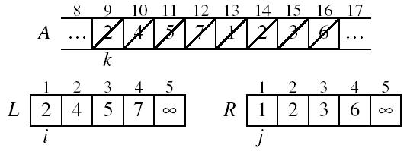
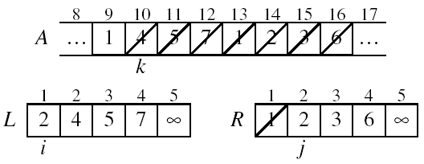
Example: MERGE(A, 9, 12, 16)
p
q
r

Slide 30
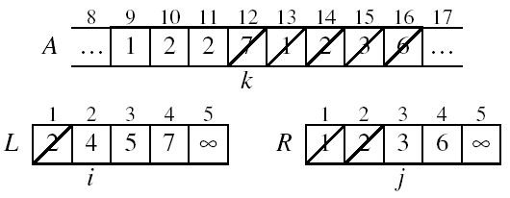
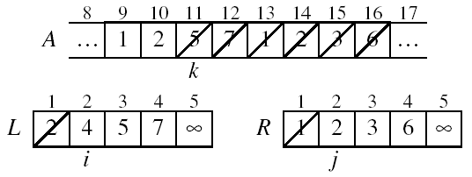
Example: MERGE(A, 9, 12, 16)

Slide 31
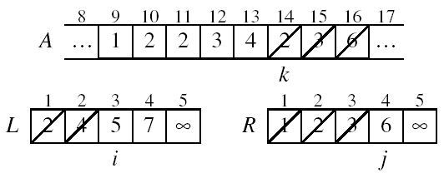
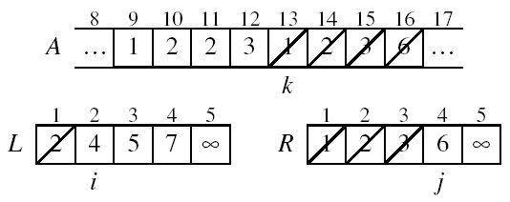
Example (continued)

Slide 32
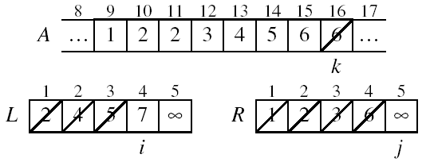
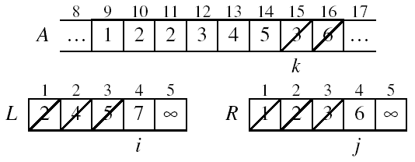
Example (continued)

Slide 33
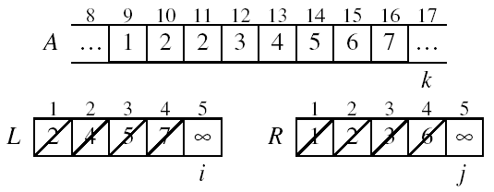
Example (continued)
Done!

Slide 34
Running Time of Merge (assume last for loop)
Initialization (copying into temporary arrays):
Θ(n₁ + n₂) = Θ(n)
Adding the elements to the final array:
- n iterations, each taking constant time ⇒ Θ(n)
Total time for Merge:
Θ(n)

Slide 35
MERGE-SORT Running Time
Divide:
compute q as the average of p and r: D(n) = Θ(1)
Conquer:
recursively solve 2 subproblems, each of size n/2 ⇒ 2T (n/2)
Combine:
MERGE on an n-element subarray takes Θ(n) time ⇒ C(n) = Θ(n)
Θ(1) if n =1
T(n) = 2T(n/2) + Θ(n) if n > 1

Slide 36
Mergesort Complexity...
Comparisons:
Merge: depends on the ordering of array1
if ordered or elements in the right half precede elements in the left half:
(first + last)/2 comparisons
in the worst case (last element of one half precedes only the last element of the other half - ex: [1 6 10 12] and [5 9 11 13]:
last -first comparisons => n-1
Mergesort: use the recurrence relation:
C(1) = 0
C(n) = 2C(n/2) + n-1 => O(nlogn)

Slide 37
Mergesort Complexity...
Use the substitution method:
M(n) = 2(2M(n/4) + 2(n/2)) + 2n = 4M(n/4) + 4n
= 4(2M(n/8) + 2(n/4)) + 4n = 8M(n/8) + 6n
…..
= 2^{i}M(n/2^{i}) + 2in
choosing i = lg n so that n = 2^{i} allows us to infer
M(n) = 2^{i}M(n/2^{i}) + 2in
= nM(1) + 2n lg n
= 2n lg n
= O(nlgn)

Slide 38
Merge Sort - Discussion
Running time insensitive of the input
Advantages:
Guaranteed to run in Θ(nlgn)
Disadvantage
Requires extra space ≈N

Slide 39
Quicksort
Fastest known sorting algorithm in practice
Caveats: not stable
Vulnerable to certain attacks
Average case complexity →O(n log n)
Worst-case complexity → O(n²)
Rarely happens, if coded correctly

Slide 40
Quicksort Outline
Divide and conquer approach
Given array S to be sorted
If size of S < 1 then done;
Pick any element v in S as the pivot
Partition S-{v} (remaining elements in S) into two groups
S1 = {all elements in S-{v} that are smaller than v}
S2 = {all elements in S-{v} that are larger than v}
Return {quicksort(S1) followed by v followed by quicksort(S2) }
Trick lies in handling the partitioning (step 3).
Picking a good pivot
Efficiently partitioning in-place

Slide 41
Quicksort example
81
43
31
57
75
13
92
65
26
0
Select pivot
81
43
31
57
75
13
65
26
0
92
partition
13
31
57
65
81
43
26
0
92
75
Recursive call
Recursive call
0
13
26
31
43
57
75
81
92
Merge
0
13
26
31
43
57
65
75
81
92

Slide 42
Picking the Pivot
How would you pick one?
Strategy 1: Pick the first element in S
Works only if input is random
What if input S is sorted, or even mostly sorted?
All the remaining elements would go into either S1 or S2!
Terrible performance!
Why worry about sorted input?
Remember → Quicksort is recursive, so sub-problems could be sorted
Plus mostly sorted input is quite frequent

Slide 43
Picking the Pivot (continued)
Strategy 2: Pick the pivot randomly
Would usually work well, even for mostly sorted input
Unless the random number generator is not quite random!
Plus random number generation is an expensive operation

Slide 44
Picking the Pivot (continued)
Strategy 3: Median-of-three Partitioning
Ideally, the pivot should be the median of input array S
Median = element in the middle of the sorted sequence
Would divide the input into two almost equal partitions
Unfortunately, its hard to calculate median quickly, without sorting first!
So find the approximate median
Pivot = median of the left-most, right-most and center element of the array S
Solves the problem of sorted input

Slide 45
Picking the Pivot (contd.)
Example: Median-of-three Partitioning
Let input S = {6, 1, 4, 9, 0, 3, 5, 2, 7, 8}
left=0 and S[left] = 6
right=9 and S[right] = 8
center = (left+right)/2 = 4 and S[center] = 0
Pivot
= Median of S[left], S[right], and S[center]
= median of 6, 8, and 0
= S[left] = 6

Slide 46
Partitioning Algorithm
Original input : S = {6, 1, 4, 9, 0, 3, 5, 2, 7, 8}
Get the pivot out of the way by swapping it with the last element
Have two ‘iterators’ – i and j
i starts at first element and moves forward
j starts at last element and moves backwards
8 1 4 9 0 3 5 2 7 6
pivot
8 1 4 9 0 3 5 2 7 6
i
j
pivot

Slide 47
Partitioning Algorithm (contd.)
While (i < j)
Move i to the right till we find a number greater than pivot
Move j to the left till we find a number smaller than pivot
If (i < j) swap(S[i], S[j])
(The effect is to push larger elements to the right and smaller elements to the left)
Swap the pivot with S[i]

Slide 48
Partitioning Algorithm Illustrated
i
j
pivot
8 1 4 9 0 3 5 2 7 6
Move
i
j
pivot
8 1 4 9 0 3 5 2 7 6
swap
i
j
pivot
2 1 4 9 0 3 5 8 7 6
move
i
j
pivot
2 1 4 9 0 3 5 8 7 6
swap
i
j
pivot
2 1 4 5 0 3 9 8 7 6
move
j
i
pivot
i and j
have crossed
2 1 4 5 0 3 9 8 7 6
Swap S[i]
with pivot
2 1 4 5 0 3 6 8 7 9
j
i
pivot

Slide 49
Dealing with small arrays
For small arrays (N ≤ 20),
Insertion sort is faster than quicksort
Quicksort is recursive
So it can spend a lot of time sorting small arrays
Hybrid algorithm:
Switch to using insertion sort when problem size is small (say for N < 20)

Slide 50
Quicksort Summary/Analysis
The place where the pivot goes is critical to the speed of quicksort
If the pivot lands in the middle then
T(n) = 2T(n/2) +n
Hence here a =2, b=2, k =1 and T(n) = O(nlg(n))
If the pivot lands at either end then
T(n) = T(n-1)+ n ➔ T(n) = O(n²)
There is a way to ENSURE a good pivot called using the Median of Three
Instead of choosing the first element in the array for the pivot we choose the median of the left, right and center values. (recall the median element is the element that appears in the middle if the list is sorted. It is NOT the average)

Slide 51
Heapsort
Can use a priorityqueue to sort.
Initialize a max heap (O(n))
Then do a deleteMax (O(lg(n)) n times
Total is O(n + nlg(n))
Does not use any extra storage (this is a good method when the data to swap is large).

Slide 52
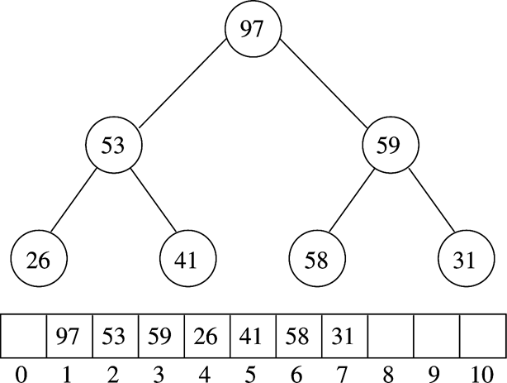
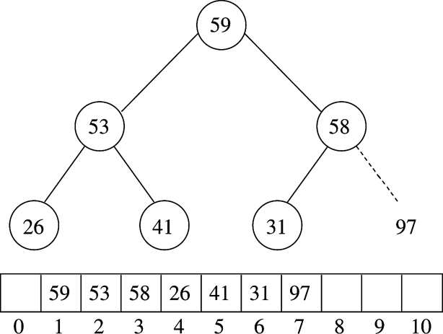
Example
Max-Heap – repeat removing root and placing it in location vacated
by root replacement
After BuildHeap
After first deleteMax
97 removed, 31 (position 7) moves to root, heap-down,
97 moves to position 7 (note that position 7 no longer considered part of the heap!)

Slide 53
Linear Sorting - Radix Sorting
Proved that the best sort must take at least O(nlg(n)) time.
Now it is time to sort in O(n) time. We can do this without going crazy by making an additional assumption. The assumption is that the range of the values to be sorted is fixed.
This is not such an outrageous assumption. Consider any digital image. If we want to sort the values they range from a max to a min.
Idea - sort by digit (or equivalent). Start with the least significant digit and then move up to the most significant digit, using a sort that preserves order.
This is called radix or bucket sort.

Slide 54
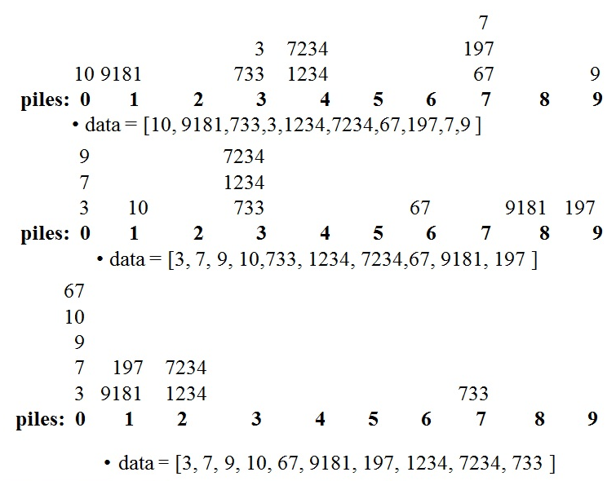
Radix/Bucket Sorting Example
Consider sorting the a list of values which are in the range 0 – 10,000
data = [10, 1234,9,7234,67, 9181, 733, 197,7,3 ]

Slide 55
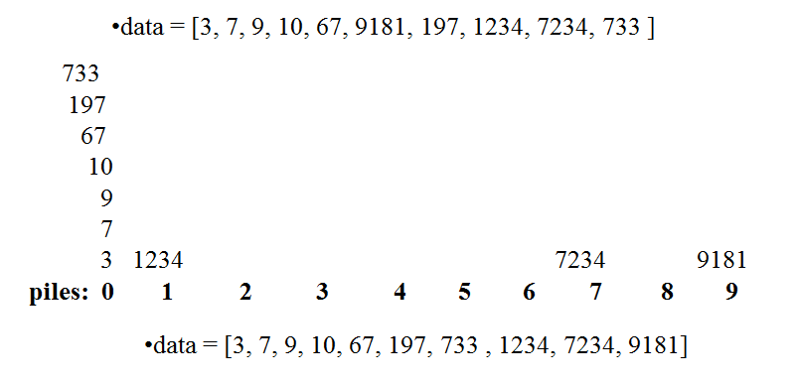
Radix/Bucket Sorting Example

Slide 56
Radix Code (base 10)
void radixsort(long data[], int n)
{
register int i, j, k , factor;
const int radix = 10;
const int digits = 10’ // the max number of digits for a long
Queue<long> queues[radix]; // integer
for (i = 0, factor = 1; i < digits; factor *= radix, i++)
{
for (j = 0; j < n; j++)
queues[(data[j]/factor)%radix].enque(data[j]);
for (j=k=0; j < radix; j++)
while (!queues[j].empty())
data[k++] = queues[j].dequeue());
}
}

Slide 57
Analysis
So the if the numbers are k digits
then this method takes O(kn)
The number of digits log(v)
O(log(v)*n) vs other methods O(n lg(n))

Slide 58
Radix Code (base 2)
void bitRadixsort(long data[], int n)
{
register int i, j, k , mask=1;
const int bits = 31;
Queue<long> queues[2]; // integer
for (i = 0; i < bits; i++)
{
for (j = 0; j < n; j++)
queues[(data[j]& mask ? 1:0].enqueue(data[j]);
mask<<=1;
k = 0;
while (!queues[0].empty())
data[k++] = queues[0].dequeue();
while (!queues[1].empty())
data[k++] = queues[1].dequeue());
}
}

Slide 59
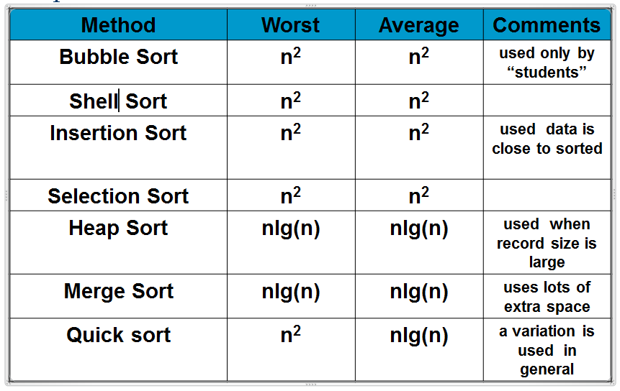
Comparison of Sorts

Slide 60
Frequency Sort
sort on frequency of access not on key
change order in array (swap with prior element) every access
splay tree
less “effort” to find element

Slide 61
External Sorting
So far all the algorithms require that the input fit into main memory.
If this is not true then we need an external sort
Main Idea:
Divide the data up into pieces (each of which fit into main memory)
Then sort each of the pieces
Then merge them all together.

Slide 62
Searching
Basic searches
Linear search
array, vector, linked list (single, double, circular, sublists)
Binary search
array
good but have time taken to sort array

Slide 63
Review of Searching
If we want to search for an element from an unsorted list must use sequential search. O(n) worst case performance.
If we want to search for an element in a sorted list we can use a binary search
Based on divide and conquer
In divide and conquer we reduce a problem of size n into smaller problems of the same time and combine the small solutions to form the solution to a larger problem.
Probe the middle
if probe is less than target we throw away the smaller half of the list and call ourselves on the greater half
if probe is more than target we throw away the larger half of the list and call ourselves on the smaller half
Either way we if T(n) is the time needed to search a list of n elements, then T(n) = T(n/2) + 1 T(1) = 1 T(n) = O(lg(n))

Slide 64
Other Searches
Hashing
Trees
BST
B and B+
Splay
AVL
etc.

Slide 65
Lower Bound for Sorting
Three types of sorting algorithms
Based on comparisons
Comparison of ADJACENT vector elements
Insertion, Selection, Shell, Bubble => O(n²)
Comparison of NON-ADJACENT elements
Heapsort, Quicksort, Mergesort => O(nlogn)
Quicksort is the algorithm of choice (the worst case O(n²) has very little likelihood of happening
Mergesort has the drawback of extra space used by the temporary array
Not based on comparisons
Bucket sort and Radix sort => O(n)
=>Any algorithm which performs sorting using comparisons cannot have a worst-case performance better than O(n logn).

Slide 66
Lower Bound on Sorts
One question is: Is there a limit to how fast a sort (or for that matter any problem can be solved on single cpu)
There are related questions when one has access to a network or a multiple CPU machine.
Sometimes we can find such a lower bound. This is great when it exits since it tells us when we have an algorithm that runs in optimal speed.
What follows is such a lower bound on sorting.
Assumptions:
The sorting algorithm must be able to sort a list that is entered in ANY order.
At each step of the sort we will make a comparison and swap
based on the result swap some elements.

Slide 67
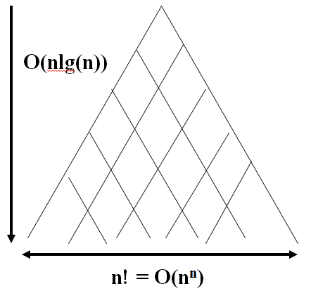
Lower Bound on Sorting
If at each step of the sort we will make a comparison
We can represent this as a tree
Since we have to allow for all permutations the number of elements on the bottom of the tree is n! (the total number of permutations of list)
The height of such a tree is hence
lg(n^{n}) which is Ω (nlg(n))

Slide 68
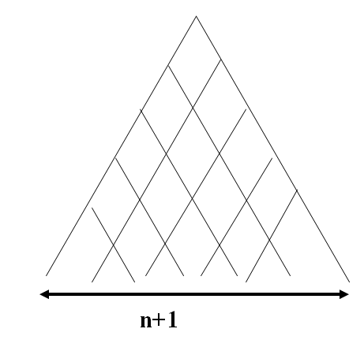
Find a lower bound on searching?
Given a list of n elements the places where element can be is n+1
There n+1 elements at the base
Ω(n+1)
Lower bound is lg(n)

Slide 69
Lower bound
List of numbers and we want a subset whose sum = a target
{ 1, 3, 10, 29,32} Find a subset whose sum 30
There are 2^{n} subset of n items
The lower bound is lg(2^{n}) = lg(n)

Slide 70
Solving Recurrences using the Masters Theorem
if T(n) = aT(n/b) + Θ(n^{k}log^{p}n)
Then
{ O(n^{log}_{b}^{(a)}) if a > b^{k}
T(n) = {O(n^{k}lg^{p+1}(n)) if a = b^{k}
{O(n^{k}lg^{p}(n)) if a < b^{k}
In the case of the binary search T(n) = T(n/2) + 1
so here a =1, b= 2, k = 0, p = 0 and hence a = 1, b^{k}= 2⁰ = 1
Here a=b^{k} hence T(n) = O(lg(n))

Slide 71
Mergesort and Quicksort
MergeSort
Recall mergesort works by dividing the list into 2 parts, sorting each one and then merging. The time to merge the 2 sorted n/2 length lists is n
Merge (1,3,10,13) and (2,4,5,6,7) compare
Compare 1 and 2 choose 1 (1,3,10,13) and (2,4,5,6,7)
Compare 3 and 2 choose 2 (1,3,10,13) and (2,4,5,6,7)
Compare 3 and 4 choose 3 (1,3,10,13) and (2,4,5,6,7)
Compare 10 and 4 choose 4 (1,3,10,13) and (2,4,5,6,7)
Mergesort is a an easy split, hard to recombine
Hence T(n) = 2T(n/2) + n
Here a =2, b=2, k = 1 p = 0 so b^{k} = 2
Hence T(n) = O(n¹lg¹(n))
Quicksort
Is hard to split and easy recombine.
It works by choosing an element called the pivot and putting all the elements less than the pivot on the left and all the elements > the pivot on the right.

