Slide 1
Algorithms

Slide 2
Types of Algorithms
Greedy
Divide and Conquer
Dynamic Programming
Backtracking
Branch and Bound

Slide 3
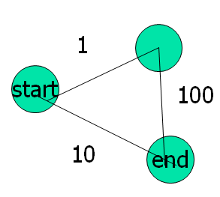
Greedy algorithms
Do what looks best first!!
Do not always lead to optimal solutions

Slide 4
Loading Problem
A large ship is to be loaded with cargo. The cargo is containerized and all containers are the same size. Different containers have different weights. Let w_{i} be the weight of the i^{th} container. The cargo capacity of the ship is c. We wish to load the ship with the maximum number of containers.
Here the constraints are Σ_{i=1}^{n} w_{i}x_{i} < c , while the optimization function is Σ_{i=1}^{n} x_{i} where x_{i} represents 0 or 1 where 1 means container i is included in set.

Slide 5
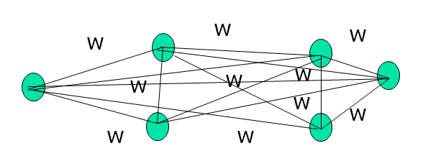
Minimum-Cost Communication Network
Given a set of cities and possible communication links that can be represented as an undirected graph. Each edge has a cost (or weight). Find a spanning tree with the minimum total edge weight.
Choose the edge with the smallest edge weight 1st that does not form a cycle.

Slide 6
The Greedy Method
Try to create the solution in stages.
At each stage try to make a decision that appears to be the best under some criterion.
Once a decision is made it is never changed.
So at each stage must choose something that is feasible.

Slide 7
Machine Scheduling
Given n tasks and an infinite number of machines to work on them.
Each task i has a start time s_{i} and a finish time f_{i}.
No machine can do 2 tasks at the same time.
[1,4) and [2,5) over lap while [1,4)[4,6) do not overlap
The challenge is to assign the tasks so that no 2 overlap and all the tasks are assigned using the fewest machines.
Greedy solution
At each stage a assign a task. Try to use machines already used first. If can’t use a new machine.

Slide 8
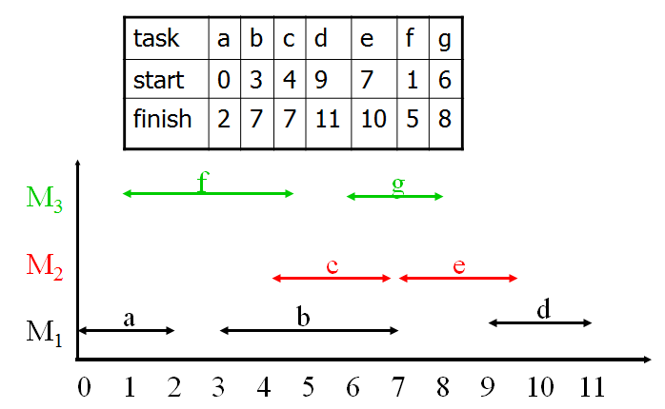
Machine Scheduling Example
Analysis
We can improve by sorting the tasks by start time. Then checking for overlap is a O(1). Put them in a heap. If there are n tasks then takes O(nlg(n)).

Slide 9
Loading Problem Revisited
A large ship is to be loaded with cargo. The cargo is containerized and all containers are the same size. Different containers have different weights. Let w_{i} be the weight of the i^{th} container. The cargo capacity of the ship is c. We wish to load the ship with the maximum number of containers.
Here the constraints are S_{i=1}^{n} w_{i}x_{i} < c , while the optimization function is S_{i=1}^{n} x_{i}
The greedy strategy would be at each stage load the container with the least amount of weight.
Example Let n = 8 weights = [100, 200, 50, 90, 150, 50, 20, 80] and c = 400.
When the greedy strategy is used, containers 7,3, 6, 4 ,8 and 1 are are loaded and they weigh 390 units. So here x= [1,0,1,1,0,1,1,1,1] and S_{i=1}^{n} x_{i} = 7.

Slide 10
Knapsack Problem
We wish to pack a knapsack with a capacity of c. From a list of n items, we must select the items that are to be packed into the knapsack. Each object i has a weight w_{i} and a profit p_{i}. In a feasible knapsack packing, the sum of the weights of the packed objects does not exceed the knapsack capacity. An optimal packing is a feasible one with maximum profit.
Sort by p_{i}/w_{i} this solves the fractional knapsack problem.
Items profit 200 17
Items weight 100 9
Knapsack holds 108

Slide 11
0/1 Knapsack Problem
We want to maximize S_{i=1}^{n} p_{i}x_{i} subject to S_{i=1}^{n} w_{i}x_{i} < c , x_{i} ∈{0,1}
If i is in the knapsack then x_{i} is 1 else it is 0.
Note that the knapsack problem is just a generalization of the container problem. We have added a value to each container not just the number of containers.
The greedy solution is to add the items with the largest profit to weight ratio. (p_{i}/w_{i})
This greedy solution does NOT give the optimal solution.
It does a pretty good job but is NOT optimal.
It runs in O(nlg(n)) time.
It is a classic hard problem. (NP-complete)
Np = nondeterministic polynomial time

Slide 12
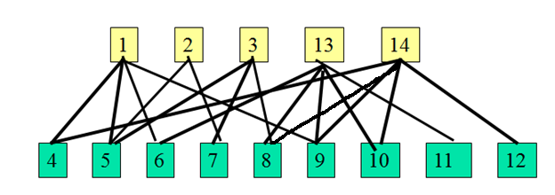
Bipartite Cover
A bipartite graph is an undirected graph in which the n vertices can be partitioned into 2 sets A and B so the no edge in the graph connects 2 vertices in the same set.
A subset A’ of A is said to cover B if and only if every vertex of B is adjacent to a vertex in A’.
The size of the cover A’ is the number of vertices in A’, A’ is a minimum cover if A has not smaller subset that covers B.
This is also an NP-hard problem.
A greedy heuristic for this would be to pick the vertex of A that covers the largest number of uncovered vertices

Slide 13
Bipartite Cover Code
m = 0; // current side of cover
New[i] = Degree[i] for all i in A.
Cov[i] = false for all i in B.
while(New[i] > 0 for some i in A){
Let v be a vertex with the largest New[i]
C[m++] = v;
for (all vertices j adjacent from v){
if (!Cov[j]){
Cov[j] = true;
Reduce New[k] by one for all vertices
adjacent from j.
}
}
}
if (some vertices are uncovered) fail
else a cover has been found.

Slide 14
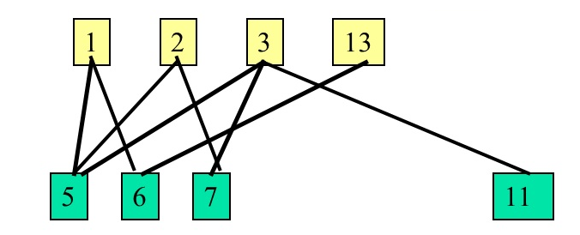
Bipartite Cover Example
First we take 14 which covers 5 vertices 4,8,9,10,12
Next we take 3 which covers 3 vertices 5, 7, 11

Slide 15
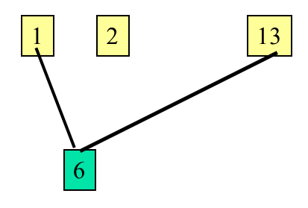
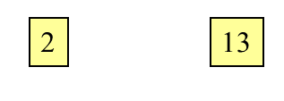
Bipartite Cover Example
Finally choose 1 which covers 6

Slide 16
Bipartite Cover
Selection of Data Structure
To implement the algorithm need to select a representation for A’ and to decide how to keep track of number of uncovered vertices of B that each vertex of A covers. Since only additions are made to A’ a 1 dimensional C[ 0: m-1] array works. We need to cover A to and reduce each element of A

Slide 17
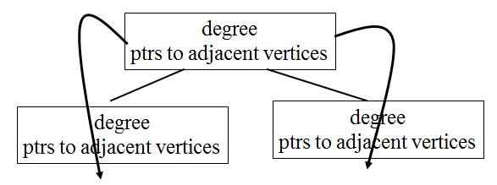
Bipartite Cover Analysis
It takes O(n²) to find the edges adjacent to a vertex in the adjacency matrix and O(n+e) in an adjacency list.
The overall complexity is O(|A|² + n +e)
Can reduce the time by using a heap.
Then use decrease key to update.
Can improve this further since know the range of possible values of the heap. Can use bins for the array values and then updates can be done in time O(1).

Slide 18
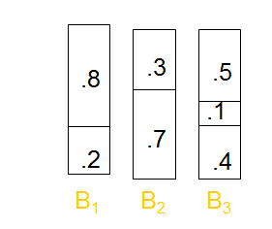
Approximate Bin Packing
Given N items of sizes s₁, s₂, …s_{N} 0 < s_{i} < 1. Object is to pack these items in the fewest number of bins, given the bins have unit capacities.
Example Items .2, .5, .4, .7, .1, .3, .8 with bin capacity of 1
There are 2 versions on-line (an item must be placed before the next one is given)
and off-line, only place after all items given.

Slide 19
On-Line Bin Packing
Cannot always give an optimal solution (can choose the next item size to upset things)
3 simple algorithms
Next Fit
First Fit
Best Fit

Slide 20
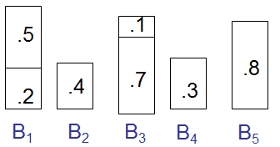
Next Fit
If next item fits in the same bin as the last item. If it does we fit it there.
Example .2, .5, .4, .7, .1, .3, .8
Time to place is O(1)

Slide 21
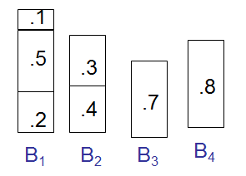
First Fit
Goes through each bin and attempts to fit the next item (i.e. always start with first bin)
Example .2, .5, .4, .7, .1, .3, .8
Time to place O(N)

Slide 22
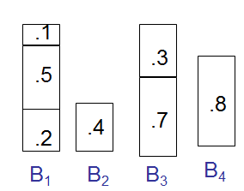
Best Fit
Goes the tightest spot
Example .2, .5, .4, .7, .1, .3, .8
Time to place O(N lg(N)) all items

Slide 23
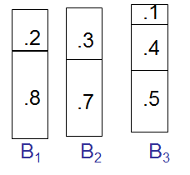
Off-Line Bin Packing
Theoretically, we can achieve optimal results by looking at possible combinations.
Sort the items by size and pack the large items first using first fit or best fit
Example .2, .5, .4, .7, .1, .3, .8

Slide 24
Greedy Algorithm Summary
Choose what looks best first
Never change your mind
May NOT be optimal (usually is not optimal)
The problem must have optimal subproblem property.
The choice of a subproblem is a singleton

Slide 25
Divide and Conquer
Has 2 parts Divide (break the problem into 2 smaller parts)
Conquer: The solution to the original problem is then formed from the solutions to the subproblems.
Usually at least 2 recursive calls.
Examples
Mergesort (MergeSort 1st half, MergeSort 2nd half, Merge)
Quicksort (Partition, Quicksort 1st half, Quicksort 2nd half)

Slide 26
Solving Recurrences using the Masters Theorem
if T(n) = aT(n/b) + Q(n^{k}log^{p}n)
Then
{ O(n^{log}_{b}^{(a)}) if a > b^{k}
T(n) = {O(n^{k}lg^{p+1}(n)) if a = b^{k}
{O(n^{k}lg^{p}(n)) if a < b^{k}
In the case of the binary search T(n) = T(n/2) + 1
so here a =1, b= 2, k = 0, p = 0 and hence a = 1, b^{k}= 2⁰ = 1
Here a=b^{k} hence T(n) = O(lg(n))

Slide 27
Mergesort and Quicksort
MergeSort
Recall mergesort works by dividing the list into 2 parts, sorting each one and then merging. The time to merge the 2 sorted n/2 length lists is n
Merge (1,3,10,13) and (2,4,5,6,7) compare
Compare 1 and 2 choose 1 (1,3,10,13) and (2,4,5,6,7)
Compare 3 and 2 choose 2 (1,3,10,13) and (2,4,5,6,7)
Compare 3 and 4 choose 3 (1,3,10,13) and (2,4,5,6,7)
Compare 10 and 4 choose 4 (1,3,10,13) and (2,4,5,6,7)
Mergesort is a an easy split, hard to recombine
Hence T(n) = 2T(n/2) + n
Here a =2, b=2, k = 1 p = 0 so b^{k} = 2
Hence T(n) = O(n¹lg¹(n))
Quicksort
Is hard to split and easy recombine.
It works by choosing an element called the pivot and putting all the elements less than the pivot on the left and all the elements > the pivot on the right.

Slide 28
The Selection Problem
Given a list of n elements, find the kth largest item in the list.
Could sort it (O(nlg(n)) and then select (O(1)).
Want to select in O(n) time.
Idea- Use the partition algorithm from quicksort. Recall that divides the list into stuff below the pivot, and above the pivot.
Then throw away the part of the list that is useless and recursively pick another pivot.

Slide 29
Selection Example
Try and find the (5th element) of
65 10 81 92 43 57 31 26 75 13
^pivot ^swap ^swap
65 10 13 92 43 57 31 26 75 81
^pivot ^swap ^swap
65 10 13 26 43 57 31 | 92 75 81
Swap Pivot into Place
31 10 13 26 43 57| 65 | 92 75 81
Now we want to find the 5th element in
31 10 13 26 43 57
Swap Pivot into Place
26 10 13 | 31| 43 57
Now we want to find the 1st element in
43 57
The answer is 43

Slide 30
Selection Analysis
In the best case can throw away half the list at each step
T(n) = T(n/2) + n➔ O(n)
But need to guarantee a good pivot.
Pivot Select algorithm – median of medians

Slide 31
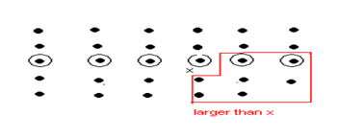
Steps to find i-th smallest element Algorithm Select
Divide elements in n/5 groups of 5 elements, plus at most one group with (n mod 5) elements.
Find median of each group:
Insertion sort: O(1) time (at most 5 elements).
Take middle element (largest if two medians).
Use Select recursively to find median x of medians.
Partition input array around median-of-medians x. Let k be the number of elements on low side, n-k on high side.
a₁,a₂,…,a_{k} | a_{k+1},a_{k+2},…,a_{n}
a_{i} < a_{j}, for 1 ≤ i ≤ k, k+1 ≤ j ≤ n.
Use Select recursively to:
Find i-th smallest element on low side, if i ≤ k
Find (i-k)-th smallest on high side, if i > k.

Slide 32
Analysis of Median of Medians
The worst case would leave a 70-30 split around the pivot
So the recursion is T(n) = T(7n/10) + T(n/5)
Can find the median in O(n) which guarantees selection in O(n) time

Slide 33
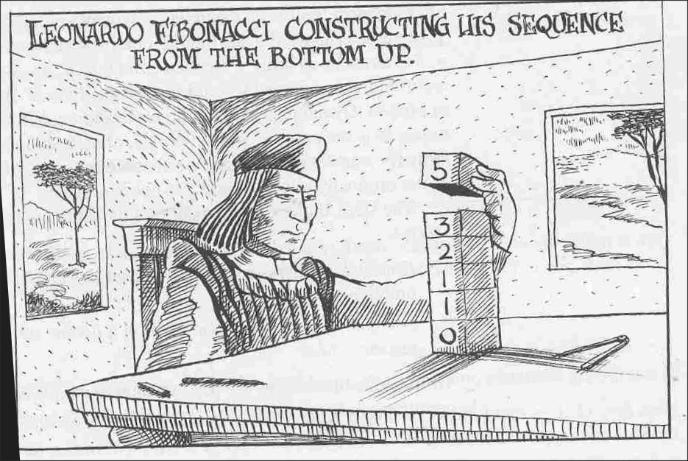
Dynamic Programming
Is a bottom up approach.
Again we break the problem up but we start at the bottom to compute larger solutions

Slide 34
Fibbanaci Series
F_{n} = F_{n-1} + F_{n-2}
int fibb(n)
{
if (n == 0) return 0;
else if (n == 1) return 1;
else return fibb(n-1) + fibb(n-2);
}

Slide 35
Timing of recursive fibb
T(n) = T(n-1) + T(n-2)
Guess T(n)= A r^{n}
Ar^{n} = Ar^{n-1} + Ar^{n-2}
Divide by A r^{n-2}
r² - r -1= 0
r = [1 + sqrt(1 + 4)]/2
T(n) = O(sqrt(5)^{n}) Grows exponentially

Slide 36
Fibbanaci Series
fibb(0) = 0
fibb(1) = 1
fibb(2) = fibb(1) + fibb(0) = 1
fibb(3) = fibb(2) + fibb(1) = 2
fibb(4) = fibb(3) + fibb(2) = 3
fibb(5) = fibb(4) + fibb(3) = 5

Slide 37
Non-Recursive Fibb
Int fibb(int n)
{
vector<int> fib(n+1);
fib[0] = 0;
fib[1] = 1;
for (int I = 2; I < = n; i++)
fib[i] = fib[i-1] + fib[i-2];
return fib[n];
}

Slide 38
Binomial Coefficients
C(n,k) = C(n-1,k-1) + C(n-1,k)
C(n, 1) = 1
K = 1,… n
Use the recursion results in C(n,k) is computed in exponential time
Save previous C( , ) then it can be computed in O(n²)

Slide 39
Optimal Subproblem Property
Problems that can be sped up by dynamic programming
Have the optimal subproblem property
An optimal solution can be divided up into optimal solutions to smaller problems.

Slide 40
Knapsack problem
Given some items, pack the knapsack to get
the maximum total value. Each item has some
weight and some value. Total weight that we can
carry is no more than some fixed number W.
So must consider weights of items as well as
their values.
Item # Weight Value
1 1 8
2 3 6
3 5 5

Slide 41
Knapsack problem
There are two versions of the problem:
“0-1 knapsack problem”
Items are indivisible; you either take an item or not. Some special instances can be solved with dynamic programming
“Fractional knapsack problem”
Items are divisible: you can take any fraction of an item

Slide 42
0-1 Knapsack problem
Given a knapsack with maximum capacity W, and a set S consisting of n items
Each item i has some weight w_{i} and benefit value b_{i} (all w_{i} and W are integer values)
Problem: How to pack the knapsack to achieve maximum total value of packed items?

Slide 43
0-1 Knapsack problem
Problem, in other words, is to find
The problem is called a “0-1” problem, because each item must be entirely accepted or rejected.

Slide 44
0-1 Knapsack problem: brute-force approach
Let’s first solve this problem with a straightforward algorithm
Since there are n items, there are 2^{n} possible combinations of items.
Go through all combinations and find the one with maximum value and with total weight less or equal to W
Running time will be O(2^{n})

Slide 45
Defining a Subproblem
We can do better with an algorithm based on dynamic programming
We need to carefully identify the subproblems
Let’s try this:
If items are labeled 1..n, then a subproblem
would be to find an optimal solution for
S_{k} = {items labeled 1, 2, .. k}

Slide 46
Defining a Subproblem
If items are labeled 1..n, then a subproblem would be to find an optimal solution for S_{k} = {items labeled 1, 2, .. k}
This is a reasonable subproblem definition.
The question is: can we describe the final solution (S_{n} ) in terms of subproblems (S_{k})?
Unfortunately, we can’t do that.

Slide 47
Defining a Subproblem
w₁ =2
b₁ =3
w₂ =4
b₂ =5
w₃ =5
b₃ =8
w₄ =3
b₄ =4
Weight
Benefit
Item
#
w_{i}
b_{i}
?
1
2
3
Max weight: W = 20
For S₄:
Total weight: 14
Maximum benefit: 20
S₄
2
4
5
S₅
3
5
8
4
3
4
5
9
10
w₁ =2
b₁ =3
w₂ =4
b₂ =5
w₃ =5
b₃ =8
w₅ =9
b₅ =10
Solution for S₄ is not part of the solution for S₅!!!
For S₅:
Total weight: 20
Maximum benefit: 26

Slide 48
Defining a Subproblem
As we have seen, the solution for S₄ is not part of the solution for S₅ – item 4 is replaced by item 5!
So our definition of a subproblem is flawed and we need another one!

Slide 49
Defining a Subproblem
Let’s add another parameter: w, which will represent the maximum weight for each subset of items
The subproblem then will be to compute V[k,w], i.e., to find an optimal solution for S_{k} = {items labeled 1, 2, .. k} in a knapsack of size w

Slide 50
Recursive Formula for subproblems
The subproblem will then be to compute V[k,w], i.e., to find an optimal solution for S_{k} = {items labeled 1, 2, .. k} in a knapsack of size w
Assuming knowing V[i, j], where i=0,1, 2, … k-1, j=0,1,2, …w, how to derive V[k,w]?

Slide 51
Recursive Formula for subproblems (continued)
Recursive formula for subproblems:
It means, that the best subset of S_{k} that has total weight w is:
1) the best subset of S_{k-1} that has total weight ≤ w, or
2) the best subset of S_{k-1} that has total weight ≤ w-w_{k} plus the item k

Slide 52
Recursive Formula
The best subset of S_{k} that has the total weight ≤ w, either contains item k or not.
First case: w_{k}>w. Item k can’t be part of the solution, since if it was, the total weight would be > w, which is unacceptable.
Second case: w_{k} ≤ w. Then the item k can be in the solution, and we choose the case with greater value.

Slide 53
0-1 Knapsack Algorithm
for w = 0 to W
V[0,w] = 0
for i = 1 to n
V[i,0] = 0
for i = 1 to n
for w = 0 to W
if w_{i} <= w // item i can be part of the solution
if b_{i} + V[i-1,w-w_{i}] > V[i-1,w]
V[i,w] = b_{i} + V[i-1,w- w_{i}]
else
V[i,w] = V[i-1,w]
else V[i,w] = V[i-1,w] // w_{i} > w

Slide 54
Running time
for w = 0 to W
V[0,w] = 0
for i = 1 to n
V[i,0] = 0
for i = 1 to n
for w = 0 to W
< the rest of the code >
O(W)
Repeat n times
O(W)
What is the running time of this algorithm?
O(n*W)
Remember that the brute-force algorithm
takes O(2^{n})

Slide 55
Example
Let’s run our algorithm on the
following data:
n = 4 (# of elements)
W = 5 (max weight)
Elements (weight, benefit):
(2,3), (3,4), (4,5), (5,6)

Slide 56
Example (2)
i\W
0
1
2
3
4
5
0
0
0
0
0
0
0
1
2
3
4
for w = 0 to W
V[0,w] = 0

Slide 57
Example (3)
i\W
0
1
2
3
4
5
0
0
0
0
0
0
0
1
0
2
0
3
0
4
0
for i = 1 to n
V[i,0] = 0

Slide 58
Example (4)
Items:
1: (2,3)
2: (3,4)
3: (4,5)
4: (5,6)
i\W
0
1
2
3
4
5
i=1
b_{i}=3
w_{i}=2
w=1
w-w_{i} =-1
0
0
0
0
0
0
0
1
0
0
2
0
3
0
4
0
if w_{i} <= w // item i can be part of the solution
if b_{i} + V[i-1,w-w_{i}] > V[i-1,w]
V[i,w] = b_{i} + V[i-1,w- w_{i}]
else
V[i,w] = V[i-1,w]
else V[i,w] = V[i-1,w] // w_{i} > w

Slide 59
Example (5)
Items:
1: (2,3)
2: (3,4)
3: (4,5)
4: (5,6)
i\W
0
1
2
3
4
5
i=1
b_{i}=3
w_{i}=2
w=2
w-w_{i} =0
0
0
0
0
0
0
0
1
0
0
3
2
0
3
0
4
0
if w_{i} <= w // item i can be part of the solution
if b_{i} + V[i-1,w-w_{i}] > V[i-1,w]
V[i,w] = b_{i} + V[i-1,w- w_{i}]
else
V[i,w] = V[i-1,w]
else V[i,w] = V[i-1,w] // w_{i} > w

Slide 60
Example (6)
Items:
1: (2,3)
2: (3,4)
3: (4,5)
4: (5,6)
i\W
0
1
2
3
4
5
i=1
b_{i}=3
w_{i}=2
w=3
w-w_{i} =1
0
0
0
0
0
0
0
1
0
0
3
3
2
0
3
0
4
0
if w_{i} <= w // item i can be part of the solution
if b_{i} + V[i-1,w-w_{i}] > V[i-1,w]
V[i,w] = b_{i} + V[i-1,w- w_{i}]
else
V[i,w] = V[i-1,w]
else V[i,w] = V[i-1,w] // w_{i} > w

Slide 61
Example (7)
Items:
1: (2,3)
2: (3,4)
3: (4,5)
4: (5,6)
i\W
0
1
2
3
4
5
i=1
b_{i}=3
w_{i}=2
w=4
w-w_{i} =2
0
0
0
0
0
0
0
1
0
0
3
3
3
2
0
3
0
4
0
if w_{i} <= w // item i can be part of the solution
if b_{i} + V[i-1,w-w_{i}] > V[i-1,w]
V[i,w] = b_{i} + V[i-1,w- w_{i}]
else
V[i,w] = V[i-1,w]
else V[i,w] = V[i-1,w] // w_{i} > w

Slide 62
Example (8)
Items:
1: (2,3)
2: (3,4)
3: (4,5)
4: (5,6)
i\W
0
1
2
3
4
5
i=1
b_{i}=3
w_{i}=2
w=5
w-w_{i} =3
0
0
0
0
0
0
0
1
0
0
3
3
3
3
2
0
3
0
4
0
if w_{i} <= w // item i can be part of the solution
if b_{i} + V[i-1,w-w_{i}] > V[i-1,w]
V[i,w] = b_{i} + V[i-1,w- w_{i}]
else
V[i,w] = V[i-1,w]
else V[i,w] = V[i-1,w] // w_{i} > w

Slide 63
Example (9)
Items:
1: (2,3)
2: (3,4)
3: (4,5)
4: (5,6)
i\W
0
1
2
3
4
5
i=2
b_{i}=4
w_{i}=3
w=1
w-w_{i} =-2
0
0
0
0
0
0
0
1
0
0
3
3
3
3
2
0
0
3
0
4
0
if w_{i} <= w // item i can be part of the solution
if b_{i} + V[i-1,w-w_{i}] > V[i-1,w]
V[i,w] = b_{i} + V[i-1,w- w_{i}]
else
V[i,w] = V[i-1,w]
else V[i,w] = V[i-1,w] // w_{i} > w

Slide 64
Example (10)
Items:
1: (2,3)
2: (3,4)
3: (4,5)
4: (5,6)
i\W
0
1
2
3
4
5
i=2
b_{i}=4
w_{i}=3
w=2
w-w_{i} =-1
0
0
0
0
0
0
0
1
0
0
3
3
3
3
2
0
0
3
3
0
4
0
if w_{i} <= w // item i can be part of the solution
if b_{i} + V[i-1,w-w_{i}] > V[i-1,w]
V[i,w] = b_{i} + V[i-1,w- w_{i}]
else
V[i,w] = V[i-1,w]
else V[i,w] = V[i-1,w] // w_{i} > w

Slide 65
Example (11)
Items:
1: (2,3)
2: (3,4)
3: (4,5)
4: (5,6)
i\W
0
1
2
3
4
5
i=2
b_{i}=4
w_{i}=3
w=3
w-w_{i} =0
0
0
0
0
0
0
0
1
0
0
3
3
3
3
2
0
0
3
4
3
0
4
0
if w_{i} <= w // item i can be part of the solution
if b_{i} + V[i-1,w-w_{i}] > V[i-1,w]
V[i,w] = b_{i} + V[i-1,w- w_{i}]
else
V[i,w] = V[i-1,w]
else V[i,w] = V[i-1,w] // w_{i} > w

Slide 66
Example (12)
Items:
1: (2,3)
2: (3,4)
3: (4,5)
4: (5,6)
i\W
0
1
2
3
4
5
i=2
b_{i}=4
w_{i}=3
w=4
w-w_{i} =1
0
0
0
0
0
0
0
1
0
0
3
3
3
3
2
0
0
3
4
4
3
0
4
0
if w_{i} <= w // item i can be part of the solution
if b_{i} + V[i-1,w-w_{i}] > V[i-1,w]
V[i,w] = b_{i} + V[i-1,w- w_{i}]
else
V[i,w] = V[i-1,w]
else V[i,w] = V[i-1,w] // w_{i} > w

Slide 67
Example (13)
Items:
1: (2,3)
2: (3,4)
3: (4,5)
4: (5,6)
i\W
0
1
2
3
4
5
i=2
b_{i}=4
w_{i}=3
w=5
w-w_{i} =2
0
0
0
0
0
0
0
1
0
0
3
3
3
3
2
0
0
3
4
4
7
3
0
4
0
if w_{i} <= w // item i can be part of the solution
if b_{i} + V[i-1,w-w_{i}] > V[i-1,w]
V[i,w] = b_{i} + V[i-1,w- w_{i}]
else
V[i,w] = V[i-1,w]
else V[i,w] = V[i-1,w] // w_{i} > w

Slide 68
Example (14)
Items:
1: (2,3)
2: (3,4)
3: (4,5)
4: (5,6)
i\W
0
1
2
3
4
5
i=3
b_{i}=5
w_{i}=4
w= 1..3
0
0
0
0
0
0
0
1
0
0
3
3
3
3
2
0
0
3
4
4
7
3
0
0
3
4
4
0
if w_{i} <= w // item i can be part of the solution
if b_{i} + V[i-1,w-w_{i}] > V[i-1,w]
V[i,w] = b_{i} + V[i-1,w- w_{i}]
else
V[i,w] = V[i-1,w]
else V[i,w] = V[i-1,w] // w_{i} > w

Slide 69
Example (15)
Items:
1: (2,3)
2: (3,4)
3: (4,5)
4: (5,6)
i\W
0
1
2
3
4
5
i=3
b_{i}=5
w_{i}=4
w= 4
w- w_{i}=0
0
0
0
0
0
0
0
1
0
0
3
3
3
3
2
0
0
3
4
4
7
3
0
0
3
4
5
4
0
if w_{i} <= w // item i can be part of the solution
if b_{i} + V[i-1,w-w_{i}] > V[i-1,w]
V[i,w] = b_{i} + V[i-1,w- w_{i}]
else
V[i,w] = V[i-1,w]
else V[i,w] = V[i-1,w] // w_{i} > w

Slide 70
Example (16)
Items:
1: (2,3)
2: (3,4)
3: (4,5)
4: (5,6)
i\W
0
1
2
3
4
5
i=3
b_{i}=5
w_{i}=4
w= 5
w- w_{i}=1
0
0
0
0
0
0
0
1
0
0
3
3
3
3
2
0
0
3
4
4
7
3
0
0
3
4
5
7
4
0
if w_{i} <= w // item i can be part of the solution
if b_{i} + V[i-1,w-w_{i}] > V[i-1,w]
V[i,w] = b_{i} + V[i-1,w- w_{i}]
else
V[i,w] = V[i-1,w]
else V[i,w] = V[i-1,w] // w_{i} > w

Slide 71
Example (17)
Items:
1: (2,3)
2: (3,4)
3: (4,5)
4: (5,6)
i\W
0
1
2
3
4
5
i=4
b_{i}=6
w_{i}=5
w= 1..4
0
0
0
0
0
0
0
1
0
0
3
3
3
3
2
0
0
3
4
4
7
3
0
0
3
4
5
7
4
0
0
3
4
5
if w_{i} <= w // item i can be part of the solution
if b_{i} + V[i-1,w-w_{i}] > V[i-1,w]
V[i,w] = b_{i} + V[i-1,w- w_{i}]
else
V[i,w] = V[i-1,w]
else V[i,w] = V[i-1,w] // w_{i} > w

Slide 72
Example (18)
Items:
1: (2,3)
2: (3,4)
3: (4,5)
4: (5,6)
i\W
0
1
2
3
4
5
i=4
b_{i}=6
w_{i}=5
w= 5
w- w_{i}=0
0
0
0
0
0
0
0
1
0
0
3
3
3
3
2
0
0
3
4
4
7
3
0
0
3
4
5
7
4
0
0
3
4
5
7
if w_{i} <= w // item i can be part of the solution
if b_{i} + V[i-1,w-w_{i}] > V[i-1,w]
V[i,w] = b_{i} + V[i-1,w- w_{i}]
else
V[i,w] = V[i-1,w]
else V[i,w] = V[i-1,w] // w_{i} > w

Slide 73
Comments
This algorithm only finds the max possible value that can be carried in the knapsack
i.e., the value in V[n,W]
To know the items that make this maximum value, an addition to this algorithm is necessary

Slide 74
How to find actual Knapsack Items
All of the information we need is in the table.
V[n,W] is the maximal value of items that can be placed in the Knapsack.
Let i=n and k=W
if V[i,k] ≠ V[i−1,k] then
mark the i^{th} item as in the knapsack
i = i−1, k = k-w_{i}
else
i = i−1 // Assume the i^{th} item is not in the knapsack
// Could it be in the optimally packed knapsack?

Slide 75
Finding the Items
Items:
1: (2,3)
2: (3,4)
3: (4,5)
4: (5,6)
i\W
0
1
2
3
4
5
i=4
k= 5
b_{i}=6
w_{i}=5
V[i,k] = 7
V[i−1,k] =7
0
0
0
0
0
0
0
1
0
0
3
3
3
3
2
0
0
3
4
4
7
3
0
0
3
4
5
7
4
0
0
3
4
5
7
i=n, k=W
while i,k > 0
if V[i,k] ≠ V[i−1,k] then
mark the i^{th} item as in the knapsack
i = i−1, k = k-w_{i}
else
i = i−1

Slide 76
Finding the Items (2)
Items:
1: (2,3)
2: (3,4)
3: (4,5)
4: (5,6)
i\W
0
1
2
3
4
5
i=4
k= 5
b_{i}=6
w_{i}=5
V[i,k] = 7
V[i−1,k] =7
0
0
0
0
0
0
0
1
0
0
3
3
3
3
2
0
0
3
4
4
7
3
0
0
3
4
5
7
4
0
0
3
4
5
7
i=n, k=W
while i,k > 0
if V[i,k] ≠ V[i−1,k] then
mark the i^{th} item as in the knapsack
i = i−1, k = k-w_{i}
else
i = i−1

Slide 77
Finding the Items (3)
Items:
1: (2,3)
2: (3,4)
3: (4,5)
4: (5,6)
i\W
0
1
2
3
4
5
i=3
k= 5
b_{i}=5
w_{i}=4
V[i,k] = 7
V[i−1,k] =7
0
0
0
0
0
0
0
1
0
0
3
3
3
3
2
0
0
3
4
4
7
3
0
0
3
4
5
7
4
0
0
3
4
5
7
i=n, k=W
while i,k > 0
if V[i,k] ≠ V[i−1,k] then
mark the i^{th} item as in the knapsack
i = i−1, k = k-w_{i}
else
i = i−1

Slide 78
Finding the Items (4)
Items:
1: (2,3)
2: (3,4)
3: (4,5)
4: (5,6)
i\W
0
1
2
3
4
5
i=2
k= 5
b_{i}=4
w_{i}=3
V[i,k] = 7
V[i−1,k] =3
k − w_{i} =
5 – 3 =
2 units remaining so move to column 2
0
0
0
0
0
0
0
1
0
0
3
3
3
3
2
0
0
3
4
4
7
7
3
0
0
3
4
5
7
4
0
0
3
4
5
7
i=n, k=W
while i,k > 0
if V[i,k] ≠ V[i−1,k] then
mark the i^{th} item as in the knapsack
i = i−1, k = k-w_{i}
else
i = i−1

Slide 79
Finding the Items (5)
Items:
1: (2,3)
2: (3,4)
3: (4,5)
4: (5,6)
i\W
0
1
2
3
4
5
i=1
k= 2
b_{i}=3
w_{i}=2
V[i,k] = 3
V[i−1,k] =0
k − w_{i} =
3 – 3 =
0 units remaining so knapsack is full
0
0
0
0
0
0
0
1
0
0
3
3
3
3
3
2
0
0
3
4
4
7
3
0
0
3
4
5
7
4
0
0
3
4
5
7
i=n, k=W
while i,k > 0
if V[i,k] ≠ V[i−1,k] then
mark the i^{th} item as in the knapsack
i = i−1, k = k-w_{i}
else
i = i−1

Slide 80
Finding the Items (6)
Items:
1: (2,3)
2: (3,4)
3: (4,5)
4: (5,6)
i\W
0
1
2
3
4
5
i=0
k= 0
0
0
0
0
0
0
0
1
0
0
3
3
3
3
2
0
0
3
4
4
7
3
0
0
3
4
5
7
The optimal knapsack should contain {1, 2}
4
0
0
3
4
5
7
i=n, k=W
while i,k > 0
if V[i,k] ≠ V[i−1,k] then
mark the n^{th} item as in the knapsack
i = i−1, k = k-w_{i}
else
i = i−1

Slide 81
Finding the Items (7)
Items:
1: (2,3)
2: (3,4)
3: (4,5)
4: (5,6)
i\W
0
1
2
3
4
5
0
0
0
0
0
0
0
1
0
0
3
3
3
3
3
2
0
0
3
4
4
7
7
3
0
0
3
4
5
7
The optimal knapsack should contain {1, 2}
4
0
0
3
4
5
7
i=n, k=W
while i,k > 0
if V[i,k] ≠ V[i−1,k] then
mark the n^{th} item as in the knapsack
i = i−1, k = k-w_{i}
else
i = i−1

Slide 82
Memorization (Memory Function Method)
Goal:
Solve only subproblems that are necessary and solve it only once
Memorization is another way to deal with overlapping subproblems in dynamic programming
With memorization, we implement the algorithm recursively:
If we encounter a new subproblem, we compute and store the solution.
If we encounter a subproblem we have seen, we look up the answer
Most useful when the algorithm is easiest to implement recursively
Especially if we do not need solutions to all subproblems.

Slide 83
0-1 Knapsack Memory Function Algorithm
for i = 1 to n
for w = 1 to W
V[i,w] = -1
for w = 0 to W
V[0,w] = 0
for i = 1 to n
V[i,0] = 0
MFKnapsack(i, w)
if V[i,w] < 0
if w < w_{i}
value = MFKnapsack(i-1, w)
else
value = max(MFKnapsack(i-1, w),
b_{i} + MFKnapsack(i-1, w-w_{i}))
V[i,w] = value
return V[i,w]

Slide 84
Conclusion
Dynamic programming is a useful technique of solving certain kind of problems
When the solution can be recursively described in terms of partial solutions, we can store these partial solutions and re-use them as necessary (memorization)
Running time of dynamic programming algorithm vs. naïve algorithm:
0-1 Knapsack problem: O(W*n) vs. O(2^{n})

Slide 85
Maximum Contiguous Subsequence Sum
Problem: Given a sequence of numbers, find the maximum sum of a contiguous subsequence.
Consider:
What if all the numbers were positive?
What if they all were negative?
What if word “contiguous” was left out?

Slide 86
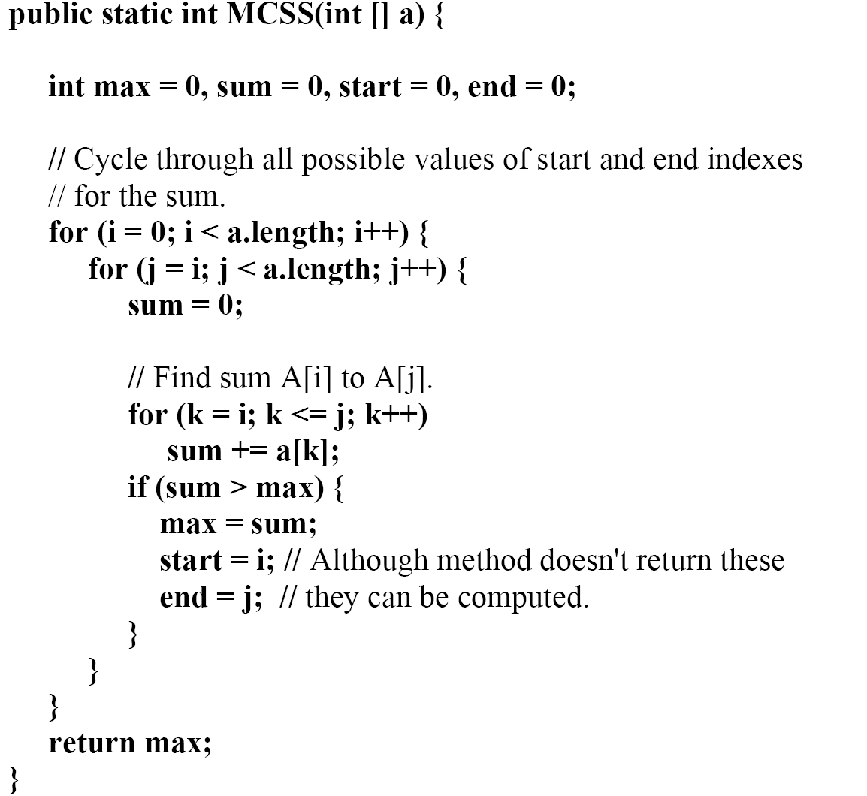
Brute-Force Approach

Slide 87
Dynamic-Programming Approach
(1) SMaxV(0) = 0
(2) MaxV(0) = 0
(3) for i=1 to n
(4) SMaxV(i) = max(SmaxV(i-1)+x_{i}, 0)
(5) MaxV(i) = max(MaxV(i-1), SMaxV(i))
(6) return MaxV(n)

