Slide 1
Hashing

Slide 2
Hashing
Hashing is a method for storing and accessing data. (often used in dictionaries where few deletions and few non-initial insertions and lots of finds)
It is a function which maps the data to be stored (or key to the data) to a memory location. This function is called a hash function and the storage is called a hash table.

Slide 3
Hashing
In an “ideal” situation the function maps each piece of data into a unique memory location.
  Given key k, if f(k) is i, the data is stored in memory location i.
  Then if we search for k we just look in i.
  When 2 pieces of data map into the same memory location it is called a collision.
In the ideal case if we have n pieces of data to store and m memory locations,
  It takes Θ(1) to find, insert, or delete some data.
  It takes Θ(m) to clear the table.

Slide 4

Hash Functions and Hash Tables
A hash function h maps keys of a given type to integers in a fixed interval [0, N − 1]
Example:
h(x) = x mod N
is a hash function for integer keys
The integer h(x) is called the hash value of key x
A hash table for a given key type consists of
  Hash function h
  Array (called table) of size N
When implementing a map with a hash table, the goal is to store item (k, o) at index i = h(k)

Slide 5
Example
We design a hash table for a map storing entries as (SSN, Name), where SSN (social security number) is a nine-digit positive integer
Our hash table uses an array of size N = 10,000 and the hash function
h(x) = last four digits of x
0
∅
1
025-612-0001
2
981-101-0002
3
∅
4
451-229-0004
…
9997
∅
9998
200-751-9998
9999
∅

Slide 6

Hash Functions
A hash function is usually specified as the composition of two functions:
Hash code:
h₁: keys → integers
Compression function:
h₂: integers → [0, N − 1]
The hash code is applied first, and the compression function is applied next on the result, i.e.,
h(x) = h₂(h₁(x))
The goal of the hash function is to “disperse” the keys in an apparently random way

Slide 7

Hash Codes
Memory address:
  We reinterpret the memory address of the key object as an integer
  Good in general, except for numeric and string keys
Integer cast:
  We reinterpret the bits of the key as an integer
  Suitable for keys of length less than or equal to the number of bits of the integer type (e.g., byte, short, int and float in C++)
Component sum:
  We partition the bits of the key into components of fixed length (e.g., 16 or 32 bits) and we sum the components (ignoring overflows)
  Suitable for numeric keys of fixed length greater than or equal to the number of bits of the integer type (e.g., long and double in C++)

Slide 8
Hash Codes (cont.)
Polynomial accumulation:
  We partition the bits of the key into a sequence of components of fixed length (e.g., 8, 16 or 32 bits)
  a₀ a₁ … a_{n−1}
  We evaluate the polynomial
  p(z) = a₀ + a₁ z + a₂ z² + …
  … + a_{n−1}z^{n−1}
  at a fixed value z, ignoring overflows
  Especially suitable for strings (e.g., the choice z = 33 gives at most 6 collisions on a set of 50,000 English words)
Polynomial p(z) can be evaluated in O(n) time using Horner’s rule:
  The following polynomials are successively computed, each from the previous one in O(1) time
  p₀(z) = a_{n−1}
  p_{i} (z) = a_{n−i−1} + zp_{i−1}(z)
  (i = 1, 2, …, n −1)
We have p(z) = p_{n−1}(z)

Slide 9

Compression Functions
Division:
  h₂ (y) = y mod N
  The size N of the hash table is usually chosen to be a prime
  The reason has to do with number theory and is beyond the scope of this course
Multiply, Add and Divide (MAD):
  h₂ (y) = (ay + b) mod N
  a and b are nonnegative integers such that
  a mod N ≠ 0
  Otherwise, every integer would map to the same value b

Slide 10
A Simple Function
If
  Hash(K) == K % M
What is wrong?
Suppose
  M = 10,
  K = 2, 20, 34, 42,76
Then K % M = 2, 0, 4, 2, 6,...
  Since 10 is even, all even K are hashed to even numbers ...

Slide 11
Yet Another Simple Function
If
  Hash(K) = K % P, with P a prime number
Suppose
  P = 11
  K = 10, 20, 30, 40
K % P = 10, 9, 8, 7
More uniform distribution…

Slide 12
Another Good Function
h(K) = ((a * K + b) mod p) mod M
is a yet better hash function. Here, a, b, and p are positive integers, p is a large prime, and p >> M. Now, the number M of buckets doesn’t need to be prime

Slide 13
Hashing a Sequence of Keys
K = {K₁, K₂, …, K_{n})
E.g., Hash(“test”) = 98157
Design Principles
  Use the entire key
  Use the ordering information
Notes:
The hash functions in this section take a sequence of integers k=k1,...,kn and produce a small integer bucket value h(k). m is the size of the hash table (number of buckets), which should be a prime number. The sequence of integers might be a list of integers or it might be an array of characters (a string).
The specific tuning of the following algorithms assumes that the integers are all, in fact, character codes. In C++, a character is a char variable which is an 8-bit integer. ASCII uses only 7 of these 8 bits. Of those 7, the common characters (alphabetic and number) use only the low-order 6 bits. And the first of those 6 bits primarily indicates the case of characters, which is relatively insignificant. So the following algorithms concentrate on preserving as much information as possible from the last 5 bits of each number, and make less use of the first 3 bits.
When using the following algorithms, the inputs ki must be unsigned integers. Feeding them signed integers may result in odd behavior.

Slide 14
Use the Entire Key
int Hash(const string & key, int tableSize) {
int hashVal = 0;
for (int j = 0; j < key.length(); j++) {
hashVal = hashVal + Key[j];
}
return hashVal % tableSize;
}
Problem: Hash(“ab”)==Hash(“ba”)

Slide 15
Better Hash Function
int Hash(const string & key, int tableSize) {
{
int hashVal = 0;
for (int i=0; i < key.length(); i++)
hashVal = 37 * hashVal + Key[i];
hashVal %= tableSize;
if (hashVal < 0)
hashVal += tableSize;
return hashVal
}

Slide 16
Designing a hash table
Hash function: establishing a key with an indexed location in a hash table.
  Index = hash(key) % table_size;
Resolve conflicts:
  Need to handle multiple keys that may be mapped to the same index.
  Two representative solutions
    Linear probe open addressing
    Chaining with separate lists.

Slide 17
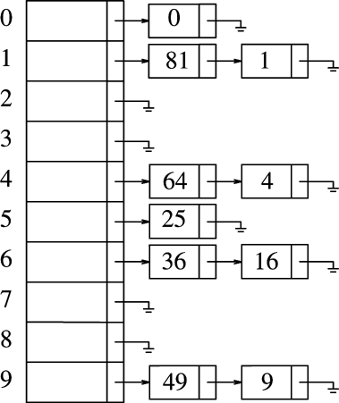
Separate Chaining
Each table entry stores a list of items
So we don’t need to worry about multiple keys mapped to the same entry.

Slide 18
Separate Chaining
Chains provide a good solution to collisions
Basically each bucket is a pointer to a list of all the keys that hash to that bucket.
To search for a key k, first compute the home bucket and then search along the chain.
To delete, first compute the home bucket and then search along the chain and then delete
It is less expensive to maintain the chains in descending order than in an unsorted way.

Slide 19
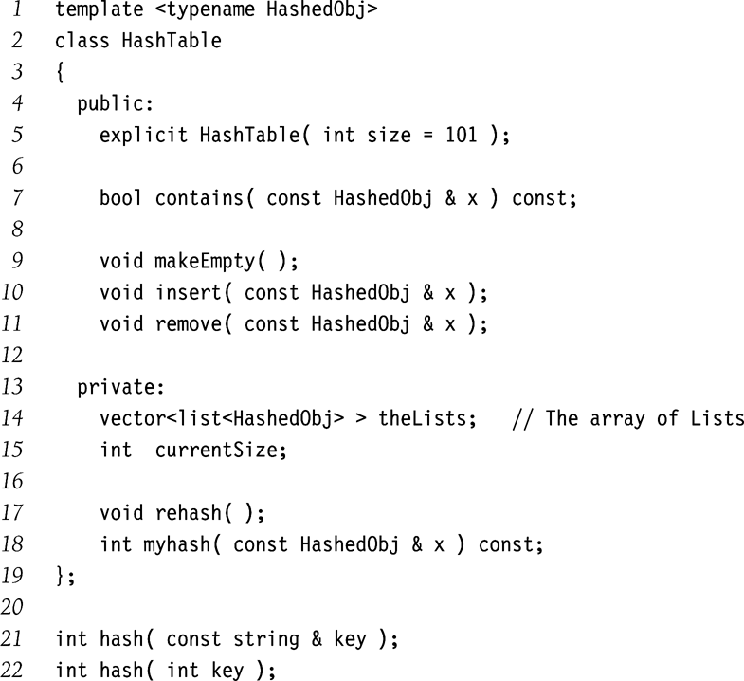
Separate Chaining (contd.)
Type Declaration for
Separate Chaining
Hash Table

Slide 20
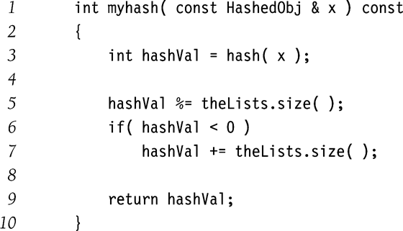
Separate Chaining (contd.)

Slide 21
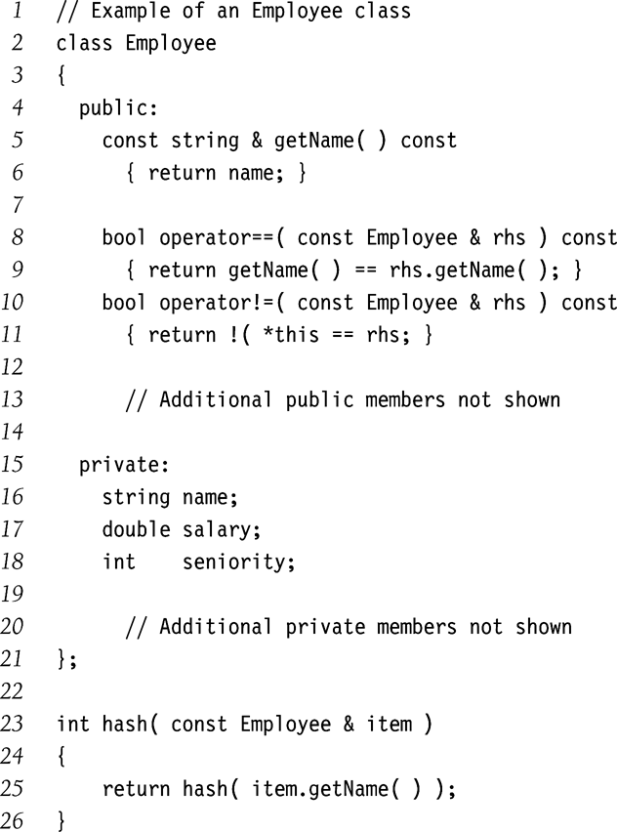
Separate Chaining (contd.)

Slide 22
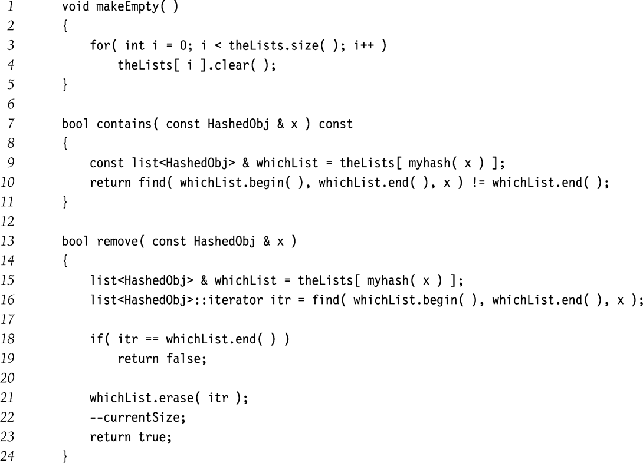
Separate Chaining (contd.)

Slide 23
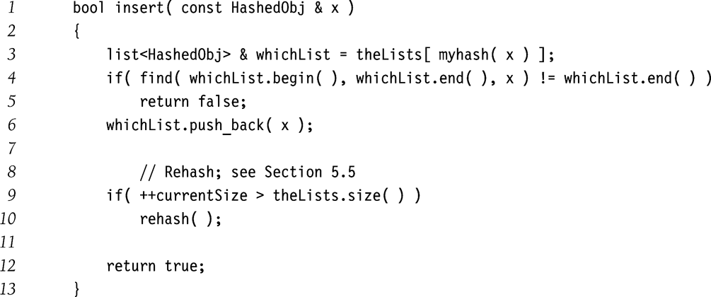
Separate Chaining (contd.)

Slide 24
Performance analysis of Chaining
the load factor, α = n/m, the ratio of the number of elements in the hash table to the table size.
The average length of a list is α .
An unsuccessful search, the number of nodes to examine is α .
A successful search requires that about 1+ α/2 links to be traversed.
Generally, the load factor should be around 1.0.

Slide 25
Hash Tables Without Chaining
Try to avoid buckets with separate lists
How ➔ use Probing Hash Tables
  If collision occurs, try another cell in the hash table.
  More formally, try cells h₀(x), h₁(x), h₂(x), h₃(x)… in succession until a free cell is found.
    h_{i}(x) = (hash(x) + f(i))
    And f(0) = 0
Generally, the load factor, α = n/m, should be below 0.5

Slide 26
Linear Probing: f(i) = i
Insert(k,x) // assume unique keys
  index = hash(key) % table_size;
  if (table[index]== NULL)
    table[index]=
    new key_value_pair(key, x);
  Else {
        index++;
        index = index % table_size;
        goto 2;
    }

Slide 27
Linear Probing: Search
Search (key)
  Index = hash(key) % table_size;
  If (table[index]==NULL)
  return –1; // Item not found
  Else if (table[index].key == key) return index;
  Else {
    Index ++;
    index = index % table_size;
    goto 2;
  }

Slide 28
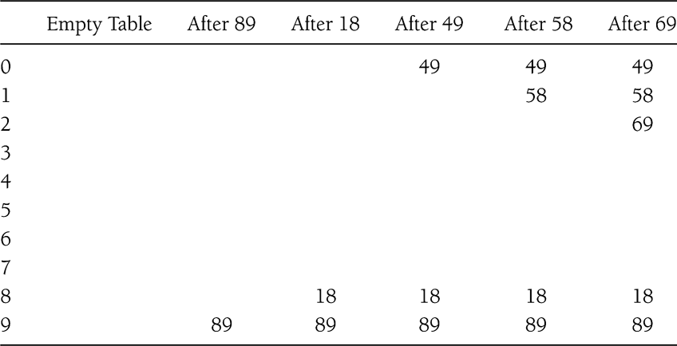
Linear Probing Example
Insert 89, 18, 49, 58, 69

Slide 29
Linear Probing: Delete
Can be tricky ...
How to maintain the consistency of the hash table
What is the simplest deletion strategy you can think of?

Slide 30
Performance Analysis
Worst Case insert and search time is Θ(n)
worst case happens when all keys hash to the same bucket
Let U_{n} be the average number of buckets examined during a unsuccessful search
Let S_{n} be the average number of buckets examined during a successful search
It can be shown that
U_{n} ≈ ½ [ 1 + 1/(1-α)²], S_{n} ≈ ½ [ 1 + 1/(1-α)],
Where α is n/m defined as the loading factor
When α = .5 ➔ U_{n}= 2.5 and S_{n} = 1.5
When α = .9 ➔ U_{n}= 50.5 and S_{n} = 5.5

Slide 31
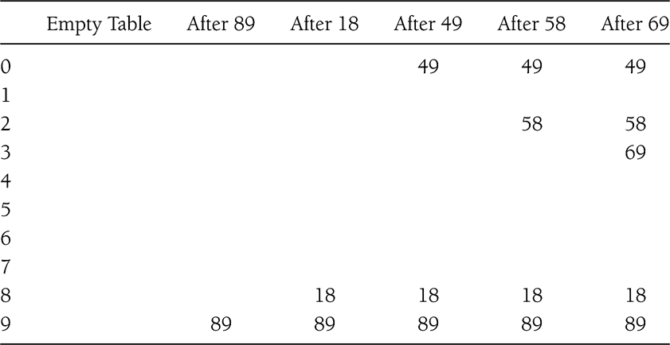
Quadratic Probing
f(i) = i²

Slide 32
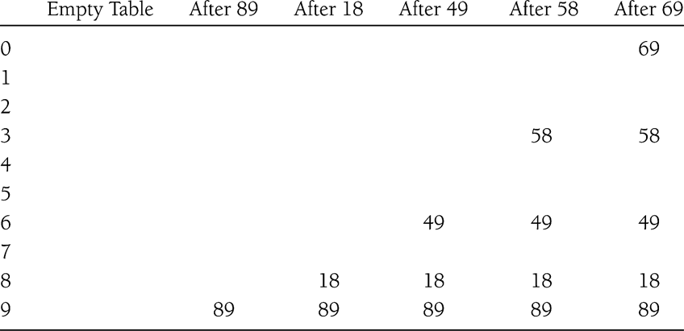
Double Hashing
f(i) = i*hash₂(x)
E.g.: hash₂(x) = 7 – (x % 7)
What if hash₂(x) == 0 for some x?

Slide 33
Rehashing
Hash Table may get full
  No more insertions possible
Hash table may get too full
  Insertions, deletions, search take longer time
Solution: Rehash
  Build another table that is twice as big and has a new hash function
  Move all elements from smaller table to bigger table
Cost of Rehashing = O(N)
  But happens only when table is close to full
  Close to full = table is X percent full, where X is a tunable parameter

Slide 34
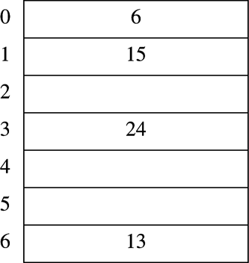
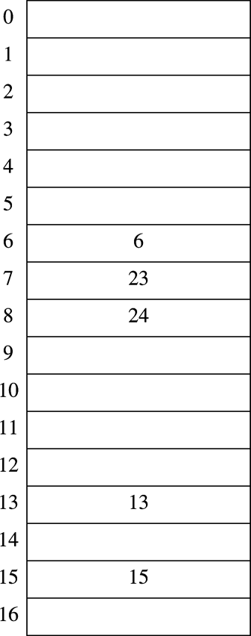
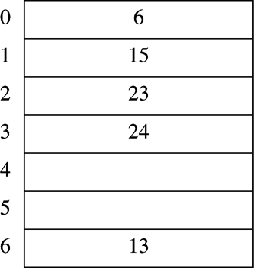
Rehashing Example
Original Hash Table
After Rehashing
After Inserting 23

Slide 35
Hash Table Sample Applications
Symbol table: used by compiler to keep track of declared variables in source code.
Transposition Table: used in game trees.
Spelling checkers: misspelling detection only.

