Slide 1
B/B+ Trees

Slide 2
Motivation
When data is too large to fit in main memory, then the number of disk accesses becomes important.
A disk access is unbelievably expensive compared to a typical computer instruction.
One disk access is equivalent to 200,000 or more instructions.
The number of disk accesses will dominate the running time.

Slide 3
Motivation (cont.)
Secondary memory (disk) is divided into equal-sized blocks (typical sizes are 512, 2048, 4096 or 8192 bytes).
The basic I/O operation transfers the contents of one disk block to/from main memory.
Goal is to devise a multiway search tree that will minimize file accesses (by exploiting disk block read).

Slide 4
Motivation (cont.)
Assume that we use an AVL tree to store about 20 million records
We end up with a very deep binary tree with lots of different disk accesses; log₂ 20,000,000 is about 24, so this takes about 0.2 seconds
We know we can’t improve on the log n lower bound on search for a binary tree
But, the solution is to use more branches and thus reduce the height of the tree!
As branching increases, depth decreases

Slide 5
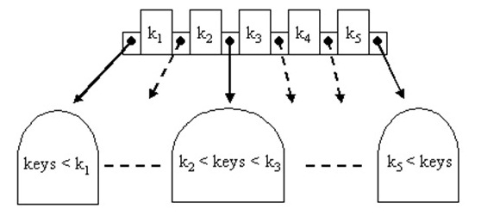
Multiway Search Trees (of order m)
A generalization of binary search trees
Each node has at most m children
If k<= m is the number of children, then the node has exactly k-1 keys
the number of keys in each non-leaf node is one less than the number of its children and these keys partition the keys in the children in the fashion of a search tree
The tree is ordered

Slide 6
Definition of a B-Tree
A B-tree of order m is an m-way tree such that
All leaves are on the same level
a leaf node contains no more than m – 1 keys
All internal nodes except the root are constrained to have at most m non-empty children and at least m/2 non-empty children
all non-leaf nodes except the root have at least ⎡m / 2⎤ children
The root has at most m non-empty children
either a leaf node, or it has from two to m children
The number m is usually odd

Slide 7
Traversing Very Large Datasets
Suppose we had very many pieces of data (as in a database), e.g., n = 2³⁰ ≈ 10⁹.
How many (worst case) hops through the tree to find a node?
BST 10⁹
AVL log 10⁹ = 1.44 log₂ 10⁹ = 43
Splay 10⁹

Slide 8
Memory Considerations
What is in a tree node? In an object?
Node:
Object obj;
Node left;
Node right;
Node parent;
Object:
Key key;
…data…
Suppose the data is 1KB.
How much space does the tree take? 1TB
How much of the data can live in 1GB of RAM? 0.1%

Slide 9
Memory Hierarchy
Processor
Secondary Storage (HHD)
Core
L2 Cache
Registers
L1 Cache
Secondary Storage (SSD)
Main
Memory
(DRAM)
Core
L3 Cache (shared)
Registers
L1 Cache
L2 Cache
Speed (ns):
0.3
1
3
10-30
100
100,000 (0.1 ms)
10,000,000
(10 ms)
Size (bytes):
100Bs
10kBs
100kBs
MBs
GBs
100GBs
TBs

Slide 10
Minimizing Random Disk Access
In our example, almost all of our data structure is on disk.
Thus, hopping through a tree amounts to random accesses to disk. Ouch!
How can this problem be addressed?
Decrease depth with big “fanout”
Array storage of children
Store keys in nodes

Slide 11

M-ary Search Tree
Suppose, somehow, devise a search tree with maximum branching factor M:
Complete tree has height O(log_{m} n)
# hops for find for arbitrary tree
worst: O(n)
balanced: O(log_{M} n)
Runtime of find worst: O(n)
balanced: O(log_{M} n)

Slide 12
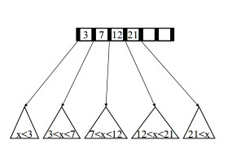
B-Trees
How do we make an M-ary search tree work?
• Each node has (up to) M-1 keys.
• Order property:
– subtree between two keys x and y
contain leaves with values v M = 7
such that x < v < y

Slide 13
B-Tree Structure Properties
Root (special case)
– has between 2 and M children (or root could be a leaf)
Internal nodes
– store up to M-1 keys
– have between ⎡M/2⎤ and M children
Leaf nodes
– store between ⎡(M-1)/2⎤ and M-1 sorted keys
– all at the same depth

Slide 14
B-Tree Example
26
A B-tree of order 5 containing 26 items
6
12
42
51
62
1
2
4
7
8
13
15
18
25
27
29
45
46
48
53
55
60
64
70
90
Note that all the leaves are at the same level

Slide 15
Constructing a B-tree
Suppose we start with an empty B-tree and keys arrive in the following order:1 12 8 2 25 5 14 28 17 7 52 16 48 68 3 26 29 53 55 45
We want to construct a B-tree of order 5
The first four items go into the root:
To put the fifth item in the root would violate condition 5
Therefore, when 25 arrives, pick the middle key to make a new root
1
2
8
12

Slide 16
Constructing a B-tree
8
1
2
12
25
6, 14, 28 get added to the leaf nodes:
8
1
2
6
12
14
25
28

Slide 17
Constructing a B-tree
Adding 17 to the right leaf node would over-fill it, so we take the middle key, promote it (to the root) and split the leaf
8
17
1
2
6
12
14
25
28
7, 52, 16, 48 get added to the leaf nodes
8
17
1
2
6
7
12
14
16
25
28
48
52

Slide 18
Constructing a B-tree (contd.)
Adding 68 causes us to split the right most leaf, promoting 48 to the root, and adding 3 causes us to split the left most leaf, promoting 3 to the root; 26, 29, 53, 55 then go into the leaves
3
8
17
48
1
2
6
7
12
14
16
25
26
28
29
52
53
55
68
Adding 45 causes a split of
25
26
28
29
and promoting 28 to the root then causes the root to split

Slide 19
Constructing a B-tree
17
3
8
28
48
1
2
6
7
12
14
16
25
26
29
45
52
53
55
68

Slide 20
Inserting into a B-Tree
Attempt to insert the new key into a leaf
If this would result in that leaf becoming too big, split the leaf into two, promoting the middle key to the leaf’s parent
If this would result in the parent becoming too big, split the parent into two, promoting the middle key
This strategy might have to be repeated all the way to the top
If necessary, the root is split in two and the middle key is promoted to a new root, making the tree one level higher

Slide 21
Removal from a B-tree
During insertion, the key always goes into a leaf. For deletion we wish to remove from a leaf. There are three possible ways we can do this:
1 - If the key is already in a leaf node, and removing it doesn’t cause that leaf node to have too few keys, then simply remove the key to be deleted.
2 - If the key is not in a leaf then it is guaranteed (by the nature of a B-tree) that its predecessor or successor will be in a leaf -- in this case we can delete the key and promote the predecessor or successor key to the non-leaf deleted key’s position.

Slide 22
Removal from a B-tree
If (1) or (2) lead to a leaf node containing less than the minimum number of keys then we have to look at the siblings immediately adjacent to the leaf in question:
3: if one of them has more than the min. number of keys then we can promote one of its keys to the parent and take the parent key into our lacking leaf
4: if neither of them has more than the min. number of keys then the lacking leaf and one of its neighbours can be combined with their shared parent (the opposite of promoting a key) and the new leaf will have the correct number of keys; if this step leave the parent with too few keys then we repeat the process up to the root itself, if required

Slide 23
Type #1: Simple leaf deletion
Assuming a 5-way
B-Tree, as before...
12
29
52
2
7
9
15
22
31
43
56
69
72
Delete 2: Since there are enough
keys in the node, just delete it
Note when printed: this slide is animated

Slide 24
Type #2: Simple non-leaf deletion
12
29
52
56
Delete 52
7
9
15
22
31
43
56
69
72
Borrow the predecessor
or (in this case) successor
Note when printed: this slide is animated

Slide 25
Type #3: Enough siblings
12
29
Demote root key and
promote leaf key
7
9
15
22
31
43
56
69
Delete 22
Note when printed: this slide is animated

Slide 26
Type #3: Enough siblings
12
31
7
9
15
29
43
56
69
Note when printed: this slide is animated

Slide 27
Type #4: Too few keys in node and its siblings
12
29
56
Join back together
7
9
15
22
31
43
69
72
Too few keys!
Delete 72
Note when printed: this slide is animated

Slide 28
Type #4: Too few keys in node and its siblings
12
29
7
9
15
22
31
43
56
69
Note when printed: this slide is animated

Slide 29
Analysis of B-Trees
The maximum number of items in a B-tree of order m and height h:
root m – 1
level 1 m(m – 1)
level 2 m²(m – 1)
. . .
level h m^{h}(m – 1)
So, the total number of items is (1 + m + m² + m³ + … + m^{h})(m – 1) = [(m^{h+1} – 1)/ (m – 1)] (m – 1) = m^{h+1} – 1
When m = 5 and h = 2 this gives 5³ – 1 = 124

Slide 30
Reasons for using B-Trees
When searching tables held on disc, the cost of each disc transfer is high but doesn't depend much on the amount of data transferred, especially if consecutive items are transferred
If we use a B-tree of order 101, say, we can transfer each node in one disc read operation
A B-tree of order 101 and height 3 can hold 101⁴ – 1 items (approximately 100 million) and any item can be accessed with 3 disc reads (assuming we hold the root in memory)

Slide 31
Comparing Trees
Binary trees
Can become unbalanced and lose their good time complexity (big O)
AVL trees are strict binary trees that overcome the balance problem
Heaps remain balanced but only prioritise (not order) the keys
Multi-way trees
B-Trees can be m-way, they can have any (odd) number of children
One B-Tree, the 2-3 (or 3-way) B-Tree, approximates a permanently balanced binary tree, exchanging the AVL tree’s balancing operations for insertion and (more complex) deletion operations

Slide 32
What is a B+ Tree?
A variation of B trees in which
internal nodes contain only search keys (no data)
Leaf nodes contain pointers to data records
Data records are in sorted order by the search key
All leaves are at the same depth
The properties of B+Trees are a bit more complex than previous tree structures looked at.
The maximum branching factor is M (tunable for a given tree).
The root has between 2 and M children or at most L keys. (L is another parameter)
These restrictions will be different for the root than for other nodes.

Slide 33
Definition of a B+Tree
A B+ tree is a balanced tree in which every path from the root of the tree to a leaf is of the same length, and each non-leaf node of the tree has between [M/2] and [M] children, where m is fixed for a particular tree.

Slide 34
B+ Tree Nodes
Internal node
Pointer (Key, NodePointer)*M-1 in each node
First i keys are currently in use
k₀
k₁
…
k_{i-1}
__
…
__
0
1
i-1
M - 2
Leaf
(Key, DataPointer)* L in each node
first j Keys currently in use
k₀
k₁
…
k_{j-1}
__
…
__
0
1
L-1
Data for k₀
Data for k₂
Data for k_{j-1}

Slide 35
B+ Tree Nodes
Internal nodes are arrays of pointers to children interspersed with search keys.
Why must they be arrays rather than linked lists?
Because want contiguous memory!
If the node has just I+1 children, it has I search keys, and M-I empty entries.
A leaf looks similar and has similar properties. Often, leaf nodes linked together
Why are these different?
Because internal nodes need subtrees-1 keys.

Slide 36
Advantages of B+ tree usage for databases
keeps keys in sorted order for sequential traversing
uses a hierarchical index to minimize the number of disk reads
uses partially full blocks to speed insertions and deletions
keeps the index balanced with a recursive algorithm
In addition, a B+ tree minimizes waste by making sure the interior nodes are at least half full. A B+ tree can handle an arbitrary number of insertions and deletions.

Slide 37
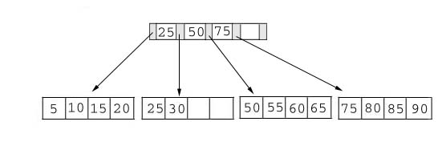
Searching
Just compare the key value with the data in the tree, then return the result.
For example: find the value 45, and 15 in below tree.
1. For the value of 45, not found.
2. For the value of 15, return the position where the pointer located.

Slide 38
Insertion
inserting a value into a B+ tree may unbalance the tree, so rearrange the tree if needed.
Example #1: insert 28 into the below tree.
25 28 30
Fits inside the leaf

Slide 39
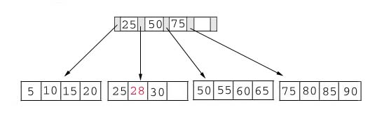
Insertion
Result:

Slide 40
Insertion
Example #2: insert 70 into below tree

Slide 41
Insertion
Process: split the leaf and propagate middle key up the tree
50 55 60 65 70
Does not fit inside the leaf
50 55
60 65 70

Slide 42
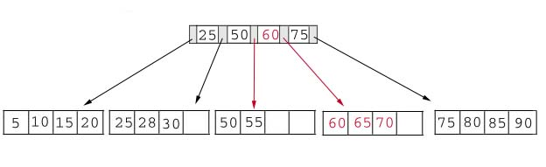
Insertion
Result: chose the middle key 60, and place it in the index page between 50 and 75.

Slide 43
Insertion
The insert algorithm for B+ Tree
Leaf Node Full | Index Node Full | Action
NO | NO | Place the record in sorted position in the appropriate leaf page
YES | NO | Split the leaf node Place Middle Key in the index node in sorted order. Left leaf node contains records with keys below the middle key. Right leaf node contains records with keys equal to or greater than the middle key.
YES | YES | Split the leaf node. Records with keys < middle key go to the left leaf node. Records with keys >= middle key go to the right leaf node. Split the index node. Keys < middle key go to the left index node. Keys > middle key go to the right index node. The middle key goes to the next (higher level) index node. IF the next level index node is full, continue splitting the index nodes.

Slide 44
Insertion
Exercise: add a key value 95 to the below tree.
Add 95 to 75, 80, 85, 90; node full. Split into: 75, 80 and 85, 90 95. Propagate middle value (85) to parent.
Parent is full with 25, 50, 60, 75. Split into 25, 50 and 60, 75, 85. Propagate middle value (60) up the tree.
75 80 85 90 95
Leaf node full, split the leaf.
75 80
85 90 95
25 50 60 75 85

Slide 45
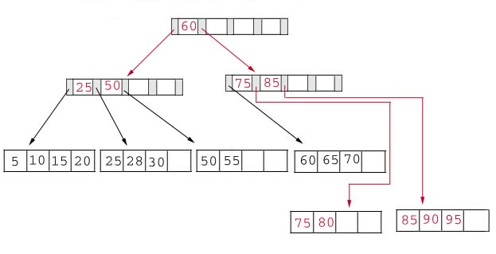
Insertion
Result: again put the middle key 60 to the index page and rearrange the tree.
B+ Trees grow UP from the bottom

Slide 46
Deletion
Same as insertion, the tree has to be rebuild if the deletion result violate the rule of B+ tree.
Example #1: delete 70 from the tree
OK. Node >=50% full
60 65

Slide 47
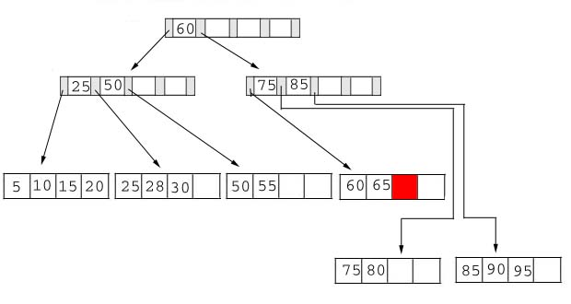
Deletion
Result: Locate it in the leaf node. Delete it. Node is still >= 50% full, all done.

Slide 48
Deletion
Example: delete 25 from below tree, but 25 appears in the index page.
Locate 25 in leaf. Delete it. Node still >= 50% full so okay.
BUT, 25 was used in index node…. Propagate smallest value in leaf node (28) up the tree to replace it.
But…
28 30
This is OK.

Slide 49
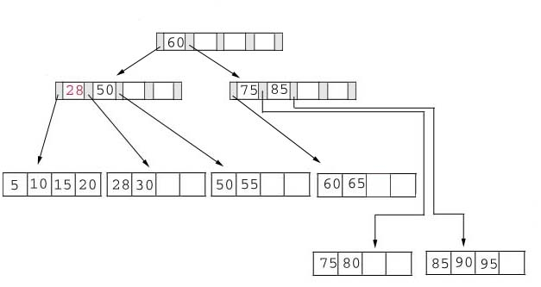
Deletion
Result: replace 28 in the index page.
Add 28

Slide 50
Deletion
Example: delete 60
Locate 60 in leaf node Delete it. Leaf now < 50% full.
Neighbor at most 50% full, so merge with neighbor to the right. Guaranteed to fit.
65
Less than 50% full
50 55 65

Slide 51
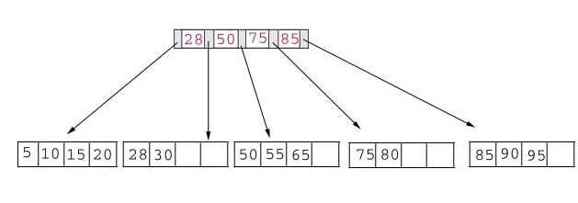
Deletion
Result: delete 60 from the index page and combine the rest of index pages.

Slide 52
Deletion
Delete algorithm for B+ trees
Data Page Below Fill Factor | Index Page Below Fill Factor | Action
NO | NO | Delete the record from the leaf page. Arrange keys in ascending order to fill void. If the key of the deleted record appears in the index page, use the next key to replace it.
YES | NO | Combine the leaf page and its sibling. Change the index page to reflect the change.
YES | YES | Combine the leaf page and its sibling. Adjust the index page to reflect the change. Combine the index page with its sibling. Continue combining index pages until you reach a page with the correct fill factor or you reach the root page.

Slide 53
Conclusion
For a B+ Tree:
It is “easy” to maintain its balance
Insert/Deletion complexity O(log_{M/2}N)
The searching time is shorter than most of other types of trees because branching factor is high
Try it https://www.cs.usfca.edu/~galles/visualization/BPlusTree.html

Slide 54
B+Trees and DBMS
Used to index primary keys
Can access records in O(log_{M/2}N) traversals (height of the tree)
Interior nodes contain Keys only
Set node sizes so that the M-1 keys and M pointers fits inside a single block on disk
E.g., block size 4096B, keys 10B, pointers 8 bytes
(8+ (10+8)*M-1) = 4096
M = 228; 2.7 billion nodes in 4 levels
One block read per node visited

