Slide 1
IMSE/CIS 381
INDUSTRIAL ROBOTS
IMSE381
Notes:
IMSE 381
E. ORADY

Slide 2
INDUSTRILAL ROBOTS
Definition
  Webster Definition
    An Automatic apparatus or device that performs functions ordinarily ascribed to humans or operators with what appears almost human intelligence
  Robotic Industries Association (RIA) Definition
    A robot is a reprogrammable, multifunctional manipulator designed to move materials, parts, tools, or specialized devices through variable programmed motion for the performance of a variety of tasks.
IMSE381
Notes:
IMSE 381
E. ORADY

Slide 3
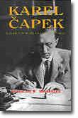
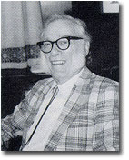
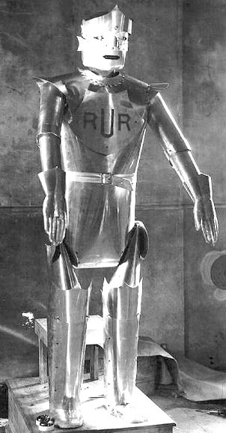
Historical Perspective of Robots
In 1921: The word “Robot” used by Czech playwriter Karel Capek in the Drama entitled R.U.R (Rossum’s Universal Robot).
Word Robotics introduced by Isaac Asimov in his short story “Runaround” in 1942
  Asimov three rules:
    1. A robot may not injure a human being, or, through inaction, allow one to come to harm
    2. A robot must obey the orders given by human beings except where such orders would conflict with the First Law
    3. A robot must protect its own existence as long as such protection does not conflict with the First and Second Law.
IMSE381
Notes:
IMSE 381
E. ORADY

Slide 4
Historical Perspective of Robots
History of programmed machines: Appeared in the 18th century
  Joseph Jacquard developed the mechanical loom controlled by punched cards in 1801.
  Jointed mechanical arm was first developed in 1938 by Willard Pollard. The arm was utilized primarily in paint spray.
  Teleoperator or telecheric was developed during World War II to handle radioactive materials in nuclear reactors.
IMSE381
Notes:
IMSE 381
E. ORADY

Slide 5
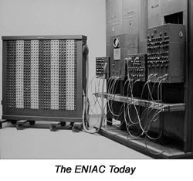
Historical Perspective of Robots
  In 1946, George Devol {father of the robot industry}, developed the magnetic controller
  In 1946, Eckert and Mauchly built ENIAC, the first large-scale electronic computer, and at the MIT the general purpose computer “Whirlwind” solved its first problem.
  In 1947, the servoed electric-powered teleoperator was introduced by R. Goertz
  In 1952, the first NC machine was developed
  in MIT.
IMSE381
Notes:
IMSE 381
E. ORADY

Slide 6
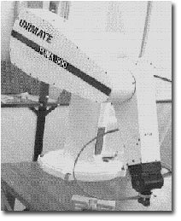
Historical Perspective of Robots
Beginning of the Recent robot History
  In 1954, George Devol patented first manipulator with a playback memory. It was a point-to-point arm. It is named “universal automation”
  In 1959, the first commercial robot was sold by the Planet Corporation.
  In 1960, Unimation, Inc produced the Unimate robot which combines the feature of NC and the Servoed telecherics.
https://vimeo.com/23372660
IMSE381
Notes:
IMSE 381
E. ORADY

Slide 7
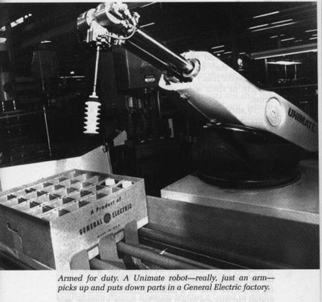
Historical Perspective of Robots
  In 1962, GE installed the first Unimate robot in its assembly line in die-casting applications.
  In mid 1960’s, several centers of research concentrated in developing robots:
    MIT
    Stanford University
    University of Edinburgh in Scotland
IMSE381
Notes:
IMSE 381
E. ORADY

Slide 8
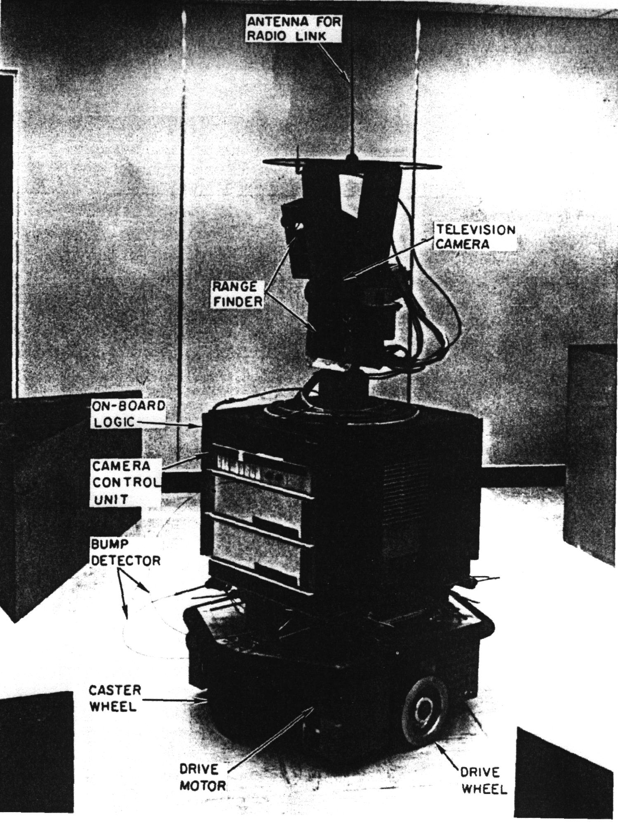
Historical Perspective of Robots
Source: Klafter, Chmielewski, and Negin
Stanford Research Institute (SRI) Robot (1968)
  First successful mobile robot
  Has a vision systems using TV camera
  An optical range finder
  Touch sensor
  Understand English
  Jerky motion
Stanford Robot, A wheeled, nonautonomous robot
developed in 1968 by Stanford Research Institute
IMSE381
Notes:
IMSE 381
E. ORADY

Slide 9
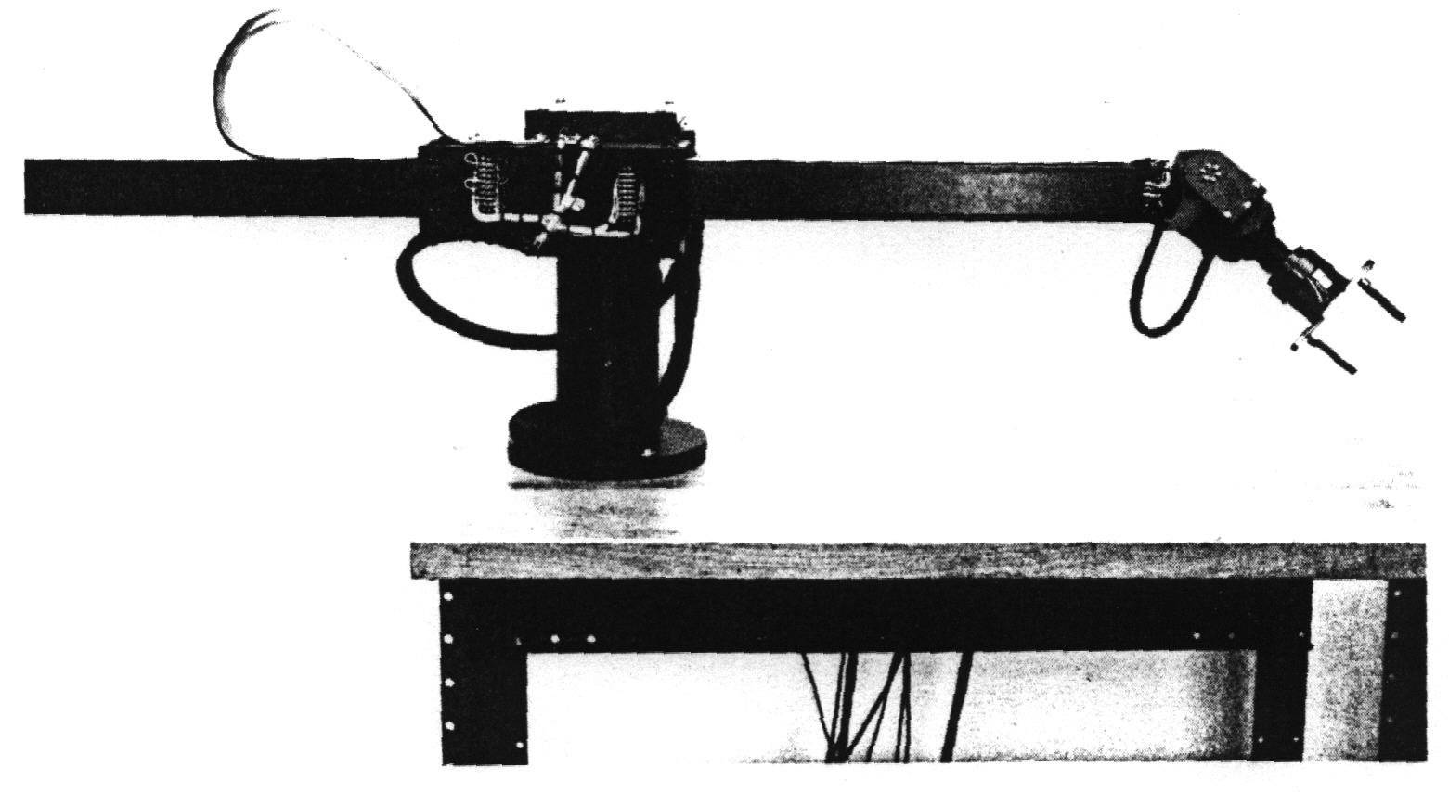
Historical Perspective of Robots
Source: Klafter, Chmielewski, and Negin
Scheinman or Stanford Arm
  Developed in 1970
  Computer controlled with servomotors
  Six-axis device
  Sophisticated and complex
Stanford Arm - A 6-axis electrically actuated robot
(Courtesy of Dr. A. K. Bejczy and Jet Propulsion Lab.,
Pasadena, CA)
IMSE381
Notes:
IMSE 381
E. ORADY

Slide 10
Historical Perspective of Robots
In 1973, Cincinnati Milacron introduce T³ robot
  Designed by Richard Hohn
  Hydraulically actuated
  Can lift payloads of up 100 lb.
In 1976, NASA introduced Viking 1 and 2 landers (used to collect samples on Mars).
In 1976, First microprocessor controlled robot was developed by Vicram.
In 1976, MIT Draper Lab developed RCC (Remote-Centered Compliance) wrist.
1977, worktable vision system was developed by SRI
IMSE381
Notes:
IMSE 381
E. ORADY

Slide 11
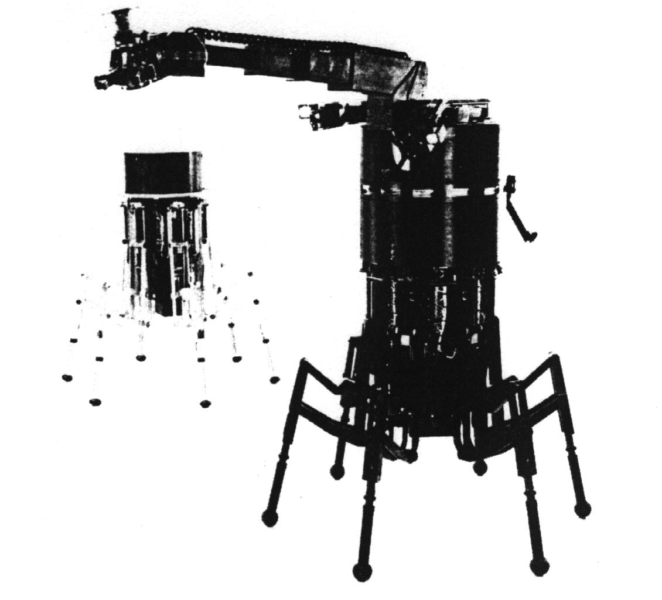
Historical Perspective of Robots
PUMA (Programmable Universal Machine) robot was developed Unimation. A five axis machine used in assembly by GM.
In 1983, Odetics, Inc. Introduce the similar to human ODEX experimental robot. ODEX II is a second generation.
6-axis arm
Hexapod legs
ODEX II: A human like robot used in nuclear power
plants, developed by Odetics, Inc. (courtesy of
Odetics, Inc. Anaheim, CA.)
Source: Klafter, Chmielewski, and Negin
IMSE381
Notes:
IMSE 381
E. ORADY
ODEX II is called Robin
Capable of lifting loads up to 5.6 times its weight
Can Change geometry to move through doorways or passageways
Has 6-axis manipulator

Slide 12
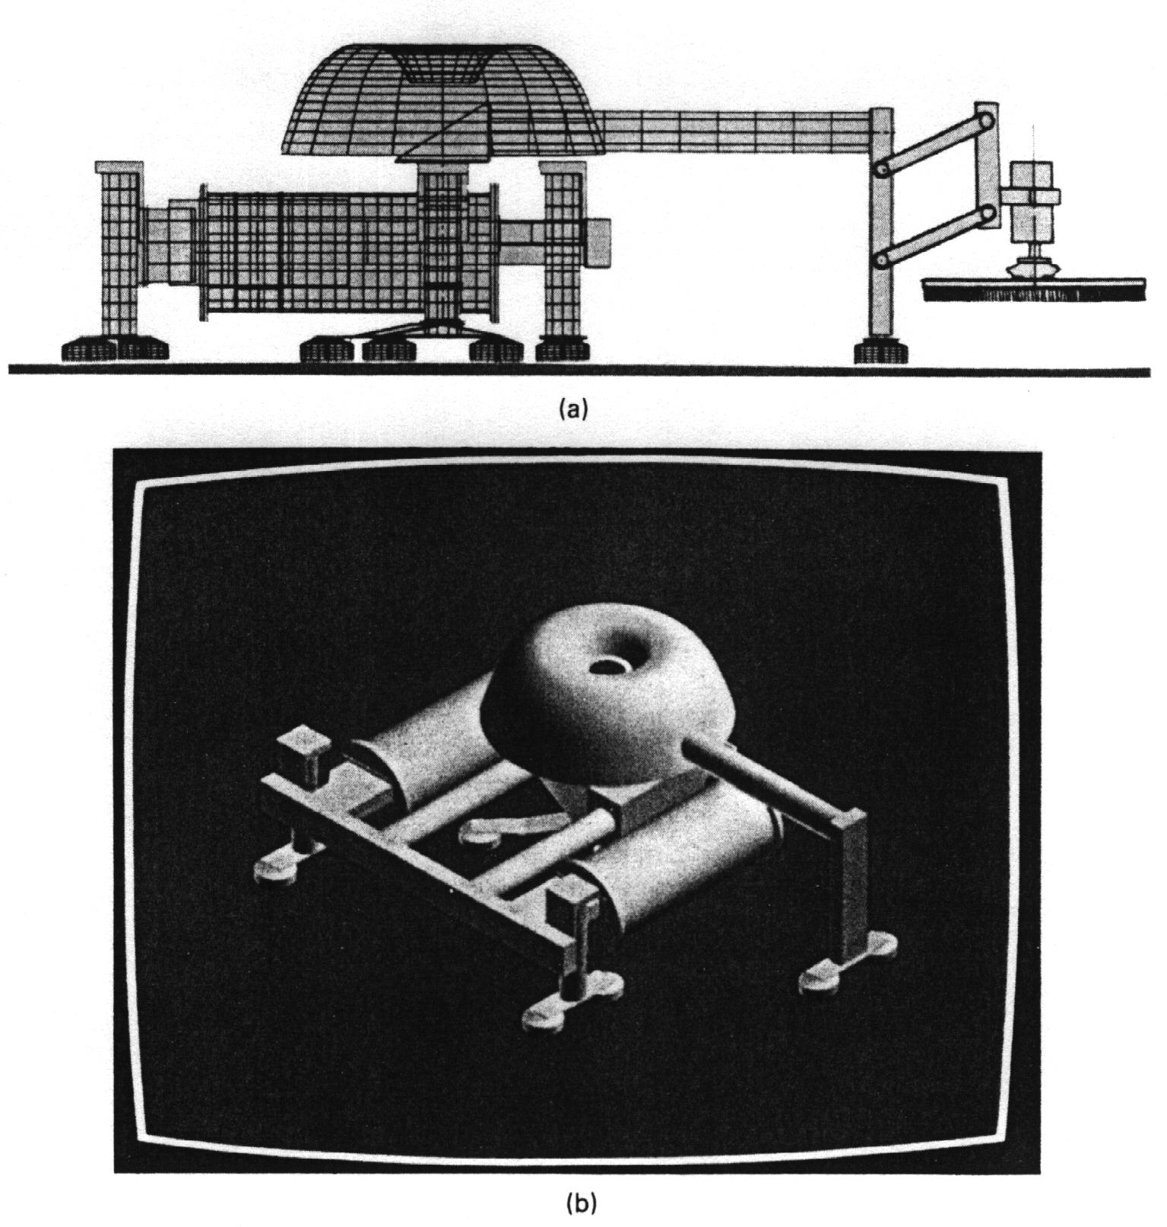
Historical Perspective of Robots
Source: Klafter, Chmielewski, and Negin
Wire drawing
In 1984, a French ship building company introduce the first successful marine robot. The robot was designed to clean the sides and bottoms of large ships. The device then used by Renault to paint the walls of large tanks.
Solid Model
RMS Marine Robot
(Courtesy of P. Kroczinski, Industrial Robot
Technologies, Inc, Marina del Rey, CA)
IMSE381
Notes:
IMSE 381
E. ORADY
* An amphibious mobile device consisting of three legs arm that can walk
* Can walk at 150 meters/hour
* Used to clean the hulls of ships both above and below water.

Slide 13
Historical Perspective of Robots
Japanese industry started to manufacture robot based on a license from Unimation and produced the first industrial robot in 1968.
Robots now used in a lot of applications in industry.
IMSE381
Notes:
IMSE 381
E. ORADY

Slide 14
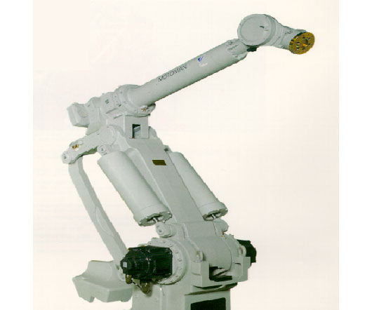
The MOTOMAN-SK120 robot, with a payload of 120kg, is best suited for material handing and spot welding applications.
Handling and spot welding require speed, ruggedness, and a large work envelope. The SK120 meets all of these requirements. The SK120 is designed for easy operation and maintenance.
IMSE381
Notes:
IMSE 381
E. ORADY

Slide 15
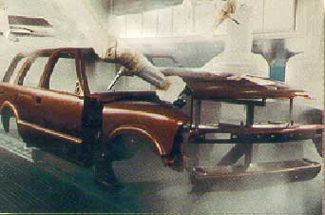
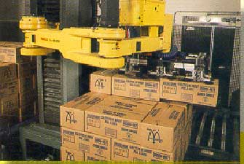
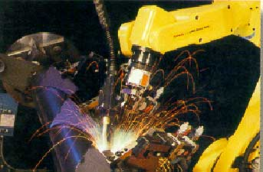
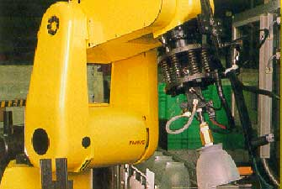
FANUC Robotics
IMSE381
Notes:
IMSE 381
E. ORADY

Slide 16
Automation
Automation is the technology concerned with the application of complex mechanical, electronic, and computer-based systems in the operation and control of production.
Three Basic Types
  Fixed automation
  Programmable automation
  Flexible automation
IMSE381
Notes:
IMSE 381
E. ORADY

Slide 17
Fixed Automation
Fixed automation is a system in which the sequence of processing is fixed by equipment configuration.
The operations are usually simple.
It is based on the integration and coordination of many simple operations into one piece of equipment, which makes the system complex.
Examples
  Transfer lines
  Mechanized assembly lines.
IMSE381
Notes:
IMSE 381
E. ORADY

Slide 18
Features of Fixed Automation
High initial cost
High production rate
Relatively inflexible in accommodating product changes
High volume of production
Few product variety.
IMSE381
Notes:
IMSE 381
E. ORADY

Slide 19
Programmable Automation
The equipment are designed to be flexible to change sequence of operation by changing the program instruction
Examples
  Computer Numerical Control Machines (CNC)
  Robotics
IMSE381
Notes:
IMSE 381
E. ORADY

Slide 20
Features of Programmable Automation
High investment in general purpose equipment
Low production rate relative to fixed automation
Flexibility makes it suitable for low volume batch production
Suitable for low volume and high variety
IMSE381
Notes:
IMSE 381
E. ORADY

Slide 21
Flexible Automation
It is an extension of programmable automation with the exception that different products can be made at the same time in the same system
Examples
  Flexible machining systems.
  Flexible assembly systems.
IMSE381
Notes:
IMSE 381
E. ORADY

Slide 22
Features of Flexible Automation
High investment for custom-engineering system
Continuous production of variable mixture product
Flexibility to deal with product design variations
Capable to change part programs with no lost production line
Capable to change over set up with no lost time
IMSE381
Notes:
IMSE 381
E. ORADY

