Slide 1
Industrial Applications of Robots
IMSE/CIS 381
Industrial Robots
Robot Industrial Applications

Slide 2
Robots’ Applications
General application characteristics
  Hazardous or uncomfortable working condition
  Repetitive tasks
  Difficult handling
  Multishift Operations
Selection of right application
  Ideal applications should possess the four characteristics described above
  Economic criteria like any other investment
  Application should be simple, particularly in first application
Robot Industrial Applications

Slide 3
Industrial Application of Robots
1. Material transfer and machine loading/unloading
  • Metal machining operations
  • Die casting
  • Plastic molding
  • Certain forging operations
2. Processing operations
  • Spot welding
  • Arc welding
  • Spray painting
  • Certain machining operations
3. Assembly and inspection operations
Robot Industrial Applications

Slide 4
Material Handling Operations
Can be divided into two specific categories:
1. Material transfer applications
2. Machine loading/unloading operations
    1. Part positioning and orientation
    2. Gripper design
    3. Minimum distance moved
    4. Robot work volume
    5. Robot weight capacity
    6. Accuracy and repeatability
    7. Robot configuration, degrees of freedom, and control
    8. Machine utilization problems
General Considerations in Robot Material Handling
Robot Industrial Applications

Slide 5
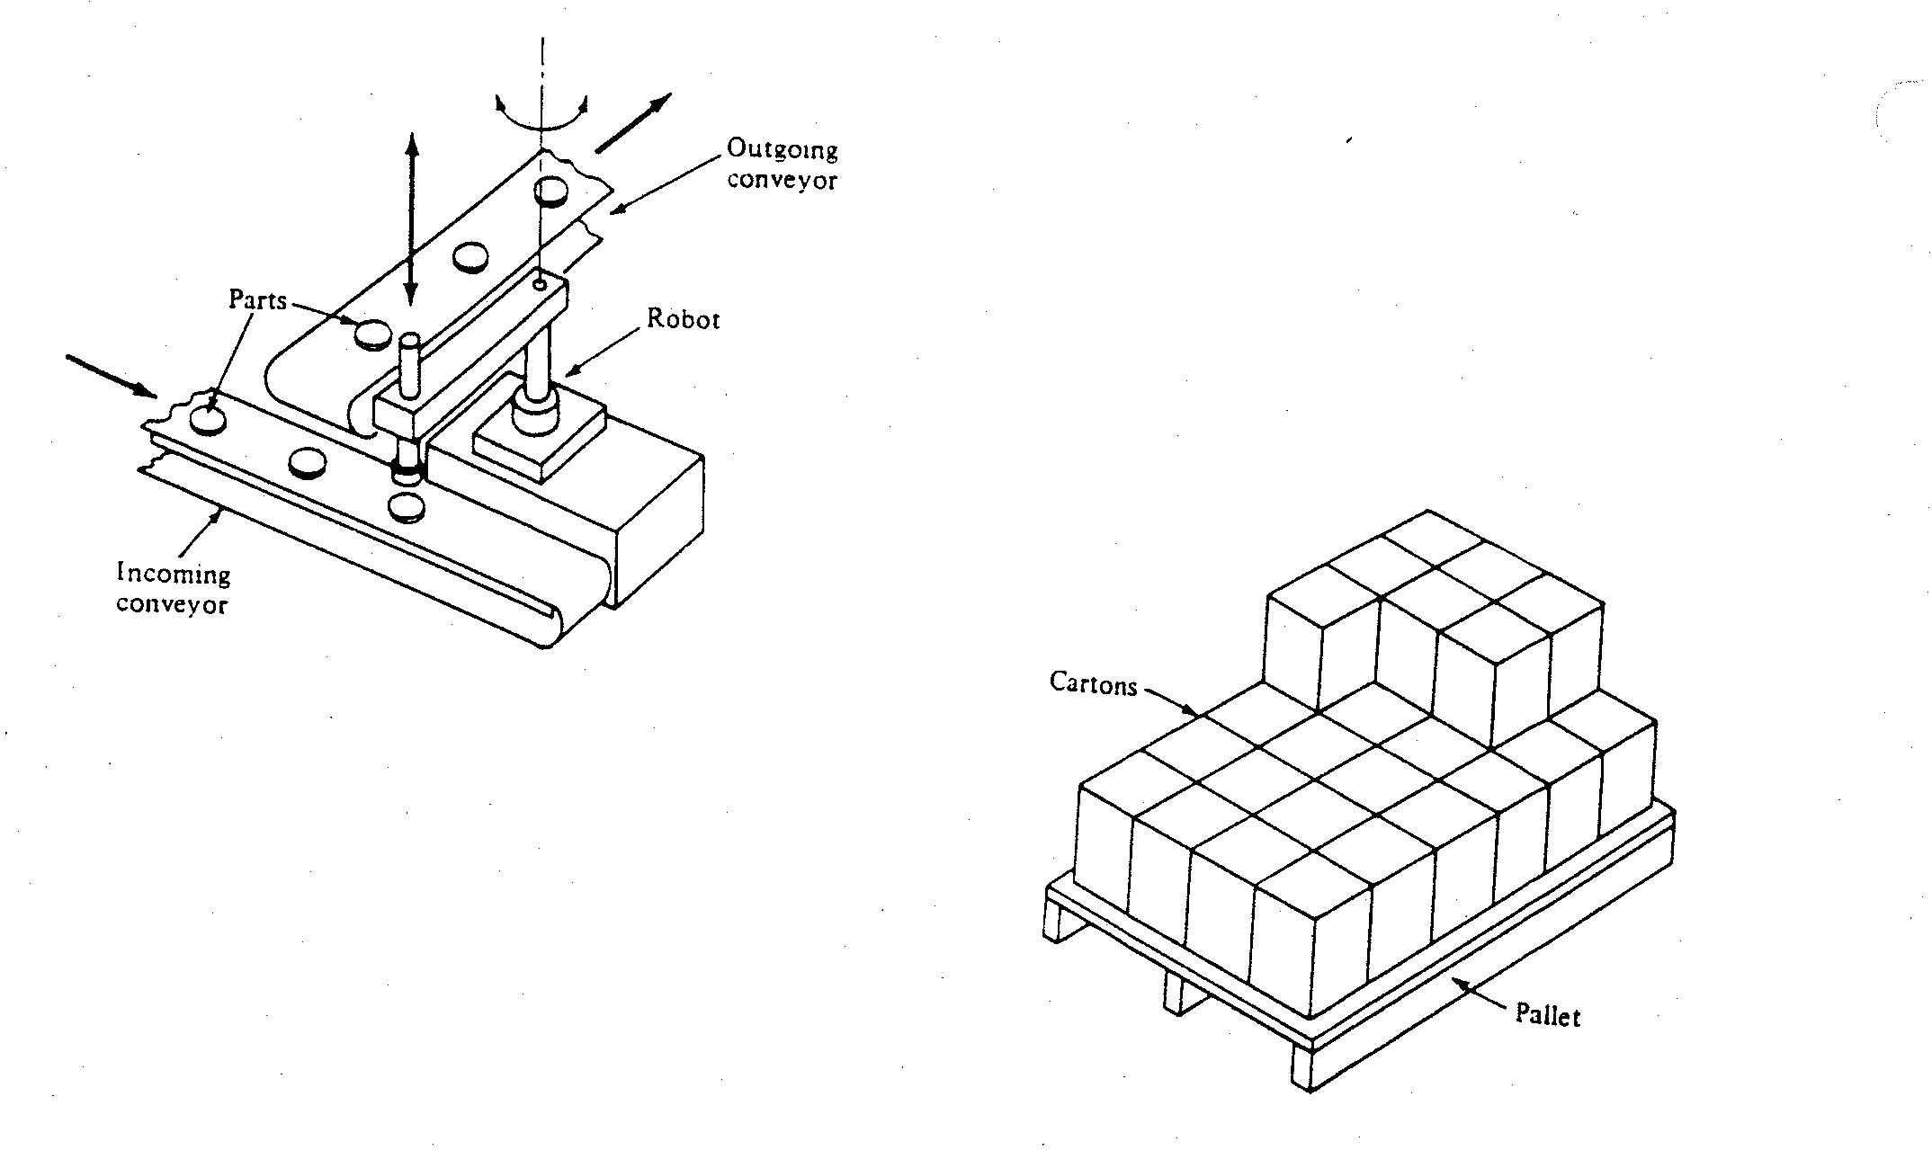
Material Handling
Robot Industrial Applications

Slide 6
Material Transfer Operations
These are operations in which the primary objective is to move a part from one location to another location.
1) Pick and Place Operations
  These operations involve tasks in which the robot picks up the part at one location and moves it to another location.
  Possible complications:
    • The robot required to track a moving pick up point.
    • Different objects are being handled by the same robot.
2) Palletizing Operations
  In these type of operations, the robot must place each part in a different location on the pallet, thus forcing the robot to remember or compute a separate motion cycle until the pallet is fully loaded.
  Possible complications:
    • The variation of a location is in three dimensions.
    • High programming language is required.
https://www.youtube.com/watch?v=QfbdVboVNUM
Robot Industrial Applications

Slide 7
Machine Loading and Unloading
These applications are material - handling operations in which the robot is used to service a production machine by transferring parts to and/or from the machine.
The robots have been successfully applied to accomplish the loading and/or unloading function in the following production operations:
  • Die casting
  • Plastic molding
  • Forging operations
  • Machining operations
  • Stamping press operations
Robot Industrial Applications

Slide 8
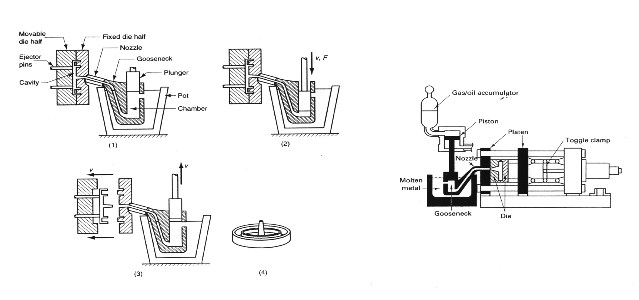
Hot Chamber Die Casting Machine
Close chamber and let metal
flow in chamber
Plunger then forces metal into die, and
maintains the pressure during part solidification
Finished product
Components of a hot-chamber die-casting
machine
Source:DeGarmo/Black/Kohser
After part solidification, plunger withdrawn
and die opened, and the part is then ejected
using ejectors
Source: Groover
Robot Industrial Applications
Notes:
Figure 13.13 Groover page 277
and Figure 15.5 Degarmo page 405

Slide 9
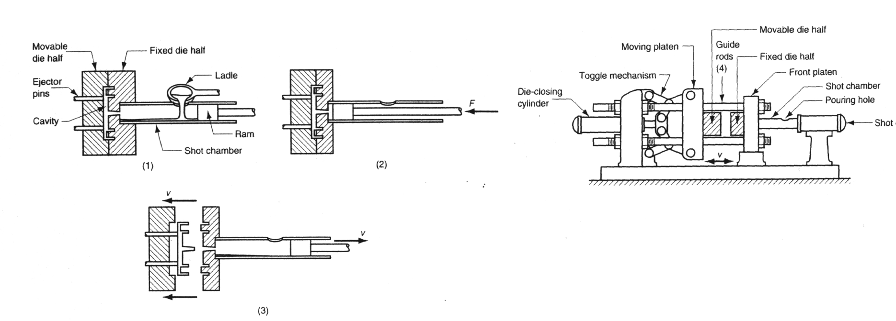
Cold-Chamber Die Casting Machines
Close die and withdraw ram, then pour molten metal in the chamber
Activate ram to force metal in the die
and maintain pressure until part
solidify
Configuration of cold chamber
die-casting machine
Once part solidify, withdraw ram and activate
ejection system to eject casting.
Source: Groover
Robot Industrial Applications
Notes:
Figure 13.12 and 13.14 Groover

Slide 10
Applications of Robots in Die Casting
Why die casting is a suitable application for robots?
  Unpleasant environment
  Repetitive work
  Simple and straight forward
Robot task mainly include unloading the finished part from the machine, quench it in a coolant, and deposit it on a conveyor, a belt or a pin.
Other functions include:
  Operating more than one machine ( two or three machines)
  Unloading, quenching, trimming and disposing of the parts
  Unloading the machine and preparing the die for the next casting cycle
  Loading cores, or inserts in the die and unloading the finished part
Applications Requirements
  A gripper that can handle high temperature
  Interlock sensors to coordinate and ensure the success of the operation
  https://www.youtube.com/watch?v=YcXmwOc1IkQ
Robot Industrial Applications

Slide 11
Advantages of Using Robots in Die Casting
Removes operator from unpleasant work condition, thus reduces the need for health and safety equipment.
Improves the work cycle, thus increases the productivity.
Consistent work cycle, leads to improvement on product quality.
Helps in meeting the employee shortage.
Robot Industrial Applications

Slide 12
Processing Operations
In these class of operations the robot performs work on the part. This work always requires that the robot's end effector is a tool rather than a gripper. The type of tool depends on the processing operation that is performed.
Typical Processes are:
  • Spot welding:
    It is a class of resistance welding processes
  • Arc welding
  • Spray painting
  • Certain machining operations
Robot Industrial Applications

Slide 13
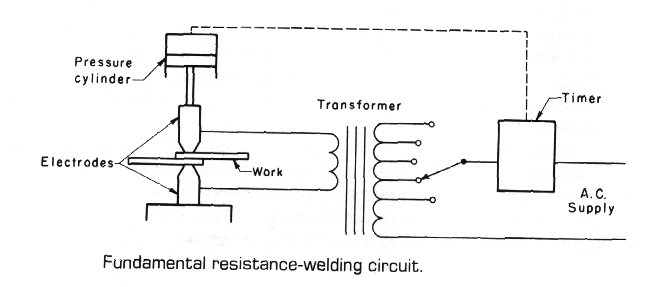
Resistance Welding
Principles
  Resistance welding is based on the generation of heat on the welding joint by passing electrical current in the two pieces constituting the joint, then applying high pressure when the metal at the faying surfaces reaches the required temperature for forge welding. The heat is generated because of the electrical resistance of the joint.
Types of Resistance Welding Processes
  Resistance spot welding (RSW)
  Resistance seam welding (RSEW)
  Resistance projection welding (RPW)
I
V
Source: DeGarmo
Robot Industrial Applications

Slide 14
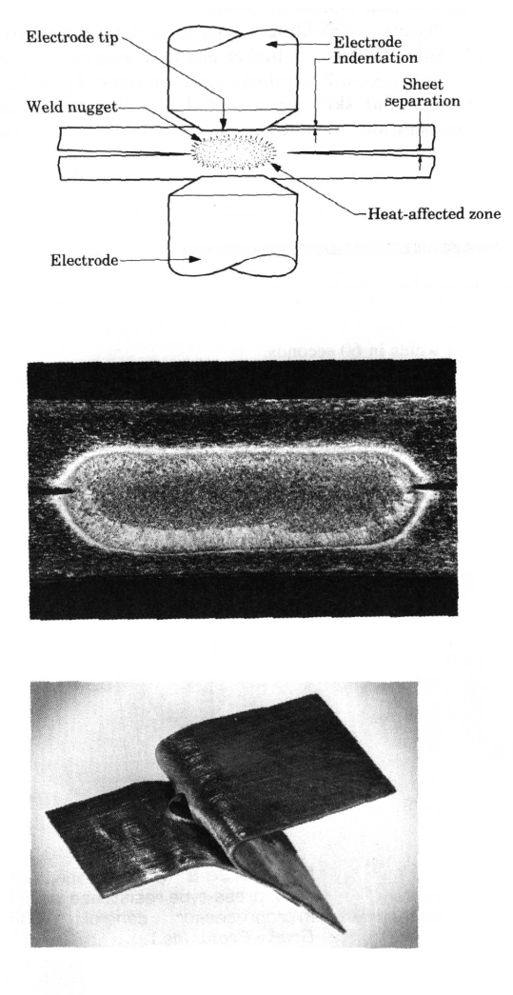
Resistance Spot Welding (RSW)
RSW can be used to weld sheets with thickness up to 3 mm (1/8 in.).
The size and the shape of the weld is controlled by the electrode tip. Most common tip is round but other shapes such as hexagonal, square and other shapes are used.
The result is a nugget of coalesced metal at the faying surface. The nugget size varies from 5 to 10 mm (0.2 to 0.4 in.) is diameter with a heat affected zone slightly extended in the base metal.
Weld tear test should show failure out side the welding zone.
RSW electrode materials are mainly copper-based alloys or refractory metal composition such as copper tungsten.
Cross section of a spot weld
Nugget for 1.3-mm aluminum sheet
Robot Industrial Applications
Tear test of a sound RSW, failure
occurs outside the weld

Slide 15
Robots in Spot Welding
http://www.youtube.com/watch?v=XAb8QiJKluQ&feature=player_embedded
The robots used in spot welding must possess certain capabilities and features to perform the process.
  1. The robot must be relatively large and it must have a sufficient payload capacity to readily manipulate the welding gun for the application.
  2. The robot must be able to position and orient the welding gun in places on the product that might be difficult to access. This might result in the need for an increased number of degrees of freedom.
  3. The controller memory must have enough capacity to accomplish the many positioning steps required for the spot welding cycle.
Advantages and Benefits of Robot Spot Welding
  1. Improved product quality
  2. Operator safety
  3. Better control over the production operation
Robot Industrial Applications

Slide 16
Robots in Arc Welding
http://www.youtube.com/watch?v=HUU3HdxOqZs&feature=player_embedded
Arc welding is a continuous welding process as opposed to spot welding which might be called as discontinuous process.
Problems for Robots in Arc Welding
  One of the most difficult technical problems for welding robots is the presence of variations in the components that are to be welded. These variations are manifested in two forms:
    1) Variation in the dimensions of the parts in the batch production job.
    2) Variation in the edges and surfaces to be welded together.
Advantages and Benefits of Robots Arc Welding
  1. High productivity
  2. Improved safety and quality - of - work life
  3. Greater quality of product
  4. Process rationalization
Robot Industrial Applications

Slide 17
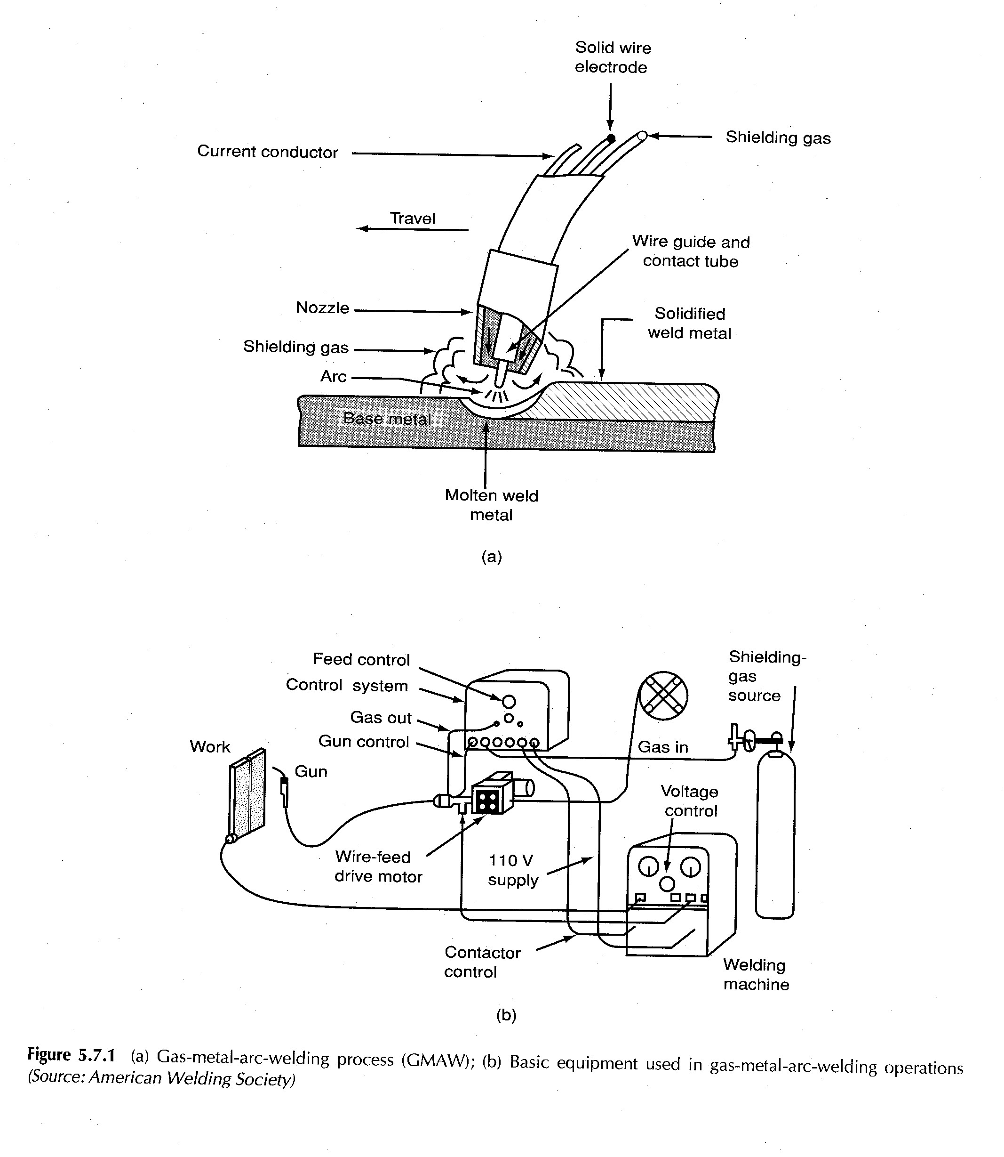
GMAW Process
Robot Industrial Applications

Slide 18
Features of the Welding Robot
1. Work volume and degrees of freedom
  The robot's work volume must be large enough for the sizes of the parts to be welded.
2. Motion control system
  Continuous - path control is required for arc welding.
3. Precision of motion
  The accuracy and repeatability of the robot determines to a large extent the quality of the welding job.
4. Interface with other systems
  The robot must be provided with sufficient input/output and control capabilities to work with the other equipment in the cell.
5. Programming
  Welding paths might have irregular shapes. Therefore, it is convenient to use the walk through method in which the robot wrist is physically moved through its motion path.
  Off-line programming method would be an advantage.
Robot Industrial Applications

Slide 19
Robots in Spray Painting
This involves the use of spray guns to apply the paint or other coating to the object.
Hazards in spray coating include: Fumes and mist in the air, noise from the nozzle, fire hazard, potential cancer hazards.
Use of industrial robots has developed as an alternative means of performing spray coating operations.
General Requirements of the Robot for the Spray Coating
  1. Continuos path control
  2. Hydraulic drive
  3. Manual walk through programming
  4. Multiple program storage
http://www.youtube.com/watch?v=aA28IYXB34w&feature=player_embedded
Robot Industrial Applications

Slide 20
Advantages of Robots Spray Coating
1. Removal of operators from hazardous environment
2. Lower energy consumption
3. Consistency of finish
4. Reduced coating material usage
5. Greater productivity
Robot Industrial Applications

Slide 21
Robots Assembly Automation
The assembly process consists of the sequential addition of components to a base part or existing subassembly to create a more complex subassembly or a complete product. As such, assembly operations involve a considerable amount of handling and orienting of parts to mate them together properly. The difference between assembly tasks and other material handling tasks is that value is added to the product through the assembly operation.
There are three major areas of study in the application of robotics to assembly:
    1. Parts presentation
    2. Assembly task
    3. Assembly cell design
Robot Industrial Applications

Slide 22
Parts Presentation
In order for a robot to perform an assembly task, the part that is to be assembled must be presented to the robot. There are three ways to accomplish this presentation function, involving various levels of structure in the workplace.
  1. Part located within a specific area (parts not positioned and oriented).
    Sensors are required to guide a robot to pick up parts (vision system could be used)
  2. Part located at a known position (parts not oriented).
    An additional handling process may be needed to orient the part
  3. Parts located at a known position and oriented.
    Most common, less work to the robot.
Robot Industrial Applications

Slide 23
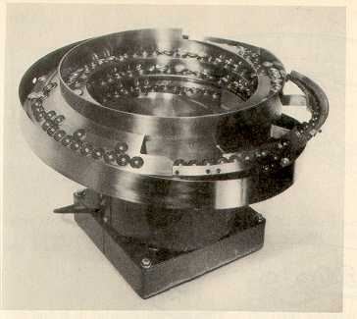
Part Presentation
There are number of methods for presenting parts in a known position and orientation:
  Bowl feeders
  http://www.youtube.com/watch?v=cVYitUj6JXk&eurl=http://video.google.com/videosearch?q=bowl+feeder&hl=en&emb=0&aq=0&oq=Bowl+fe&feature=player_embedded
  2. Magazine feeders
  3. Trays and pallets
Bowl Feeders
  Most common
  Consists of two parts; bowl and vibrating base
  A track rising in spiral to deliver the part at the bottom of the bowl
  Vibrating base
  Orientation and delivery fixture.
Vibratory Bowl Feeder
Source: Groover
Robot Industrial Applications

Slide 24
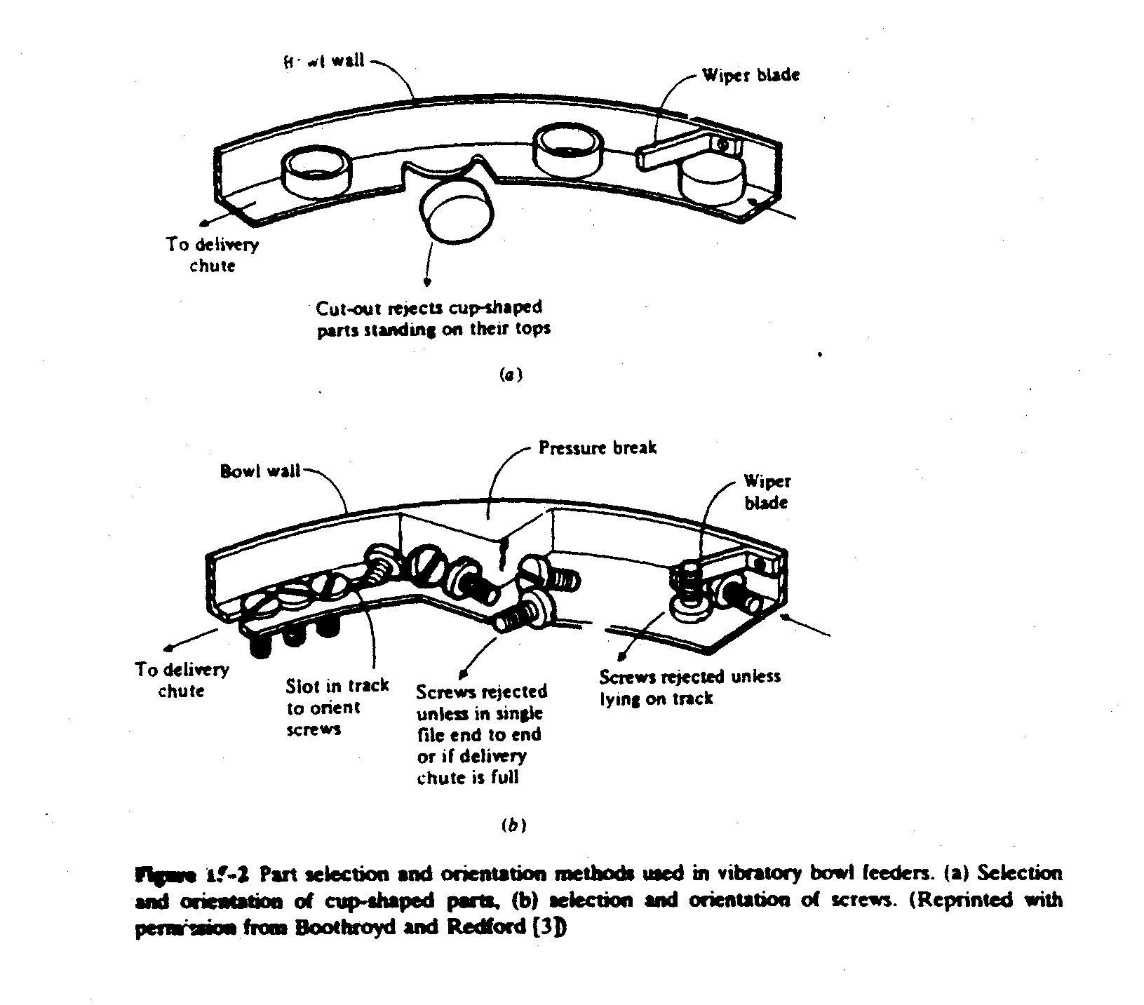
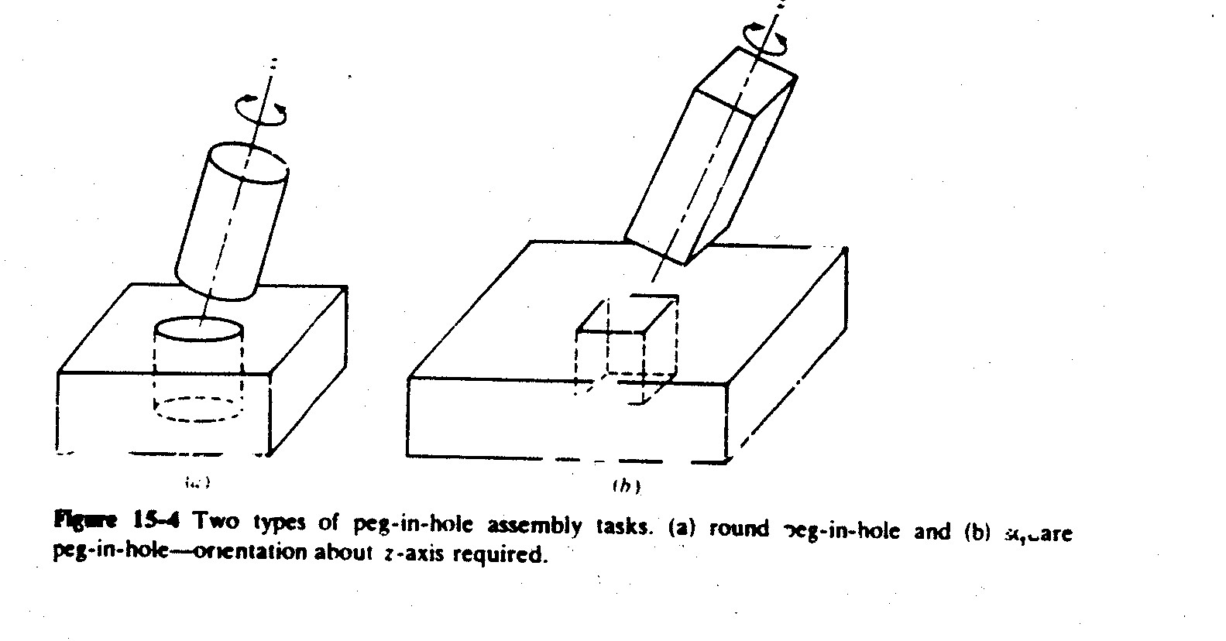
Assembly Tasks
Robot Industrial Applications

Slide 25
Assembly Operations
Assembly operations can be divided into two basic categories:
1. Parts mating
  In part mating, two (or more) parts are brought into contact with each other.
2. Stacking
  In this type of assembly, several components are placed one on the top of the next, with no pins or other devices for locating the parts relative to each other. In a subsequent assembly operation, the group of parts would be joined together.
  https://www.youtube.com/watch?v=v9oeOYMRvuQ
Robot Industrial Applications

Slide 26
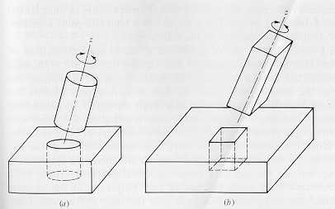
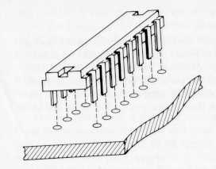
Parts Mating
Round peg in a hole
Square peg in a hole
Multiple peg-in-hole
Peg-in-hole
  Common assembly task
  Round peg in a hole; robot requires five d.o.f.
  Square Peg in a hole; robot requires six d.o.f., one more d.o.f. for aligning corners
  Multiple peg-in-hole; requires orientation of parts in all directions; e.g. micro-electronic module assembly in a circuit or card.
Robot Industrial Applications

Slide 27
Assembly Operations (continue)
2. Parts - Joining tasks
In parts joining, not only must the two (or more) components be mated, but also some type of fastening procedure is required to hold the parts together. The possible joining operations include the following:
Fastening screws
Retainers
  In this operation the pins inserted through several parts in order to maintain the relationship among the parts.
Press fits
  This is a variation of the peg - in - hole task except that the parts to be mated have an interference fit. This simply means that the peg is slightly larger than the hole into which it is to be inserted.
Welding and related joining methods
Adhesives
Robot Industrial Applications

Slide 28
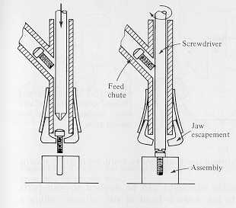
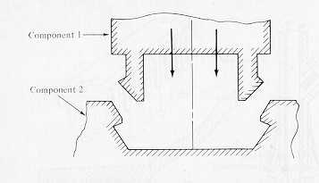
Assembly Operations (continue)
Power screw driver
Snap fit assembly
Fastening Screw
  Robot can use power screw driver machine or a power screw driver as an end effector.
Snap fit is an ideal method for automatic assembly.
http://www.youtube.com/watch?v=3LV2KL4buaw&feature=player_embedded
http://www.youtube.com/watch?v=-yoXkWpcOu8&feature=player_embedded
Robot Industrial Applications

Slide 29
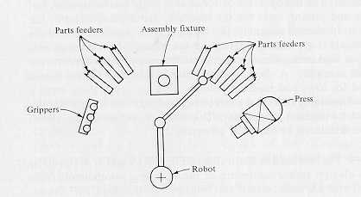
Assembly System Configuration
There are three basic configurations of assembly systems:
  A single workstation
  A series workstations (an assembly line)
  Parallel assembly systems.
A single workstation assembly
  In this configuration all of the parts which are required to complete the desired assembly are presented to the robot at a single workstation.
  A single station robotic assembly system would typically be used for low and medium volume work in which there are a limited number of assembly tasks and parts to be handled. This means that the product is of low to medium complexity.
Single station workcell
for assembly of electric motor
Robot Industrial Applications

Slide 30
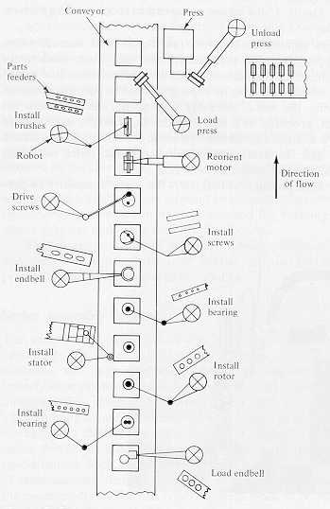
Series Assembly System
Series assembly cell for motor assembly
This configuration is used for many medium and high production assembly situations. The assembly line consists of a series of workstations (the workstations are manned by robots) at which only a few operations are performed on the product at each station. Each station is working on a different product, and the products are gradually built up as they move down the line.
Example
  Assembly cell for assembly of a motor
  http://www.youtube.com/watch?v=Q8WnAN9jmEc&feature=player_embedded
Robot Industrial Applications

Slide 31
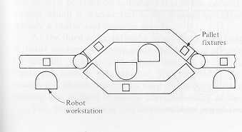
Parallel Assembly Systems
In this assembly system the work can take either of two or (more) routes to have the same operations performed. There are two conditions:
  1. The production cycle times at a particular workstation or group of workstations are too long to keep up with the other sections of the line. The other stations are forced to wait for the slow workstations.
  2. The reliability of a certain station (or group of stations) is a problem.
Parallel work-station on
an Assembly system
Source: Groover
Robot Industrial Applications

Slide 32
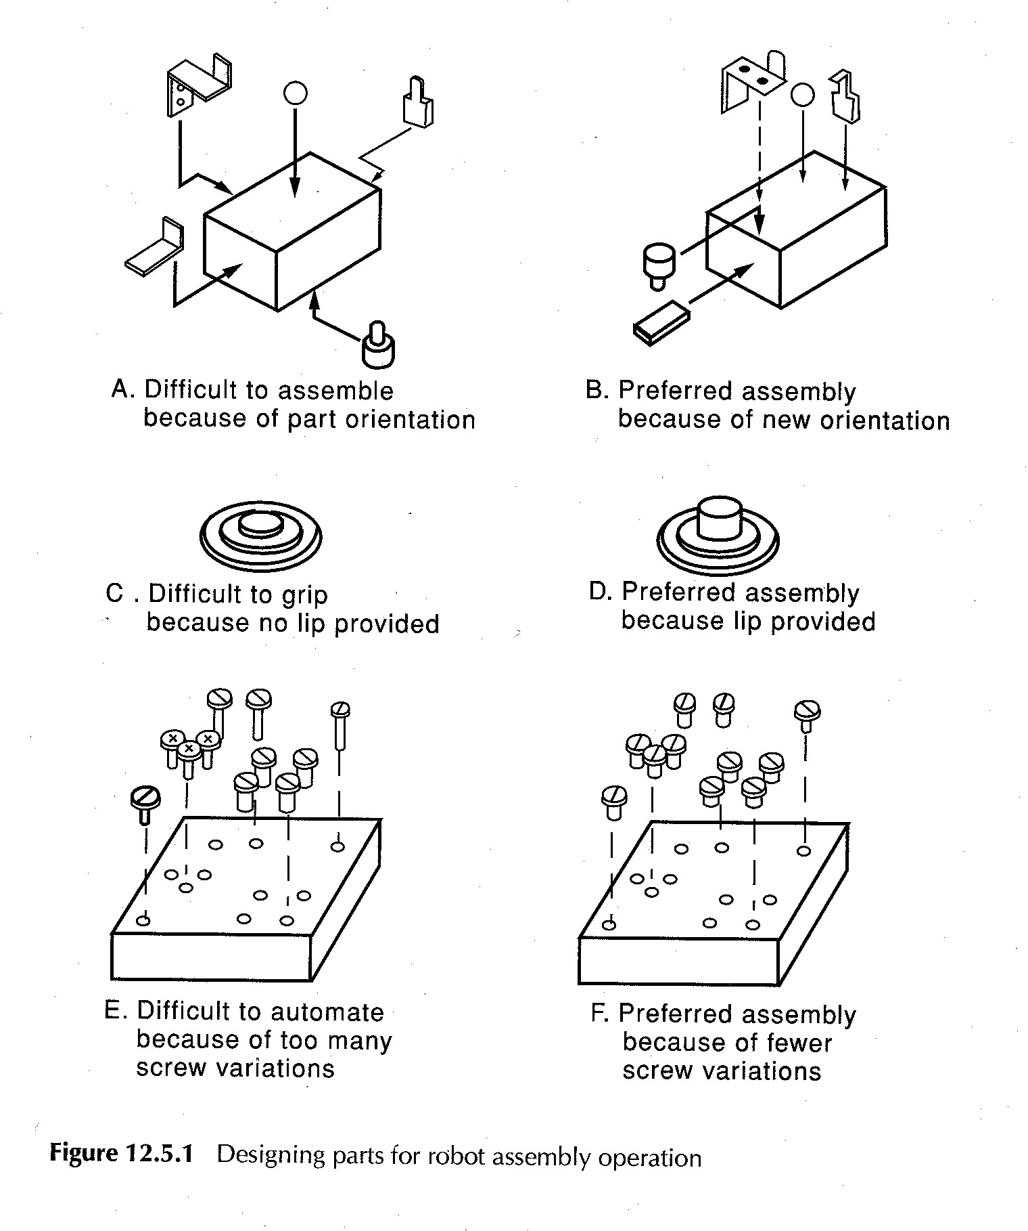
Design for Robot Assembly
Robot Industrial Applications

Slide 33
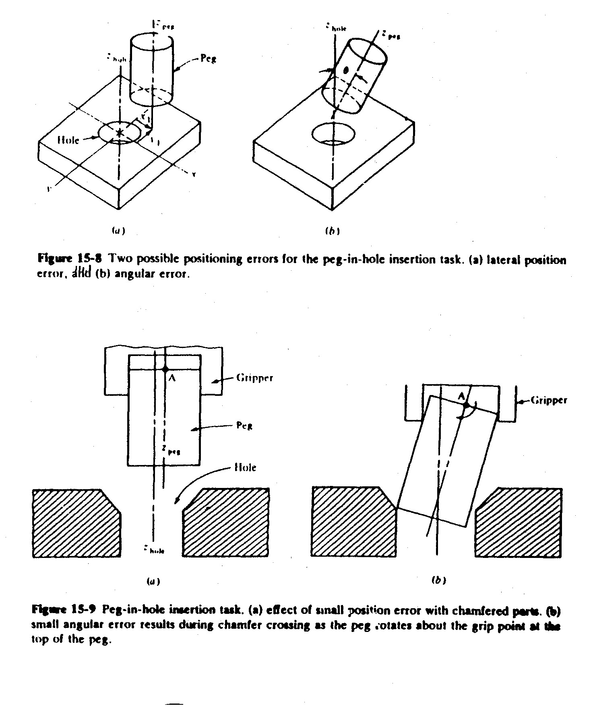
Peg in Hole Insertion Task
Robot Industrial Applications

Slide 34
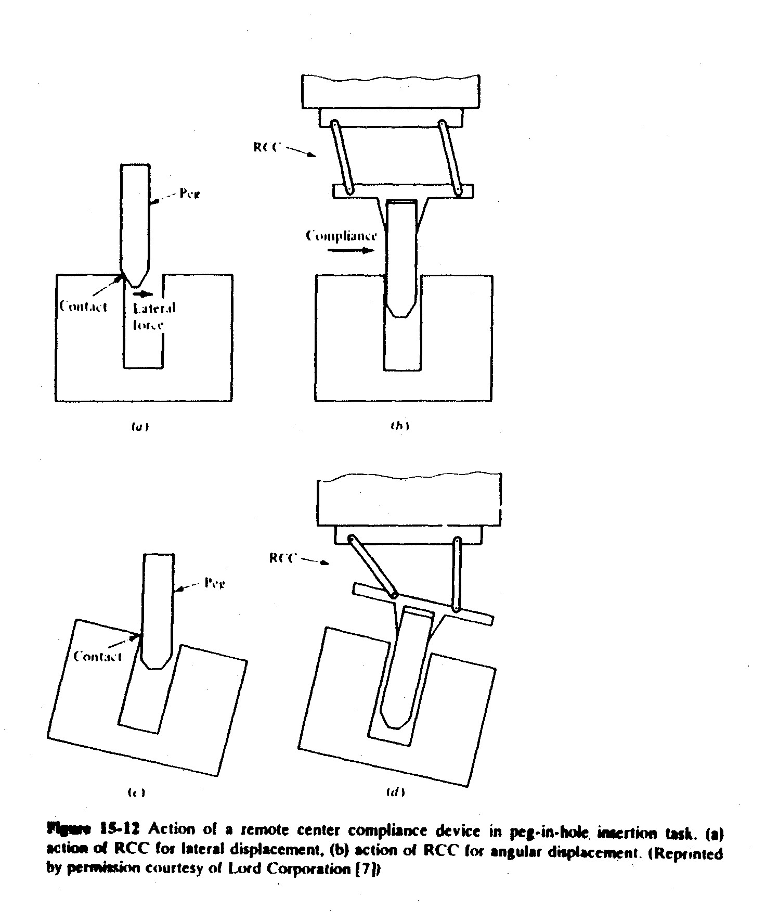
Remote Center Compliance Device
Robot Industrial Applications

