Slide 1
Robot Systems and Robot Programming
Lecture # 8
IMSE/CIS 381: Industrial Robots
Robot Systems and Programming

Slide 2
Robot System Architecture
It consists basically of:
  Hardware System
    manipulator
    controller
    sensors (internal, external)
    power conversion
  Software System
    operating system
    manipulator specific modules
    programming language
Robot Systems and Programming

Slide 3
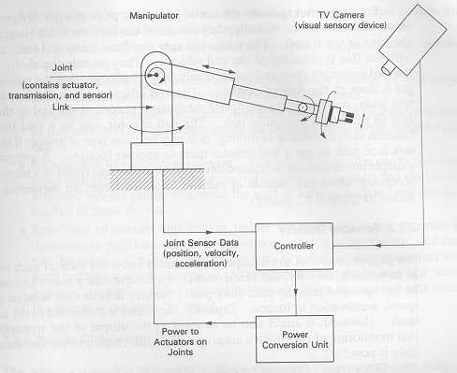
Robot System
Source:R. Klafter, T. Chmielewski and M. Negin
Basic Components of a Robot System
  Manipulator
  Sensor devices
  Controller
  Power conversion Unit
Controller
  The controller provides the “intelligence” to cause the manipulator to perform in the manner described by the user or “trainer.”
Components of a robot system
Robot Systems and Programming

Slide 4
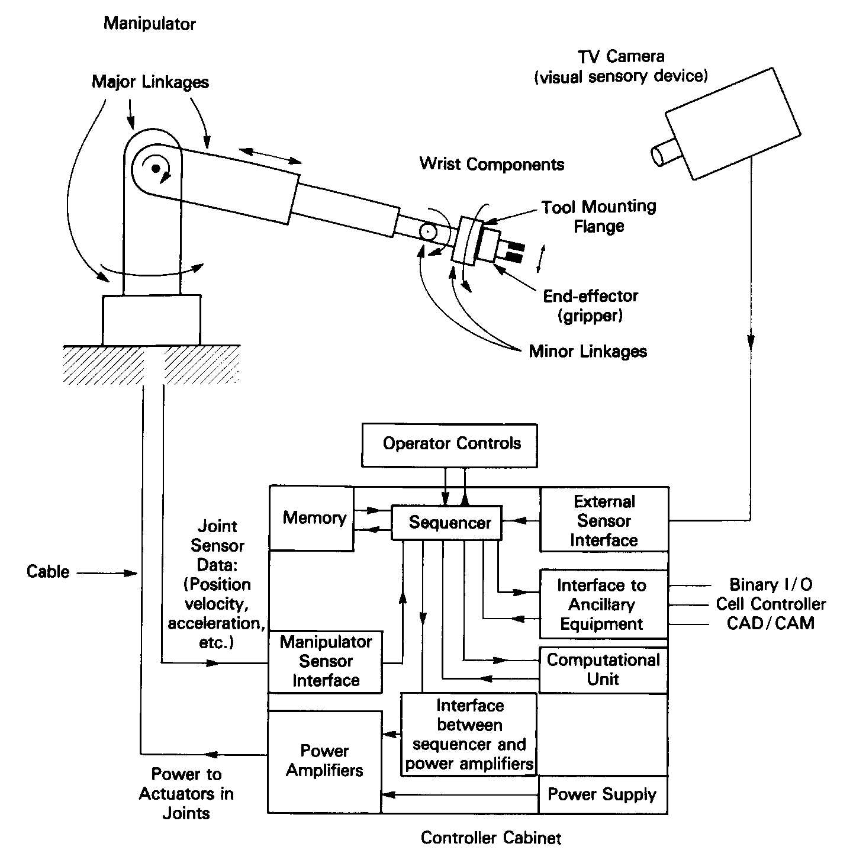
Subsystem of a Robot Components
Source:R. Klafter, T. Chmielewski and M. Negin
Robot Systems and Programming

Slide 5
Element of a Robot Controller
The controller consists of:
  A memory to program data, sequence of operation, and manipulator positions
  A sequencer that interprets and utilizes the data stored in the memory to interface with other components in the controller
  A computational unit that provides the necessary computations to aid the sequencer
  An interface to obtain the sensor (internal or external sensors) data into the sequencer
  An interface to transfer sequencer data to the power conversion unit to perform physical moves by manipulator
  An interface to ancillary devices such as limit switches, and other external devices
  Operator interface, such as control panel, teach pendent, etc.
Robot Systems and Programming

Slide 6
Functions of Robot Controller
Should be able to handle and support:
  Multi-axis control, motion control, acceleration/deceleration control, dynamic compensation, etc.
  Digital and analog interface
  Standard communication interface (RS 232, TCP/IP, USB, etc.) to remote controllers or computers
  Standard peripherals, such as teach pendants, USB flash drives, operator’s panel, etc.
  Safety devices, interlocks, built-in-error detection sensors, leak detection devices in case of hydraulic robots, power interruption control, extra power sources for sensors requiring power, etc.
  Optionally multiple device and arm control.
Robot Systems and Programming

Slide 7
Robot System Software
1. Operating System
  A set of programs integrated with the hardware that:
    Coordinate the actions taking place inside the controller
    Provide communication link to the outside
    Transferring and receiving data input/output from/to control units, peripherals, sensors, etc.
  Characteristics
    Portable,
    Fast enough to react to signals occurring in real time
    Capable of expansion
Robot Systems and Programming

Slide 8
Robot System Software
2. Manipulator Software
  It is the software module to handle different coordinate transformation, it should be capable to:
    translate the application specific command to the manipulator
    provide trajectory generation
    take care of kinetic and kinematic limits
    handles force feedback
    speed control
    vision and other sensors I/O data
Robot Systems and Programming

Slide 9
Robot System Software
3. Robot Programming Language
  It is the software interface by which the robot programmer can direct the manipulator to perform the desired actions
  Characteristics
    User friendly
    Capable to provide editing
    Can be extended using macros, or subroutines
Robot Systems and Programming

Slide 10
Operating System and Controller Type
There are three styles of of robot controller:
  Limited-sequence controller
  Point-to-point controller
  Continuous-path controller
Each has its unique programming requirements,
Robot Systems and Programming

Slide 11
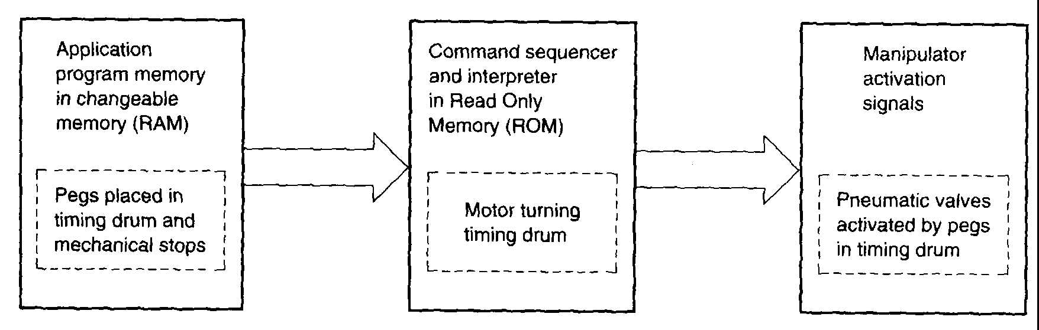
Limited-sequence Robot Operating system
Source: J. L. Fuller
Used with materials transfer devices (simple type)
Programming usually done by mechanical setup and timers
The mechanical system can be replaced by a electronic controller such as programmable logic controller (PLC) as the one shown in the figure above
The function of OS is to translate the program commands into pneumatic valve activation.
Robot Systems and Programming

Slide 12
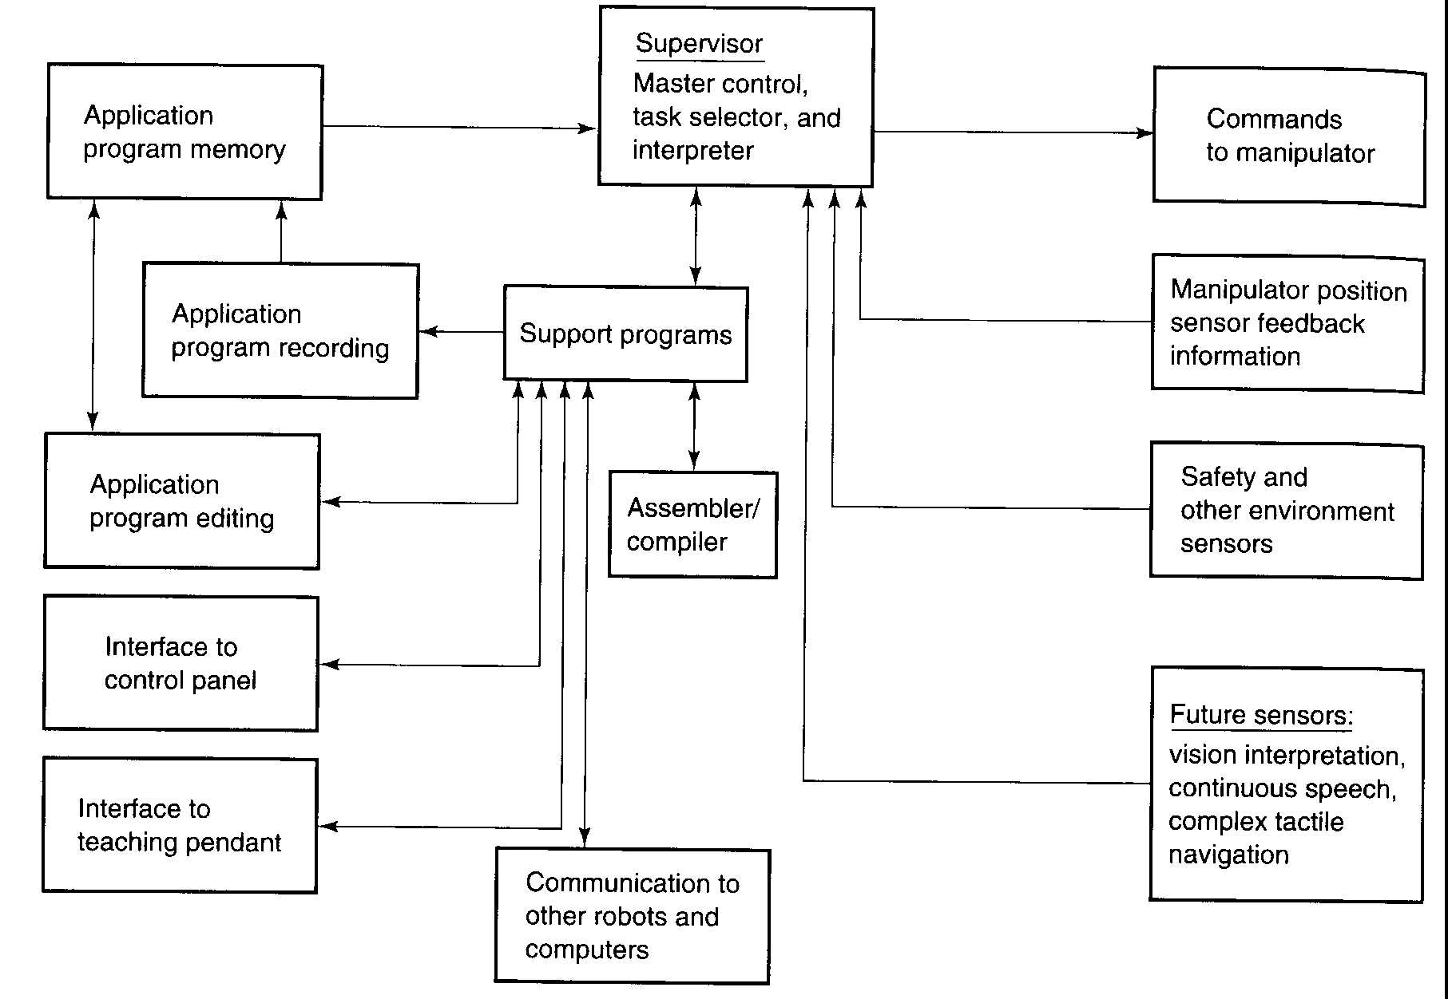
Point-to-Point robot Operating System
-Uses electronic memory
- Record the positions
of the manipulator.
- Establish moves
to required positions
- Must support:
* feedback
* teach pendant
* control panel
Source: J. L. Fuller
Robot Systems and Programming

Slide 13
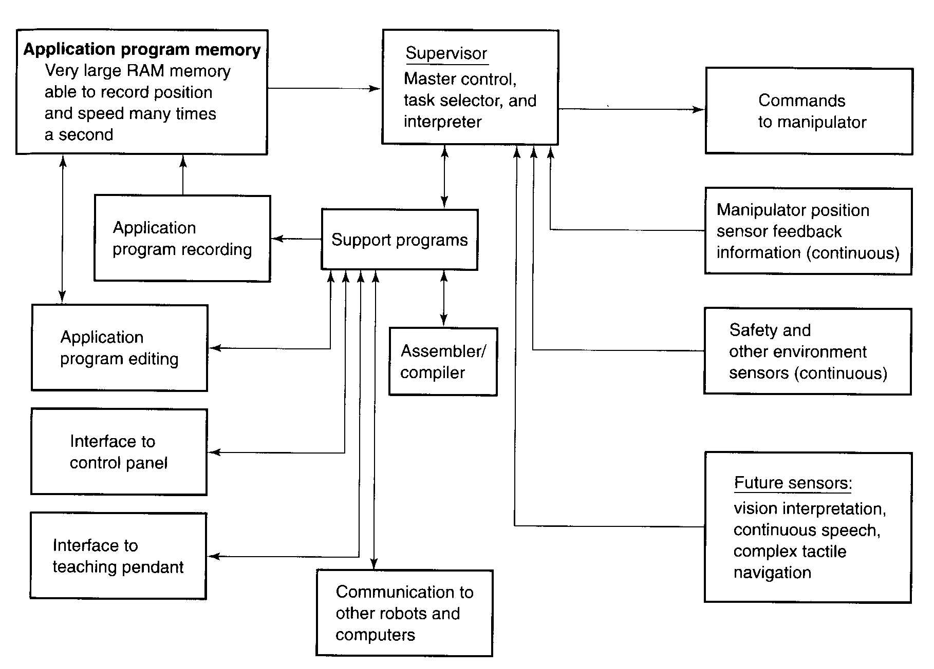
Continuous-Path Robot OS
Controller must
support:
- continuous feedback
information in real time
for manipulator position
and sensors
- Playback programs
- Control panel
- Teach pendant
- Leadthrough
programming
It should have large
memory
Source: J. L. Fuller
Robot Systems and Programming

Slide 14
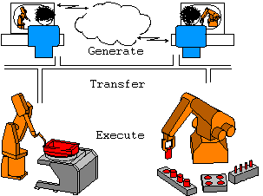
Programming the robot
The greatest force of robots is their flexibility, their ability to rearrange for new production and their large movement range. Utilization of the robot's flexibility presupposes effective programming. The robot programming can take place in two principally different ways: on-line or off-line. In On-line programming the use of the robot and equipment is required, whereas off-line programming is based on computer models of the production equipment. Both these methods have advantages and disadvantages. In this section we will take a look at how the two methods can be combined.
Robot Systems and Programming

Slide 15
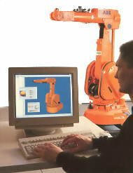
ON-LINE PROGRAMMING
On-line programming takes place at the site of production itself and involves the workcell. The robot is programmed with a teach box. On-line programming has the following advantages and disadvantages compared to off-line programming:
Advantages Easily accessible. | Disadvantages Slow movement of the robot while programming. Program logic and calculations are hard to program. Suspension of production while programming. Cost equivalent to production value. Poorly documented.
The most significant advantage of on-line programming is that the robot is programmed in concordance with the actual position of equipment and pieces. Contrary, the most significant disadvantage is that it occupies valuable production equipment.
Robot Systems and Programming

Slide 16
Methods of Robot Programming
Four Basic Methods
  Manual set up procedure (Limited sequence programming)
  Leadthrough programming
  Textual robot languages
  Off-line programming
Manual Set Up Procedure
  It the limited sequence programming and it is performed by setting up limits for the robot joint. It is limited for material transfer devices
Robot Systems and Programming

Slide 17
Leadthrough Programming
It is teaching by showing method
  Two types:
    Power leadthrough:
      Uses teach pendant to teach the robot a set of points
      A simple program is then written to perform the job
      Limited to PTP
      Used in applications such as material transfer, loading/unloading machines, spot welding, etc.
    Continuous-path leadthrough
      Continuous path programming
      Walk through method
      Mainly for painting, arc welding and like applications
  Control systems operates in two modes:
    Teaching mode, and
    Run mode
Robot Systems and Programming

Slide 18
Textual Programming
High level programming that uses English like commands
Several Generations
  First generation: A combination of teach pendant and command statement procedure. It has limited switch capability, and joint and line interpolation. Example: ACL, Robotalk
  Second Generation
    Uses structure programming
    Capable of motion control and advanced sensors
    Limited intelligence
    Capable of data communication and processing
    Examples: AML, HELP, Karel and VAL
Robot Systems and Programming

Slide 19
Off-Line Programming
Off line programming may be considered the process by which robot programs are developed, partially or completely, without requiring the use of robot itself. This includes generating point coordinate data, function data, and cycle logic.
It is used when the proportion of teaching time to production time is small.
Benefits:
  1. Reduction of production downtime
  2. Removal of programmer from partially hazardous environment
  3. Single programming system
  4. Simplification of complex task
  5. Verification of robot programs
Examples:
  ROBCAD
  ROBOGUIDE
Robot Systems and Programming

Slide 20
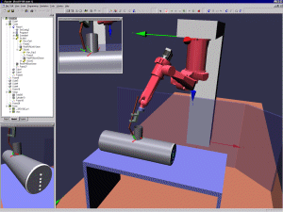
Off-line Programming
Off-line programming takes place on a computer and models of the workcell with robot, pieces and surroundings are used. The robot programs can in most cases be created by the reuse of existing CAD data so that the programming will be quick and effective. The robot programs are verified in simulation and any errors are corrected.
Robot Systems and Programming

Slide 21
Off-line Programming
Off line programming should incorporate simulation capability to allow robot motions to be verified prior to implementation. Moreover, simulation can assist to:
  Test the feasibility of getting to specific coordinates.
  Judge the ability to sidestep interfering objects within the work area.
  Select type of machine and equipment.
  Evaluate potential problems that might occur in operation of manufacturing cell which includes a robot.
Robot Systems and Programming

Slide 22
World and Robot Coordinate Systems
A point in space can be defined by one of the following methods:
  Joint Coordinate
  World coordinate
  Tool Coordinate
  User Coordinate
Robot Systems and Programming

Slide 23
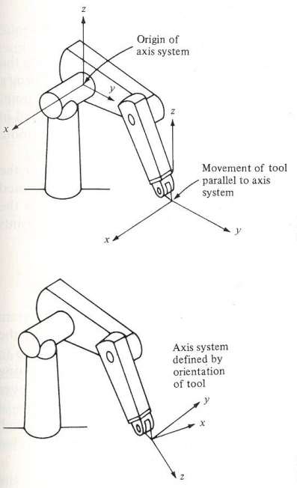
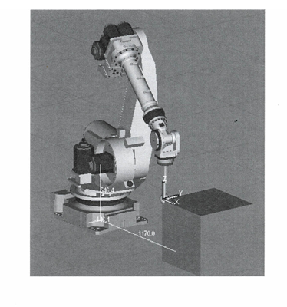
Coordinate Systems
User Frame
World Frame vs. Tool Frame
Robot Systems and Programming

Slide 24
A simple Leadthrough Programming
Commands:
  MOVE: commands robot to move to a previously taught and defined point
  DEFINE: Defines a point, or a line
  SIGNAL line number: Instructs the controlled to send an OUTPUT signal through a power line; defined by the specified number,
  WAIT line umber, Indicates that the robot should wait at its current position until a signal is received on the line; defined by the specified number.
  DELAY x sec. Indicates that the robot should wait x seconds before proceeding to next step in the program
  BRANCH name: Used when the robot has to perform more than one task, so a separate branch can be used for each individual task.
Robot Systems and Programming

Slide 25
Example 1
Programming strategy: Define two Branches one BRING part from A to B and one to BACK part from B to A
Define lines
DEFINE line 5 : close gripper
DEFINE line 6 : Open gripper
DEFINE point A
DEFINE point B
DEFINE point C
DEFINE point AA
DEFINE point BB
DEFINE point C
Points AA and BB are points above point A and B, receptively
The robot is to be programmed to pick up a part from point A and move it to point B, followed by a move to a neutral position. Point A and B are to be defined by the programmer within the robot’s work volume. Then the robot should pick up the part at point B and move it back to point A, followed by a move to the previous neutral position. The robot can be operated continuously in the “run” mode to repeat the motion pattern over and over.
Solution
  Draw a layout to the work space
B
C
A
Robot Systems and Programming

Slide 26
Program for Example 1
B
C
A
BRANCH BRING
MOVE AA
MOVE A
SIGNAL 5 :Close gripper
DELAY 0.5
MOVE AA
MOVE BB
MOVE B
SIGNAL 6 :Open gripper
MOVE BB
MOVE C
END BRING
BRANCH BACK
MOVE BB
MOVE B
SIGNAL 5
DELAY 0.5
MOVE AA
MOVE A
SIGNAL 6
MOVE AA
MOVE C
END BACK
MAIN PROGRAM
DEFINE ALL VARIABLES
SIGNAL 6
M BRING
BACK
GO TO M
Robot Systems and Programming

Slide 27
Capabilities and Limitations of On-Line Programming
Switches can be added to teach pendants to have WAIT, SIGNAL, and BRANCHING
Limitations
  Robots can not be used in production during programming
  Not suitable for complex programming
  Not compatible with new computer based technologies such as CAD/CAM, CIM, and data communications.
Robot Systems and Programming

Slide 28
High Level Robot Programming Languages
High level programming languages are developed based on high level computer programming languages such as Visual Basic, Pascal, C and C+
For example:
  AL developed by Stanford University Artificial Intelligence Lab based on Pascal
  VAL developed for Unimation robots based on BASIC and developed for PUMA Robots based on C language.
Objective
  The objective of the following section is to demonstrate how a high level computer programming language can be converted to a high level robot programming language. It is not intend to write a manual for a new language.
Robot Systems and Programming

Slide 29
Basic Element of a Robot Programming Language
Constants, variables and other data objects
Motion commands
End effector commands
Computation commands
Program control and subroutine commands
Communication and data processing
Monitor mode commands
Robot Systems and Programming

Slide 30
Constants, variables and other data objects
Constants
  A value that does not change during the execution of the program, such as: A = 1000.
Variables
  It is a symbol that changes value during the execution of the program, it could be INTEGER, REAL or Complex. The symbols could be one letter or more from A to Z or combined by numbers 0- 9, example: A20 = x + y
  Aggregate and Location Variables: In robotics a location is defined by a set of numbers or variables such as:
  DEFINE A1 = POINT<50.5, 23.6, 14.5, 26.67, 125.1, 90.2>
  This command defines the coordinate of a point at the end of the wrist where the first three values define x-y-z coordinates, and the remaining points define the orientation angles α, β, γ in degrees.
  Similar command can be used to define location in joint coordinates, where the six values indicate motors’ positions.
Robot Systems and Programming

Slide 31
Motion Commands
There are variety of motions commands that are used in several high level robot programming languages. These include:
MOVE point
  Move from current position to the defined point using joint interpolation
MOVES point
  Move from current position to the defined point using straight line interpolation.
MOVE point1 VIA point2
  Move from current position to point1 through intermediate point2 using joint interpolation. This command is useful in avoiding collision. When MOVES is used, it means using straight line interpolation instead.
DMOVE (<joint1, joint2, …, jointn> <value1, value 2, ……, valuen>)
  This is an incremental move which means move joint1 by the value1, joint 2 by the value 2, and so on. The units for the values could be degrees or unit length (in., or mm) depending on the robot configuration and the interpolation scheme.
Robot Systems and Programming

Slide 32
Motion Commands
In VAL language, the following command are used:
APPRO point, distance
  This command is used to move arm close to the pick up point using joint interpolation, and the distance is specified in the z-direction.
DEPART distance
  This commands the robot to move away from the pick up point by the specified distance in z-direction using joint interpolation.
When straight line interpolation is used letter S is added to the command, such as:
APPROS point, distance
DEPARTS distance
Example:
1. Define POINT A= POINT <20, 30, 50>
2. APPROS A, 20
3. MOVES A
4. DEPART 20
Explanation:
1. Defines point A in the world coordinates by x =20, y =30, and z = 50 inches.
2. Approach the top of point A by 20 inches using straight line interpolation.
3. Move to point A using straight line interpolation
4. Depart on top of point A by 20 inches.
Robot Systems and Programming

Slide 33
Motion Commands
Path and Frame
  PATH command defines a path connecting a set of points:
DEFINE name = PATH(p₁, p₂, …p_{n})
Points p₁, p₂, …p_{n} are previously defined in the program. MOVE command can be used to move through the path either in joint coordinates
MOVE name (name of the path)
or straight line interpolation
MOVES name
Example
Consider the path defines by p₁, p₂, p₃ and p₄ shown in the figure
1. Define point p₁, p₂, p₃ and p₄
2. DEFINE PAT = PATH(p₁, p₂, p₃ p₄)
3. MOVE PAT
y
p₄
p₂
p₁
p₃
x
Robot Systems and Programming

Slide 34
Motion Commands
Frame: It is a Cartesian coordinate system that may have other points and paths relative to it. It is defined as:
DEFINE name = FRAME(point1, point2, point3)
Where
  point1 is the origin of the frame
  point2 is a point in the x axis of the frame
  point 3 a point in xy plane of the frame
  all points are defined in the world space
  The z-axis of the frame is defined perpendicular to xy-plane.
A path is defined relative to the frame as:
DEFINE path_name:frame_name = PATH(p₁, p₂, …p_{n})
Robot Systems and Programming

Slide 35
FRAME Example
Consider the path defined in the previous example needs to be made in FRAME FAM1 as shown in Figure.
Solution
1. Define points A1,A2, and A3 in world coordinates
2. DEFINE FAM1 = FRAME(A1,A2,A3)
3. DEFINE PAT1:FAM1=PATH(p₁,p₂,p₃,p₄)
4. MOVE PAT1:FAM1
Explanation:
1. Point A1, A2 and A3 are defined in world coordinates
2. The frame coordinate is defined by x’ and y’.
3. The path is now defined by points p1 to p4 relative to(:) the frame coordinates (PAT1)
4. The move is now relative to the frame (PAT1)
y
p₄
A3
p₂
y’
p₃
x’
p₁
A2
A1
x
Robot Systems and Programming

Slide 36
FRAME Example
$$ PO TO P2 ARE POINTS DEFINED RELATIVE TO GLOBAL COORDINATES
DEFINE P0=POINT(0,0,0)
DEFINE P1=POINT(5,0,0)
DEFINE P2=POINT(5,5,0)
DEFINE P3=POINT(5,0,5)
DEFINE P4=POINT(5,5,5)
DEFINE FACE=FRAME(P1,P2, P3)
$$ S1 TO S4 ARE POINTS DEFINED RELATIVE TO FRAME COORDINATES
DEFINE S1:FACE=POINT(1, 0,3)
DEFINE S2:FACE=POINT(1, 0,1)
DEFINE S3:FACE=POINT(3, 0,1)
DEFINE S4:FACE=POINT(3, 0,3)
DEFINE LETTER:FACE =PATH(S1,S2,S3,S4)
MOVES S1:FACE
MOVES LETTER:FACE
END
Z
P5
P4
Y
P3
P2
P0
P1
X
Robot Systems and Programming

Slide 37
End Effector Commands
Close and open are used instead of SIGNAL
  CLOSE - OPEN
Immediate close and open used in VAL II
  OPENI - CLOSEI
Close and open with certain opening
  CLOSE opening - OPEN opening
Close by controlled force
  CLOSE x pounds
CENTER: allows the arm to center its position around the object using tactile sensing
OPERATE: to operate tools at certain speed, force, torque or a period of time
  OPERATE TOOL (SPEED = 300 RPM)
Robot Systems and Programming

Slide 38
Sensor Commands
Sensors use SIGNAL and WAIT command, such as:
SIGNAL line #x, ON : A line defined by line # x and connected to the sensor. If the sensor is off and needs to be turned on, this command is used.
WAIT line #y, ON : Sensor connected to line #y will send signal back indicating that it is ON.
Lines can be replaced by device names, e.g., sensor, motor, etc.
DEFINE MOTOR = OUTPORT line #x
DEFINE SENSOR = INPORT line #x
Example
SIGNAL 5, ON
WAIT15, ON
……
……
SIGNAL 5, OFF
WAIT 15 OFF
When using a name as a variable
DEFINE MOTOR=OUTPORT 5
DEFINR SENSOR=INPORT 15
SIGNAL MOTOR, ON
WAIT SENSOR, ON
…..
…..
SIGNAL MOTOR, OFF
WAIT SENSOR, OFF
Robot Systems and Programming

Slide 39
Sensor Commands
REACT Statement
  VAL uses the REACT statement to continuously monitor an incoming signal and respond to changes in the signal. The reaction to changes can be immediate or based on a priority level.
Command
REACT line #x, subroutine_name
  Monitor line #x, if changes happen execute subroutine
REACT with priority
REACT line#y, subroutine (priority)
Lines can be defined by a variable such as SENSOR and MOTOR.
Example
Monitor the safety gate sensor defined by line # 20, when changes in sensor status happen, execute subroutine SAFETY
DEFINE SENSOR = INPORT 20
REACT SENSOR, SAFETY
If the action based on priority level 3, then the statement is:
REACT SENSOR, SAFETY (PRIORITY 3)
Robot Systems and Programming

Slide 40
Computation and Operations
All computations and operations of a high level programming language can be used, such as:
Mathematical operators: +, -, *, /, **, =
Common trigonometric, logarithmic, exponential and similar functions
  sin (x), cos(x), …etc.
  LOG(X), EXP(X), ABS(X), SQRT(X), …etc
Relation command
  EQ, NE, GT, LT, LE
Logical operators: AND, OR, NOT
Robot Systems and Programming

Slide 41
Program control and Subroutine Command
Program control such as:
  GO TO statement
  IF (logical expression) GO TO xxx
  IF (logical expression) THEN …… ELSE ……… END
  DO ……… UNTIL
  DELAY x SEC
  STOP with different levels
    STOP1 : stop program executions and arm moves
    STOP2: Stop arm but continue program execution to shut other devices.
  PAUSE
  RESUME
BRANCH
  BRANCH name
  ..
  ..
  END BRANCH
SUBROUTINE
  SUBROUTINE NAME (set of arguments)
  ….
  ….
  …
  RETURN
Robot Systems and Programming

Slide 42
Communications and Data Processing
Communication between robot system or operator, robot system and other computer-based systems and their peripherals. Devices such as LCD display, printer, buzzers, teach pendants, etc.
Commands:
  READ, WRITE, SEND, RECEIVE
  READ (part name)
  SEND DATA1 (Display)
Robot Systems and Programming

Slide 43
Monitor Mode Commands
Monitor mode commands such as:
EDIT : To write a new program or edit existing one
EXIT : To end EDIT to store program
STORE (name) : to save program
READ (name) :to read program from storage into robot controller
LIST (name) :to display program on the monitor
PPRINT(name) :
DIR :Directory
DELETE
EXECUTE
ABORT
STOP
Robot Systems and Programming

Slide 44
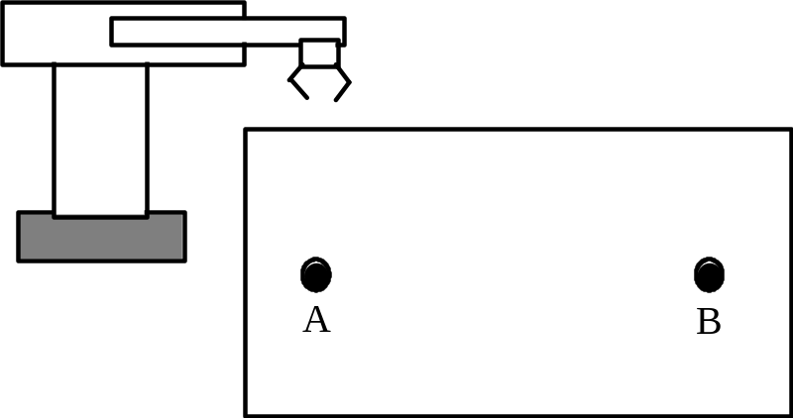
Example 2
Program robot to pick up objects from one defined location A and deposit them in another location B.
Program 1
Program A_TO_B.
OPEN
MOVE A
CLOSEI
MOVE B
OPENI
Program 2
BETTER A_TO_B.
OPEN
APPRO A, 25
MOVE A
CLOSEI
DEPART 25
APPRO B, 25
MOVE B
OPENI
DEPART 25
Robot Systems and Programming

Slide 45
Example 3 Palletizing
In a robot workcell, the robot picks up parts from an incoming chute and deposit them onto a pallet. The pallet has four rows that are 50 mm apart and six columns that are 40 mm apart. The plane of the pallet is xy plane. The rows of the pallet are parallel to the x axis and the columns of the pallet are parallel to the y axis as shown in Figure. The objects are 25 mm tall. Write a complete program to perform the process.
Solution
Define variables:
  ROW Row number
COLUMN Column number
x An x coordinate value
y A y coordinate value
PICKUP pickup point on the chute
CORNER the corner starting point of the pallet
DROP the drop off point
y
40 mm
4
3
2
1
50 mm
1 2 3 4 5 6
x
Robot Systems and Programming

Slide 46
Solution Palletizing Example
y
40 mm
PROGRAM PALLETIZING
DEFINE PICKUP = JOINTS(1,2,3,4,5)
DEFINE CORNER = JOINTS(1,2,3,4,5)
DEFINE DROP = COORDINATES (X,Y)
OPEN I
ROW = 0 : Initialize ROW
10 Y = ROW*50.0 : Compute y for drop off point
COLUMN = 0 : Initialize COLUMN
20 X = COLUMN*40 : Compute x for drop off point
DROP =CORNER + <X,Y> : Define DROP for each iteration
APPRO PICKUP : Pickup sequence
MOVES PICKUP : Pickup sequence
CLOSI : Pickup sequence
DEPART 50 : Pickup sequence
APPRO DROP 50 : Drop off sequence
4
3
2
1
50 mm
1 2 3 4 5 6
x
Robot Systems and Programming

Slide 47
Solution (continue)
MOVES DROP : Drop off sequence
OPENI : Drop off sequence
DEPART 50 : Drop off sequence
COLUMN = COLUMN +1 : Increment COLUMN variable
IF COLUMN .LT. 6 GOTO 20 : Check if COLUMN limit reached
ROW = ROW + 1 : Increment ROW variable
IF ROW .LT. 4 GO TO 10 : Check if ROW limit reached
END PROGRAM
y
40 mm
4
3
2
1
50 mm
1 2 3 4 5 6
x
Robot Systems and Programming

Slide 48
Use of Ladder Logic for Robot and Robot Cell
Often used for controlling a non-servo controlled robot so that operations take place in sequence according to interlock signals
Most frequently used for coordinating operations of (multiple) robot(s), conveyor belts and other machines in a robot work-cell
The control logic is written in ‘ladder logic diagram’ and typically executed by a programmable logic controller (PLC)
Robot Systems and Programming

Slide 49
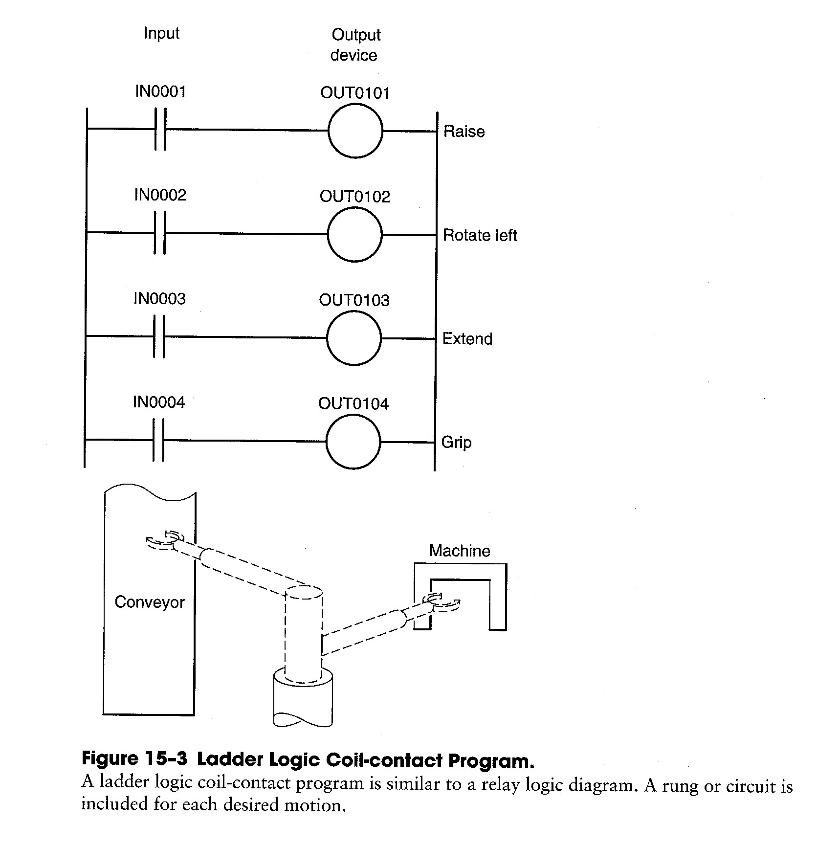
Ladder Logic
Robot Systems and Programming

Slide 50
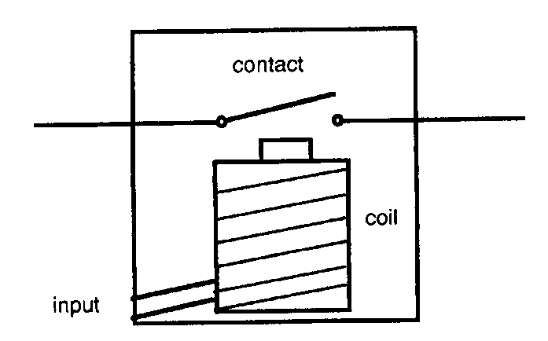
Relays in Discrete Control
Relay with a normally open contact
Source: Chang et al.
Symbols
Normally open contact
Coil
Normally closed contact

Slide 51
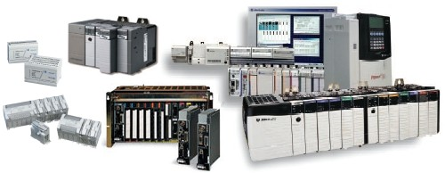
Programmable Logic Controllers (PLCs)
Microprocessor based controllers
Use stored instructions in programmable memory
Used to implement logic, sequencing, timing, counting, and arithmetic control functions.
Mostly used for discrete control.

Slide 52
Applications of PLCs
Sequence control
Motion control: machine tools, robots
Process control: input of set points, offsets, and tuning parameters
Database management
Communications: cell controllers communicate within programmable devices through PLCs

Slide 53
Characteristics of PLCs
Perform logical operations, timing, counting
Programmable
Deterministic scanning
  If the program is too long, the tasks with high priority will be executed
Error checking & diagnostics

Slide 54
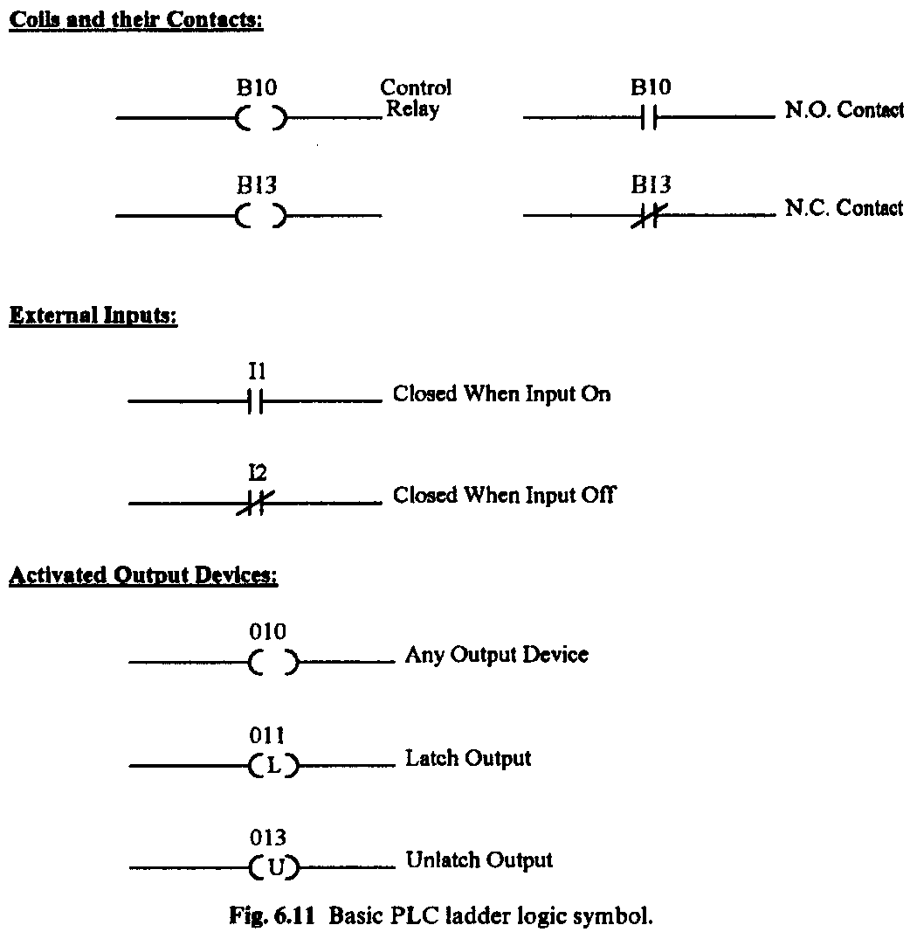
Basic PLC Ladder Logic Symbols
I: input
O: output
B: memory bit
T: timer
C: counter
Source: Boucher

Slide 55

Example 4: Push Button
Controller
Start Stop
Motor
The motor magnetic starter will be energized (M = 1) only if:
  The stop button (B) is not pressed and
  Start button (A) is pressed or the motor (M) is running already

Slide 56

Example 4: Push Button
Boolean algebra:
PLC programming
Stop (I1)
Start (I2)
O1
O1

Slide 57
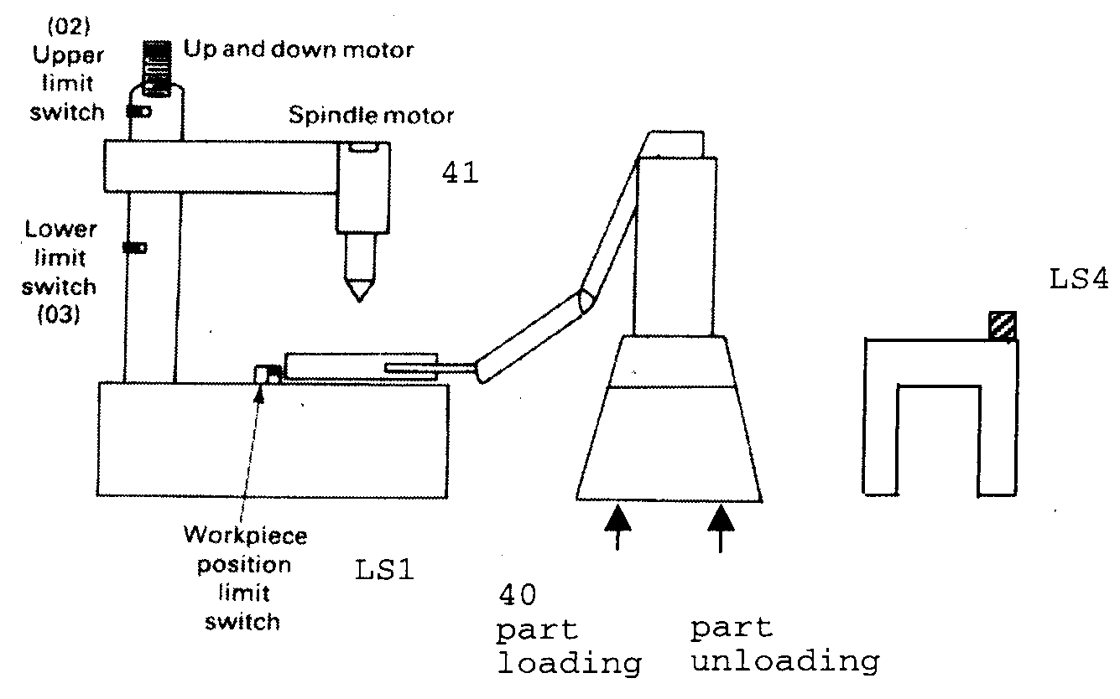
Example 5: Drilling Operation with a Robot
42
43
44

Slide 58
I/O Definition for Drilling Operation with a Robot
Inputs:
  LS1: limit switch for the workpiece position
  LS2: spindle upper limit switch
  LS3: spindle lower limit switch
  LS4: limit switch for the workpiece position on the conveyor
Outputs:
  A40: robot cycle start for part loading
  A41: spindle motor start
  A42: spindle up
  A43: spindle down
  A44: robot cycle start for part unloading

Slide 59
Logics for Drilling Operation with a Robot
When a part has arrived (LS4 = 1) & there is no part on the machine (LS1 = 0), begin the robot loading cycle (A40 = 1)
When workpiece is in position (LS1 = 1) & spindle is not touching the lower limit switch (LS3 = 0), move the spindle down (A43 = 1) and turn on the spindle (A41 = 1)
When lower limit is reached (LS3 = 1), move the spindle upward (A42 = 1) until the upper limit switch is reached (LS2 = 0)
When upper limit switch is touched (LS2 = 1), begin the robot cycle to unload the part (A44 = 1)

Slide 60
Timer
I1
T1
TMR
12s
T1
O2
A timer is used to introduce a time-delay in the logic
When the input signal (=I1) is received, the timer waits the specified delay time (=12 sec) before switching on or off the output signal (=T1 contact thereby O2)
The timer is reset (output is set back to its initial value) by turning off the input signal (= I1)
Robot Systems and Programming

Slide 61
Example 6: Drilling Operation with a Robot + Time Delay
Add the following functions to the operation in Example 5
After drilling is completed (lower limit switch LS3 is touched), there will be 2 seconds dwelling time before the drill begins to retract (A42 = 1).
When the drill arm finishes retracting (upper limit switch LS2 is touched), the spindle motor must stop (A41 = 0)

