Slide 1
Robot Cell Design and Control
Lecture 9
IMSE 381: Industrial Robots
Robot Cell Design

Slide 2
Robots Workcell
Robot workcell desig, Dr. Chang
http://www.youtube.com/watch?v=QuQjjOxvTlA
VDK600 Robotics workcell
https://www.youtube.com/watch?v=nrifjE1rAaE
Vision Guided workcell, grinding and debaurring
https://www.youtube.com/watch?v=pyxmz4ewE6s
Assembley of Automotive Distributor
https://www.youtube.com/watch?v=8a3FA6sHYXc
Sync workcell
https://www.youtube.com/watch?v=SnJvaLLEhmM
Robot Cell Design

Slide 3
Robot Cell Layout
Three Basic Classes:
  1. Robot centered cell
  2. In line robot cell
  3. Mobile robot cell
Robot Cell
Robot centered
cell
In line robot cell
Mobile Robot cell
Intermittent
Transfer
Continuous
Transfer
Non-synchronous
Transfer
Moving baseline
tracking system
Stationary base
line tracking system
Robot Cell Design

Slide 4
Robot Centered Workcell
Machine 2
In this system, the robot is located at the approximate center of the cell and equipment is arranged in a partial circle around it.
This class of robot work cells was the first installation in industry.
Examples
  Die casting
  Machining
  Machine loading and unloading
  Arc welding: The robot accomplishes the production operation itself.
Machine 3
Machine 1
Robot
Input Conveyor
Output conveyor
Typical layout for robot centered workcell
Robot Cell Design

Slide 5
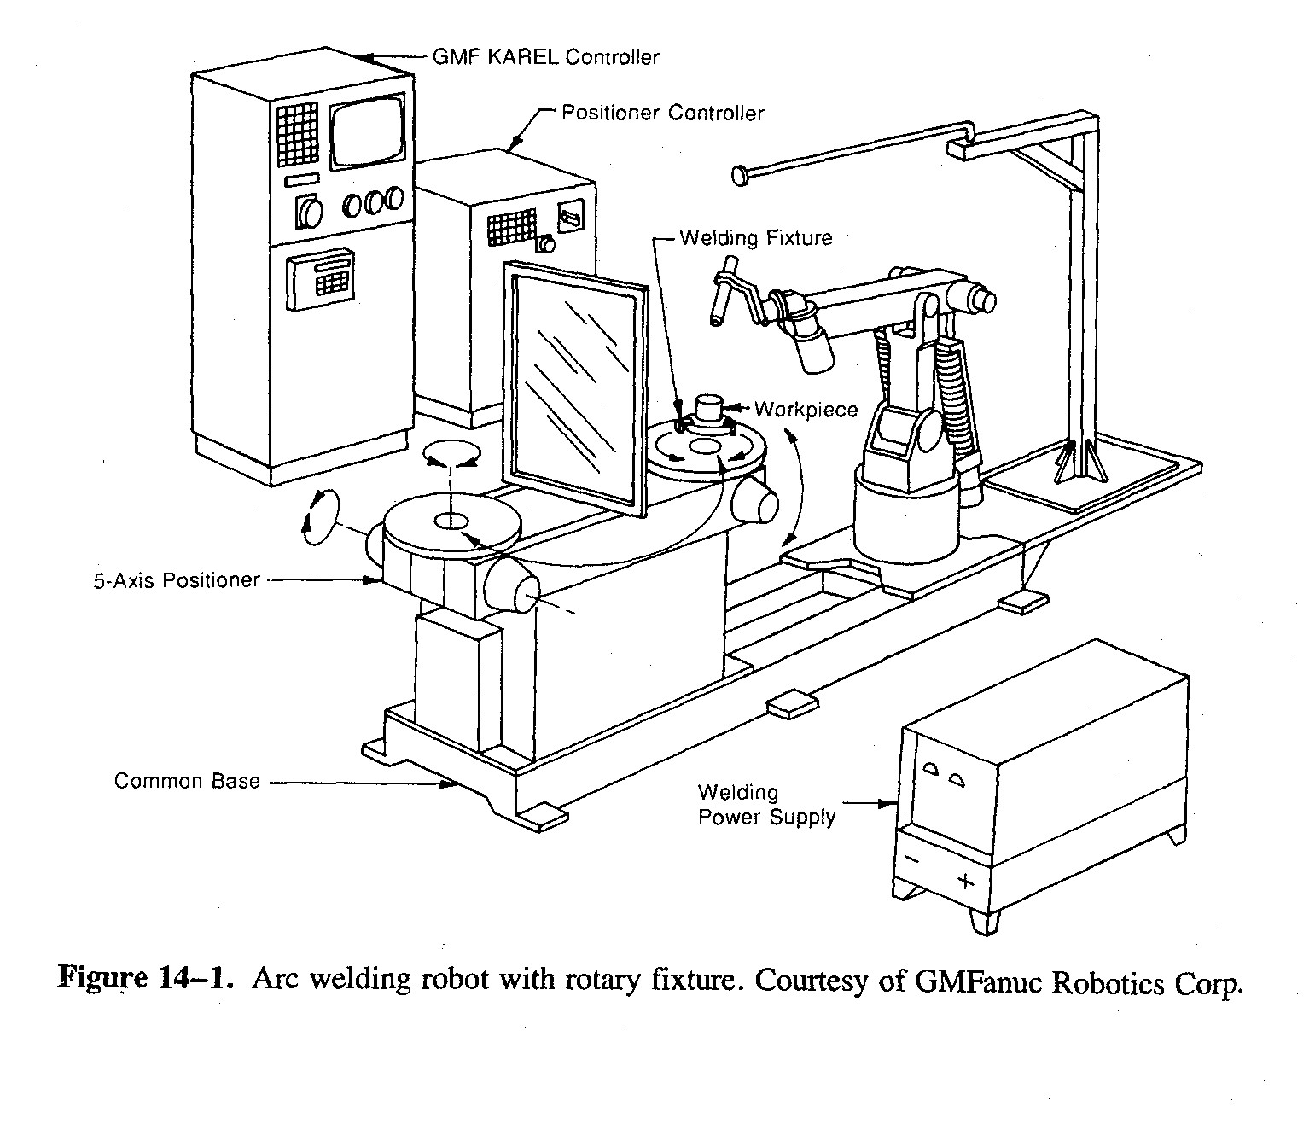
Arc welding robot station
https://www.youtube.com/watch?v=TMznVlciWwk&list=PLE7753C812C799F82
Robot Cell Design

Slide 6
Robot Centered Workcell
Advantages
  Simple
  Easy to program and balance the cycle time
Disadvantages
  For some loading/unloading operations, the cycle times of the machine is relatively long compared to the part handling time of the robot. This requires the robot to be idle for a high proportion of the cycle, causing low utilization of the robot.
  A method for delivering the work parts into and out of the workcell must be provided such as input and output conveyers.
Robot Cell Design

Slide 7
In Line Robot Cell
Typical In line robot workcell
Product
The robot is located along a moving conveyor or other materials handling system and performs a task on the product as it travels past on the conveyor.
Three categories:
  1. Intermittent (synchronous) transfer
  2. Continuous transfer
  3. Nonsynchronous transfer
Conveyor
Robot 1
Robot 2
Robot n
Robot Cell Design

Slide 8
Intermittent Transfer In Line Robot Workcell
This system moves the parts with a start - and - stop motion from one workstation along the line to the next. In a robot layout using intermittent transfer, the robot is at a stationary location and constitutes one position along the line at which a part or product stops for processing.
It is sometime called synchronous transfer system
Advantage:
  The part can be registered in a fixed location and orientation with respect to the robot during the robot's work cycle
Disadvantages
  Low utilization of robots unless robot cycle times are well balanced
  Parts should stand by before moving to the next robot until all the robots finish their operations
Robot Cell Design
Notes:
Dis

Slide 9
Continuous Transfer Robot Workcell
In this system, the workpieces moves continuously along the line at a constant speed. Therefore, the position and orientation of the part is continuously changing with respect to any fixed location along the line. Here, the registration of the part relative to the robot becomes a problem. This problem can be solved by using either of two means:
  1) Moving baseline tracking system.
    This involves the use of some transport system to move the robot along a path parallel to the line of travel of the workpiece, while the operation performed on the part.
  Disadvantages:
    An additional degree of freedom must be provided for the robot to move along the conveyor.
    Involves significant capital expense.
    Interference and collision problem between robots at adjacent stations along the line.
    Requires significant amount of floor space.
Robot Cell Design

Slide 10
Continuous Transfer Robot Workcell
2) Stationary baseline tracking system
  In this system, the robot is located in a stationary position along the line but its manipulator is capable of tracking the moving workpiece. Where "Tracking" means that the robot is able to maintain the positions of the programmed points, including the orientation of the end - effector and the motion velocities, in relation to the workpiece even though the part is moving along a conveyor.
  Disadvantages:
    The robot must have sufficient computational and control capability to accomplish tracking.
    Sensing of the part on the conveyor.
    Control of the "tracking window", where tracking window is the intersection of the robot's work volume, with the line of travel of the workpiece along the conveyor.
Robot Cell Design

Slide 11
Stationary baseline tracking system
Line of conveyor travel
Tracking
Window
Robot work volume
Robot
Concept of tracking window
Robot Cell Design
Notes:
Tracking window is smaller than the overlap between the robot work volume with the line of travel workparts to account for:
manipulation of the wrist and end effector
access to portions of the workpart that might be difficult to reach

Slide 12
Nonsynchronous Transfer Robot Workcell
In this system, each part moves independently along the conveyor in a stop - and - go fashion. When a particular workstation has completed its processing of a part, that part proceeds to move toward next workstation in the line. Hence, at any given moment, some workpieces are being processed, while others are located between stations.
Disadvantages:
  Design and operation of this type of transfer system is more complicated.
  Requires extensive use of sensors.
  Each part must be provided with its own independently operated moving cart.
Robot Cell Design

Slide 13
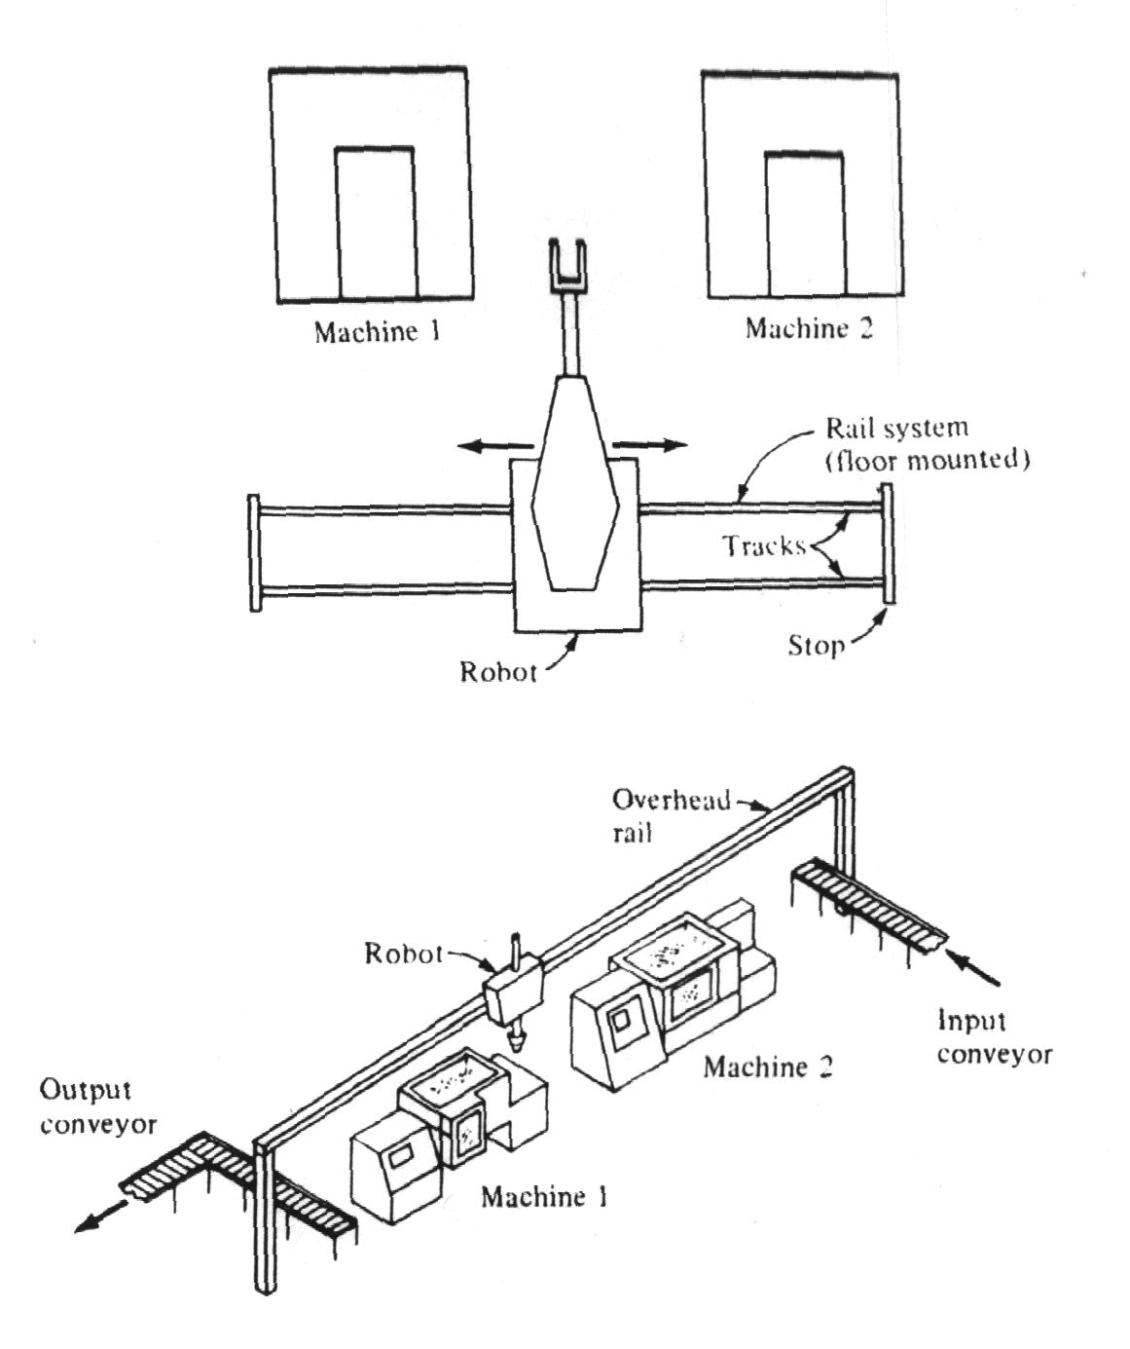
Mobile Robot Workcells
Mobile Robot Cell
In this system, the robot is capable of moving to the various pieces of equipment within the cell. This is typically accomplished by mounting the robot on a mobile base which can be transported on a rail system. The rail systems used in the robot cells are either tracks fastened to the floor of the plant or overhead rail system.
The advantage of the overhead rail system compared to the floor mounted track system is that less floor space required. The disadvantage is the increased cost of constructing the overhead system.
Source: Groover
Overhead Rail System for Mobile
Robot Cell
Robot Cell Design

Slide 14
Multiple Robots and Machine Interference
In robot cell design care must be taken to ensure that the different pieces of equipment do not interfere with one another. There are two ways in which this interference can occur:
  Physical interference
  Machine interference
Physical interference:
  This case involves physical interference of the robots, where the work volumes of two robots in the cell overlap each other. In this situation, the danger of collision exists between the robot arms.
  This interference can be prevented:
    By separating the robots by an adequate distance to avoid the problem.
    By coordinating the programmed motion cycles of the two robots so that the arms are never close enough to risk a collision.
Robot Cell Design

Slide 15
Multiple Robots and Machine Interference
Machine Interference
It occurs when there are two or more machines being serviced by one robot, and the machine cycles are timed in such a way that idle time is experienced by one or more machines while another machine is being served by the robot.
Machine interference can be measured as the total idle time of all the machines in the cell as compared to the robot cycle time. The measure is most commonly expressed as a percent.
When the cycles of the machines are the same, then the question of whether or not machine interference will occur is determined by the relative values of machine cycle time and robot cycle time.
  The machine cycle time = (service time) + (run time)
  The robot cycle time = (number of machines) * (service time)
  If the robot cycle time > the machine cycle time, then there will be machine interference.
  If the robot cycle time < the machine cycle time, then there will be no machine interference, but the robot will be idle for part of the cycle.
Robot Cell Design

Slide 16
Example 1
Consider a robot cell in which a robot is used to load and unload three machines. Assume, each of the three machines in the cell are identical. The cycle time is divided between run time of 30 s, and robot’s service time of 20 s. Draw a robot and machine process chart. Determine the actual cycle, robot idle time and machine interference.
_______________________________________________________________________
Activity& time M/C1 M/C2 M/C3
________________________________________________________________________
From the chart it can be seen that each machine has idle time during its cycle of 10 s
while the robot is fully occupied throughout its work cycle. Hence,
Total machine idle time of all three machines is 3*10 = 30 s
The cycle time = 60 s
The machine interference is 30 s/ 60 s = 50 %
0
20
40
50
60
80
100
Actual
cycle time
120
Robot Cell Design

Slide 17
Other Considerations in Workcell Design
There are several issues that must be considered in the design of the workcell:
  1. Changes to other equipment in the cell
    Fixtures and work holding devices
    Materials handling systems such as conveyors
  2. Part position and orientation
    Position and orientation on the conveyors
    Keeping part orientation during transferring it from one position to another
  3. Part identification problem
    Optical techniques
    Sensors
    Bar code
  4. Protection of the robot from its environment
    Spray painting
    Welding
  5. Utilities
    Air, Water, Electrical supplies
  6. Control of the workcell
    Coordination with other equipment
  7. Safety
Robot Cell Design

Slide 18
Workcell Control
Coordination of various activities in the workcell is accomplished by a device called the workcell controller or workstation controller. The function performed by the workcell controller can be divided into three categories:
  1. Sequence control
  2. Operator control
  3. Safety control
Robot Cell Design

Slide 19
Sequence Control
Includes the following control functions:
  Control of the sequence of activities in the workcell.
  Control of simultaneous activities.
  Making decision to proceed with the work cycle based on events that occur in the cell.
  Making decision to stop or delay the work cycle based on events that occur in the cell.
Example
  In a machining cell consisting of a robot, machine tools, and conveyors; a workstation controller is used to coordinate the operation of the workcell.
Other functions may include:
  Performing computations
  Deal with exceptional events such as equipment malfunction.
  Performing irregular cycles such as tool changes at periodic intervals.
Robot Cell Design

Slide 20
Operator Interface
The purpose of the operator interface in workstation control is to provide means for human operator to interact with the operation of the cell. There are several situations when this would be required:
  • The human is an integral part of the workcell
    Welding work cell
    Forging workcell
  • Emergency stop conditions
  • Program editing or data input by operator.
Robot Cell Design

Slide 21
Safety Monitoring
The safety monitoring includes the following functions:
  Provide an operator ability to override the regular work cycle in the event of an observed safety hazard.
  Provide capability to the workcell controller to monitor its own operation for unsafe conditions in the cell.
Robot Cell Design

Slide 22
Interlocks in Workcell
Functions:
  Regulating work cycle sequence
  Preventing a sequencing from continuing unless certain conditions are met.
Types
  Output
  Input
Output
  Involves the use of a signal sent from the workstation controller to one of the machines or devices in the work cell. It corresponds with “SIGNAL line” statement
Examples: Making sure that:
  a part has been loaded to the machine
  the robot moved to a safe position, etc.
Robot Cell Design

Slide 23
Interlocks in Workcell
Input interlocks
  A signal sent from a component in the workcell to the controller. It corresponds with “WAIT line” statement.
  Function
    Indicate that a certain condition or a set of conditions has been met and the work cycle can continue.
Why interlocks?
  Provide synchronization of the activities in the workcell
  Allow for time variations for certain elements in the cycle
  Help in preventing damage of various components in the cell
Interlocks signals include:
  Signals from the controller
  Simple sensors such as microswitches
  Complex sensors such as vision systems
  Signals sent to/from machine controllers
Robot Cell Design

Slide 24
Errors In Workcell
Errors in workcell operation could lead to delays in the production. It is necessary to have some means to detect theses errors and recover from them.
Classes of Errors:
  Random errors: This type is usually from stochastic phenomena, e.g. part size variations.
  Systematic errors: Due to some bias that exits in the process, e.g. incorrect set up of a machine or a fixture.
  Illegitimate errors: Results from outright mistake either by equipment or a human, e.g. error in a robot program, or electrical failure, or hydraulic leak of the machine, etc.
Therefore, there is a need not only for detection of the error but also to recover from it.
Robot Cell Design

Slide 25
Error Detection and Recovery
Error detection needs:
  Use of appropriate sensors
  Intelligence routines to recognize and classify the errors
Recovery
  Requires appropriate strategies such as:
  Adjustment at the end of current cycle: this is for low level urgency error; e.g.
    Part drop from a robot; action: pick another part and don’t search for the lost
  Adjustment during current cycle: Serious error not requiring stop action, correction action by calling a special subroutine for specific error; e.g.
    Part oversize; action: add one machining pass.
  Stop process and invoke corrective algorithm: an urgent error that requires stopping and calling a subroutine to correct error then work resume, e.g.
    Tool failure; action: stop and replace tool
  Stop process and call for help: Malfunction that can not be corrected by robot and needs human interference; e.g.
    hydraulic failure of robot, action: call operator
Robot Cell Design

Slide 26
Example2
A machining work cell consists of THREE identical machining centers and a robot, input conveyor and output conveyer. The robot is used to load and unload the machines. The robot picks up a part from the incoming conveyer and loads it on a machine fixture, then after completion of machining it unloads the part and drops it onto the exit conveyer. The work cycle for a SINGLE machine consists of the following sequence of activities:
Step no. Activity Time in Seconds
1. Robot moves from safe position to the incoming conveyer,
picks up a part, load it onto the machine fixture, moves out
of the machine and signals to it to start machining 13
2. Machining cycle (automatic) 45.00
3. Robot reaches in the fixture, retrieves the part and deposits
onto exit conveyer, then moves back to the safe position 14
Robot Cell Design

Slide 27
Example 2 continue
Machine 2
a. What type of workcell layout is the
most suitable for this case? Make a sketch
of the workcell showing relative positions
of different pieces of equipment in the cell.
Machine 3
Machine 1
Robot
Input conveyor
Output conveyor
Robot Cell Design

Slide 28
b. Draw a machine/process time chart showing the activities in the work cell. Indicate on each activity the status of both the robot and the machine.
Robot Cell Design

Slide 29
c. Determine the amount of machine interference and the amount of robot idle time.
Robot Cell Design

Slide 30
d. List five errors which could happen during the operation of this work cell. Give a recovery strategy for each error.
Error | Recovery
Robot Cell Design

Slide 31
Examples of Possible Errors in an Automated Machining Cell
1. Tooling
  Tool wear-out
  Tool Breakage
  Vibration (chatter)
  Tool not present
  Wrong tool
2. Work part
  Work part not present
  Wrong work piece
  Oversized or under sized part
3. Process
  Wrong part program
  Wrong part
  Chip fouling
  No coolant when there should be
  Vibration (chatter)
  Excessive force
  Cutting temperature too high
4. Fixture
  Part in fixture (yes or no)
  Part located properly (yes or no)
  Clamps actuated
  Part dislodged during processing
  Part breakage
  Chip causing location errors
  Hydraulic or pneumatic failure
Robot Cell Design

Slide 32
Examples of Possible Errors in an Automated Machining Cell
5. Machine tool
  Vibration
  Loss of power
  Power overload
  Mechanical, electric or hydraulic failure
6. Robot/End Effector
  Improper grasping of workpiece
  No part present at pick up
  Hydraulic or electrical failure
  Loss of position accuracy
  Robot drops a part during handling
Robot Cell Design

Slide 33
e. Make a list of the interlocks required for the work cell. For each interlock indicate whether it is an input interlock or an output interlock. For each of the input interlocks, define what the interlock should sense before the signal is sent to the work cell controller. For each output interlock, define what conditions must be satisfied before the signal is sent from the work cell controller.
 | Interlock | Type | Condition
1
2
3
4
5
6
7
8
9
10
Robot Cell Design

Slide 34
Workcell Controller
Three options
  Robot controller
  Programmable logic controller (PLC)
  Computer
Robot Cell Design

Slide 35
A Robot Controller as the Workcell Controller
More sophisticated robot controllers usually have a limited input/output ports to interface with other equipments
This input/output interface is provided for the incorporation of interlocks in the workcell
A typical arrangement for the input/output module of the robot controller
  Input ports (10 – 25 input lines) – These would be used for incoming signal from external equipments. The signals would be binary (voltage on or off) and could be referenced as logical conditions in the robot program for purposes of interlocking. Some input ports are reserved for safety interlocks.
  Output ports (10 – 25 input lines) – These ports would be used for output interlock signals to the external equipment. The signals would be initiated or terminated according to logical conditions in the robot program, thus resulting in some response by the external equipment.
  Most robot controllers are limited to sequence control and often do not possess the capability to incorporate any significant safety monitoring or operator interfacing into the workcell control system.
Robot Cell Design

Slide 36
A Programmable Logic Controller as the Workcell Controller
Typical functions that can be accomplished on a PLC:
  Control relay functions – The generation of an output signal based on logic rules applied to one or more input signals
  Timing functions – For example, the generation of an output signal for a specified length of time
  Counting functions – An internal counter in the PLC is used to sum the number of contact closures and generate an output signal when the sum reaches a certain level
  Arithmetic functions – Many PLCs can perform the arithmetic operations such as addition, subtraction, and so on
  Analog control functions – Some PLCs have the capability to simulate analog control functions such as proportional, integral and derivative control
Robot Cell Design

Slide 37
A Programmable Logic Controller as the Workcell Controller
Some PLCs have the capacity to accept several hundred input/output connections, significantly more than a typical robot controller
The PLCs can control a more complex workcell with more activities taking place in the cell e.g. automobile spot-welding line
Additional features of PLCs
  Maintenance and diagnostic functions
  Operator interface – It provides operating performance information about production rates, tool usage, equipment breakdowns and other data
  Safety monitoring – A greater number of safety conditions can be observed than is possible with the robot controller alone
Robot Cell Design

Slide 38
A Computer as the Workcell Controller
A typical PLC has limitations in data processing and programming languages
A computer can be used either in series with a PLC or as a substitute for the PLC for some of the following applications:
  Case in which there are several cells whose operations must be coordinated and significant amount of data must be communicated
  Case in which the error detection and recovery problem constitutes a significant portion of the coding
  Where several different products are made on the same robot-automated production line
  Where a high level of production scheduling and inventory control are required in the operation of the cell
Robot Cell Design

Slide 39
Example 3
A robot workcell is to be installed for plastic molding. The cell will consist of a large robot, three-injection molding machines, and a belt conveyer for delivering the molded parts out the cell. The three machines will have identical work cycles. The work cycle for each machine consists of the following sequence of activities:
_______________________________________________________________________
Activity Time
___________________________________________________________________
1. The machine injects the plastic automatically in the mold after
it gets a signal from the cell controller, and holds the mold
pressure until it solidifies. 27
2. Then, the molding machine opens the mold and signals
"part ready to pick up" 3
3. The robot reaches into the molding machine to retrieve molded part. 6
4. The robot moves out to a safe position out of the mold cavity and
signals the machine to start a new cycle. 2
5. Machine closes the mold and starts new molding cycle 3
6. The robot moves to deposit the part onto the conveyer. This activity
performed simultaneously with molding cycle. 2
7. Robot moves back to starting position. This activity performed
simultaneously with molding cycle. 4
____________________________________________________________________
Robot Cell Design

Slide 40
Example 3 (continue)
1. Draw a machine process time chart showing the activities in the work cell.
2. Determine the amount of machine interference and the amount of robot idle time.
3. Make a list of the interlocks required for the workcell. For each interlock indicate whether it is an input or output interlock. For each of the input interlocks, define what the interlock should sense before the signal is sent to the work cell controller. For each output interlock, define what conditions must be satisfied before the signal is sent from the workcell controller. (A point will be given for each accurately defined interlock)
4. What type of workcell layout is the most suitable for this case? Make a sketch of the workcell showing relative positions of different pieces of equipment in the cell. Justify your selection.
5. List five errors which could happen during the operation of this workcell. Give a recovery strategy for each error.
Robot Cell Design

Slide 41
 | Interlock | Type | Condition
1
2
3
4
5
6
7
8
9
10
Robot Cell Design

Slide 42
Error | Recovery
Robot Cell Design

Slide 43
Robot Cycle Time Analysis
The cycle time determines the production rate for the job, a significant factor in the economic success of the robot installation
Estimating the cycle time will allow comparing alternative methods for performing robot tasks and even choosing the best robot for a given application
The goal of robot cycle time analysis is to estimate the amount of time required to accomplish a certain work cycle before setting up the workstation and programming the robot
Basic Idea behind Robot Time and Motion (RTM) Approach
  Divide the work cycle into its basic motion elements
  Use standard time values which were previously complied by studying similar elements and analyzing the factors that determine the time e.g. weight of the object and the distance to move
Robot Cell Design

Slide 44
Methodology of Robot Time and Motion (RTM)
There are 10 general categories of robot work cycle (see Table 11-1) which can be classified into four major groups
  Motion elements. These are the manipulator movements, performed either with or without load
  Sensing elements. These are sensory activities such as vision sensing, force sensing and position sensing
  End effector elements. These elements relate to the action of the gripper or tool attached to the robot wrist
  Delay elements. These are delay times resulting from waiting and processing conditions in the work cycle
To use Table 11-1, the robot work cycle must be divided into its corresponding elements, and each element is specified in terms of associated parameters such as distance and speed
Table 11-2 shows hypothetical values for a hypothetical robot model as an example
Robot Cell Design

Slide 45
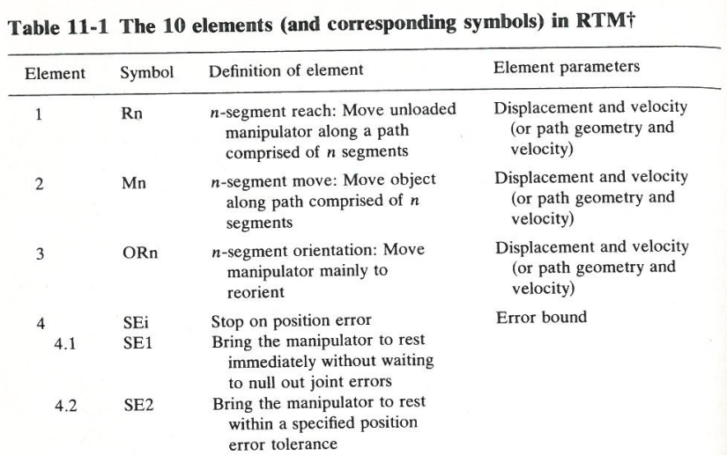
The 10 Elements in RTM
Robot Cell Design

Slide 46
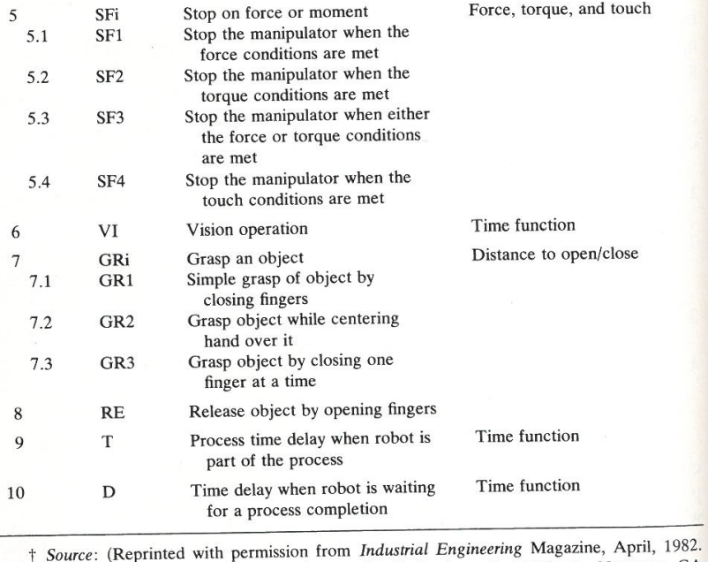
The 10 Elements in RTM
Table 11-1, p. 334
Robot Cell Design

Slide 47
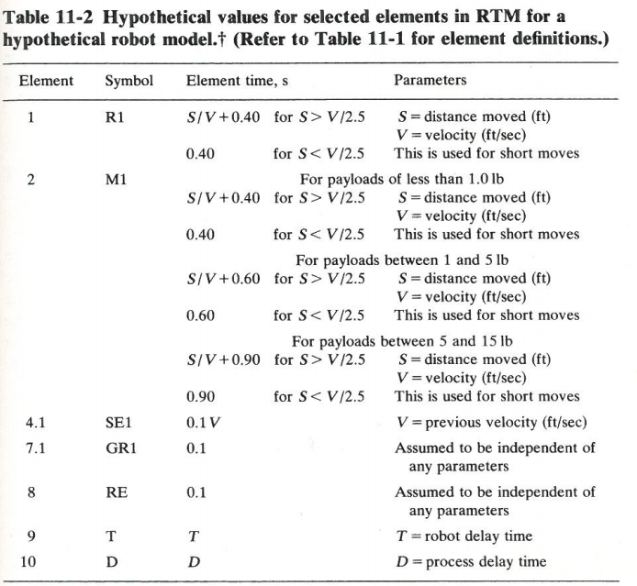
Hypothetical Values for Selected Elements in RTM
Table 11-2, p. 335
Source: Groover
Robot Cell Design

Slide 48
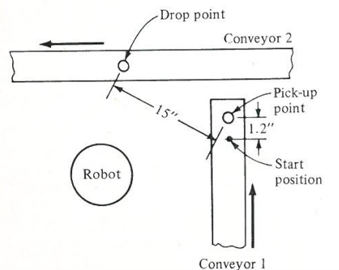
Example 4
The robot must move parts weighing 3 lb from one conveyor to another conveyor (See Fig) . The sequence of the work cycle proceeds as follows:
  Robot picks up part from first conveyor which has delivered the part to a known pickup position.
  Robot transfers part to second conveyor and releases part
  Robot moves back to ready position at first conveyor
Source: Groover
Robot Cell Design

Slide 49
Example 4
List the detailed sequence of elements to accomplish the work cycle
Solution:
Sequence | Element description
1 | Conveyor delivers a part to a fixed position every 15 s. Robot in ready position above conveyor must await part delivery before executing its motion cycle
2 | Robot approaches part with gripper in open position. Speed setting is 0.1 ft/sec.
3 | Robot gripper closes on part.
4 | Robot lifts part 0.1 ft above conveyor. Speed is 0.1 ft/sec
5 | Robot moves part to a position 0.1ft above second conveyor. Robot arm speed is 0.5 ft/sec. Distance traveled is 15 in.
6 | Robot moves part to conveyor surface. Gripper would have to be oriented so that conveyor motion does not cause immediate tipping of the part when released. Speed is 0.1 ft/sec.
7 | Robot gripper opens to release part on conveyor surface.
8 | Robot moves empty gripper away from conveyor surface by 0.1 ft. Speed is 0.1ft/sec.
9 | Robot arm returns to ready position 0.1 ft above first conveyor surface. Distance traveled between conveyors is 15 in. Robot arm speed is 0.5 ft/sec.
Robot Cell Design

Slide 50
Example 4
Calculate elements times, total cycle time, and robot motion cycle time using the hypothetical robot values in Table 11-2
Solution:
Sequence | RTM symbol | Distance, ft | Velocity, ft/sec | Delay time, s | Element time, s | Description
1 | D | − | − | 15.0 | 15.0 | Await delivery
2 |  |  |  |  |  | Approach part
3 |  |  |  |  |  | Grasp part
4 |  |  |  |  |  | Lift part
5 |  |  |  |  |  | Move part
6 |  |  |  |  |  | Approach release point
7 |  |  |  |  |  | Release part
8 |  |  |  |  |  | Depart release point
9 |  |  |  |  |  | Reposition
Total
Robot Cell Design

Slide 51
Example 4
The conveyor belt delivers one part every 15 s while the time for the robot motion cycle is 12.2 s
  Total cycle time = 15 s
  Time for the robot motion cycle = 12.2 s
The conveyor is the limiting factor in the cycle requiring 2.8 s more time than the robot motion cycle.
It might be possible to increase the feed rate on the conveyor belt such that one part is delivered every 12.2 s.
Robot Cell Design

