Slide 1
Public Key Cryptography

Slide 2
Introduction
Foundation of today’s secure communication
Allows communicating parties to obtain a shared secret key
Public key (for encryption) and Private key (for decryption)
Private key (for digital signature) and Public key (to verify signature)

Slide 3
Brief History Lesson
Historically same key was used for encryption and decryption
Challenge: exchanging the secret key (e.g. face-to-face meeting)
1976: Whitfield Diffie and Martin Hellman
key exchange protocol
proposed a new public-key cryptosystem
1978: Ron Rivest, Adi Shamir, and Leonard Adleman (all from MIT)
attempted to develop a cryptosystem
created RSA algorithm

Slide 4
Outline
Public-key algorithms
Diffie-Hellman key exchange
RSA algorithm
Digital signature
Public-key infrastructure
SSL/TLS protocol

Slide 5
Diffie-Hellman Key Exchange
Allows communicating parties with no prior knowledge to exchange shared secret keys over an insecure channel
Alice and Bob want to communicate
Alice and Bob agree on:
Number p: big prime number (such as a 2048-bit number)
Generator g: small prime number (such as 2 and 3)
Alice picks a random positive integer x < p
Bob picks a random positive integer y < p

Slide 6
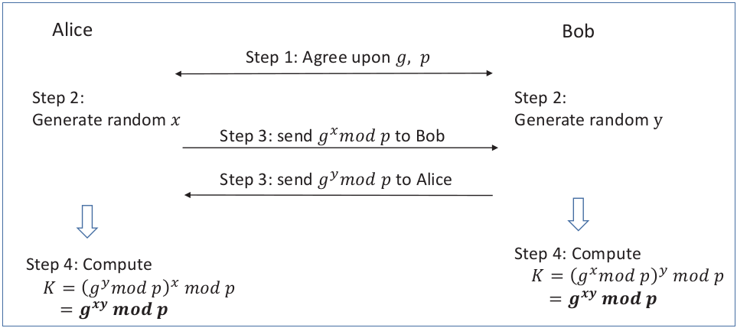
Diffie-Hellman Key Exchange (Contd.)

Slide 7
Turn DH Key Exchange into a Public-Key Encryption Algorithm
DH key exchange protocol allows exchange of a secret
Protocol can be tweaked to turn into a public-key encryption scheme
Need:
Public key: known to the public and used for encryption
Private key: known only to the owner, and used for decryption
Algorithm for encryption and decryption

Slide 8
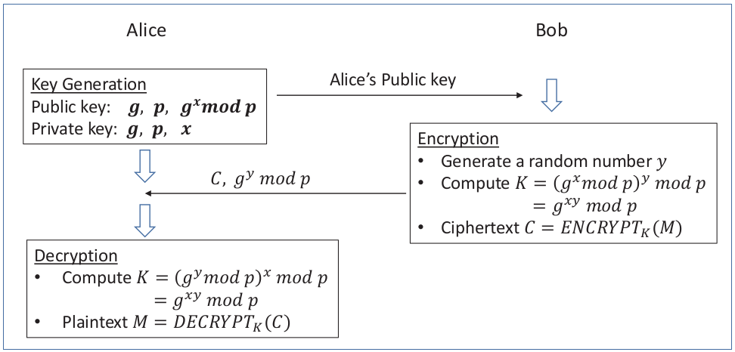
Turn DH Key Exchange into a Public-Key Encryption Algorithm (Contd.)

Slide 9
RSA Algorithm
We will cover:
Modulo Operation
Euler’s Theorem
Extended Euclidean Algorithm
RSA Algorithm
Algorithm example on small and large number

Slide 10
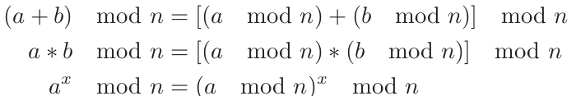
Modulo Operation
The RSA algorithm is based on modulo operations
a mod n is the remainder after division of a by the modulus n
Second number is called modulus
For example, (10 mod 3) equals to 1 and (15 mod 5) equals to 0
Modulo operations are distributive:

Slide 11
Euler’s Theorem
Euler’s totient function φ(n) counts the positive integers up to a given integer n that are relatively prime to n
φ(n) = n − 1, if n is a prime number.
Euler’s totient function property:
if m and n are relatively prime, φ(mn) = φ(m) ∗ φ(n)
Euler’s theorem states:
a ^{φ(n)} = 1 (mod n)

Slide 12
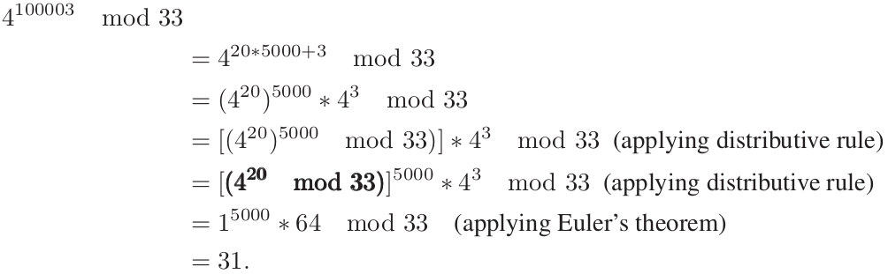
Euler’s Theorem (Contd.)
Example: to calculate 4 ¹⁰⁰⁰⁰³ mod 33
φ(33) = φ(3) ∗ φ(11) = (3 − 1) ∗ (11 − 1) = 20
100003 = 5000φ(33) + 3

Slide 13
Extended Euclidean Algorithm
Euclid’s algorithm: efficient method for computing GCD
Extended Euclidean algorithm:
computes GCD of integers a and b
finds integers x and y, such that: ax + by = gcd(a, b)
RSA uses extended Euclidean algorithm:
e and n are components of public key
Find solution to equation:
e ∗ x + φ(n) ∗ y = gcd(e, φ(n)) = 1
x is private key (also referred as d)
Equation results: e ∗ d mod φ(n) = 1

Slide 14
RSA Algorithm
We will cover:
Key generation
Encryption
Decryption

Slide 15
RSA: Key Generation
Need to generate: modulus n, public key exponent e, private key exponent d
Approach
Choose p,q (large random prime numbers)
n = pq (should be large)
Choose e, 1 < e < φ(n) and e is relatively prime to φ(n)
Find d, ed mod φ(n) = 1
Result
(e,n) is public key
d is private key

Slide 16
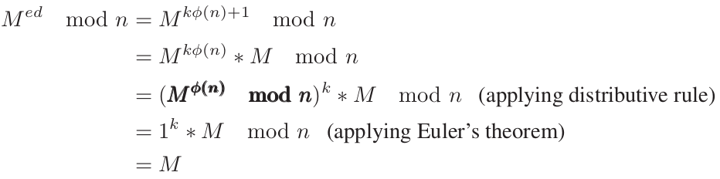
RSA: Encryption and Decryption
Encryption
treat the plaintext as a number
assuming M < n
C = Me mod n
Decryption
M = C^{d} mod n

Slide 17
RSA Exercise: Small Numbers
Choose two prime numbers p = 13 and q = 17
Find e:
n = pq = 221
φ(n) = (p − 1)(q − 1) = 192
choose e = 7 (7 is relatively prime to φ(n))
Find d:
ed = 1 mod φ(n)
Solving the above equation is equivalent to: 7d + 192y = 1
Using extended Euclidean algorithm, we get d = 55 and y = −2

Slide 18
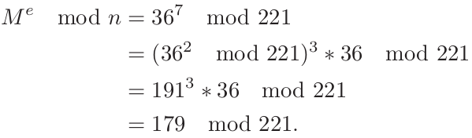
RSA Exercise: Small Numbers (Contd.)
Encrypt M = 36
Cipher text ( C ) = 179

Slide 19
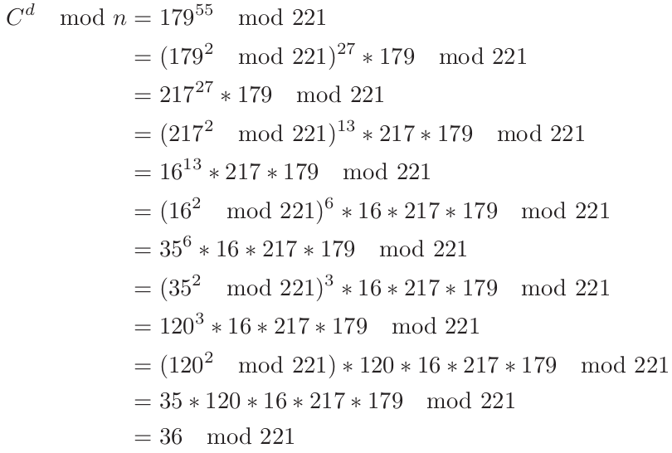
RSA Exercise: Small Numbers (Contd.)

Slide 20
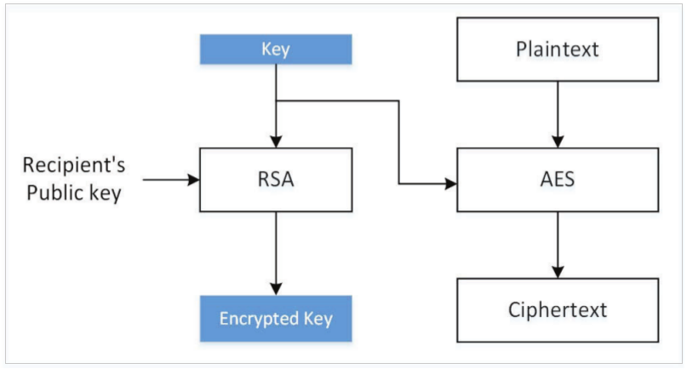
Hybrid Encryption
High computation cost of public-key encryption
Public key algorithms used to exchange a secret session key
Key (content-encryption key) used to encrypt data using a symmetric-key algorithm

Slide 21
Using OpenSSL Tools to Conduct RSA Operations
We will cover:
Generating RSA keys
Extracting the public key
Encryption and Decryption

Slide 22
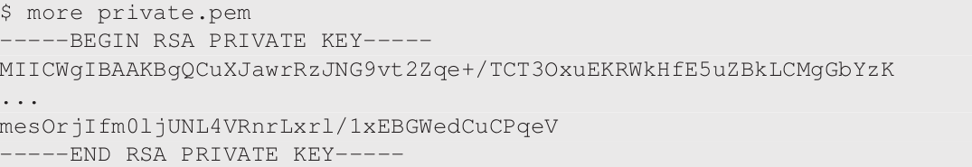
OpenSSL Tools: Generating RSA keys
Example: generate a 1024-bit public/private key pair
openssl genrsa -aes128 -out private.pem 1024
private.pem: Base64 encoding of DER generated binary output

Slide 23
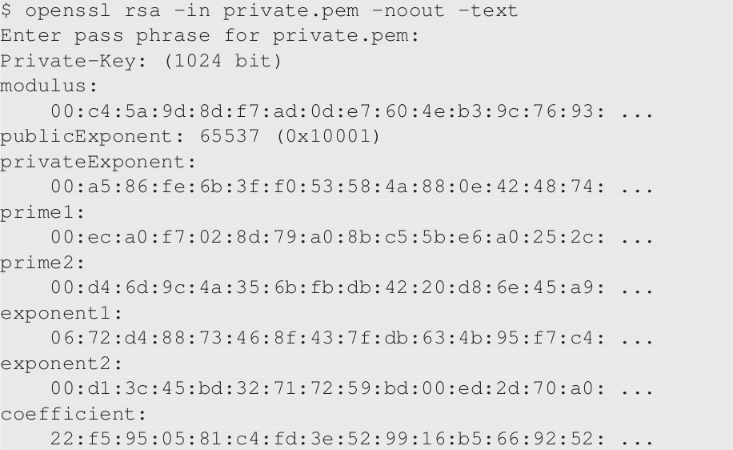
OpenSSL Tools: Generating RSA keys (Contd.)
Actual content of private.pem

Slide 24
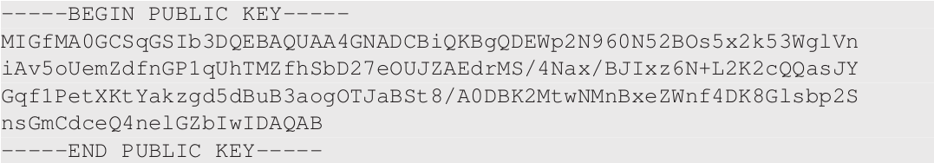
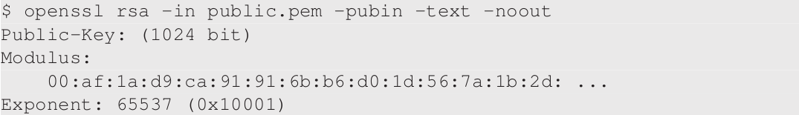
OpenSSL Tools: Extracting Public Key
openssl rsa -in private.pem -pubout > public.pem
Content of public.pem:

Slide 25

OpenSSL Tools: Encryption and Decryption
Plain Text
Encryption
Decryption

Slide 26
Paddings for RSA
Secret-key encryption uses encryption modes to encrypt plaintext longer than block size.
RSA used in hybrid approach (Content key length << RSA key length)
To encrypt:
short plaintext: treat it a number, raise it to the power of e (modulo n)
large plaintext: use hybrid approach (treat the content key as a number and raise it to the power of e (modulo n)
Treating plaintext as a number and directly applying RSA is called plain RSA or textbook RSA

Slide 27
Attacks Against Textbook RSA
RSA is deterministic encryption algorithm
same plaintext encrypted using same public key gives same ciphertext
secret-key encryption uses randomized IV to have different ciphertext for same plaintext
For small e and m
if m^{e} < modulus n
e-th root of ciphertext gives plaintext
If same plaintext is encrypted e times or more using the same e but different n, then it is easy to decrypt the original plaintext message via the Chinese remainder theorem

Slide 28
Paddings: PKCS#1 v1.5 and OAEP
Simple fix to defend against previous attacks is to add randomness to the plaintext before encryption
Approach is called padding
Types of padding:
PKCS#1 (up to version 1.5): weakness discovered since 1998
Optimal Asymmetric Encryption Padding (OAEP): prevents attacks on PKCS
rsautl command provides options for both types of paddings (PKCS#1 v1.5 is default)

Slide 29
PKCS Padding
Plaintext is padded to 128 bytes
Original plaintext is placed at the end of the block
Data inside the block (except the first two bytes) are all random numbers
First byte of the padding is always 00 (so that padded plaintext as integer is less than modulus n)
Second byte is 00, 01, and 02 (different strings used for padding for different types)

Slide 30
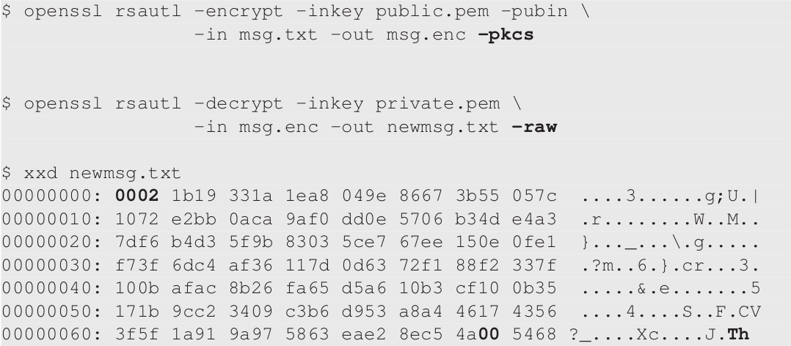
PKCS Padding (Contd.)

Slide 31
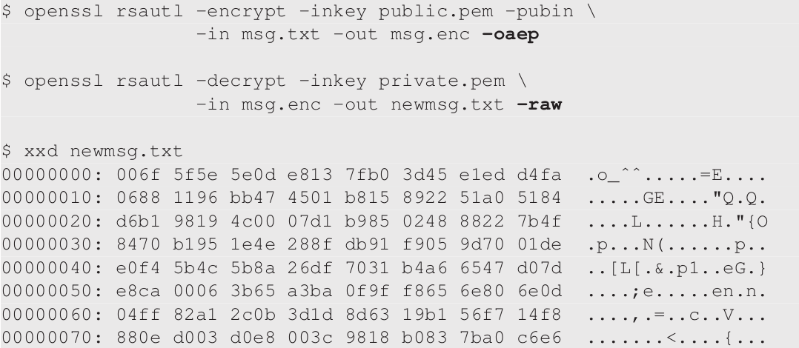
OAEP Padding
Original plaintext is not directly copied into the encryption block
Plaintext is XORed with a value derived from random padding data

Slide 32
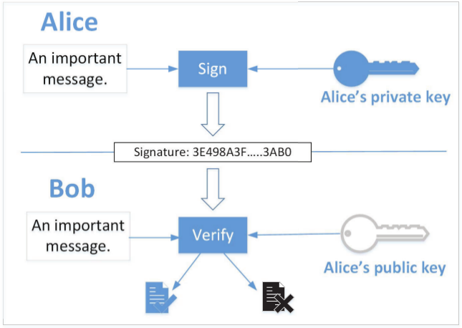
Digital Signature
Goal: provide an authenticity proof by signing digital documents
Diffie-Hellman authors proposed the idea, but no concrete solution
RSA authors developed the first digital signature algorithm

Slide 33
Digital Signature using RSA
Apply private-key operation on m using private key, and get a number s, everybody can get the m back from s using our public key
For a message m that needs to be signed:
Digital signature = m^{d} mod n
In practice, message may be long resulting in long signature and more computing time
Instead, we generate a cryptographic hash value from the original message, and only sign the hash

Slide 34
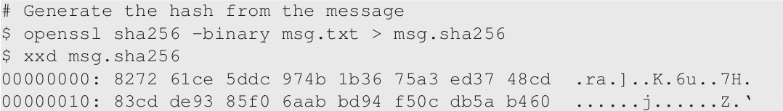
Digital Signature using RSA (Contd.)
Generate message hash

Slide 35
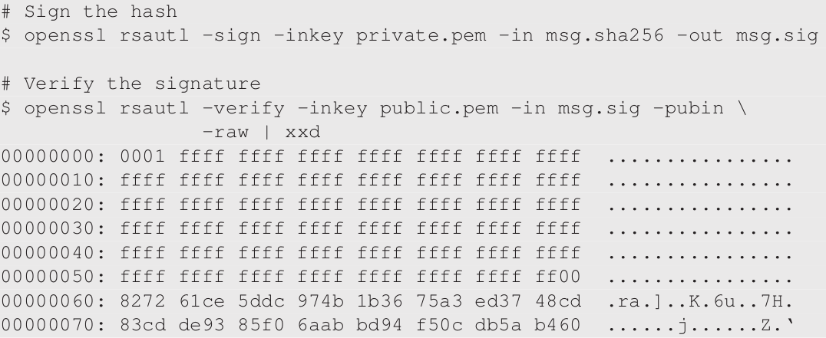
Digital Signature using RSA (Contd.)
Generate and verify the signature

Slide 36
Attack Experiment on Digital Signature
Attackers cannot generate a valid signature from a modified message because they do not know the private key
If attackers modifies the message, the hash will change and it will not be able to match with the hash produced from the signature verification
Experiment: modify 1 bit of signature file msg.sig and verify the signature

Slide 37
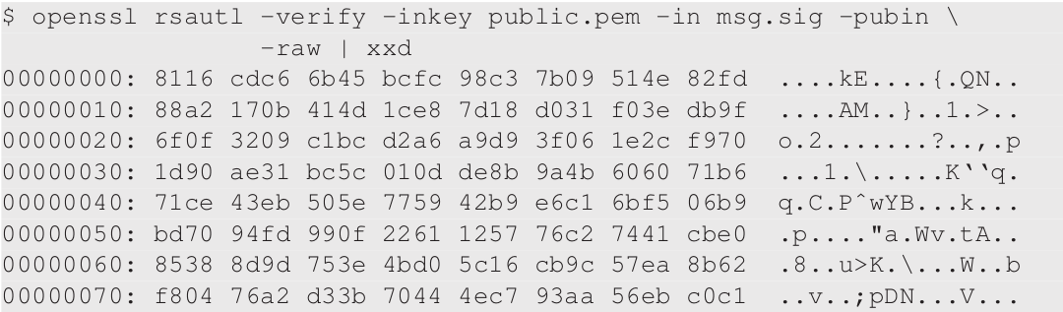
Attack Experiment on Digital Signature (Contd.)
After applying the RSA public key on the signature, we get a block of data that is significantly different

Slide 38
Programming using Public-Key Cryptography APIs
Languages, such as Python, Java, and C/C++, have well-developed libraries that implement the low-level cryptographic primitives for public-key operations
Python:
no built-in cryptographic library
use Python packages (e.g. PyCryptodome)
We will cover:
Key Generation
Encryption and Decryption
Digital Signature

Slide 39
Public-Key Cryptography APIs:
Key Generation
Python example (next slide) using Python Crypto APIs to generate a RSA key and save it to a file
Lines in code:
Line (1): generate a 2048-bit RSA key
Line (2): export key() API serializes the key using the ASN.1 structure
Line (3): extract public-key component

Slide 40
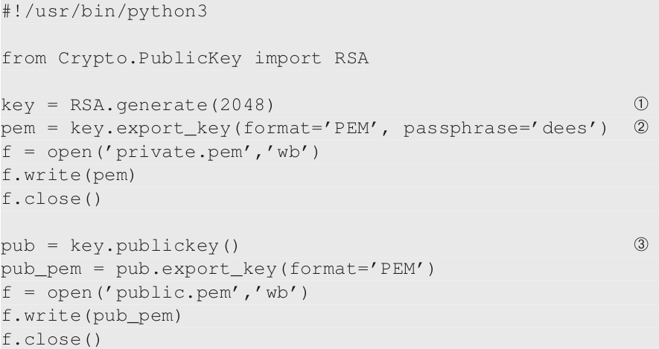
Public-Key Cryptography APIs:
Key Generation (Contd.)

Slide 41
Public-Key Cryptography APIs: Encryption
To encrypt a message using public keys, we need to decide what padding scheme
For better security, it is recommended that OAEP is used
Lines in code (example on next slide):
Line (1): import the public key from the public-key file
Line (2): create a cipher object using the public key

Slide 42
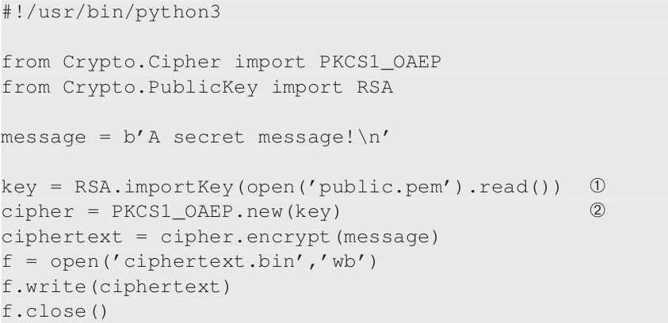
Public-Key Cryptography APIs: Encryption (Contd.)

Slide 43
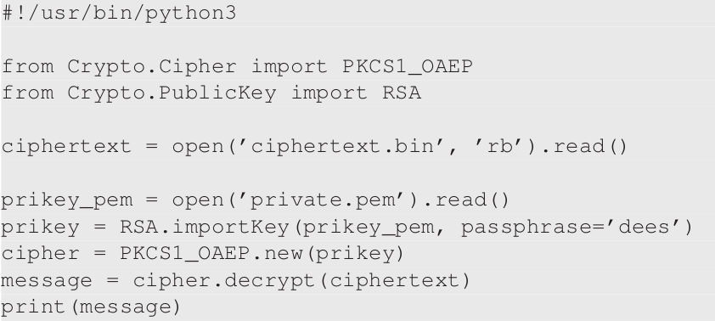
Public-Key Cryptography APIs: Decryption
Uses the private key and the decrypt() API

Slide 44
Public-Key Cryptography APIs: Digital Signature
In Python code, one canuse PyCryptodome library’s Crypto.Signature package
Four supported digital signature algorithms:
RSASSA-PKCS1-v1_5
RSASSA-PSS
DSA
RSASSA-PSS
Show example with RSASSA-PSS

Slide 45
Public-Key Cryptography APIs: Digital Signature using PSS
Probabilistic Signature Scheme (PSS) is a cryptographic signature scheme designed by Mihir Bellare and Phillip Rogaway
RSA-PSS is standardized as part of PKCS#1 v2.1
Sign a message in combination with some random input.
For same input:
two signatures are different
both can be used to verify

Slide 46
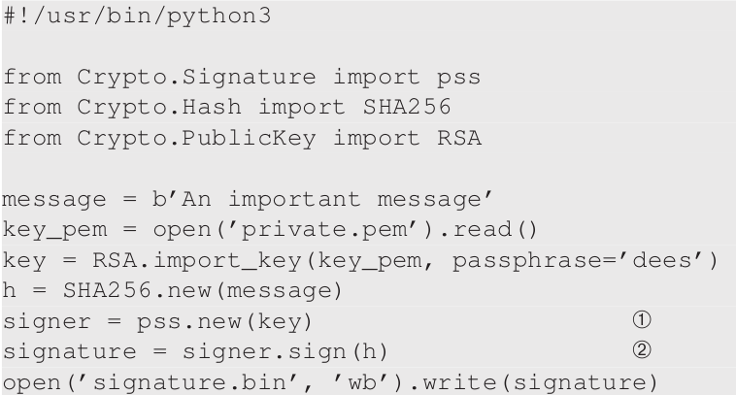
Public-Key Cryptography APIs: Digital Signature using PSS (Contd.)
Lines in code example:
line (1): create a signature object
line (2): generate the signature for the hash of a message

Slide 47
Applications
We will cover:
Authentication
HTTPS and TLS/SSL
Chip Technology Used in Credit Cards

Slide 48
Applications: Authentication
Typical way to conduct authentication is to use passwords
Disadvantage:
A sends password to B: B can get hacked and A may use same password for multiple accounts
cannot be used for many parties to authenticate a single party
Fundamental problem: password authentication depends on a shared secret

Slide 49
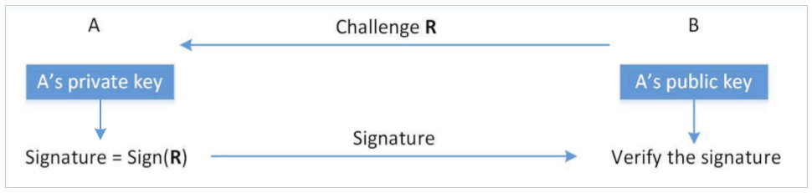
Applications: Authentication (Contd.)
Solution:
Making the encryption and decryption keys different
generate the authentication data using one key, and verify the data using a different key

Slide 50
Applications: Authentication (Contd.)
SSH Case Study
SSH uses public-key based authentication to authenticate users
Generate a pair of public and private keys: ssh-keygen -t rsa
private key: /home/seed/.ssh/id_rsa
public key: /home/seed/.ssh/id_rsa.pub
For Server:
send the public key file to the remote server using a secure channel
add public key to the authorization file~/.ssh/authorized_keys
Server can use key to authenticate clients

Slide 51
Applications: HTTPS and TLS/SSL
HTTPS protocol is used to secure web services
HTTPS is based on the TLS/SSL protocol (uses both public key encryption and signature
encryption using secret-key encryption algorithms
public key algorithms are mainly used for key exchange

Slide 52
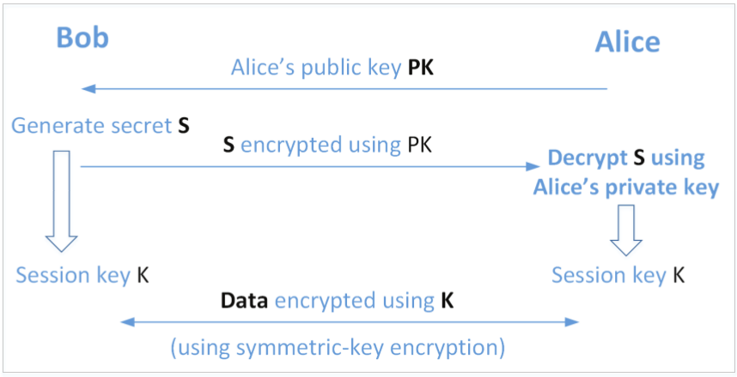
Applications: HTTPS and TLS/SSL (Contd.)

Slide 53
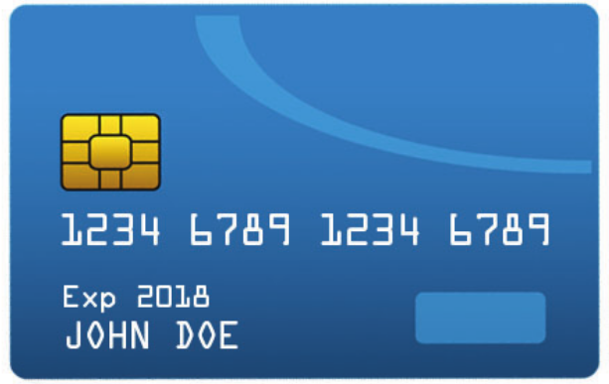
Applications: Credit Card Chip
Past: cards store card information in magnetic stripe (easy to clone)
With Chip:
chips can conduct computations and store data (not disclosed to outside)
EMV standard (Europay, MasterCard, and Visa)
We will cover how public key technologies are used for:
Card authentication
Transaction authentication

Slide 54
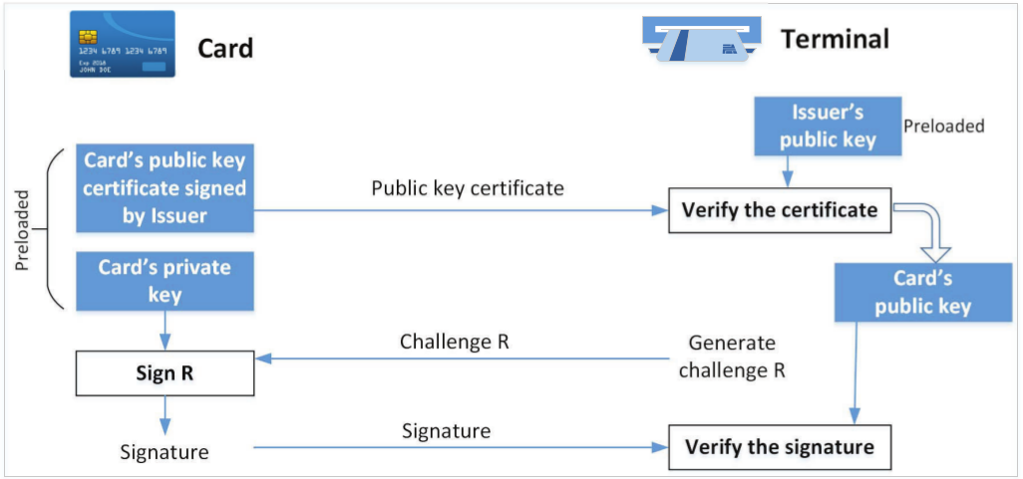
Applications: Credit Card Chip Authentication
Card contains a unique public and private key pair
Private key is protected and will never be disclosed to the outside
Public key is digitally signed by the issuer, so its authenticity can be verified by readers

Slide 55
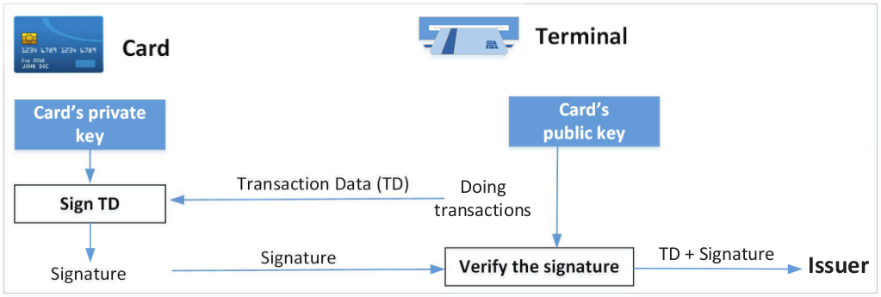
Applications: Credit Card Transaction Authentication
Issuer needs to know whether the transaction is authentic
Transaction needs to be signed by the card using its private key
Verified Signature:
To issuers: card owner has approved the transaction
To honest vendor: enables the vendor to save the transactions and submit them later

Slide 56
Summary
We covered:
the basics of public key cryptography
both theoretical and practical sides of public key cryptography
RSA algorithm and the Diffie-Hellman Key Exchange
tools and programming libraries to conduct public-key operations
how public key is used in real-world applications

