Slide 1
Transport Layer Security

Slide 2
Overview of TLS
Transport Layer Security (TLS) is a protocol that provides a secure channel between two communicating applications. The secure channel has 3 properties:
Confidentiality: Nobody other than the two ends of the channel can see the actual content of the data transmitted.
Integrity: Channel can detect any changes made to the data during transmission
Authentication: At least one end of the channel needs to be authenticated, so the other end knows who it is talking to.
Notes:
TLS evolved from its predecessor SSL and is gradually replacing SSL
When SSL was standardized by IETF, it was renamed to TLS
SSL version 3.0 was deprecated and replaced by TLS in June 2015
TLS is designed to run on top of TCP but can be implemented with other protocols such as UDP

Slide 3
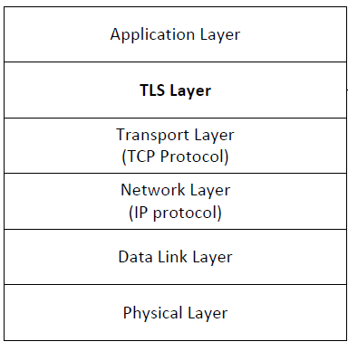
TLS Layer
TLS sits between the Transport and Application layer
Unprotected data is given to TLS by Application layer
TLS handles encryption, decryption and integrity checks
TLS gives protected data to Transport layer

Slide 4
TLS Handshake
Before a client and server can communicate securely, several things need to be set up first:
Encryption algorithm and key
MAC algorithm
Algorithm for key exchange
These cryptographic parameters need to be agreed upon by the client and server
This is the primary purpose of the handshake protocol

Slide 5
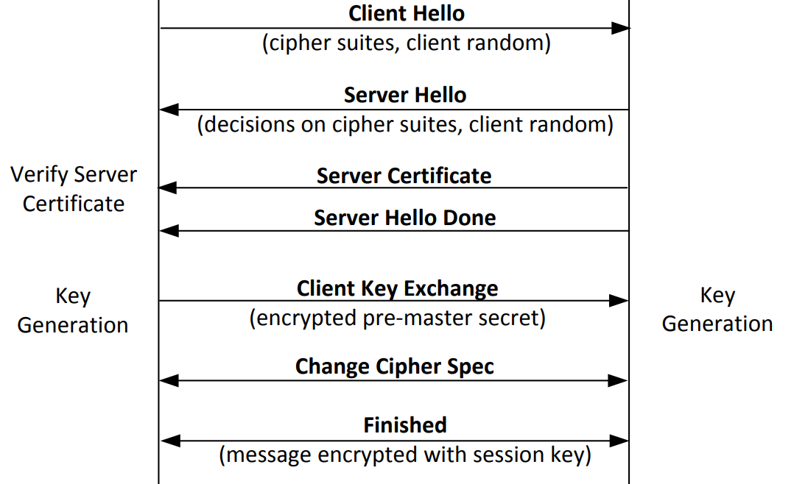
TLS Handshake Protocol
Notes:
Explanation in further slides

Slide 6
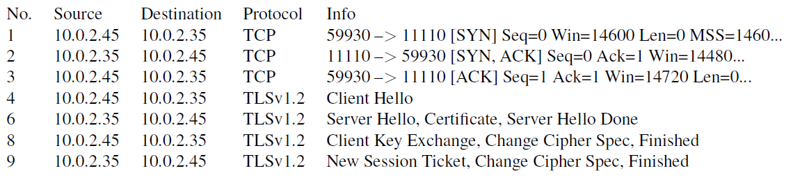
Network Traffics During TLS Handshake
Since TLS runs top of TCP, a TCP connection needs to be established before the handshake protocol. This is how the packet exchange looks between a client and server during a TLS handshake protocol captured using Wireshark:

Slide 7
Certificate Verification
The client first does a validation check of the certificate
Check expiration date, signature validity, etc.
Hostname and certificate’s common name match
The client needs to have the singing CA’s public-key certificate.
Notes:
Client programs, such as browsers, need to load a list of trusted CA certificated beforehand, or they will not be able to verify any certificate
If the signing CA is on the list, the certificate can be directly verified

Slide 8
Key Generation and Exchange
Although public-key algorithms can be used to encrypt data, it is much more expensive than secret-key algorithms.
TLS uses PKI for key exchange.
After that, server and client switch to secret-key encryption algorithm
The entire key generation consists of three steps:
Step 1: Generating pre-master secret
Step 2: Generating master secret
Step 3: Generating session keys

Slide 9
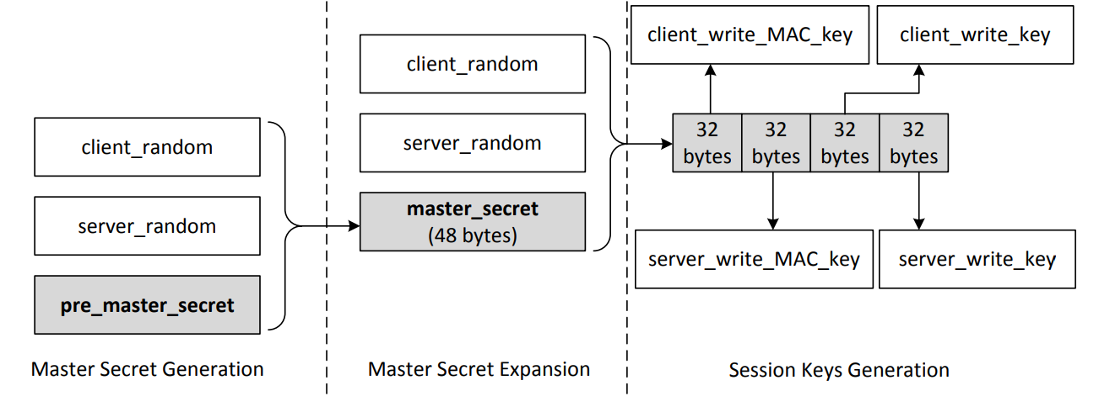
Key Generation and Exchange
These keys are used to protect an SSL session
Notes:
Pre master secret : The length of the number depends on the key exchange algorithm. Secret is encrypted with the servers public key and sent to the server.
Session keys: the client_write keys are used to secure the data from the client to the server which the server_write keys are used to secure data from the server to the client. The communication is bi-directional so both directions use separate keys.
The figure assumes we are using AES_256_CBC_SHA so each key is 32 bytes long

Slide 10
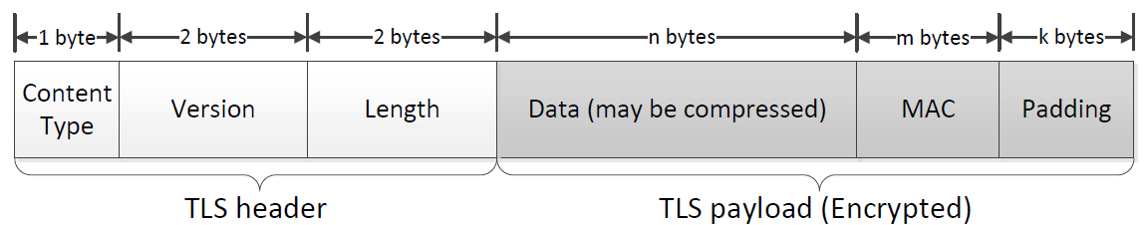
TLS Data Transmission
Once the handshake protocol is finished, client and server can start exchanging data.
Data is transferred using records.
Each record contains a header and a payload
Notes:
In this section, we focus on the application record type, which is used to transfer application data between a client and a server
Content Type: Indicates the type of protocol data carried by current record (handshake, alert, application, heartbeat or ChangeCipherSpec)
Version: This field identifies major and minor version of TLS being used
Length: The length of the payload field.

Slide 11
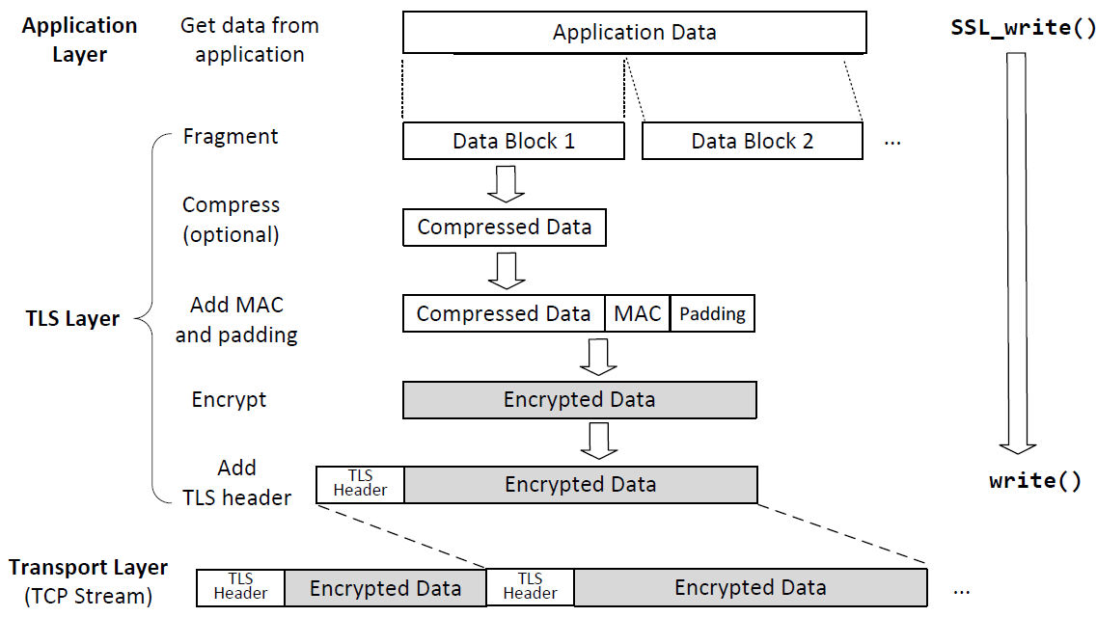
Sending Data with the TLS Record Protocol
Notes:
Applications invoke SSL_write() to send data over TLS.
This API breaks data into blocks and generates MAC for each block before encrypting the block
TLS puts the encrypted block into the payload field of the TLS record, and gives it to the transport layer for transmission

Slide 12
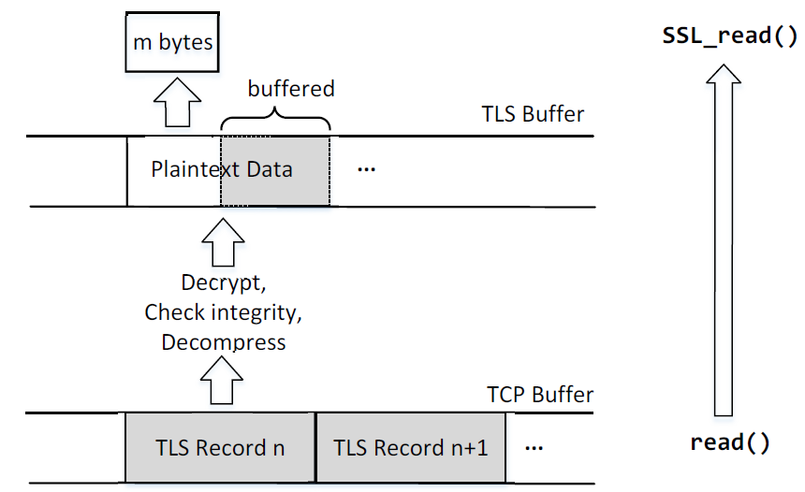
Receiving Data with the TLS Record Protocol
Notes:
Applications invoke SSL_read() to read data over TLS which calls the system read() to read one or multiple records from the TCP stream
After reading, the packet is decrypted, MAC is verified, data is decompressed (if needed) and then data is given to the application
When SSL_read() is called and TLS buffer is empty:
one TLS record is retrieved from the TCP buffer and processed
If the number of bytes is not enough to satisfy the request, another TLS record is retrieved.
This will repeat until the request is satisfied or no more data is available
If the total number of processed bytes exceeds the required number, leftover is stored in the TLS buffer for later read requests
When SSL_read() is called and TLS buffer is not empty:
TLS tries to get the requested amount of data from the TLS buffer
If the buffer contains enough data, TLS returns the required amount to the application
If the buffer does not contain enough data, TLS returns all the amount to the application

Slide 13
TLS Client Program

Slide 14
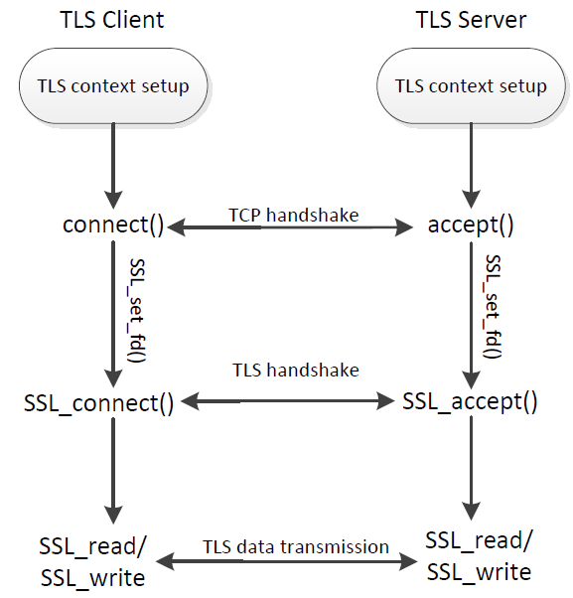
TLS Programming : Overall Picture

Slide 15
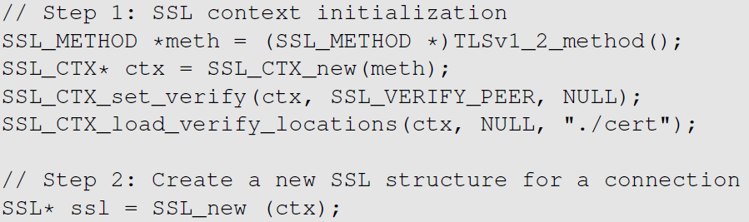
TLS Client Program: TLS Initialization
TLS protocol is a stateful protocol
Create a context data structure
Create a SSL structure to hold state information
SSL Context: holding SSL configuration
Holding SSL states

Slide 16

TLS Client Program: TLS Initialization (cont’d)
Should verify server’s certificate
Folder containing trusted CA’ certificates, such as root CA’s certificates.
Check whether the certificate’s subject field matches with hostname.

Slide 17
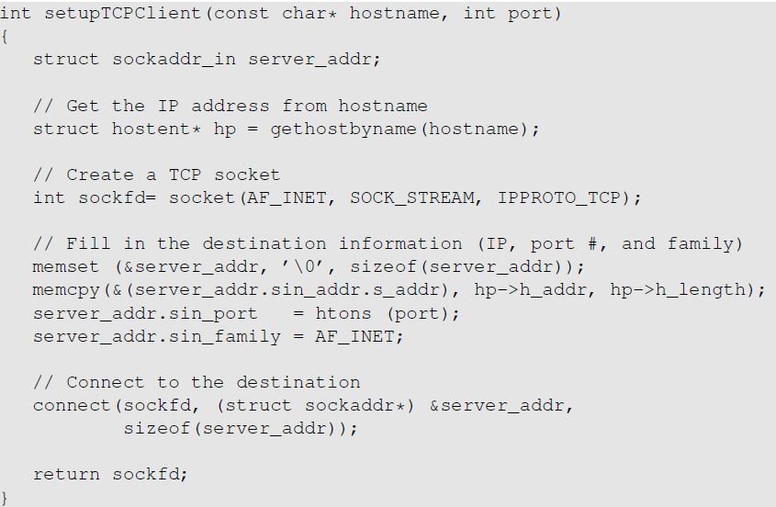
TLS Client Program: Set Up a TCP Connection
TLS is primarily built on top of TCP.
This part is standard.

Slide 18
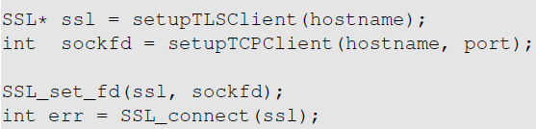
TLS Client Program: Initiate TLS Handshake
Establish the SSL session on top of an established TCP connection
Initiate the TLS Handshake protocol

Slide 19
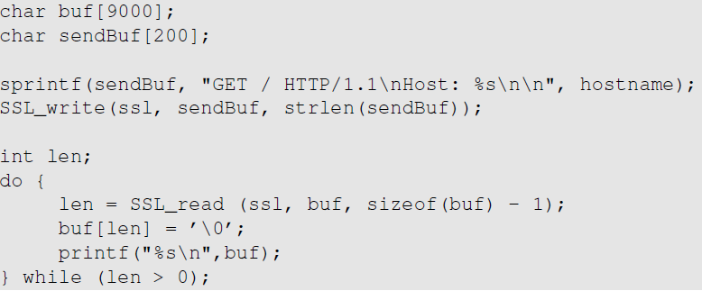
TLS Client Program: Send/Receive Data
We construct a simple HTTP GET request, and print out the reply from the web server.
Send data
Send data

Slide 20
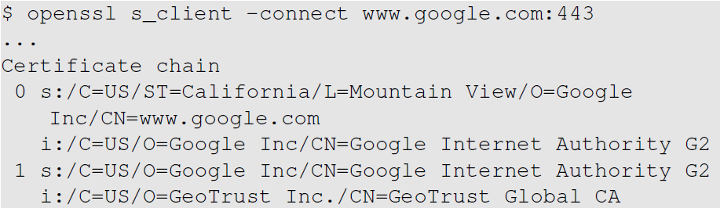
TLS Client Program: Set Up Certificate Folder
We need to gather some trusted CA certificates and store them in the “./cert” folder:
Let’s see what certificates are need for verifying google.com’s certificate:
We need to have this certificate, or we will not be able to verify Google’s certificate
We can export Equifax’s certificate from a browser, and save it in ./cert.
Notes:
Exporting certificate from Firefox:
Click on the edit item on Firefox's menu bar, and in the drop down menu, click preferences
Select advanced icon, and select certificates. Click the “view certificates” button
Select authorities tab, and we can see the list of trusted certificates. Select the one we need and click export button

Slide 21
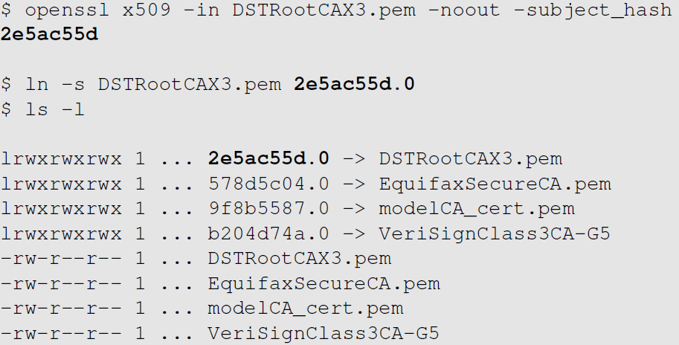
TLS Client Program: Set Up Certificate Folder
Generate the hash using the subject field of the certificate
When TLS tries to verify a certificate, it generates a hash from the issuer’s identity information.
The hash value is used as part of the filename to find the issuer’s certificate.

Slide 22
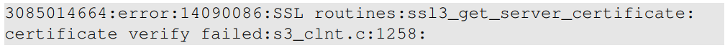
TLS Client Program: Testing
If everything is set up correctly, we should be able to see an HTML page from the web server.
However, if we did not setup the certificates properly, we are likely to see this error:
Many reason can trigger this error such as an expired certificate, corrupted certificate etc.

Slide 23
Use Our Client Program to Conduct an MITM Experiment

Slide 24
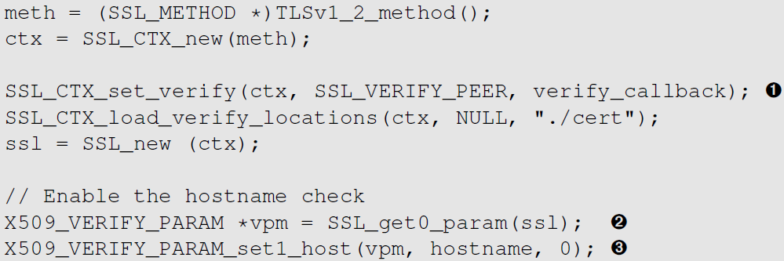
Experiment: Verifying Server’s Hostname
We design an experiment to show how important it is to verify server’s hostname. We slightly modify our client program, so we can print out more information during runtime.
We add a callback function here. It will be triggered every time a certificate is verified.

Slide 25
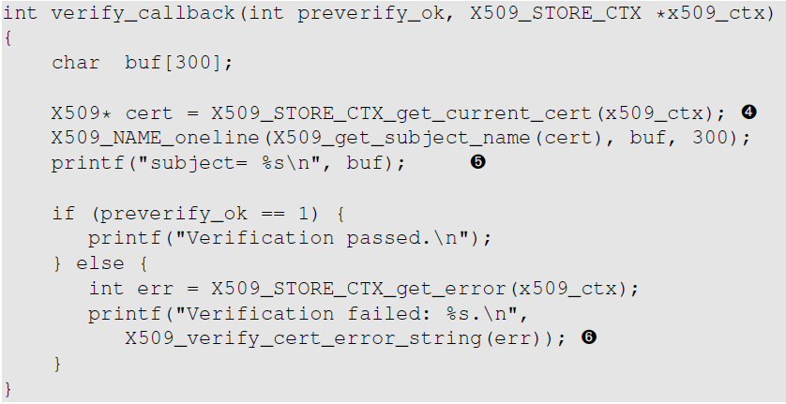
Experiment Callback Function
Get and print out the certificate’s subject information
Print out the verification result

Slide 26
Experiment: Man-In-The-Middle Attack
We simulate a DNS Cache poisoning attack. So, every time users want to visit www.facebook.com, they will go to www.example.org
Instead of launching a real DNS attack, we manually add an entry to the /etc/hosts file:
First we try to visit Facebook using our modified client program. But, we comment out the lines that conduct hostname check.
www.example.org’s IP address
Due to the “attack”, we will actually visit www.example.org.
Notes:
The first six lines are printed out from the verify_callback() function. Every time a certificate is verified by TLS, the callback function is invoked.
In total we see that, three verifications are conducted

Slide 27
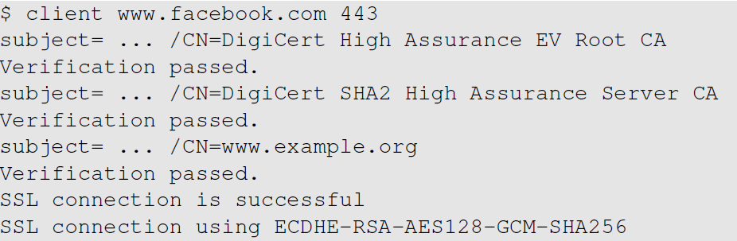
Experiment: Man-In-The-Middle Attack
Running result
All certificate verifications are successful.
MITM attack is successful.

Slide 28
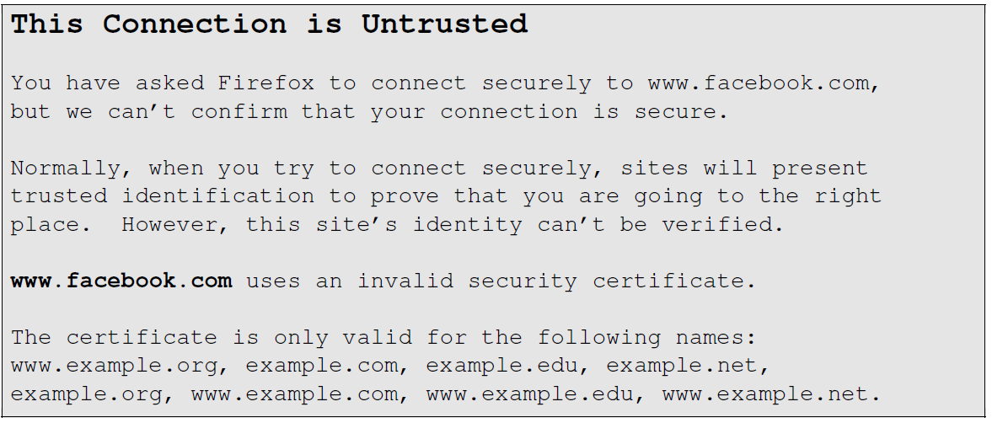
Running a Real Client (Browser)
Hostname match failed
Notes:
Imagine if www.example.org was evil and returned a login page which looked exactly like Facebook’s login page.

Slide 29
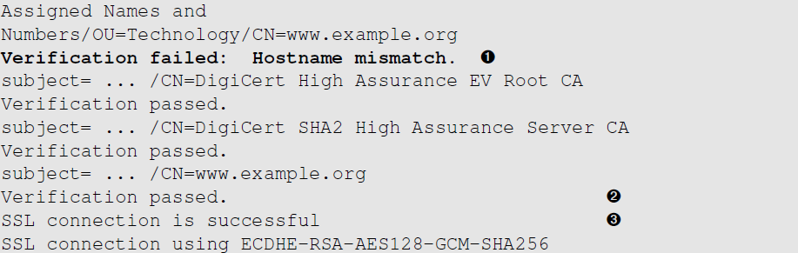
Verifying Server’s Hostname
Let us add the hostname check back to our own code
Now we can detect the mismatch
We should abort the program, instead of continuing with the SSL connection.
Notes:
Result:
Hostname verification and certificate verification are two different verification processes
Many developers think that certificate verification process automatically takes care of hostname checks, this is not true
SSL connection is still successful? This is because we did not abort the TLS connection in the callback function incase of a hostname mismatch

Slide 30
TLS Server Program Create a simple HTTPS server

Slide 31
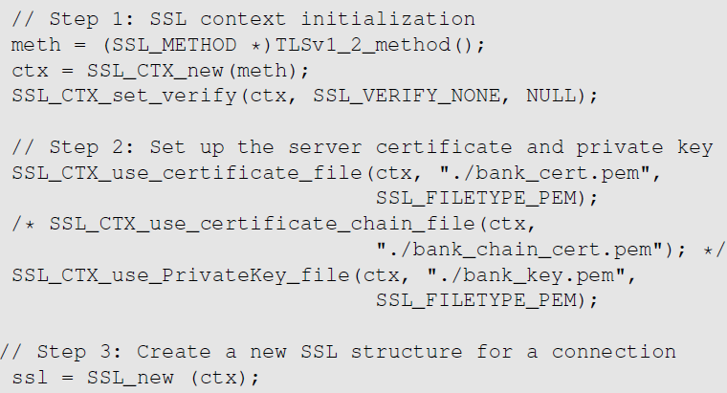
TLS Server Program: Setup
Will not verify the client’s certificate
Server’s certificate
Server’s private key

Slide 32
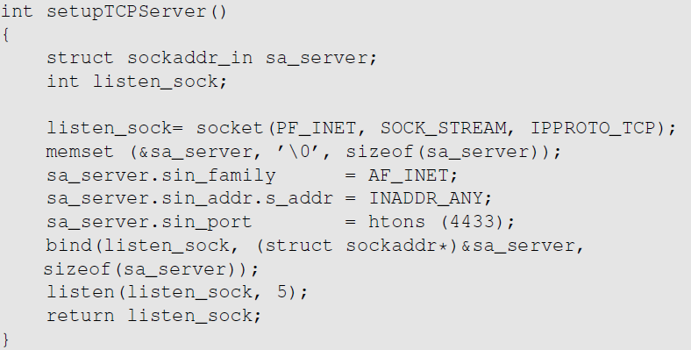
TLS Server Program: TCP Setup
This program creates a TCP socket, binds it to a TCP port (4433) and marks the socket as a passive socket. This is quite standard.
Notes:
Typical TLS program runs on top of TCP, so before running TLS, a TCP connection needs to be established

Slide 33
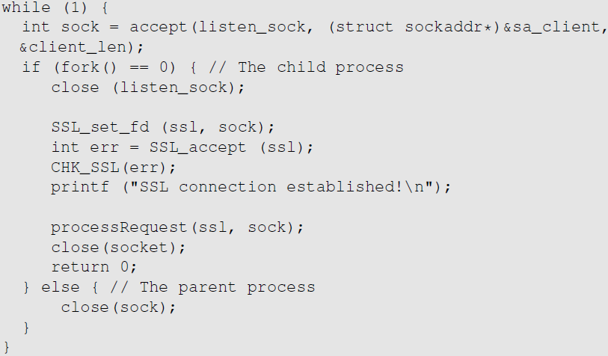
TLS Server: Handshake & Data Communication
Conduct TLS handshake with the client
We can now use this established SSL session to conduct data communication
Notes:
Once the TCP is set up, the server program enters the waiting state via the accept() system call
By default, accept() will block
Once the three-way handshake is finished and connection is established, TCP will unblock accept()

Slide 34
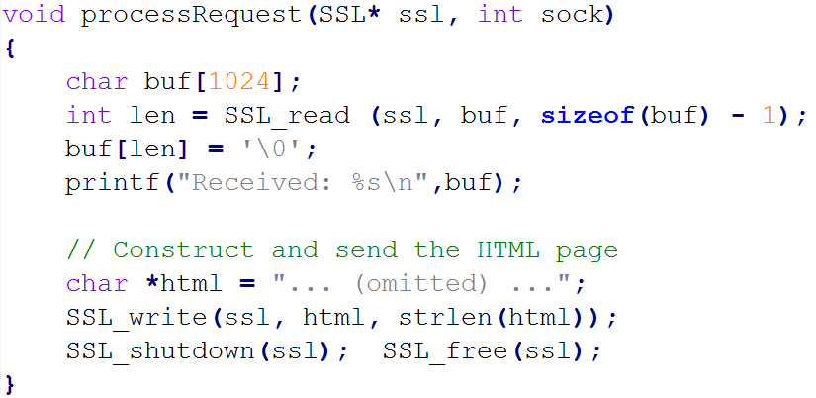
TLS Server Program: Data Transmission
Logic for sending/receiving data is the same as the client program.
We simply send an HTTP reply message back to the client.
Notes:
We construct a reply message and then use SSL_write() to send the message to the client

Slide 35
Summary
TLS Protocol
Write a simple TLS client program
Use the client program to understand how MITM attacks are defeated
Write a simple TLS server program

